Slide 1
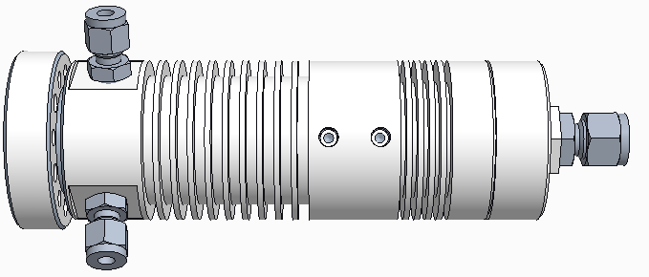
TI-4
TI-5
TI-3
TI-6
PI-3
QC
TI-2
PI-1
FI
PI-2
TI-1
M
HPLC
S

