Slide 1
Spark

Slide 2
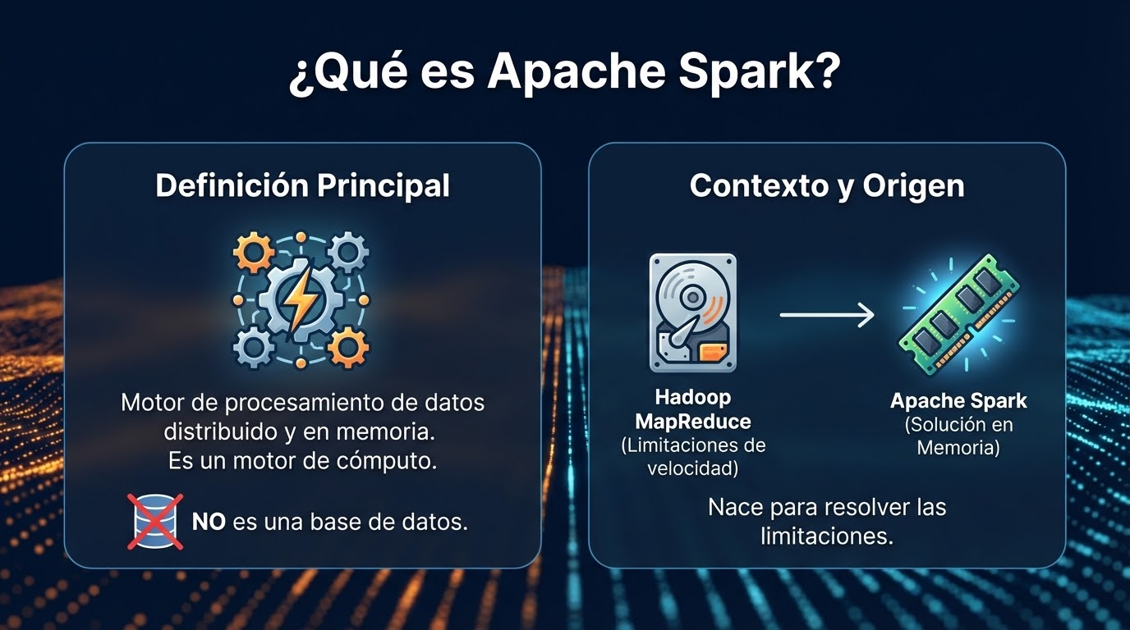

Slide 3
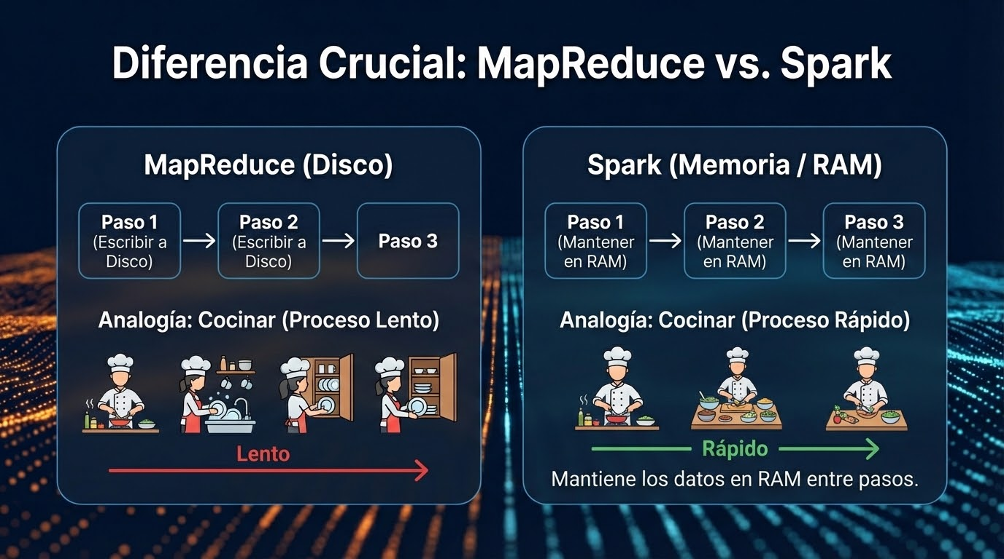

Slide 4
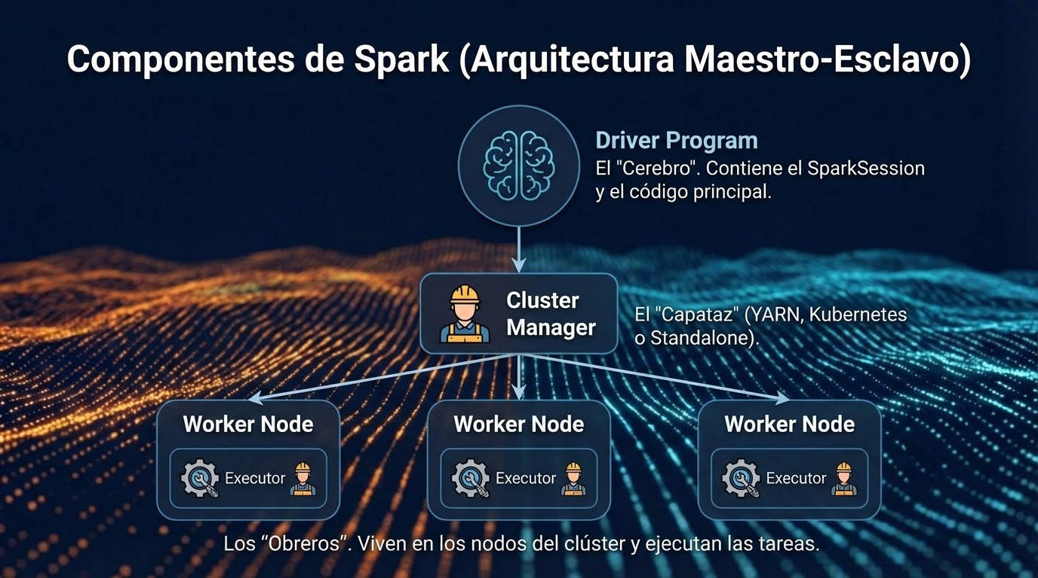

Slide 5
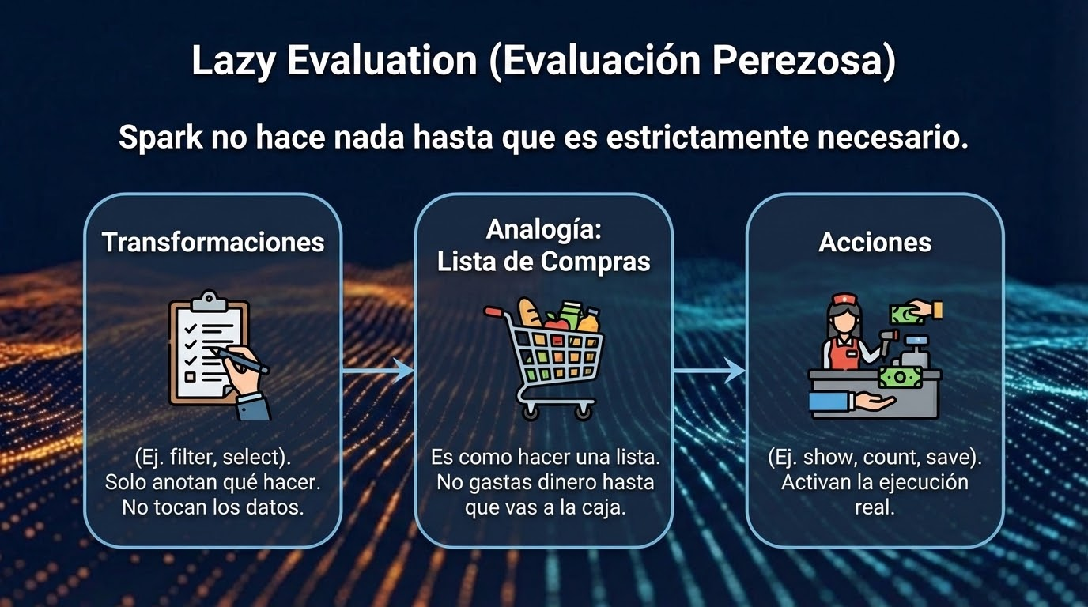

Slide 6
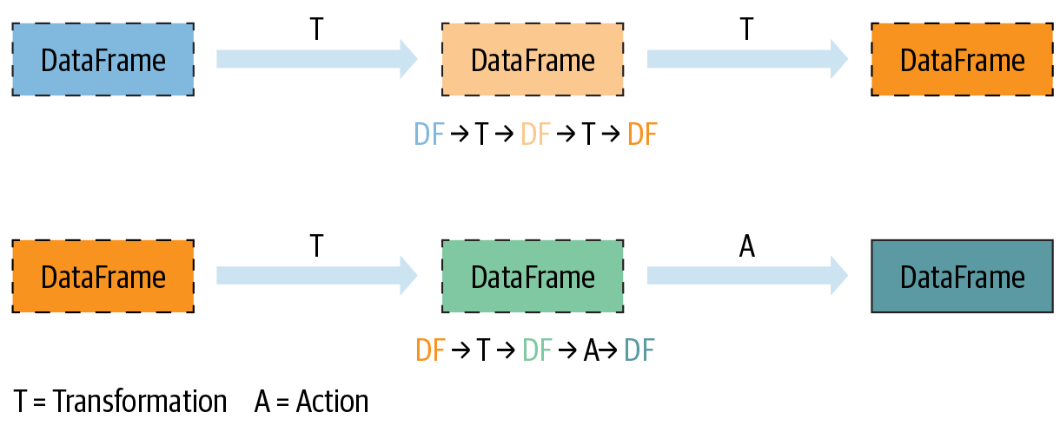
Transformations, Actions, and Lazy Evaluation
Transformations | Actions
orderBy() | show()
groupBy() | take()
filter() | count()
select() | collect()
join() | save()
Notes:
Spark operations on distributed data can be classified into two types: transformations and actions. Transformations, as the name suggests, transform a Spark DataFrame into a new DataFrame without altering the original data, giving it the property of immutability. Put another way, an operation such as select() or filter() will not change the original DataFrame; instead, it will return the transformed results of the operation as a new DataFrame.
All transformations are evaluated lazily. That is, their results are not computed immediately, but they are recorded or remembered as a lineage. A recorded lineage allows Spark, at a later time in its execution plan, to rearrange certain transformations, coalesce them, or optimize transformations into stages for more efficient execution. Lazy evaluation is Spark’s strategy for delaying execution until an action is invoked or data is “touched” (read from or written to disk).

Slide 7
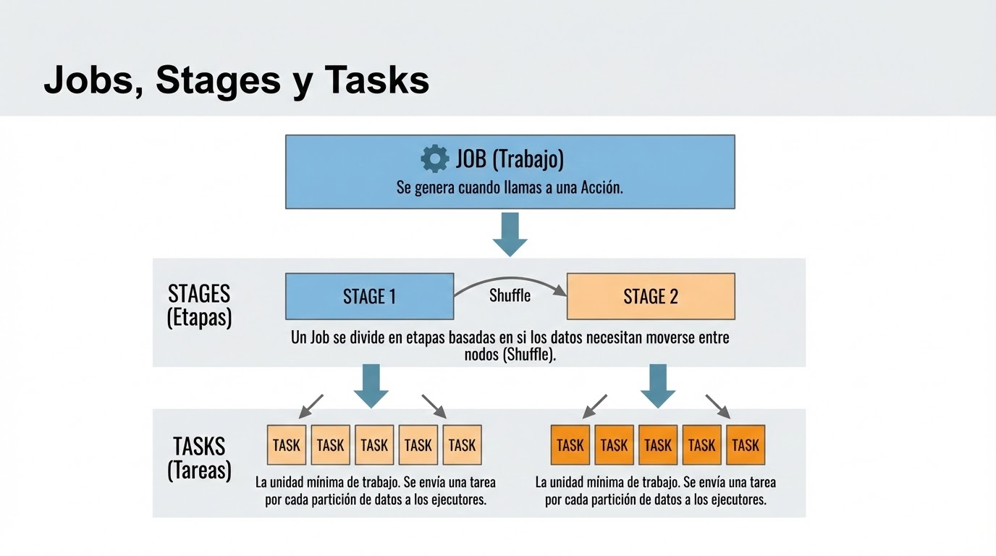

Slide 8
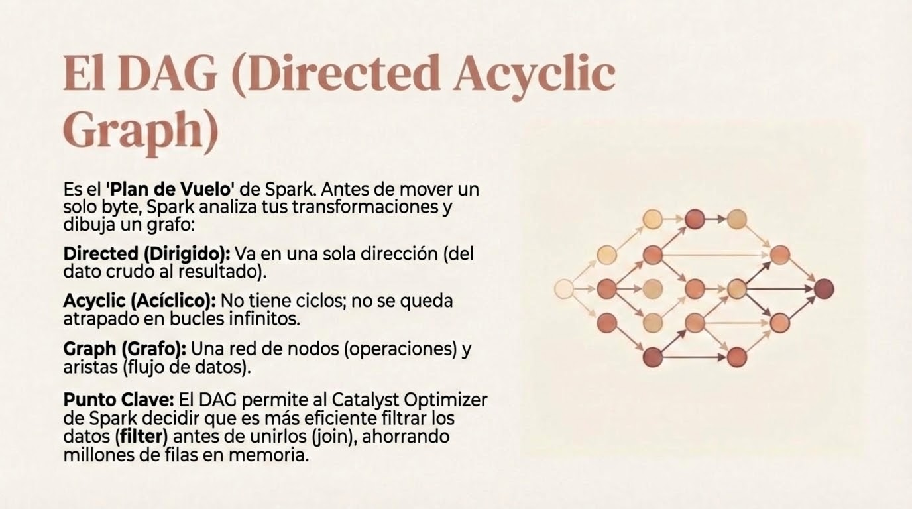

Slide 9
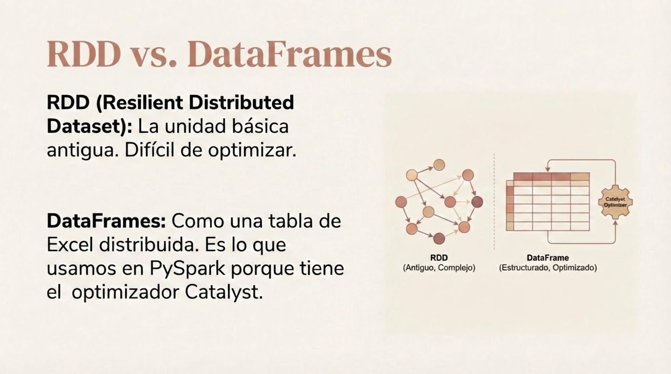

Slide 10
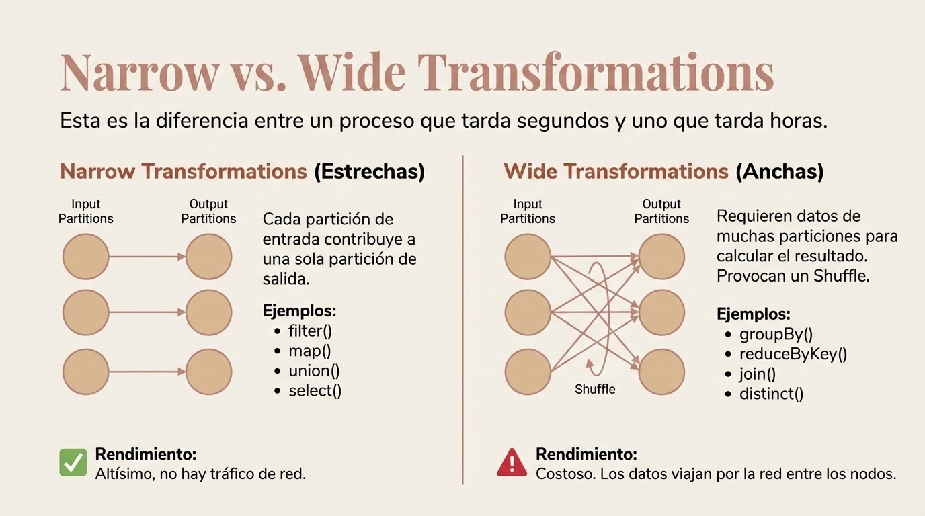

Slide 11
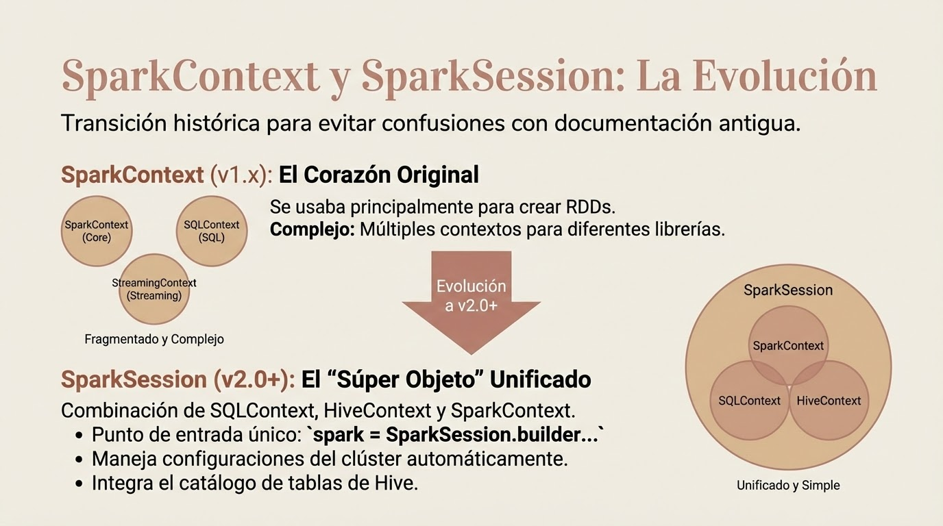

Slide 12
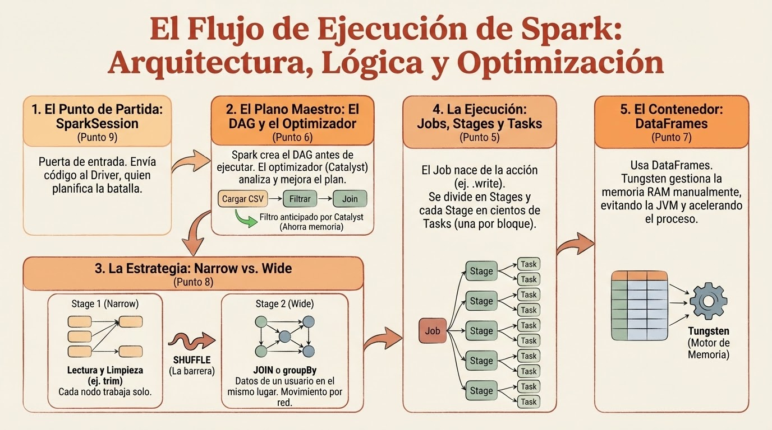

Slide 13
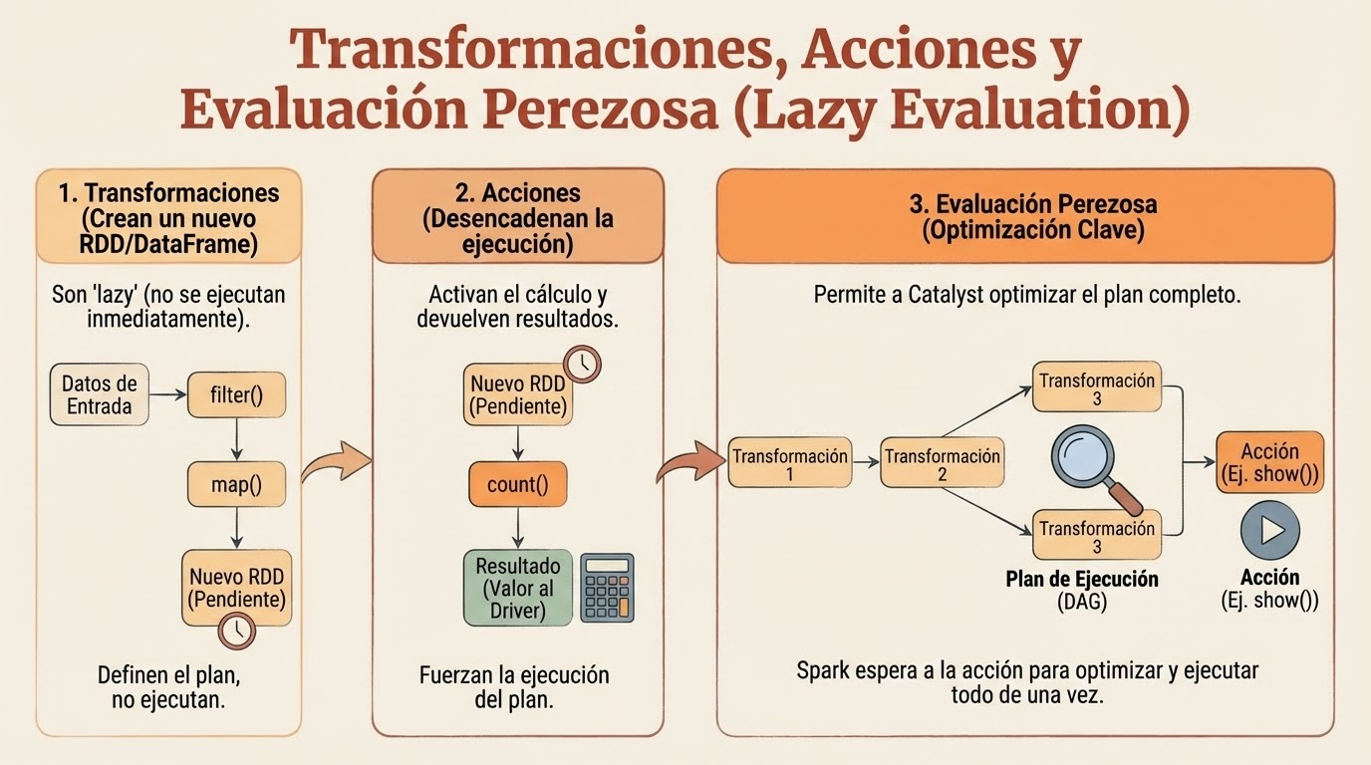

Slide 14
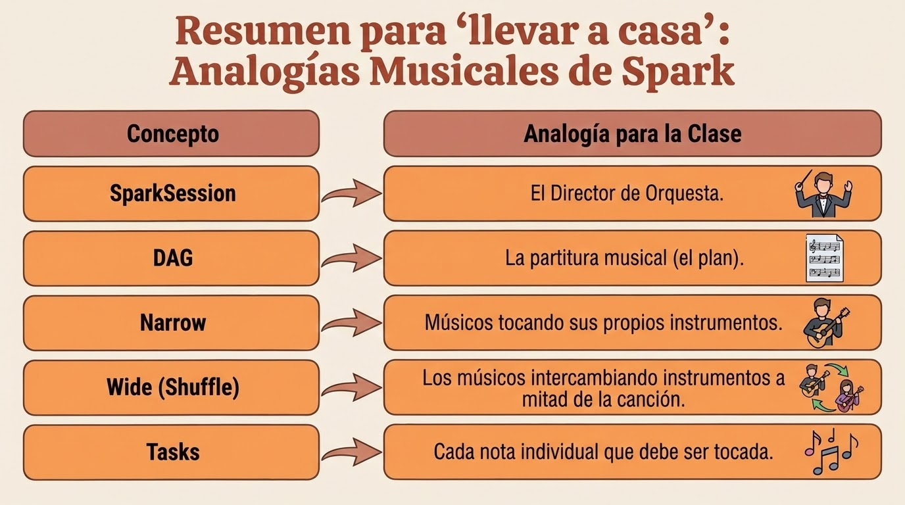

Slide 15


Slide 16
Usemos un script para ver el las parte de Spark
import org.apache.spark.sql.functions._
import org.apache.spark.sql.types._
// 1. GENERACIÓN DE DATOS (Creación de DataFrames de ejemplo)
val httpDF = spark.range(100000).withColumn("logged_user", concat(lit("user_"), col("id") % 100)).withColumn("sentiment", rand()).withColumn("url", lit("http://portal-interno.com/login")).withColumn("visited", current_timestamp())
val emailDF = spark.range(50000).withColumn("logged_user", concat(lit("user_"), col("id") % 100)).withColumn("size", (rand() * 100).cast(IntegerType)).withColumn("attachment_count", (rand() * 5).cast(IntegerType))
// 2. TRANSFORMACIONES NARROW (Filter y Trim)
val httpFiltered = httpDF.filter(col("sentiment") > 0.4).withColumn("logged_user", trim(col("logged_user"))) // Modifica una columna, sin shuffle
// 3. TRANSFORMACIÓN WIDE (JOIN)
val joinedDF = httpFiltered.join(emailDF, "logged_user") // Requiere shuffle
// 4. AGREGACIÓN (Cálculo de métricas por usuario)
//requiere shuffle
val resultDF = joinedDF.groupBy("logged_user").agg(
avg("sentiment").as("sentimiento_avg"),
sum("size").as("total_kb_enviados"),
count("url").as("clicks_realizados")
)
// 5. ACCIÓN (Dispara la ejecución de todas las transformaciones)
resultDF.show(10)

Slide 17
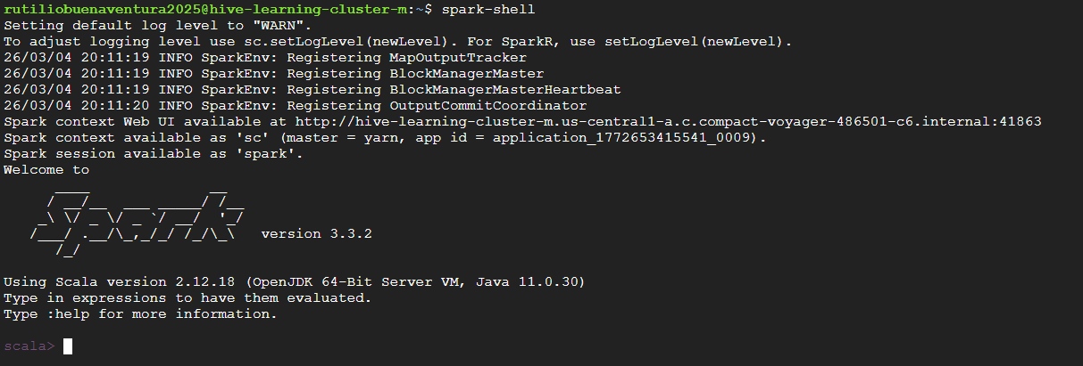

Slide 18
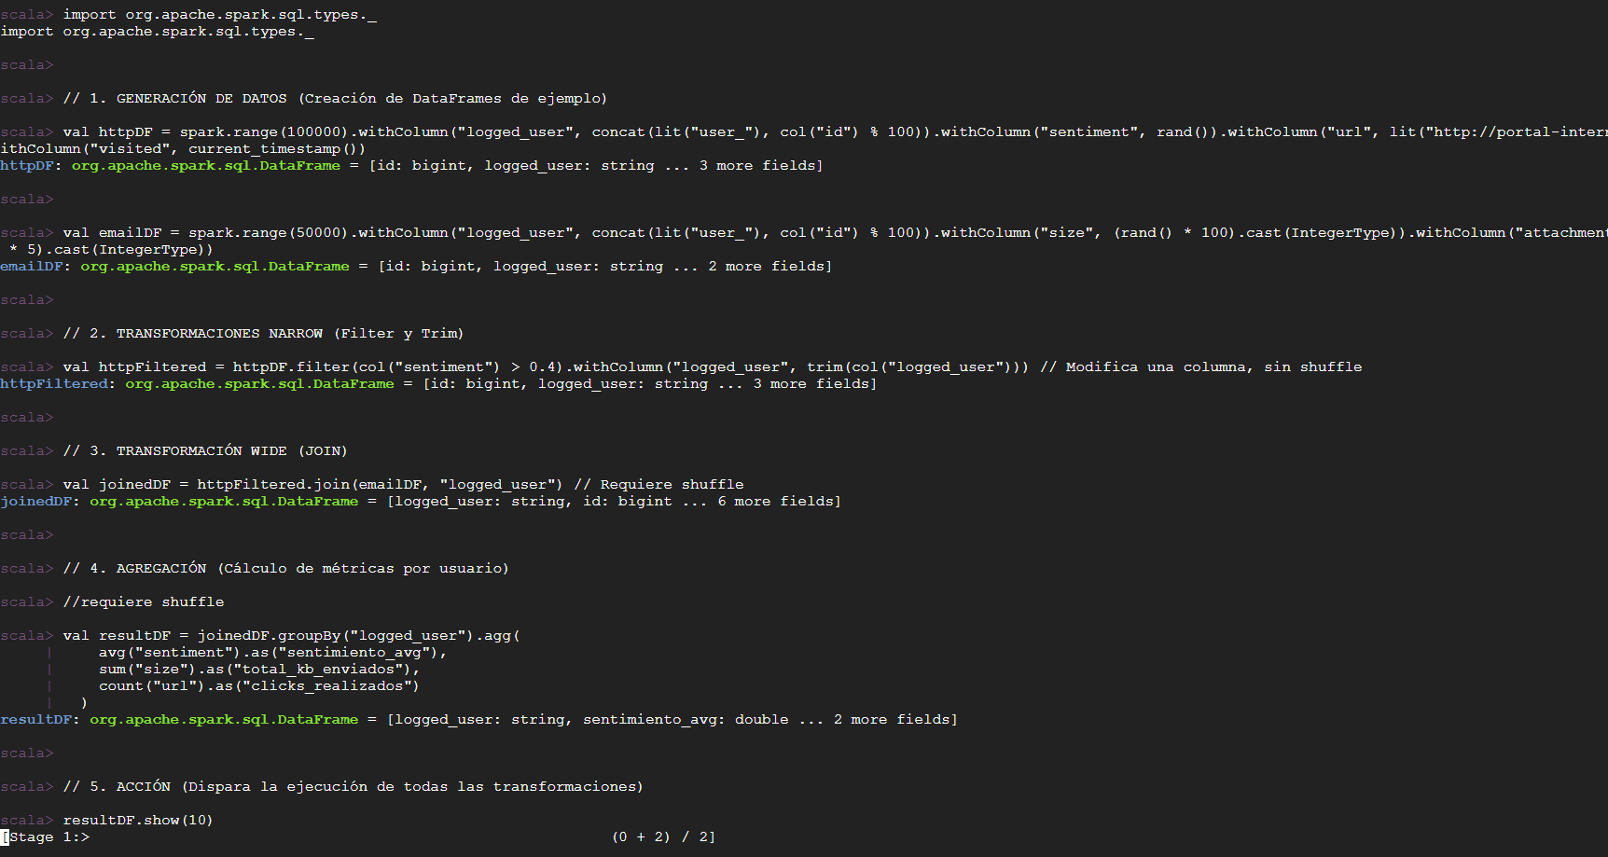

Slide 19
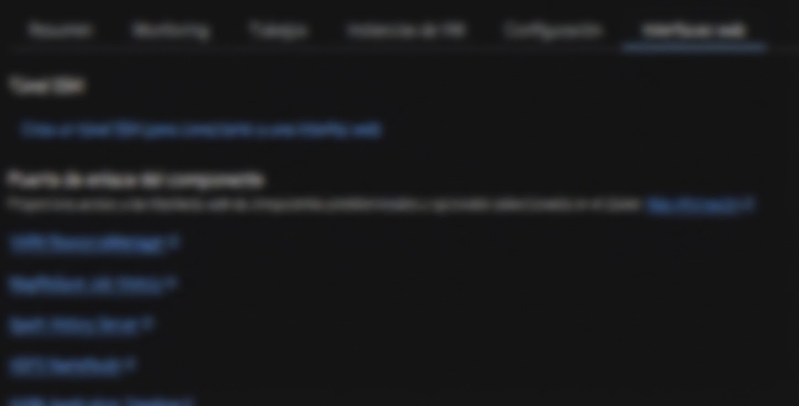
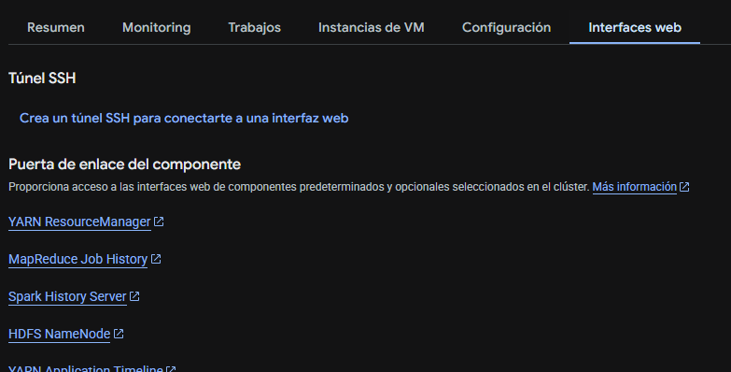

Slide 20
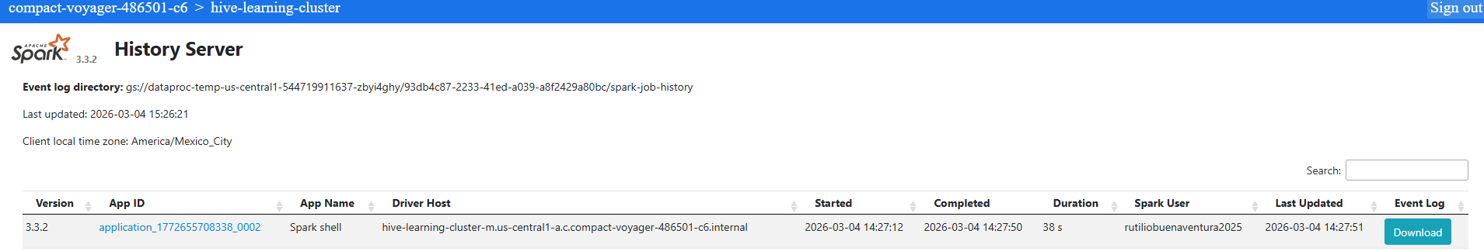
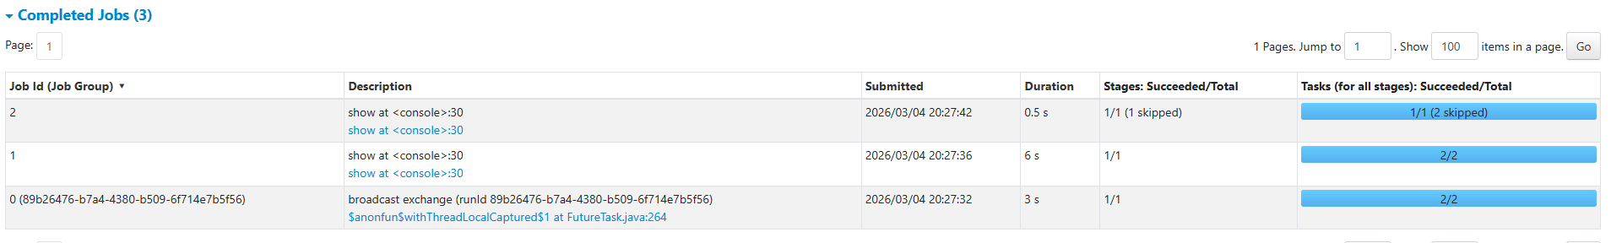

Slide 21
Lugares de interés
https://sparkbyexamples.com/pyspark
https://spark.apache.org/docs/latest/index.html

