Slide 1
Post-Secondary Employment Outcomes (PSEO)
Chemi Dolkar

Slide 2
Post-Secondary Employment Outcomes (PSEO)
Experimental research by the U.S. Census Bureau
Earnings and employment outcomes of university and college graduates.
Data provided by partner educational institutions.

Slide 3
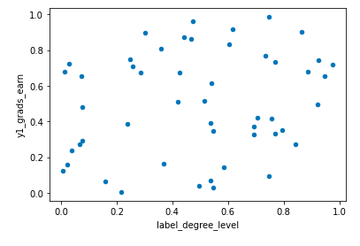
Earnings and degree level
Earning after one year of graduation and degree level.

Slide 4
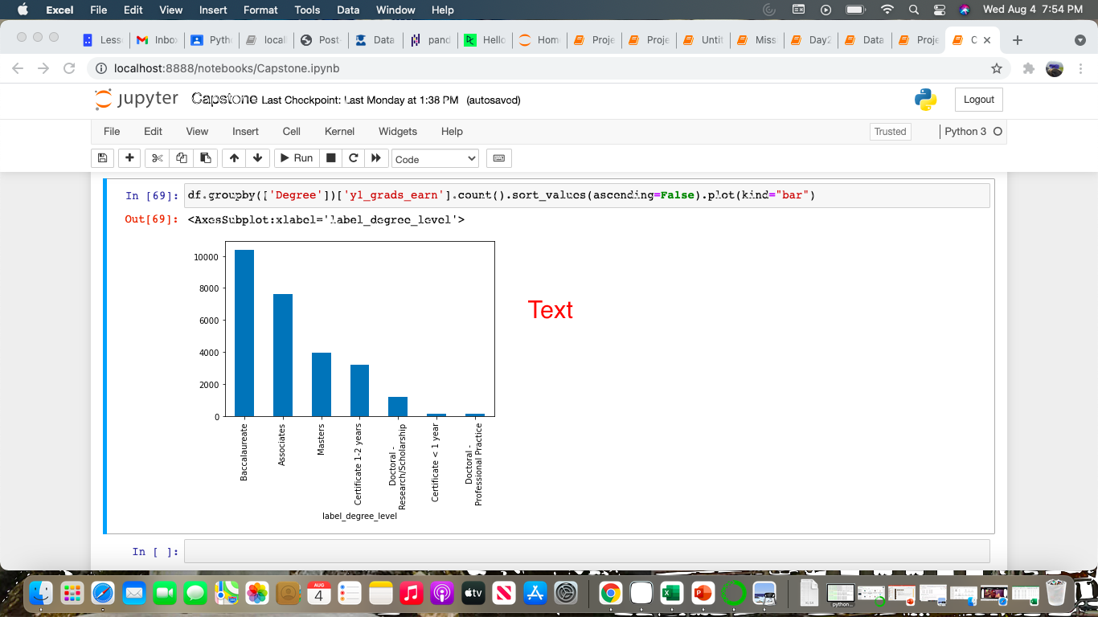
Earnings and Degree level
Earnings after one year of graduation from NY colleges and universities.

Slide 5
Conclusion
Limitations:
Lot of missing values
Does not have clear information on the earnings
Recommendation:
Employability rate of the graduates
Source: https://lehd.ces.census.gov/data/pseo_experimental.html

