Slide 1
January 2023
Category review: Chips
Retail Analytics
Brand note: If client logo is not required, use alternate title page layout right click slide thumbnail > Layout > Title

Slide 2
Notes:
To view Privacy video explaining how important data privacy is to Quantium, please click here: https://www.youtube.com/watch?v=Zq1QDAkoRzU
or here Q:\Company Reference\Brand & Design\Brand videos\Q Privacy.mp4
At Quantium, we believe that data is the behavioural footprint of humanity and that it has to be treated with the utmost care and responsibility.
Histories, attitudes, indeed lives are stored within it in ways that aren’t always apparent – and that’s what makes its potential so powerful.
To work with it responsibly, sensitively, we set ourselves the highest data privacy protection and governance standards.
We have spent 17 years perfecting privacy-by-design and secure-by-design principles. Central to this is not holding any personally identifiable information about people –
we neither receive it, and put the necessary protections in place to be unable to decipher it.
Every aspect of handling data is safeguarded: from its de-identification, to its encryption – data security is paramount and of the highest grade.
We pride ourselves on gaining the trust of iconic organisations around the world through years of securely working with their data,
and in turn the trust that builds with their stakeholders.
<number>

Slide 3
Executive summary
01
Task 1
The number of chips transactions dramatically increases prior to Christmas.
Thus, added visibility to customers via a promotional display or Gondola end
would increase purchases driving sales growth over this holiday period.
Also we found that there are three group – young singles/couples, retirees (from Mainstream segment) and older families (Budget) who contributed mainly in sales process. There is more opportunity for sales with these shoppers.
02
Task 2
In the second part of the research we found that 77 and 88 stores showed significant increase in sales and number of customers compared with control stores in trial period, but in 86 store increase in sales was in just one month of three.

Slide 4
01
Category

Slide 5
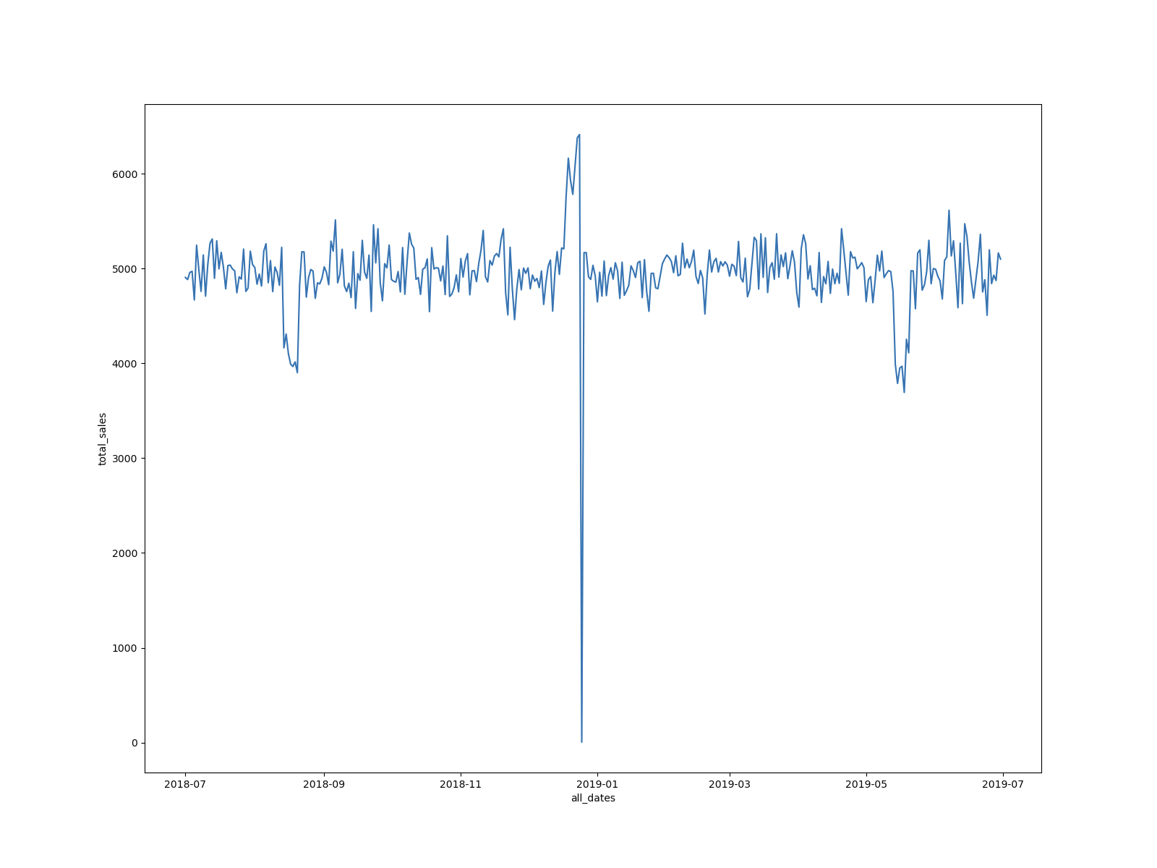
The number of Chips transitions has remained relatively consistent over the
last 52wks; a notable increase occurred in the week leading up to Christmas. The figure below shows transactions of Snacks - Chips over time.

Slide 6
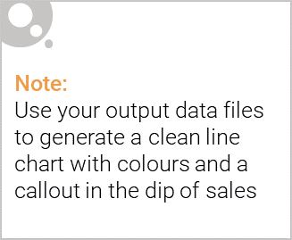
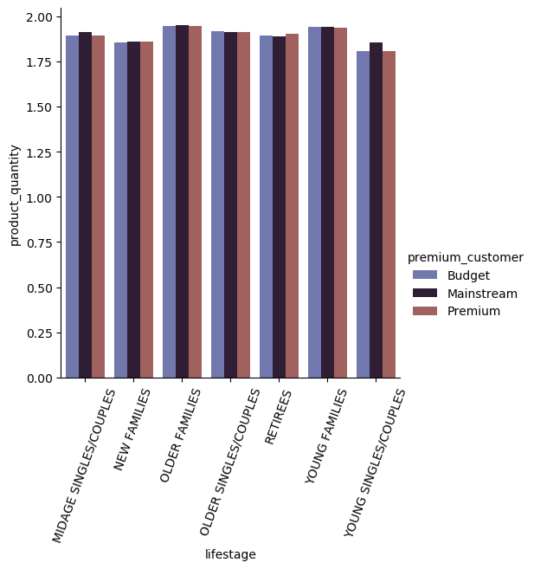
We found that Older Families and Young Families despite on their class purchase more chips per customer.

Slide 7
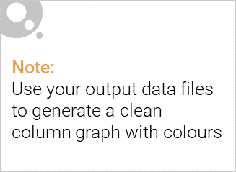
We made a conclusion that main contributors in sales are Older Budget Families, Mainstream Young singles/couples and Mainstream retirees. Two last because there are more of them among customers, but the first ones just purchasing more chips per customer.

Slide 8
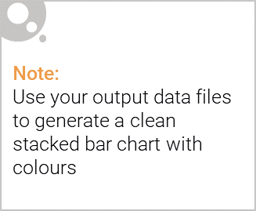
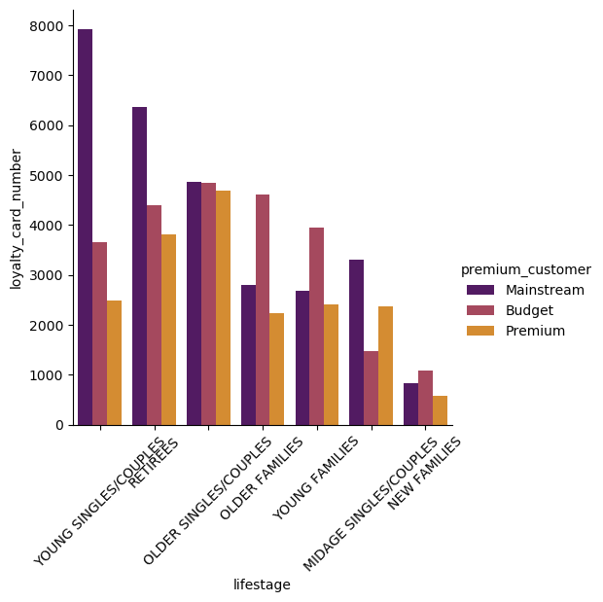
Editable (delete this)
The figure shows distribution of customers depending on their Lifestage and affluence.

Slide 9
02
Trial store performance

Slide 10
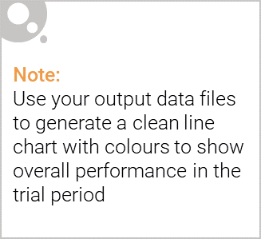
There are three trial stores 77, 86 and 88 which were explored during their trial period from 1 of February 2023 to the end of April 2019. We found very similar stores to those ones among 269 remaining stores for estimation of probable enhancement impact, and the control stores are 233, 155 and 237 respectively.

Slide 11
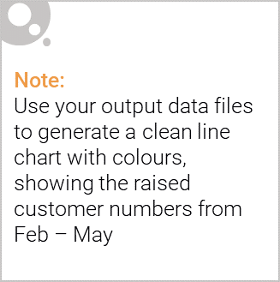
77 and 88 trial stores showed significant increase in total sales in at leas two of three months of trial period. But 86 store showed not so good results in total sales, at the same time the number of customers in 86 store increased significant, while in 86 store just in one month of three.

Slide 12
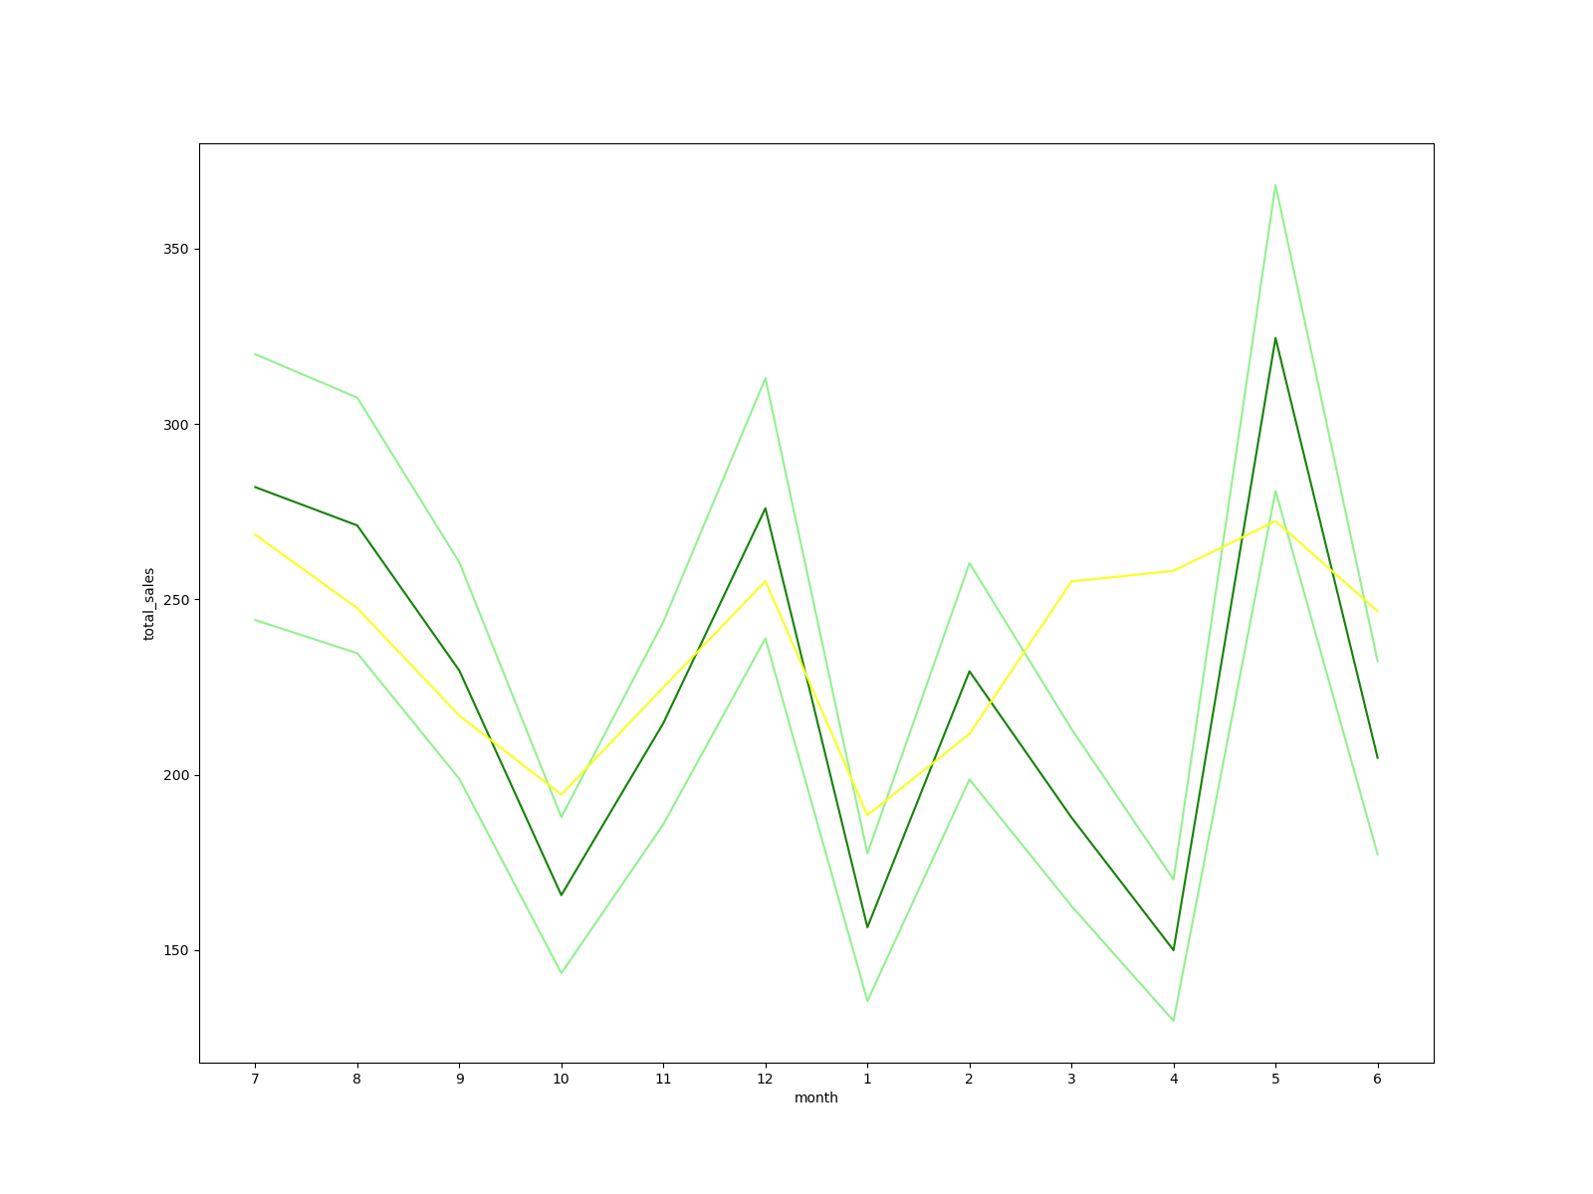
Sales increase in 77 store vs 233 (yellow line in 2, 3, 4 months)

Slide 13
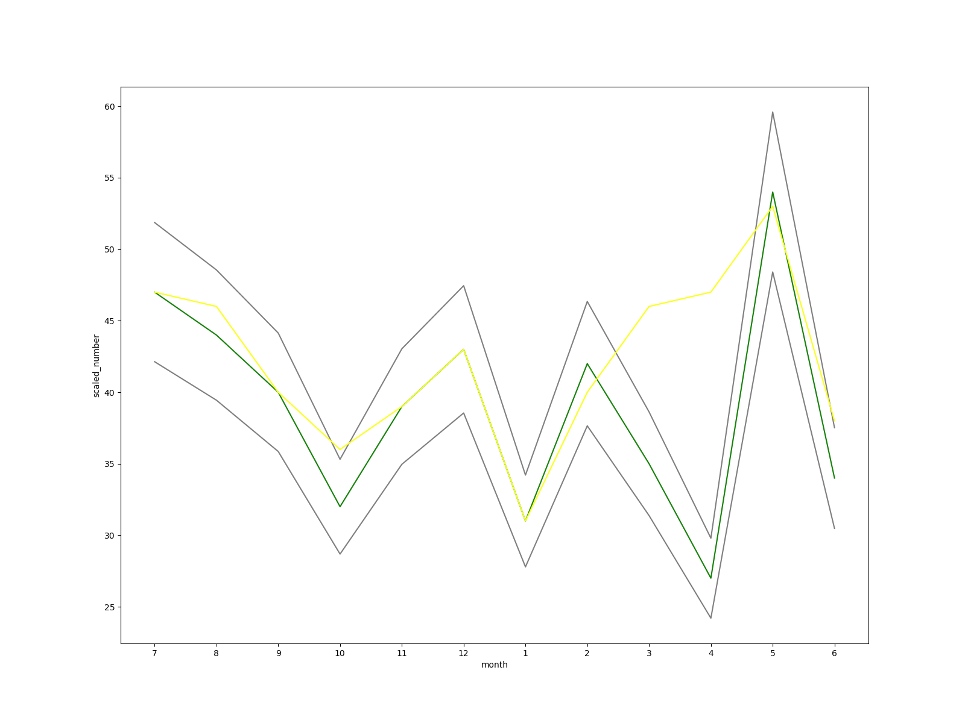
Number of customers increase in 77 store vs 233 in trial period (yellow line).

Slide 14
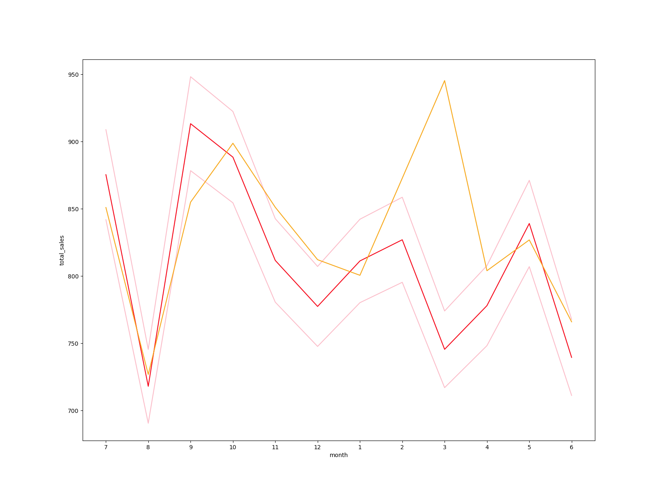
Sales increase in 86 store vs 155 (orange line in 2, 3, 4 months)

Slide 15
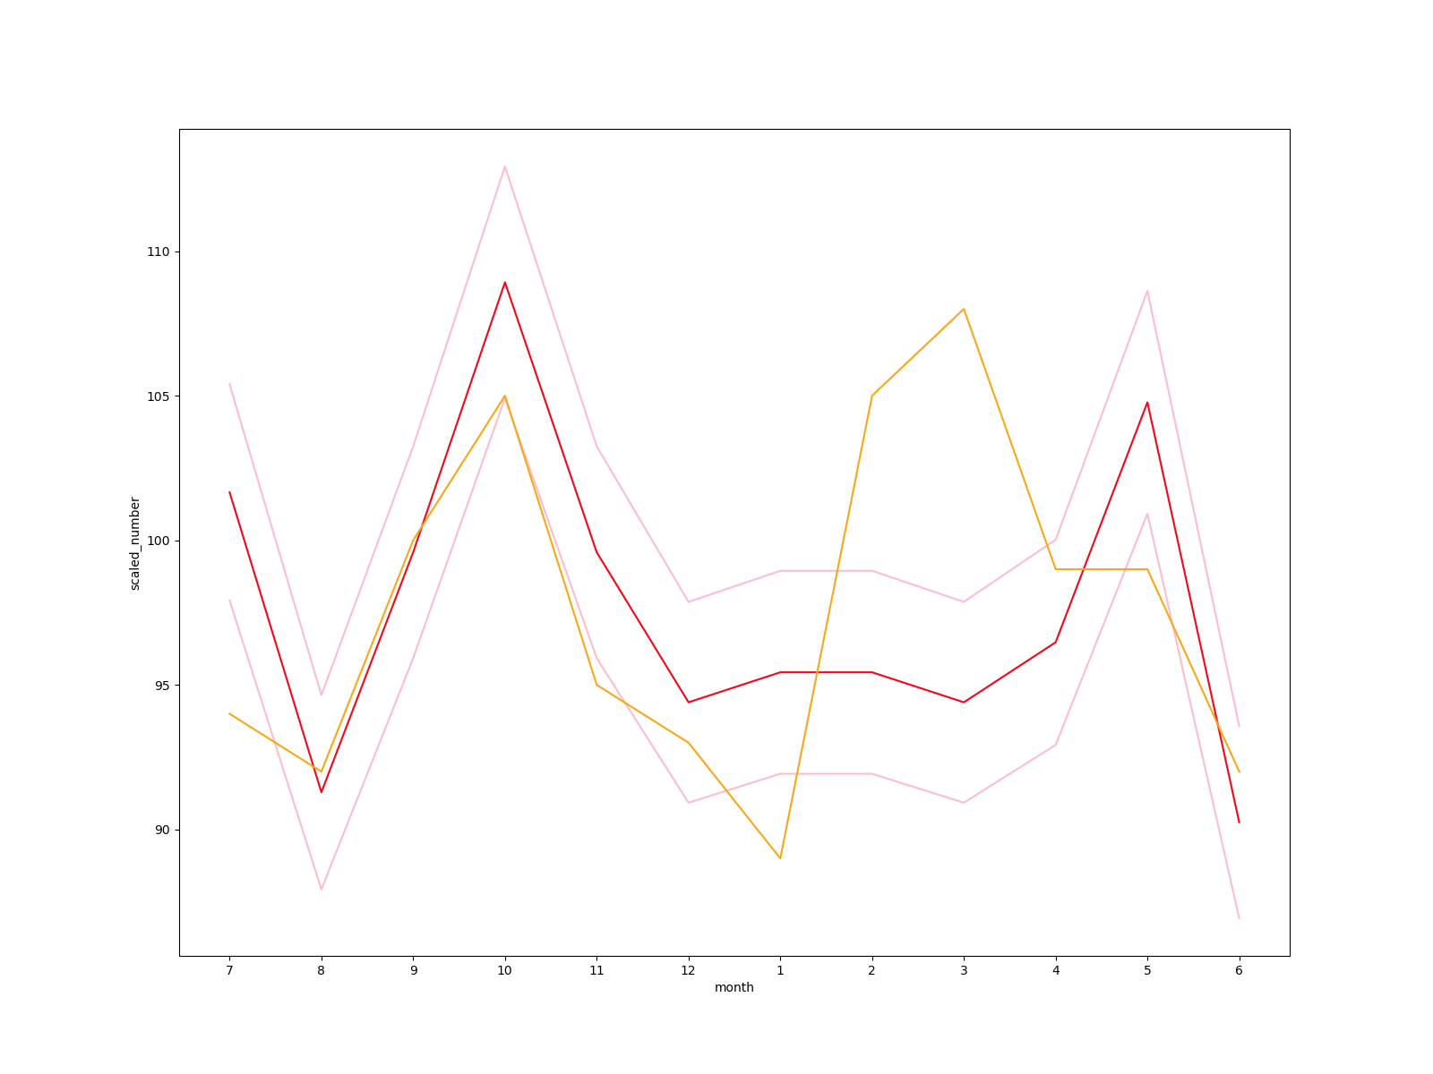
Number of customers increase in 86 store vs 155 in trial period (orange line).

Slide 16
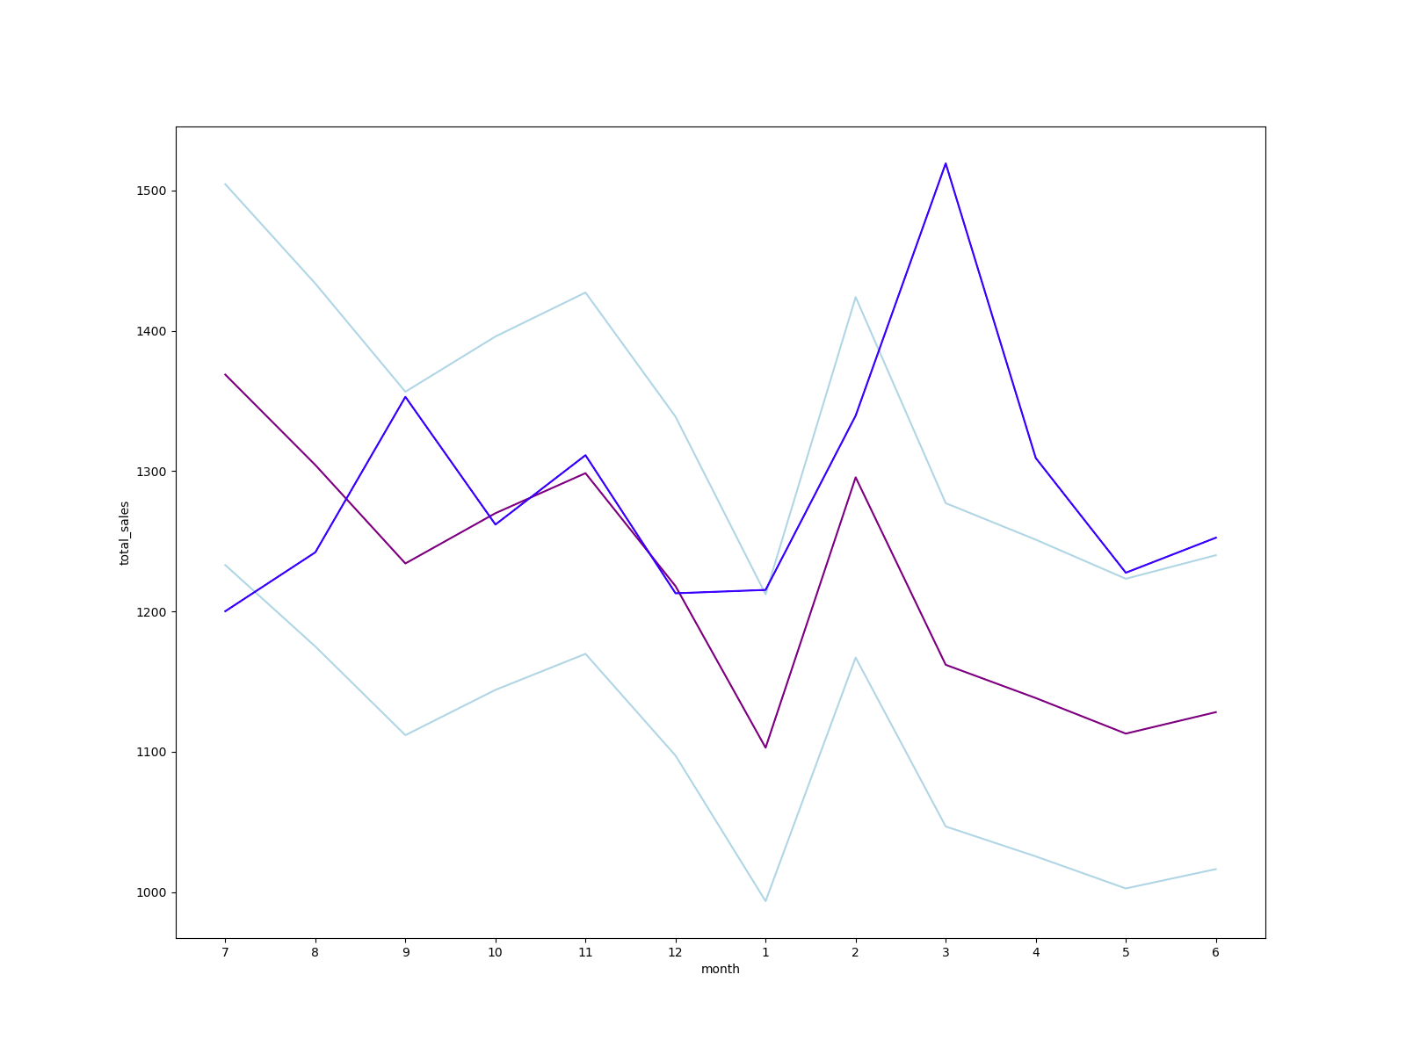
Sales increase in 88 store vs 237 (blue line in 2, 3, 4 months)

Slide 17
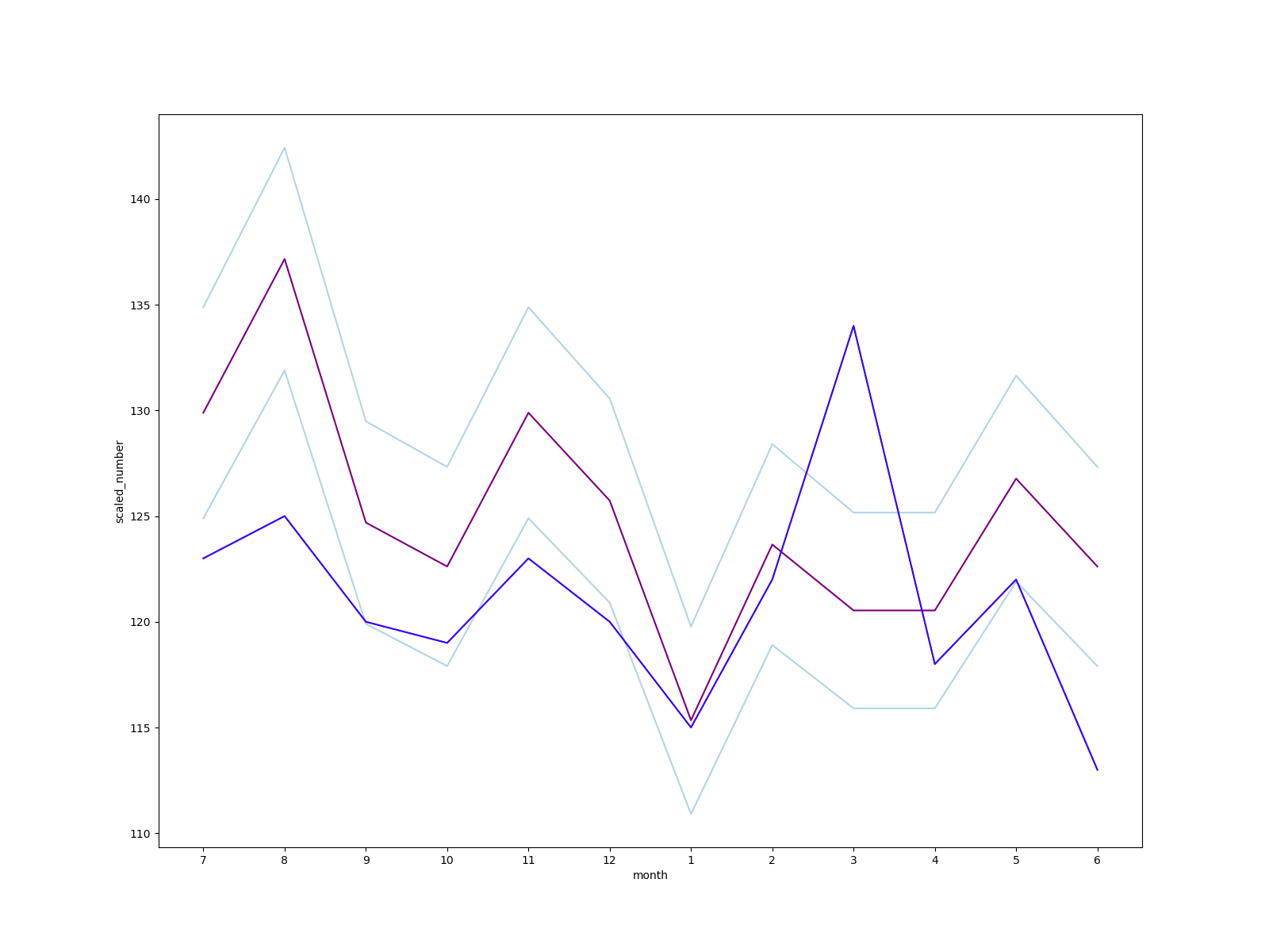
Number of customers increase in 88 store vs 237 in trial period (blue line).

Slide 18
Notes:
<number>

