Slide 1
Development of advanced chemometric methods for the analysis of deep-UV resonance Raman spectra of proteins
John Simpson

Slide 2
Goal
To improve the methods employed to determine the secondary structural content of proteins from UV resonance Raman spectra.

Slide 3
S₂
ν₀
ν₀-v_{v}
S₁
Virtual state
ν₀
ν₀-v_{v}
ν₀
ν₀-v_{v}
S₀
Fluorescence
Non-Resonance Raman
Resonance Raman
Resonance Raman: Excitation energy is sufficient for an electronic transition.
The electronic transition results in an exponential increase in the polarizability of the chromophore, and a corresponding increase in signal intensity.

Slide 4
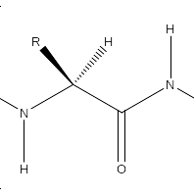

3 torsion angles : Ψ, Φ, ω
Omega tends to be either 0° or 180°
  Trans conformation dominant
  Cis conformation appears most often with proline
Φ
ω
Ψ
Secondary structure is determined by the relationship of Ψ and Φ angles.
  Value ranges for Ψ and Φ correspond to specific conformations of secondary structure due to steric hindrance.
Vibrational spectra of proteins are sensitive to secondary structure.

Slide 5
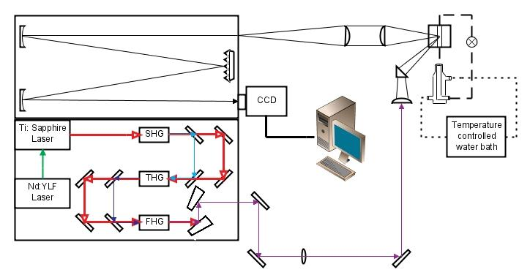
Second harmonic (SHG) generated through an LBO (Lithium Triborate ) crystal by frequency doubling.
Third and Fourth Harmonic generated through BBO (Beta Barium Borate) crystal through frequency mixing with the Ti:Sapphire beam.

Slide 6
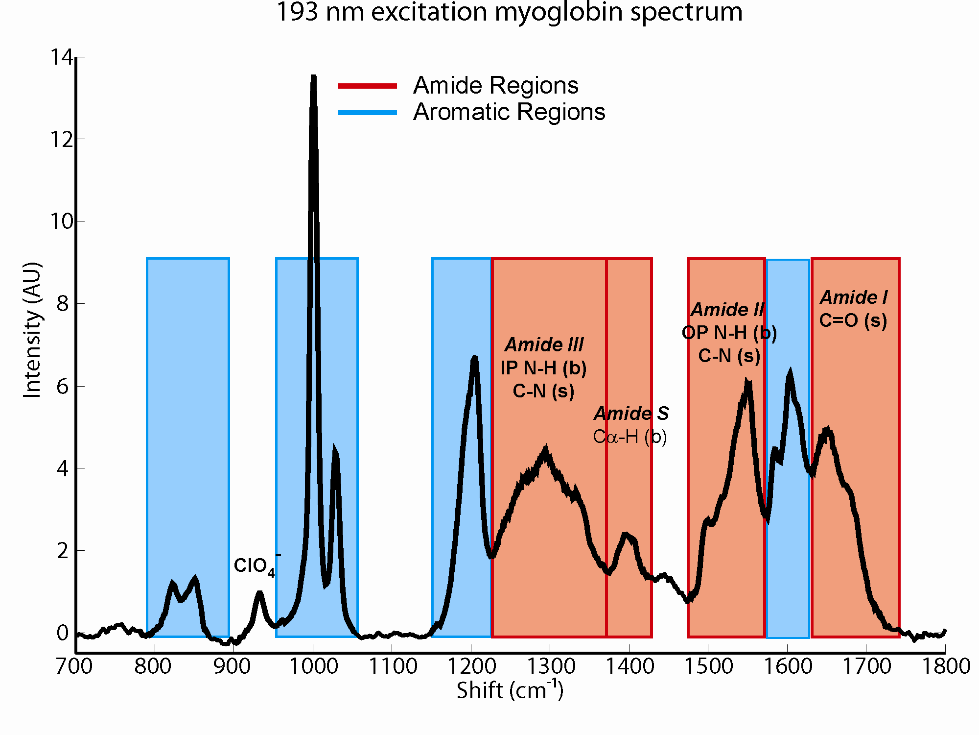

Slide 7
What is Chemometrics?
A collection of data management and analysis techniques.
  Existed in its current form for only around 30 years.¹
Exact definition of the field is still in question.
  “The techniques and methods used to get chemically relevant information out of measured chemical data, how to represent and display this information, and how to get such information into data” ²
  “The application of mathematical and statistical techniques to chemical data.” ¹
  “The information aspects of chemistry.” ²
  “Chemometrics is what chemometricians do.”²
1 Matthias Otto. Chemometrics: Statistics and Computer application in Analytical Chemistry. Wiley. New York, New York. 1999.
2 Wold, Svante. Chemometrics and Intelligent Laboratory Systems, 1998, 44, 3-14.

Slide 8
Structural determination methods:
  Linear calibrations for α-helical content based on the following:
    Amide II
    Amide S
  Bilinear model
    Zhenhuan Chi, X. G. Chen, Janet S. W. Holtz, and Sanford A. Asher, Biochemistry, 1998. 37, p. 2854-2864.

Slide 9
Bilinear Model
[D]=[R][C]
D = Data C = Composition
R = Pure Secondary Structure Spectra (PSSR)
Least squares optimization
Single excitation wavelength spectra of multiple proteins.
PSSR determined both computationally and from the spectra of poly-L-lysine and poly-L-glutamic acid.
Non iterative method

Slide 10
Goal
To improve the methods employed to determine the secondary structural content of proteins from UV resonance Raman spectra.
How?
Multi-excitation data to take advantage of each of the selective response of each structure type.
Application of multivariate curve resolution using alternating least squares algorithm (MCR-ALS).
Chemically relevant constraints.

Slide 11
Our Approach
Multi-excitation spectra: selective response
MCR-ALS will be used to apply bilinear model
  Non linear least squares (NNLS) fitting are the initialization parameters.
  Iterative method
Utilize a peak shape constraint:
  Constrains the peak to a Gaussian/Lorentzian line shape defined by:
    Location
    Height
    Width
    % Lorentzian

Slide 12
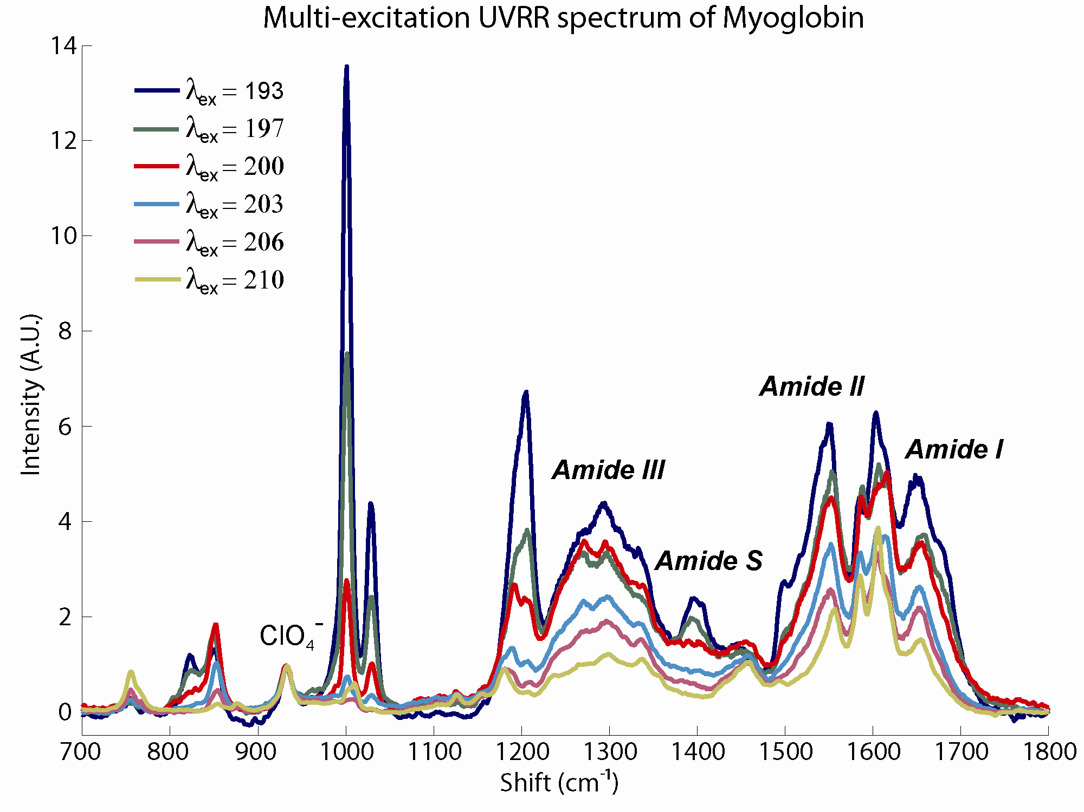

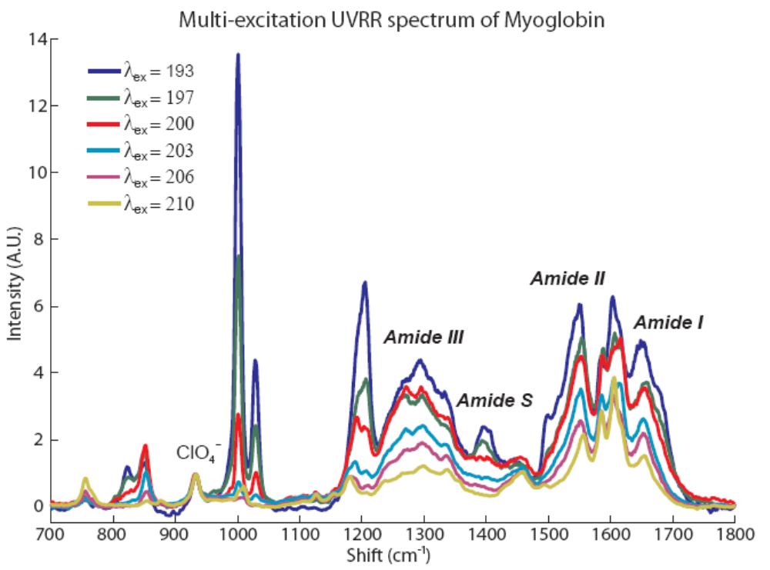

Slide 13
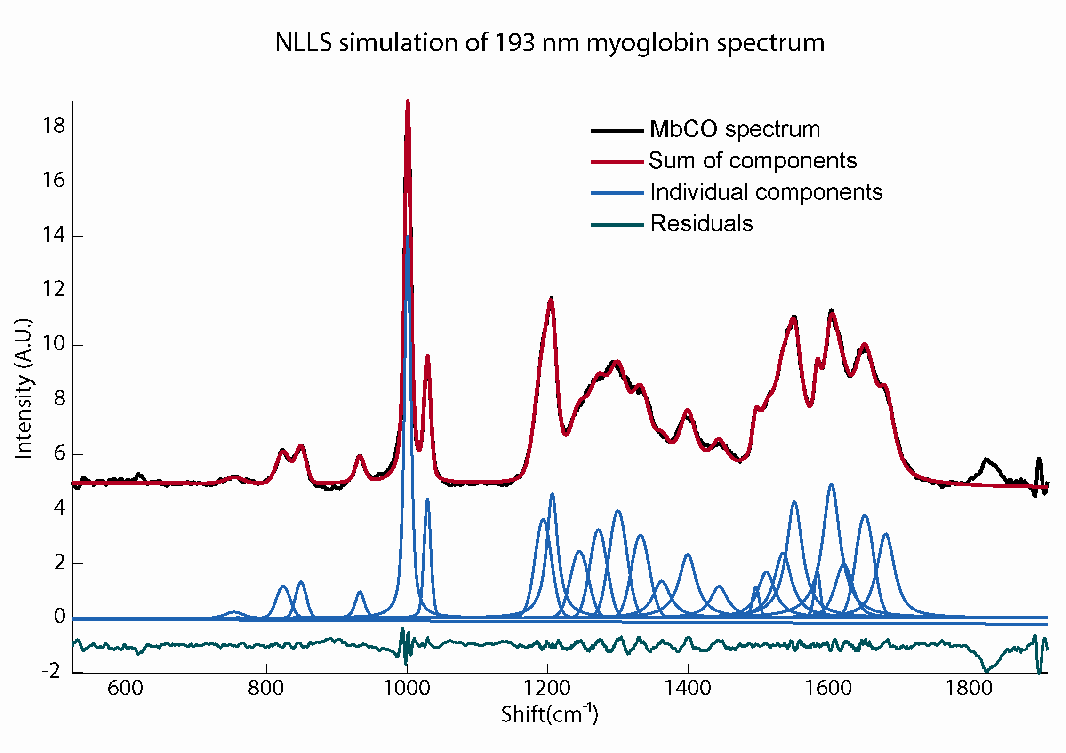

Slide 14
MCR-ALS algorithm
X=AD'+E¹
  X = Data A = Peak Profiles E = Error
  D = Cross Section
  0. Initialize A (using NLLS fits)
  1. D=XA(A'A)⁻¹
  2. A=X'D(D'D)⁻¹
  a. C=X-DA' + D_{i}A_{i}'
  b. A_{i}=D_{i}'C(D_{i}'D_{i})⁻¹
  a. minimize|| C - D_{i}A_{i}' ||² subject to A_{i} being Gaussian/lorentzian
  3. Repeat until convergence
These steps are done for i components
1. Sidiropoulos., J. Chemometrics, 1998, 12, 223
2. Kiers, H. Phychometrika, 1997, 62, 251

Slide 15
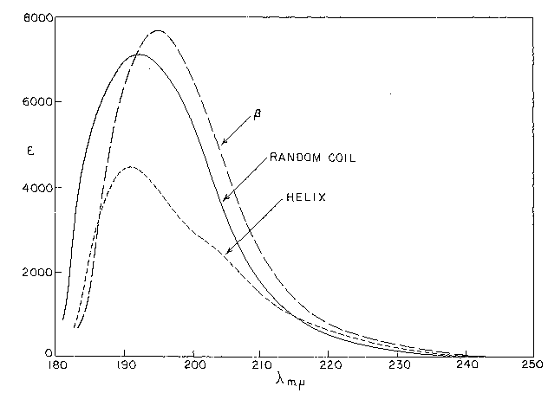
3. Rosenheck,K., PNAS. 1961, 47, 1776

Slide 16
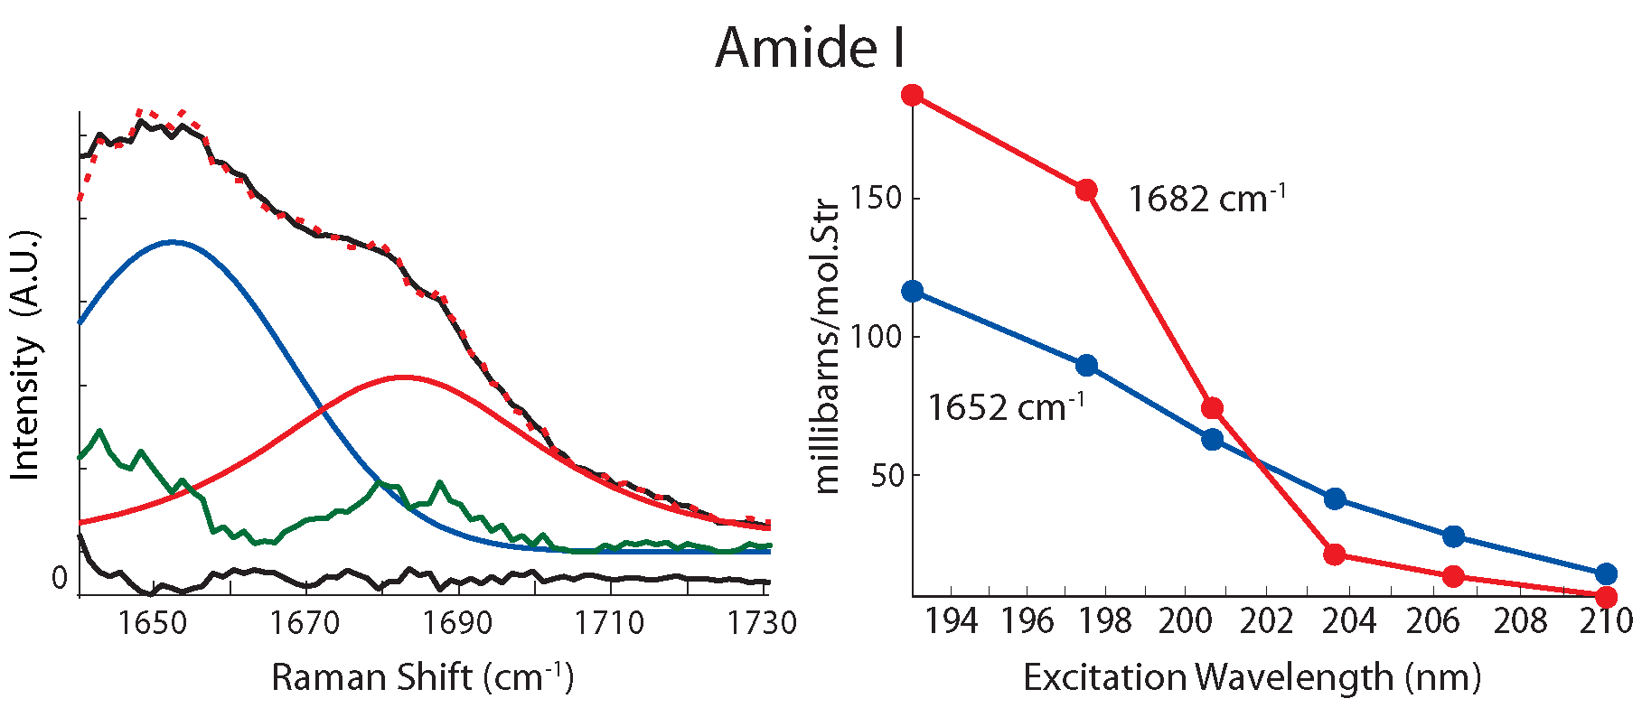
Assignment of each band can be performed based on the relative intensity of the band at each excitation wavelength.
This analysis was performed for each Amide mode.
4. Spiro, T.., App. Spectro. 2005, 6, 776

Slide 17
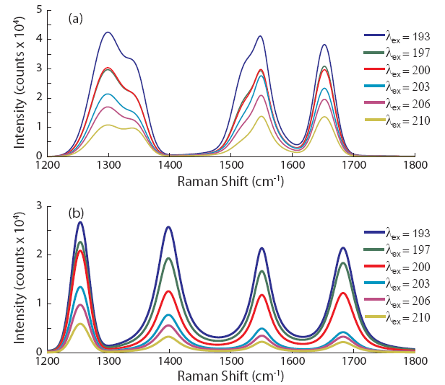
Conclusions

Slide 18
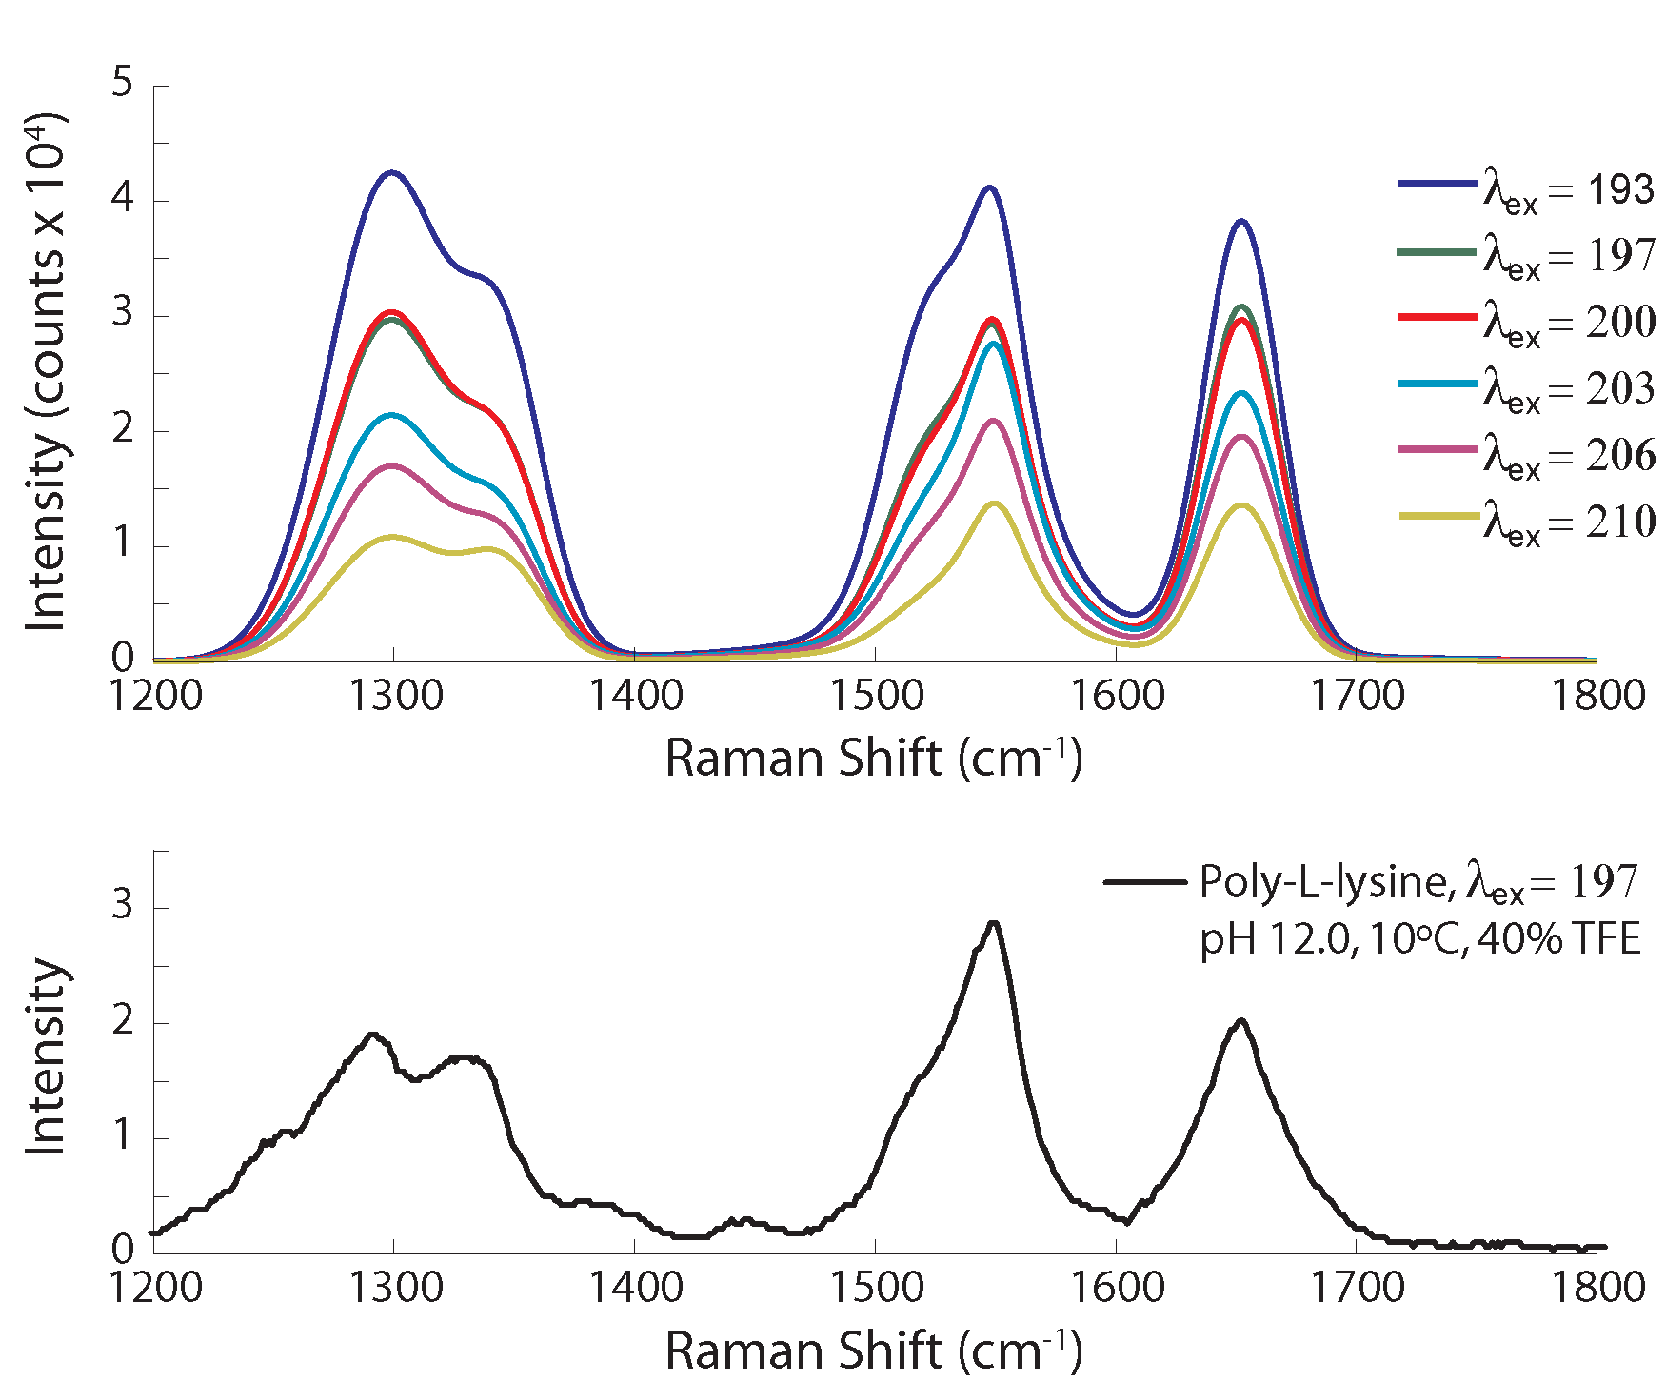
Jiji R., Spiro, T., Biochemistry 2006, 45, 34

Slide 19
Attempts to expand MCR-ALS to a three dimensional data encountered two major challenges.
  Data Alignment
  Water band subtraction

Slide 20
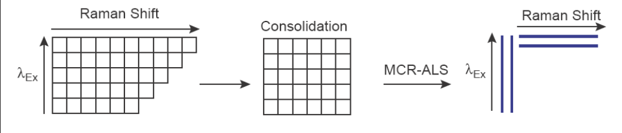
Many challenges arise with the use of multi-excitation data:
  Resolution changes with excitation.
  Can be addressed through:
    A linear interpolent
    Removing data points
    Correlation optimized warping (COW)

Slide 21
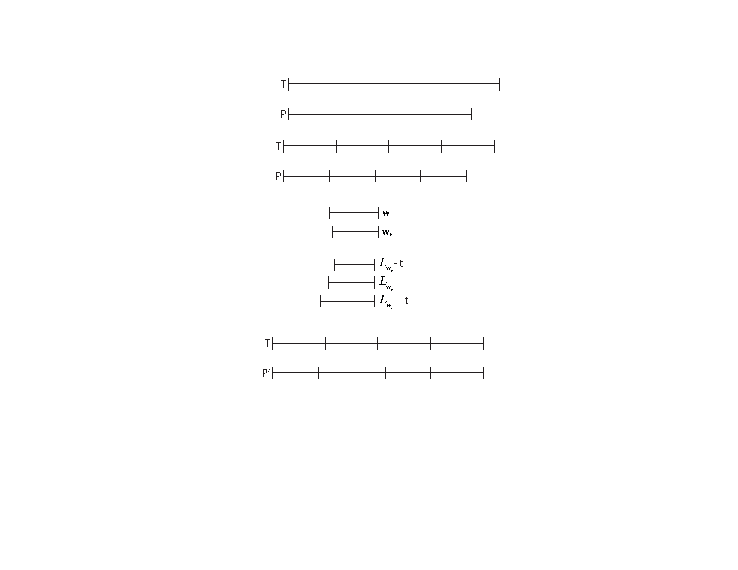
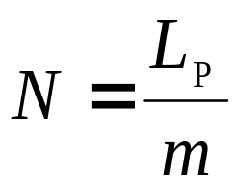
Reference
Sample
Each of these spectra are then divided into segments:

Slide 22
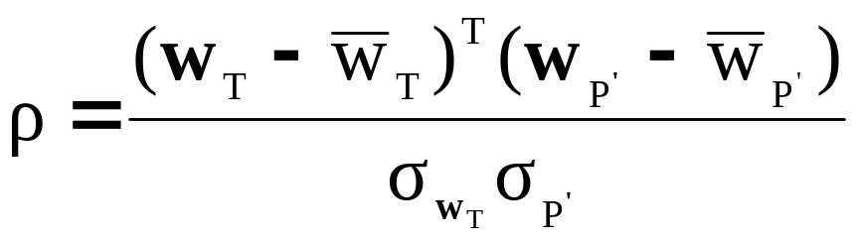
Starting from the end of the spectra, the segments are compared:
The sample segment is expanded or compressed by a set number of points, the slack (t).
The optimum warping is determined by the segment with the highest correlation coefficient

Slide 23
All the segments are then combined into the final warped spectra of the same number of points as the reference.

Slide 24
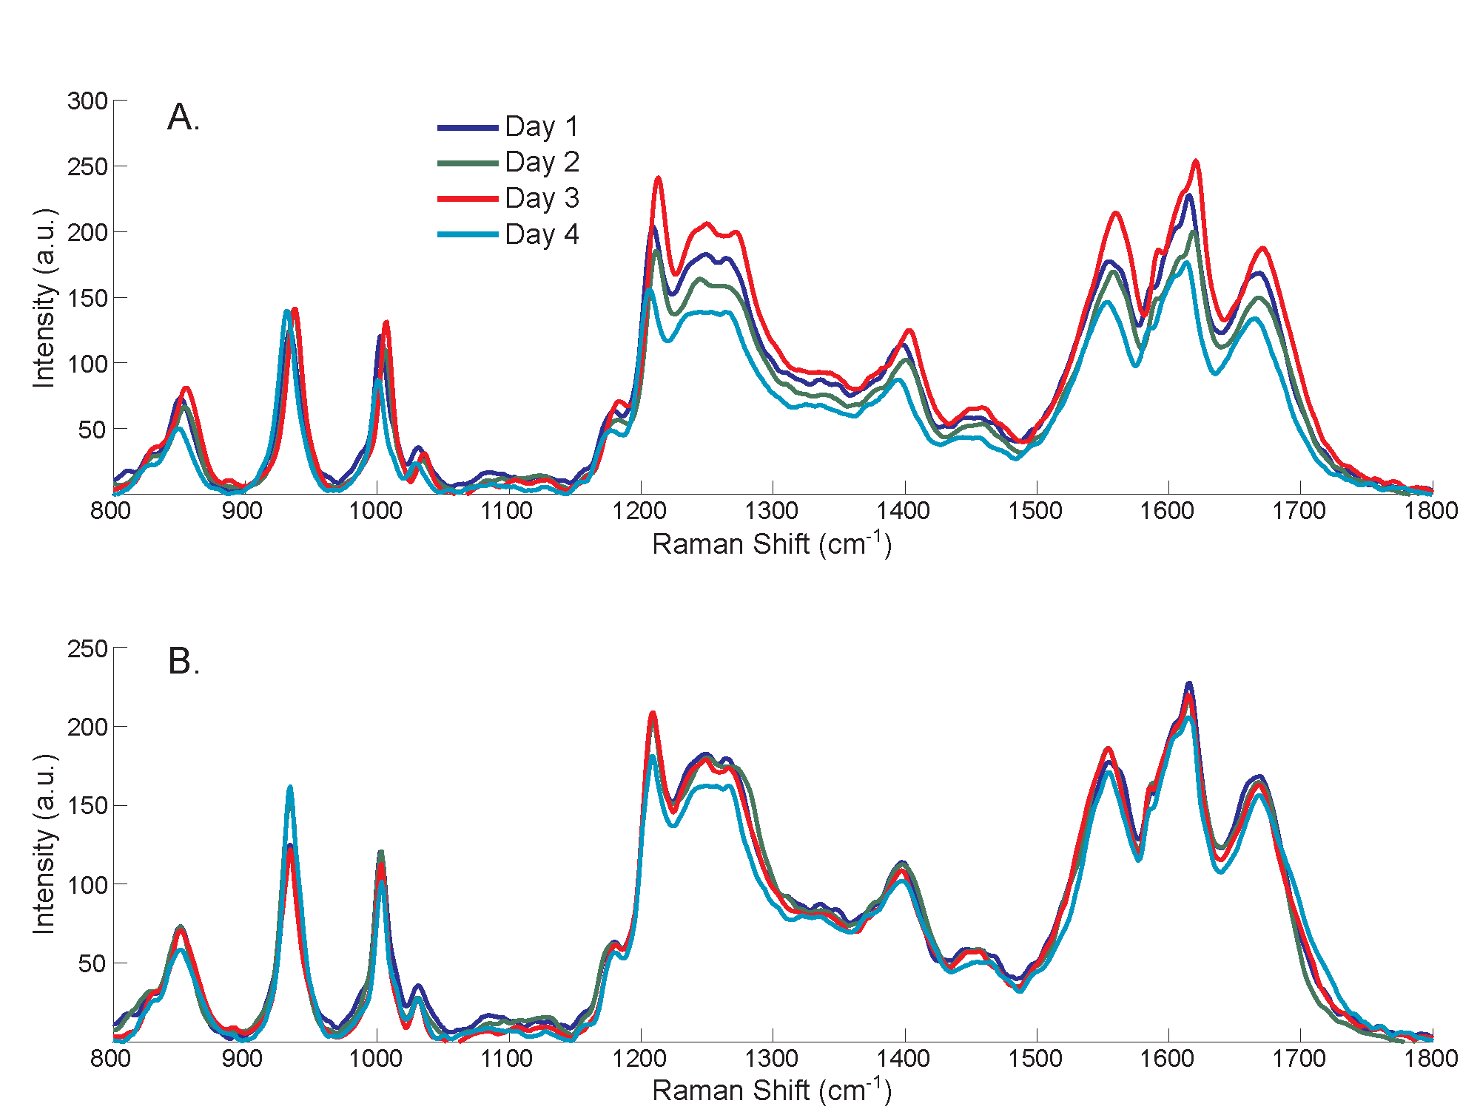
UVRR spectra of 1 mg/ml ovalbumin excited at 200 nm over four days, pre (A) and post (B) application of correlation optimized warping.

Slide 25
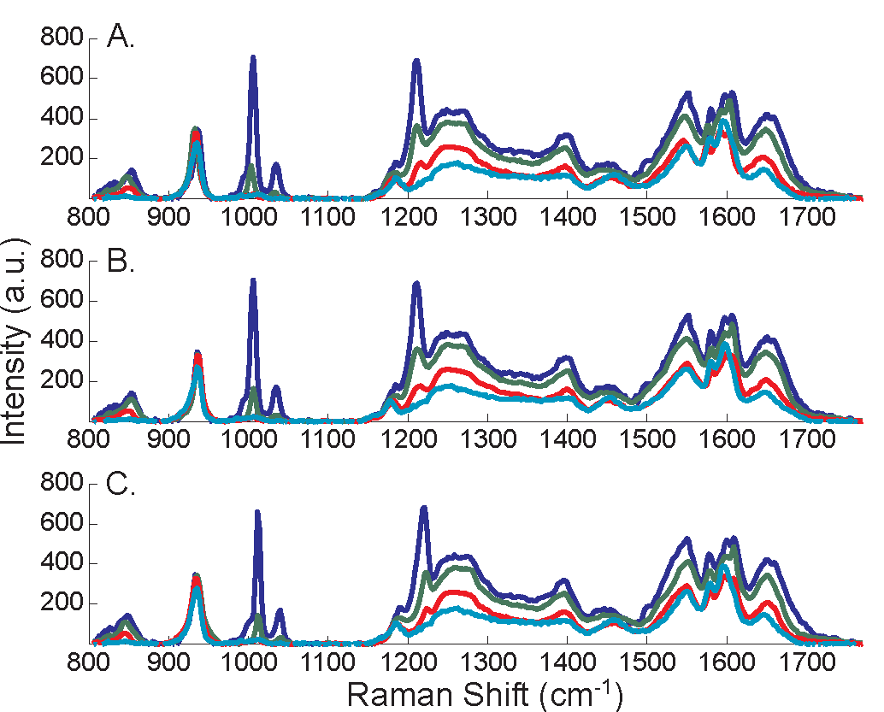
UVRR spectra of 1 mg/ml ovalbumin excited at 197 nm, 201 nm, 205 nm, and 209 nm, pre (A) and post (B) correlation optimized warping starting at 197 nm as the first reference spectra and (C) 209 nm as the first reference spectrum.

Slide 26
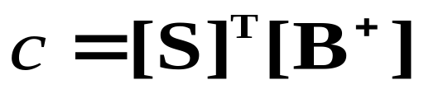
Removal of the water band from UVRR is usually accomplished through the use of an internal intensity standard.
  Can cause negative intensity in the amide region due to over subtraction
  Quality of the subtraction initially appears to be dependent on the analyte concentration
An alternate method is to use the tail end of the water spectrum, 1750-1900 cm⁻¹(B), to determine the concentration (c) of the water band through a least squares optimization with the sample spectrum (S).

Slide 27
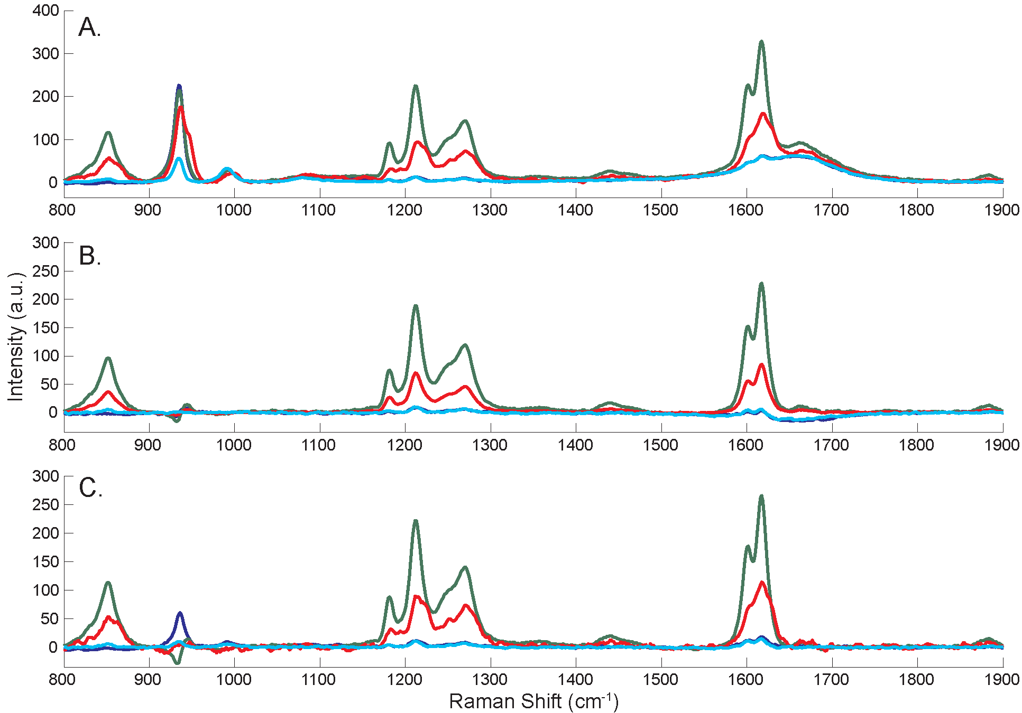
UVRR spectra of L-tyrosine, 20 µM (blue), 100 µM (green), and 200 µM (red) in 10 mM phosphate buffer with an internal intensity standard, sodium perchlorate, at 0.2 M concentration. The UVRR spectrum of 20 µM with 0.05 mM sodium perchlorate is shown in cyan. (A) pre water band subtraction, (B) water band subtraction according to the internal intensity standard, and (C) water band subtraction determined through least squares method.

Slide 28
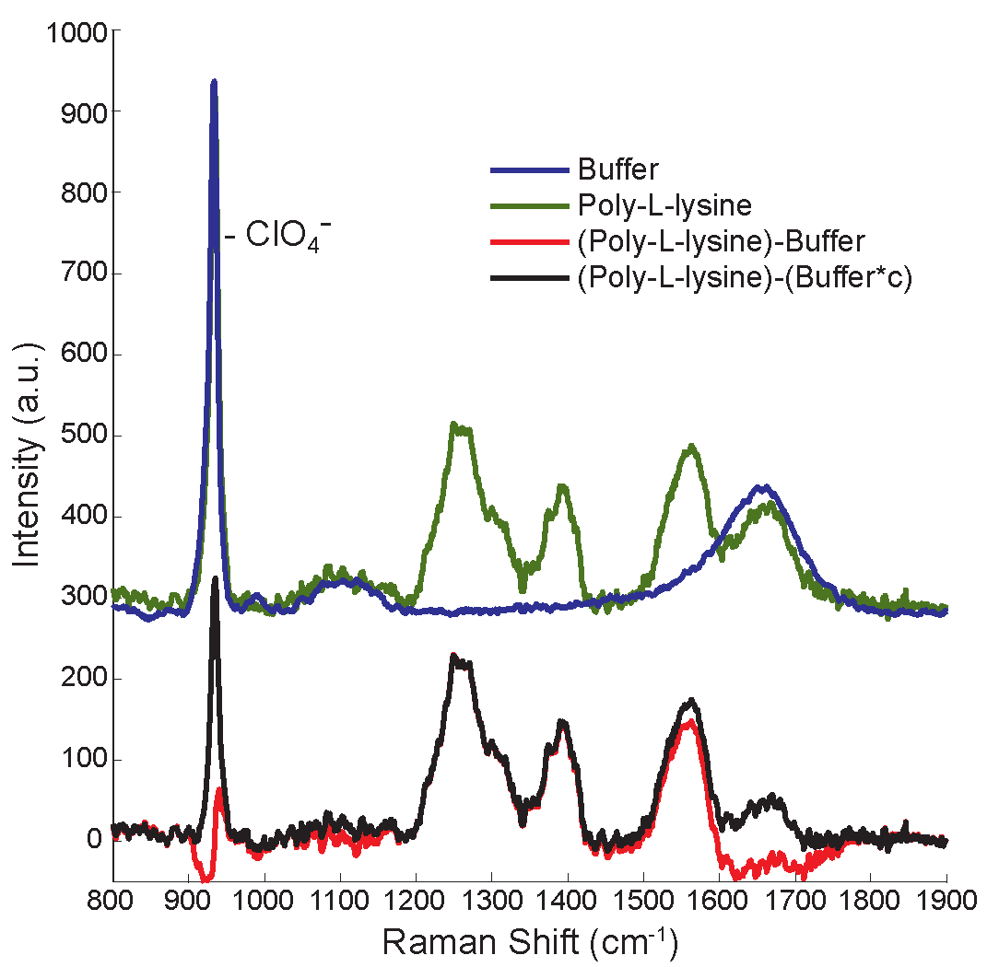
UVRR spectra (λ_{ex}= 206 nm) of 10 mM phosphate buffer (blue), poly-L-lysine (1000-4000 Da) (green) offset from poly(L-lysine) with water band subtraction determined by the internal intensity standard (red), 0.2 M perchlorate, and the tail end of the water band (1750-1900 cm⁻¹)(black).

Slide 29
Conclusions
Correlation optimized warping will become an invaluable tool in the analysis of three dimensional UVRR dataset by alleviating calibration errors which occur during collection and enable better alignment in multi-excitation data sets.
Using the intensity of the far outlining points beyond the amide I mode appears to provide an equivalent water band subtraction method at high analyte concentrations, and does not over subtract the water band with low analyte concentrations.

Slide 30
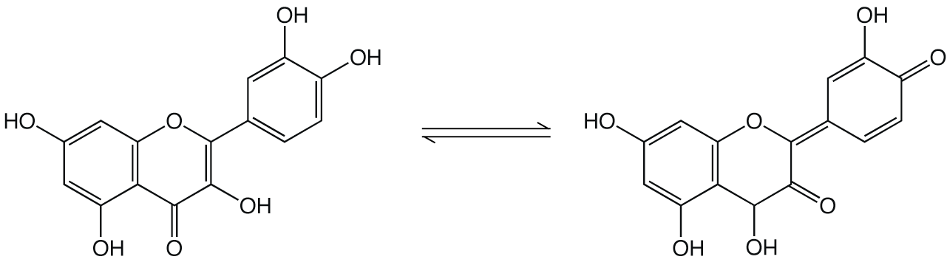
Introduction
Flavonoids are poly-phenolic compounds of great interest due to their many health benefits
  Anti-inflammatory
  Cardioprotective
  Anti-amyloidogenic
Behavior in solution and with proteins poorly understood:
  Photo-induced tautomerization
  Readily oxidized in solution
Quercetin

Slide 31
Experimental
Excitation emission matrix fluorescence spectroscopy
  Emission collected from 300 to 650 nm
  Excitation from 270 to 500 nm in 10 nm increments
Quercetin: model flavonoid compound
  Concentration will vary from 0.25 to 100 μM
  pH will vary from 6.2-8.0 in 0.2 pH increments
Bovine Serum Albumin (BSA): model protein
Analysis: Weighted Parallel Factor Analysis (W-PARAFAC)

Slide 32
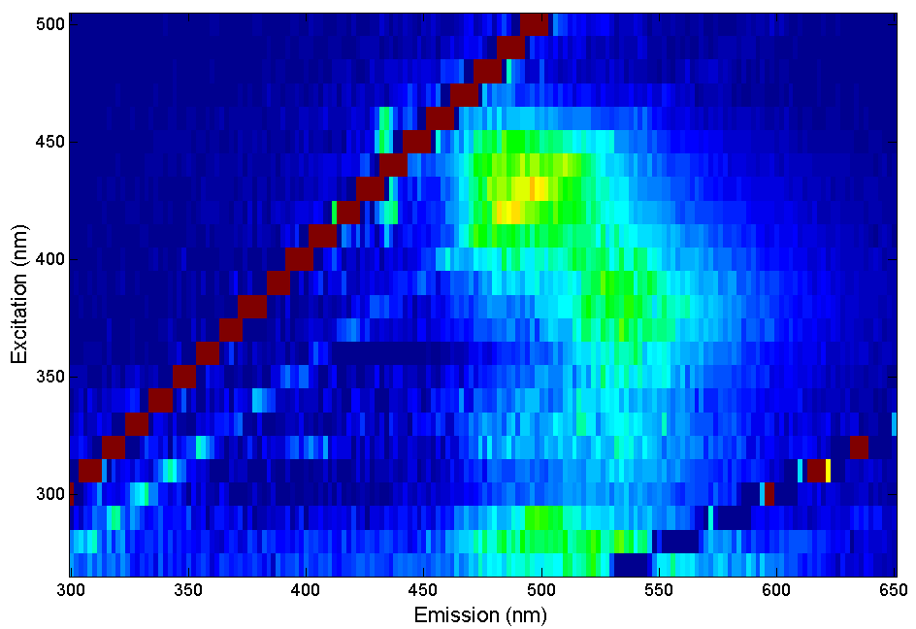
EEM fluorescence of 25 μM quercetin in 10 mM phosphate buffer at pH 7.4. Excitation increments 10 nm.

Slide 33
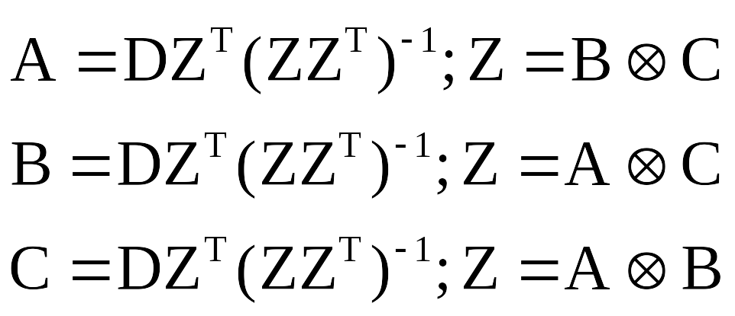
PARAFAC
B and C are first initialized. This is done with random inputs.
  A is then estimated from the original data and the Kronecker product of B and C.
This process is repeated alternating between A, B, and C until convergence. This cycling process of estimating A, B, or C from the original data and the tensor product of the other two can be called an “Alternating Least Squares” manner.

Slide 34
Weighting Matrix
The weighting matrix is user defined:
  Removes the influence of data points in the model by removing them from the minimization of the model to the data
  Hard weighting scheme was employed:
    Binary weighting values of 1 or 0
    Regions of the spectra corresponding to Rayleigh or Raman scattering a weight of zero.

Slide 35
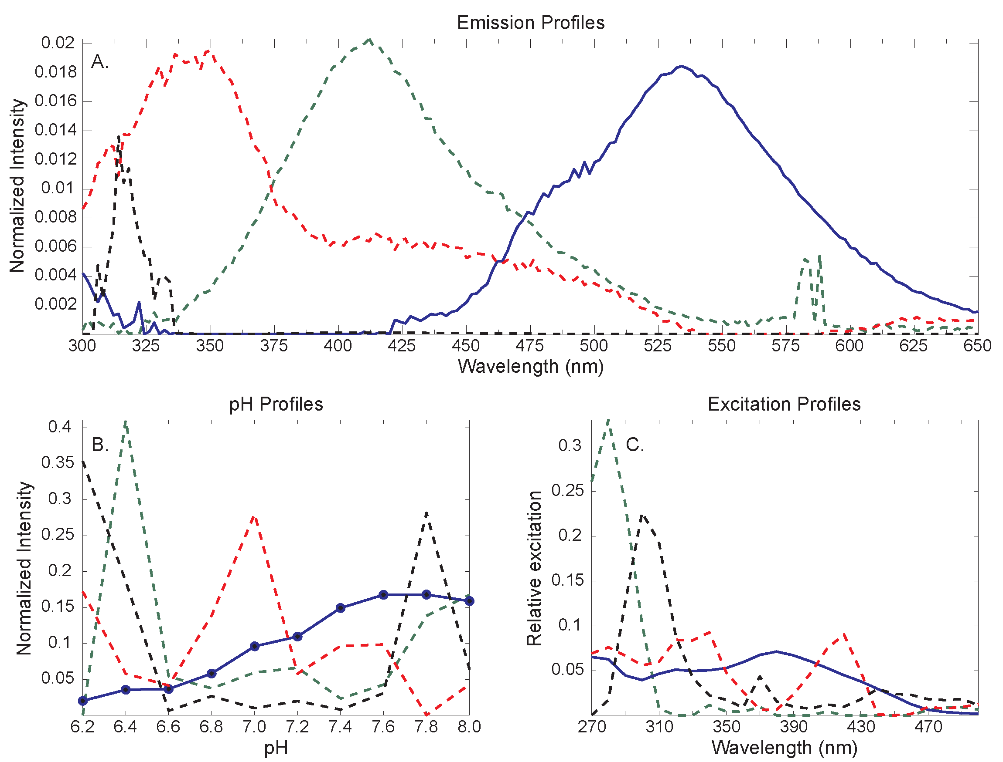
(a) Emission, (b) pH, and (c) excitation profiles of 5 μM quercetin at pH values ranging from 6.2 to 8.0.

Slide 36
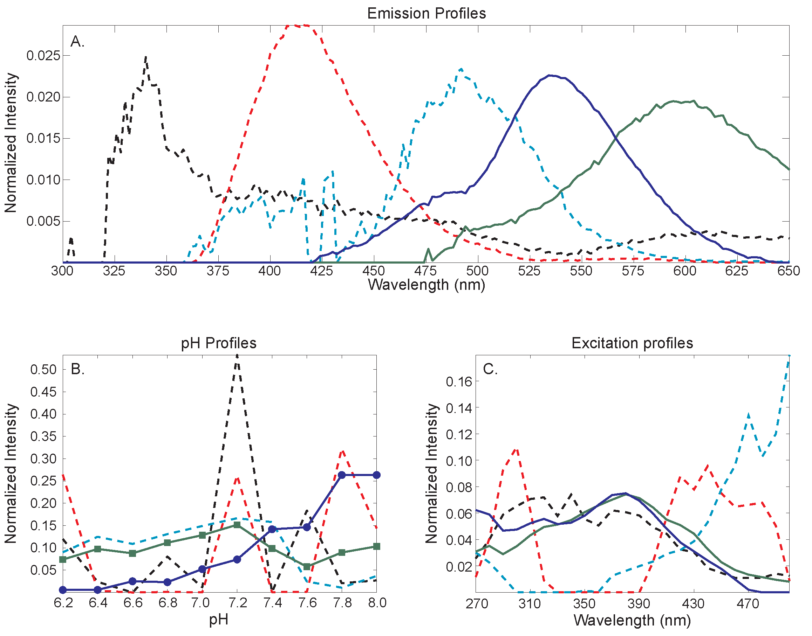
(a) Emission, (b) pH, and (c) excitation profiles of 25 μM quercetin at pH values ranging from 6.2 to 8.0.

Slide 37
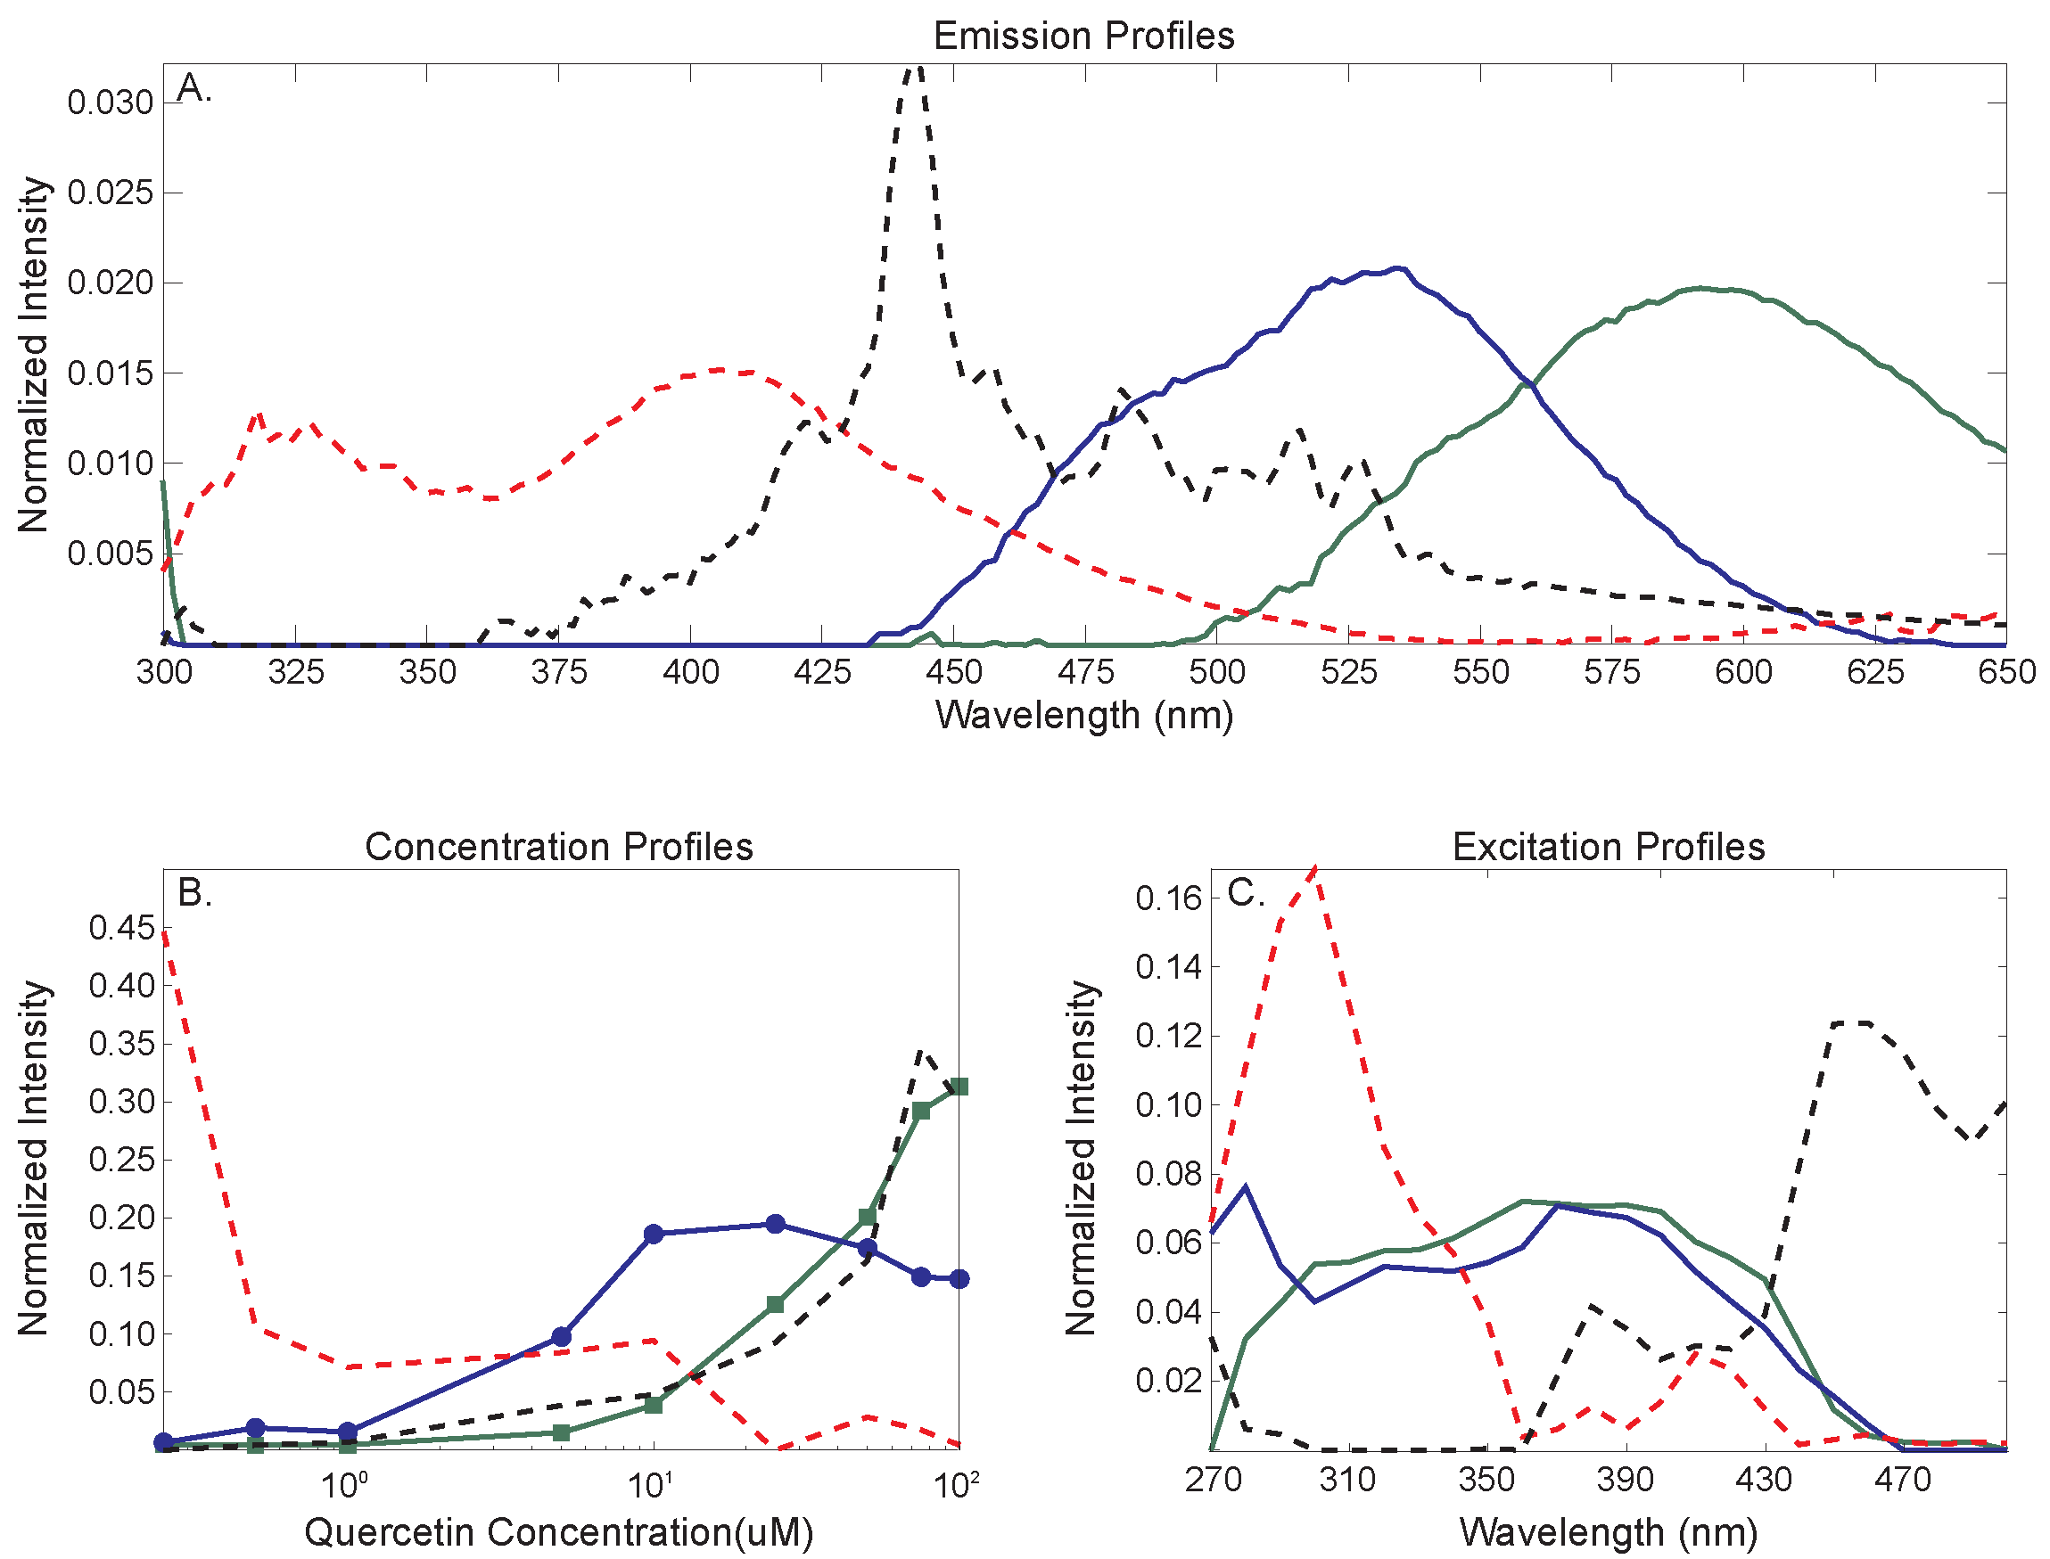
(a) Emission, (b) concentration, and (c) excitation profiles of quercetin solutions ranging from 0.25 to 100 μM at pH 7.4.

Slide 38
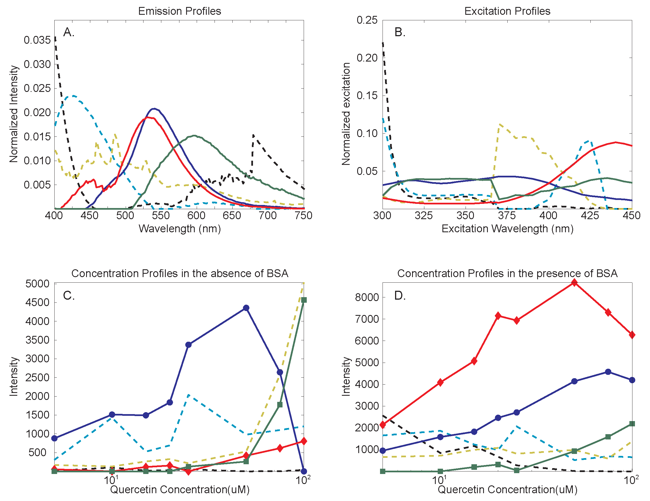
a) Emission, (b) excitation, and concentration profiles in the absence (c) and presence of BSA (d). Samples consist of 5 to 100 μM at pH 7.4, with 5 μM of BSA in samples containing protein.

Slide 39
Conclusions
The factor at 540 nm represents the combination of enol and keto forms of quercetin.
The factor at 600 nm represents the higher order aggregates of quercetin, larger than dimers.
The 530 nm factor represents the fluorescence of the quercetin/BSA complex, as it is only present with BSA.
These forms of quercetin were simultaneously modeled in addition to the presence of a fluorescence interferent.

Slide 40
Acknowledgements
My advisor Dr. Jiji
My committee
Dr. Cooley
The Jiji and Cooley Groups
My many friends in the chemistry department
The University of Missouri
The University of Missouri Department of chemistry

Slide 41
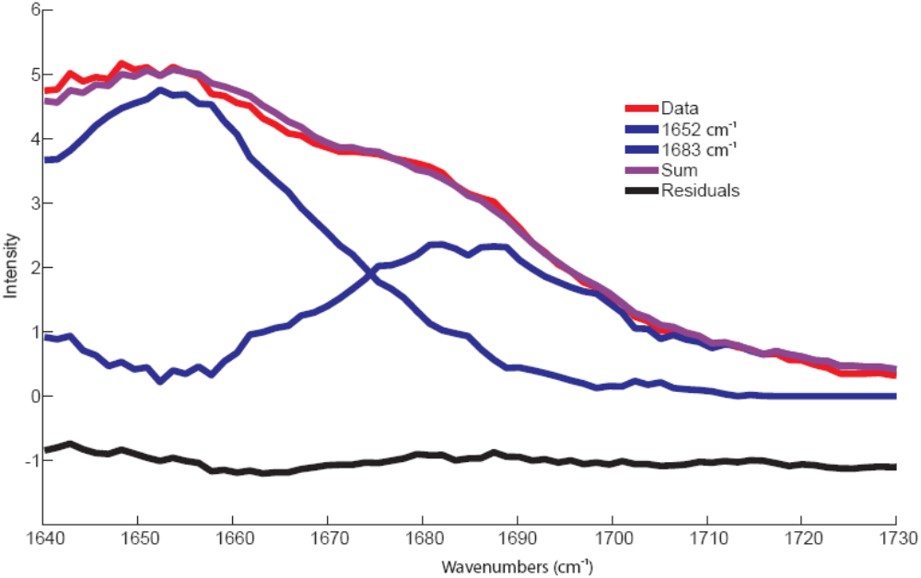
Amide I region of 193nm excitation spectra of Myoglobin: Unconstrained model

Slide 42
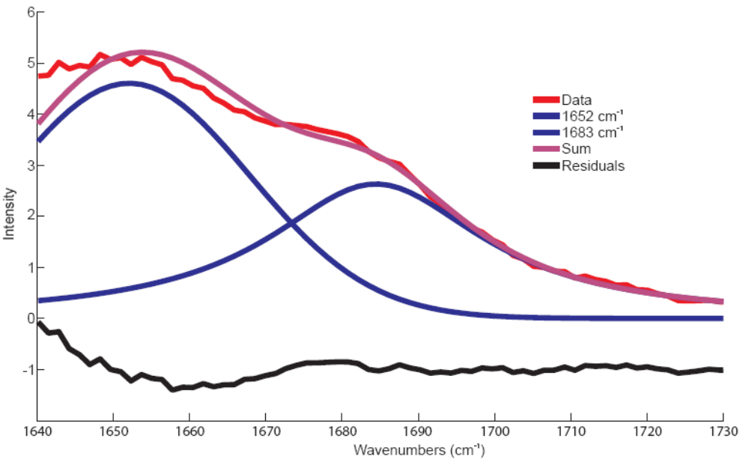
Amide I of region 193nm excitation spectra of Myoglobin: Fully constrained model

Slide 43
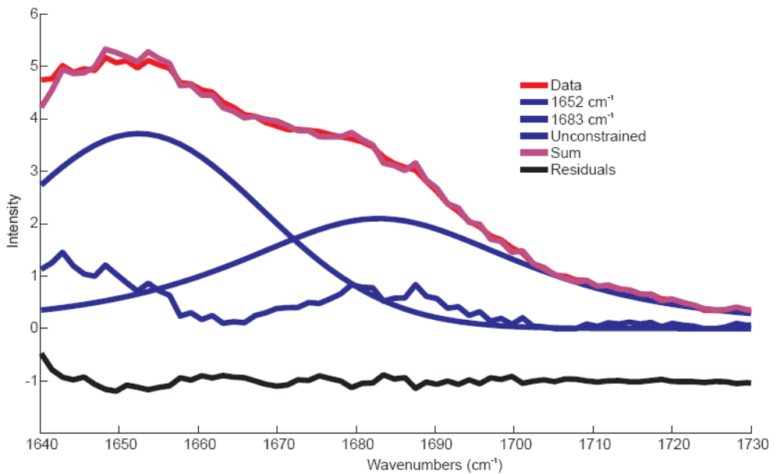
Amide I region of 193nm excitation spectra of Myoglobin: Partially constrained model

Slide 44
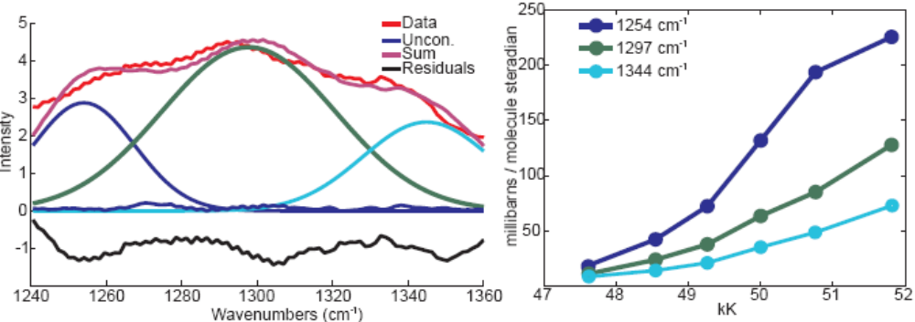
Amide III region of 193nm excitation spectra of Myoglobin: Partially constrained model and cross sections calculation
Both (1344 cm⁻¹)⁸ and (1297 cm⁻¹)⁹ are both identified as α-helix bands by frequency.
(1254 cm⁻¹)¹⁰ is classified as a non helical band, however the shape and intensity of cross sections suggests the possibility that it still contains some α-helix content.
8. Spiro, T.., J. Raman Spec. 2006, 37, 277
9. Callender, R.., Protein Science. 1997, 6, 2134
10. Spiro, T.., J. Am. Chem. Soc. 1991, 113, 6359

Slide 45
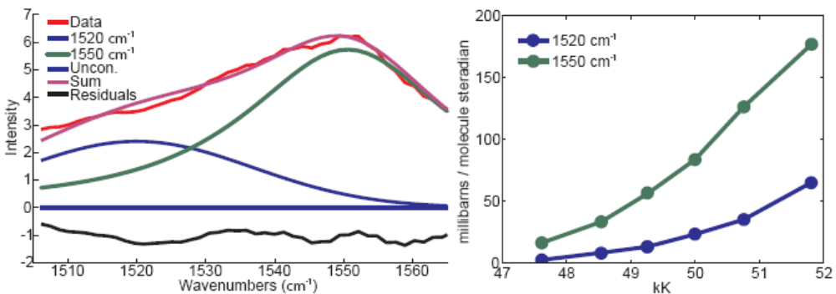
Amide II region of 193nm excitation spectra of Myoglobin: Partially constrained model and cross sections calculation
Both the (1520 cm⁻¹) and (1550 cm⁻¹) bands can be classified as α-helix bands.¹¹
11. Asher, S.A.., Biochemistry. 1998, 37, 2854

Slide 46
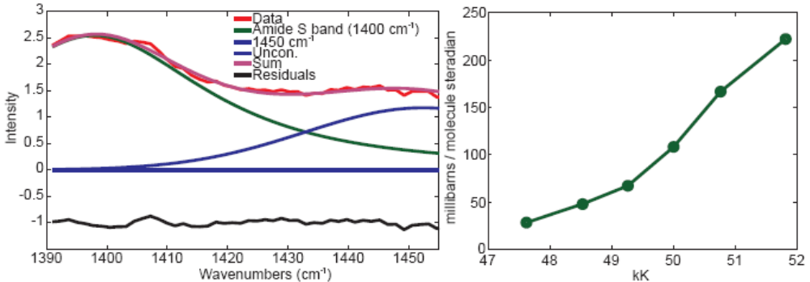
Amide S region of 193nm excitation spectra of Myoglobin: Partially constrained model and cross sections calculation
The Amide S band is classified as non-helical.¹⁰

Slide 47
[ ]
(
)
(ν₀ – ν_{s})
4
(
)
I_{N}
C_{S}
σ_{N} = σ_{S} x
x
x
I_{S}
(ν₀ – ν_{N})
C_{N}
N denotes the sample
S denotes the internal standard, (in our case sodium perchlorate)
ν₀ denotes laser excitation frequency, (cm⁻¹)
ν_{s} denotes vibrational frequency of internal standard, (cm⁻¹)
ν_{N} denotes vibrational frequency of sample, (cm⁻¹)
(
)
I_{N}
I_{S}
Peak height ratio of the sample and internal standard
(
)
C_{S}
concentration ratio of the sample and internal standard
C_{N}
σ_{S} denotes cross section of internal standard, in Millibarns/molecule steradian

Slide 48
 | α - Helix | β - Sheet | β - Turn | Unordered
 | wavenumber (cm-1)
Amide III | 1265^{b} | 1229^{b} | 1244ª | 1248^{b}
 | 1294^{b} | 1289^{b} | 1297ª | 1279ª
 | 1345^{d}
Amide S |  | 1359^{f} | 1332ª | 1332ª
 | 1393ª | 1395e | 1374ª | 1395e
Amide II | 1525ª | 1537ª | 1542ª | 1560^{c}
 | 1545^{c} | 1551^{c}
Amide I | 1649^{b} | 1654^{c} | 1652ª | 1665^{b}
 |  | 1666^{b}
a: Spiro, T. J. Raman Spec., 2006, 37: 277.
b: Callender, R.H. Protein Science. 1997; 6: 2134.
c. Asher, S.A. Biochemistry 1998; 37:2854.
d. Spiro, T. J. Am. Chem. Soc. 2001; 113: 6359
e. Asher, S.A. J. Am. Chem. Soc. 1989; 111: 4295
f. Lord RC. Appl. Spectrosc. 1977; 31:187

Slide 49
Enol
Keto

