Slide 1

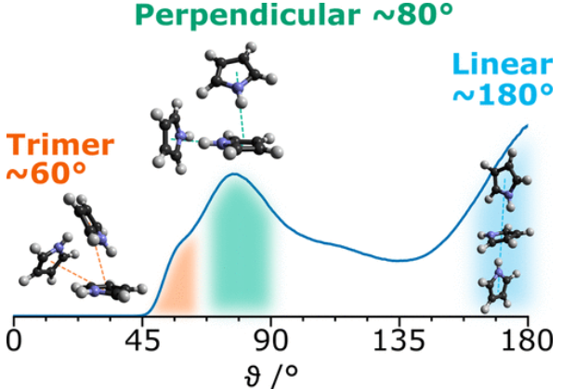

News (inc. Frontpage)
Crop here to 5:3 Landscape
Use gimp to set to 1000x600px
Paper Images (for 3x Demos in Research Page)
WE WANT YOU*
*to do a PhD on
Nanoribbons for
Photovoltaics

Slide 2
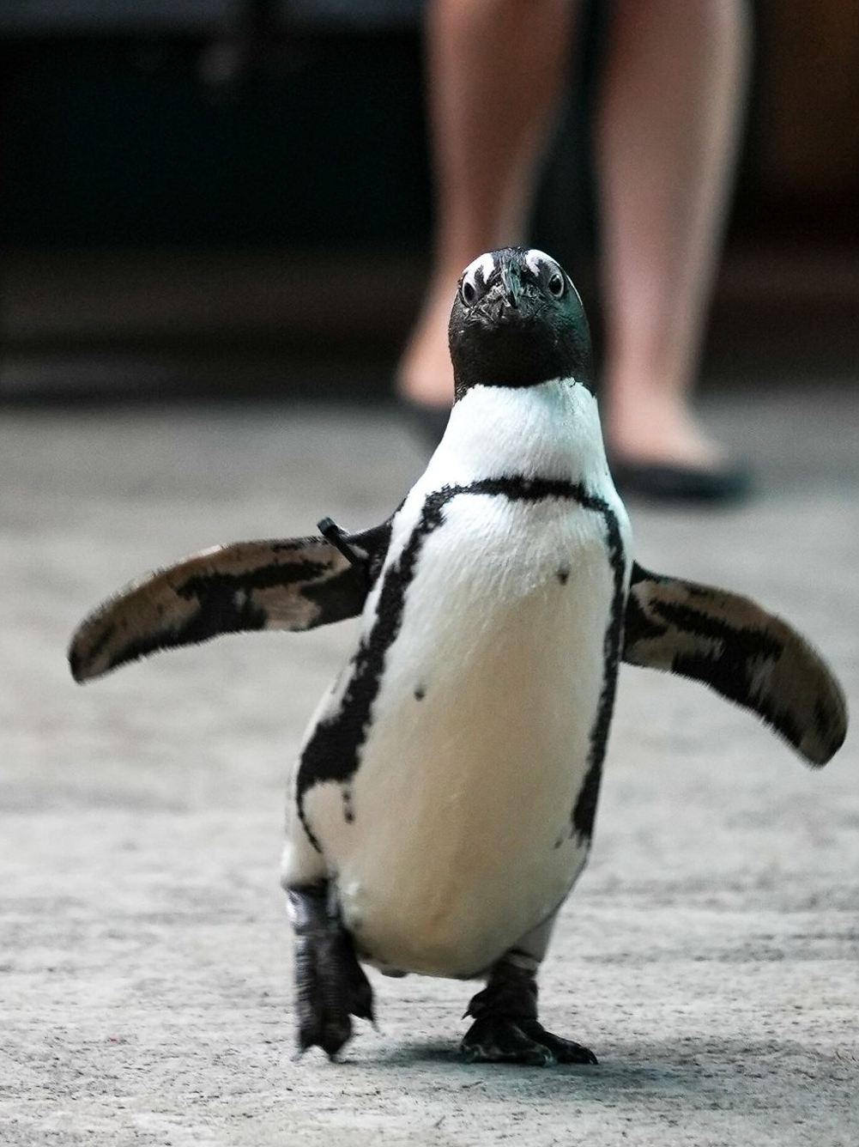
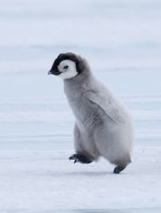
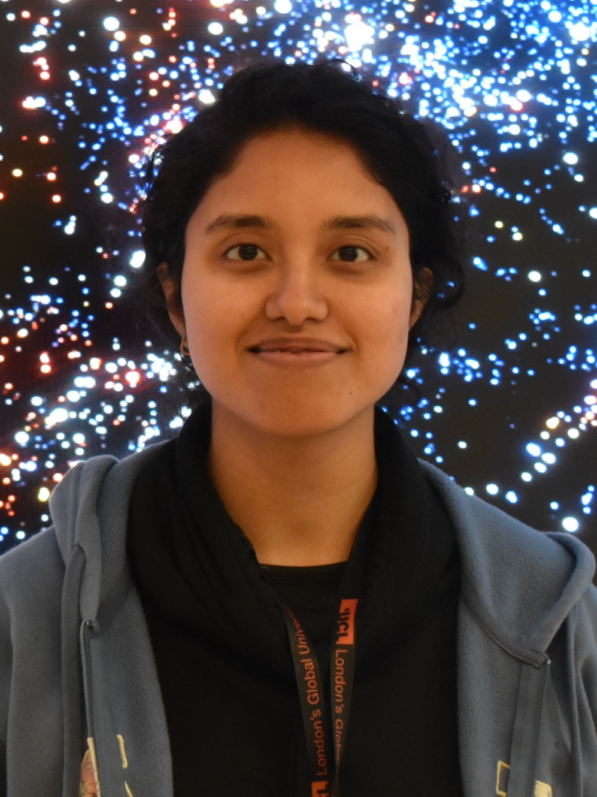
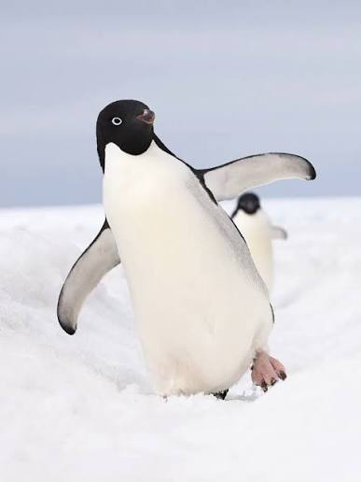

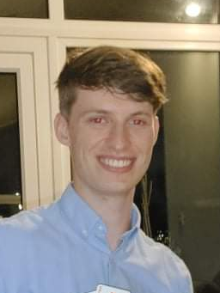
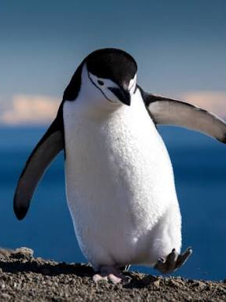
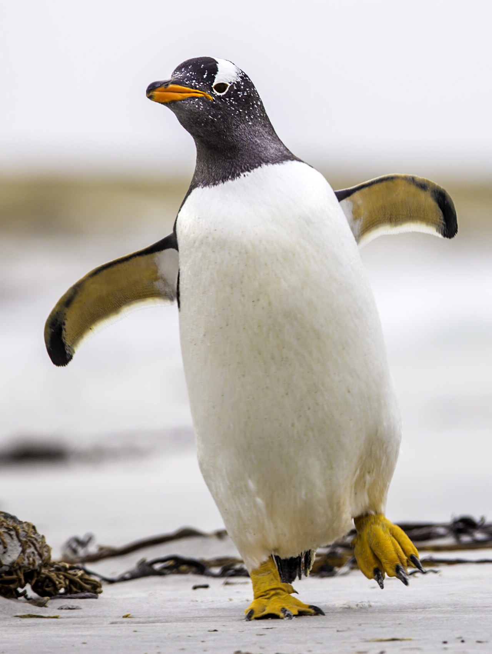
Crop here to 4:3 portrait
Use gimp to set to 300x400px
Member Portraits

Slide 3
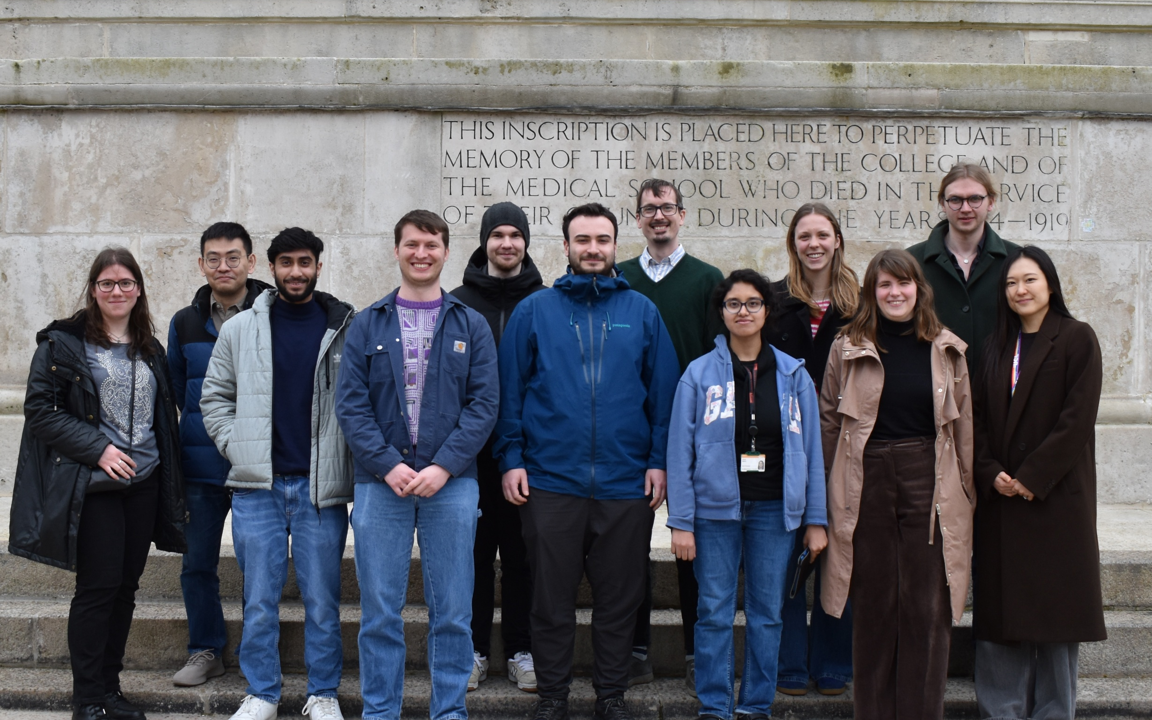
Crop here to 16:10 Landscape
Use gimp to set to 1600x1000 px
Group Photos

