Slide 1
Pothole Challenge
Presentation on
Submitted By
Tech_Pirates
Problem Statement ID : | DR112
Problem Category : | Software
Problem Creators Organization : | Government Of Goa

Slide 2
Introduction of Protoype
Development of Mobile based Android Application which has ability to capture and process the image into composed data file
Application will have location checking system to meet first requirement of the user .
It will generate the strong communication between people , government , and people representative.
We are developing the easy UI for better response of the user for more involvement of public
For better governance, we are providing facility to user to communicate with Stake holders and People representative.

Slide 3
Objective
Communication
Better involvement of public
Keep the user interest into App
Use of social media
User satisfaction

Slide 4
Problem Solution
What they want
Connection between people , stake holders and people representative
Involvement of public for better governance
What we do
Providing window for communication with stake holder and people representatives
Access of social media into App under some condition

Slide 5
Our process is easy
Click
Report
Monitor
User will click the photo of the pothole and composed with landmark and comment
By simply clicking report it will send on the server list which will seen by the admin
This feature will allow user to monitor the there reported compliant where report will have status like pending
In-work or completed

Slide 6
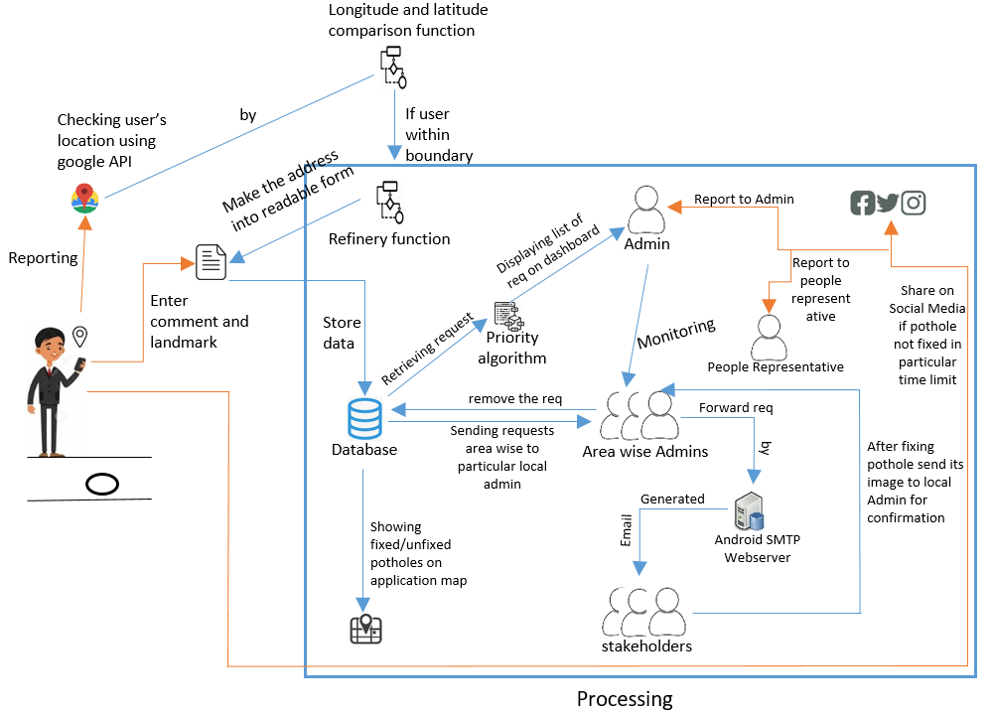
System Architecture

Slide 7
Technolgy Stack
Used
Kotlin
Firebase
Php
Google API
Why ?
Kotlin is more concise, safe , easy, speedup development, reduce bugs
It provide real time interface, secure hosting , notification facility
Php has secure data transmission, easy to perform basic crud operation ,easily operate with query language
API will provide real time coordinate of user in app for further operation

Slide 8

Thanks!
Any questions?
You can find us @Team_Tech_pirates

