Slide 1
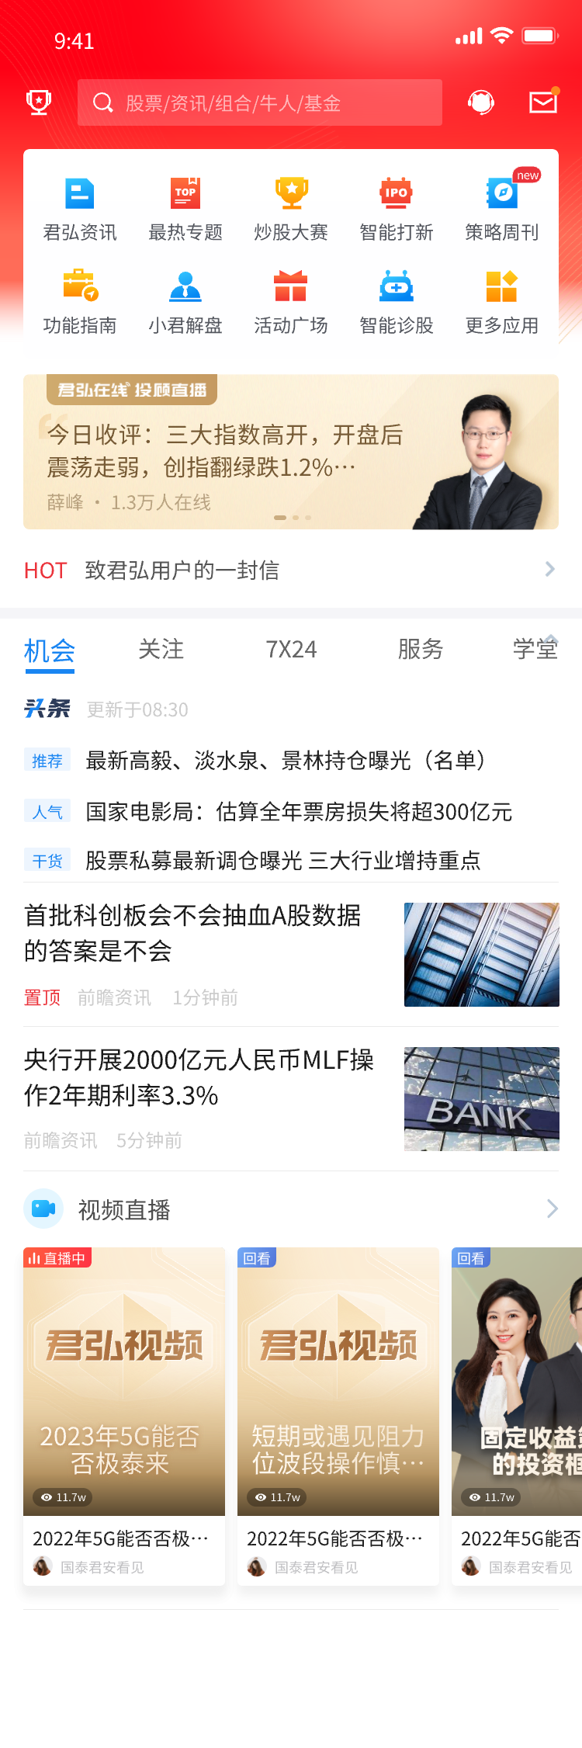


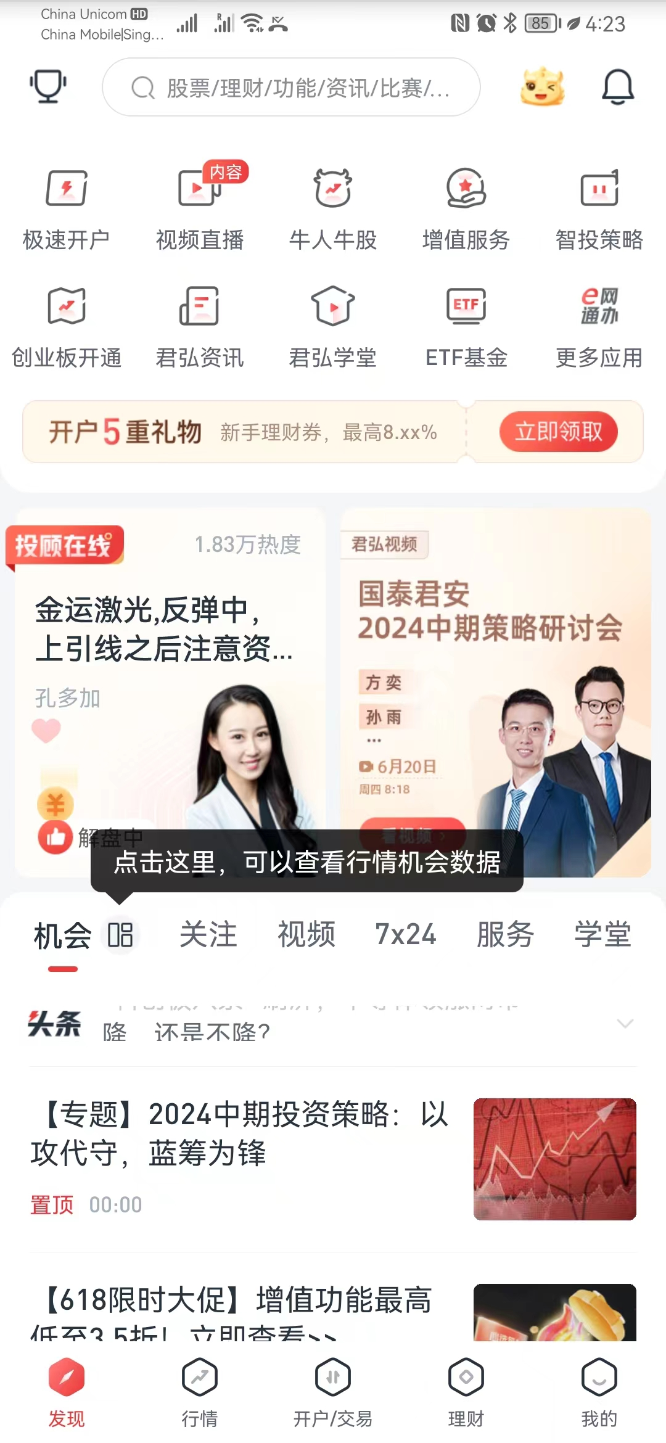
Source Screen
(Mock-up)
Target Screen
(Mock-up)
Locate
VLM
Source Screen
(Implementation)
Action Description
Action Completion
Action Execution
Updated Screen
(Implementation)
Screen Matching
Incorrect screen
No screen transition
Process Inconsistency
Report

Slide 2
1
Process
0..*
1
starts
1
1
contains
ends
1
1..*
contains
leads to
1..*
Screen
0..*
leads to
1
contains
1..*
1
1..*
Widget
triggers
Action
1
1..*
1

Slide 3
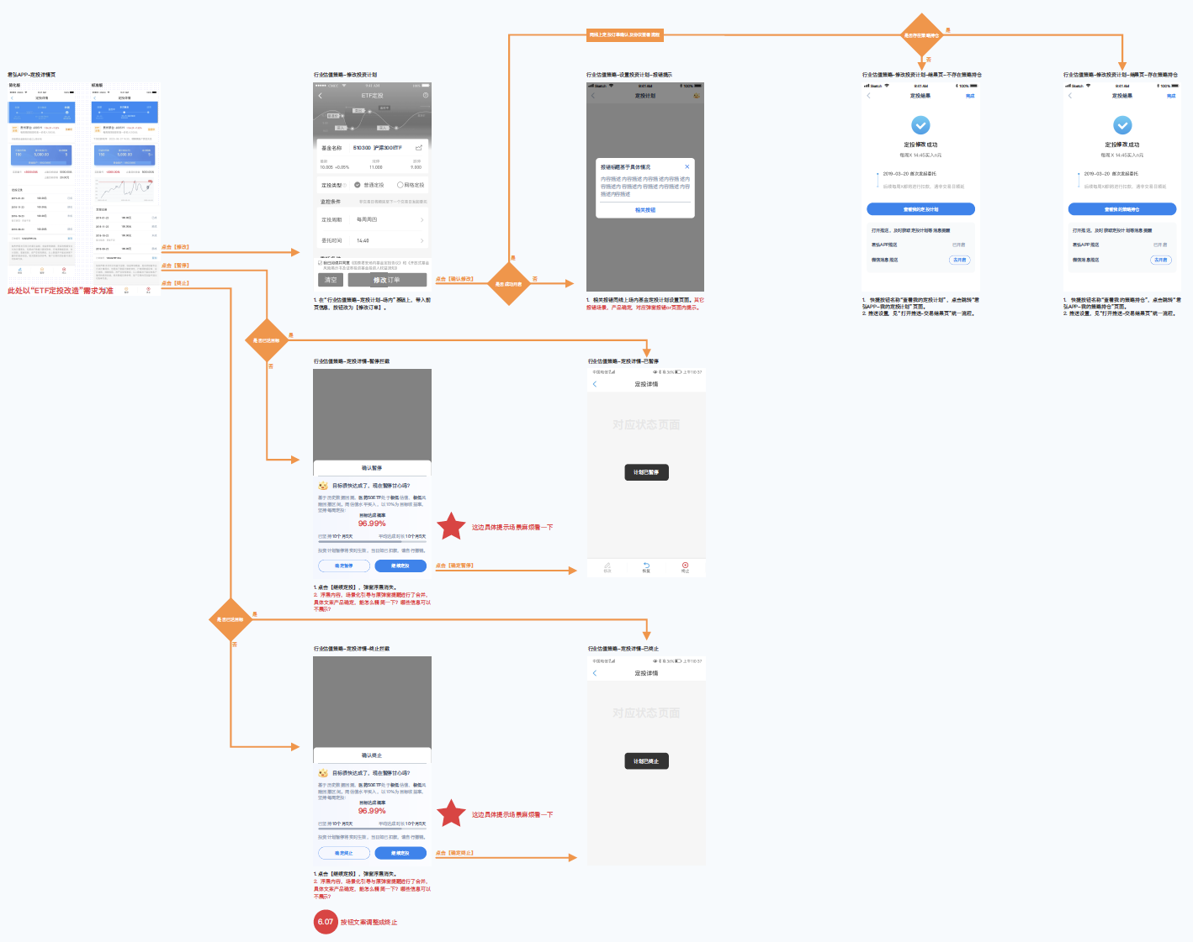
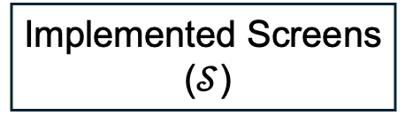
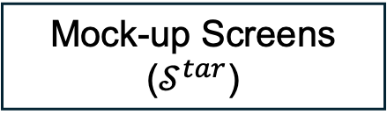
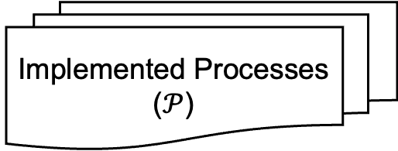
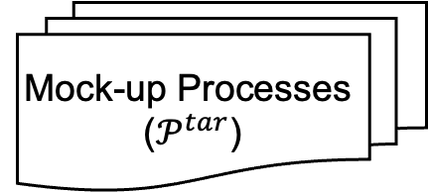
Input
Implemented Processes
($𝒫$)
App Implementations
Implemented Screens
($𝒮$)
Screen Inconsistency
Checking
VLM
Output
App Mock-ups
Action Chain Completion
and Execution
Inconsistency Report
Process Inconsistency
Checking
Compliance
Checking
Instantiation
Mock-up Processes
($𝒫^{tar}$)
Standardized
Mock-ups
Mock-up Screens ($𝒮^{tar}$)

Slide 4
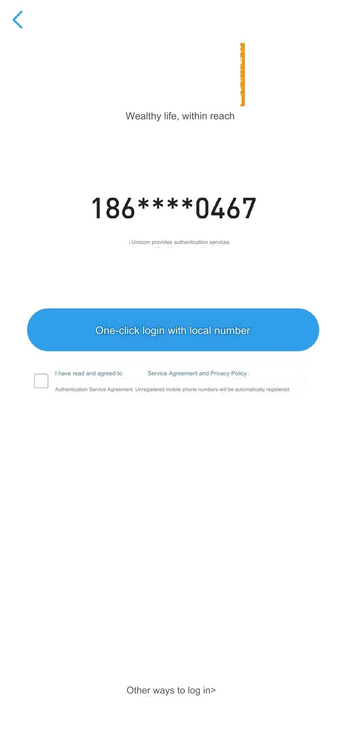
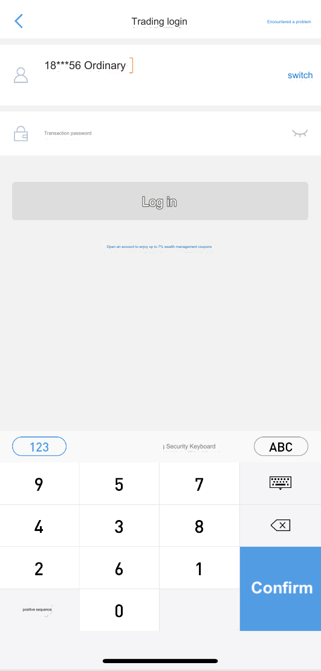
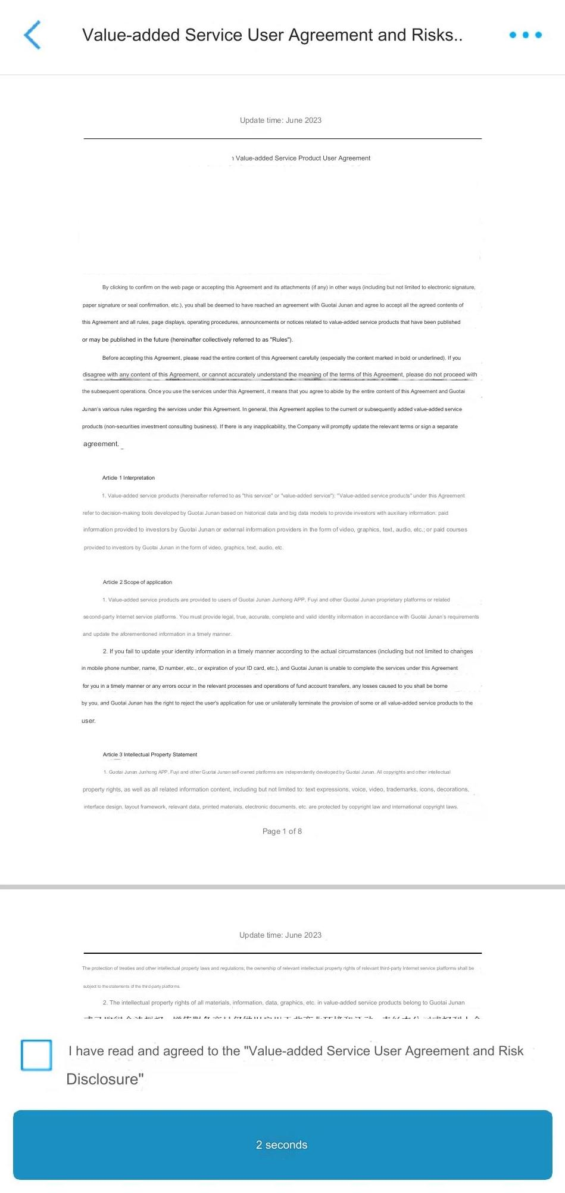
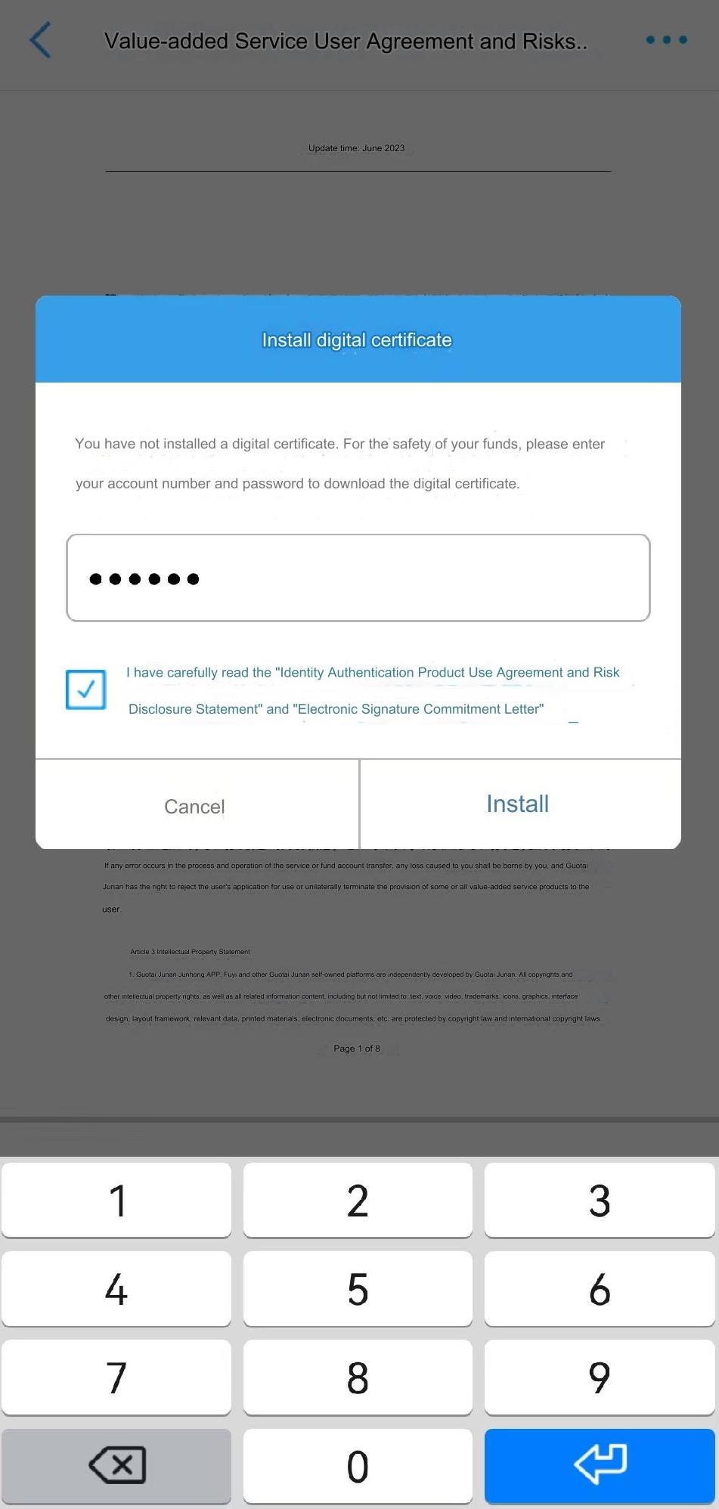
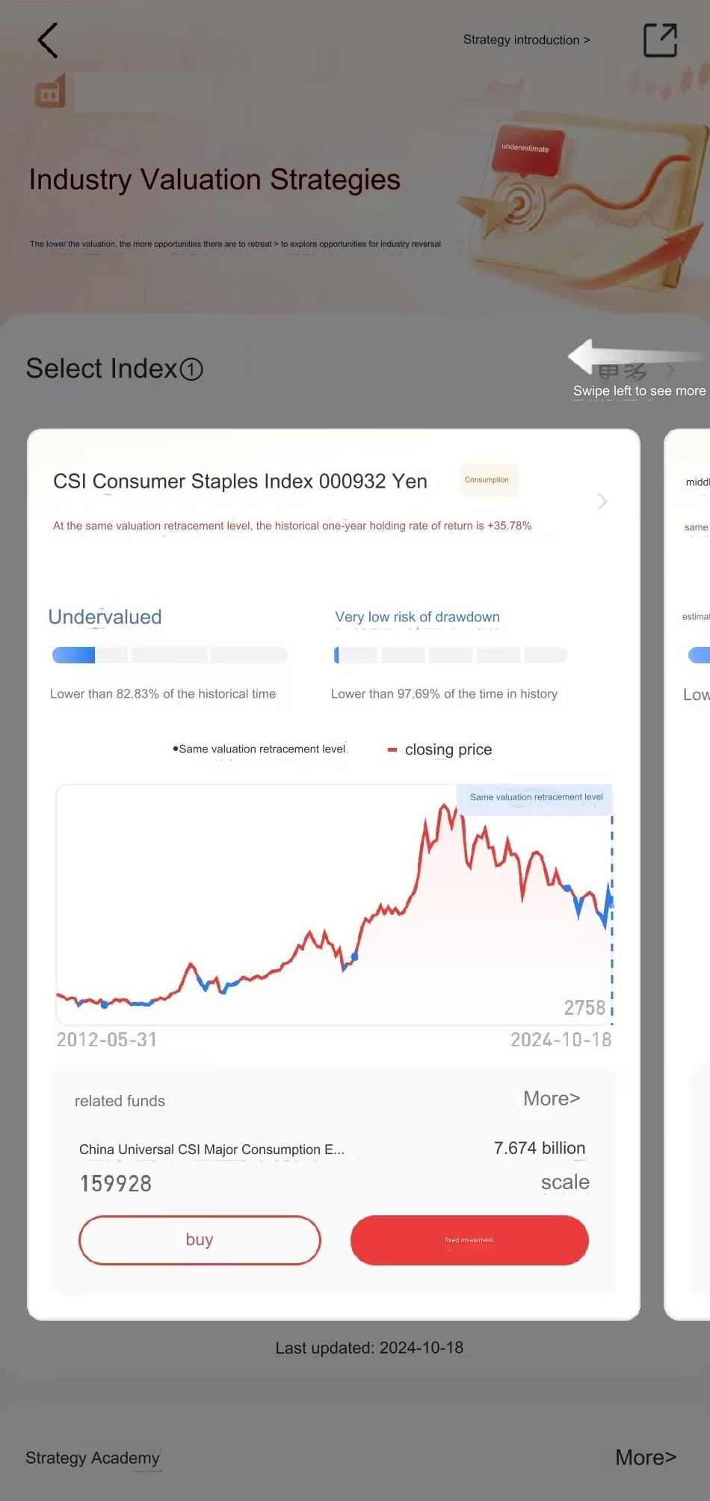
Type in the password and login
Agree to the terms and login
Install the certificates
Scroll to the bottom and agree to the terms

