Slide 1
Data Mining Algorithms Implementation: An Online Retail Data Set Case
Huayi Chen, Yu Shi, Xunqing Wen, Tianhao Wu, Xing Zhou

Slide 2
Introduction
Several data mining algorithms are introduced in the introduction to data mining course. We want to apply these classical algorithms to real life data to see what meaningful information can be extracted.
Clustering
Frequent Pattern Mining
Frequent Sequence Mining

Slide 3
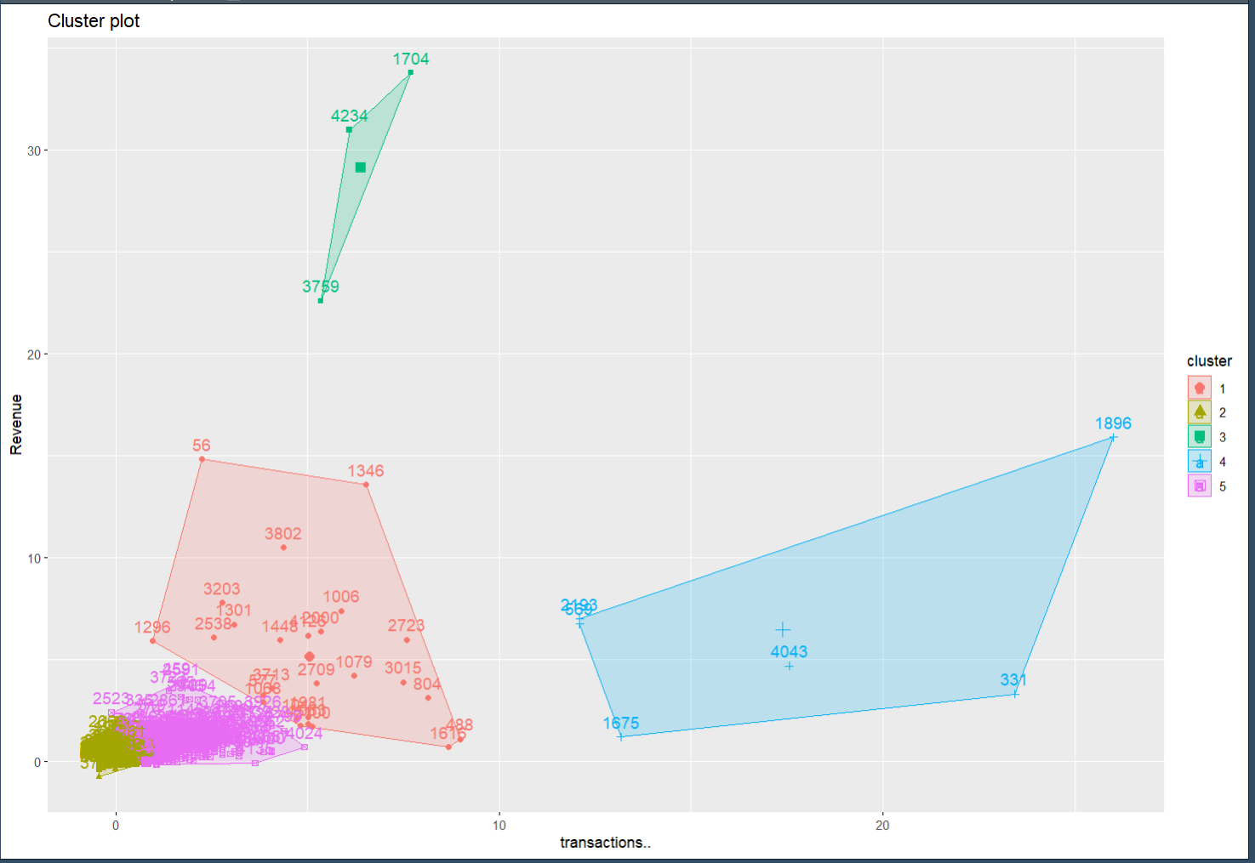
Clustering
We use a 2D coordinate system here to locate customers and calculate distances. The X-axis represents the total number of transactions that a customer has, while the Y-axis represents the total sales revenues that a customer contributes.
Notes:
The logic of the axis setting is that these two attributes are effective to evaluate a customer.

Slide 4
Clustering
The logic of the axis setting is that these two attributes are effective to evaluate a customer. By differ customers into different clusters, we can treat them in different company resources allocation.

Slide 5
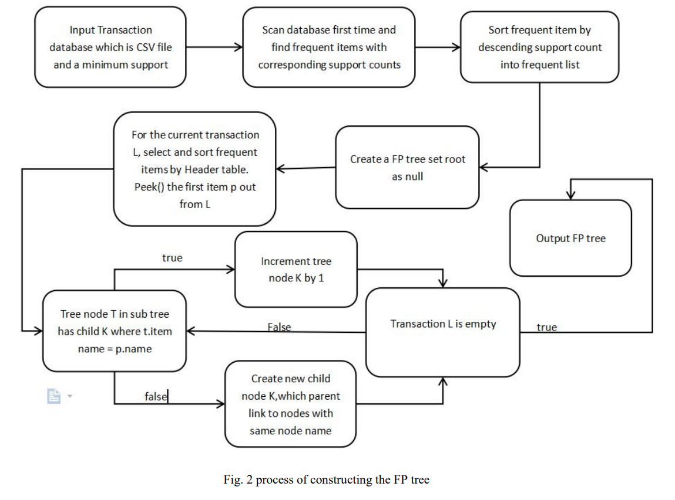
Fp tree Fp-growth algorithm
We also import fp-growth algorithm in our project.
Here is the coding flow.
Notes:
The logic of the axis setting is that these two attributes are effective to evaluate a customer.

Slide 6
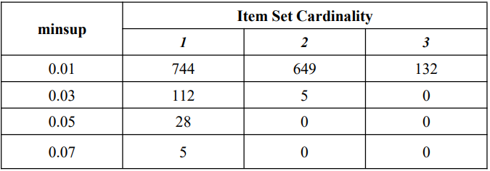
Fp tree Fp-growth algorithm
Overall frequent patterns
The minimal support was originally set as 0.05, then nothing was found. Then we decreased the minimal support to 0.03 and finally to 0.01, in the end we could find something.
By this result, most of products in our data set have very low transaction frequency and connections between products seem to be very weak.
Notes:
most of products in our data set have very low transaction frequency and connections between products seem to be very weak.

Slide 7
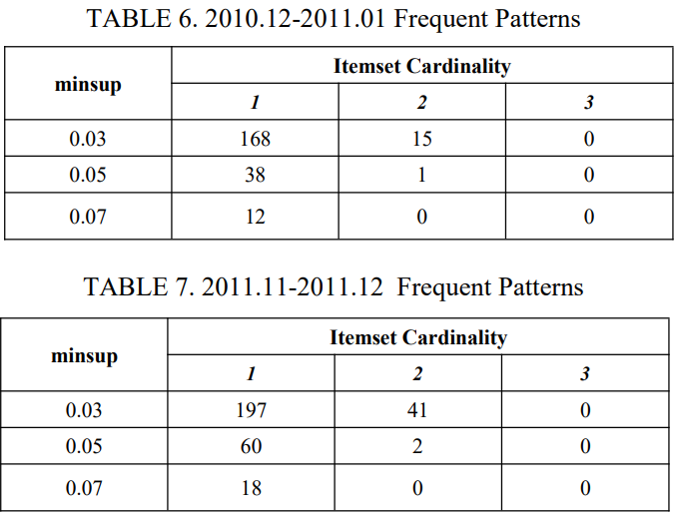
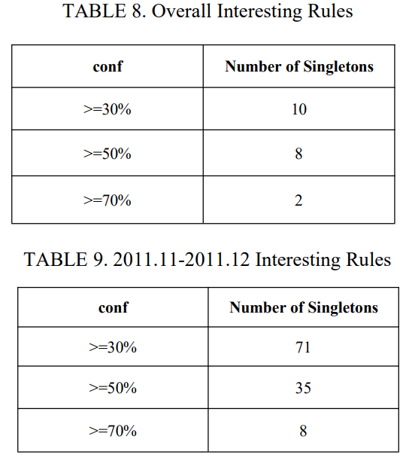
Fp tree Fp-growth algorithm
However, once we defined Nov to Jan as holiday season and only run fp-growth algorithm on this period of data, we find there are more frequent item sets and the confidences of interesting rule are relatively high.
Notes:
frequent item sets

Slide 8
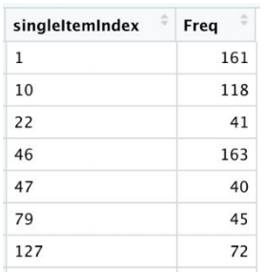
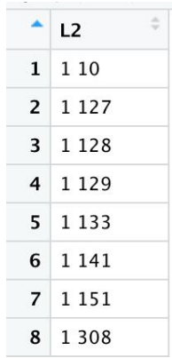
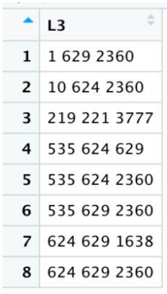

Frequent Sequence Mining
First 7 out of 30 in L1 with frequency
First 8 out of 79 in L2
In this section, we are trying to apply AprioriAll algorithm into our selected real life data set. In the beginning, we set minsup = 5%, but nothing meets the minsup. Then we changed this dynamic minsup into a fix number 5, which is a super small number compared to the total number of transactions. The result is obvious, we found 30 frequent items in L1, 79 frequent 2-itemset in L2, 8 frequent 3-itemset in L3 and only one 4-itemset are found in L4.
Notes:
most of products in our data set have very low transaction frequency and connections between products seem to be very weak.

