Slide 1

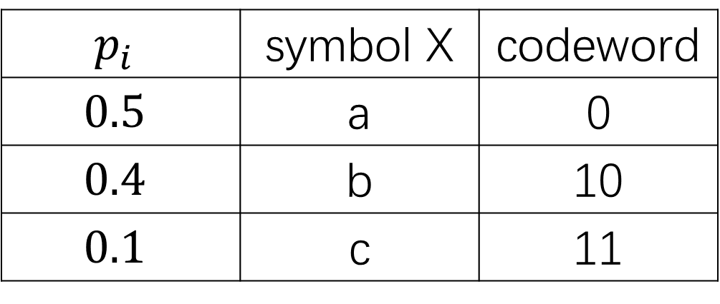

$$p_{i}$$ | symbol X | codeword
$$0.5$$ | a | 0
$$0.4$$ | b | 10
$$0.1$$ | c | 11
0
0
$$1$$
$$0.5$$
1
1

Slide 2



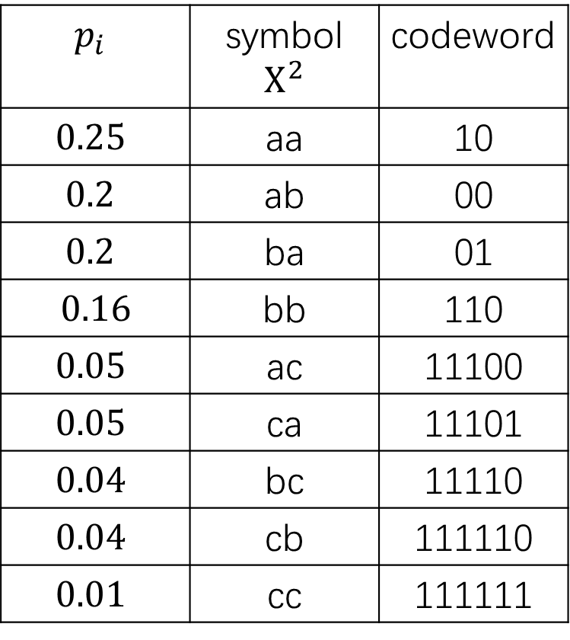





$$p_{i}$$ | symbol $X^{2}$ | codeword
$$0.25$$ | aa | 10
$$0.2$$ | ab | 00
$$0.2$$ | ba | 01
$$0.16$$ | bb | 110
$$0.05$$ | ac | 11100
$$0.05$$ | ca | 11101
$$0.04$$ | bc | 11110
$$0.04$$ | cb | 111110
$$0.01$$ | cc | 111111
0
$$0.4$$
1
0
0
$$1$$
0
$$0.1$$
1
$$0.6$$
0
1
1
$$0.35$$
0
1
$$0.19$$
0
1
$$0.09$$
0
1
$$0.05$$
1

