Slide 1

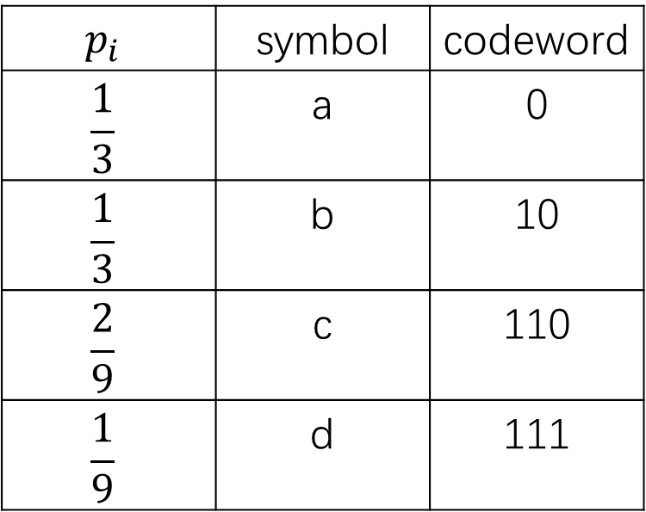


$$p_{i}$$ | symbol | codeword
$$\frac{1}{3}$$ | a | 0
$$\frac{1}{3}$$ | b | 10
$$\frac{2}{9}$$ | c | 110
$$\frac{1}{9}$$ | d | 111
0
0
$$1$$
1
$$\frac{2}{3}$$
0
$$\frac{1}{3}$$
1
1

Slide 2
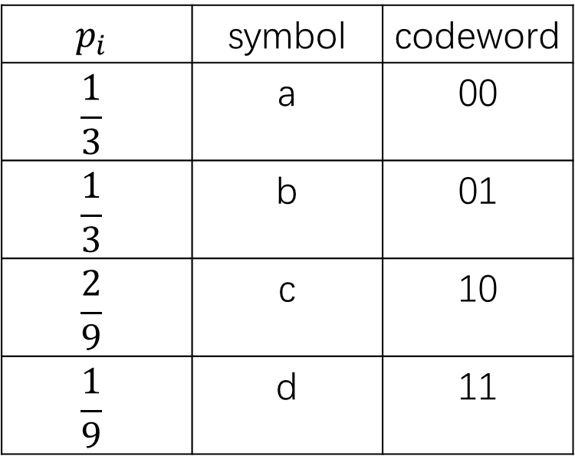


$$p_{i}$$ | symbol | codeword
$$\frac{1}{3}$$ | a | 00
$$\frac{1}{3}$$ | b | 01
$$\frac{2}{9}$$ | c | 10
$$\frac{1}{9}$$ | d | 11
0
$$\frac{2}{3}$$
0
1
$$1$$
0
1
$$\frac{1}{3}$$
1

Slide 3
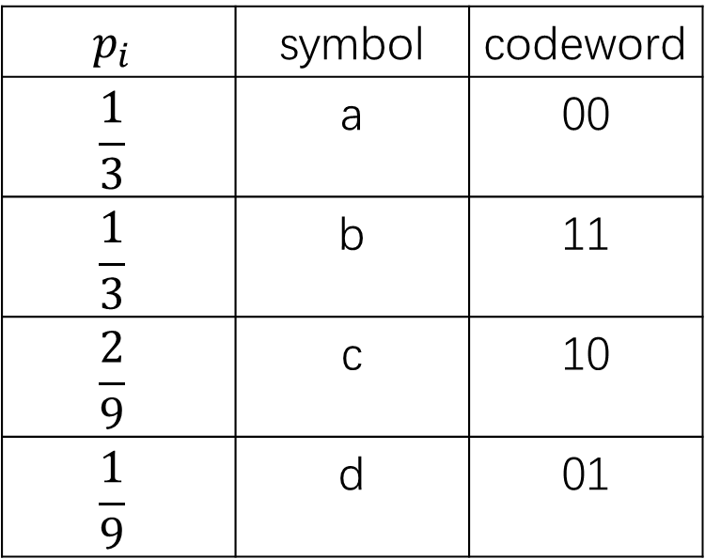
$$p_{i}$$ | symbol | codeword
$$\frac{1}{3}$$ | a | 00
$$\frac{1}{3}$$ | b | 11
$$\frac{2}{9}$$ | c | 10
$$\frac{1}{9}$$ | d | 01

