Slide 1
Dynamic-DeepHit
English Version
Dynamic survival analysis deep learning method for competing risks based on longitudinal data

Slide 2
Abstract:
Dynamic-DeepHit mathematical framework
Implementation of Dynamic-DeepHit
Related Experiments and Results

Slide 3
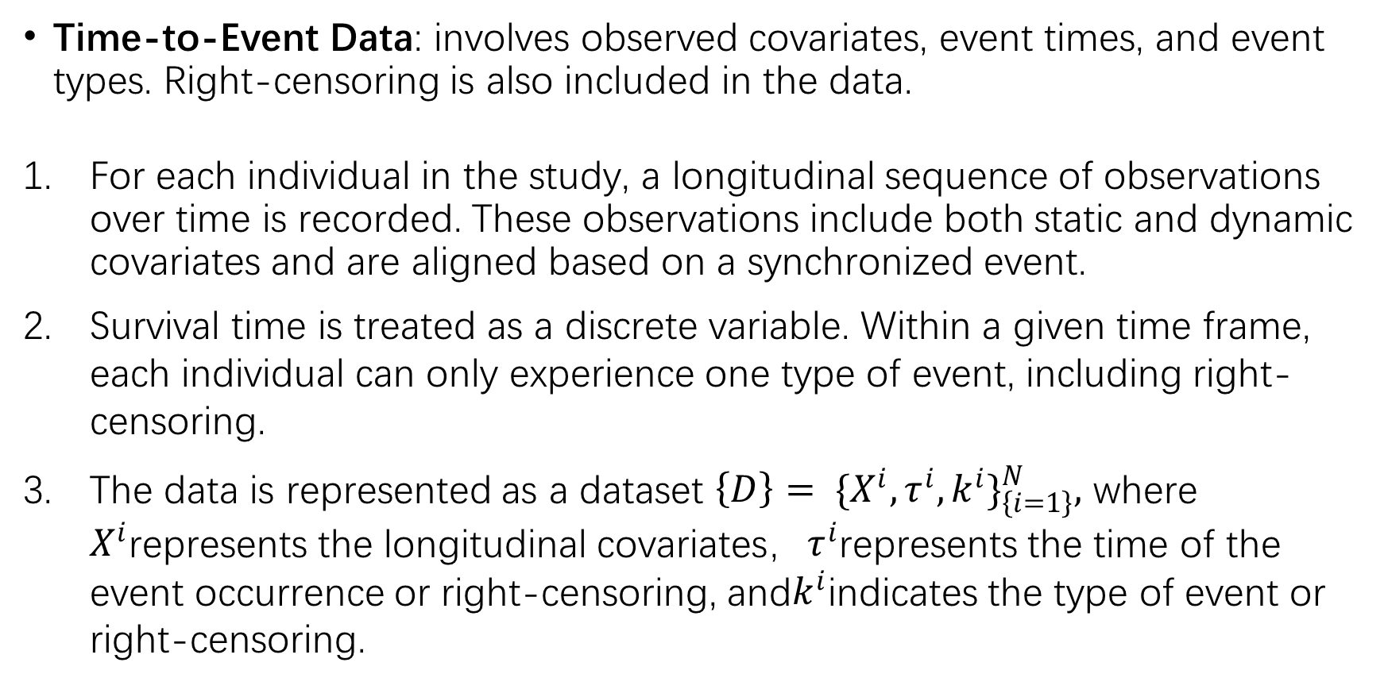
Dynamic-DeepHit mathematical framework
Time-to-Event Data: involves observed covariates, event times, and event types. Right-censoring is also included in the data.
For each individual in the study, a longitudinal sequence of observations over time is recorded. These observations include both static and dynamic covariates and are aligned based on a synchronized event.
Survival time is treated as a discrete variable. Within a given time frame, each individual can only experience one type of event, including right-censoring.
The data is represented as a dataset $\left\{D\right\}= \{X^{i}, τ^{i}, k^{i}\}_{\left\{i=1\right\}}^{N},$ where $X^{i}$represents the longitudinal covariates，$τ^{i}$represents the time of the event occurrence or right-censoring, and$k^{i}$indicates the type of event or right-censoring.

Slide 4
Dynamic-DeepHit mathematical framework
Cumulative Incidence Function (CIF): The objective of the Dynamic-DeepHit model is to analyze the risk of specific causes in the presence of competing risks, and to provide dynamic predictions as new data becomes available. It represents the probability of a specific event occurring before a particular time.

Slide 5
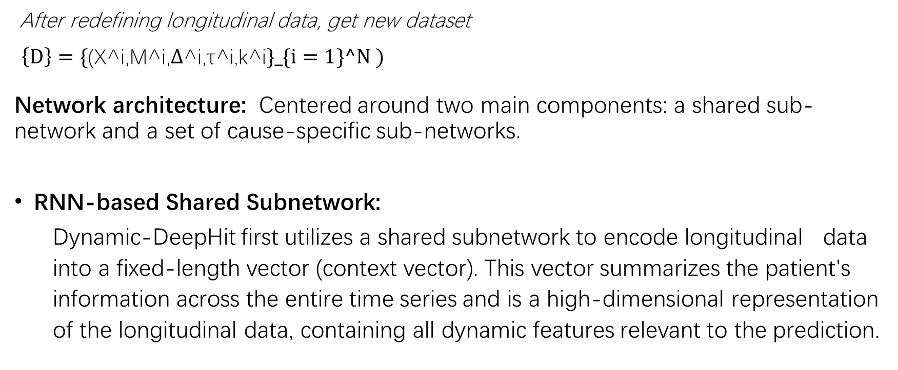
Implementation of Dynamic-DeepHit
After redefining longitudinal data, get new dataset
$\left\{D\right\}=\{\text{(}\text{X}\text{^}\text{i}\text{,}\text{M}\text{^}\text{i}\text{,∆}\text{^}\text{i}\text{,}\text{τ}\text{^}\text{i}\text{,}\text{k}\text{^}\text{i}\}_\{i=1\}^N )$
Network architecture: Centered around two main components: a shared sub-network and a set of cause-specific sub-networks.
RNN-based Shared Subnetwork:
Dynamic-DeepHit first utilizes a shared subnetwork to encode longitudinal data into a fixed-length vector (context vector). This vector summarizes the patient's information across the entire time series and is a high-dimensional representation of the longitudinal data, containing all dynamic features relevant to the prediction.

Slide 6
Implementation of Dynamic-DeepHit
RNN-based Temporal Attention Mechanism:
This mechanism can focus on different time points in the longitudinal data and capture the data to identify key time points that have the most impact on the prediction. This allows the model to concentrate on the RNN's hidden state, capturing the evolution of longitudinal data over time.
Cause-specific Subnetworks:
After generating the context vector, each cause-specific subnetwork in Dynamic-DeepHit specializes in one possible event and computes the probability distribution of that event occurring based on the context vector.

Slide 7
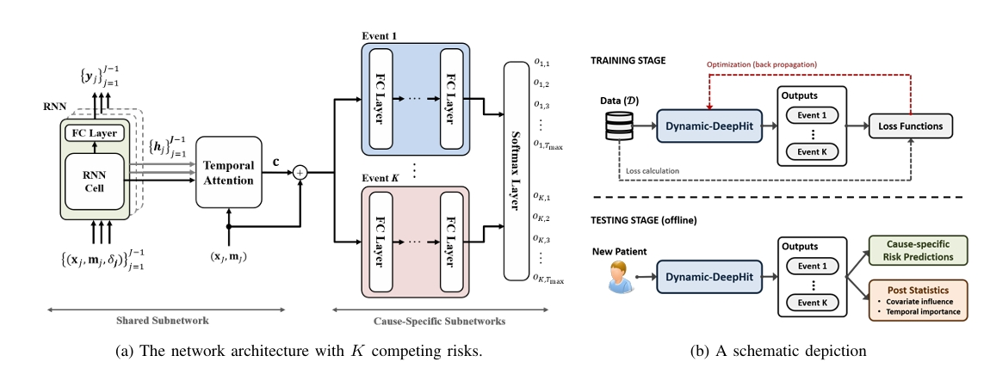
Implementation of Dynamic-DeepHit

Slide 8
Experiment
The experiments utilized multiple datasets, including simulated data and real medical data (5,883 CF patients), to ensure that the model performs well in various scenarios.
Model Comparison: Traditional Cox Proportional Hazards Model and Deep Learning Model: DeepHit
Evaluation Metrics:
- Cumulative Incidence Function (CIF) Error: Used to assess the difference between the model's predicted CIF and the actual CIF.
- Brier Score: Measures the difference between the predicted probabilities and the actual outcomes, used to evaluate the overall predictive performance of the model.

Slide 9
Experiment
Experimental Results:
Dynamic-DeepHit demonstrates superior performance in most cases, especially in handling complex survival analysis tasks with competing risks, showing a higher C-Index and lower CIF error and Brier score.
the end.

Slide 10
Dynamic-DeepHit
Chinese Version
基于纵向数据的竞合风险动
态生存分析深度学习方法

Slide 11
摘要：
Dynamic-DeepHit数学框架
Dynamic-DeepHit实现方法
相关实验和结果

Slide 12
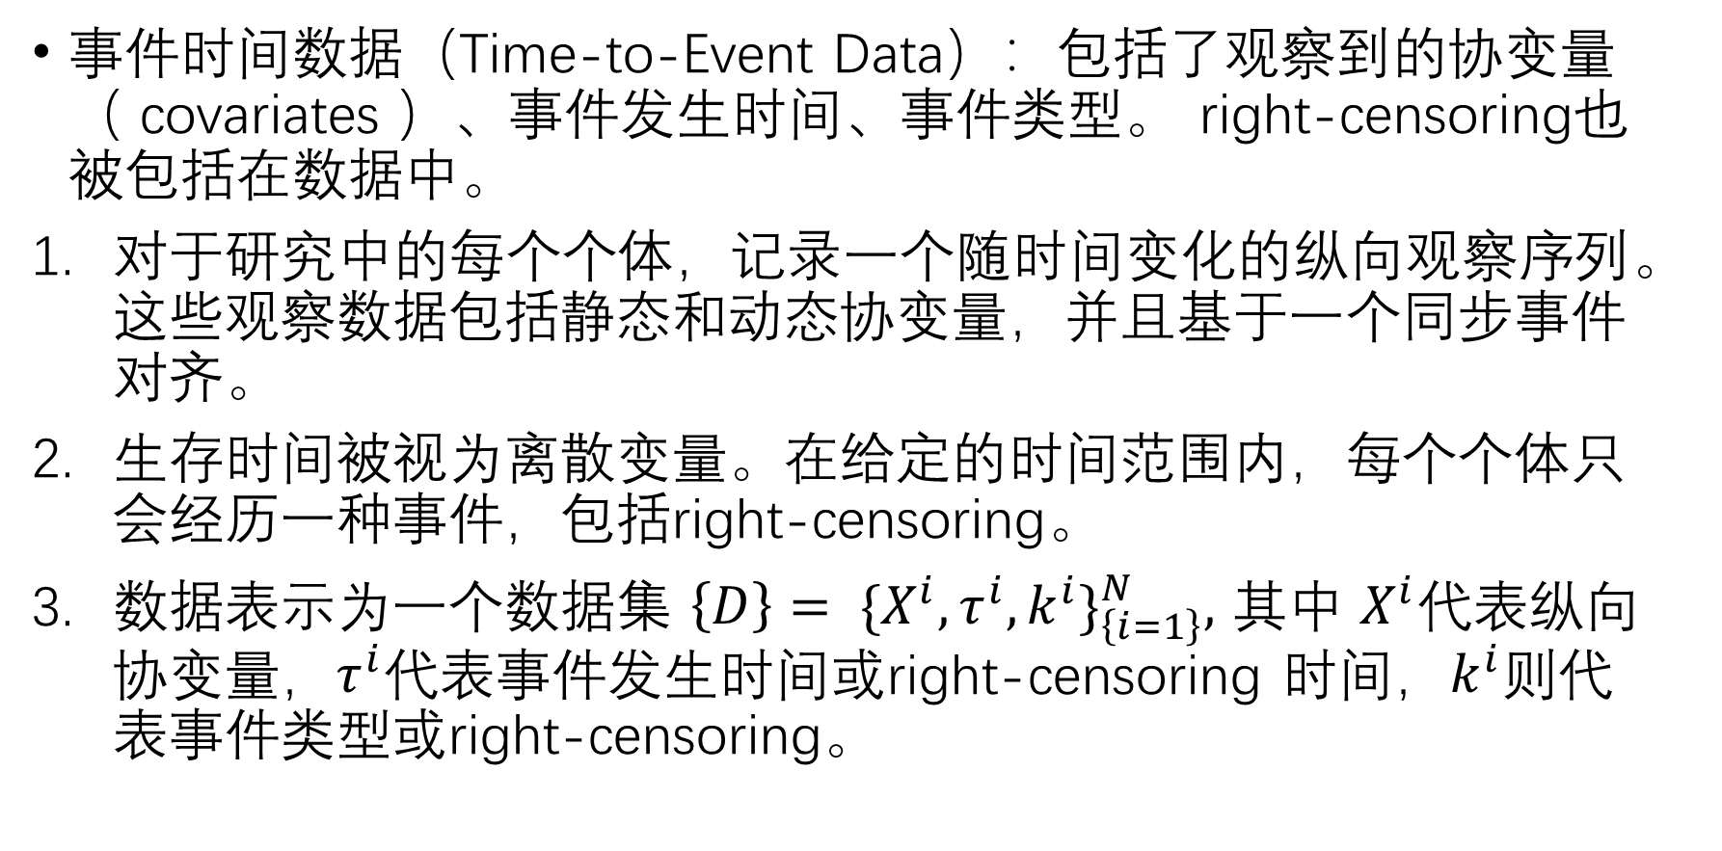
Dynamic-DeepHit数学框架
事件时间数据（Time-to-Event Data）：包括了观察到的协变量（ covariates ）、事件发生时间、事件类型。 right-censoring也被包括在数据中。
对于研究中的每个个体，记录一个随时间变化的纵向观察序列。这些观察数据包括静态和动态协变量，并且基于一个同步事件对齐。
生存时间被视为离散变量。在给定的时间范围内，每个个体只会经历一种事件，包括right-censoring。
数据表示为一个数据集 $\left\{D\right\}= \{X^{i}, τ^{i}, k^{i}\}_{\left\{i=1\right\}}^{N},$ 其中 $X^{i}$代表纵向协变量，$τ^{i}$代表事件发生时间或right-censoring 时间，$k^{i}$则代表事件类型或right-censoring。

Slide 13
Dynamic-DeepHit数学框架
累计发生函数（Cumulative Incidence Function, CIF）：Dynamic-DeepHit模型的目标是分析特定病因的风险以应对competitive risks的存在 ，并随着新数据的可用性提供动态预测。它表示在特定时间之前发生特定事件的概率。

Slide 14
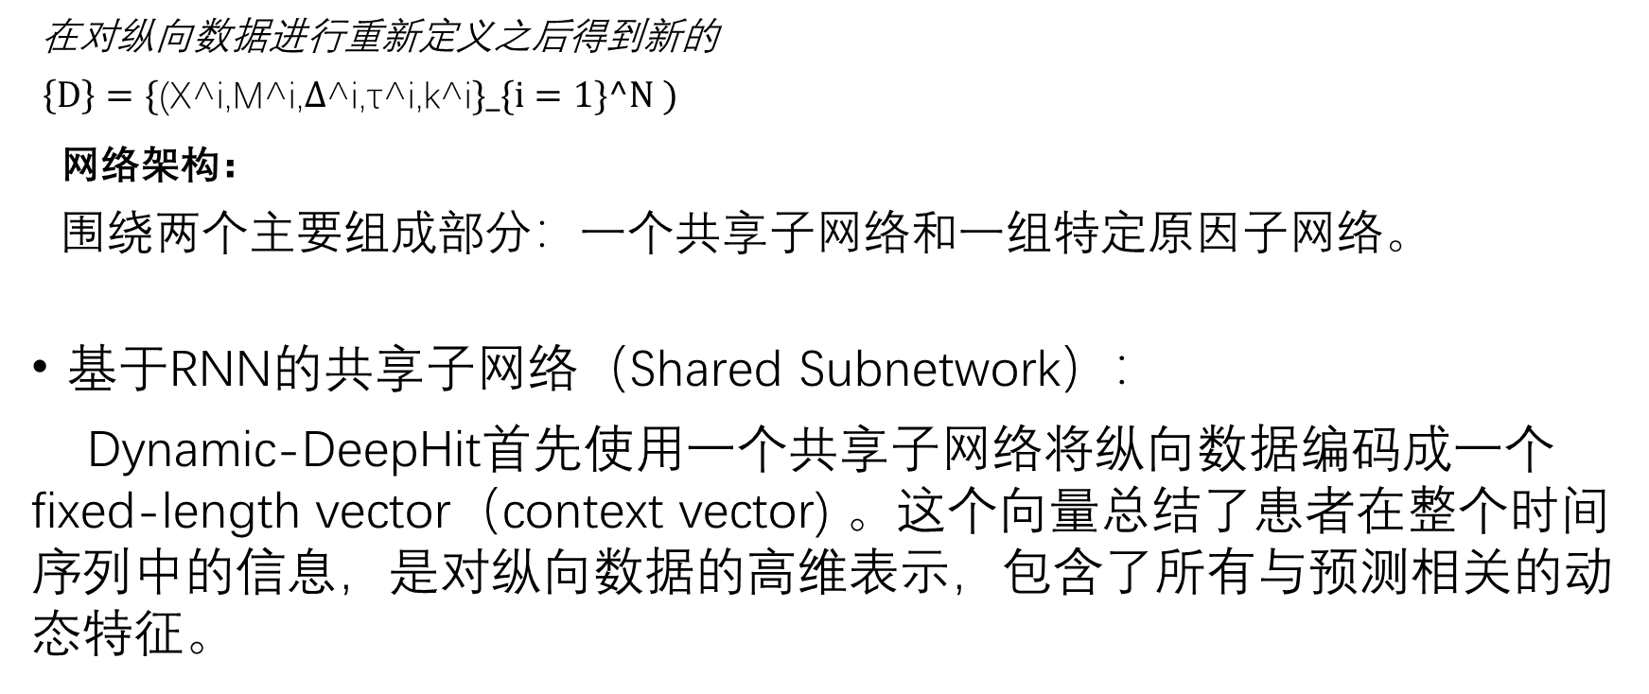
Dynamic-DeepHit实现方法
在对纵向数据进行重新定义之后得到新的
$\left\{D\right\}=\{\text{(}\text{X}\text{^}\text{i}\text{,}\text{M}\text{^}\text{i}\text{,∆}\text{^}\text{i}\text{,}\text{τ}\text{^}\text{i}\text{,}\text{k}\text{^}\text{i}\}_\{i=1\}^N )$
网络架构：
围绕两个主要组成部分：一个共享子网络和一组特定原因子网络。
基于RNN的共享子网络（Shared Subnetwork）：
Dynamic-DeepHit首先使用一个共享子网络将纵向数据编码成一个fixed-length vector（context vector) 。这个向量总结了患者在整个时间序列中的信息，是对纵向数据的高维表示，包含了所有与预测相关的动态特征。

Slide 15
Dynamic-DeepHit实现方法
基于RNN的时间注意机制（temporal attention mechanism）：
这种机制能够关注纵向数据中不同时间点并获取数据，以对预测最有影响的关键时间点，使得模型能够聚焦于RNN的hidden state，捕捉纵向数据随时间的演变.
特定原因子网络（cause-specific subnetworks）：
在生成context vector之后，Dynamic-DeepHit的每个特定原因子网络专门针对一种可能的事件, 根据context vector计算出该事件发生的概率分布。

Slide 16
Dynamic-DeepHit实现方法

Slide 17
实验
实验使用了多个数据集，包括模拟数据和真实医疗数据（5883名CF患者），以确保模型能够在多种情境下表现良好。
模型对比：
传统Cox比例风险模型和深度学习模型：DeepHit
评价指标：
累积发生函数（CIF）误差：用于评估模型预测的CIF与实际发生的CIF之间的差异。
Brier得分（Brier Score）：衡量模型的预测概率与实际结果的差异，用于评估模型的整体预测性能。

Slide 18
实验
实验结果：
Dynamic-DeepHit在大多数情况下表现优越，特别是在处理具有竞争风险的复杂生存分析任务时，表现出较高的C-Index和较低的CIF误差及Brier得分。

