Slide 1
Methods tutorial
Statistical genetics reading group · example deck
Fine-mapping from summary statistics: a worked example
Single-effect model, credible sets and a z-score check
All data simulated
Example deck made with research-slides

Slide 2
Fine-mapping usually starts from summary statistics
Genotypes are hard to share; z-scores and reference LD are not
z-scores
LD matrix
Fine-mapping
PIPs and credible sets
one per SNP, from the association study
from a reference panel matched to the study
which SNPs have nonzero effects?
candidate causal variants
Individual-level genotypes
Summary statistics
Often unavailable for consent and privacy reasons
Widely shared, and enough for a first fine-mapping pass
Notes:
Fine-mapping narrows an association signal to a small set of candidate causal variants. This deck walks through the simplest version, on simulated data, and two checks worth running before trusting it.

Slide 3
The single-effect model needs no LD matrix
Assume exactly one causal SNP in the locus and a uniform prior over SNPs
Evidence for SNP j: approximate Bayes factor
Credible set
smallest SNP set whose
PIPs sum to ≥ 0.95
${\text{ABF}}_{j} \text{=} \sqrt{\frac{V}{V \text{+} W}} \text{exp}\left(\frac{z_{j}^{2} W}{2\left(V \text{+} W\right)}\right)$
V = 1/N, W = prior variance of the effect (prior sd 0.1)
Inputs
z-scores, N, prior sd
Posterior inclusion probability
${\text{PIP}}_{j} \text{=} \frac{{\text{ABF}}_{j}}{\sum_{k}{{\text{ABF}}_{k}}}$
Output
one signal per locus
Notes:
With one causal SNP and a uniform prior, PIP_j is the Bayes factor of SNP j normalised over the locus. The credible set is built by adding SNPs in decreasing PIP until 95% of the posterior mass is covered. Because only marginal z-scores enter, LD is used implicitly (through the z-scores) but no LD matrix is needed.

Slide 4
Simulation design
Synthetic genotypes with local LD, a quantitative trait, marginal z-scores
Genotypes
Trait
z-scores
Fine-mapping
AR(1) latent haplotypes: neighbouring SNPs in LD
1–2 causal SNPs + noise
one marginal test per SNP
PIPs, 95% credible set
200
5,000
200
0.1
SNPs per locus
study samples
loci per setting
prior sd of an effect
Reproducible
simulate.py, seed 20261016; every number in this deck is read from its results.json
Notes:
Adjacent latent correlation drawn from 0.97–0.995 per locus; minor allele frequency 0.05–0.5. Causal SNPs are placed away from the locus edges. The trait is standardized after simulation.

Slide 5
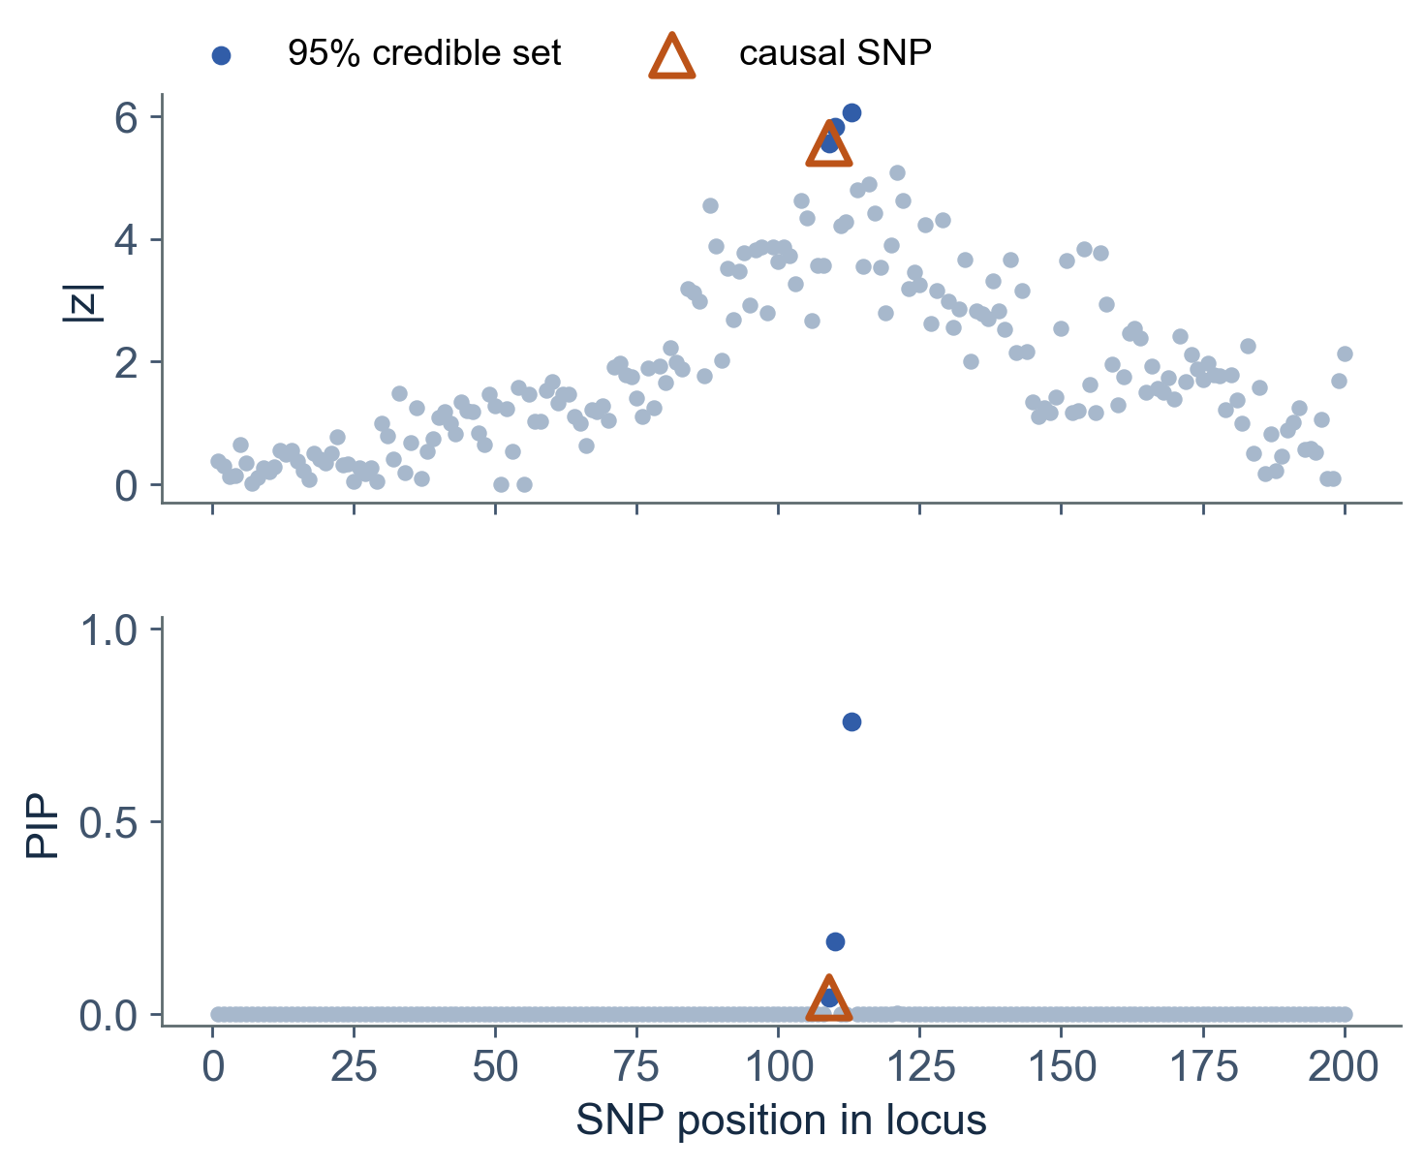
The lead SNP is not necessarily the causal one
One simulated locus: the causal SNP is in the 95% credible set, but not on top
Lead SNP
|z| = 6.1, PIP = 0.76
Causal SNP
|z| = 5.6, PIP = 0.04
95% credible set
3 SNPs; causal SNP included
Report the set, not the top SNP
Simulated locus (simulate.py)
Notes:
In this locus SNP 113 has the largest |z| (6.1) and PIP 0.76; the causal SNP 109 has |z| 5.6 and PIP 0.04, yet it is inside the 3-SNP credible set. The locus was chosen to illustrate this case; across loci the lead SNP is often causal (next slide).

Slide 6
Credible sets keep their coverage; their size depends on effect size
200 loci per setting, one causal SNP each
Median credible-set size (SNPs)
Causal SNP with PIP > 0.5
PVE 0.2%
109.5
PVE 0.2%
12.5%
PVE 0.5%
4
PVE 0.5%
62.5%
PVE 1%
1
PVE 1%
93.5%
Coverage of the 95% set: 99% at PVE 0.2% · 99% at PVE 0.5% · 99% at PVE 1%
Notes:
PVE = variance in the trait explained by the causal SNP. Coverage = share of loci whose 95% set contains the causal SNP. Coverage stays at the nominal level or above because the model matches the simulation; set size shrinks quickly with effect size.

Slide 7
With two causal SNPs, the model still reports one signal
200 loci, two causal SNPs each (PVE 0.5% each)
1
97.5%
35.5%
signal reported per locus
of loci: set holds ≥ 1 causal SNP
of loci: both merged in one set
What goes wrong
the second signal is missed or blended into the first set
What to use instead
a multi-effect model that fits several signals jointly, using the LD matrix
Notes:
The single-effect assumption is the main limitation of this simple model. Multi-signal fine-mapping needs the LD matrix, which is why the z-score check on the next slide matters.

Slide 8
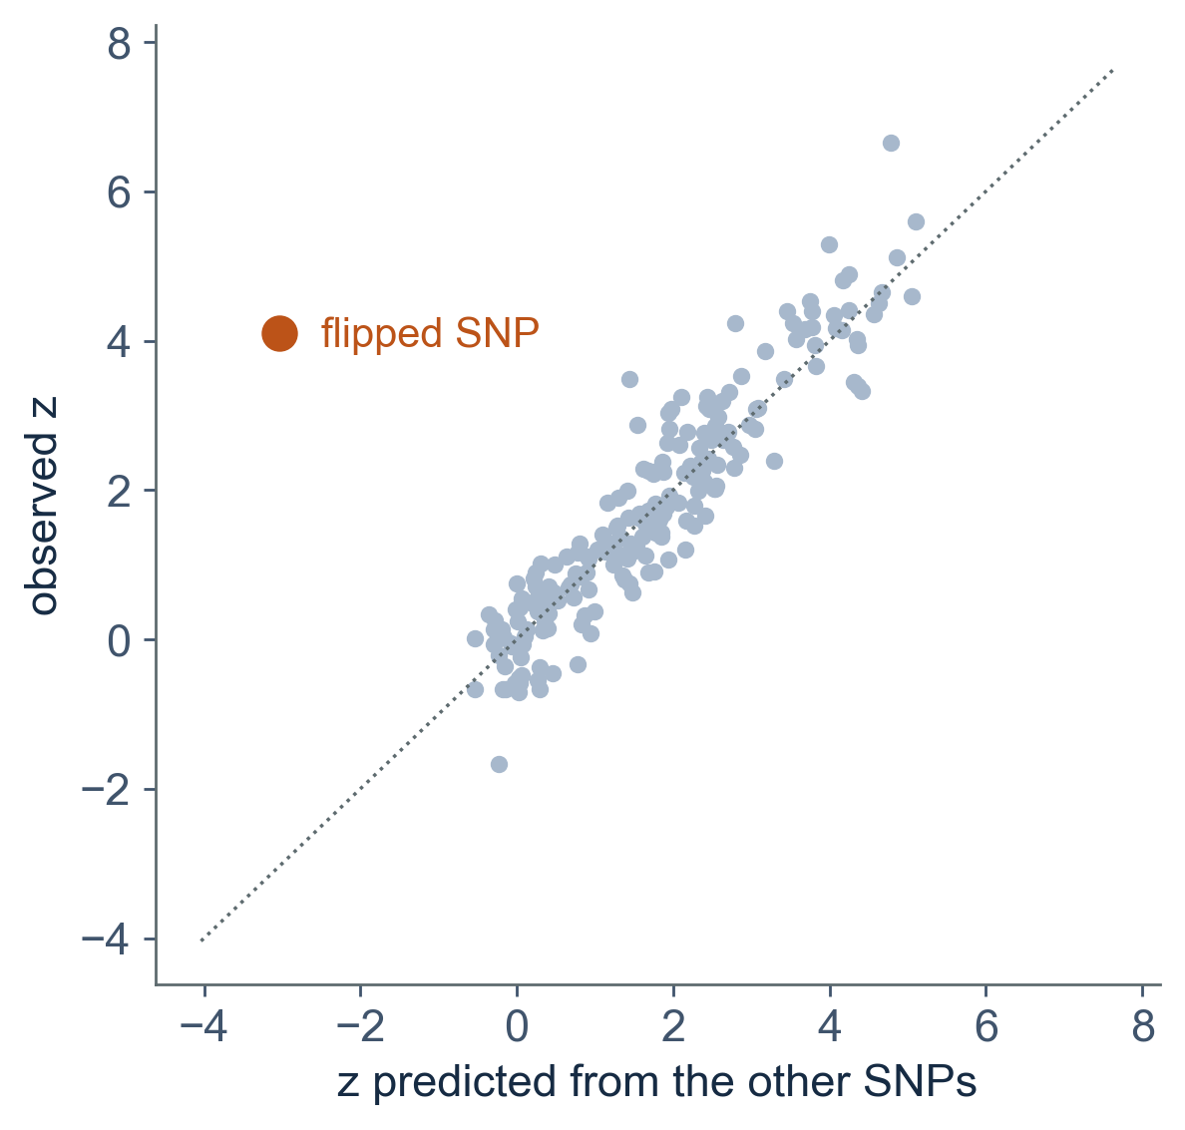
Check z-scores against the LD reference before using it
Predict each z from the other SNPs through the LD matrix; a flipped allele stands out
Flipped SNP
standardized difference |t| = 12.4
All other SNPs
|t| ≤ 3.7
Flipped SNP ranked first by |t|
reference n = 200
200/200
reference n = 1,000
200/200
reference n = 5,000
200/200
Simulated locus, one allele flipped in the reference
Notes:
For each SNP, the expected z given all the others under the LD matrix (lightly regularized) is compared with the observed z. A SNP whose alleles are coded differently in study and reference has its LD signs reversed and stands far off the diagonal. In these simulations the reference came from the same model as the study, so detection was easy at every panel size; real panels are less well matched.

Slide 9
Limitations
Of this demo, not of fine-mapping in general
One causal SNP
the model cannot separate several signals in a locus
Synthetic genotypes
AR(1) haplotypes, not real LD blocks or recombination hot spots
Matched reference
the LD reference was drawn from the same model as the study
Fixed prior
one prior sd (0.1) for every effect; no functional annotation
Quantitative trait
marginal linear-regression z-scores only

Slide 10
Three things to remember
Take-home
1
Report credible sets, not lead SNPs
The causal SNP can sit inside the set without being on top
2
Set size tracks signal strength
Coverage held across settings; resolution did not
3
Check z-scores against LD first
A flipped allele is easy to see before it misleads a multi-signal model
Notes:
Numbers behind each point: slides 5, 6 and 8.

Slide 11
(Supp.) Simulation settings
As recorded in results.json
Seed
20261016
Locus
200 SNPs; latent correlation of neighbours 0.97–0.995
Study
N = 5,000; trait standardized; causal SNPs away from the edges
Fine-mapping
approximate Bayes factors, prior sd 0.1, uniform prior over SNPs
z-score check
LD matrix + 0.1 × identity, inverted once per locus

Slide 12
(Supp.) Glossary
Terms used on the main slides
PIP
posterior inclusion probability: the chance that SNP j is the causal one
Credible set
smallest set of SNPs holding at least 95% of the posterior probability
Coverage
share of loci whose credible set contains a causal SNP
PVE
proportion of trait variance explained by a causal SNP
LD
linkage disequilibrium: correlation between nearby SNPs

