Slide 1
Lab meeting
Research progress · 13 October 2026
Method X: tissue prioritization with a hierarchical model
What it estimates, and when it fails
A. Researcher · Example Lab

Slide 2
01
Background
Why ranking annotations one at a time is not enough
01 Background
02 Method
03 Results

Slide 3
The pipeline end to end
Each box is expanded on a later slide
GWAS summary stats
LD reference
Fit the model
Read out
z-scores and sample size
ancestry-matched panel
MCMC, 4 chains
tissue-level posteriors
39
1,588
13 h
21
traits analysed
LD blocks
per trait on 24 cores
tissues ranked
All numbers: Methods, p. 12
Notes:
Takeaway: the whole method is four steps; the next slides open each box.

Slide 4
02
Method
One hierarchical model instead of separate rankings
01 Background
02 Method
03 Results

Slide 5
More discoveries with annotation-informed masks
Same data and tests; only the masks differ
Associations found
Signals survive adjustment
Model vs baseline masks
Before QTL removal: 343 vs 385
After QTL removal: 177 vs 64
Retained: 52% vs 17%
Baseline masks
595
Baseline + model
728
+22% over baseline masks
Preprint, not yet peer reviewed
Notes:
Takeaway: the gain is not driven by single-variant signals. Source: Fig. 3b.

Slide 6
03
Results
Breast cancer as the worked example
01 Background
02 Method
03 Results

Slide 7
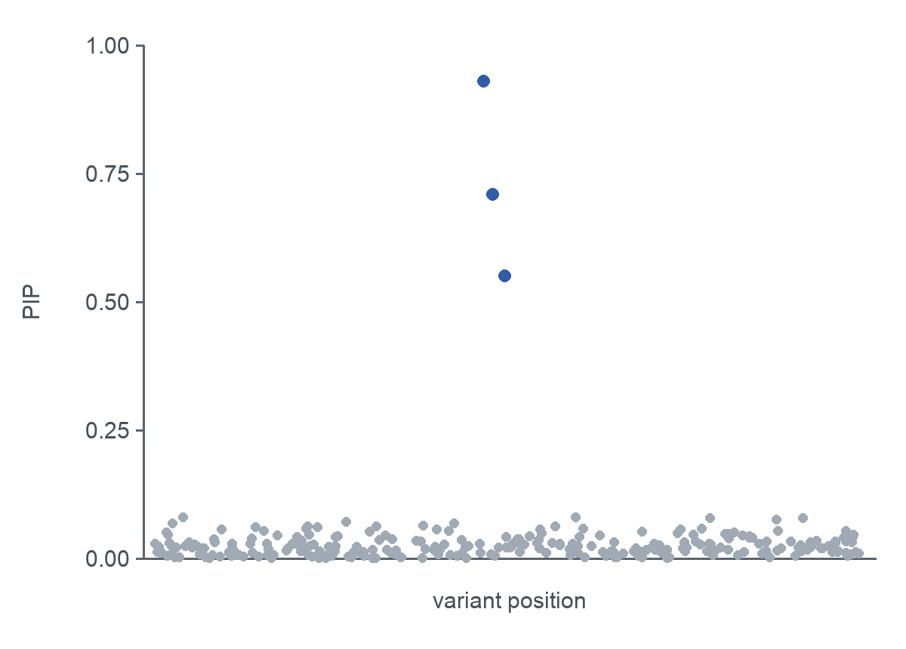
What the posterior inclusion probability means
One picture, one equation
Definition
${PIP}_{j} \text{=} 1 − \prod_{l}{\left(1 − α_{lj}\right)}$
product over the L single effects
How to read the plot
Blue points: PIP above 0.5
Grey points: little evidence of a causal effect
Simulated locus for illustration
Notes:
Explain the product form before showing the figure.

Slide 8
Limitations
What the current version cannot resolve
Incomplete annotation panel
unassayed cell states can only be represented by proxies
Power and separability
weak or correlated components may be missed
Ancestry in practice
validation remains predominantly European
Upstream resolution
inherits fine-mapping and SNP-to-gene uncertainty

Slide 9
Three things to remember
Take-home
1
The unit of analysis is the genome, not the locus
Strength is borrowed across LD blocks
2
Calibration holds in simulation
But only with a matched LD reference
3
Use it where the GWAS is large
Power drops quickly below N ≈ 100k

Slide 10
(Supp.) Glossary
Terms used on the main slides
PIP
posterior inclusion probability of a variant
Credible set
smallest set of variants holding ≥ 95% posterior mass
LD block
region treated as independent of its neighbours

