Slide 1
Android Studio Client App

Slide 2
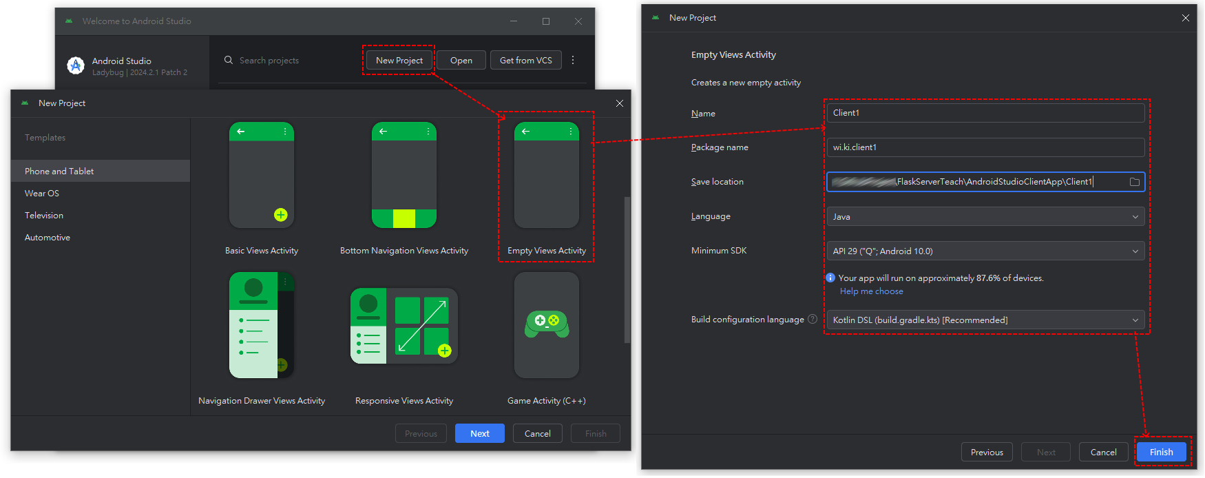
1.Install Android Studio & Create App Project
IDE Download: https://developer.android.com/studio
just next, next or download, download…
Create App Project:

Slide 3
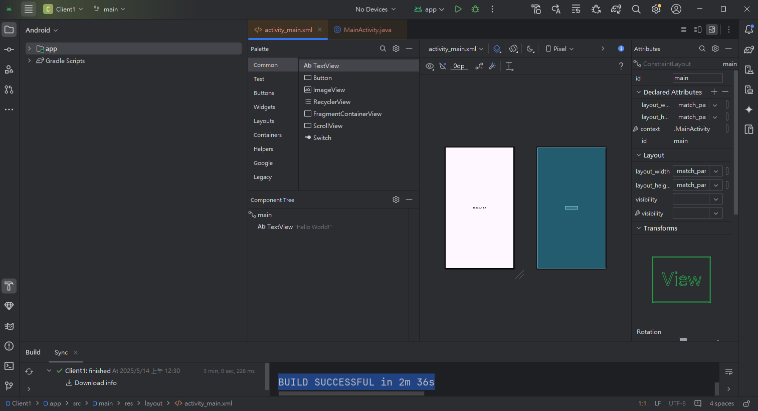
New project has ‘activity_main.xml’ & ‘MainActivity.java’…
‘activity_main.xml’ is UI design.
‘MainActivity.java’ is control Code.
It usually takes some time to create a new project.

Slide 4
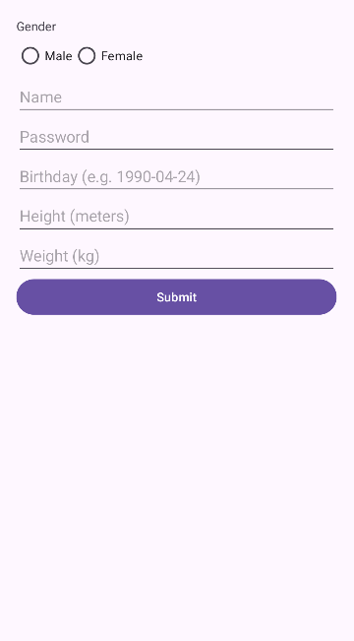
2.Design UI
‘activity_main.xml’
<!-- Name --> <EditText android:id="@+id/editTextName" android:layout_width="match_parent" android:layout_height="wrap_content" android:hint="Name" />
<!-- Password --> <EditText android:id="@+id/editTextPassword" android:layout_width="match_parent" android:layout_height="wrap_content" android:hint="Password" android:inputType="textPassword" /> <!-- Birthday --> <EditText android:id="@+id/editTextBirthday" android:layout_width="match_parent" android:layout_height="wrap_content" android:hint="Birthday (e.g. 1990-04-24)" /> <!-- Height --> <EditText android:id="@+id/editTextHeight" android:layout_width="match_parent" android:layout_height="wrap_content" android:hint="Height (meters)" android:inputType="numberDecimal" /> <!-- Weight --> <EditText android:id="@+id/editTextWeight" android:layout_width="match_parent" android:layout_height="wrap_content" android:hint="Weight (kg)" android:inputType="numberDecimal" /> <!-- Button --> <Button android:id="@+id/buttonSubmit" android:layout_width="match_parent" android:layout_height="wrap_content" android:text="Submit" /> </LinearLayout> </androidx.constraintlayout.widget.ConstraintLayout>
<?xml version="1.0" encoding="utf-8"?> <androidx.constraintlayout.widget.ConstraintLayout xmlns:android="http://schemas.android.com/apk/res/android" xmlns:app="http://schemas.android.com/apk/res-auto" xmlns:tools="http://schemas.android.com/tools" android:id="@+id/main" android:layout_width="match_parent" android:layout_height="match_parent" tools:context=".MainActivity"> <LinearLayout android:layout_width="match_parent" android:layout_height="match_parent" android:orientation="vertical" android:padding="24dp"> <!-- Radio Buttons for Gender --> <TextView android:layout_width="wrap_content" android:layout_height="wrap_content" android:text="Gender" /> <RadioGroup android:id="@+id/radioGroupGender" android:layout_width="match_parent" android:layout_height="wrap_content" android:orientation="horizontal"> <RadioButton android:id="@+id/radioMale" android:layout_width="wrap_content" android:layout_height="wrap_content" android:text="Male" /> <RadioButton android:id="@+id/radioFemale" android:layout_width="wrap_content" android:layout_height="wrap_content" android:text="Female" /> </RadioGroup>

Slide 5
3. Code Java
‘MainActivity.java’
public void OnClick_Submit(View v) { int selectedGenderId = radioGroupGender.getCheckedRadioButtonId(); String gender = ""; if (selectedGenderId == R.id.radioMale) { gender = "male"; } else if (selectedGenderId == R.id.radioFemale) { gender = "female"; } String name = editTextName.getText().toString(); String password = editTextPassword.getText().toString(); String birthday = editTextBirthday.getText().toString(); String heightStr = editTextHeight.getText().toString(); String weightStr = editTextWeight.getText().toString();
RequestQueue queue = Volley.newRequestQueue(this); try { JSONObject postData = new JSONObject(); postData.put("name", name); postData.put("birthday", birthday); postData.put("height", Float.parseFloat(heightStr)); postData.put("weight", Float.parseFloat(weightStr)); postData.put("password", password); postData.put("gender", gender); JsonObjectRequest jsonObjectRequest = new JsonObjectRequest( Request.Method.POST, SERVER_URL, postData, response -> { try { TextViewRequest.setText(response.getString("message")); } catch (JSONException e) { Toast.makeText(this, "error: message null.", Toast.LENGTH_SHORT).show(); } }, error -> Toast.makeText(MainActivity.this, "password error.", Toast.LENGTH_LONG).show() ); queue.add(jsonObjectRequest); } catch (Exception e) { Toast.makeText(this, "error: " + e.getMessage(), Toast.LENGTH_SHORT).show(); } } }
package wi.ki.client1;
import android.os.Bundle;
import android.view.View;
import android.widget.EditText;
import android.widget.RadioGroup;
import android.widget.TextView;
import android.widget.Toast;
import androidx.activity.EdgeToEdge;
import androidx.appcompat.app.AppCompatActivity;
import androidx.core.graphics.Insets;
import androidx.core.view.ViewCompat;
import androidx.core.view.WindowInsetsCompat;
import com.android.volley.Request;
import com.android.volley.toolbox.JsonObjectRequest;
import com.android.volley.RequestQueue;
import com.android.volley.toolbox.Volley;
import org.json.JSONException;
import org.json.JSONObject;
public class MainActivity extends AppCompatActivity { RadioGroup radioGroupGender; EditText editTextName,editTextPassword,editTextBirthday,editTextHeight,editTextWeight; TextView TextViewRequest; final String SERVER_URL = "http://wiciar.com/bmi/submit"; @Override protected void onCreate(Bundle savedInstanceState) { super.onCreate(savedInstanceState); EdgeToEdge.enable(this); setContentView(R.layout.activity_main); ViewCompat.setOnApplyWindowInsetsListener(findViewById(R.id.main), (v, insets) -> { Insets systemBars = insets.getInsets(WindowInsetsCompat.Type.systemBars()); v.setPadding(systemBars.left, systemBars.top, systemBars.right, systemBars.bottom); return insets; }); radioGroupGender = findViewById(R.id.radioGroupGender); editTextName = findViewById(R.id.editTextName); editTextPassword = findViewById(R.id.editTextPassword); editTextBirthday = findViewById(R.id.editTextBirthday); editTextHeight = findViewById(R.id.editTextHeight); editTextWeight = findViewById(R.id.editTextWeight); TextViewRequest = findViewById(R.id.TextViewRequest); }

Slide 6
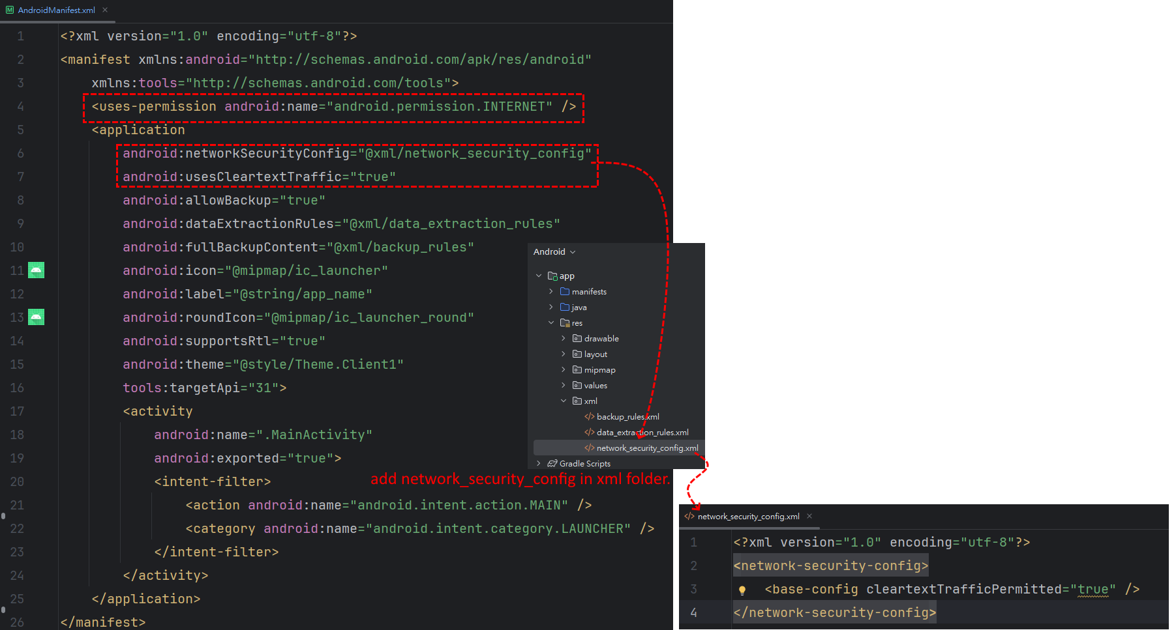
4. Check App Permission
‘AndroidManifest.xml’ is permission manager for Android App.
<uses-permission android:name="android.permission.INTERNET" />
android:networkSecurityConfig="@xml/network_security_config" android:usesCleartextTraffic="true"
‘network_security_config.xml’ is network permission.
<?xml version="1.0" encoding="utf-8"?> <network-security-config> <base-config cleartextTrafficPermitted="true" /> </network-security-config>

Slide 7
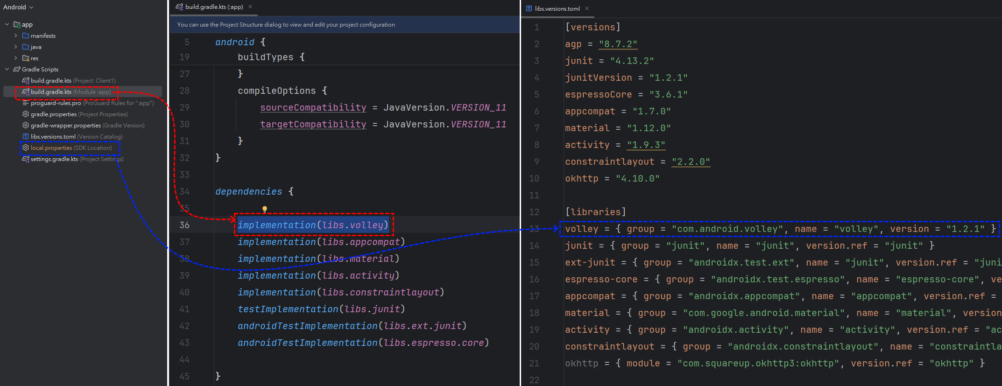
5. Check ‘volley’ plugin
‘Volloy’ is a TCP request method unique at Android.
‘Build.gradle.kts’ is libraries dependency edit. ‘local.properties’ is libraries import and version edit.
implementation(libs.volley)
volley = { group = "com.android.volley", name = "volley", version = "1.2.1" }

Slide 8
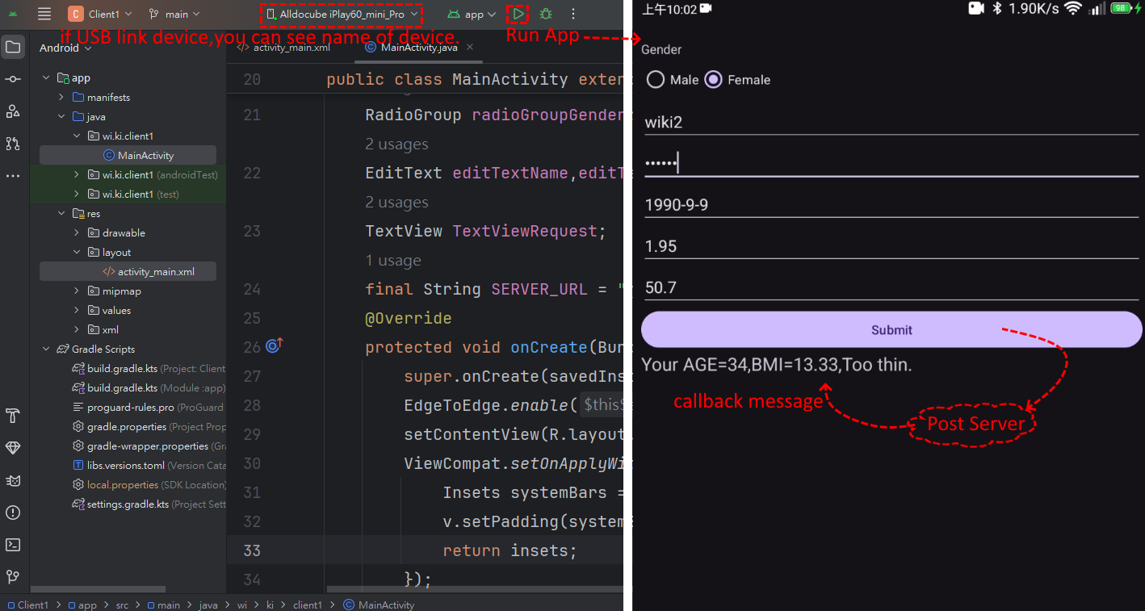
6. Run App
※Android device needs to enable developer options and USB adapter.

