Slide 1
Flask Server App Example

Slide 2
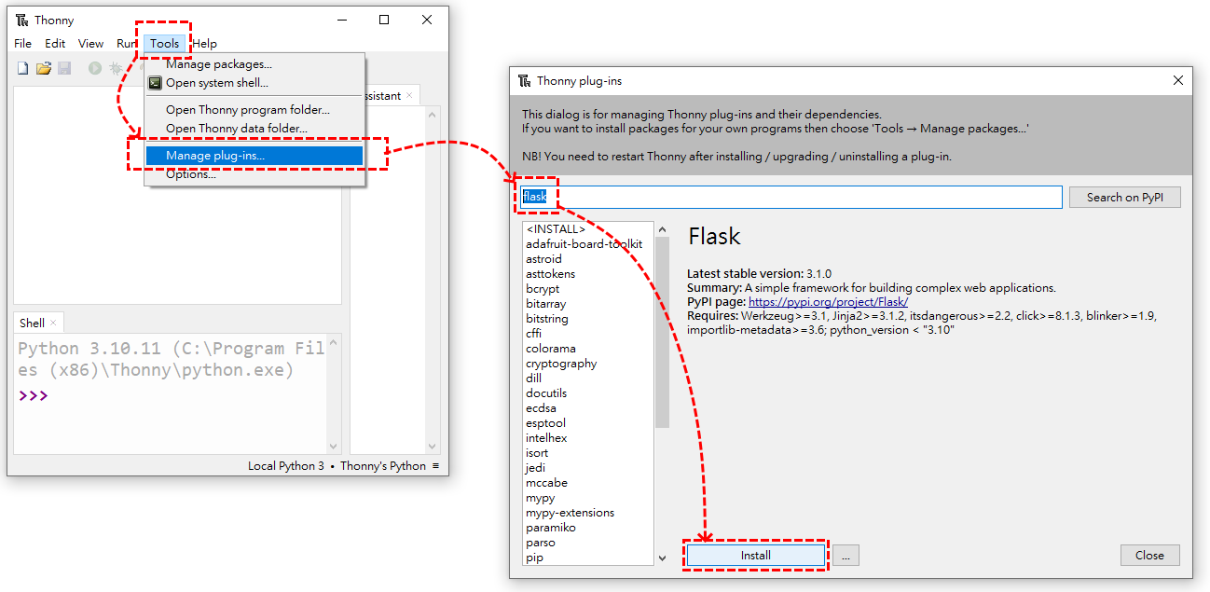
1.Install Python IDE--Thonny
Not necessarily thonny, you can choose other familiar IDE for you.
IDE Download: https://thonny.org/
2.Install Flask

Slide 3
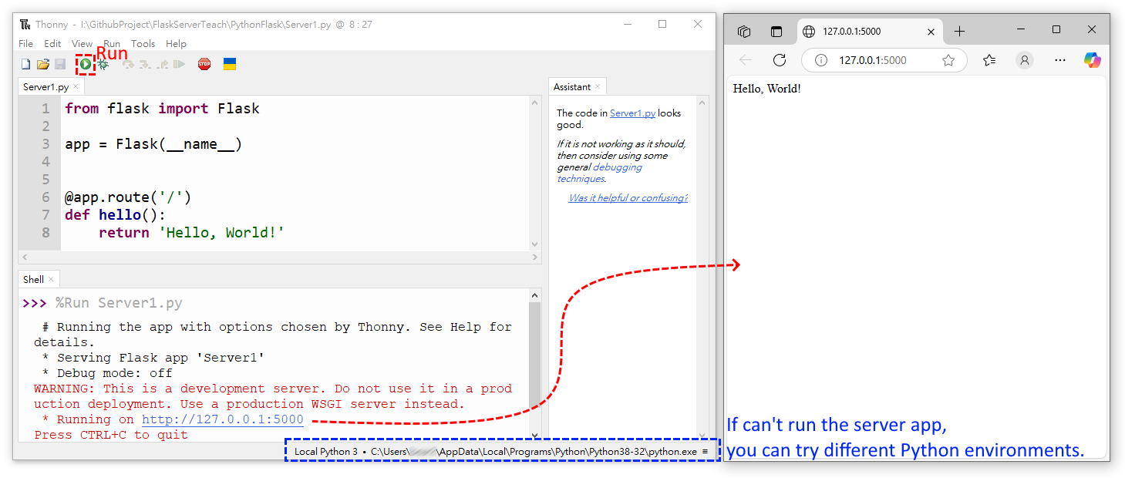
3.Write Code: Server1.py and Run
Library: https://flask.palletsprojects.com/en/stable/tutorial/layout/

Slide 4
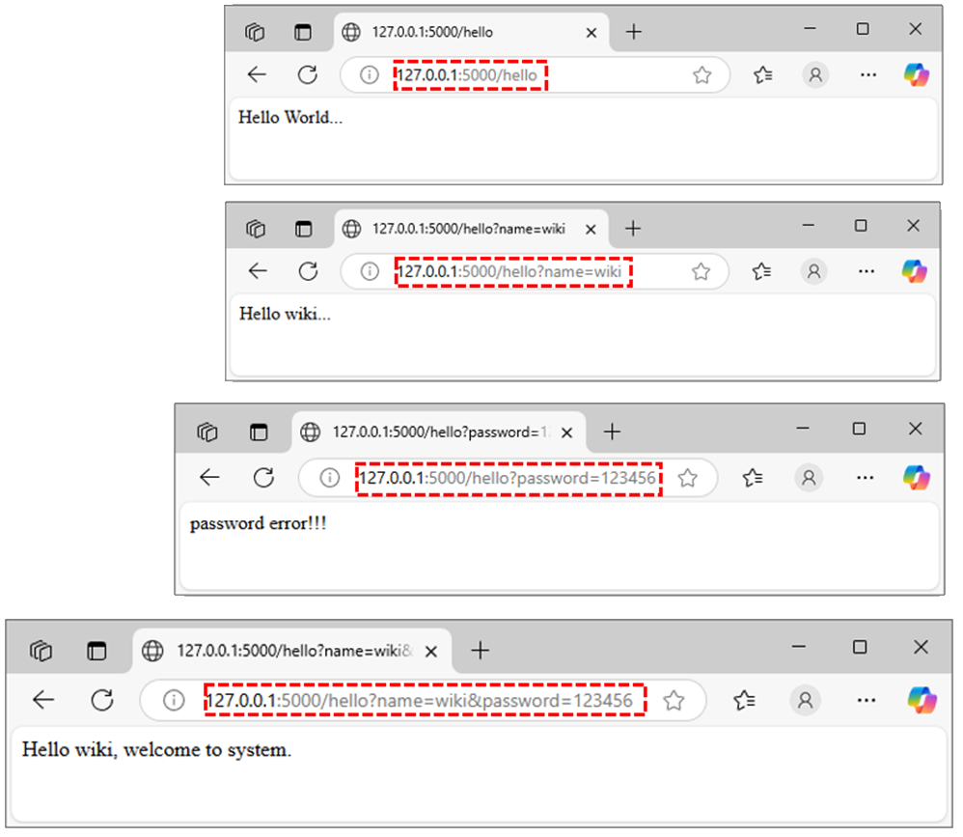
4.Write Code: Get Method
Web Output
Library: form AI
from flask import Flask, request, jsonify
app = Flask(__name__)
@app.route('/')
def hello():
return 'Hello World!'
# GET Method
@app.route('/hello', methods=['GET'])
def hello_get():
name = request.args.get('name', 'World') #'World' is default
password = request.args.get('password', 'None') #‘None' is default
if password=='None':
return f'Hello {name}...'
else:
if name=='wiki' and password=='123456':
return f'Hello {name}, welcome to system.'
elif name=='chen' and password=='456789':
return f'Hello {name}, welcome to system.'
else:
return f'password error!!!'
This a fast network transmission method. If you have passwords or personal information, please don't use this method. So this example is a bad application.

Slide 5
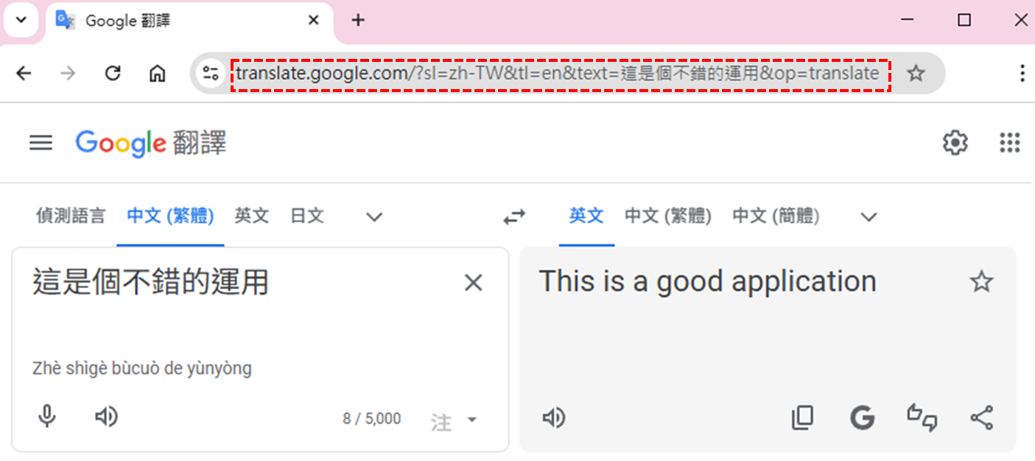
4.Write Code: Get Method
This is a good application.

