Slide 1
Flask Server App Example

Slide 2
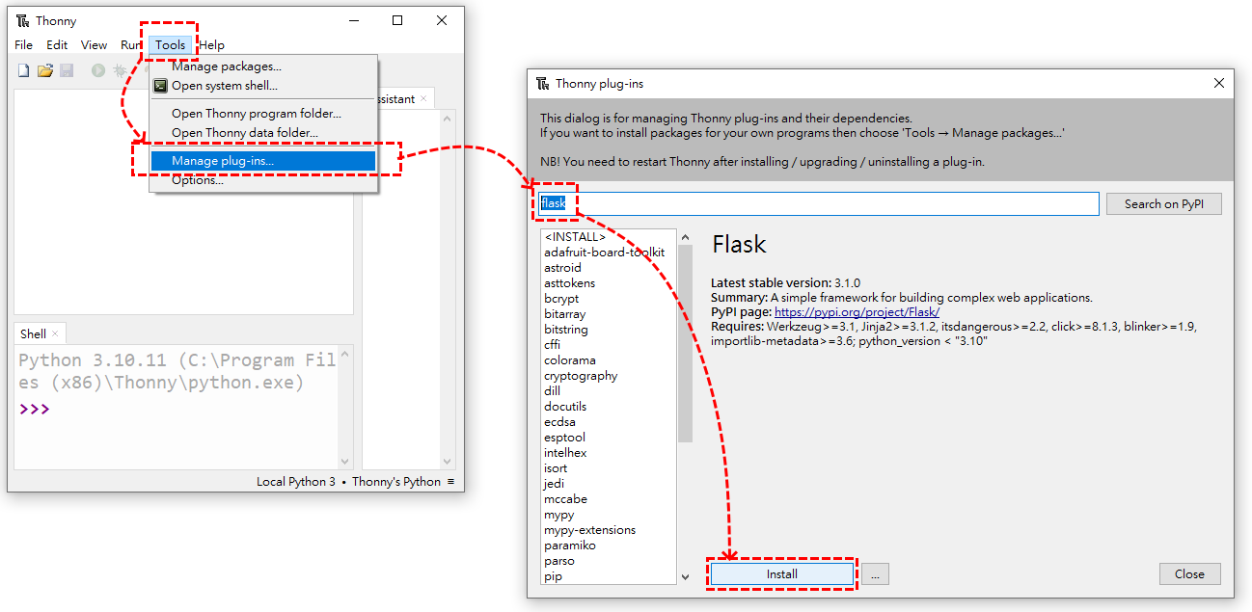
1.Install Python IDE--Thonny
Not necessarily thonny, you can choose other familiar IDE for you.
IDE Download: https://thonny.org/
2.Install Flask

Slide 3
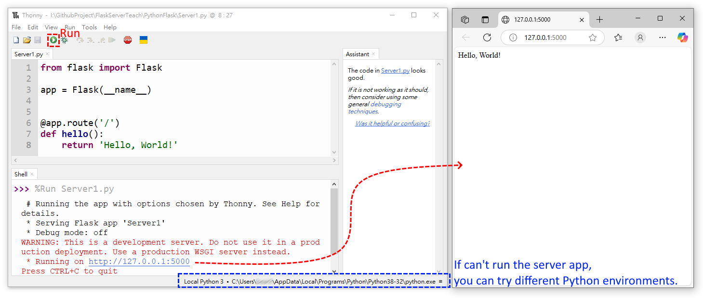
3.Write Code: Server1.py and Run
Library: https://flask.palletsprojects.com/en/stable/tutorial/layout/

