Slide 1
Unity Engine Client App

Slide 2
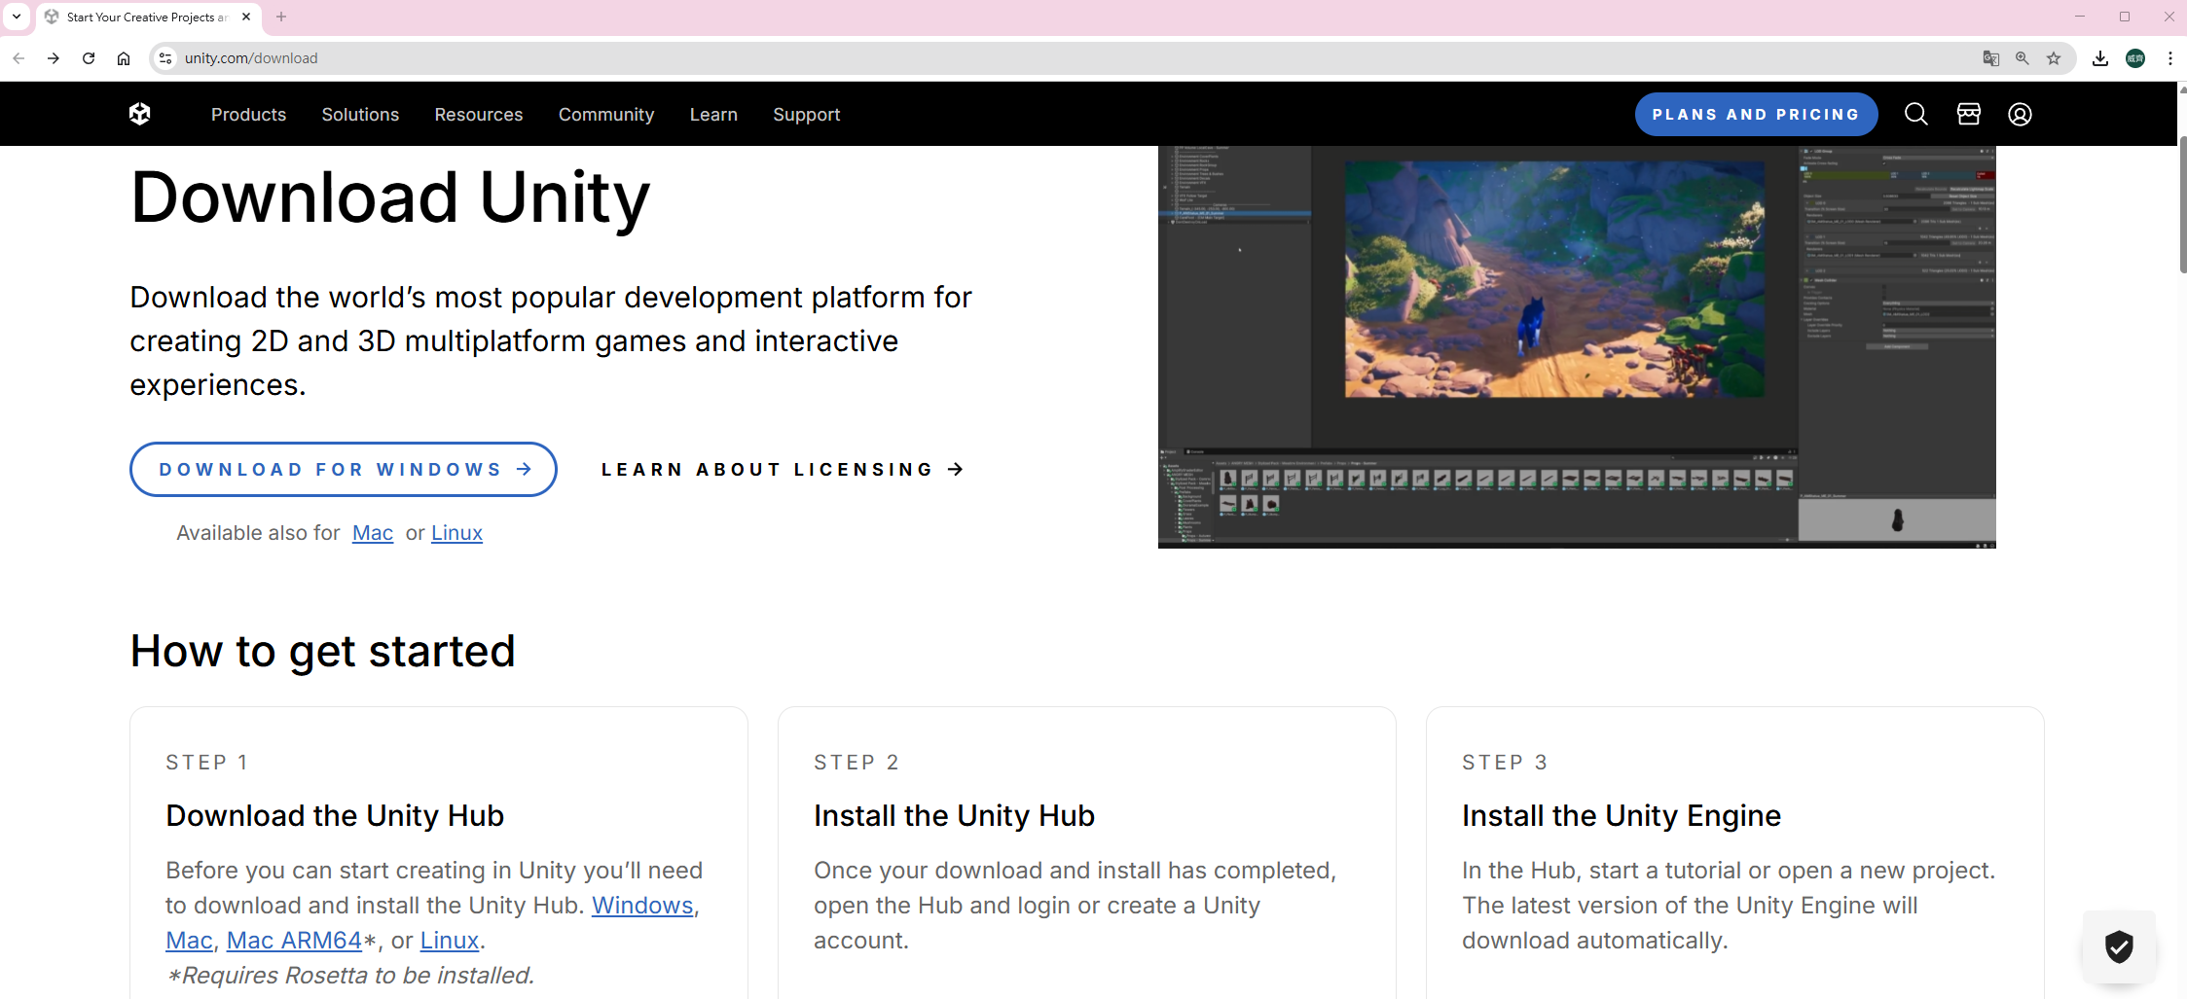
1.Install Unity Hub & Unity Editor
Unity Hub Download: https://unity.com/download

Slide 3
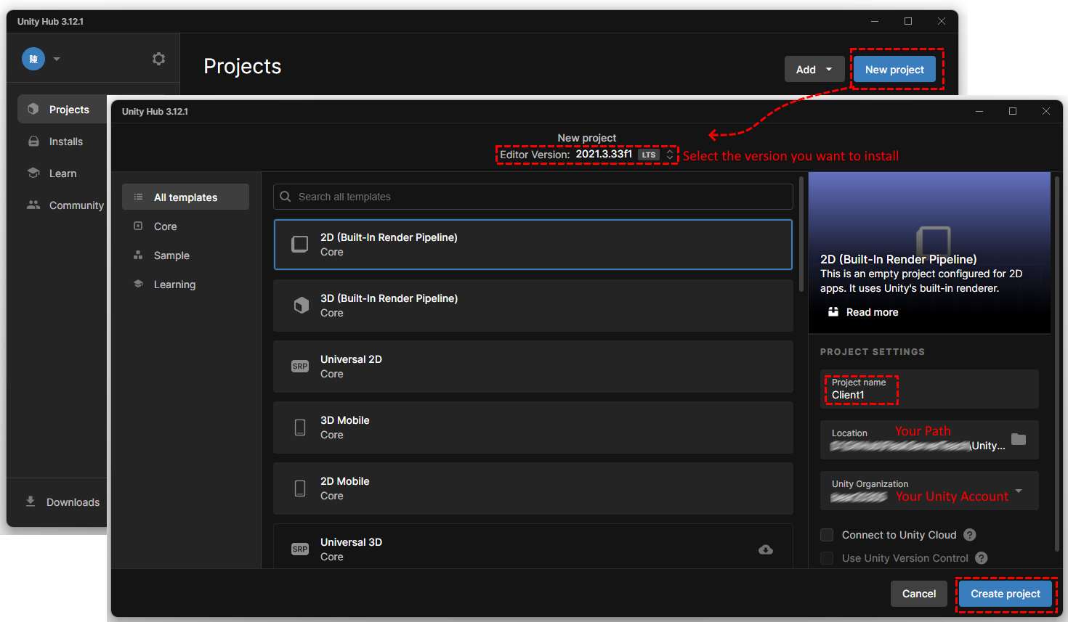
2.Create New Project

Slide 4
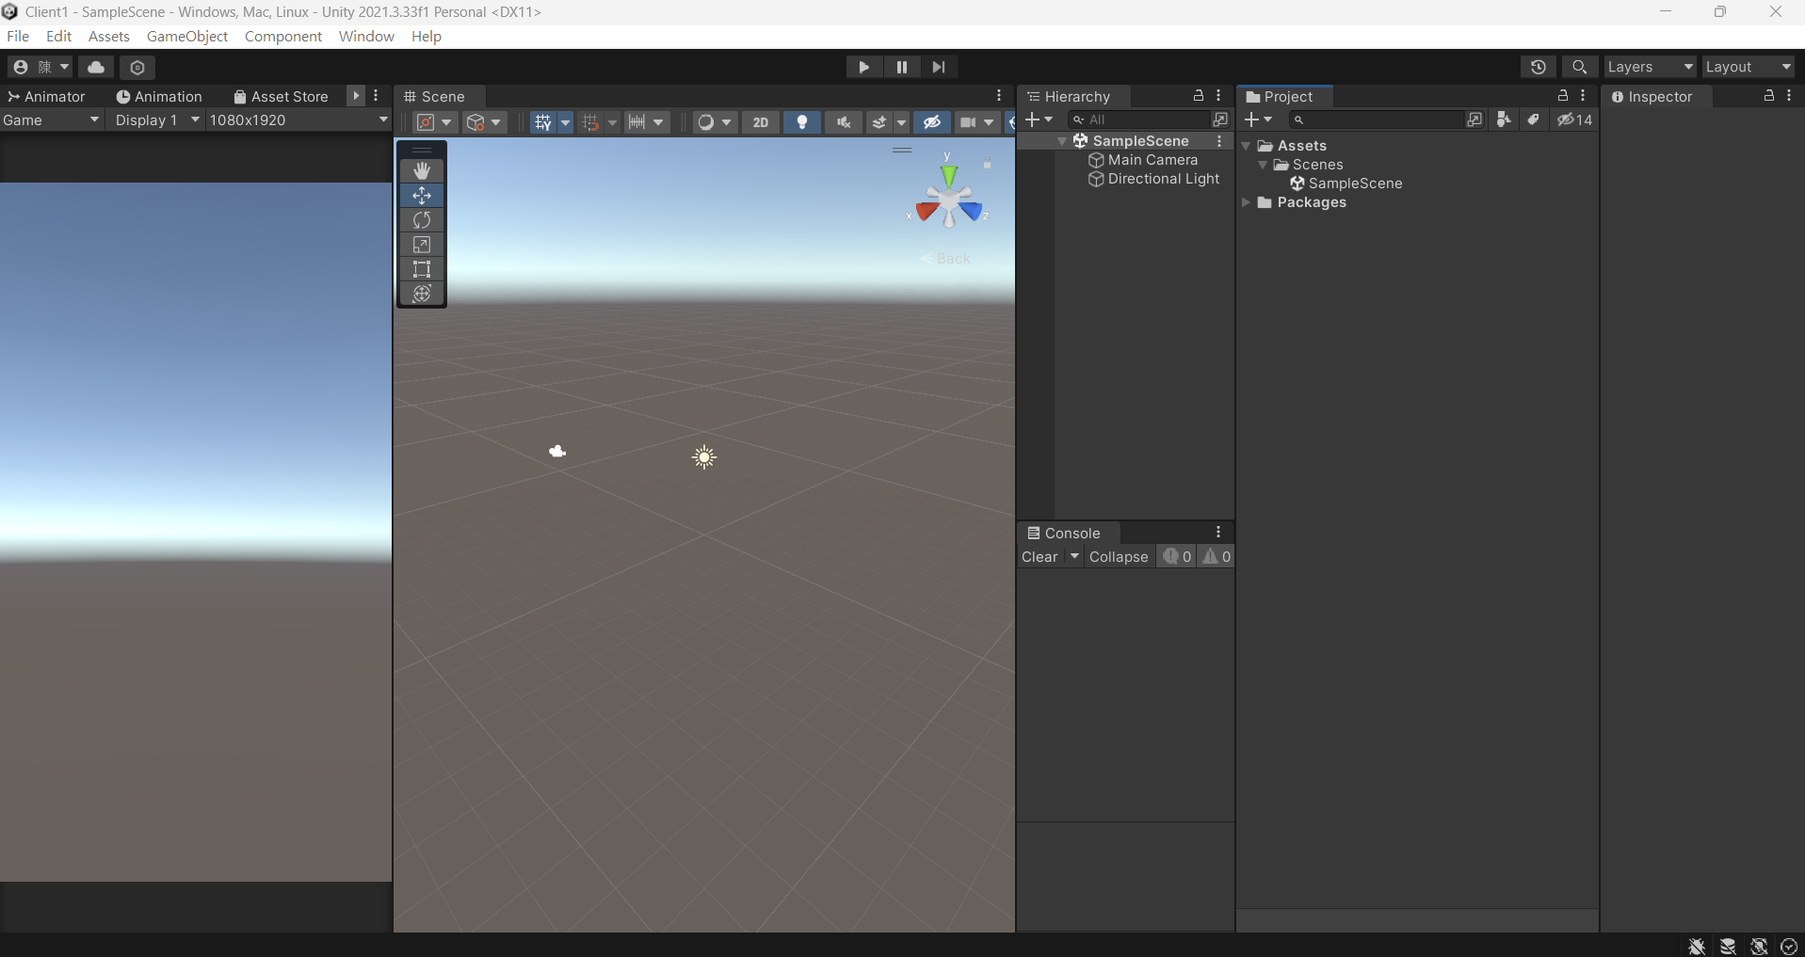
New Project View

Slide 5
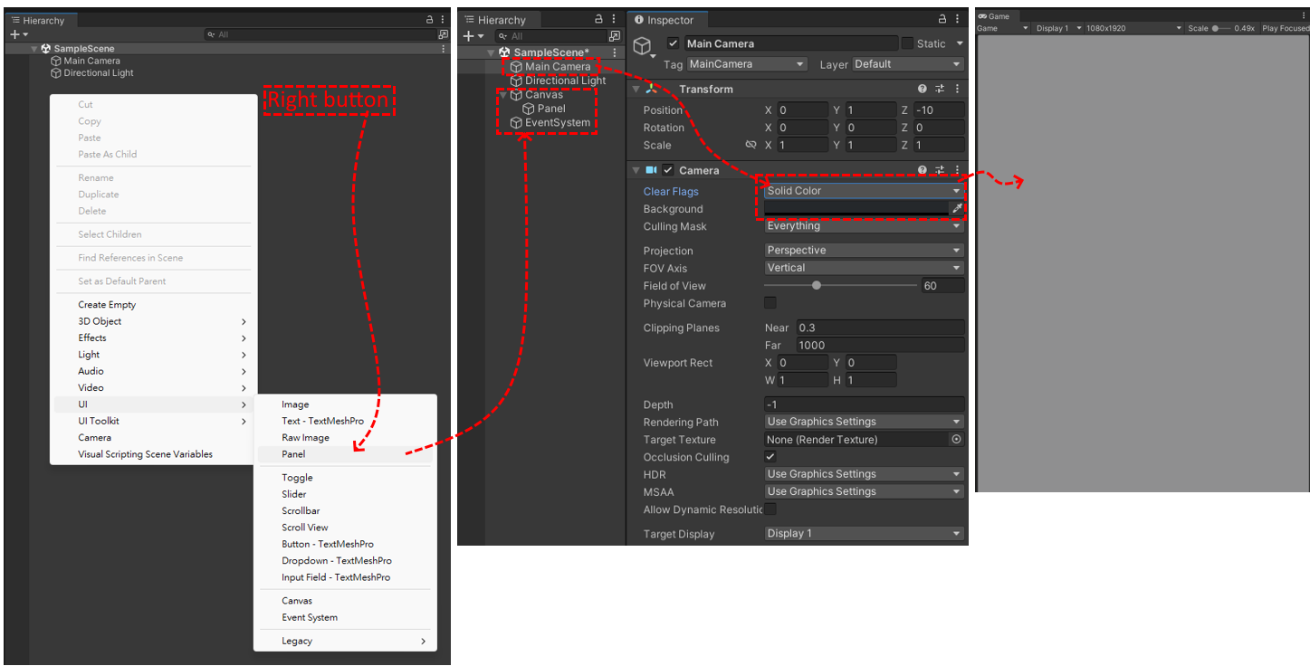
3.UI Design
‘Game’ View is User Interface.

Slide 6
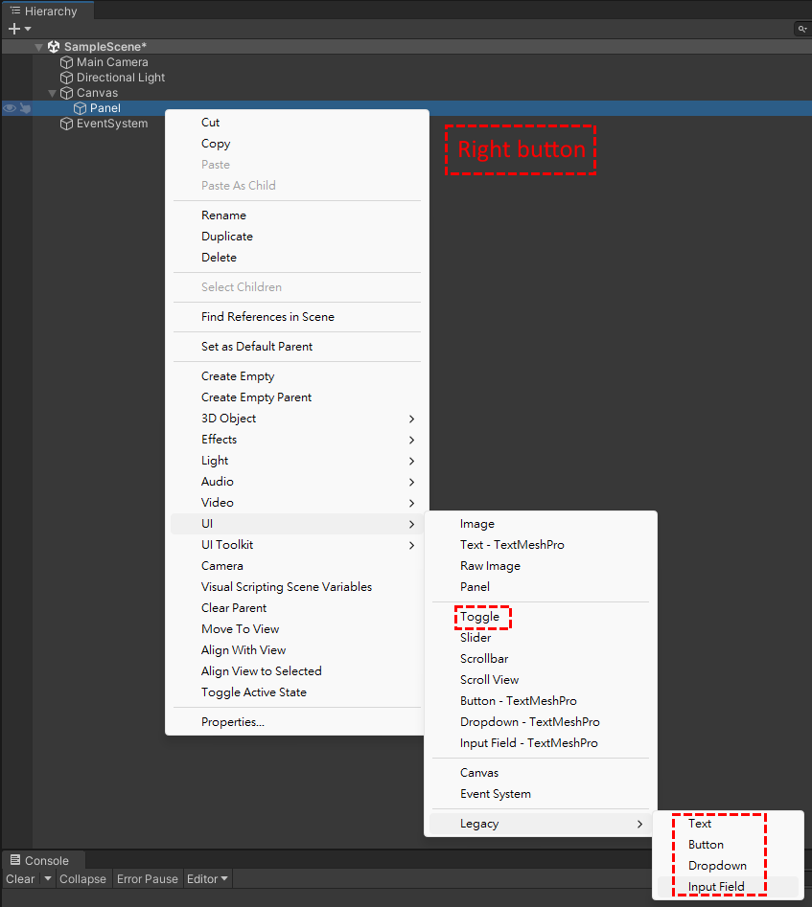
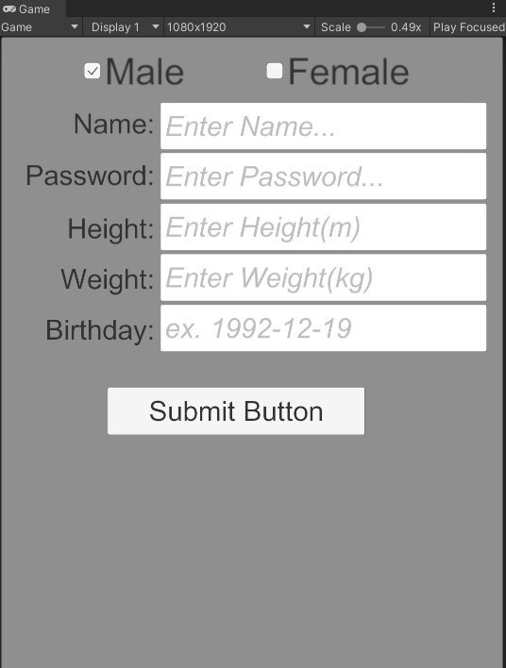
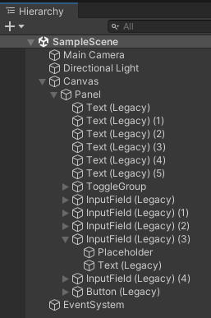
Add UI object in Hierachy.
See Game View to Design UI.

Slide 7
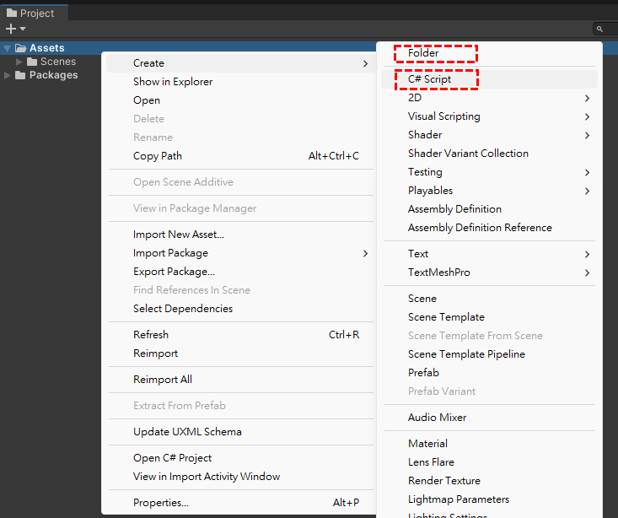
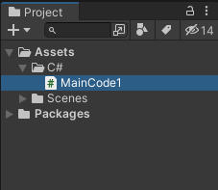
3.Add C# Code in Assets

Slide 8
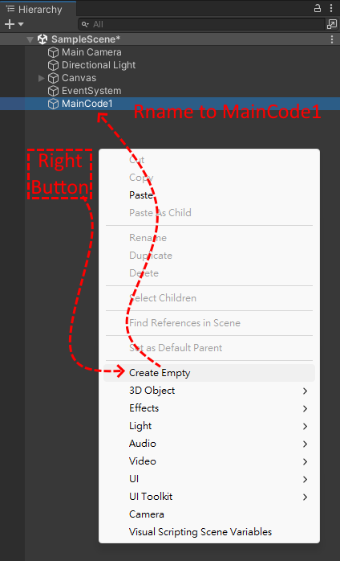
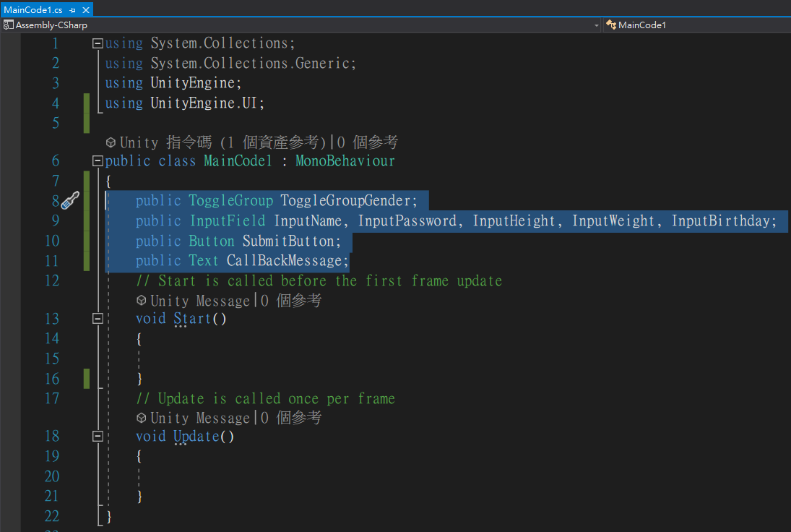
4.Write C# Code & Setting Code Object
Setting public object parameters.
public ToggleGroup ToggleGroupGender;
public InputField InputName, InputPassword, InputHeight, InputWeight, InputBirthday;
public Button SubmitButton;
public Text CallBackMessage;

Slide 9
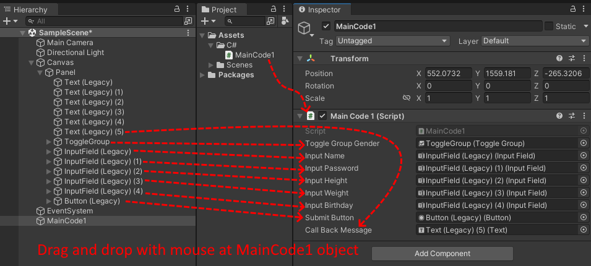
Setting Code and public object reference.

Slide 10
4.Write C# Function Code
public ToggleGroup ToggleGroupGender;
public InputField InputName, InputPassword, InputHeight, InputWeight, InputBirthday;
public Button SubmitButton;
public Text CallBackMessage;
public void PostCode()
{
string gender = ToggleGroupGender.GetFirstActiveToggle().name;
string name = InputName.text;
string password = InputPassword.text;
float height = float.Parse(InputHeight.text);
float weight = float.Parse(InputWeight.text);
string birthday = InputBirthday.text;
StartCoroutine(PostToServer(gender, name, password, height, weight, birthday));
}
IEnumerator PostToServer(string gender, string name, string password, float height, float weight, string birthday)
{
string jsonData = JsonUtility.ToJson(new PostData
{
gender = gender,
name = name,
password = password,
height = height,
weight = weight,
birthday = birthday
});
// change UTF8 of byte[]
byte[] jsonBytes = Encoding.UTF8.GetBytes(jsonData);
// Build UnityWebRequest
using (UnityWebRequest www = new UnityWebRequest("https://wiciar.com/bmi/submit", "POST"))
{
www.uploadHandler = new UploadHandlerRaw(jsonBytes);
www.downloadHandler = new DownloadHandlerBuffer();
www.SetRequestHeader("Content-Type", "application/json");
yield return www.SendWebRequest();
if (www.result == UnityWebRequest.Result.Success)
{
CallBackMessage.text = "Success：" + www.downloadHandler.text;
}
else
{
CallBackMessage.text = CallBackMessage.text + "error：" + www.downloadHandler.text;
}
}
}
[System.Serializable]
public class PostData
{
public string gender;
public string name;
public string password;
public float height;
public float weight;
public string birthday;
}
}

Slide 11
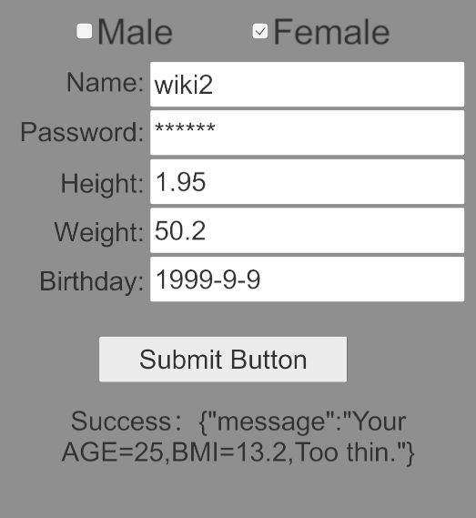
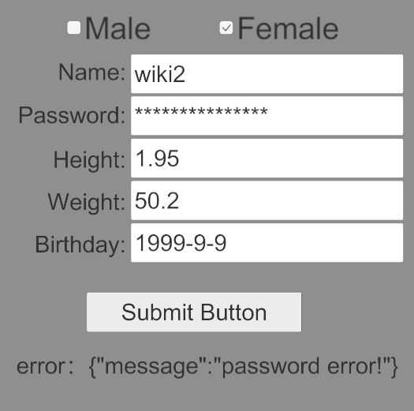
5.Run App
Request Success…
Request Success, but Password Error…

