Slide 1
Flask Server App Example

Slide 2
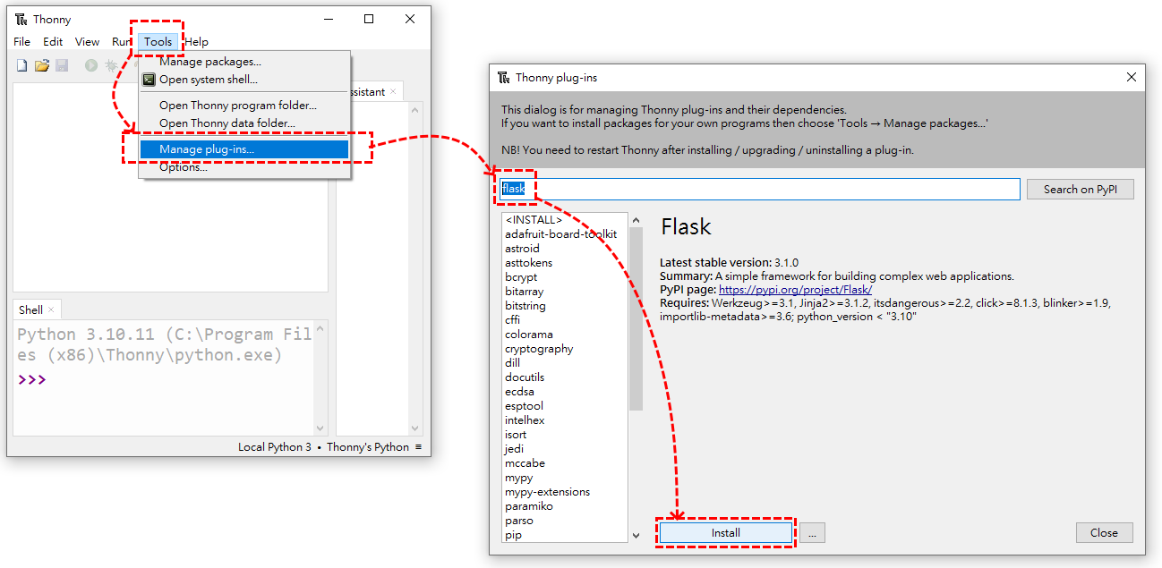
1.Install Python IDE--Thonny
Not necessarily thonny, you can choose other familiar IDE for you.
IDE Download: https://thonny.org/
2.Install Flask

Slide 3
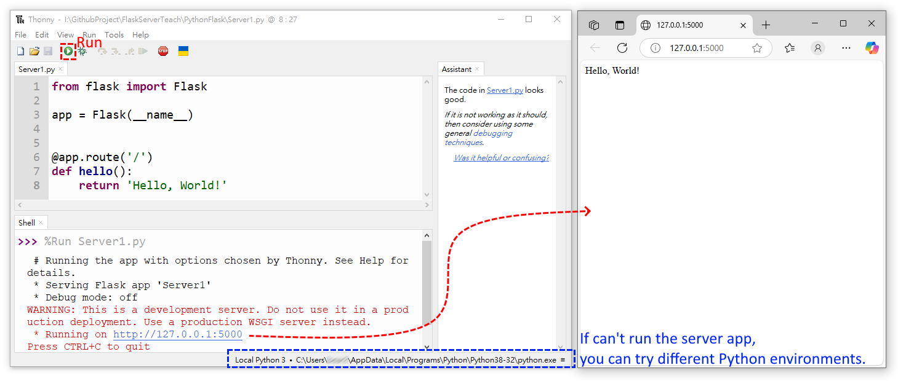
3.Write Code: Server1.py and Run
Library: https://flask.palletsprojects.com/en/stable/tutorial/layout/

Slide 4
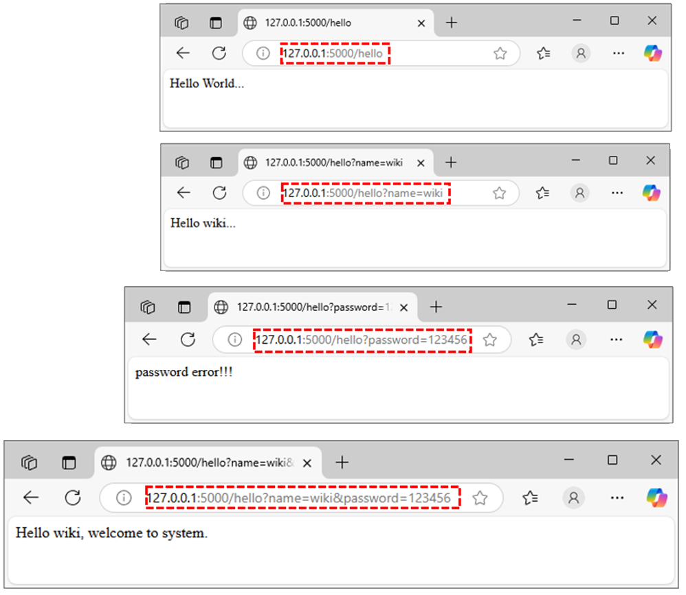
4.Write Code: Get Method
Web Output
Library: form AI
from flask import Flask, request, jsonify
app = Flask(__name__)
@app.route('/')
def hello():
return 'Hello World!'
# GET Method
@app.route('/hello', methods=['GET'])
def hello_get():
name = request.args.get('name', 'World') #'World' is default
password = request.args.get('password', 'None') #‘None' is default
if password=='None':
return f'Hello {name}...'
else:
if name=='wiki' and password=='123456':
return f'Hello {name}, welcome to system.'
elif name=='chen' and password=='456789':
return f'Hello {name}, welcome to system.'
else:
return f'password error!!!'
This a fast network transmission method. If you have passwords or personal information, please don't use this method. So this example is a bad application.

Slide 5
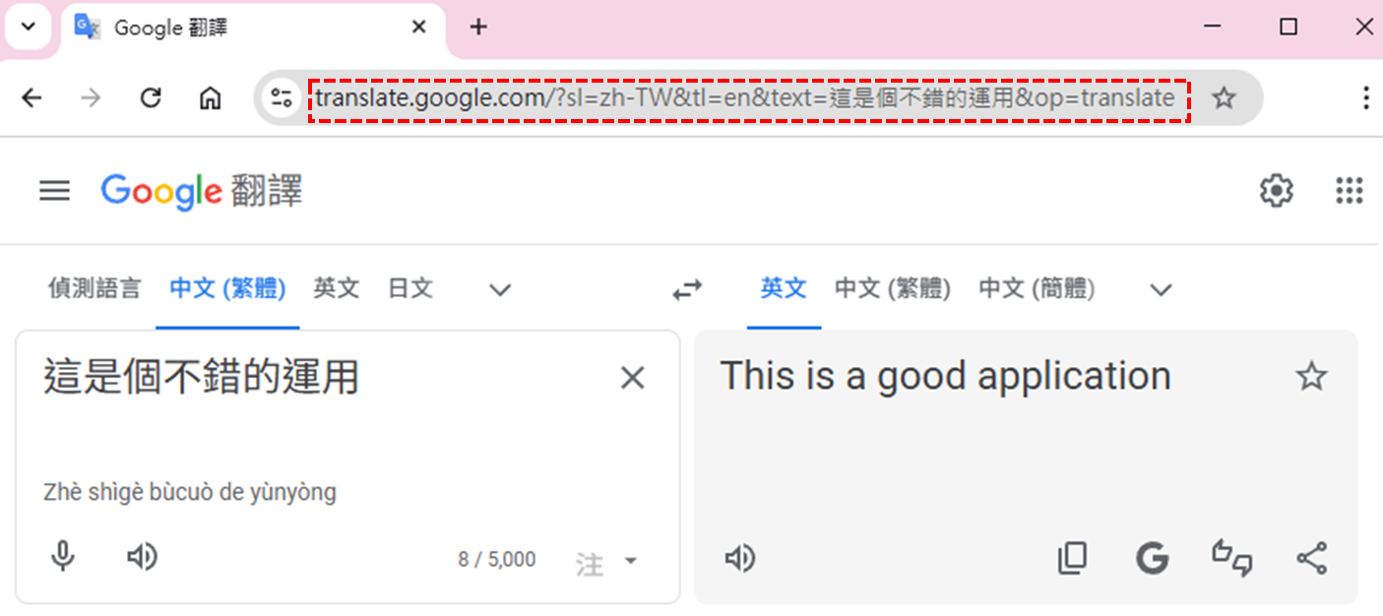
4.Write Code: Get Method
This is a good application.

Slide 6
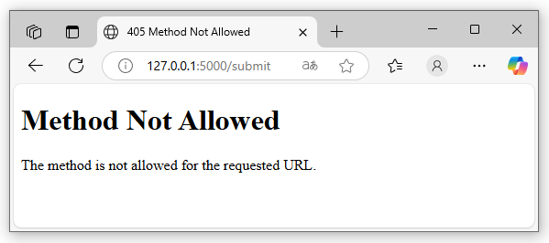
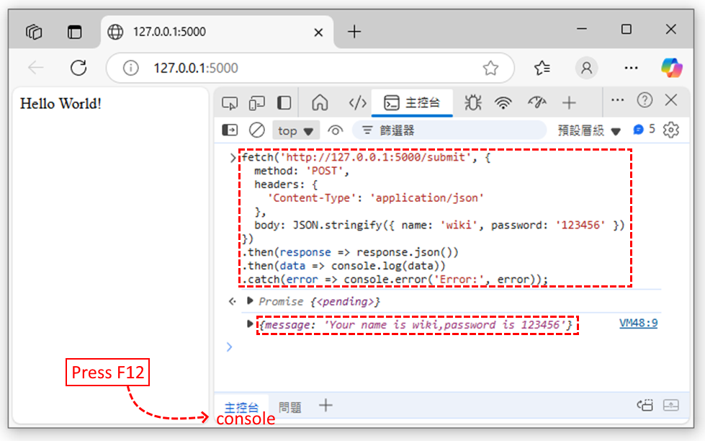
5.Write Code: Post Method
Web Output
Library: form AI
from flask import Flask, request, jsonify
app = Flask(__name__)
@app.route('/')
def hello():
return 'Hello World!'
# POST Method
@app.route('/submit', methods=['POST'])
def submit_form():
data = request.get_json()
name = f"{data.get('name')}"
password = f"{data.get('password')}"
return jsonify(message=f'Your name is {name},password is {password}')
Web Console Output
fetch('http://127.0.0.1:5000/submit', { method: 'POST', headers: { 'Content-Type': 'application/json' }, body: JSON.stringify({ name: 'wiki', password: '123456' })}).then(response => response.json()).then(data => console.log(data)).catch(error => console.error('Error:', error));

Slide 7
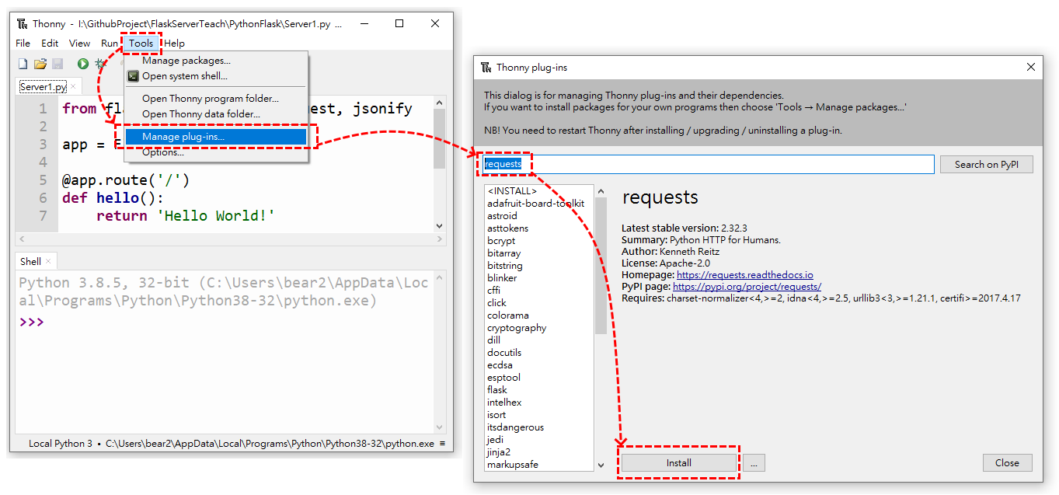
6.Write Code: Post Method Test
Step1:install requests

Slide 8
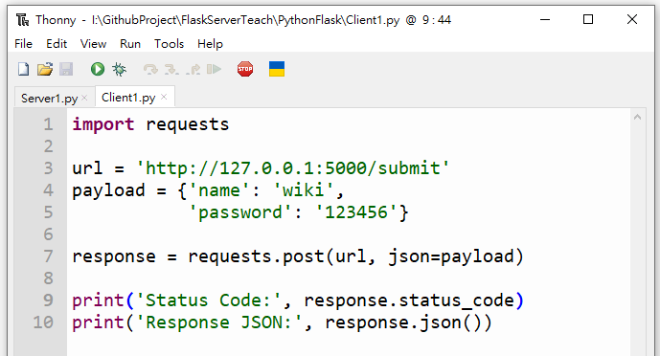
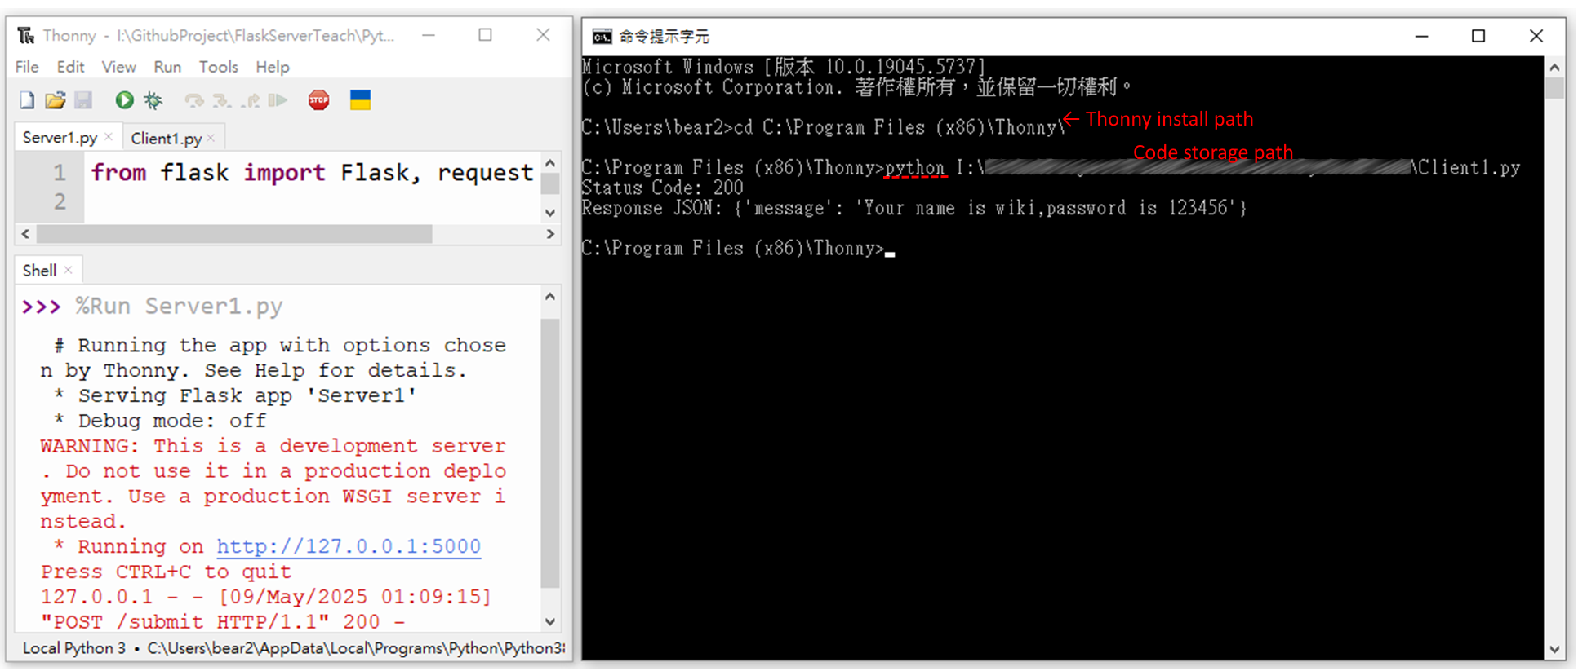
6.Write Code: Post Method Test
Step2: Write Code on Client1.py
Step3: Run Server1.py and Client1.py
Server1.py Run on IDE Shell.
Client1.py Run on Terminal.
import requests
url = 'http://127.0.0.1:5000/submit'
payload = {'name': 'wiki',
'password': '123456'}
response = requests.post(url, json=payload)
print('Status Code:', response.status_code)
print('Response JSON:', response.json())
Client1.py is run on terminal, because Thonny IDE can’t run two code at same time.
If Client1.py can't run, you may need to change the Python environment.

Slide 9
7.Write Code: Post Method Test
Step1: Write Code on Server1.py
Step2: Write Code on Client1.py
from flask import Flask, request, jsonify
from datetime import datetime
app = Flask(__name__)
@app.route('/')
def hello():
return 'Hello World!'
# POST Method
@app.route('/submit', methods=['POST'])
def submit_form():
data = request.get_json()
name = data.get('name')
password = data.get('password')
birthday = datetime.strptime((f"{data.get('birthday')}"), "%Y-%m-%d")
gender = data.get('gender')
height = data.get('height')
weight = data.get('weight')
# bmi count
bmi = round(weight / height **2,2)
# age count
today = datetime.today()
age = today.year - birthday.year - ((today.month, today.day) < (birthday.month, birthday.day))
return jsonify(message=f'Your AGE={age},BMI={bmi}')
import requests
url = 'http://127.0.0.1:5000/submit'
payload = {'name': 'wiki',
'password': '123456',
'birthday':'1990-04-24',
'height':1.75,
'weight':60}
response = requests.post(url, json=payload)
print('Status Code:', response.status_code)
print('Response JSON:', response.json())

Slide 10
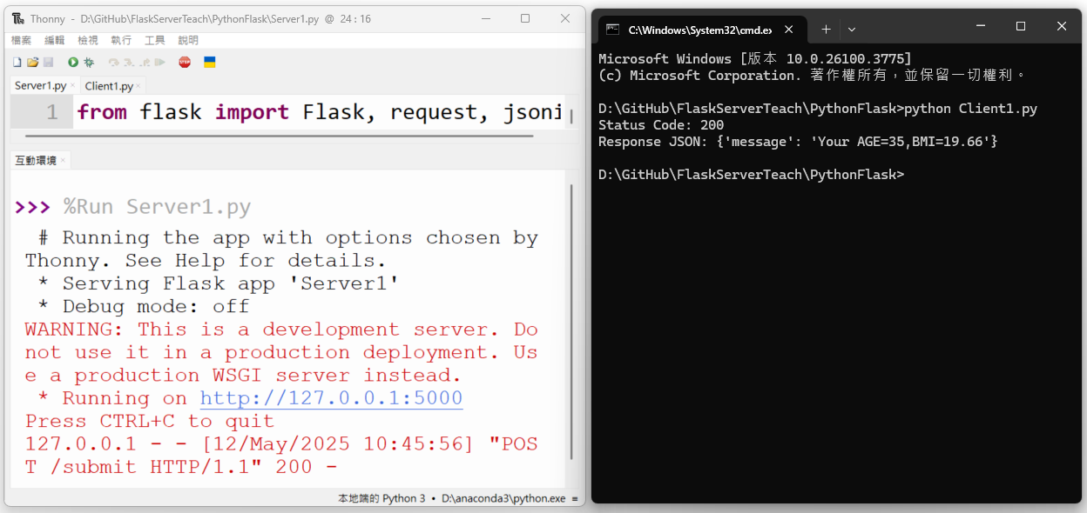
7.Write Code: Post Method Test
Step3 Run Server1.py and Client1.py
Server1.py Run on IDE Shell.
Client1.py Run on Terminal.
Client1.py is run on terminal, because Thonny IDE can’t run two code at same time.
If Client1.py can't run, you may need to change the Python environment.

Slide 11
8.Write Code: Post Method Test
Step1: Write Code on Server1.py
Step2: Write Code on Client1.py
from flask import Flask, request, jsonify
from datetime import datetime
import math
import pandas as pd
app = Flask(__name__)
# POST Method
@app.route('/submit', methods=['POST'])
def submit_form():
data = request.get_json()
name = data.get('name')
password = data.get('password')
birthday = datetime.strptime((f"{data.get('birthday')}"), "%Y-%m-%d")
gender = data.get('gender')
height = data.get('height')
weight = data.get('weight')
bmi = round(weight / height **2,2)# bmi count
today = datetime.today()# age count
age = today.year - birthday.year - ((today.month, today.day) < (birthday.month, birthday.day))
df = pd.read_csv('BMI_Normal.csv')
matched_rows = df[df['age'] == age].iloc[0]
print(matched_rows)
bmi_judge = 'wrong data'
if gender=='male':
if bmi<matched_rows['male_min']:
bmi_judge='Too thin'
elif bmi>=matched_rows['male_min'] and bmi<=matched_rows['male_max']:
bmi_judge='Normal'
else:
bmi_judge='Too fat'
elif gender=='female':
if bmi<matched_rows['female_min']:
bmi_judge='Too thin'
elif bmi>=matched_rows['female_min'] and bmi<=matched_rows['female_max']:
bmi_judge='Normal'
else:
bmi_judge='Too fat'
return jsonify(message=f'Your AGE={age},BMI={bmi},{bmi_judge}.')
import requests
url = 'http://127.0.0.1:5000/submit'
payload = {'name': 'wiki',
'password': '123456',
'birthday':'1990-04-24',
'gender':'male’,
'height':1.75,
'weight':60}
response = requests.post(url, json=payload)
print('Status Code:', response.status_code)
print('Response JSON:', response.json())

Slide 12
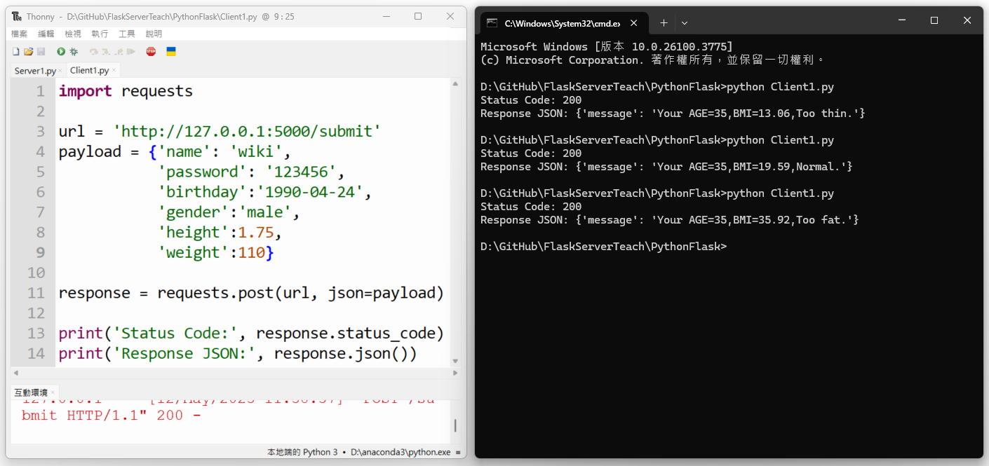
8.Write Code: Post Method Test
Step3 Run Server1.py and Client1.py
Server1.py Run on IDE Shell.
Client1.py Run on Terminal.
Client1.py is run on terminal, because Thonny IDE can’t run two code at same time.
If Client1.py can't run, you may need to change the Python environment.

Slide 13
9.Write Code: Post Method Test
Step1: Write Code on Server1.py
elif gender=='female':
if bmi<matched_rows['female_min']:
bmi_judge='Too thin'
elif bmi>=matched_rows['female_min'] and bmi<=matched_rows['female_max']:
bmi_judge='Normal'
else:
bmi_judge='Too fat'
filename = f"UserData\{name}.csv"
if os.path.exists(filename): # file exists
load_df = pd.read_csv(filename)# file load
stored_password = str(load_df.iloc[0]['password'])# password load
if stored_password != password:# password incorrect
return jsonify(message="password error!"), 403
else:# password correct
user_data = { #Save Data
'height': height,
'weight': weight,
'bmi': bmi,
'bmi_judge':bmi_judge,
'build_time':today
}
load_df = pd.concat([load_df, pd.DataFrame([user_data])], ignore_index=True)
load_df.to_csv(filename, index=False)
else:# no files
user_data = {#Save Data
'password': password,
'birthday': birthday,
'gender': gender,
'height': height,
'weight': weight,
'bmi': bmi,
'bmi_judge':bmi_judge,
'build_time':today
}
save_df = pd.DataFrame([user_data])
save_filename = f"UserData\{name}.csv".replace("/", "_")
save_df.to_csv(save_filename, index=False)
return jsonify(message=f'Your AGE={age},BMI={bmi},{bmi_judge}.')
from flask import Flask, request, jsonify
from datetime import datetime
import math
import pandas as pd
import os
app = Flask(__name__)
# POST Method
@app.route('/submit', methods=['POST'])
def submit_form():
data = request.get_json()
name = data.get('name')
password = data.get('password')
birthday = datetime.strptime((f"{data.get('birthday')}"), "%Y-%m-%d")
gender = data.get('gender')
height = data.get('height')
weight = data.get('weight')
bmi = round(weight / height **2,2)# bmi count
today = datetime.today()
age = today.year - birthday.year - ((today.month, today.day) < (birthday.month, birthday.day))
df = pd.read_csv('BMI_Normal.csv')
matched_rows = df[df['age'] == age].iloc[0]
#print(matched_rows)
bmi_judge = 'wrong data'
if gender=='male':
if bmi<matched_rows['male_min']:
bmi_judge='Too thin'
elif bmi>=matched_rows['male_min'] and bmi<=matched_rows['male_max']:
bmi_judge='Normal'
else:
bmi_judge='Too fat'

Slide 14
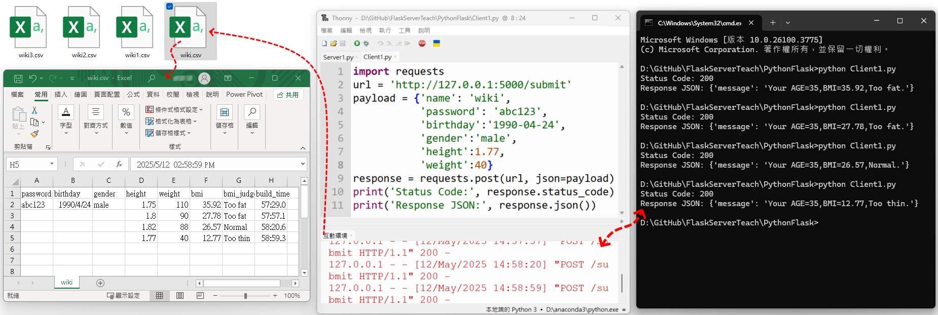
9.Write Code: Post Method Test
Step2: Run Server1.py and Client1.py
Server1.py Run on IDE Shell.
Client1.py Run on Terminal.
Client1.py is run on terminal, because Thonny IDE can’t run two code at same time.
If Client1.py can't run, you may need to change the Python environment.

Slide 15
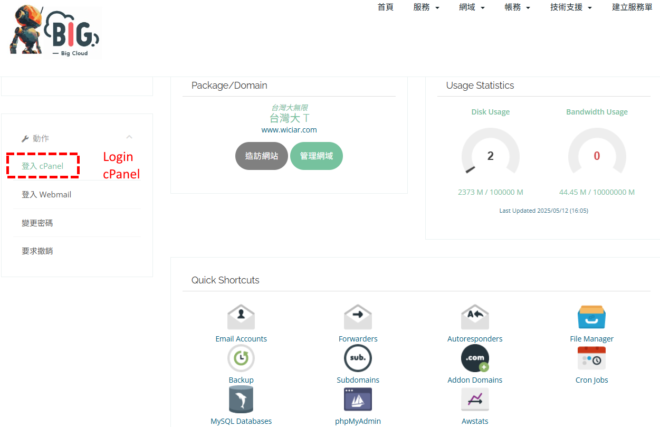
10.Web Server Building for cPanel
Step1: Paid and apply for a cloud server. (My teaching uses bigcloud.com.tw)
Not necessarily Bigcloud, you can use AWS, Azure, firebase or Alibaba Cloud…
But when you want to bid for the R.O.C gov. Project, Data center must for Chunghwa Telecom’s Device.

Slide 16
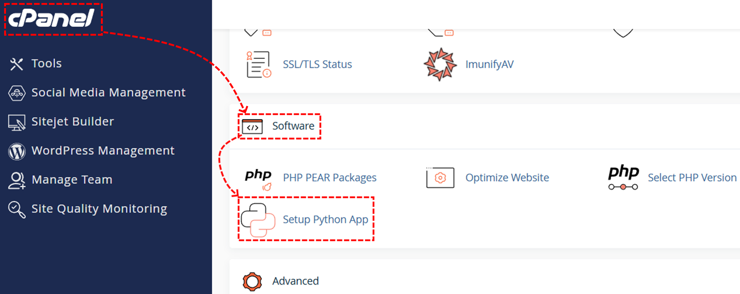
10.Web Server Building for cPanel
Step2: Create python server on cPanel.

Slide 17
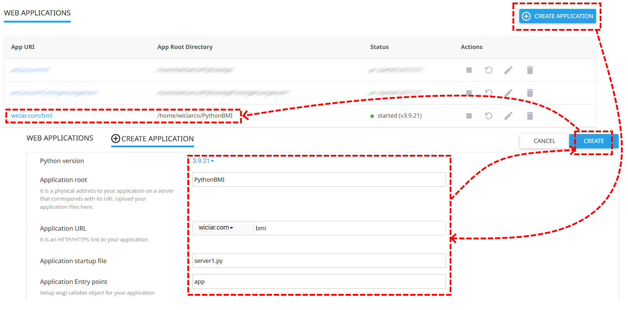
10.Web Server Building for cPanel
Step2: Create python server on cPanel.

Slide 18
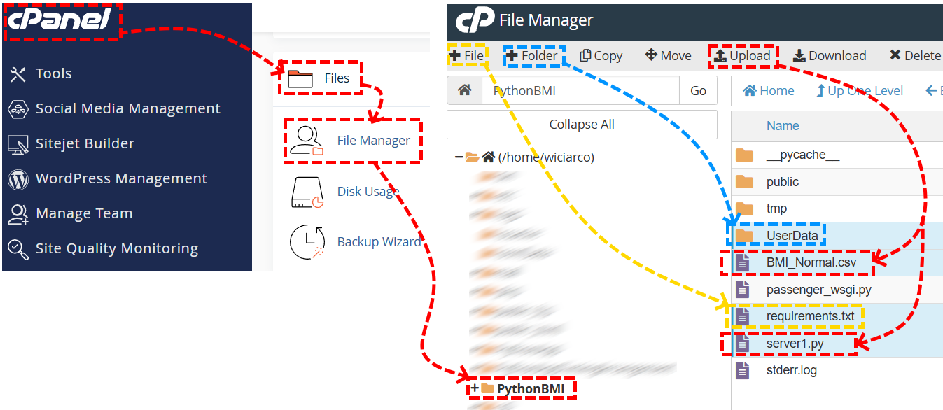
10.Web Server Building for cPanel
Step3: upload and Create app root of files & folders.

Slide 19
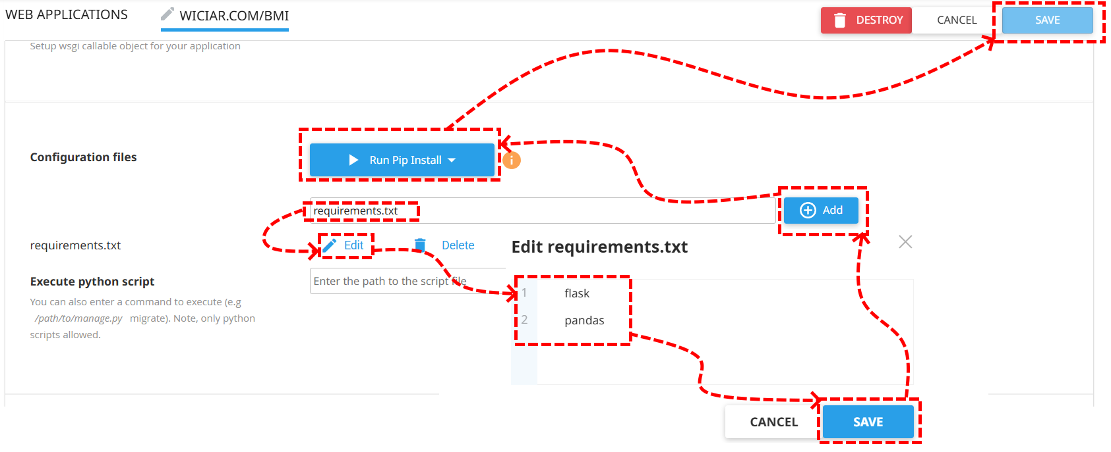
10.Web Server Building for cPanel
Step4:updata python server environmental from requirements.txt

Slide 20
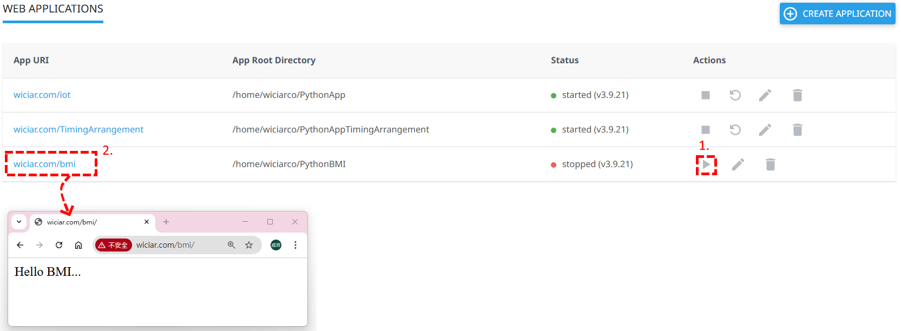
10.Web Server Building for cPanel
Step5:Run Server

Slide 21
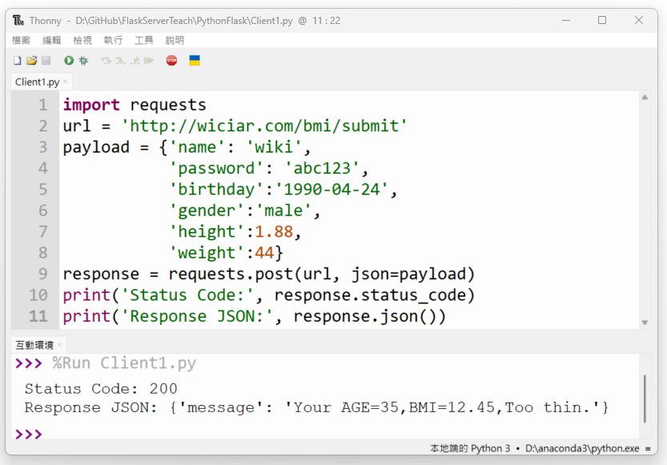
10.Web Server Building for cPanel
Step6: Client1.py Code & Test Run
import requests
url = 'http://wiciar.com/bmi/submit'
payload = {'name': 'wiki',
'password': 'abc123',
'birthday':'1990-04-24',
'gender':'male',
'height':1.88,
'weight':44}
response = requests.post(url, json=payload)
print('Status Code:', response.status_code)
print('Response JSON:', response.json())

Slide 22
10.Web Server Building for cPanel
Server1.py Code
from flask import Flask, request, jsonify
from datetime import datetime
import math
import pandas as pd
import os
app = Flask(__name__)
# GET Method
@app.route('/')
def hello():
return 'Hello BMI...'
# POST Method
@app.route('/submit', methods=['POST'])
def submit_form():
data = request.get_json()
name = data.get('name')
password = data.get('password')
birthday = datetime.strptime((f"{data.get('birthday')}"), "%Y-%m-%d")
gender = data.get('gender')
height = data.get('height')
weight = data.get('weight')
bmi = round(weight / height **2,2)# bmi count
today = datetime.today()
age = today.year - birthday.year - ((today.month, today.day) < (birthday.month, birthday.day))
df = pd.read_csv('BMI_Normal.csv')
matched_rows = df[df['age'] == age].iloc[0]
#print(matched_rows)
bmi_judge = 'wrong data'
if gender=='male':
if bmi<matched_rows['male_min']:
bmi_judge='Too thin'
elif bmi>=matched_rows['male_min'] and bmi<=matched_rows['male_max']:
bmi_judge='Normal'
else:
bmi_judge='Too fat'
elif gender=='female':
if bmi<matched_rows['female_min']:
bmi_judge='Too thin'
elif bmi>=matched_rows['female_min'] and bmi<=matched_rows['female_max']:
bmi_judge='Normal'
else:
bmi_judge='Too fat'
filename = f"UserData//{name}.csv"
if os.path.exists(filename): # file exists
load_df = pd.read_csv(filename)# file load
stored_password = str(load_df.iloc[0]['password'])# password load
if stored_password != password:# password incorrect
return jsonify(message="password error!"), 403
else:# password correct
user_data = { #Save Data
'height': height,
'weight': weight,
'bmi': bmi,
'bmi_judge':bmi_judge,
'build_time':today
}
load_df = pd.concat([load_df, pd.DataFrame([user_data])], ignore_index=True)
load_df.to_csv(filename, index=False)
else:# no files
user_data = {#Save Data
'password': password,
'birthday': birthday,
'gender': gender,
'height': height,
'weight': weight,
'bmi': bmi,
'bmi_judge':bmi_judge,
'build_time':today
}
save_df = pd.DataFrame([user_data])
#save_filename = f"UserData\{name}.csv".replace("/", "_")
save_df.to_csv(filename, index=False)
return jsonify(message=f'Your AGE={age},BMI={bmi},{bmi_judge}.')

Slide 23
11.Client UI Design for Python
def submit():
global gender,name,password,birthday,height,weight,jsonText
temp =f'gender={gender.get()}\nname={name.get()}\npassword={password.get()}\nbirthday={birthday.get()}\nheight={height.get()}\nweight={weight.get()}'
jsonText.set(temp)
url = 'http://wiciar.com/bmi/submit'
jsonSet = {'name': name.get(),
'password': password.get(),
'birthday':birthday.get(),
'gender':gender.get(),
'height':float(height.get()),
'weight':float(weight.get())}
#print(jsonSet)
try:
response = requests.post(url, json=jsonSet)
serverText.set(response.json()['message'])
print('Response JSON:', response.json())
except:
serverText.set('Server Link error!!!')
print('Status Code:', response.status_code)
submit_btn1 = tk.Button(root,command=submit,text='PassData',font=('Arial',30,'bold'),padx=10,pady=10,activeforeground='#f00')
radio_btn1.grid(column=0, row=0)
radio_btn2.grid(column=1, row=0)
labelName.grid(column=0, row=1)
entryName.grid(column=1, row=1)
labelPassword.grid(column=0, row=2)
entryPassword.grid(column=1, row=2)
labelHeight.grid(column=0, row=3)
entryHeight.grid(column=1, row=3)
labelWeight.grid(column=0, row=4)
entryWeight.grid(column=1, row=4)
labelBirthday.grid(column=0, row=5)
entryBirthday.grid(column=1, row=5)
submit_btn1.grid(column=1, row=6)
Jsonlabel.grid(column=1, row=7)
Serverlabel.grid(column=1, row=8)
root.mainloop()
import tkinter as tk
import requests
root = tk.Tk()
root.title('BMI Input')
root.geometry('720x720')
gender = tk.StringVar()
name = tk.StringVar()
password = tk.StringVar()
birthday = tk.StringVar()
height = tk.StringVar()
weight = tk.StringVar()
jsonText = tk.StringVar()
serverText = tk.StringVar()
radio_btn1 = tk.Radiobutton(root,text='Male',font=('Arial',30,'bold'),variable=gender,value='male')
radio_btn2 = tk.Radiobutton(root,text='Female',font=('Arial',30,'bold'),variable=gender,value='female')
radio_btn1.select()
labelName = tk.Label(root, text='Name:')
entryName = tk.Entry(root,font=('Arial',30,'bold'),textvariable=name)
labelPassword = tk.Label(root, text='Password:')
entryPassword = tk.Entry(root,show='*',font=('Arial',30,'bold'),textvariable=password)
labelHeight = tk.Label(root, text='Height(m):')
entryHeight = tk.Entry(root,font=('Arial',30,'bold'),textvariable=height)
labelWeight = tk.Label(root, text='Weight(kg):')
entryWeight = tk.Entry(root,font=('Arial',30,'bold'),textvariable=weight)
labelBirthday = tk.Label(root, text='Birthday(UTC):')
entryBirthday = tk.Entry(root,font=('Arial',30,'bold'),textvariable=birthday)
Jsonlabel = tk.Label(root,textvariable=jsonText,font=('Arial',20,'bold'),fg='#f00')
Serverlabel = tk.Label(root,textvariable=serverText,font=('Arial',20,'bold'),fg='#00f')
Step1: Write Code--Client_UI1.py

Slide 24
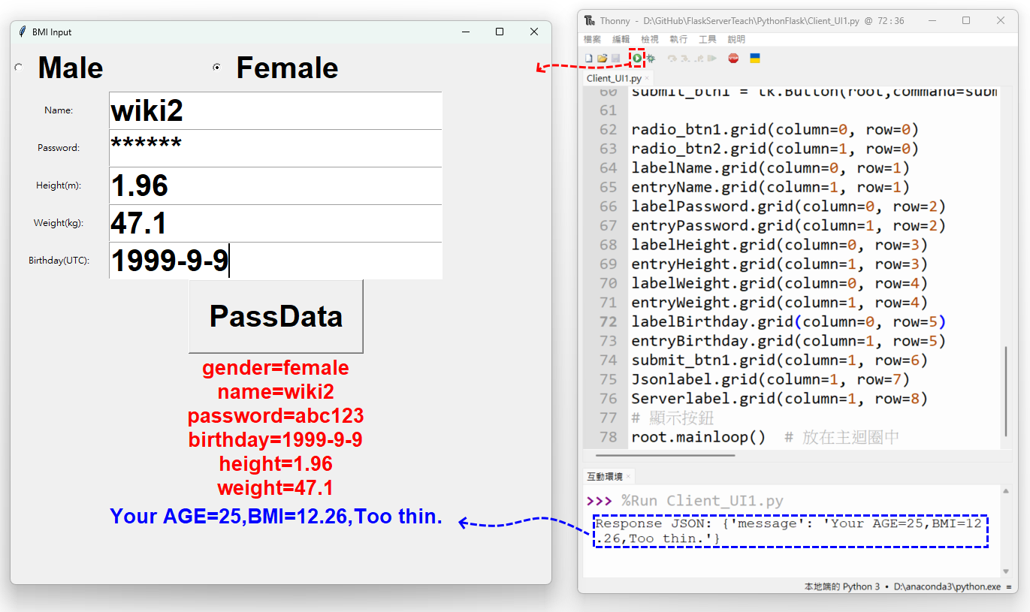
11.Client UI Design for Python
Step2: Run Client_UI1.py

Slide 25
12.Client get User historical information
Step1: Write Code--Client2.py
Server1.py Code Design
import requests
import pandas as pd
import matplotlib.pyplot as plt
url = 'http://wiciar.com/bmi/data_get'
payload = {'name': 'wiki2',
'password': 'abc123'}
print('Json Code:', payload)
response = requests.post(url, json=payload)
print('Status Code:', response.status_code)
#print('Response JSON:', response.json()['message'])
#Data visualization output
data_list = response.json()['message']
df = pd.DataFrame(data_list)
df['build_time'] = pd.to_datetime(df['build_time'])
df = df.dropna(subset=['bmi', 'build_time'])
df = df.sort_values(by='build_time')
plt.figure(figsize=(10, 5))
plt.plot(df['build_time'], df['bmi'], marker='o', linestyle='-', color='blue', label='BMI')
plt.title('BMI Trend Over Time')
plt.xlabel('Build Time')
plt.ylabel('BMI')
plt.grid(True)
plt.xticks(rotation=45)
plt.tight_layout()
plt.legend()
plt.show()
#omit…
# GET Method
@app.route('/')
def hello():
return 'Hello BMI...'
# POST Method
@app.route('/data_get', methods=['POST'])
def UserDataGet():
data = request.get_json()
name = data.get('name')
password = data.get('password')
if not name or not password:
return jsonify(message="get me 'name' & 'password'."), 400
filename = f"UserData//{name}.csv"
if os.path.exists(filename):
df = pd.read_csv(filename)
if (df["password"] == password).any():
df = pd.concat([df, pd.DataFrame()], ignore_index=True)
else:
return jsonify(message="Password error!"), 403
df = df.drop(columns=["password"], errors="ignore")
print(df)
return jsonify(message=df.to_dict(orient="records"))
else:
return jsonify(message="No User Data!"), 403
# POST Method
@app.route('/submit', methods=['POST'])
def submit_form():
#omit…
#omit… this can Refer to Section 10

Slide 26
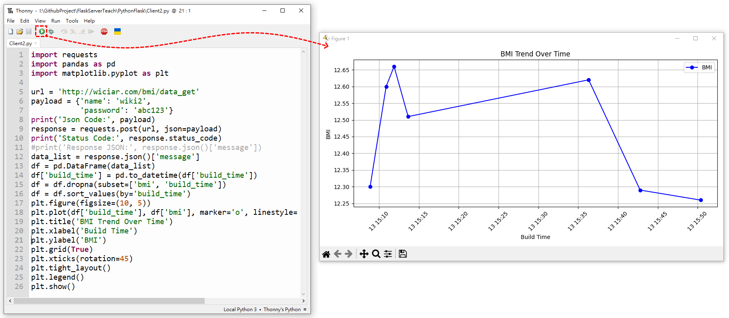
12.Client get User historical information
Step2: Run Code--Client2.py

Slide 27
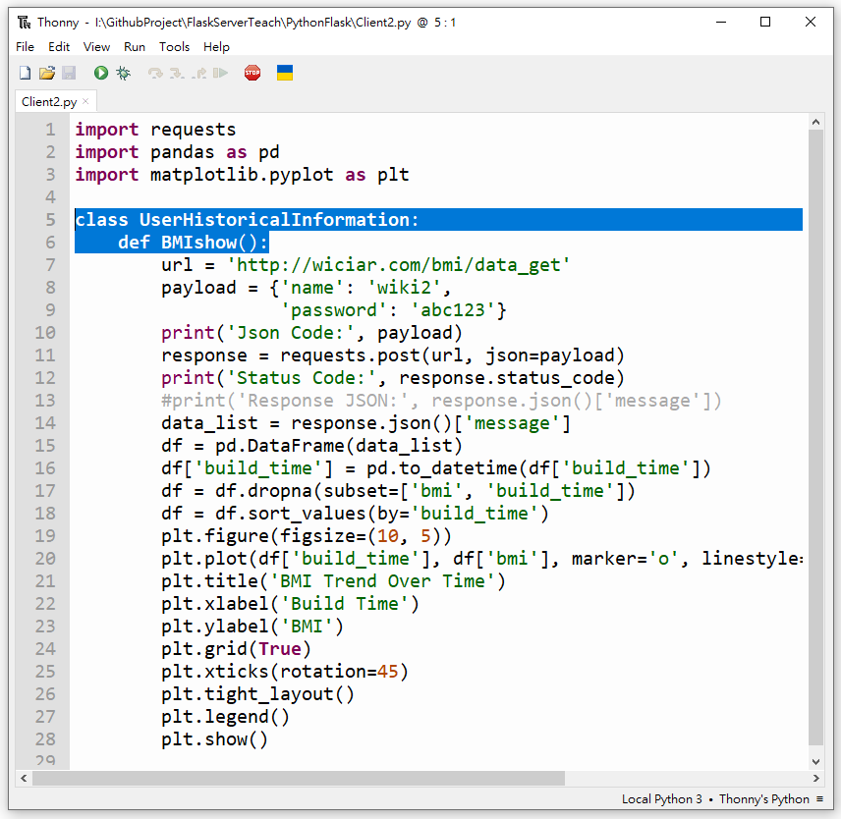
13.Client get User historical information
Step1: Client2.py Redesign
import requests
import pandas as pd
import matplotlib.pyplot as plt
class UserHistoricalInformation:
def BMIshow():
url = 'http://wiciar.com/bmi/data_get'
payload = {'name': 'wiki2',
'password': 'abc123'}
print('Json Code:', payload)
response = requests.post(url, json=payload)
print('Status Code:', response.status_code)
#print('Response JSON:', response.json()['message'])
data_list = response.json()['message']
df = pd.DataFrame(data_list)
df['build_time'] = pd.to_datetime(df['build_time'])
df = df.dropna(subset=['bmi', 'build_time'])
df = df.sort_values(by='build_time')
plt.figure(figsize=(10, 5))
plt.plot(df['build_time'], df['bmi'], marker='o', linestyle='-', color='blue', label='BMI')
plt.title('BMI Trend Over Time')
plt.xlabel('Build Time')
plt.ylabel('BMI')
plt.grid(True)
plt.xticks(rotation=45)
plt.tight_layout()
plt.legend()
plt.show()

Slide 28
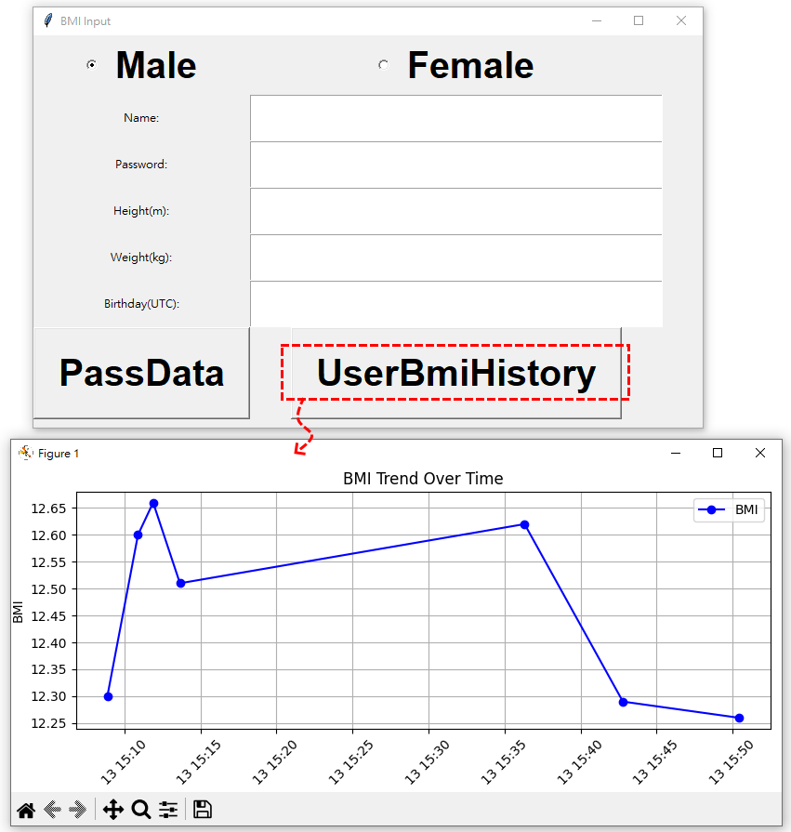
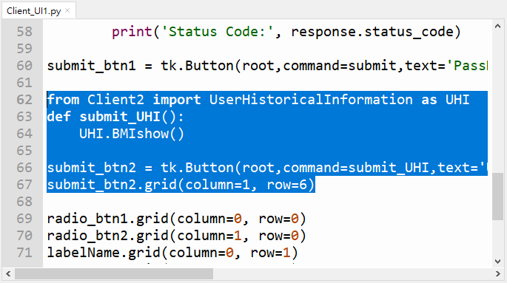
13.Client get User historical information
Step2: Client_UI1.py Redesign
Step3: Run Client_UI1.py
#omit…
submit_btn1 = tk.Button(root,command=submit,text='PassData',font=('Arial',30,'bold'),padx=10,pady=10,activeforeground='#f00')
from Client2 import UserHistoricalInformation as UHI
def submit_UHI():
UHI.BMIshow()
submit_btn2 = tk.Button(root,command=submit_UHI,text='UserBmiHistory',font=('Arial',30,'bold'),padx=10,pady=10,activeforeground='#f00')
submit_btn2.grid(column=1, row=6)
radio_btn1.grid(column=0, row=0)
radio_btn2.grid(column=1, row=0)
#omit…
#omit… this can Refer to Section 11

