Slide 1
Flask Server App Example

Slide 2
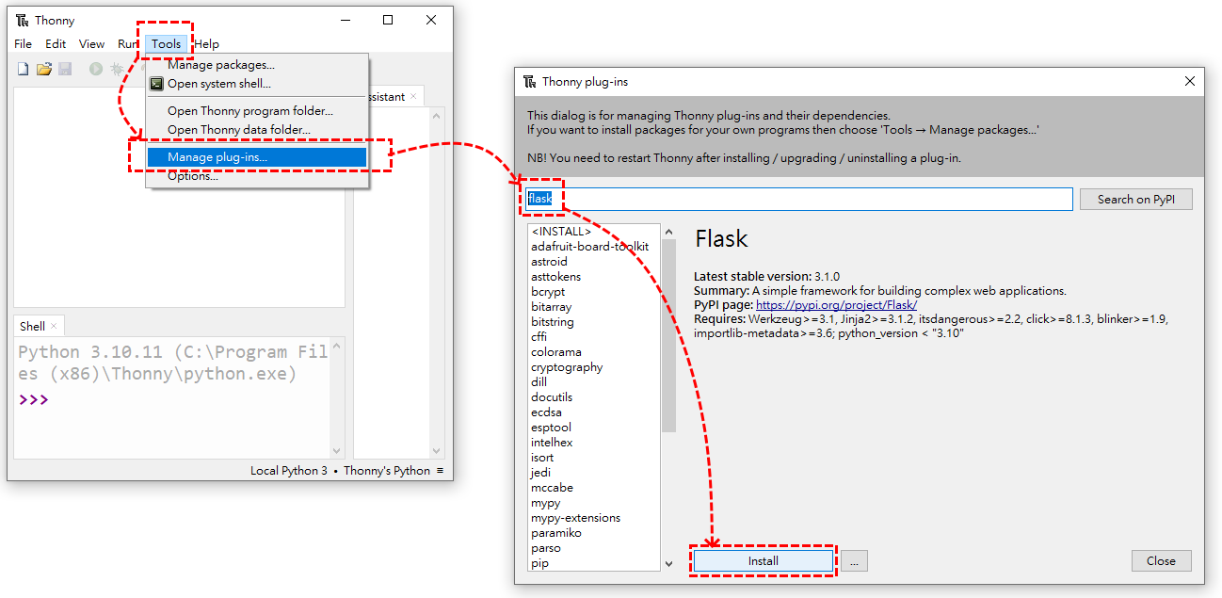
1.Install Python IDE--Thonny
Not necessarily thonny, you can choose other familiar IDE for you.
IDE Download: https://thonny.org/
2.Install Flask

Slide 3
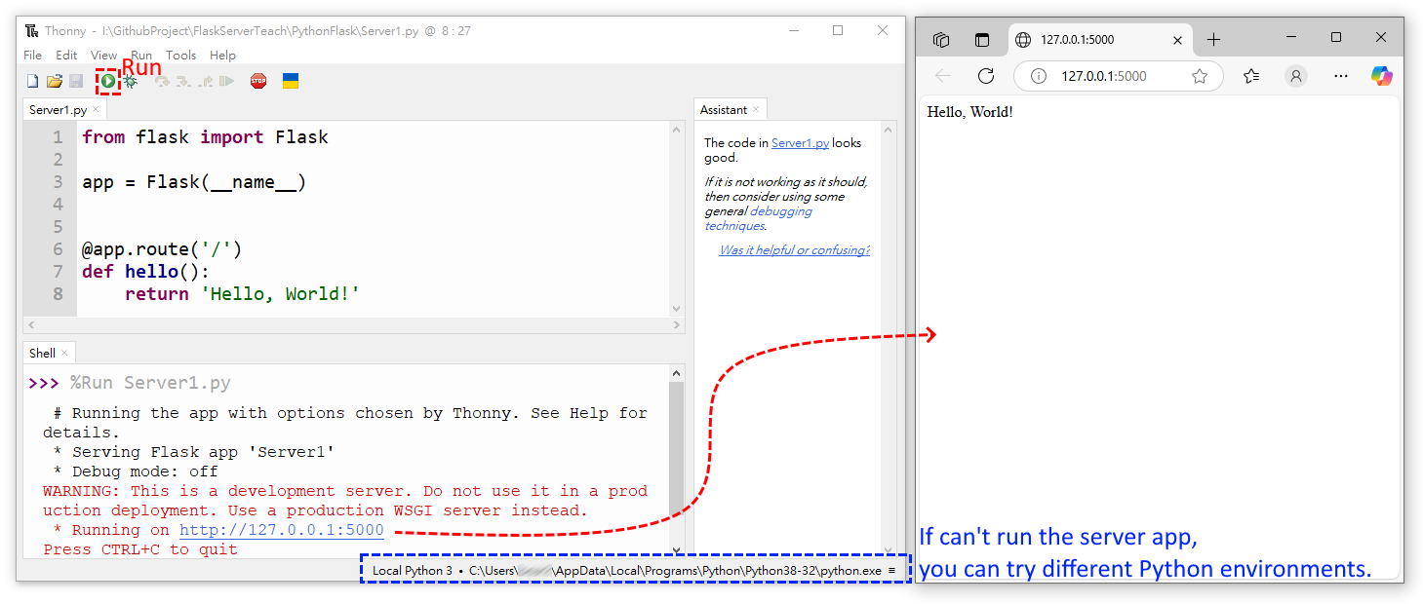
3.Write Code: Server1.py and Run
Library: https://flask.palletsprojects.com/en/stable/tutorial/layout/

Slide 4
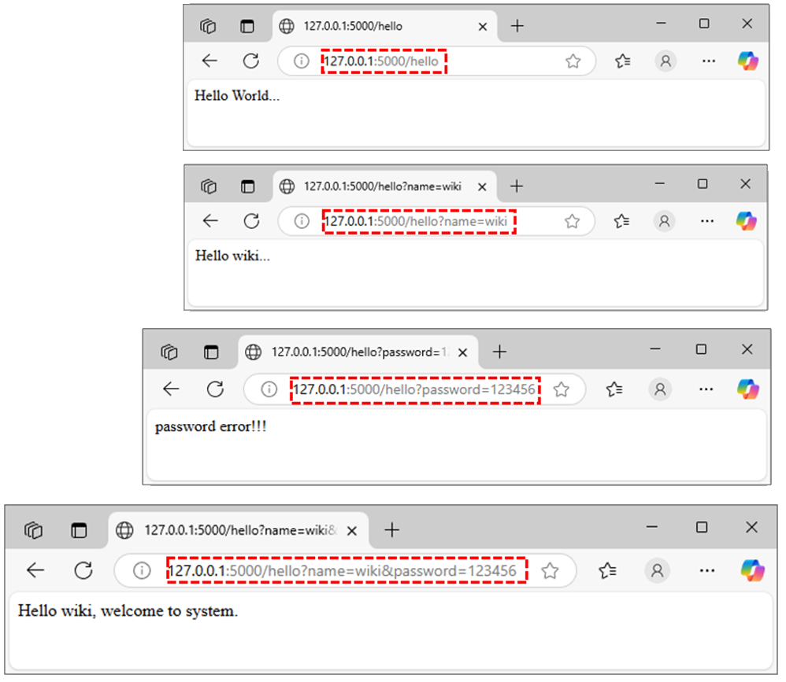
4.Write Code: Get Method
Web Output
Library: form AI
from flask import Flask, request, jsonify
app = Flask(__name__)
@app.route('/')
def hello():
return 'Hello World!'
# GET Method
@app.route('/hello', methods=['GET'])
def hello_get():
name = request.args.get('name', 'World') #'World' is default
password = request.args.get('password', 'None') #‘None' is default
if password=='None':
return f'Hello {name}...'
else:
if name=='wiki' and password=='123456':
return f'Hello {name}, welcome to system.'
elif name=='chen' and password=='456789':
return f'Hello {name}, welcome to system.'
else:
return f'password error!!!'
This a fast network transmission method. If you have passwords or personal information, please don't use this method. So this example is a bad application.

Slide 5
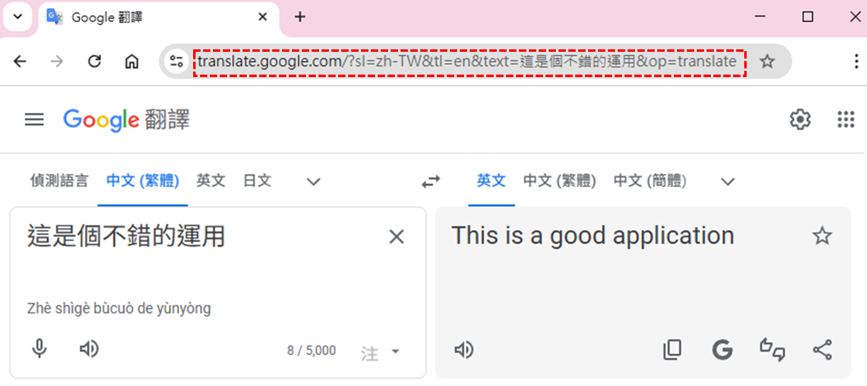
4.Write Code: Get Method
This is a good application.

Slide 6
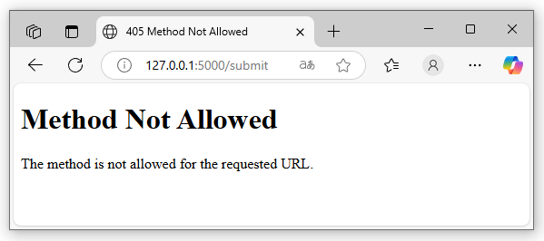
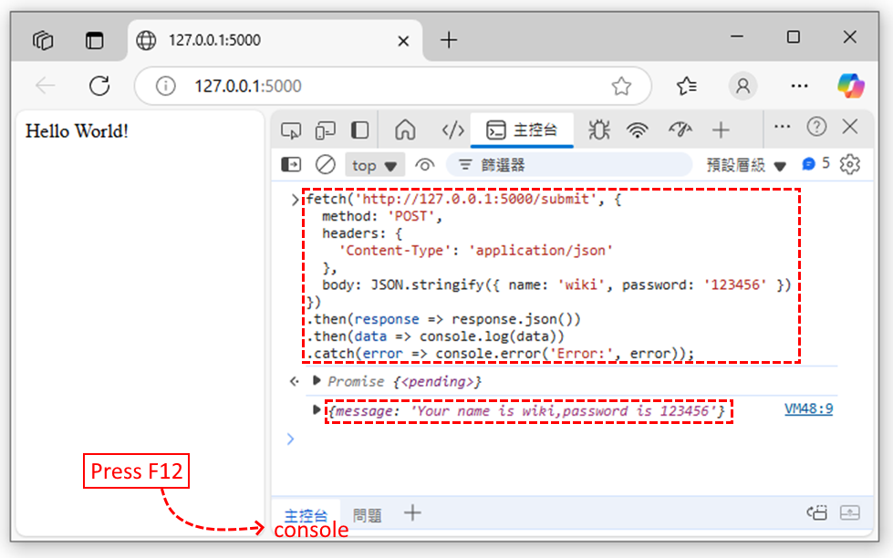
5.Write Code: Post Method
Web Output
Library: form AI
from flask import Flask, request, jsonify
app = Flask(__name__)
@app.route('/')
def hello():
return 'Hello World!'
# POST Method
@app.route('/submit', methods=['POST'])
def submit_form():
data = request.get_json()
name = f"{data.get('name')}"
password = f"{data.get('password')}"
return jsonify(message=f'Your name is {name},password is {password}')
Web Console Output
fetch('http://127.0.0.1:5000/submit', { method: 'POST', headers: { 'Content-Type': 'application/json' }, body: JSON.stringify({ name: 'wiki', password: '123456' })}).then(response => response.json()).then(data => console.log(data)).catch(error => console.error('Error:', error));

Slide 7
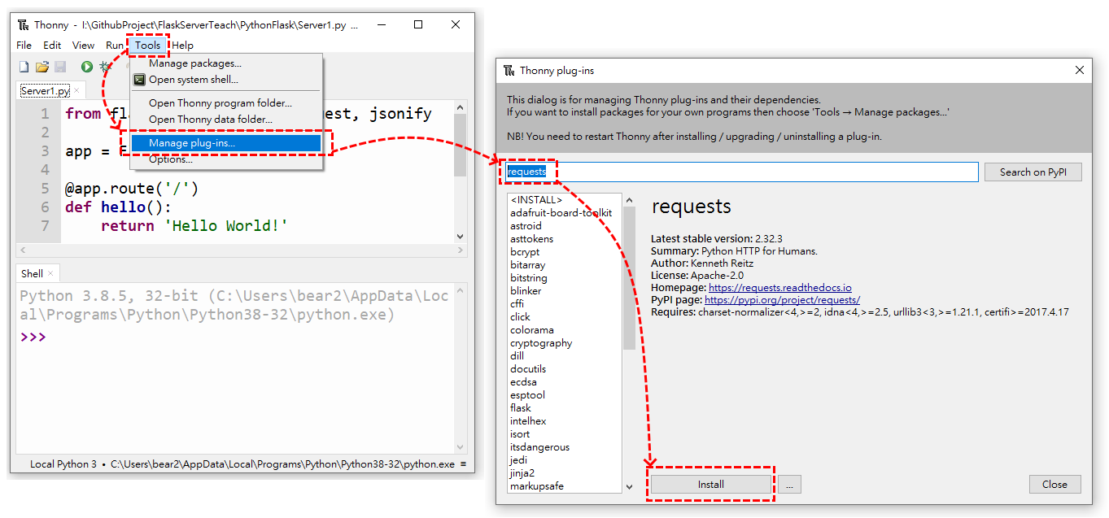
6.Write Code: Post Method Test
Step1:install requests

Slide 8
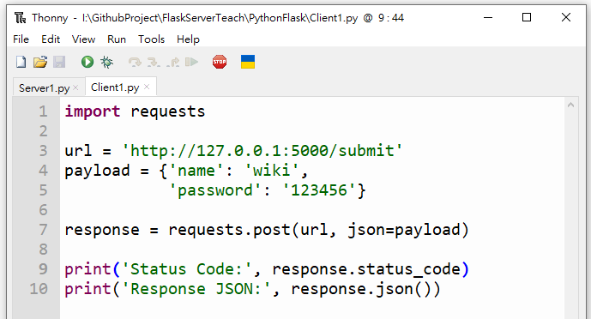
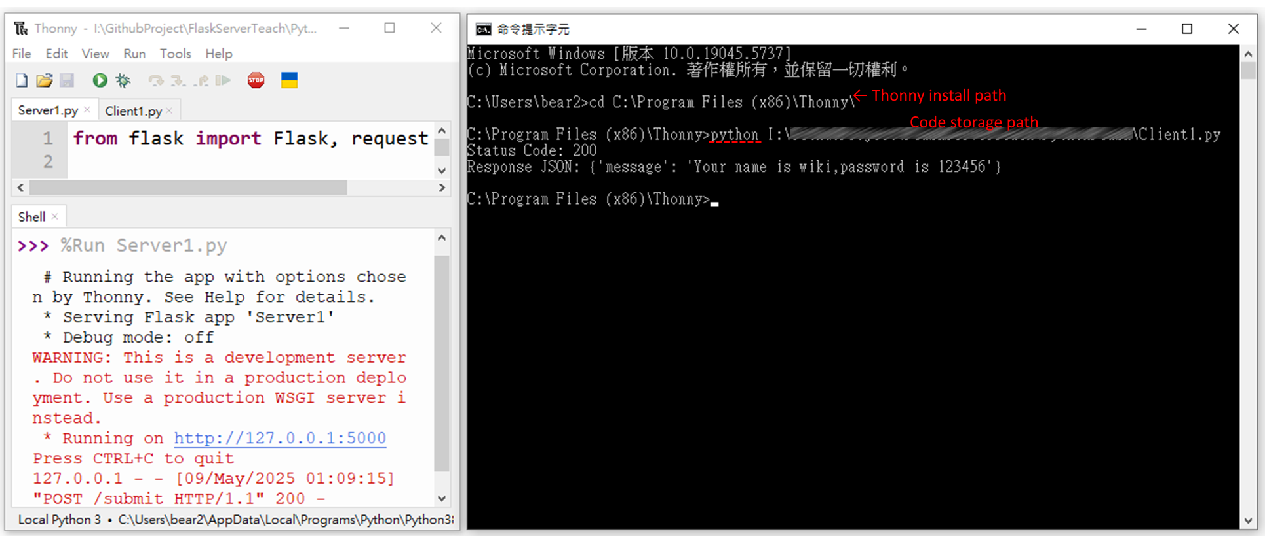
6.Write Code: Post Method Test
Step2: Write Code on Client1.py
Step3: Run Server1.py and Client1.py
Server1.py Run on IDE Shell.
Client1.py Run on Terminal.
import requests
url = 'http://127.0.0.1:5000/submit'
payload = {'name': 'wiki',
'password': '123456'}
response = requests.post(url, json=payload)
print('Status Code:', response.status_code)
print('Response JSON:', response.json())
Client1.py is run on terminal, because Thonny IDE can’t run two code at same time.
If Client1.py can't run, you may need to change the Python environment.

