Slide 1
QR code + RD545 API Teach

Slide 2
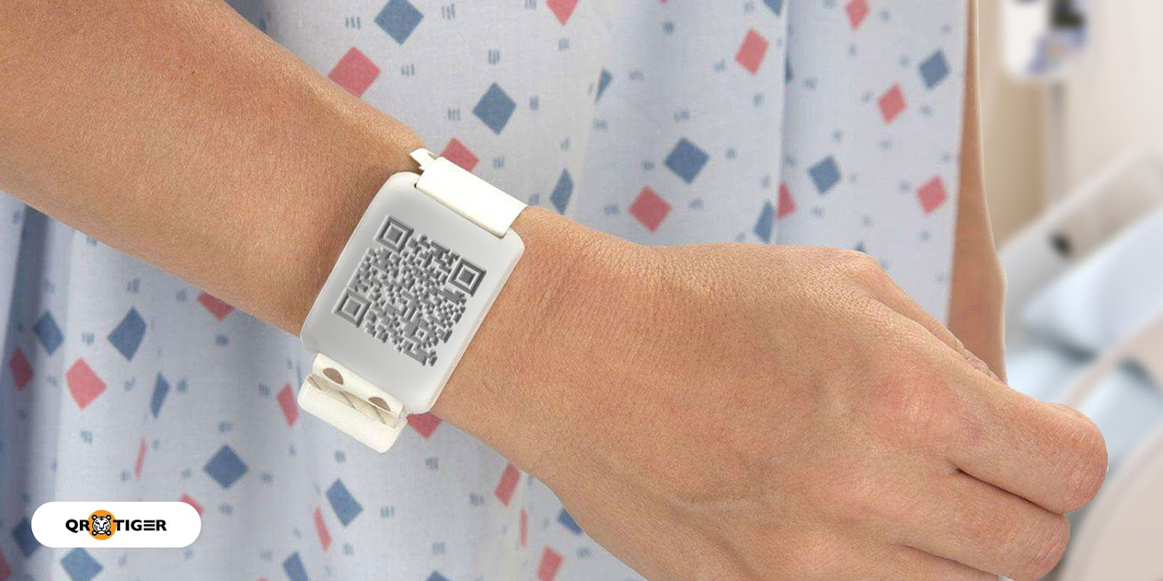
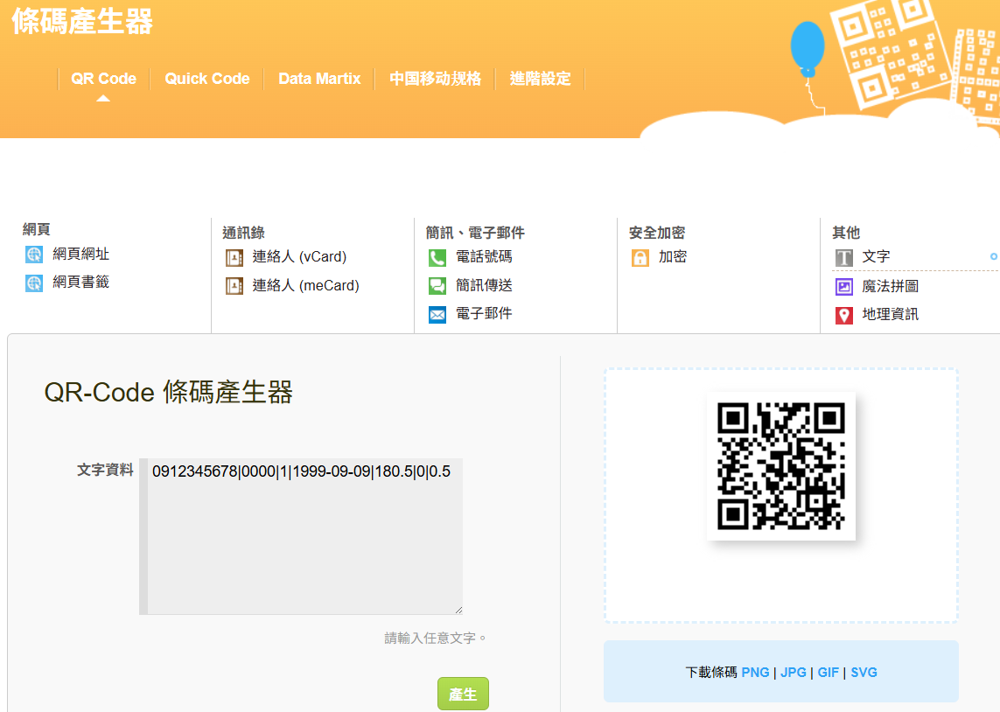
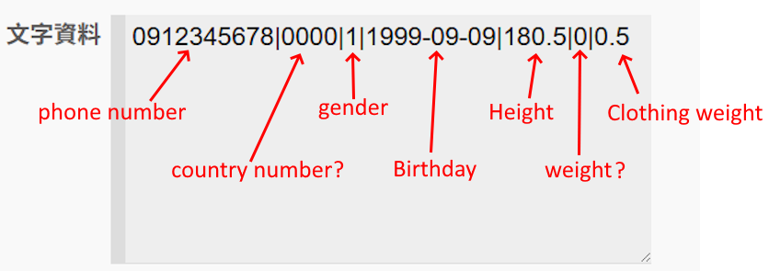
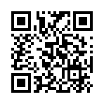
How get QR code?
https://quickmark.com.tw/cht/qrcode-datamatrix-generator/default.asp?qrText
This is the code provided by Tanita.

Slide 3
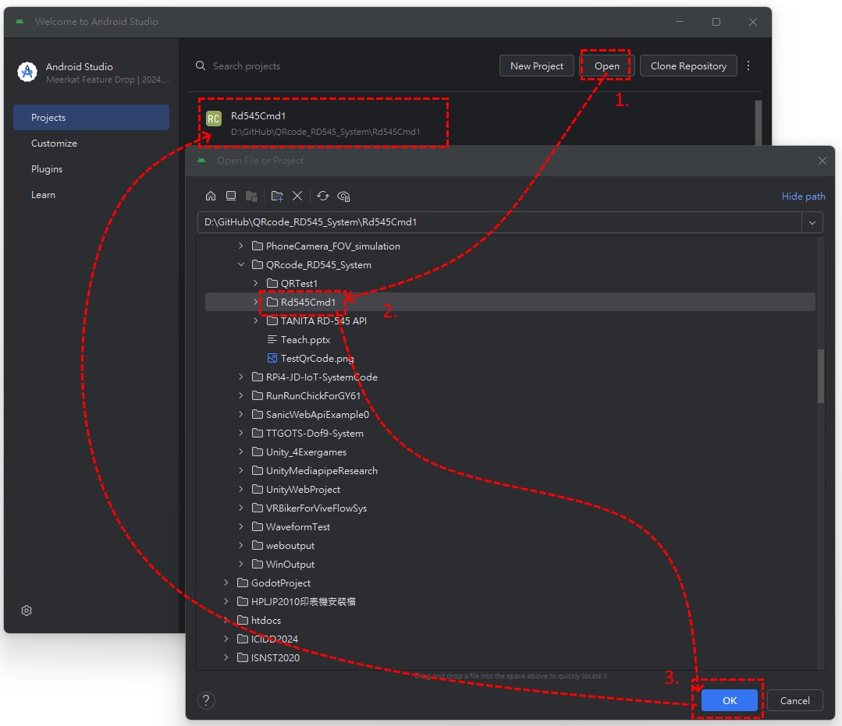
How import Project to Android Studio?

Slide 4
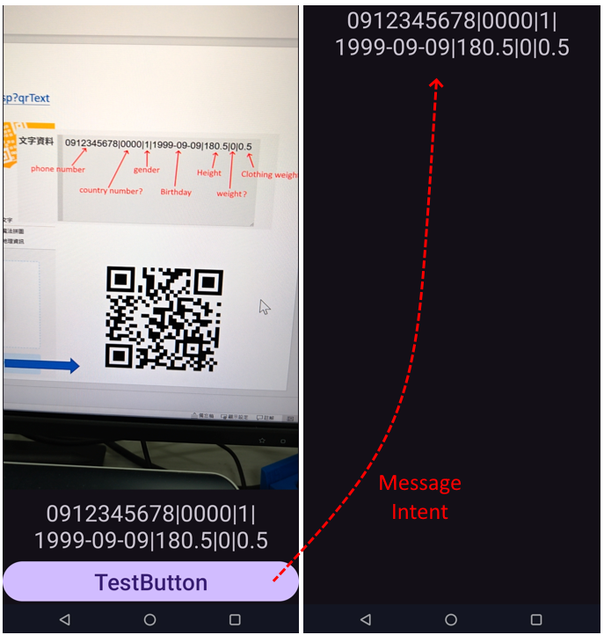
QRTest1-- Read QR Code Example
Reference from AI
APP1—Activity1
APP1—Activity2 or APP2
App1
Activity2
MainActivity
Entry Interface
Camera Sense Event
Control Event
*Automation
*Button
Message
Intent
App2
Most of the time, APP1 and APP2 are produced by two different unit engineers.
Therefore, Intent method is needed to call the other party's APP and transmit messages.

Slide 5
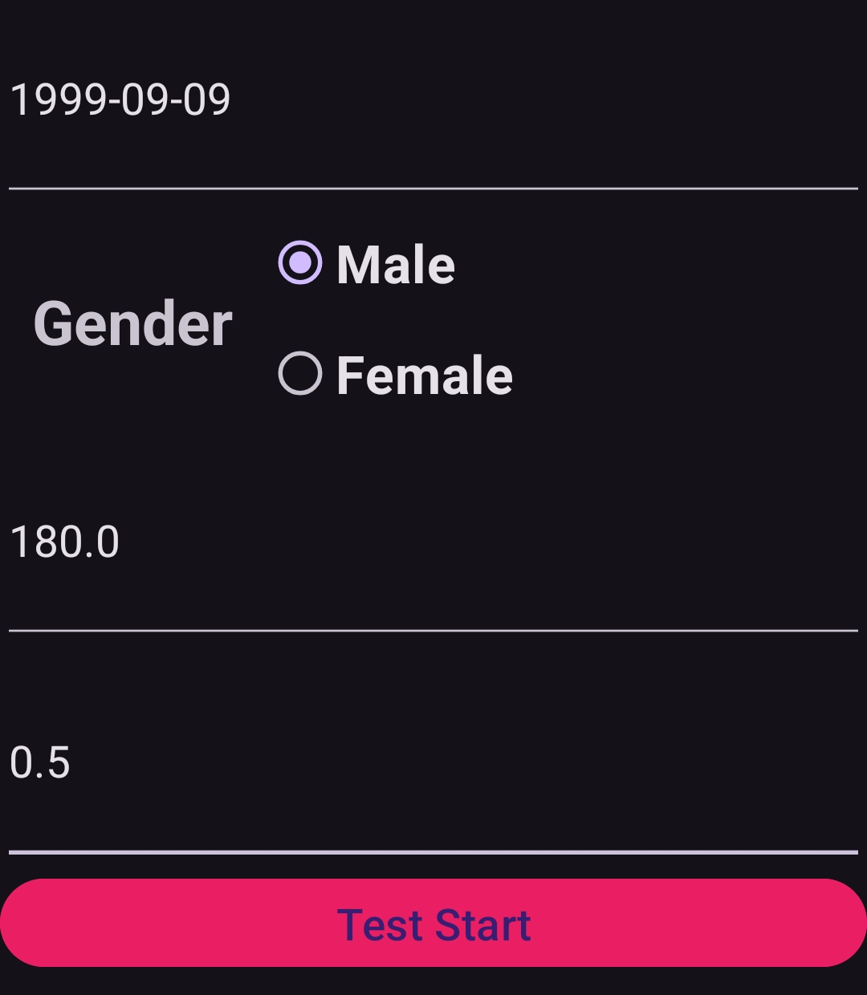
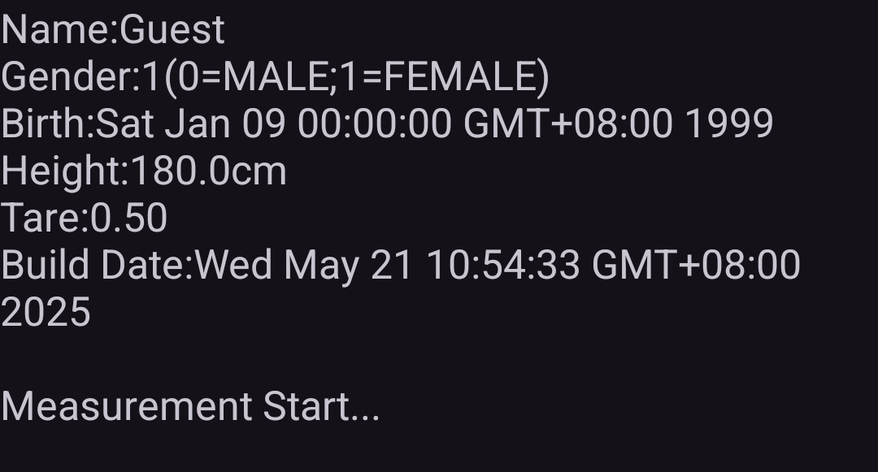
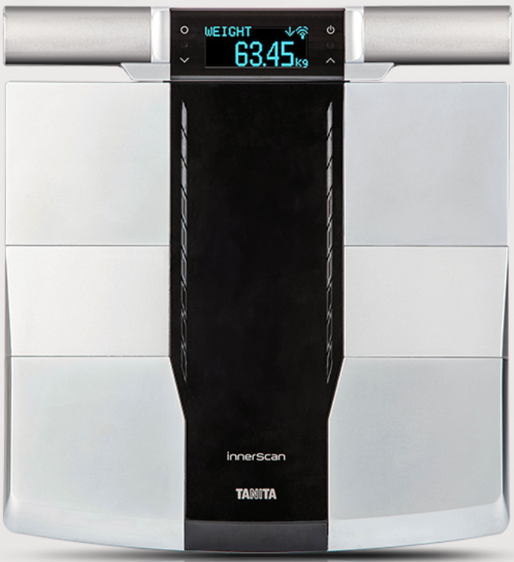
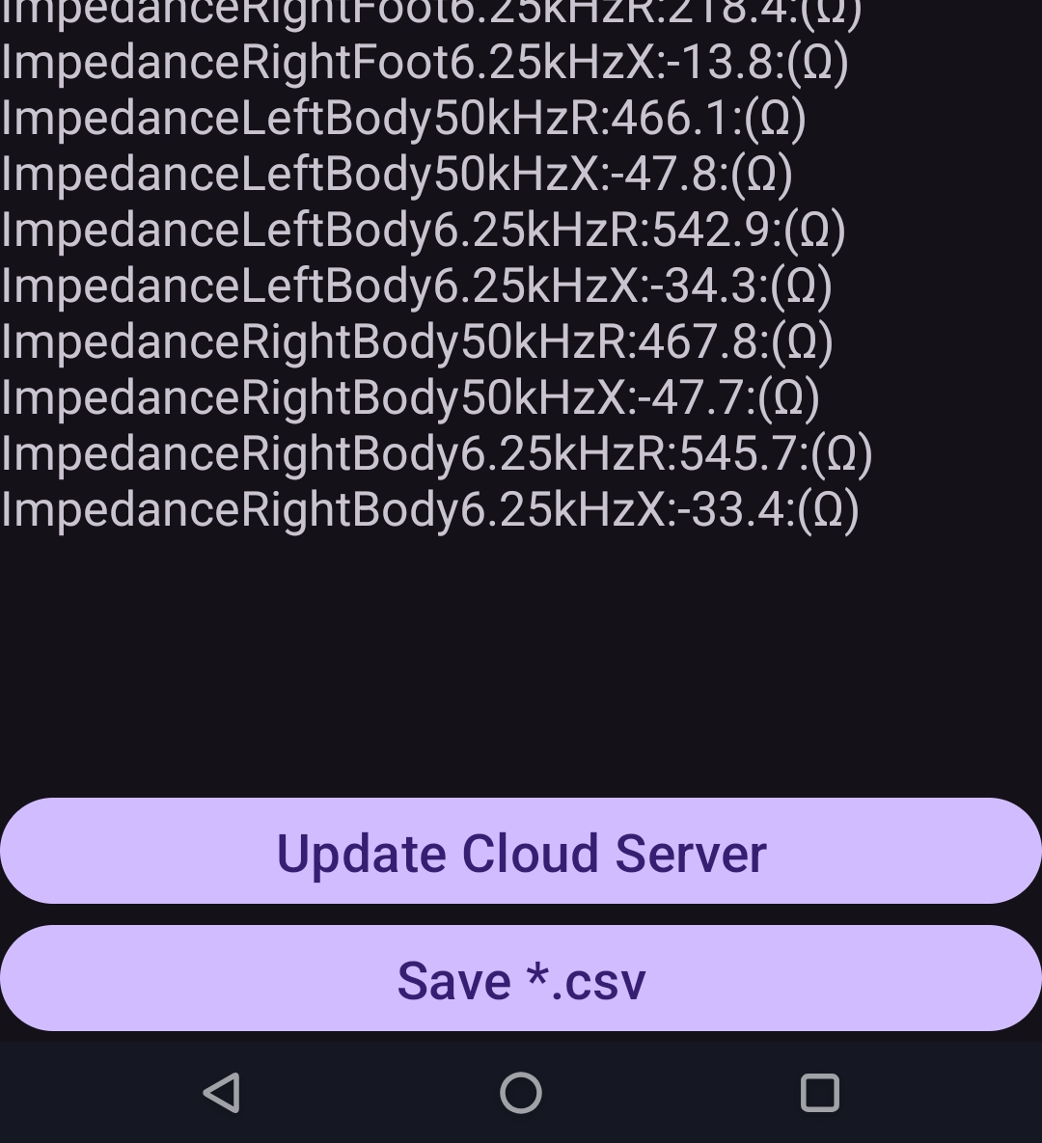
Rd545cmd1-- Rd545 Api call Example
Reference from TANITA API
Activity1
Activity2
Bluetooth LE Control Test
RD545 Device
Message
Intent
Bluetooth LE Read Data
This example has two Activities:
Set up user identity.
Start test and update cloud server.
Cloud Server App
Wi-Fi or 4G/5G Network
*.csv

Slide 6
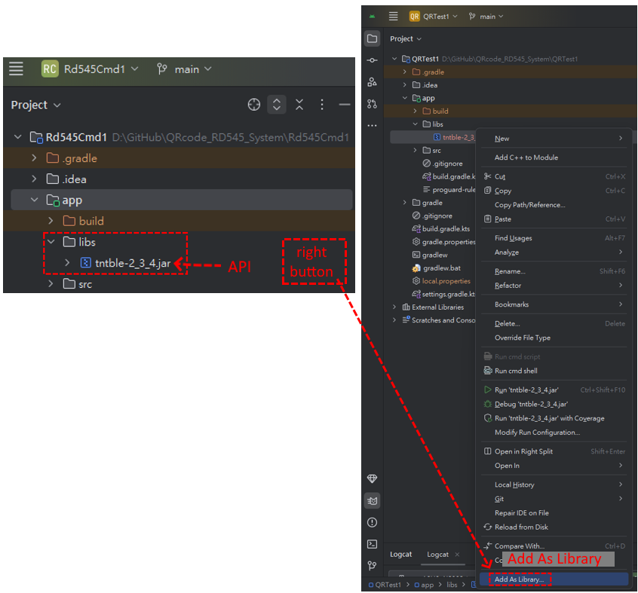
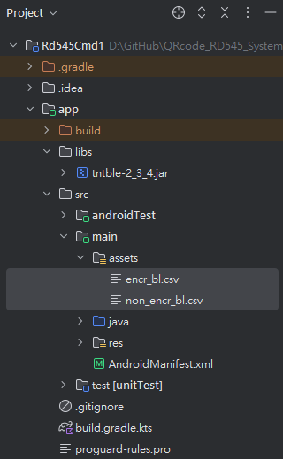
Rd545cmd1-- Rd545 Api call Example
Reference from TANITA API
Api Setting
Setup:
encr_bl.csv
non_encr_bl.csv
*if not setup ,the program will be back off when call library.

Slide 7
Rd545cmd1-- Rd545 Api call Example
Reference from TANITA API
Code in ‘AndroidManifest.xml’ ,this is a unified management interface for APP permissions.
This is the permission statement for smart devices to read and write Rom files.
<uses-permission android:name="android.permission.WRITE_EXTERNAL_STORAGE" />
<uses-permission android:name="android.permission.READ_EXTERNAL_STORAGE" /> <uses-permission android:name="android.permission.INTERNET" />
<uses-permission android:name="android.permission.BLUETOOTH" />
<uses-permission android:name="android.permission.BLUETOOTH_ADMIN" />
<uses-permission android:name="android.permission.ACCESS_COARSE_LOCATION" />
<uses-permission android:name="android.permission.ACCESS_FINE_LOCATION" />
<uses-permission android:name="android.permission.BLUETOOTH_SCAN" />
<uses-permission android:name="android.permission.BLUETOOTH_CONNECT" />
<uses-feature
android:name="android.hardware.bluetooth_le"
android:required="true" />
<application
…
<uses-library
android:name="org.apache.http.legacy"
android:required="false" />
…
</application>
This is the permission statement for smart devices to internet.
This is the permission statement for smart devices to bluetooth control.
This is the permission statement for smart devices to internet library.
Different libraries may be required, but this example only requires this one.
If this library is not called, the program will be back off when the BIA measurement completed.

Slide 8
Rd545cmd1-- Rd545 Api call Example
Reference from TANITA API
Code in ‘MeasurementActivity.java’. This Activity will automatically call the Rd545 library to wake up the RD545 device and enter the measurement state.The basic measurement information is set based on the user information of the previous Activity.

Slide 9
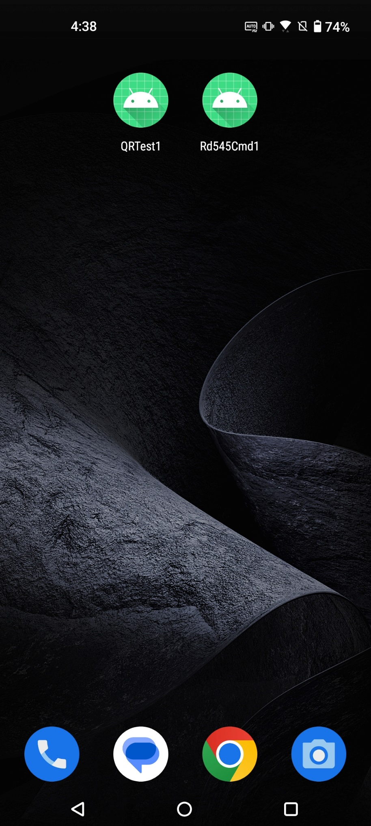
QRTest1(App1) Call Rd545cmd1(App2)
Reference from AI
Cloud Server App
App1
Message
Intent
App1
App2
TempData1
App2
Pass Server Event
Activity1
Activity1
call
TempData Parsing
Activity2
Activity2
UI
output
*.csv
*.pdf
*.jpg
TempData1 is parsed into: gender, birthday, height, clothing weight.
Measurement Data Get
Control RD545
Ble Pass Base Data:
gender, birthday, height, clothing weight.
RD545 Device
RD545 Device Measurement
Ble Pass Measurement Data

Slide 10
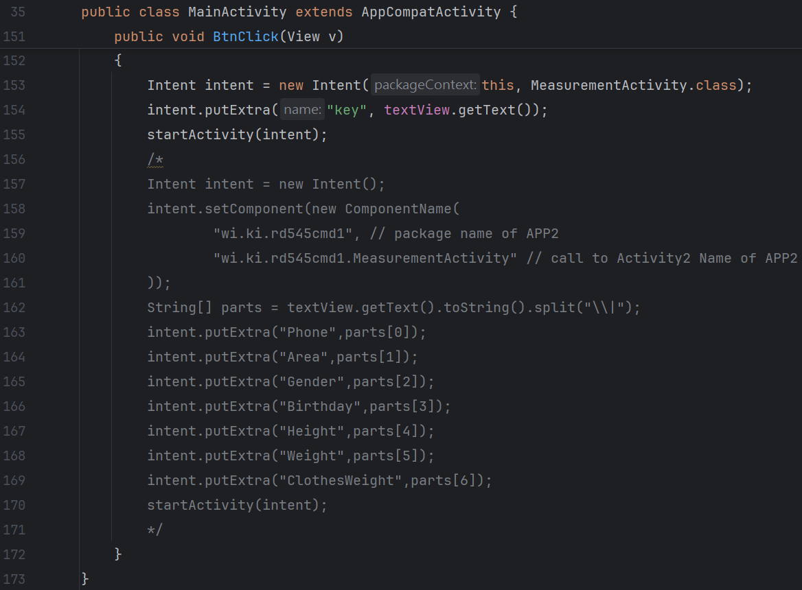
QRTest1(App1) Call Rd545cmd1(App2)
App1:Activity1 Button Event change call Object.
This Code is call Activity2 of App1.
This Code is call Activity2 of App2.

Slide 11
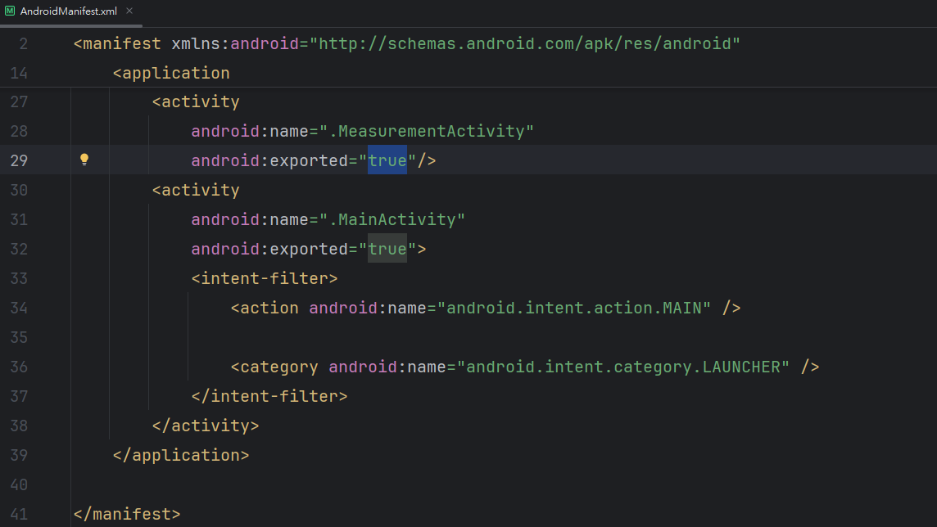
QRTest1(App1) Call Rd545cmd1(App2)
App2:Activity2 external call permission settings
Exported=“true”:
This can be called externally.
Exported=“false”:(Default)
This cannot be called externally.

