Slide 1
QR code + RD545 API Teach

Slide 2
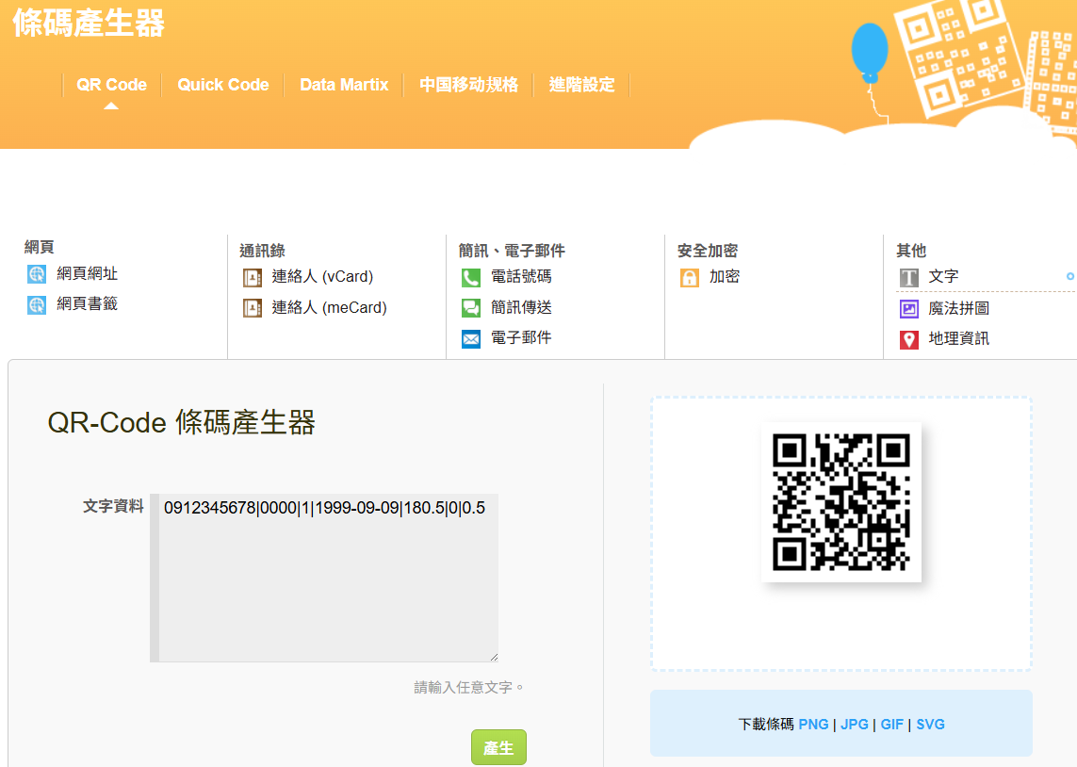
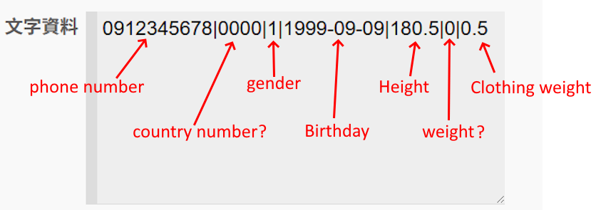
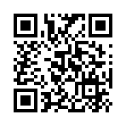
How get QR code?
https://quickmark.com.tw/cht/qrcode-datamatrix-generator/default.asp?qrText

Slide 3
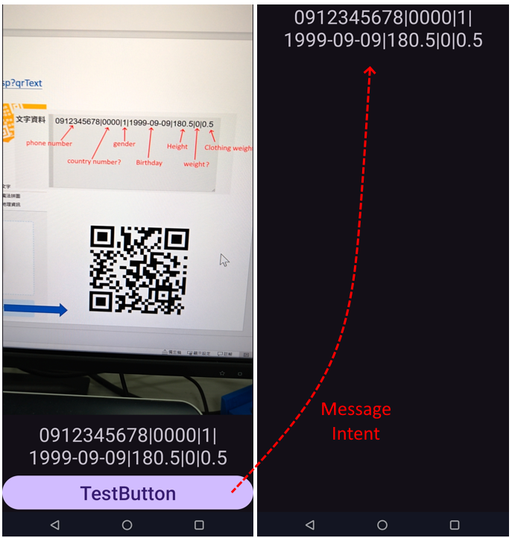
QRTest1-- Read QR Code Example
APP1—MainActivity
APP1—Activity2 or APP2
App1
Activity2
MainActivity
Entry Interface
Camera Sense Event
Control Event
*Automation
*Button
Message
Intent
App2
Most of the time, APP1 and APP2 are produced by two different unit engineers.

Slide 4
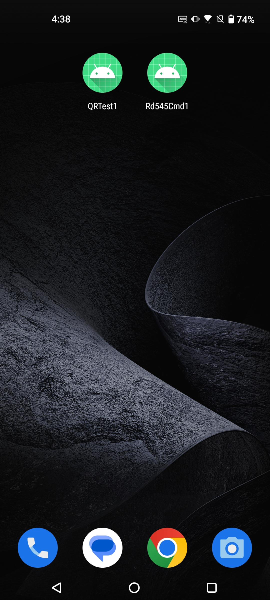
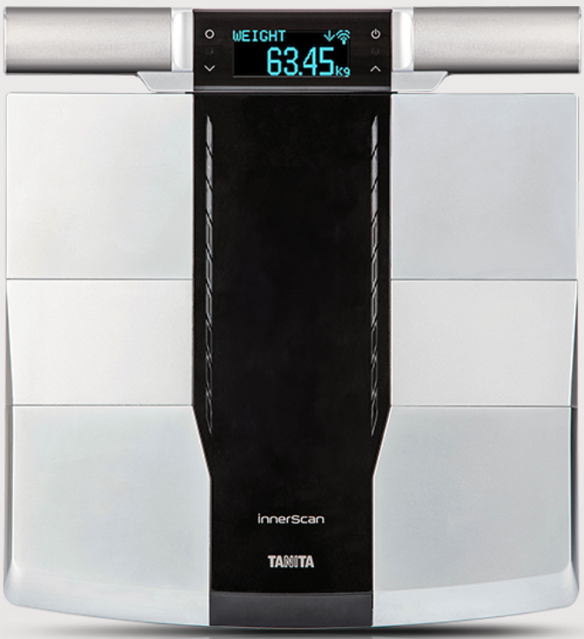
Rd545cmd1—Rd545 Api call Example
Cloud Server App
Bluetooth LE
App1
Android OS RD545 Device
Message
Intent
TempData1
App2
Pass Server Event
App1
App2
TempData Parsing
UI
output
*.csv
*.pdf
*.jpg
TempData1 is parsed into: gender, birthday, height, clothing weight.
Measurement Data Get
Control RD545
Ble Pass Base Data:
gender, birthday, height, clothing weight.
RD545 Device
RD545 Device Measurement
Ble Pass Measurement Data

