Slide 1
ResNet50-Based K-Fold Framework
機器學習期末專題 授課老師：張傳育教授
組員
M11317041何冠緯
M11317047何承宇
M11317074陳宣翰

Slide 2
Preface
To enhance the management efficiency and reliability, a novel scheme based on aerial image analysis was presented to implement intelligent supervision. They are respectively in charge of detecting multiple trees, evaluating each tree’s shoot quantity, and predicting management decision for each tree in aerial images. Detailed experiment analysis validates the proposed scheme and network on the aerial images collected from practical citrus orchards.

Slide 3
Summary
This work draws on the use of ResNet50 combined with K-fold cross-validation to achieve guava disease detection.

Slide 4
K-fold
K-Fold is a type of cross-validation technique used to evaluate the performance and robustness of a model. It divides the dataset randomly into K fold sand operates in the following steps:
1.Data Splitting
2.Iterative Training and Validation
3.Aggregating Results

Slide 5
初次訓練成果

Slide 6
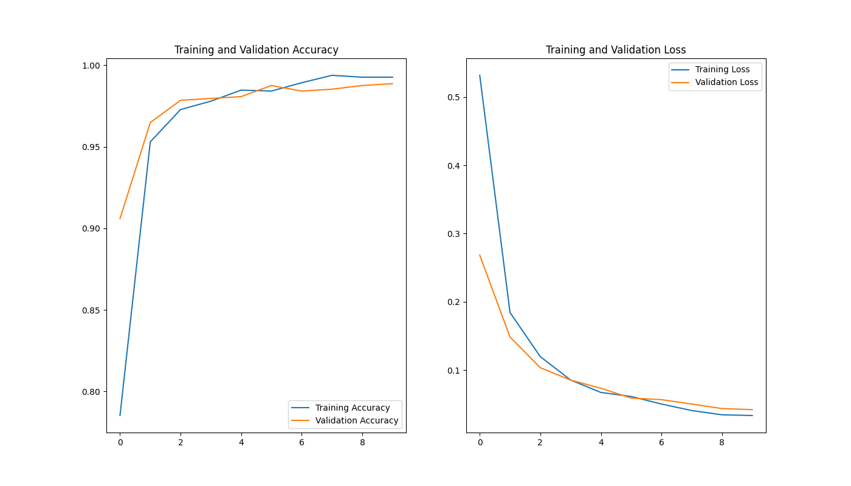
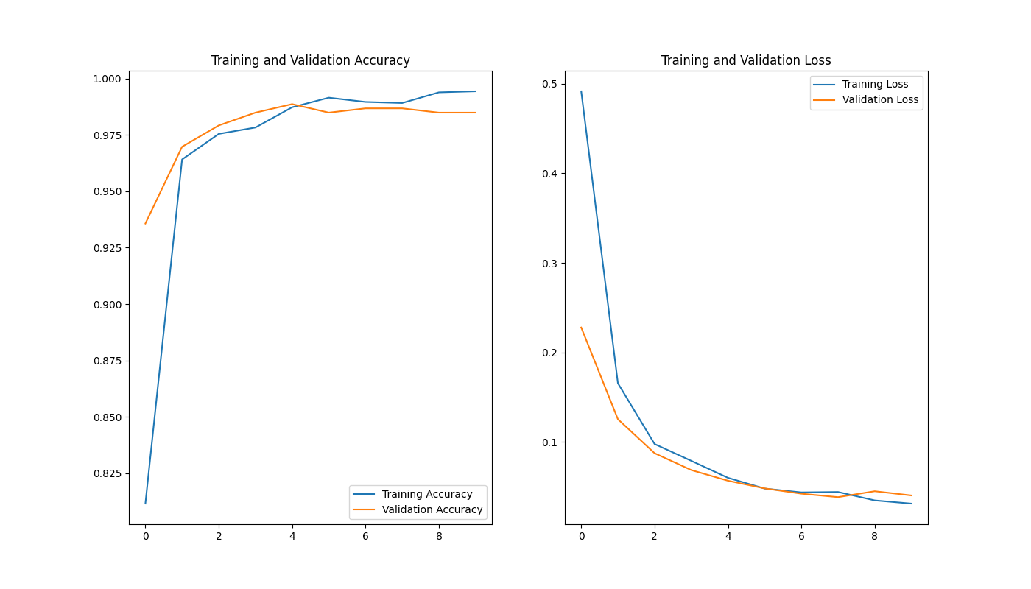
Epoch10 Fold3
Epoch10 Fold5

Slide 7
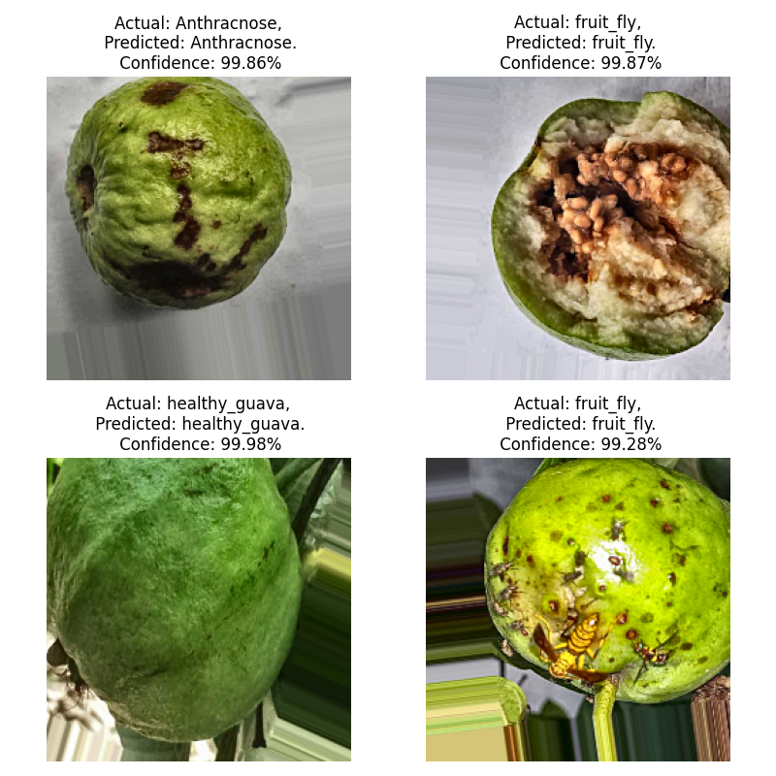

Epoch10 Fold3
Epoch10 Fold5

Slide 8
改進方法
Check data set consistency
Check model architecture and weights
The model's generalization ability on new data.

Slide 9
最終展示

Slide 10
謝謝聆聽

