Slide 1
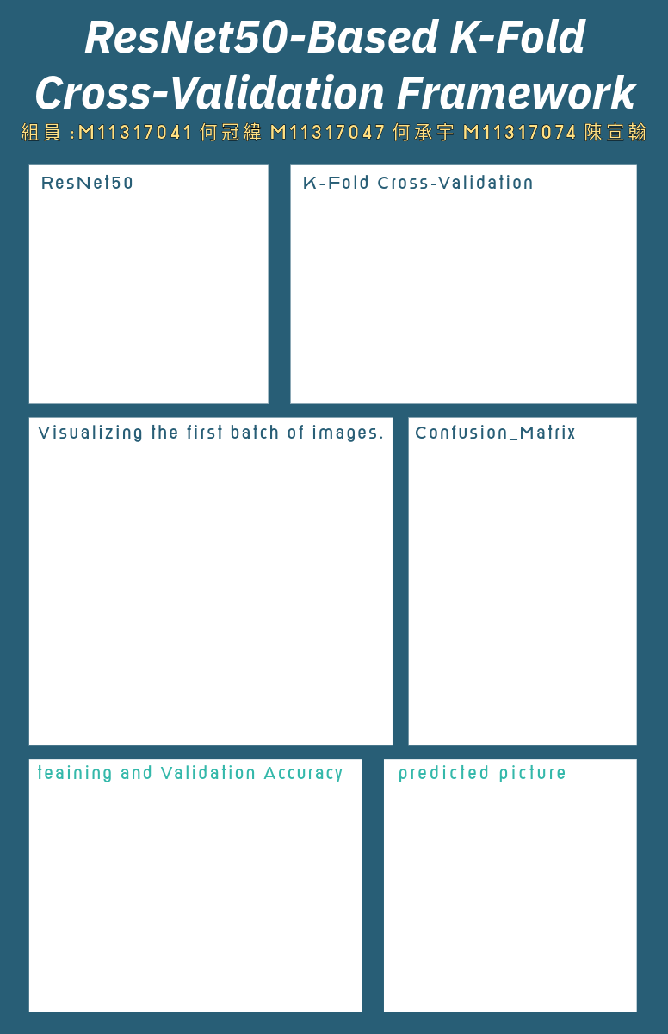
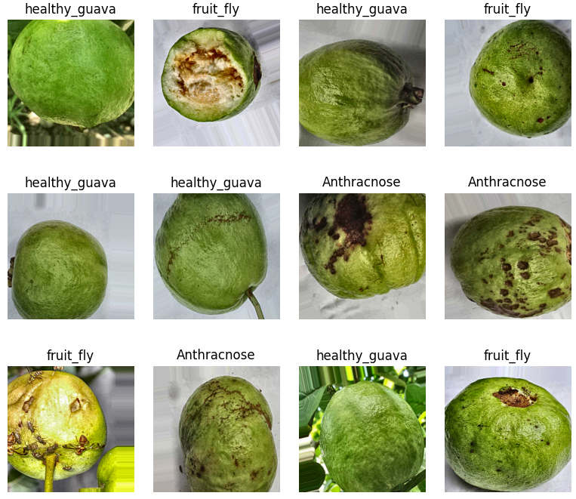
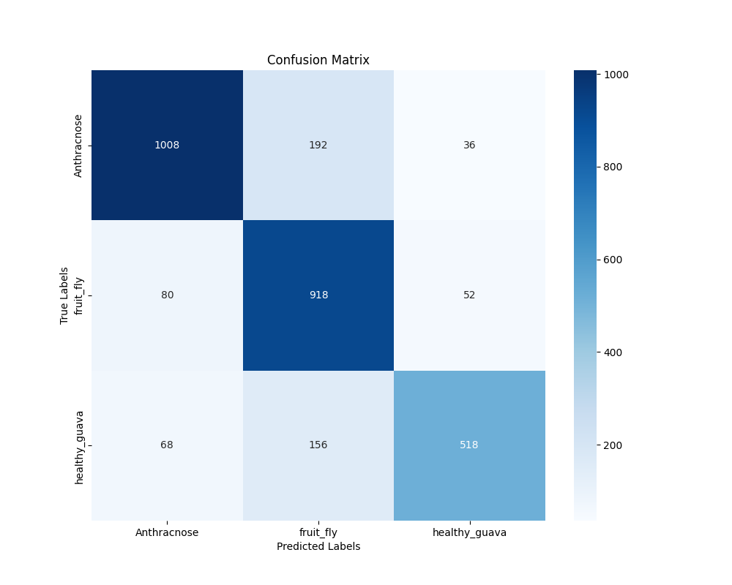
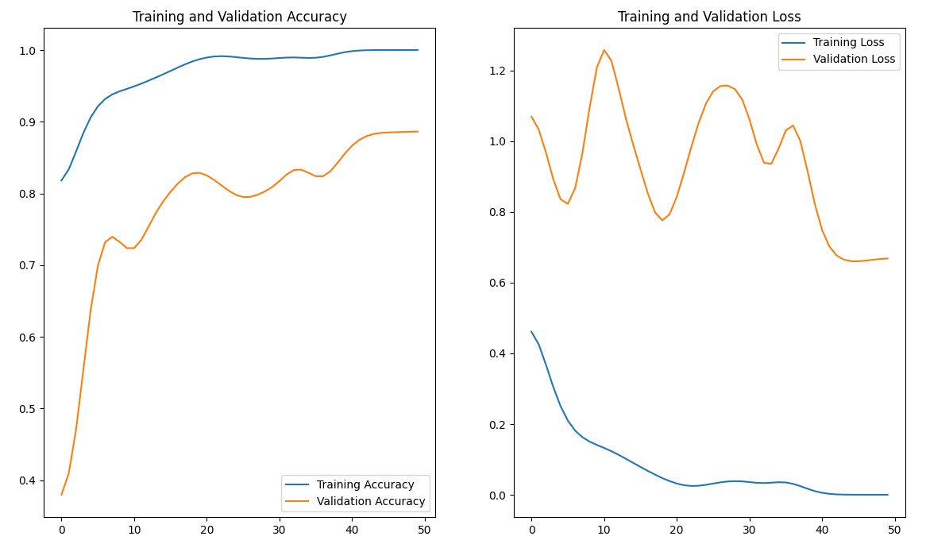
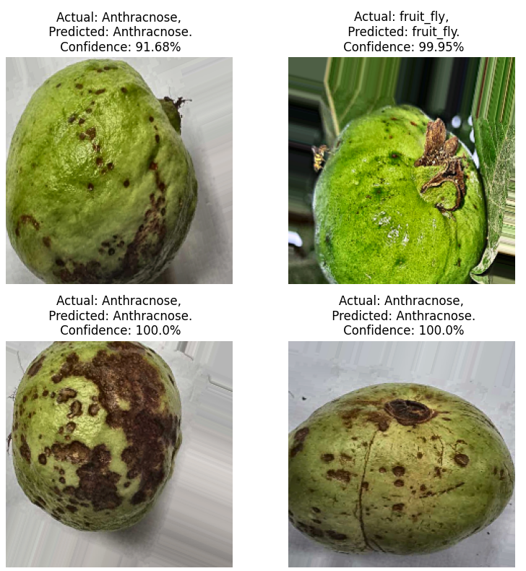
ResNet-50
Simple K-Fold
ResNet-50 is a 50-layer deep convolutional neural network using residual connections to address vanishing gradients, featuring bottleneck blocks for efficiency. It excels in image classification, object detection, and transfer learning, balancing depth and computational cost effectively.
Simple K-Fold is a type of cross-validation technique used to evaluate the performance and robustness of a model. It divides the dataset randomly into K fold sand operates in the following steps:
1.Data Splitting
2.Iterative Training and Validation
3.Aggregating Results
Training and Validation Accuracy
Predicted Picture

