Slide 2
CMake support in Visual Studio
Marian Luparu @mluparu
https://blogs.msdn.com/vcblog/

Slide 3
Tools for CMake Only in Visual Studio 2017
Skip the command line
Open CMake folders directly, no VS solution needed
CMake-focused experience
Decluttered folder-based view
CMake-specific configuration
CMake-driven environment
C++ code editing, building and debugging

Slide 4
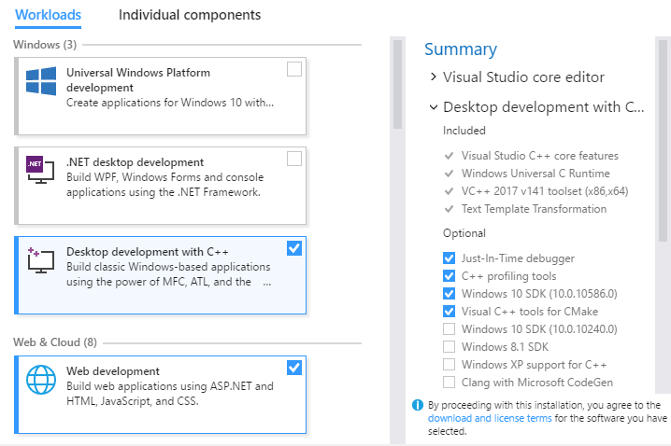
Tools for CMake How to install
❶
❷

Slide 5
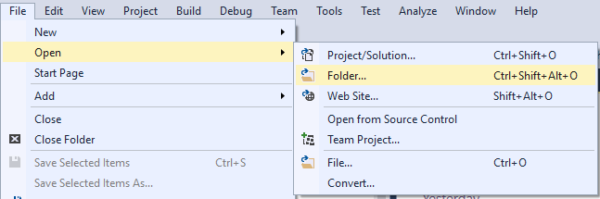
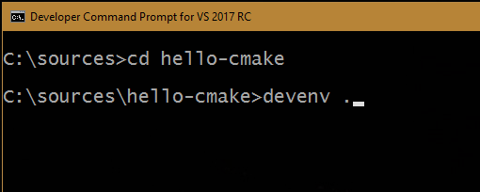
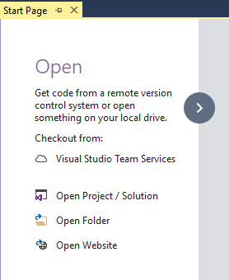
Tools for CMake ”Open Folder” to get started

Slide 6
Demo
Hello CMake!

Slide 7
Demo
Real-world project

Slide 8
Call to Action
https://aka.ms/cmake
To learn more about the CMake support in Visual Studio

