Slide 1
ISMAR相关文章
2020.2.9

Slide 2
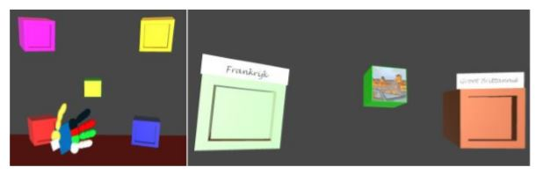
ISMAR 2017
Assessing Upper Extremity Motor Dysfunction Using an Augmented Reality Game.(使用AR游戏评估帕金森及中风病人的上肢功能)
将物体放入正确（颜色、主题）的盒子中

Slide 3
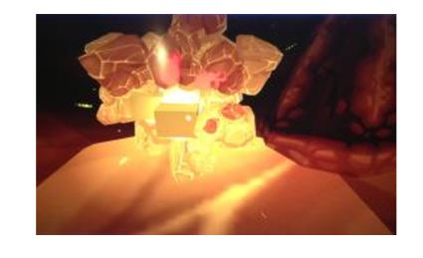
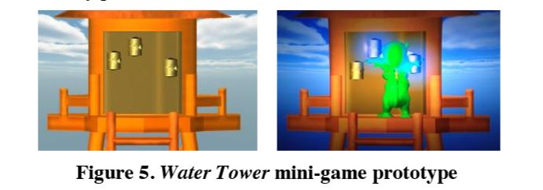
ISMAR 2014
Adventurous Dreaming Highflying Dragon: A full body game for children with Attention Deficit Hyperactivity Disorder.(使用VR游戏改善儿童的注意力缺陷多动障碍)

Slide 4
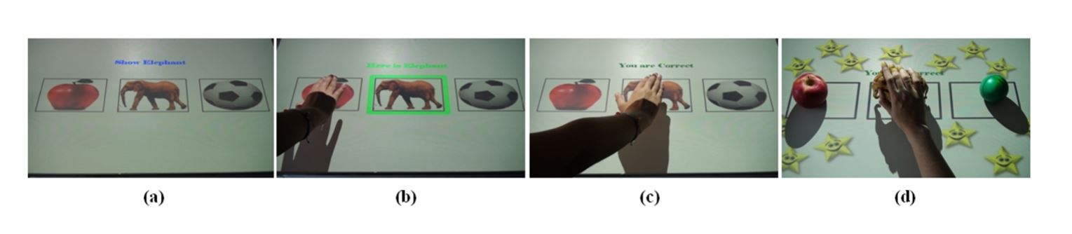
ISMAR 2014
An augmented and virtual reality system for training autistic
children.(使用VR、AR技术治疗自闭症儿童)
选出文字对应的图片

Slide 5
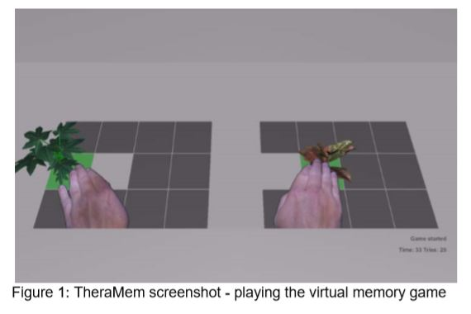
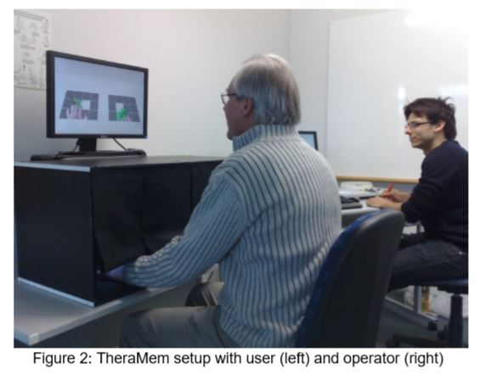
ISMAR 2011
Out of reach? - A novel AR interface approach for motor rehabilitation.(使用AR辅助中风患者手臂功能康复)
找出相同的图片

