Slide 1
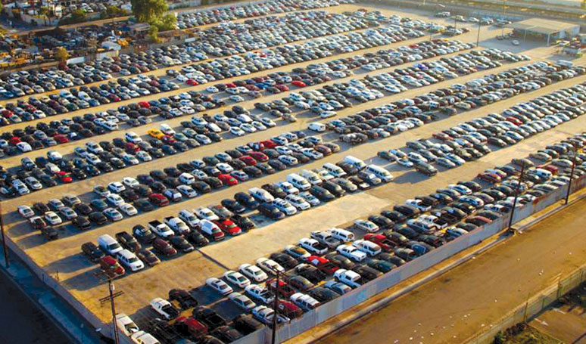

Vehicle Sale Price Prediction
High-level project summary: VIN Decode + Machine Learning
Goal
Predict auction sale price from vehicle + sale attributes to improve pricing consistency and decision speed.
Notes:
The goal of this project was to build a data-driven way to estimate vehicle sale prices using historical auction data.
This presentation is a high-level overview of what we built, why we built it, how machine learning helped, and what the results mean from a business perspective.

Slide 2


1) Business Goal & Project Scope
2
Business goal
Project scope (what was built)
Create a repeatable way to estimate expected sale price for a vehicle based on historical auction outcomes.
Use cases: pricing guidance, anomaly detection (outliers), and faster decisioning.
• Cleaned and standardized an initially unorganized dataset
• Added new vehicle attributes via VIN Decode
• Trained multiple ML models (XGB, CatBoost, ensemble/stacked)
• Evaluated on 2k / 8k / 30k record test samples
Key takeaway
On the largest sample (30k), models achieved ~93% R² and typically missed by about $1.3k (MAE).
This indicates the approach is viable, with clear next steps to improve data quality and move toward production deployment.
AAA – Vehicle Price Prediction | High-level summary
Notes:
The primary objective was to predict vehicle sale prices more consistently and accurately than manual estimation.

Slide 3



2) What is Machine Learning (and why it helps here)?
3
Machine learning in one sentence
In this project = Regression
Supervised learning uses labeled historical examples to learn patterns, then predicts outputs for new (unseen) cases.
We predict a continuous number: the expected sale price ($).
Historical
auction data
Model learns
patterns
Predicts price
for new vehicles
Why ML helps: it scales pattern-finding across thousands of variables and interactions that are hard to model manually.
AAA – Vehicle Price Prediction | High-level summary
Notes:
Machine learning allows models to learn patterns directly from historical data rather than relying on fixed rules.
In this case, we used regression-based machine learning, where the model predicts a continuous number — the vehicle price.
The model learns how vehicle attributes like mileage, age, engine type, and condition historically relate to sale prices, and then applies that learning to new vehicles.

Slide 4

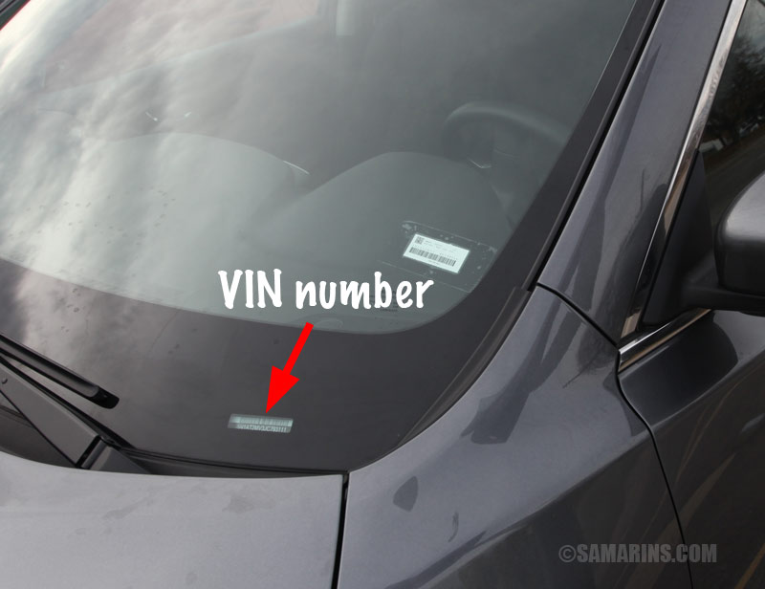
3) Data Preparation & VIN Decode (feature engineering)
4
Data preparation (what it means)
VIN Decode (why it mattered)
Clean and standardize the source data so the model sees consistent signals.
Examples: align column types, handle missing values, and remove obvious noise/outliers.
VIN is a unique 17-character identifier. Decoding it adds vehicle attributes (make/model/year/features) that strengthen price signals.
This was added after identifying VIN as an underused source of signal.
Example: VIN location (windshield)
Feature engineering
Feature engineering transforms raw data into model-ready inputs.
In this project, VIN Decode was the highest-impact feature step.
AAA – Vehicle Price Prediction | High-level summary
Notes:
Early in the project, the data was not well structured and contained inconsistencies.
Cleaning the data helped reduce noise and improve reliability.
More importantly, feature engineering allowed us to extract additional information that was not explicitly available in the raw dataset.
This step had a meaningful impact on model accuracy and stability.
After I finished the initial data cleaning, the effect was not significant and it will require manual effort forever.
A key improvement came from VIN decoding, which Shane pointed out as a great opportunity.
The VIN contains standardized information about the vehicle that wasn’t fully captured in the original data.
By decoding it through python, we were able to add features like engine type, drivetrain, fuel type, and body class. The data is from the NHTSA which is a public database so they are all standardized.
This helped the model better differentiate between similar vehicles and reduced pricing error, especially in cases where metadata was incomplete.
As you may know it now becomes a weekly update where normally the workflow will run through 30000 cars and generate relevant information about the car.

Slide 5

4) Model Options (what each does)
5
We compared multiple tree-based models + an ensemble:
XGBoost (XGB)
CatBoost
Stacked model
Gradient-boosted decision trees; builds many small trees sequentially to reduce prediction errors. Strong baseline for tabular data.
Gradient boosting optimized for categorical features. Often performs well with minimal preprocessing of high-cardinality categories.
Ensemble that combines predictions from multiple base models using a final regressor (meta-model) to improve robustness.
Why tree-based models are a good fit
• Handle non-linear relationships (e.g., age/mileage impacts differ by segment)
• Work well with mixed numeric + categorical data
• Support feature importance analysis for business explainability
AAA – Vehicle Price Prediction | High-level summary
Notes:
I evaluated several machine learning models to compare performance.
XGBoost and CatBoost are both gradient boosting models well suited for structured, tabular data.
CatBoost performs particularly well with categorical features, which is important for vehicle attributes.
The stacked model combines multiple models together, allowing it to balance strengths and reduce individual model weaknesses.

Slide 6

5) How we evaluate the model (metrics)
6
Each metric answers a different performance question:
MAE (Mean Absolute Error)
RMSE (Root Mean Squared Error)
Average absolute $ error. Interpretable: “typically off by about $X”.
Like MAE, but penalizes large misses more (squares errors before averaging).
MAPE (Mean Absolute Percentage Error)
R² (Coefficient of Determination)
Average error as a percentage of actual price; helpful for comparing across price bands.
How much of price variance is explained (1.0 is best; 0 means “predicting the average”).
Why we use multiple metrics
MAE is easy to interpret; RMSE highlights risk of big misses; MAPE normalizes by price; R² summarizes overall fit.
AAA – Vehicle Price Prediction | High-level summary
Notes:
We evaluated models using several metrics to get a complete picture of performance.
MAE tells us, on average, how many dollars the prediction is off.
RMSE penalizes large errors more heavily, which helps identify risk from big mispricing.
MAPE shows percentage error, which is easier to interpret across different price ranges.
R-squared measures how much of the variation in prices the model can explain.

Slide 7
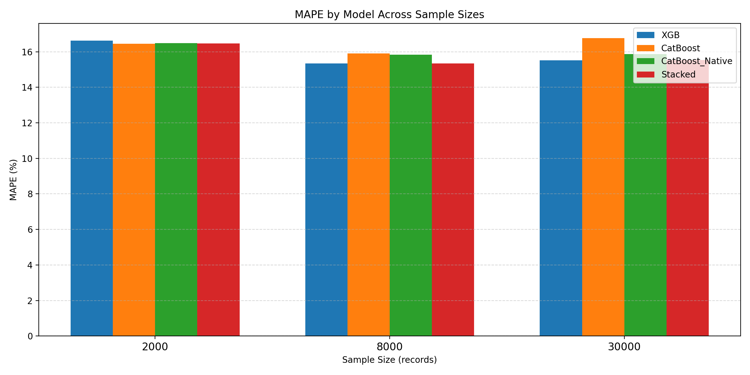
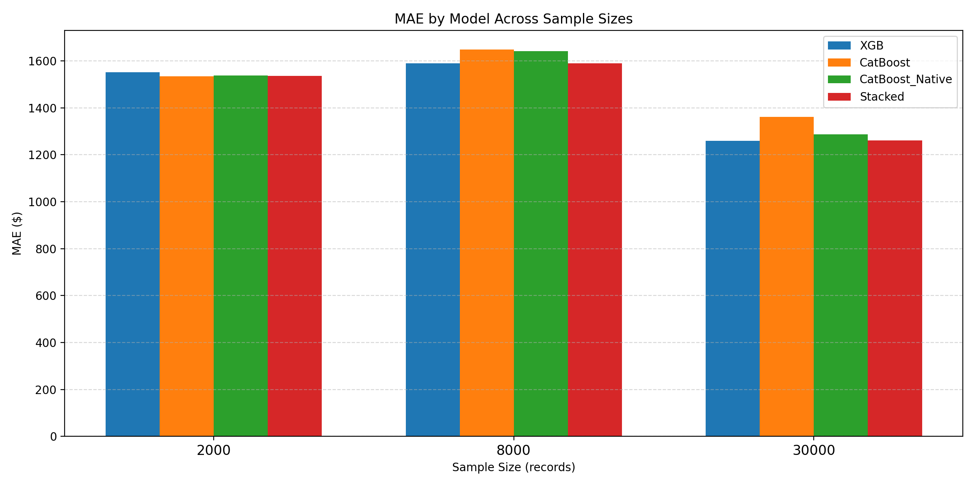

6) Results Summary
7
Best-performing models by sample
Sample size | Best MAE | Best MAPE | Highest R²
2,000 | CatBoost ($1,535) | CatBoost (16.45%) | CatBoost_Native (94.19%)
8,000 | Stacked ($1,589) | Stacked (15.34%) | XGB (89.59%)
30,000 | XGB ($1,259) | XGB (15.52%) | XGB (93.31%)
MAPE across sample sizes
MAE across sample sizes
Interpretation: as sample size grows, MAE drops to ~ $1.26k on the 30k sample; MAPE stabilizes around 15–16%.
AAA – Vehicle Price Prediction | High-level summary
Notes:
Across all sample sizes, the models performed consistently well.
R-squared values ranged from roughly 89% to 94%, meaning the models explain most of the price variation.
MAPE stayed around 15–16%, which is considered solid for vehicle pricing applications.
As expected, larger samples improved stability, and the XGB model performed best overall on large sample.
The initial goal was to get MAE to lower than $500, as I was improving the model at some point it stopped having big improvements anymore so I tested cars with exact same stats in our database, the average variance was $1500, which aligns with what we have at the end so that’s why I think it is a good stopping point to finishing up the model development and move to deployment or implementation stage.
Performance remained stable across different dataset sizes, which increases confidence in real-world applicability.

Slide 8

7) Recommendations & Next Steps
8
What I recommend reporting / proposing next:
Data & feature improvements
Modeling & deployment path
• Continue cleaning: ensure consistent schema, reduce missingness
• Expand VIN decode coverage and validate decoded fields
• Add high-signal variables (e.g., condition, trim, mileage integrity, location/time effects)
• Build data quality checks so the pipeline is reliable
• Train on larger/full dataset and evaluate by segment (make/model/year)
• Pick a “production candidate” (XGB vs Stacked) based on stability + explainability
• Add explainability outputs (top drivers of price)
• Define how the prediction will be consumed (dashboard / API / pricing tool)
• Set up monitoring (drift, error by segment)
Decision needed from leadership: prioritize data readiness + identify first operational workflow for using price predictions.
AAA – Vehicle Price Prediction | High-level summary
Notes:
From here, the model can be further improved by incorporating more recent data and refining vehicle condition indicators.
We could also segment models by vehicle category or market to improve precision.
Longer term, this could be deployed as a decision-support tool to assist pricing rather than replace judgment.

Slide 9
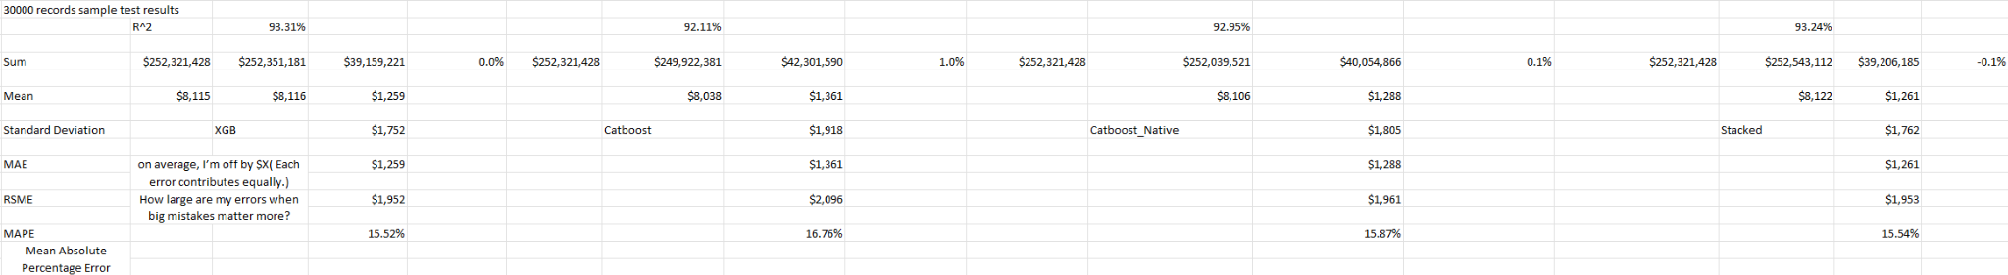
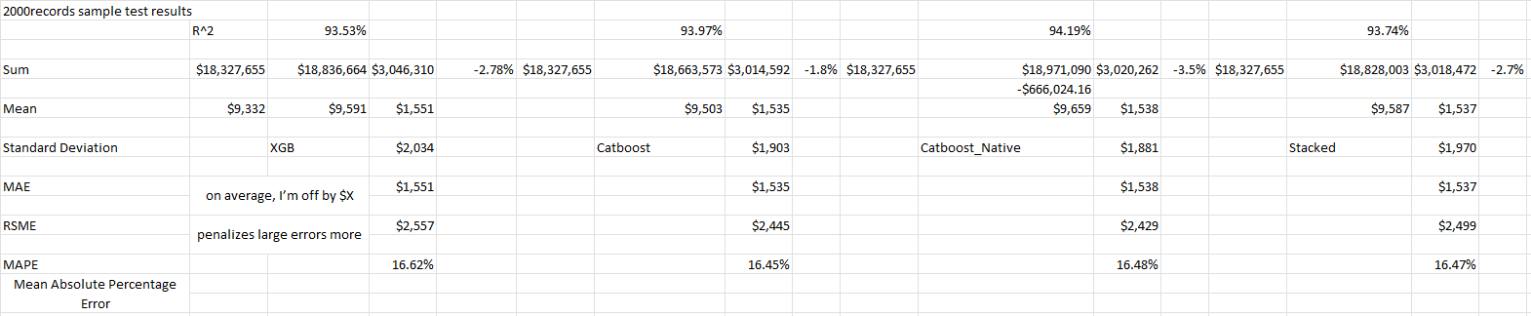
Appendix: Provided Sample Test Result Screenshots
9
30,000 record sample
2,000 record sample
AAA – Vehicle Price Prediction | High-level summary
Notes:
This appendix contains the detailed metrics by model and sample size.
It’s included for transparency and deeper technical review if needed, but the earlier slides summarize the key conclusions.

