Slide 1
Summary of the 1st week
Group2
Jan Lucas Hoppe, Chencan Wang, Yiping Xu

Slide 2
Outline
Motivation
Exercise
Outlook

Slide 3
Part 1a

Slide 4
Part 1b

Slide 5
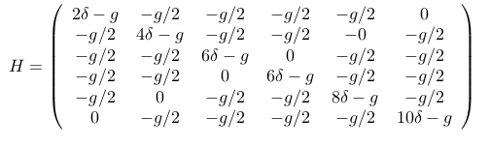
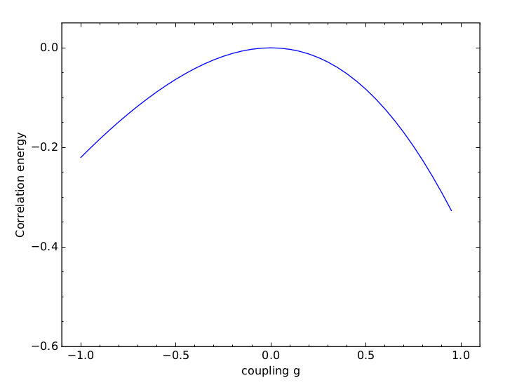
Part 1c

Slide 6
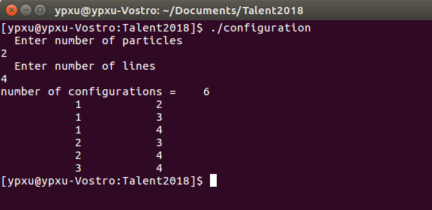
Building Hamiltonian matrix
Set up single-particle basis
read from file
code these internally(eg: 2 pairs, 4 levels)
states(1,:)=|1,2>
states(2,:)=|1,3>
states(3,:)=|1,4>
states(4,:)=|2,3>
states(5,:)=|2,4>
states(6,:)=|3,4>

Slide 7
Building Hamiltonian matrix
Generate a set of Slater determinants with fixed M (usually M=0)
Occupied | M
1,2 | 0
1,3 | -1
1,4 | 0
2,3 | 0
2,4 | 1
3,4 | 0
There are 4 states with M=0, and 1 each with M=±1.

Slide 8


Building Hamiltonian matrix
Compute the matrix elements of the Hamiltonian
  Second Quantization

Slide 9
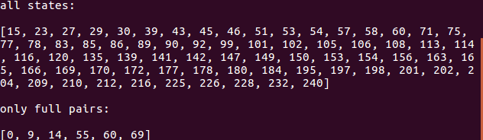
Building Hamiltonian matrix
eg: 4 particles, 8 lines

Slide 10
Summary and Outlook

