Slide 1
Summary of the 2ND week
Group2
Yi-ping Xu
Jan Lucas Hoppe
Chen-can Wang

Slide 2
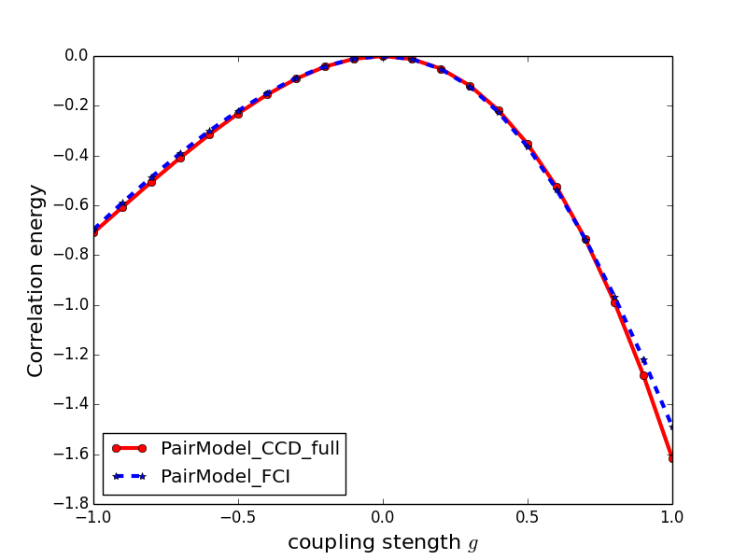
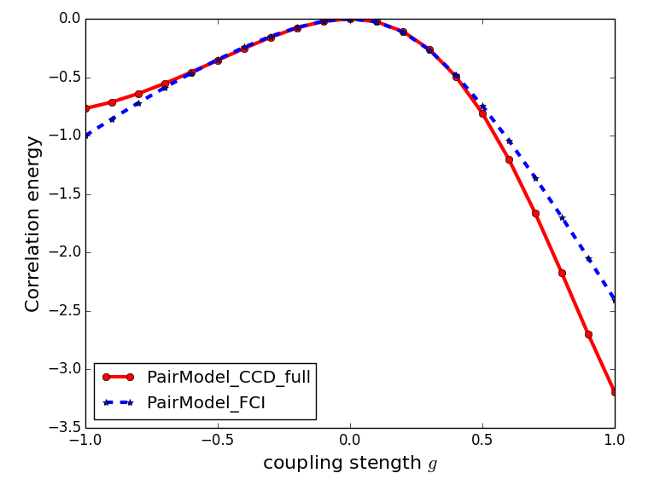
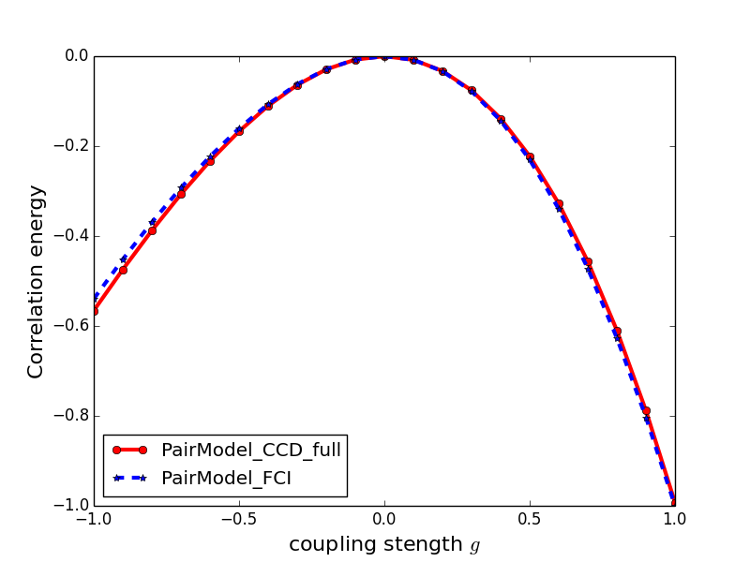
Correlation energy calculated by CCD
2
Still the pairing Hamiltonian:
with 4 orbits & 4 particles
CCD calculation for 21 points
time consumings

Slide 3
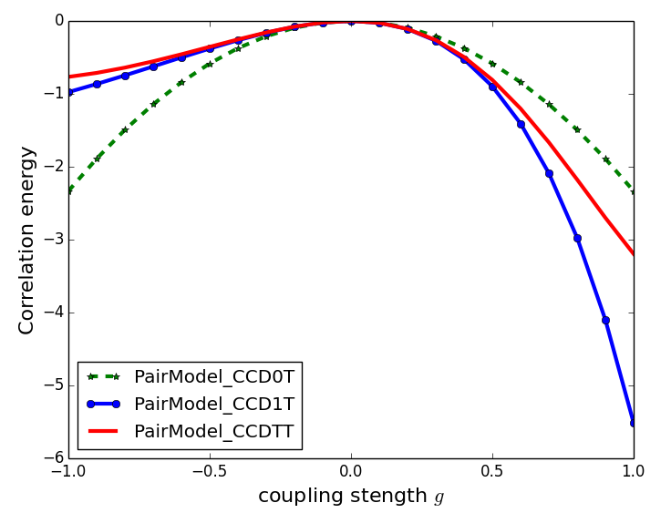
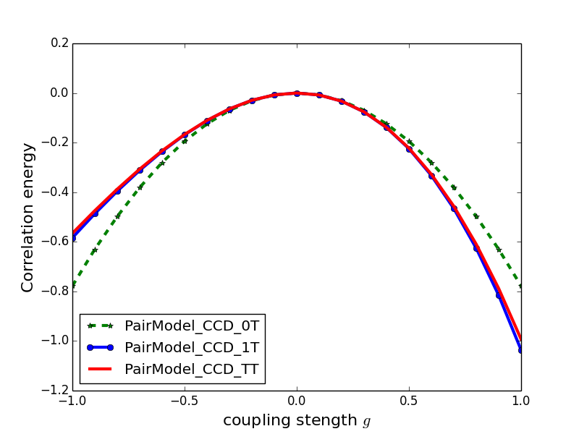
Contributions order by order
3
Iteration formula:

Slide 4
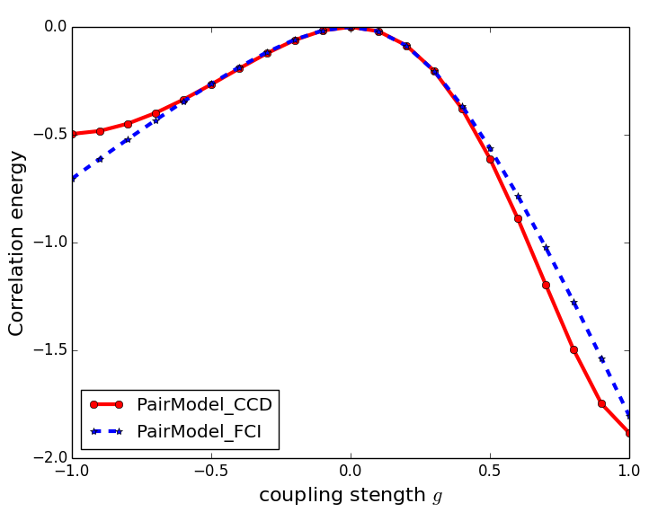
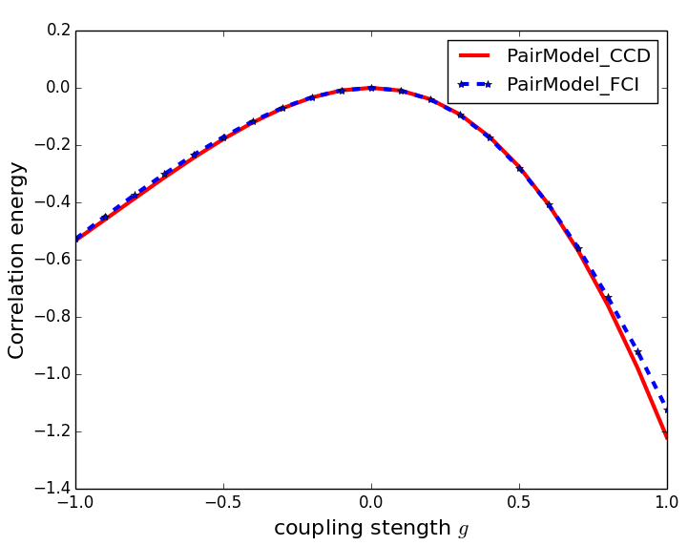
More particles – cross check
5
6 particles
4 orbits (8 sp states)
6 particles
4 orbits (8 sp states)

Slide 5
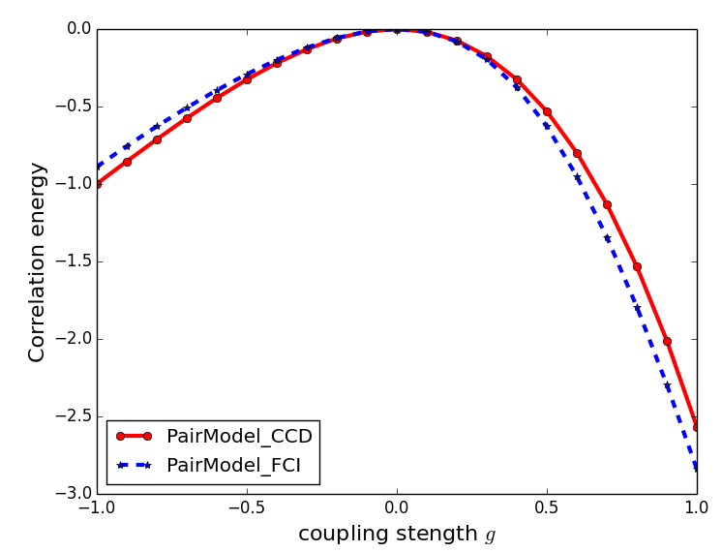
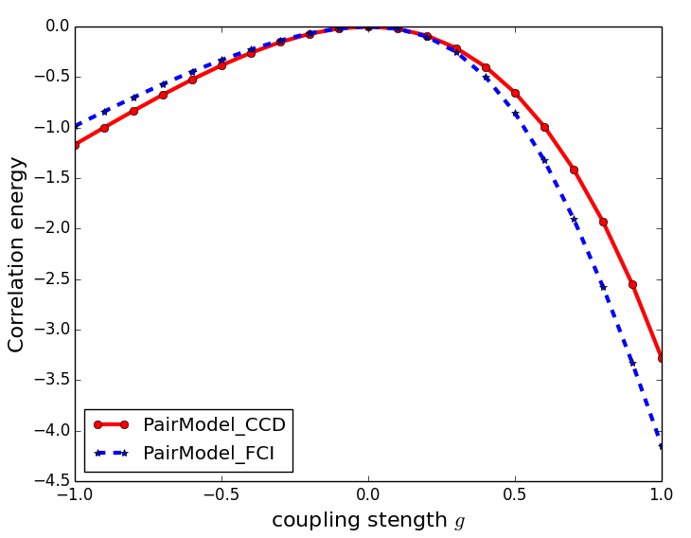
More orbits – cross check
4
4 particles
6 orbits (12 sp states)
4 particles
8 orbits (16 sp states)
Difference goes larger with the more orbits (sp states) as expected.

Slide 6
Thank You for your attention !

