Slide 1


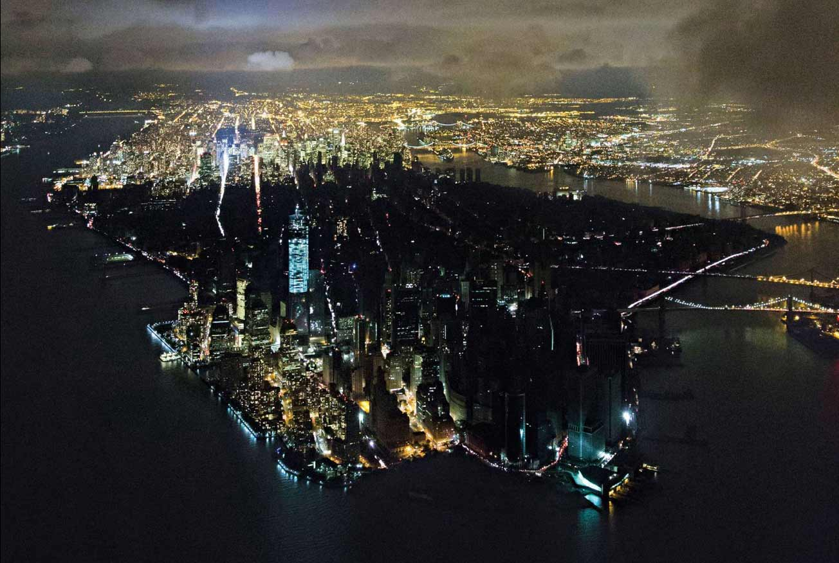
Power Outage Detection:
A Social Media Data Driven Approach
General Assembly DSI (NYC)
Boom Devahastin Na Ayudhya
Chris Lee
Henry Blais
January 2019
Notes:
Boom

Slide 2
The Problem
How to leverage user social media updates using NLP techniques to identify power outage hotspots?
Vision
During disasters, residential areas experience power outages which can last for days
Emergency response agencies need a timely and accurate way to respond to them.
Issue
Traditional methods: live feeds from utility companies, satellite data of light emissions
However, extremely expensive and difficult to maintain
Proposition
Observed generation’s ever growing dependence on social media over the past decade
More cost-efficient path to pursue
Using NLP tools, possible to leverage social media updates to identify power outage hotspots
Notes:
Boom

Slide 3
The Problem
How to leverage user social media updates using NLP techniques to identify power outage hotspots?
The Approach
Social Media Platform Focus: Twitter
Data Collection: Webscrape Tweets using Twitter API; city/county geodata
Data Cleaning: Filter out irrelevant fields; addressing missing data.
Exploratory Data Analysis: Search for ways to help systematic construction of bag of words
Preprocessing: Bag-of-Words construction, Tokenization, Vectorization
Classification Models: Word2Vec “sentiment”-style analysis
Notes:
Boom

Slide 4
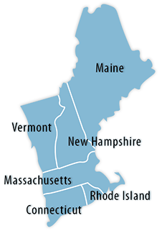



Methodology: Data Collection
Determine which local areas to cover
Which neighborhoods/area to identify?
New England: 6 East Coast states (MA, ME, VT, NH, CT, RI)
City/County Data Set
What does this city/county data include?
State - ID
City - Zip code
County - Population
Latitude and Longitude (city center) - Density
Time Zone
Notes:
Chris

Slide 5
Methodology: Data Collection
Determining social media options and scraping options
Social Media Options
Twitter Scraping Options
Facebook | Twitter
difficult to navigate API | easy to navigate API
high restriction to access API | easier to get a permission using API
 | TwitterScraper Package | Twitter Search API
Pros | Can scrape historical data | Geographical data (but very limited)
Cons | No geographical data | API has limits of tweets scraping gives only the most recent 7 days data
Notes:
Chris

Slide 6

Methodology: Data Cleaning
Scraping Tweets by TwitterScraper
Problems Encountered (TwitterScraper)
Twitter locked us out of API partway through data collection
Backup data - around 1000 tweets with no location
Workaround: randomly assign the city location data to backup data!
Back Up Data: query_tweets parameters
Search term: ‘blackout’, ‘blackouts’, ‘outage’, ‘outages’, ‘power outage’
Periods: 01/01/2018 ~ 12/31/2018
Notes:
Chris

Slide 7
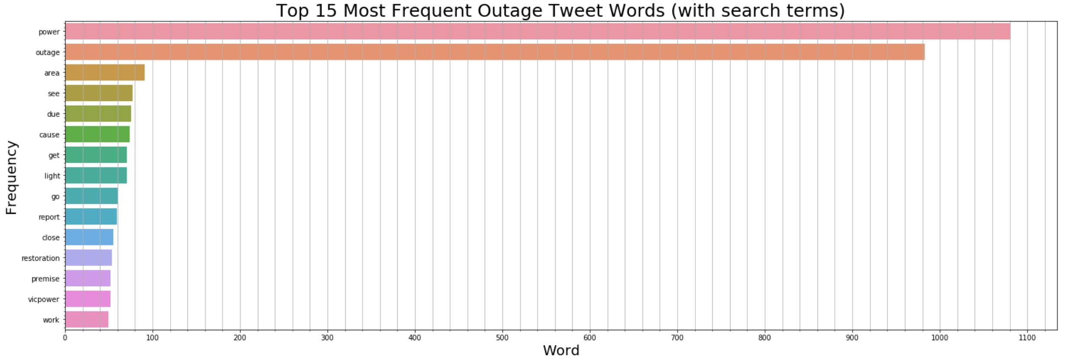
Methodology: Exploratory Data Analysis
Examining the Distribution of Top Words in Outage Tweets
Huge differential b/w frequency of query search terms and other terms as expected
“blackout” search term was not even in the top 30
Notes:
Boom

Slide 8
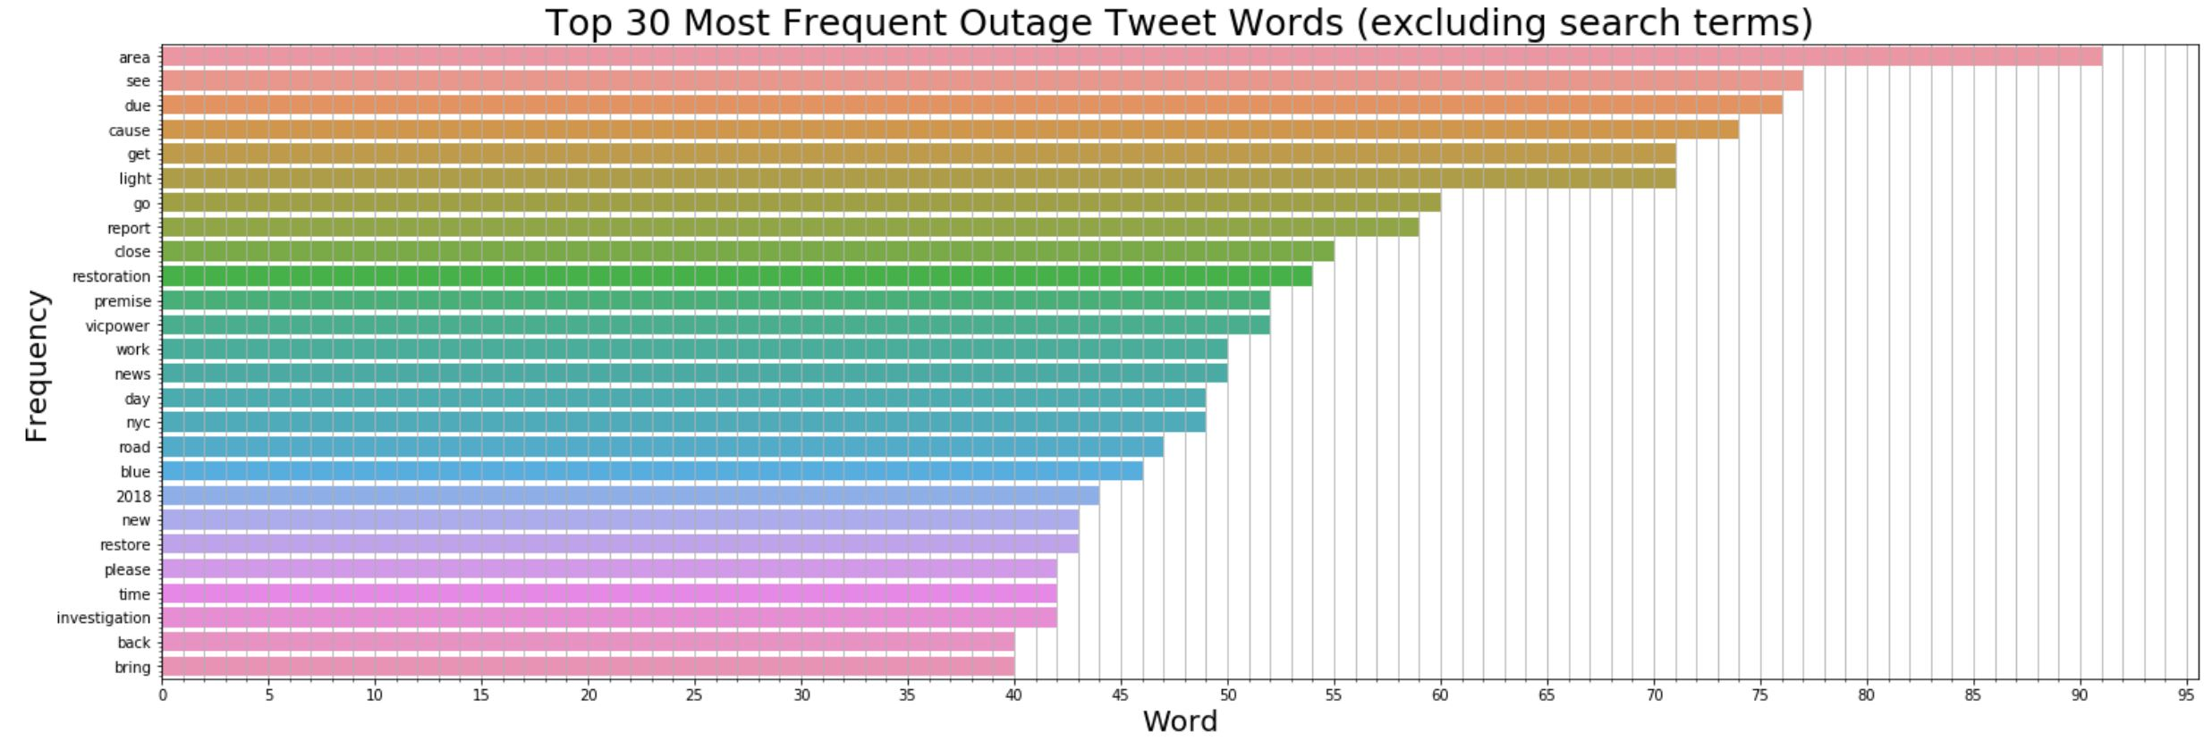
Methodology: Exploratory Data Analysis
Examining the Distribution of Top Words in Outage Tweets
Not many informative terms to help differentiate between serious / actual electric blackouts vs. irrelevant blackouts
“light” as potential serious blackout term; “vicpower” as example of irrelevant term
Notes:
Boom

Slide 9
Methodology: Exploratory Data Analysis
Identifying Related Words: LexVec Word Embedding
General Principle
Start with bag of words from power outage terminology article:
'blackout', 'power', 'outage', 'electric', 'electricity', 'electrical', 'transformer‘, 'watt', 'wattage', 'arc', 'circuit', ‘breaker', 'cable', 'fault', 'conductor', 'fuse', 'riser', 'insulator', 'meter', 'interruption', 'maintenance', 'relay', 'grid', 'severe', 'weather', 'storm', 'substation', 'surge', 'switch', 'switchyard', 'station', 'transmission', 'system', 'lines', 'line', 'frequency', 'voltage'
Compare each term to every word in English Wikipedia’s 2015 bag of words
Algorithm computes a similarity score from -1 to 1
Take top 20 words, but filter out any with score < 0.40
Sample Case
Term from Starting Bag of Words | Top 20 Similar Words
‘electricity' | 'energy', 'megawatts', 'power', 'renewable', 'renewables', 'generators', 'utilities', 'hydropower', 'kilowatts', 'hydroelectricity', 'gas', 'kilowatt', 'baseload', 'kwh', 'heating', 'fuel', 'mwh', 'gigawatts', 'sewerage', 'biomass'
Notes:
Boom

Slide 10
Modeling: Preprocessing
Tokenization
General Principle
Process of melting a body of text down to constituent words (tokens).
Create a nested list (i.e. a list of each tweets’ list of tokens) to later iterate through:
Each tweet will have a list of cleaned tokens
List length = equal to number of tokens in that tweet.
The outer list will contain these inner lists
List length = number of tweets in our scraped dataset
Format is memory-efficient and makes life easier for next step
Tweet | Inner List (of Clean Tokens) | Outer List (of Inner Lists)
“I bought a portable cell charger in 2018.” | ['bought', 'portable', 'cell', 'charger‘] | [ ['bought', 'portable', 'cell', 'charger‘], ['massive', 'hits', 'southern', 'zim', 'twimbos', 'newsday', 'zimbabwe'] ]
“Massive power outage hits southern Zim http://bit.ly/2EW2Enj\xa0 #263Chat #Twimbos #NewsDay #Zimbabwe‘” | ['massive', 'hits', 'southern', 'zim', 'twimbos', 'newsday', 'zimbabwe']
Notes:
Boom

Slide 11
Modeling: Word2Vec
Word2Vec Vectorization – Brief Introduction
General Idea
Model based on shallow neural networks that converts words into something computer can understand (e.g. 300 dimensional vector)
Each word is assigned a vector positioned in the space such that words in similar contexts will be positioned closely together
How are we using it?
Train on Google News corpus (3M words)
Define bag of words for 2 classes:
Serious / actual electrical blackout
Non-serious / irrelevant blackouts (e.g. Netflix, drunken night)
3. Obtain representative vector for each class by vectorizing all words in bag, then average
Notes:
Boom

Slide 12
Modeling: Word2Vec
Defining Bag of Words for Classes
Class | Bag of Words
Serious | 'electricity', 'electrical', 'conedison', 'con edison', 'generator', 'generators', ‘failure', 'malfunction', 'fuse', 'blow', 'explode', 'power grid', 'breaker', 'loss', 'dark', 'darkness', 'pitch black', 'blind', 'massive', 'major', 'serious', 'inclement', 'surge', 'storm', 'solar flare', 'alert', 'light', 'lights'
Irrelevant | 'netflix', 'hulu', 'time warner', 'twc', 'at&t', 'att', 'verizon', 'tmobile', 't-mobile', 'phone', 'internet', 'wireless' 'conference', 'prepare', 'meeting', 'strength', 'training', 'discipline', 'vicpowers', 'baseball'
Notes:
Boom

Slide 13




Modeling: Word2Vec
Example – class_bag_of_words = [“electric”, “power”, “outage”]
Word in Bag
Word Vector
Class Rep Vector
$$\left[\begin{matrix}2 \\ 1 \\ 5\end{matrix}\right]$$
“electric”
Word2Vec
$$\left[\begin{matrix}3 \\ 1 \\ 9\end{matrix}\right]$$
$$\left[\begin{matrix}4 \\ 3 \\ 7\end{matrix}\right]$$
“power”
Word2Vec
Average
$$\left[\begin{matrix}7 \\ 7 \\ 7\end{matrix}\right]$$
“outage”
Word2Vec
Notes:
Boom

Slide 14


Modeling: Word2Vec
Example – Tweet: “Hello World! #Bazinga”
Clean Token
Word Vector
Tweet Rep Vector
$$\left[\begin{matrix}1 \\ 5 \\ 5\end{matrix}\right]$$
“hello”
Word2Vec
$$\left[\begin{matrix}2 \\ 3 \\ 7\end{matrix}\right]$$
Average
$$\left[\begin{matrix}3 \\ 1 \\ 9\end{matrix}\right]$$
“world”
Word2Vec
“bazinga”
Not in GoogleNews
Notes:
Boom

Slide 15
Modeling: NLP Classification Step
Classification Modeling using “Sentiment” Analysis
Rationale
Dealing with an unsupervised learning problem since no true target variable for class
Nevertheless, need to assign classes to each tweet
General Idea
Use cosine similarity on representative vectors (a sentiment analysis based approach)
For each tweet,
Compute cosine similarity between tweet rep vector vs. serious rep vector.
Compute cosine similarity between tweet rep vector vs. irrelevant rep vector.
Classify tweet based on relative magnitude of cosine similarity:
If cosine similarity to serious rep vector is higher, then assign serious_blackout=1
If cosine similarity to irrelevant rep vector is higher, then assign serious_blackout=0
Then combine with (latitude, longitude) data to visualize hotspots:
Notes:
Boom

Slide 16
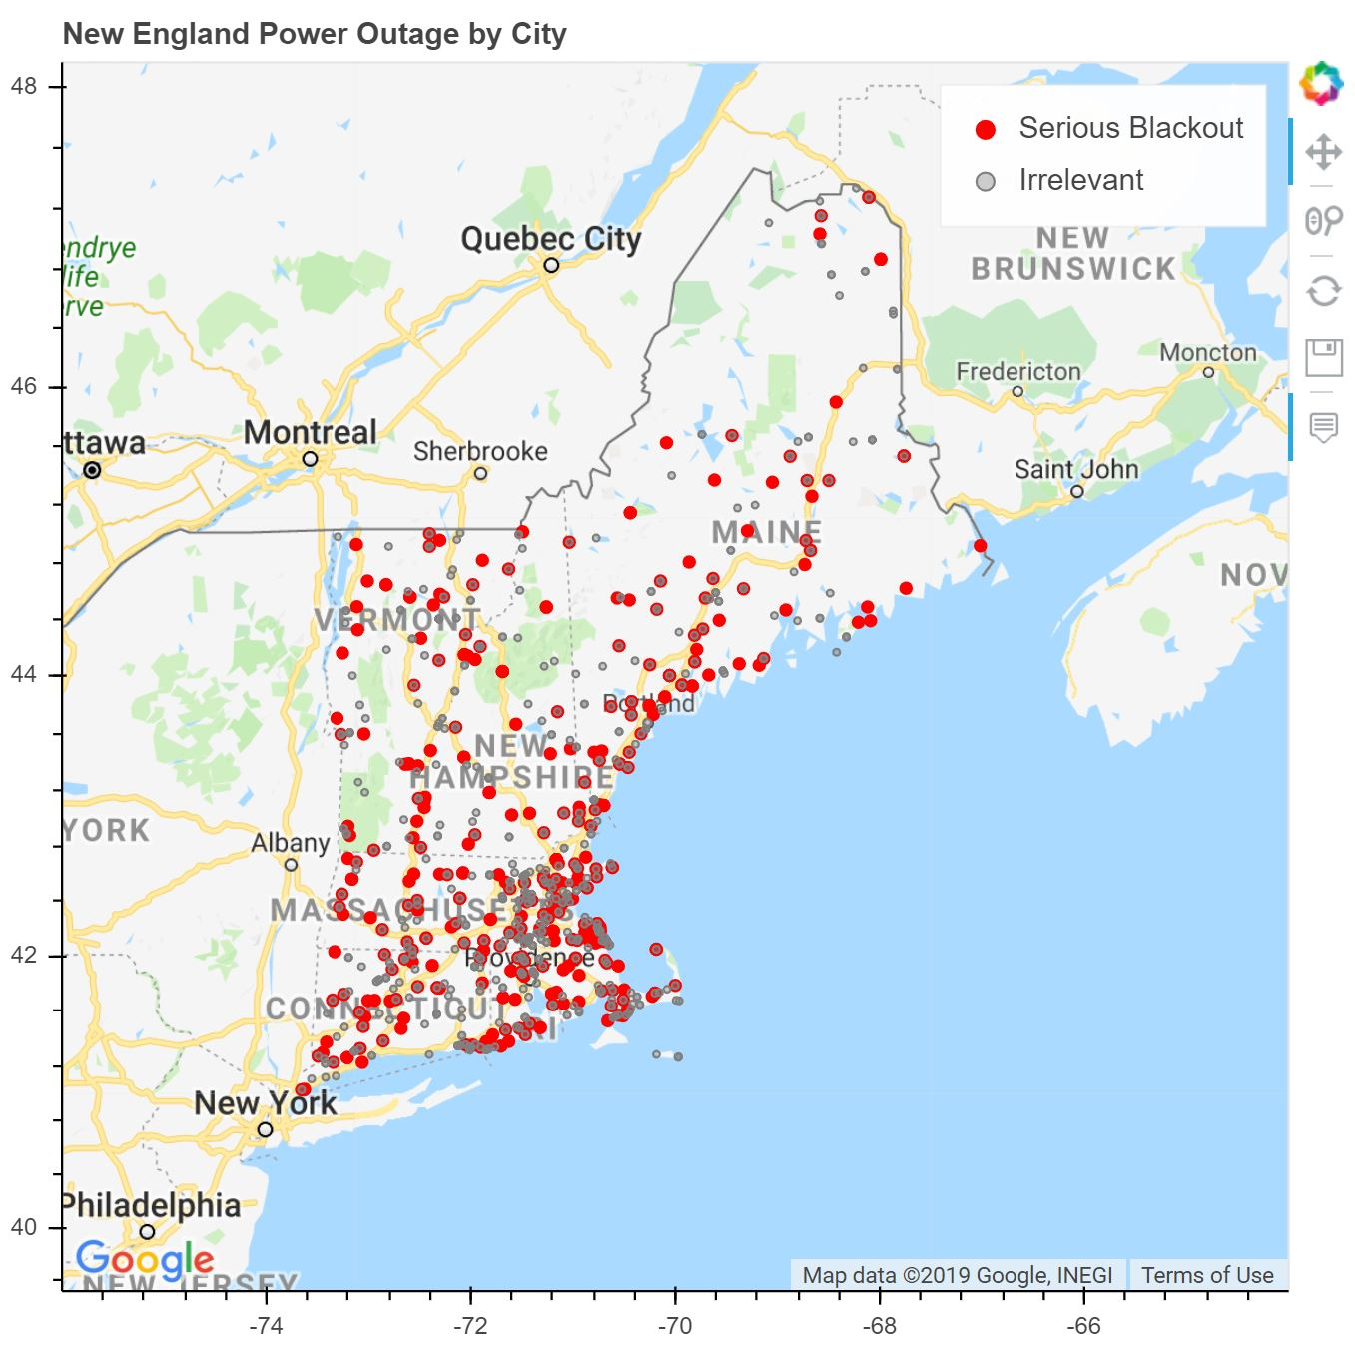
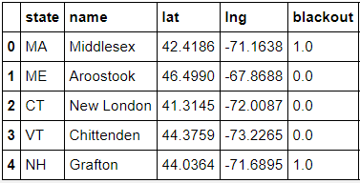
Results: Visualization
Bokeh Hotspot Map of New England Tweet Outages by Category (City Basis)
.
.
.
Notes:
Chris

Slide 17
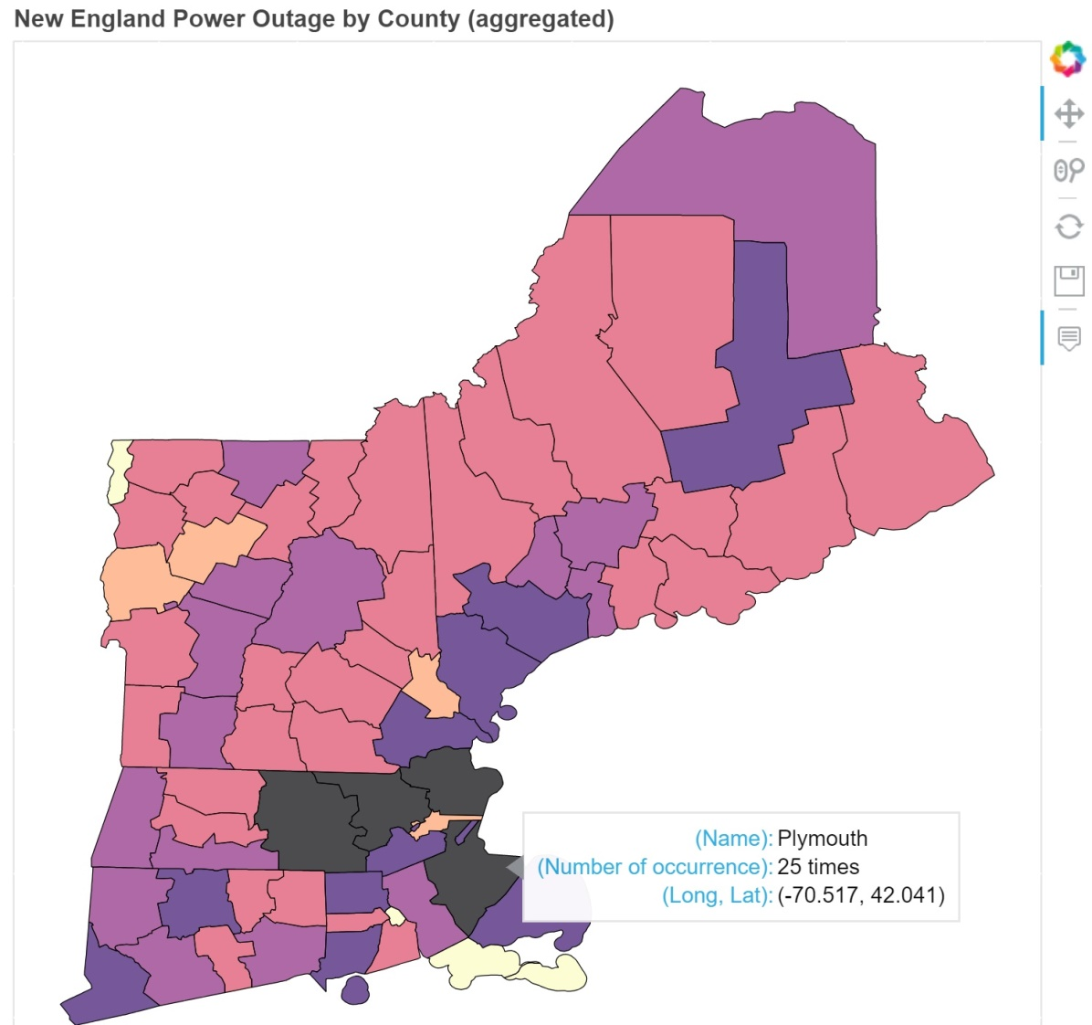
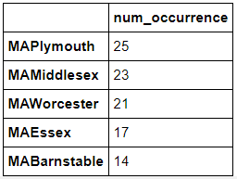






Results: Visualization
Bokeh Heat Map of New England Power Outages (County Basis)
Frequency Color Key
0 1 2 5 8 17 25
Notes:
Chris

Slide 18
Wrapping-Up
Key Takeaways and Further Enquiry
Class representative vectors for serious vs. irrelevant had cosine similarity of 0.3
Implication: Somewhat unrelated, but not necessarily perfectly orthogonal.
Refine class corpora to reduce cosine similarity of serious blackout vs irrelevant
While this is a proof of concept model on historical data, results are realistic.
Ideal Final Product: Tool utilizing Twitter’s live API stream
Requirements from Client: paid subscription to Twitter’s API
Tackled as unsupervised learning problem due to absence of true classifications to train on.
Alternative Route: Supervised learning problem
Requirements from Client: data entry to manually categorize a sample of tweets and provide us that data
Infer locations by including list of cities/neighborhoods in query search terms.
Notes:
Boom

