Slide 1
Stock price prediction using Generative Adversarial Networks
Team member:
Chen Chen, HungChun Lin

Slide 2
Introduction
In this project, we will compare different algorithms applying to stock prediction.
Goal: Built the model to get more accurate stock price prediction.
Models in this project:
Long short-term memory (LSTM)
Gated recurrent units (GRUs)
Basic Generative adversarial networks (GANs)
Wasserstein GAN with gradient penalty (WGAN-GP)

Slide 3
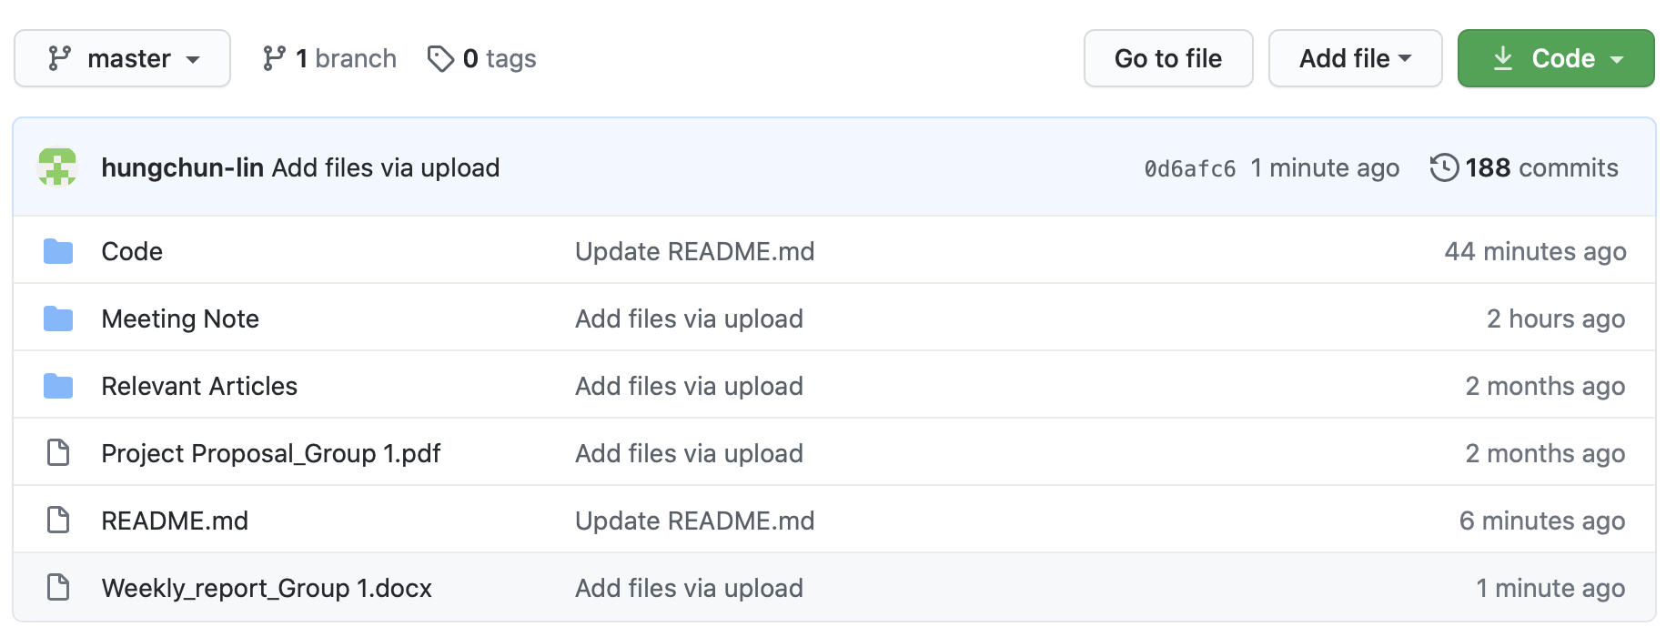
Github
Github link: https://github.com/hungchun-lin/Stock-price-prediction-using-GAN-Capstone-Group1
This Github includes:
Code
Meeting Note
Relevant Articles
Project Proposal
Weekly Report
Final Report

Slide 4
Data Source link
Data:
Stock price: https://finance.yahoo.com
Economic index: https://fred.stlouisfed.org
Daily news: http://seekingalpha.com/

Slide 5
Contribution
Compare two kinds of RNN based model, the GRU and the Long LSTM networks
Proposed the GANs model, with GRU as a generator and CNN as a discriminator for predicting the multi-step ahead stock price.
Improve the result by adjusting the loss function in the GAN model, which is the WGAN-GP
Extract the daily news topic through Natural Language Process as one of the vital indexes in the features
Compare model performance for normal times and COVID-19 period

