Slide 1
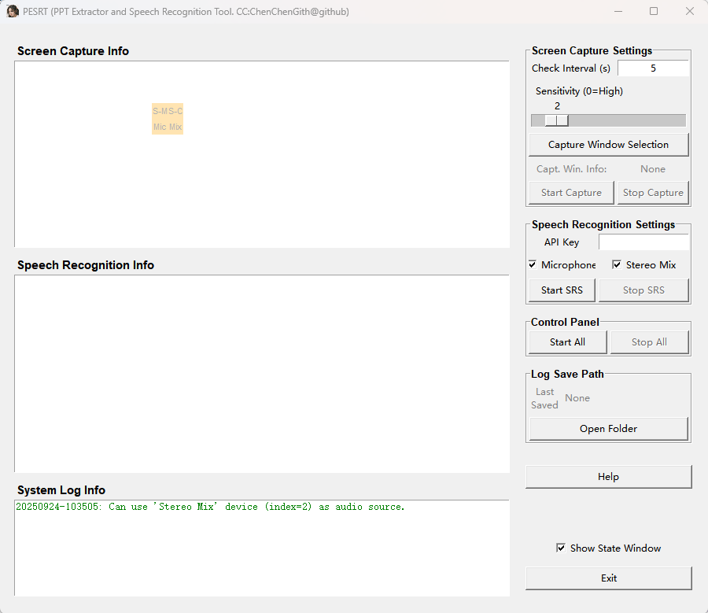
Time interval for monitoring screen pixel changes, in seconds.
Pixel Change Sensitivity: A screenshot will be taken if the pixel change value between two detections exceeds this threshold. A setting of 0 means a screenshot will be triggered by any change.
Information about screen capture displays here.
Select the screen monitoring area for the screenshot
Esc: Full-screen
Left click and move: select capture region
Enter: Confirm selection
A floating status monitoring window. You can drag this window with your mouse, and control whether to display it by checking the "Show State Window" option.
Will show monitoring area after selecting
Start / Stop capture
API key for speech recognition. You can get you key by aliyun: https://bailian.console.aliyun.com/?tab=model#/api-key
Information about speech recognition function displays here.
Check to control if listening mic or stereo mix input
Start / Stop speech recognition
Start / Stop both capture and speech recognition
Once screenshot capture or voice recognition starts, a folder will be automatically created in the root directory of the program, and the path will be displayed here.
Open the folder containing the last saved recognition results.
Help document
Information about some system log displays here.
To control whether display the float state window

