Slide 1
第10章 恒星
§10.1 恒星概述
恒星－－构成天体主体部分 。
一、恒星的距离
二、恒星的亮度和光度
1、恒星的亮度
2、恒星的光度
3、绝对星等
三、恒星的颜色和光谱型（见表）
1、恒星的温度
2、恒星的颜色
3、恒星的光谱，光谱型
四、赫罗图
1、概念：以绝对星等为纵坐标，以光谱或表面温度的对数为横坐标作图的图，叫做“光谱－－光度图“，或叫赫罗图。
2、赫罗图应用
五、恒星的大小、质量和密度
六、恒星的运动
七、恒星的化学组成及其它

Slide 2
§10.2 恒星的多样性
一.单星、双星、三星、聚星、星团和星协
1.单星: 或称孤星，如太阳。
2.双星：两颗恒星相互作用，如天狼星和它的伴星（双星可分为光学双星和物理双星等）。
3.三星：三颗恒星构成的系统。
4.聚星：三个以上的恒星聚合在一起的系统。
5.星团：由成团的恒星组成的、被各成员星的引力束缚在一起的恒星群（可分为疏散星团和球状星团两类）
6.星协 ：由光谱型类似、物理性质相近的恒星组成的系统，如O星协、B星协等。
二.变星、新星和超新星
1.不规则变星：如金牛座的T型变星。
2.脉动变星：如造父变星，刍藁变星。
3.爆发性变星 ：包括耀星、新星和超新星三类。

Slide 3
三.主序星、红巨星、白矮星、中子星、黑洞
1.主序星：指在赫罗图中沿左上方到右下方的对角线主星序上的恒星，称为主序星。它们的亮度、大小和温度之间存在稳定关系。
2.巨星：赫罗图上体积大、温度低、光度大的叫巨星
3.白矮星：在赫罗图左下角的一群星，表现为光度低，但表面温度高。
4.中子星和脉冲星：密度很大，体积很小，且磁场强称为中子星；把强磁场的快速自转着的中子星称为脉冲星
5.黑洞 ：特殊的恒星。
四.普通恒星、特殊恒星

Slide 4
§10.3 恒星的能源和演化机制
1.恒星的结构与能源
2.恒星演化的过程
星云→分子云→球状体→原恒星→年轻的恒星→中年恒星→老年恒星→衰老和死亡 （见赫罗图）
3.恒星的晚期演化
4.并非所有恒星都经历如此“平静”的演化道路。
恒星的归宿有白矮星、中子星或黑洞。
5.恒星从诞生到死亡，经历时间长短与它的质量大小有关。

Slide 5
恒星的光谱型、颜色、表面温度表
光谱型 | 光谱主要特征 | 颜色 | 有效温度（°K） | 例 子
O | 一次电离氦线（发射或吸收），强紫外连续谱 | 蓝 | 40000～25000 | 参宿一，参宿三
B | 中性氦的吸收线 | 蓝白 | 25000～12000 | 参宿五，参宿七，角宿一
A | A₀型的氢强度极强，其它次型依次递减 | 白 | 11500～7700 | 牵牛星，织女星
F | 金属线开始显现 | 黄白 | 7600～6100 | 南河三，老人星
G | 太阳型光谱，中性金属原子和离子 | 黄 | 6000～5000 | 太阳，五车二
K | 金属线为主，弱的蓝色连续谱 | 橙 | 4900～3700 | 大角星
M | 氧化钛的分子带明显 | 红 | 3600～2600 | 心宿二，参宿四

Slide 6
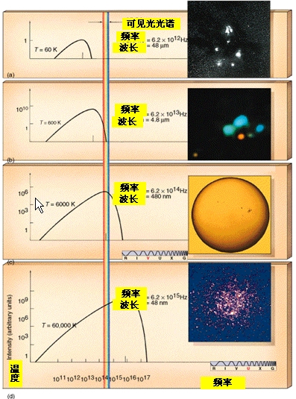
天体温度比较

Slide 7
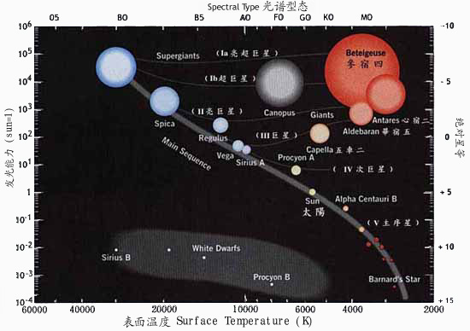

Slide 8
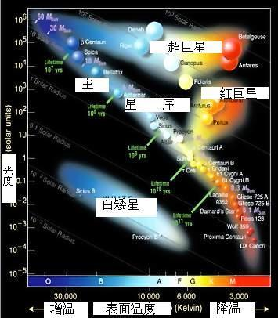

Slide 9
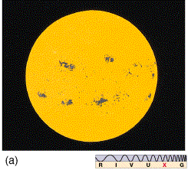
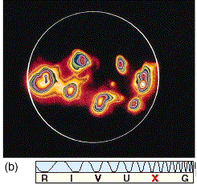
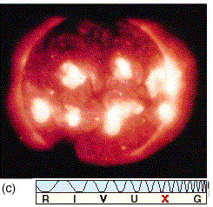
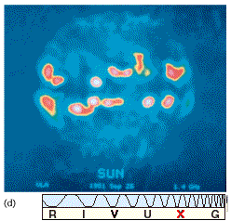
不同波段太阳的图像

Slide 10
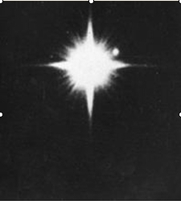
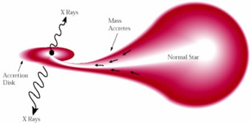
双星（正常星和衰老星）
双星－－天狼星和它的伴星

Slide 11
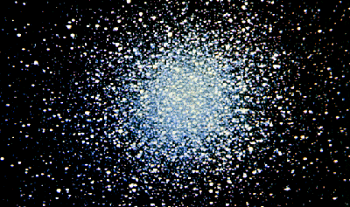
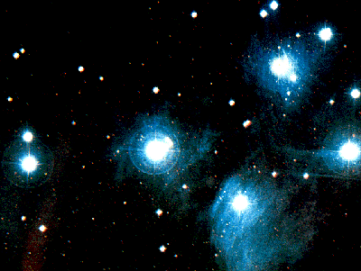
球状星团
疏散星团

Slide 12
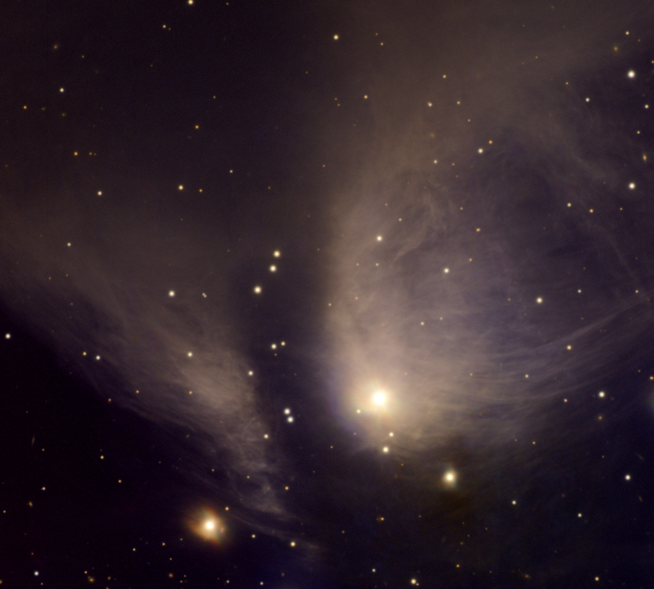
金牛座T型变星

Slide 13
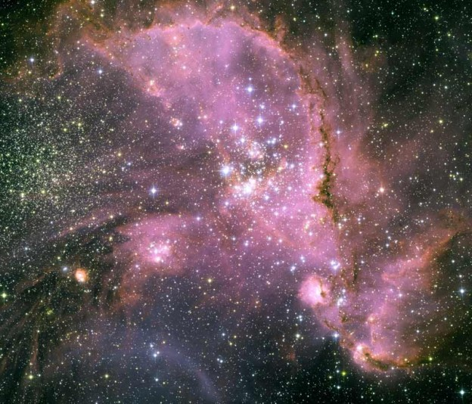
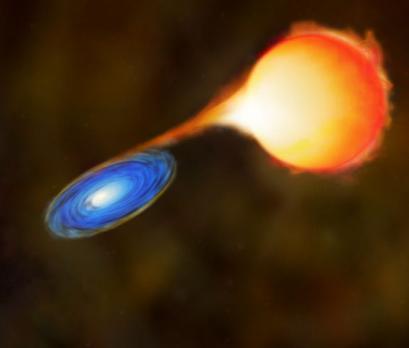
NGC346中的新星
刍藁变星

Slide 14
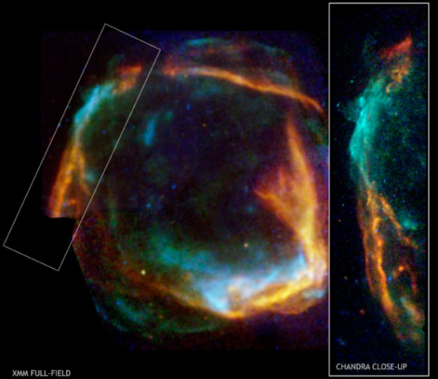
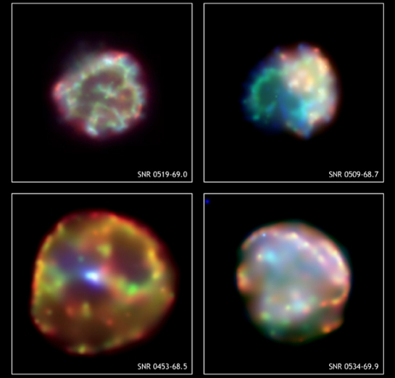
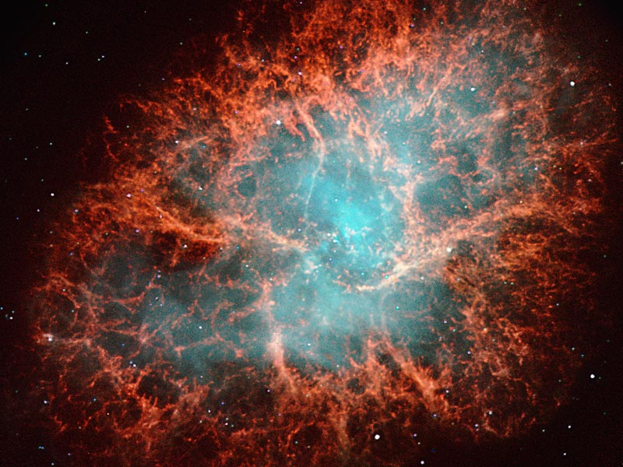
RCW86（超新星痕迹）
四个超新星的痕迹
蟹状星云

Slide 15
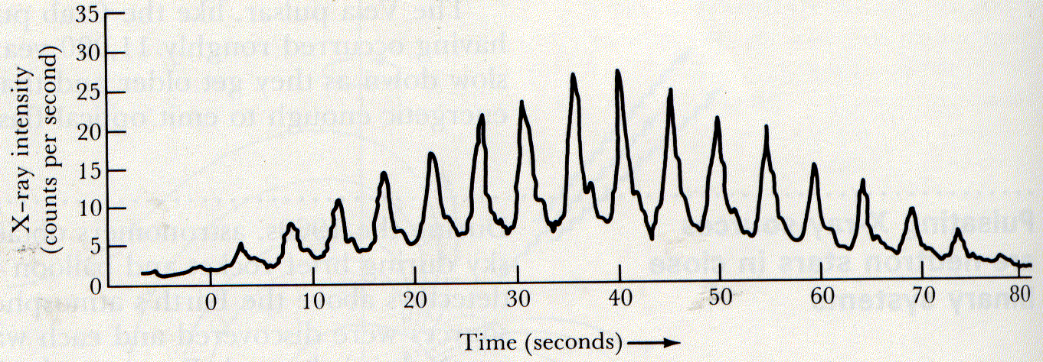
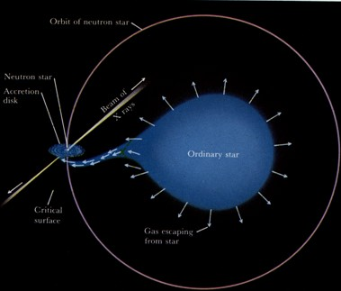
脉冲星
Notes:
X-ray pulses from Centaurus X-3 This graph shows the intensity of X rays detected by Uhuru as Centaurus X-3 moved across the satellite's field of view. The successive pulses are separated by 4.84 sec. The gradual variation in the height of the pulses from left to right is a result of the changing orientation of Uhuru's X-ray detectors toward the source as the satellite rotates. (Adapted from R. Giacconi and colleagues)

Slide 16
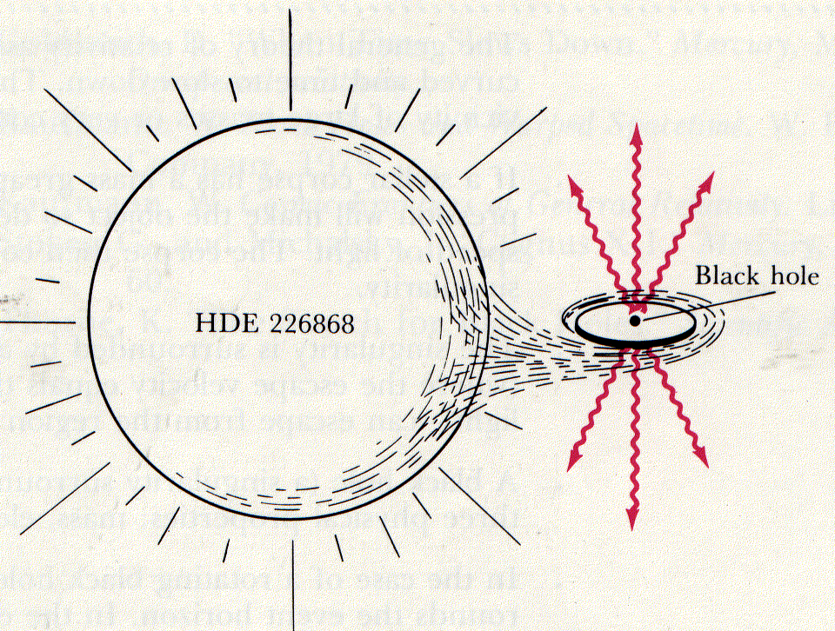
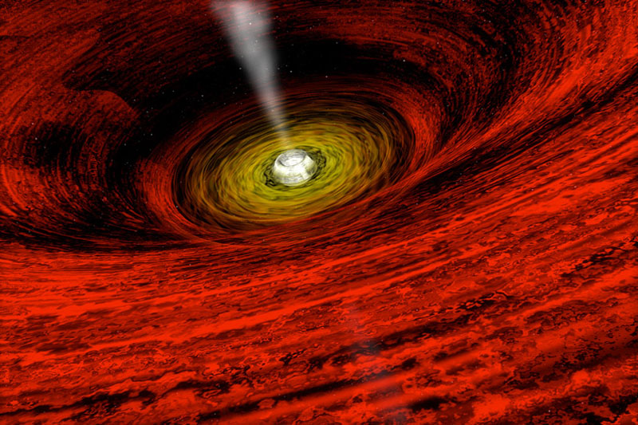
黑 洞
Notes:
A stellar wind from HDE 226868 pours matter onto an accretion disk surrounding a black hole. The infalling gases are heated to high temperatures as they spiral in toward the hole. At the inner edge of the disk, just above the black hole, the gases are so hot that they emit vast quantities of X rays.

Slide 17
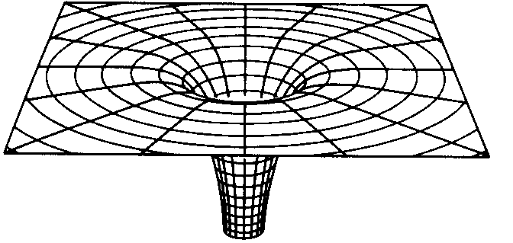
黑洞的模型
Notes:
This diagram shows how the shape of space is distorted by the gravitational field of a black hale. Far from the hole, gravity is weak and space is "flat. " Near the hole, gravity is strong and space is highly curved. This diagram uses a two-dimensional surface as an analogy for ' the three-dimensional fabric of space

Slide 18
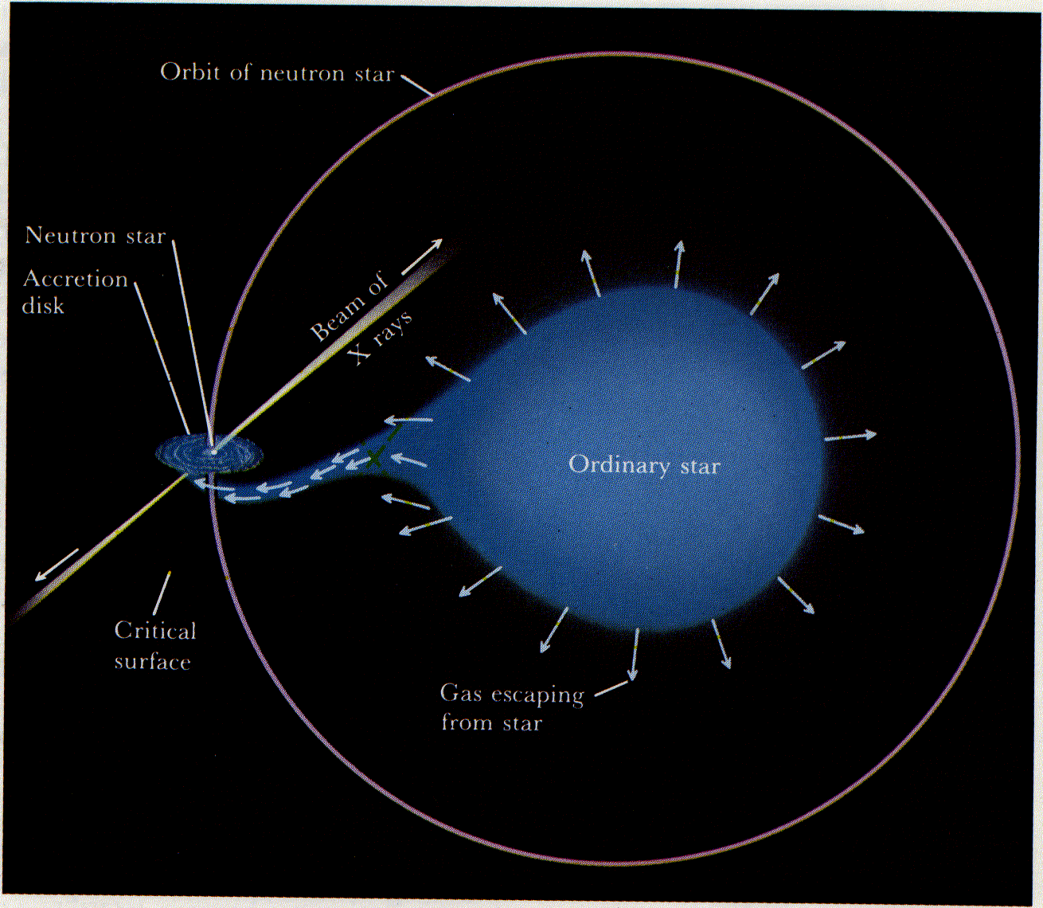
X射线源的脉冲星模型
Notes:
A model of a pulsating X-ray source Gas escaping from an ordinary star is captured by the neutron star. The infalling gas is funneled down onto the neutron star's magnetic poles where it strikes the star with enough energy to create two X-ray-emitting hot spots. As the neutron star spins, beams of X rays from the hot spots sweep around the sky.

Slide 19
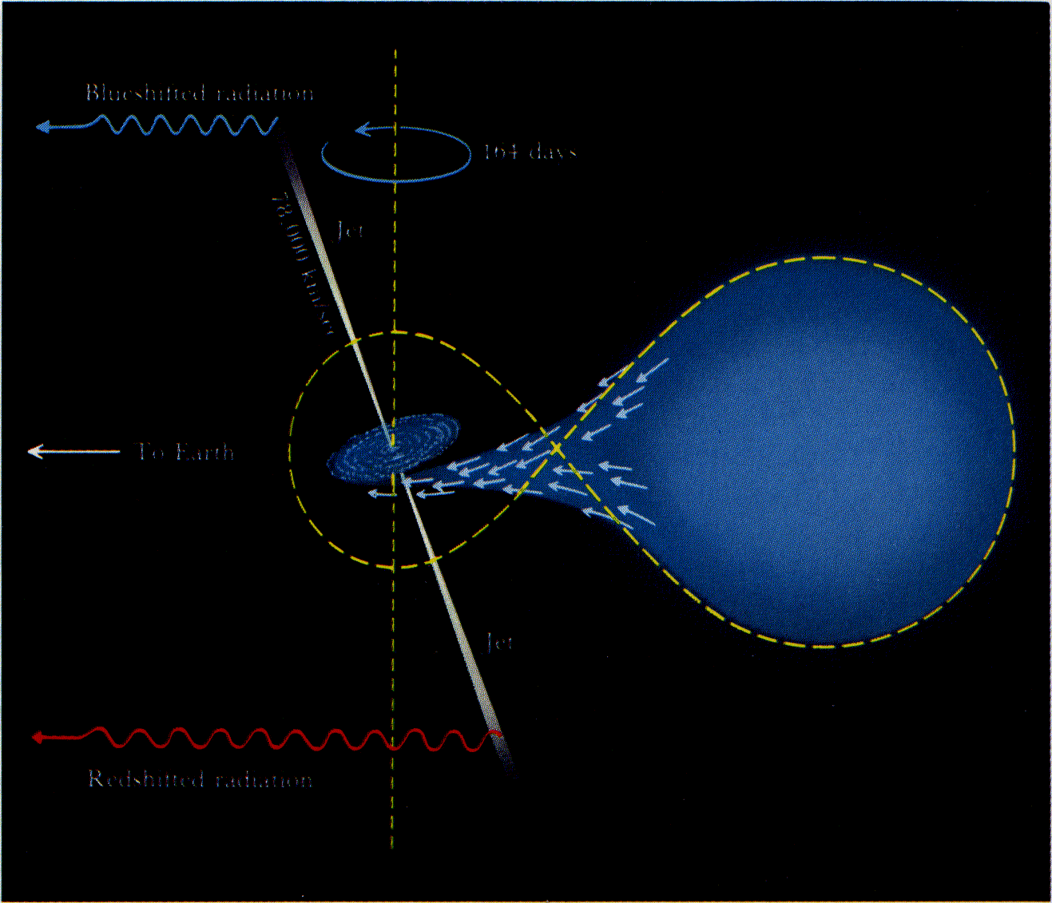
A model of SS 433
Notes:
A model of SS 433 Gas from a normal star is captured into an accretion disk about a neutron star. Two high-speed, oppositely directed jets of gas are ejected from the faces of the disk. Because the disk is tilled, the gravitational pull of the normal star causes the jets to precess with a period of 164 days.

Slide 20
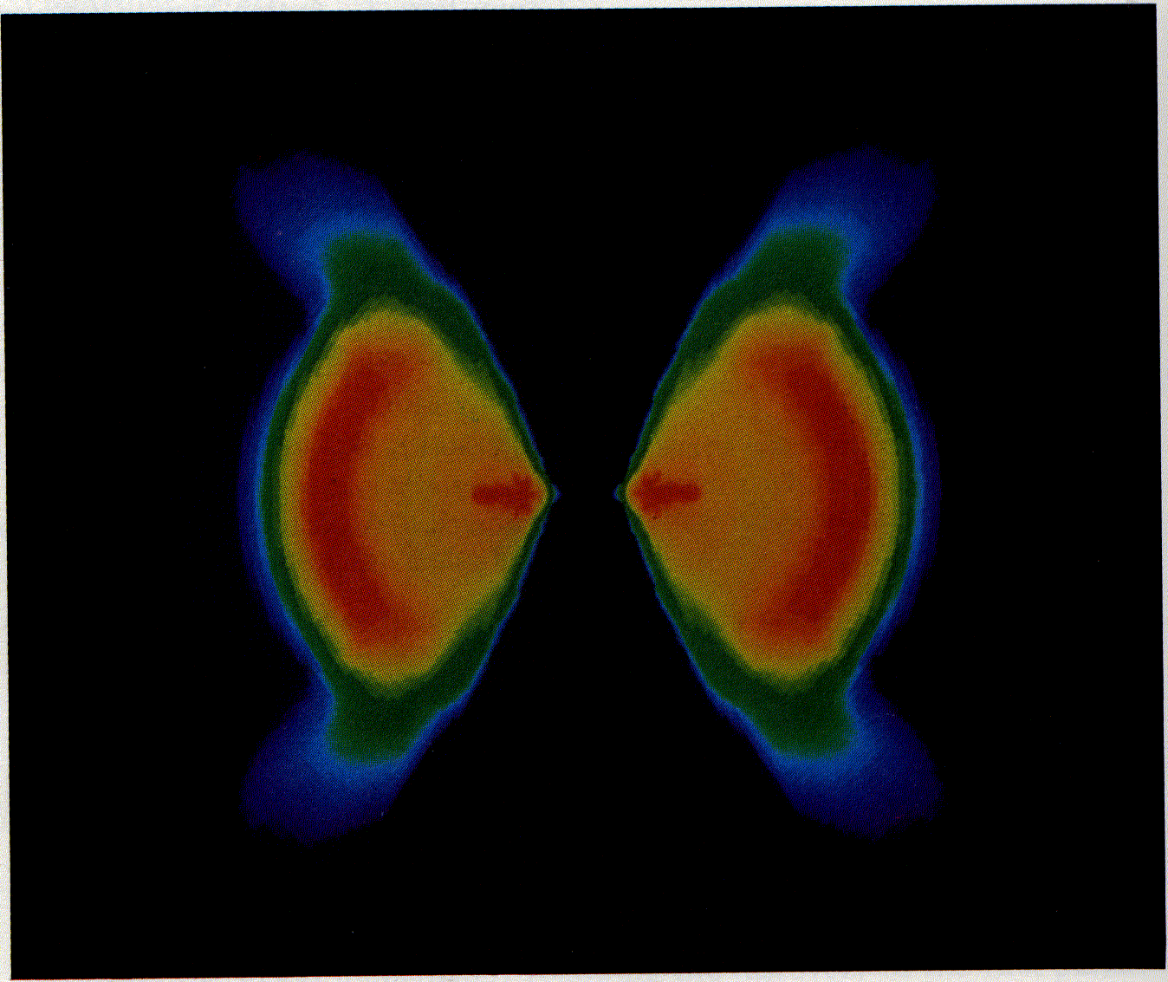
围绕黑洞的一个吸积盘
Notes:
This false color image shows in cross-section how matter distributes itself around a black hole. A "supercomputer" was used to solve the complicated relativistic equations that govern the infall of matter toward the black hole at the center of this diagram, where the two broad angles point. These calculations proved that a fat accretion disk resembling a doughnut is more stable than a thin accretion disk resembling Saturn's rings. Many astrophysicists believe that supercomputers present a new and revolutionary way of doing research by simulating a wide range of physical situations that are not easily observable. (Courtesy of L. Smarr andJ. Hawley)

Slide 21
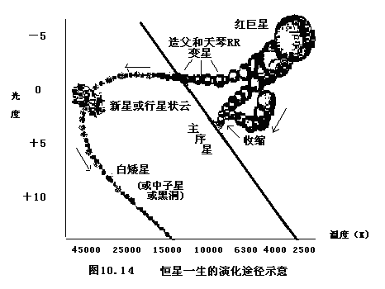
恒星的一生
Notes:
Formation of new stars near p Ophiuchi (a) A wide-angle infrared view of the region near the star p Ophiuchi, covering nearly 13° X 13° at a wavelength of 100 μ. The white rectangle indicates the smaller region covered by photograph b at visible wavelengths, (b) The white circle indicates the location of at least 20 newborn stars that are probably less than 1 millon years old. The bluish star near the top of this view at visible wavelengths is p Ophiuchi. Anteres, the brightest star in Scorpius, appears at the lower [eft.Many stars in this region have a fuzzy appearance because of interstellar dust. (National Aerospace Laboratory of the Netherlands; Royal Observatory, Edinburgh)

Slide 22
恒星“移到”主序后，内部温度高到足以发生热核反应的程度→热核反应代替引力收缩成为主要能源→温度升高，热运动加快，恒星膨胀，排斥力足以同引力相抗衡→恒星停止收缩，长期稳定依靠热核反应进行辐射。
一颗恒星在主序中的时间，占去其“生命” 的大半辈子；且在主序上逗留的时间，取决于其质量的大小→质量愈大,引力愈强→它必须维持较高的温度和较久的辐射功率以与引力收缩抗衡→它的氢燃料消耗更快，寿命更短。
热核反应是在恒星的中心区域进行的，那里的氢核燃料最先燃尽，逐渐形成一个由氦组成的核，停止释放能量。氢燃料的逐渐枯竭，是恒星在结构上逐渐发生变化的前奏

Slide 23
随着氦核的不断增大，其引力收缩急剧增强，并释放大量能量。结果，恒星的核心收缩（变得愈来愈致密和炽热），外层膨胀（温度降低而光度增大），成为一个非常巨大的具有“热”核的“冷”星。从而恒星离开主星序，进入红巨星区域——生命的“晚年”。
在红巨星阶段，恒星的演化速度大大加快。中心区域的温度和密度因收缩而继续升高，到1亿摄氏度时开始进行由氦核聚为碳核的新一轮热核反应；氦烧完后，温度继续因收缩而升高，原子核再聚变产生更重的元素→能量有限，到了“垂暮之年”，一旦核反应终止，对引力的抗衡全线崩溃→自行坍塌。
红巨星收缩时，核心部分收缩最猛烈，外部处在较弱的引力下。核心温度因猛烈收缩而急剧上升，由此掀起的热浪会把外层气壳抛掉，剩下一颗致密和炽热的白矮星→以后逐渐变冷，变成又小又暗的黑矮星→终其一生。

Slide 24
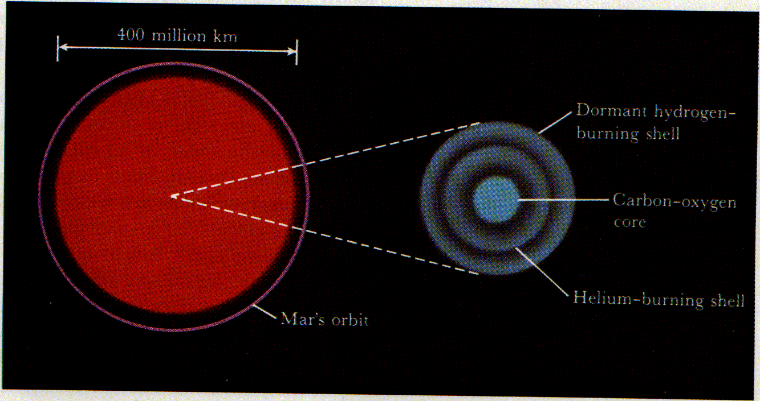
一个老的低质量恒星的结构
Notes:
Near the end of its life, a low-mass star becomes a red supergiant, with a diameter almost as large as the diameter of the orbit of Mars. The star's dormant hydrogen-burning shell and active helium-burning shell

Slide 25
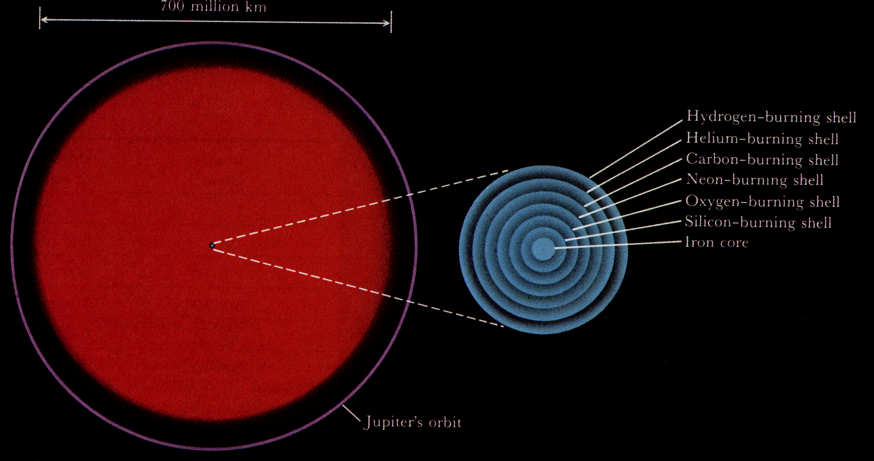
一个老的高质量恒星的结构
Notes:
The structure of an old high-mass star Near the end of its life, a high-mass star becomes a red supergiant almost as big as the orbit of Jupiter. The star's energy comes from six concentric burning shells, all contained within a volume roughly the same size as the Earth.

Slide 26
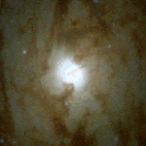
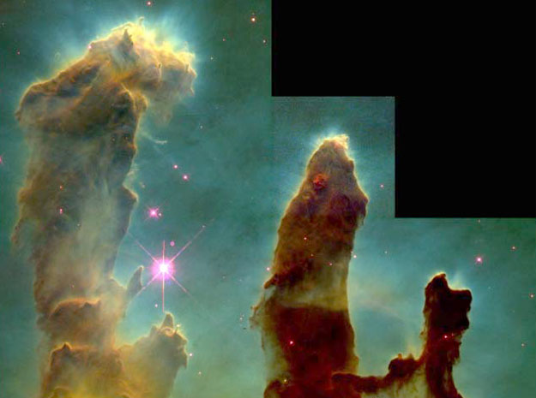
正 在 诞 生 年 轻 恒 星

Slide 27
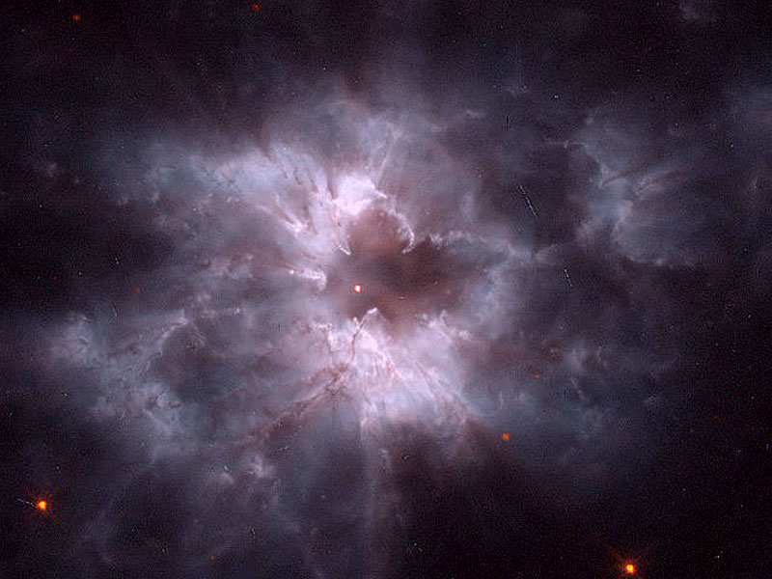
一个新白矮星
Notes:
The Sun today and as a red giant Today, the Sun's energy is produced in a hydrogen-burning core whose diameter is about 300,000 km. When the Sun becomes a red giant, in some 5 billion years, it will draw its energy from a hydrogen-burning shell surrounding a compact helium-rich core. The helium core will have a diameter of only 10,000 km.

Slide 28
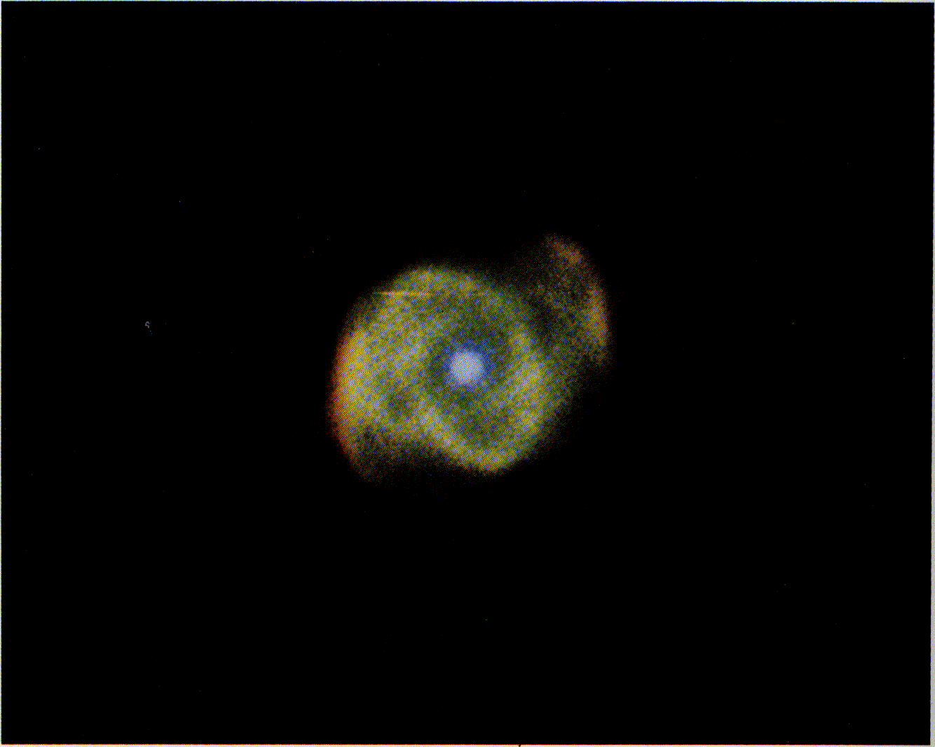
恒星的晚年（中心是致密星）
Notes:
.

Slide 29
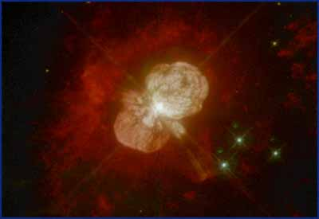
老 年 恒 星 辉 煌 的 葬 礼
Notes:
（up）The planetary nebula NGC 7293 This beautiful object, often called the Helix Nebula, covers art area of the sky equal to half the full moon. The star that ejected these gases is seen at the center of the glowing shell. The greenish color cones from oxygen ions, while the pink and red comes from nitrogen and hydrogen ions. This nebula is in the constellation of Aquarius, about 400 light years from Earth. (Angle-Australian Observatory)
（down）The planetary nebula NGC 6302 At the end of their lives, low-mass stars shed much of their mass. Although most cases involve a fairly symmetrical ejection of gases, there are many examples in which the gas has expanded unevenly. An irregular planetary nebula such as NGC 6302 in Scorpius (shown here) is the result. Spectroscopic observations of NGC 6302 indicate that the gases are moving toward us at 400 km/sec, indicating a particularly violent initial ejection. (Angle-Australian Observatory)

Slide 30
谢谢听讲
第十章结束

