Slide 1


PLANT-DETECT
Chen Dahan – 207860420
Gilad Fisher – 318471109
Daniel Zin – 208640326

Slide 2
Main goals
Allow nature lovers to be safely educated about the wild
Give experts the platform to share knowledge with the community
Share and remember your encounters with nature
Protect new foragers

Slide 3
How do we do that?
Split our users into groups of amateurs and experts
Amateurs can upload photos of an organism they encountered on a hike and ask what it is
Experts can later comment on the post to share their opinion or like a comment made by another expert if they agree
Experts can also share known locations of plants

Slide 4
Similar apps?
"iNaturalist" is very similar
iNaturalist's approach:
Utilizes user votes for organism identification.
All users have equal participation and identification authority.
Our App's Unique Approach:
Users are categorized into experts and amateurs.
Experts: Responsible for verifying and confirming identifications.
Amateurs: Upload images and initial identifications.
Notes:
Plenty of app rely on ai for classification
Experts on our app are required to provide a certificate as proof of their experties

Slide 5

Chen's Part
Sign up and Login activities
Comment upload and view system
Maps integration and land markers

Slide 6
Gilad's Part
Comment Likes System
Expert certificate upload
Post retrieval and view

Slide 7
Daniel's Part
Task bar and activity fragments

Slide 8
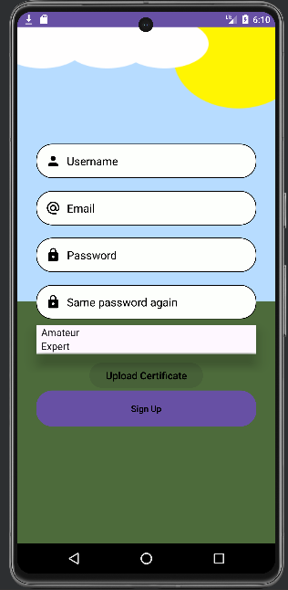
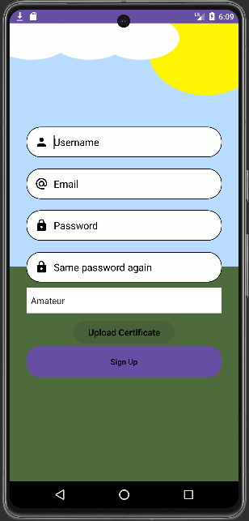
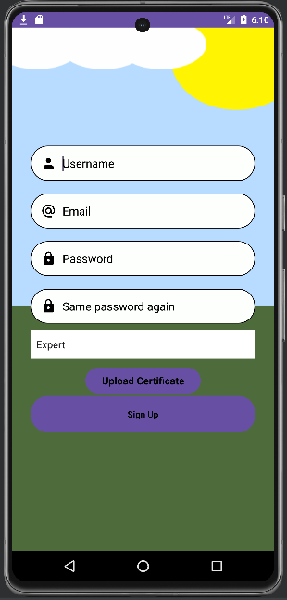
Signing up
Choose amateur or expert account
Amateur account doesn't require certificate
Expert account requires certificate

Slide 9
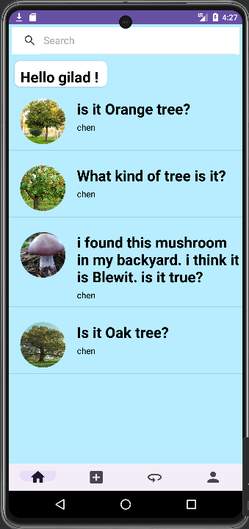
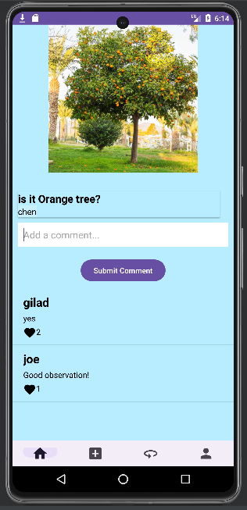
What it looks like

Slide 10
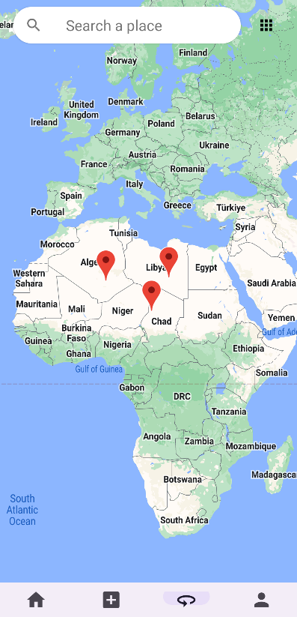
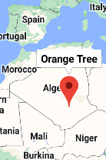
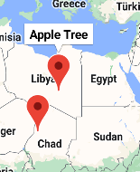
What it looks like

Slide 11
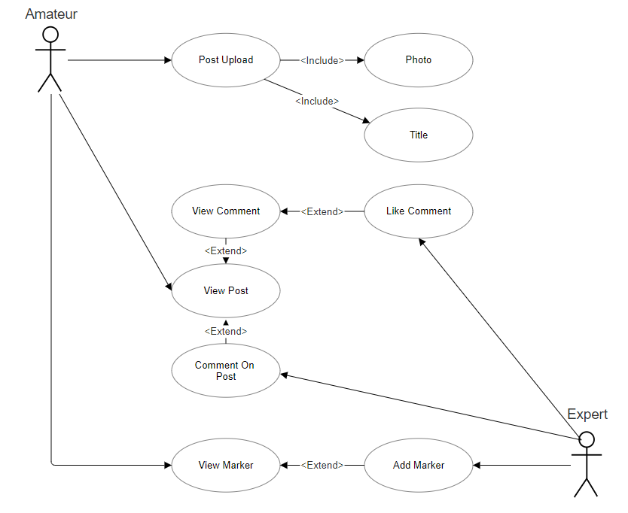
Use Case Diagram
Amateurs can view posts or post a new one
An expert can add comments to an existing post
Experts can later like comments made by other experts
Amateurs can also view the comments

Slide 12
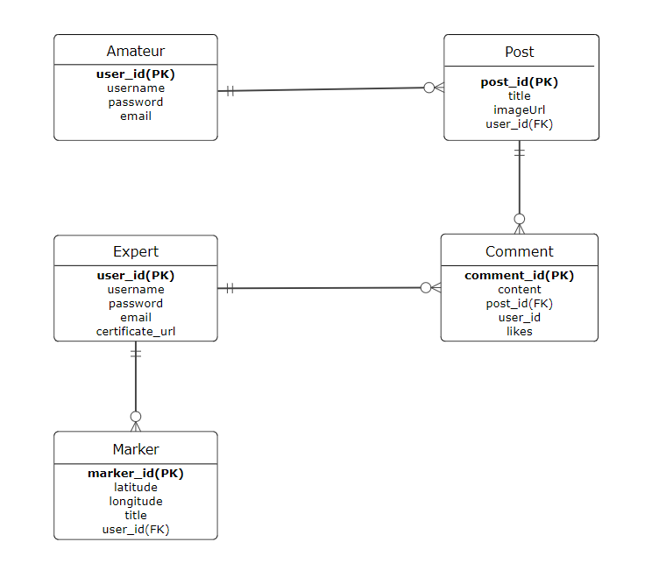
ERD
Posts have a picture in the form of a URL
Each comment has one post reference (ID)
Comments remember the IDs of Experts who liked them to avoid double-likes
Markers have GPS coordinates and description of organism

Slide 13
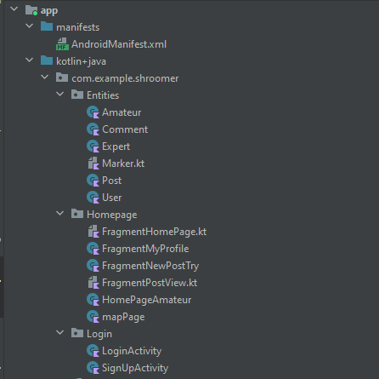
Files Order
Entities – for objects
Homepage – for the fragments of the main activity
Login – for the login and sign up phase

Slide 14
Functional Requirements
New user sign up
User authentication (Login)
Post upload
Comment on post
Like a comment
Search post by title
Add geo-markers
Retrieve expert's certificate

Slide 15
Non - Functional Requirements
Compatibility with Android OS
Scalability – unlimited number of users
Usability – hard to make mistakes
Availability – System is up 24/7
Follow MVC design pattern

Slide 16
Unfulfilled Plans
Support for multiple images and videos in the same post
E-mail verification by one-time code
Password recovery

