Slide 1

HongShing
A phone-first loyalty & pickup-ordering platform for restaurants
Product demo · Bridgeway Innovations · 2026

Slide 2
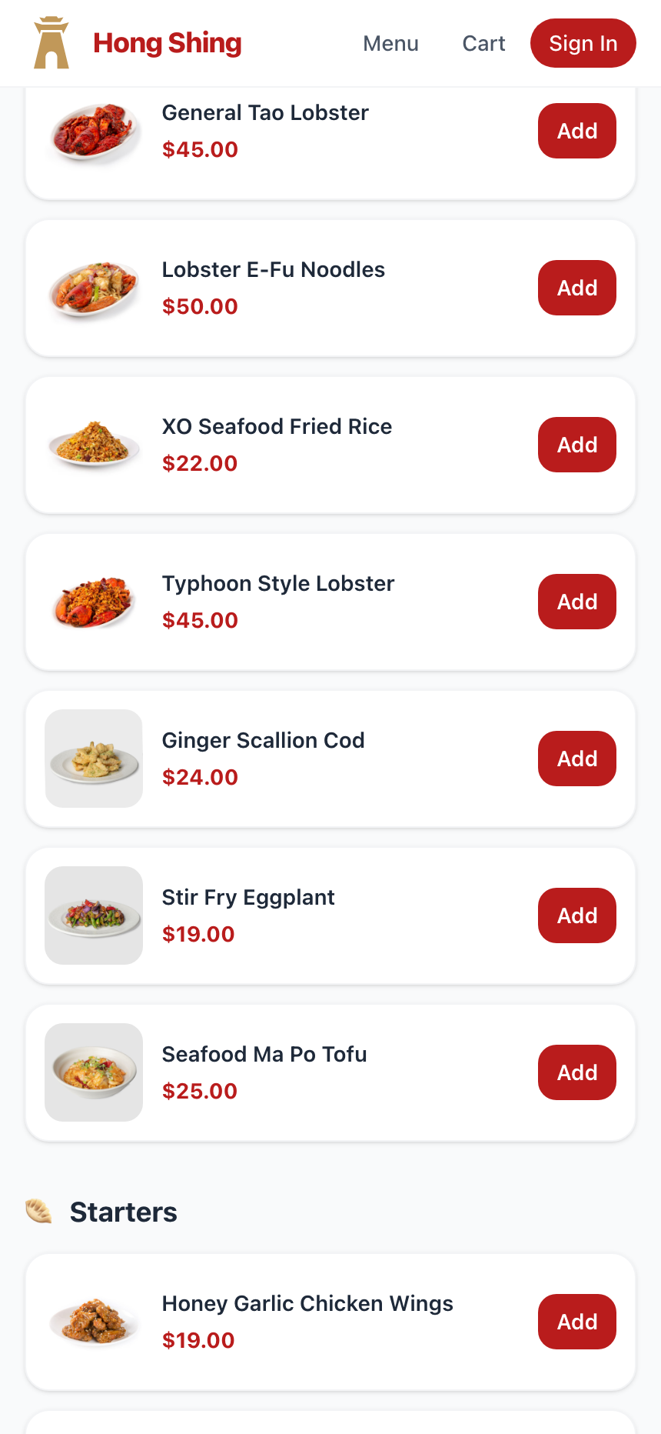
Turn every table into a rewards member
Put a QR code on every table and receipt. Diners join in about ten seconds — just a phone number.
1
10-second signup
Phone number only — no app, no password.
2
You own the customers
The member list is yours, not a delivery app's.
3
Attribution built in
See which QR placement drives each signup.

Slide 3
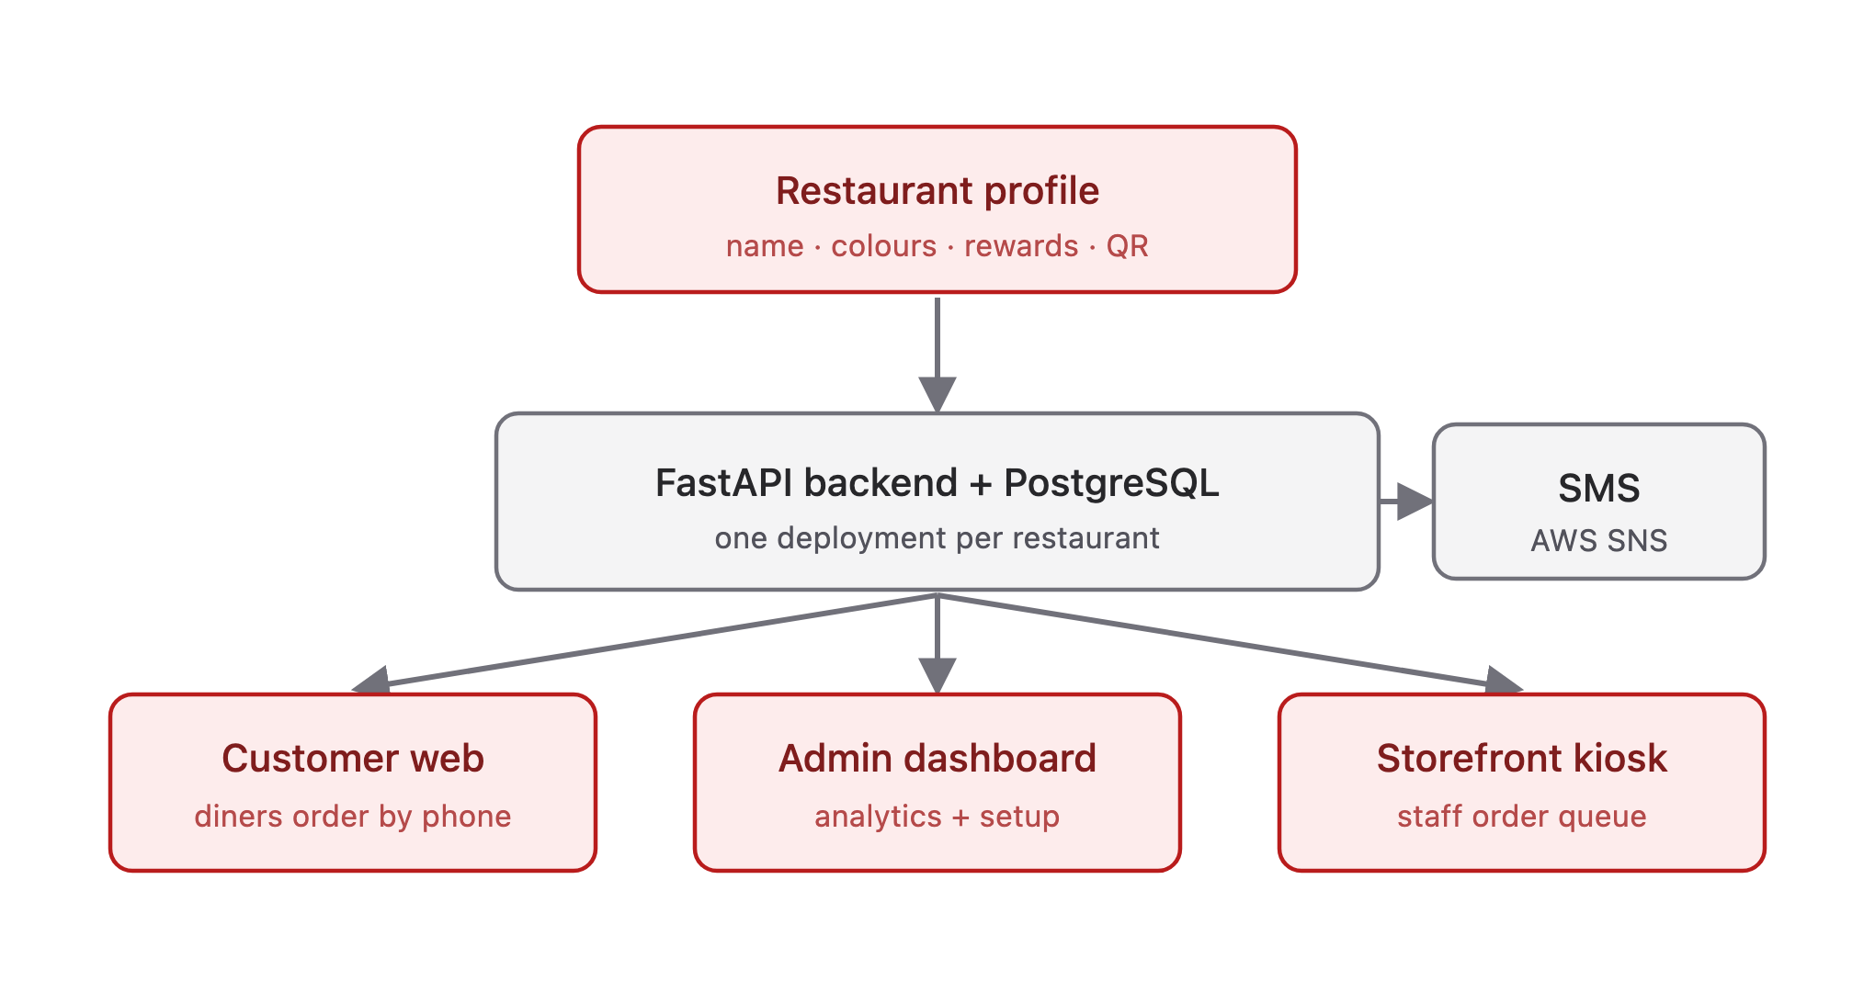
One platform, three surfaces
A single restaurant profile configures the backend and all three apps.

Slide 4
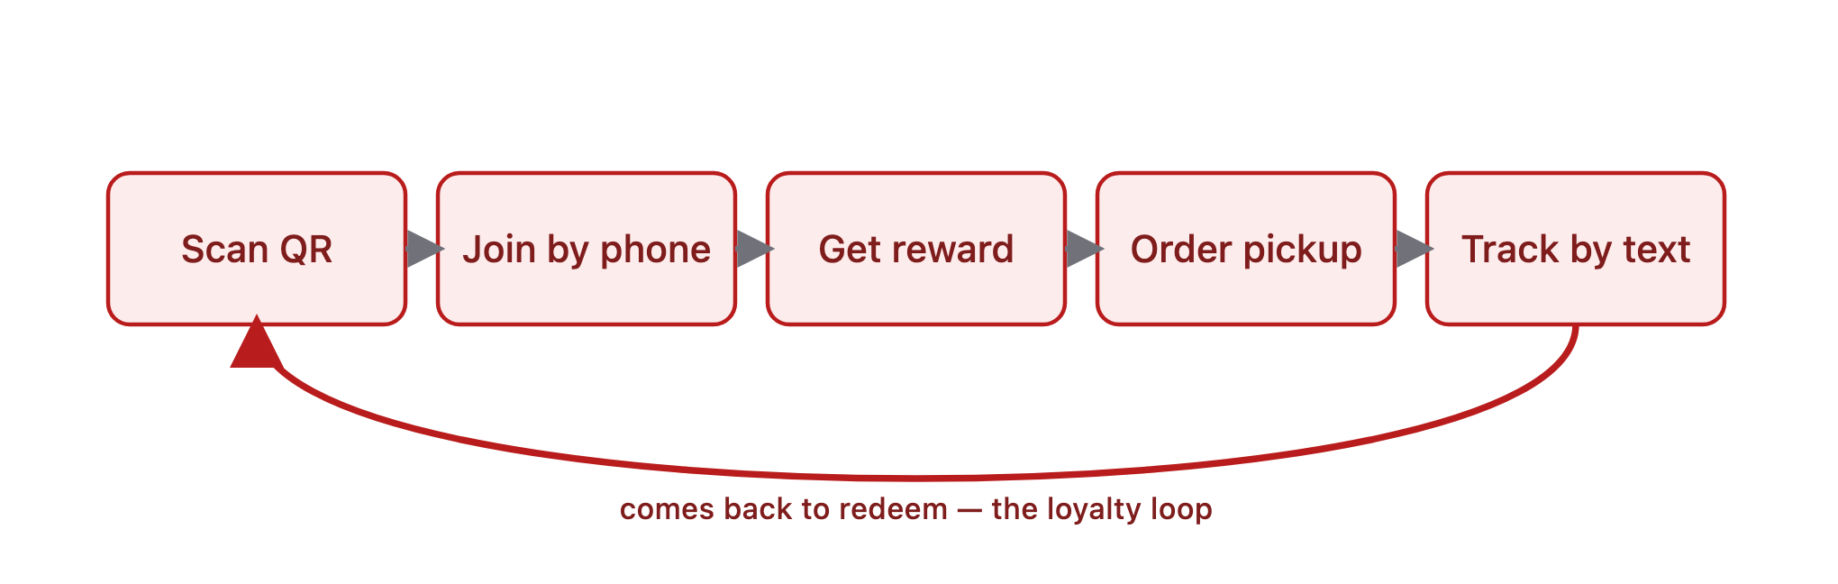
A loop that brings diners back
Scan → join → reward → order → return. The reward is the reason to come back.

Slide 5
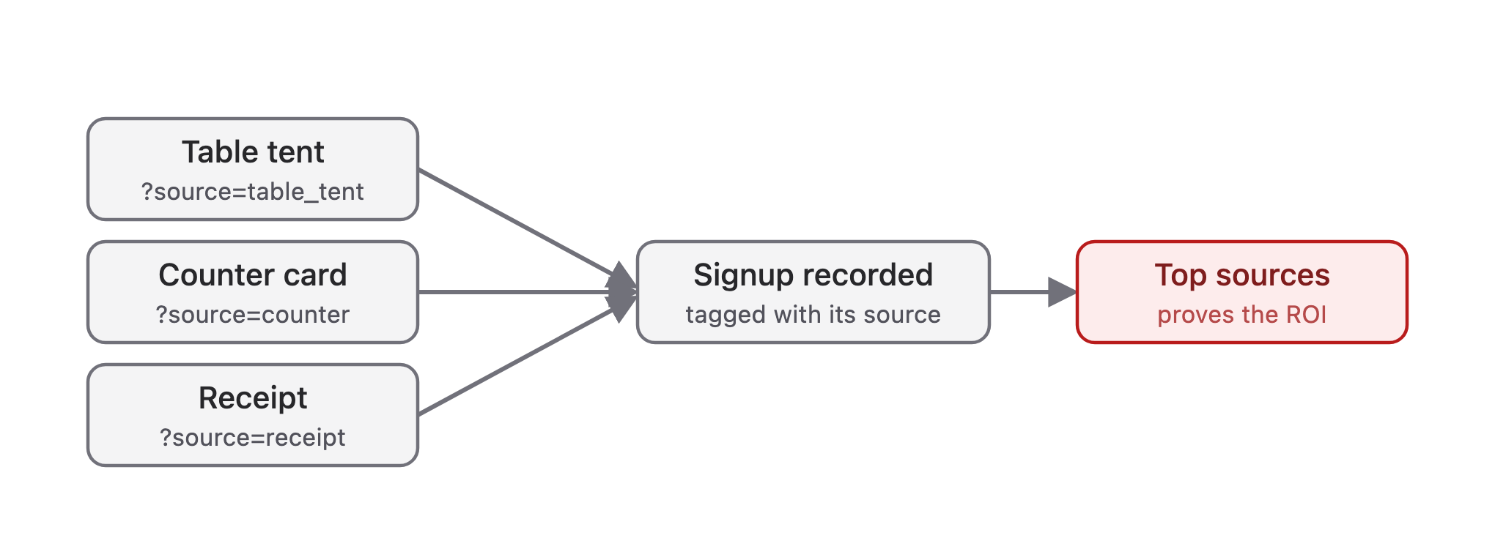
Every scan is attributed
Each QR placement carries its own code, so you see what actually drives signups — ROI for free.

Slide 6
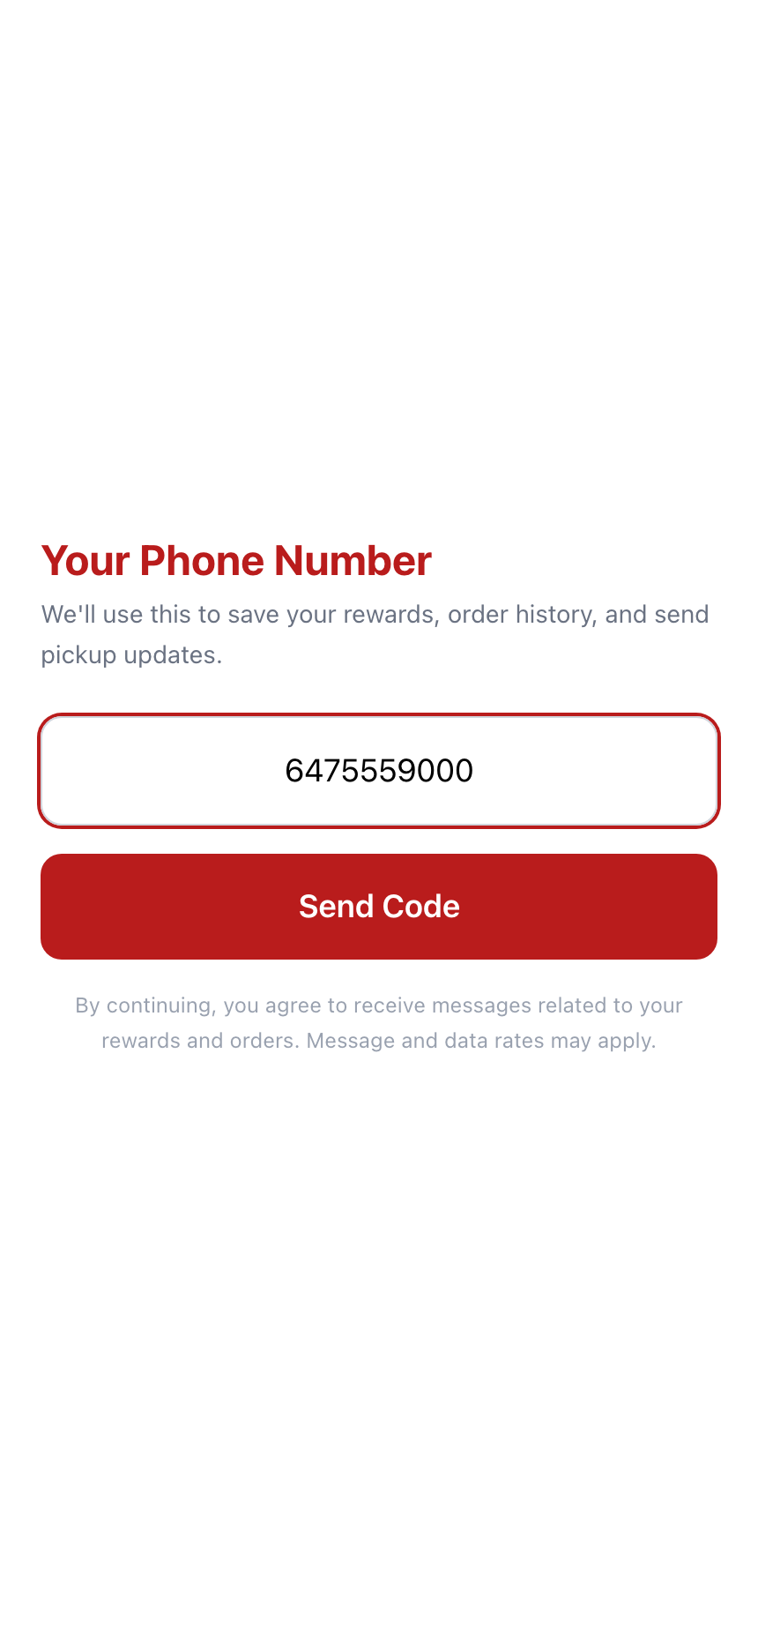
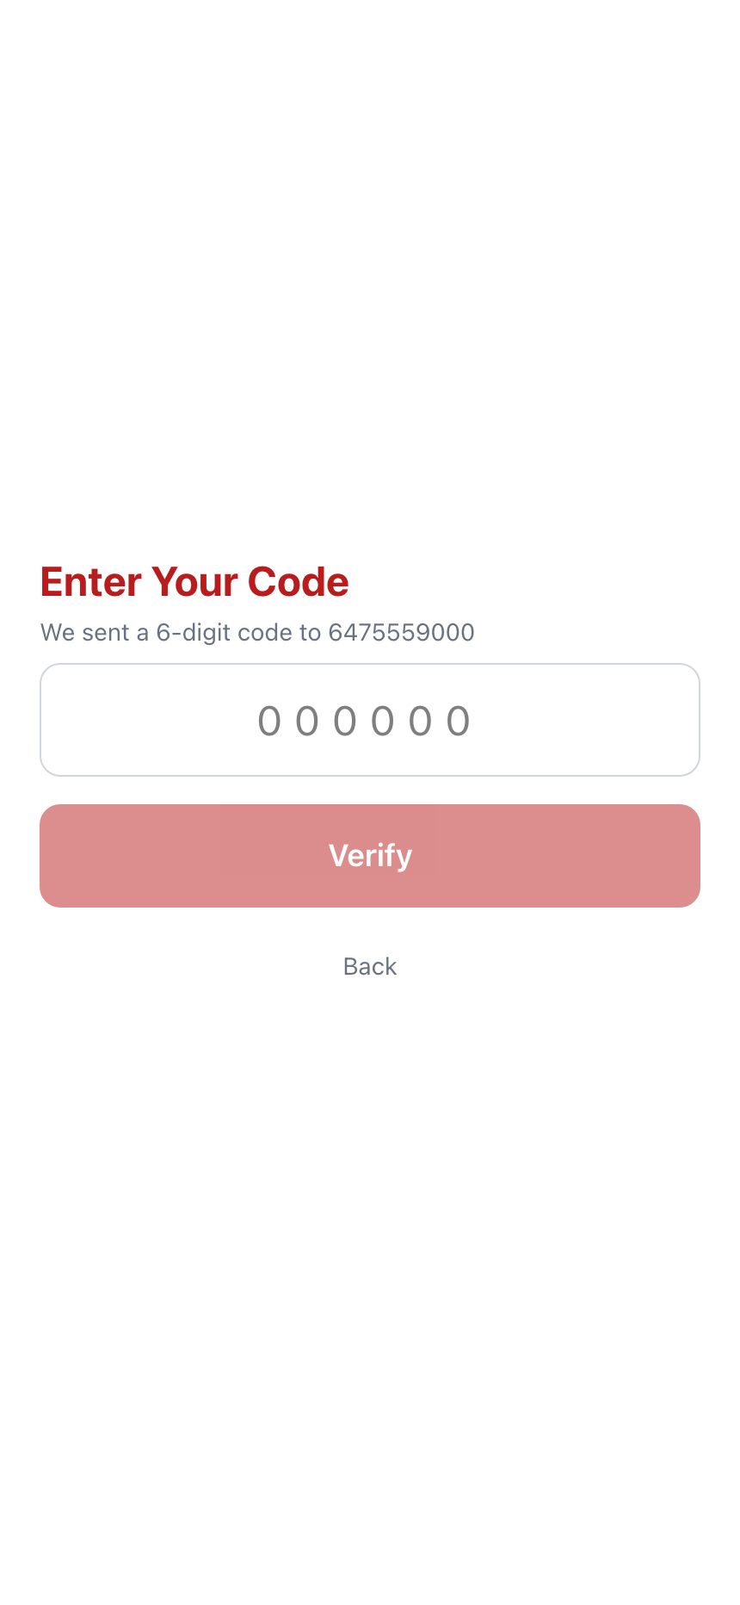
Join in ten seconds — no app
Scan → branded menu
Just a phone number
6-digit text code

Slide 7
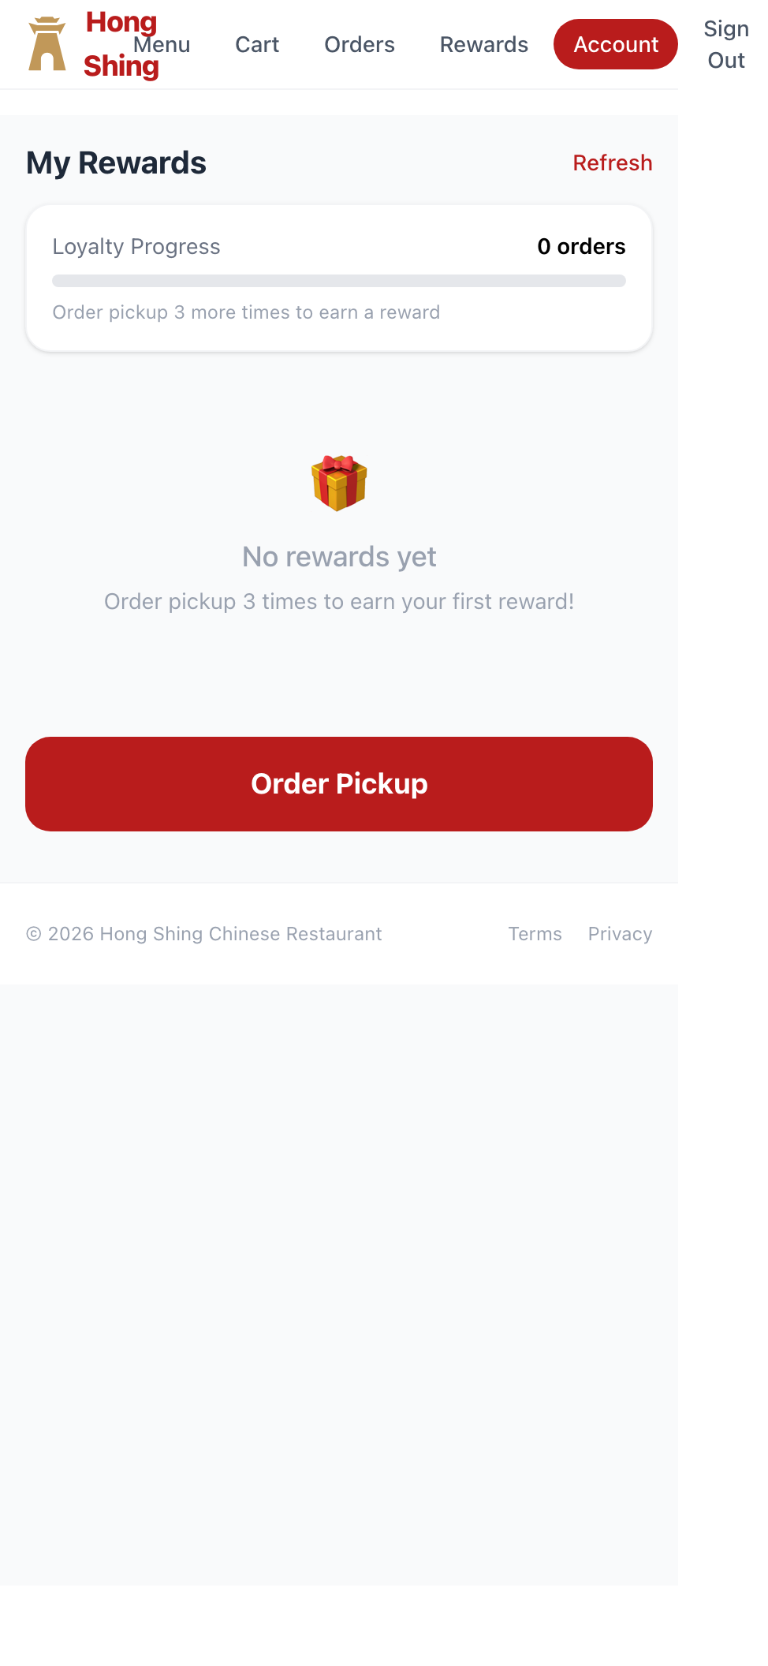
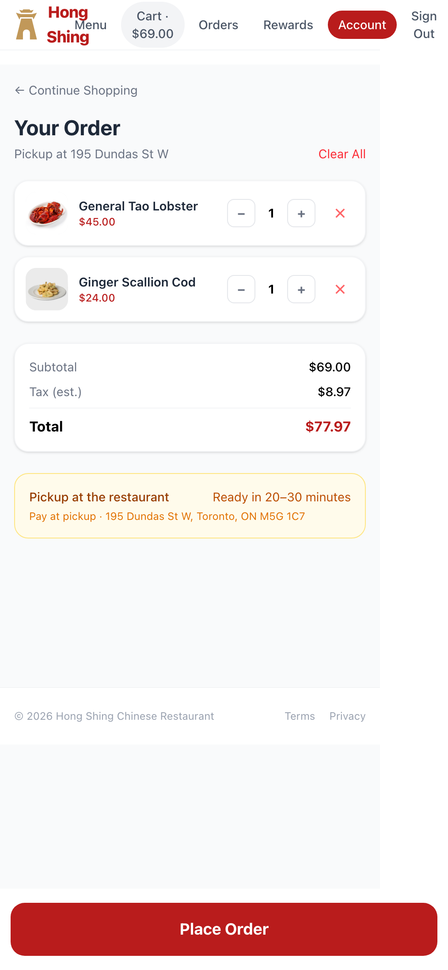
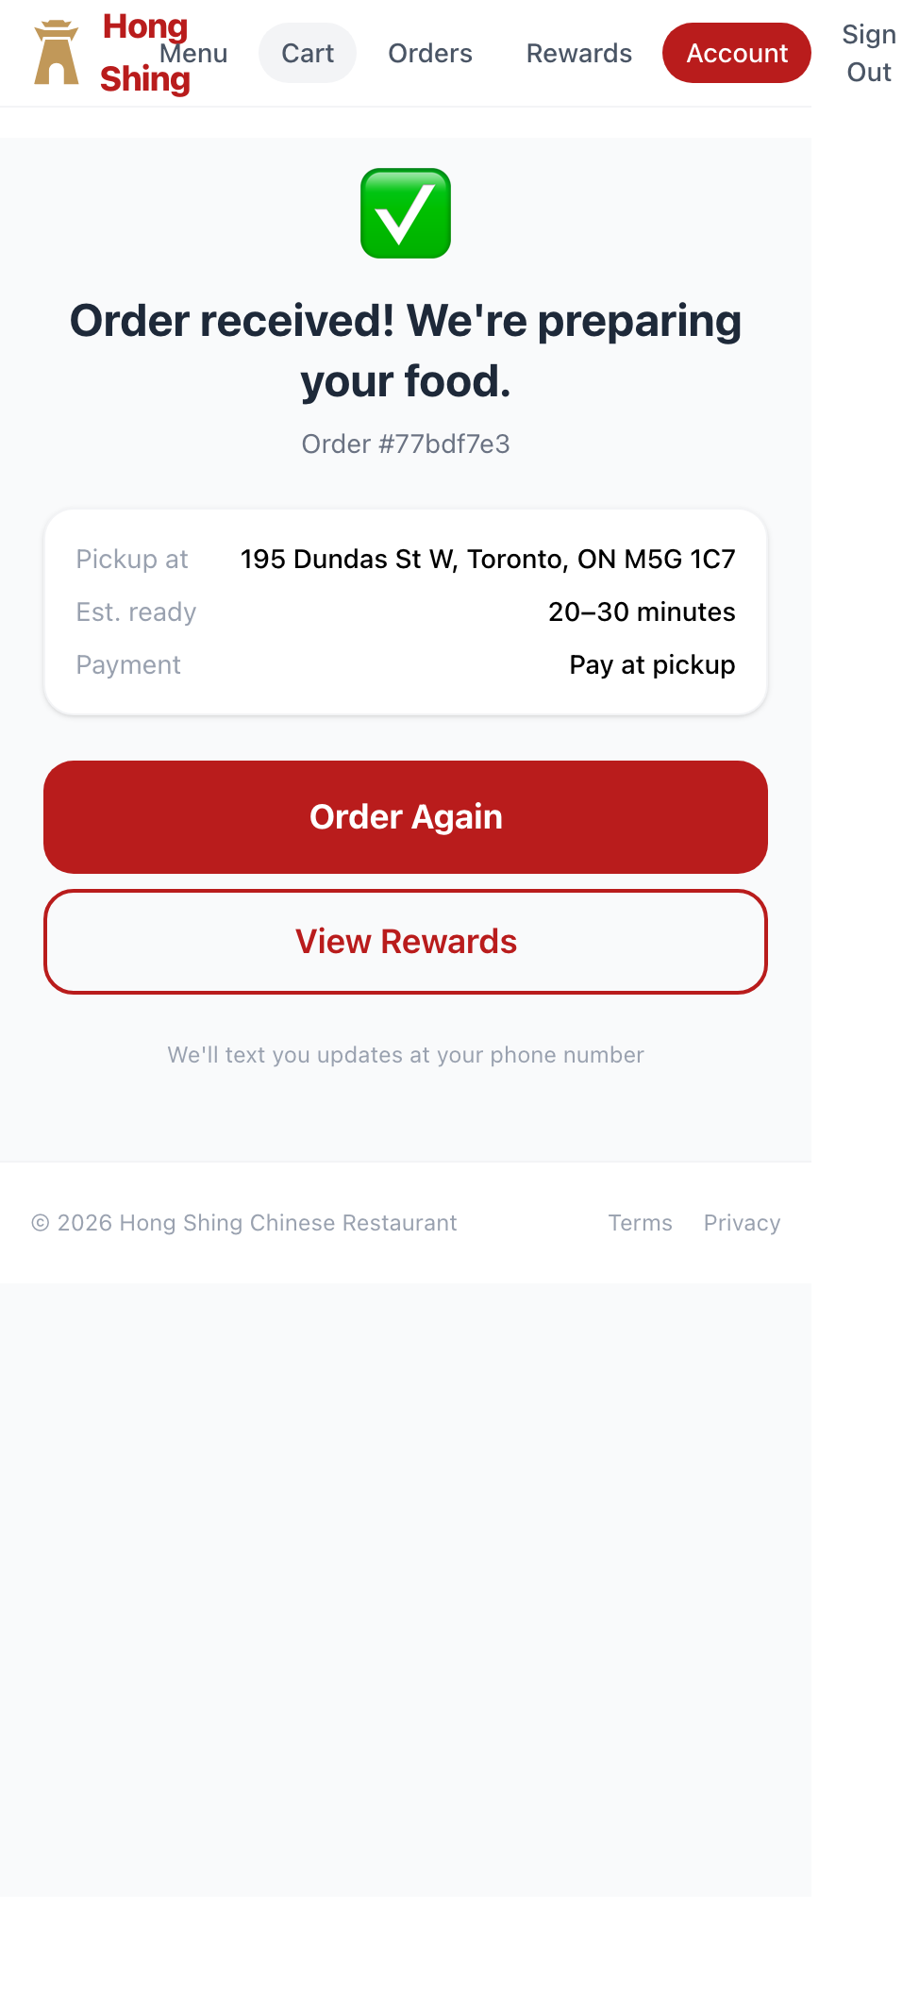
Order pickup, earn the reward
Your reward, ready
Cart with tax + total
Order placed — texted updates

Slide 8
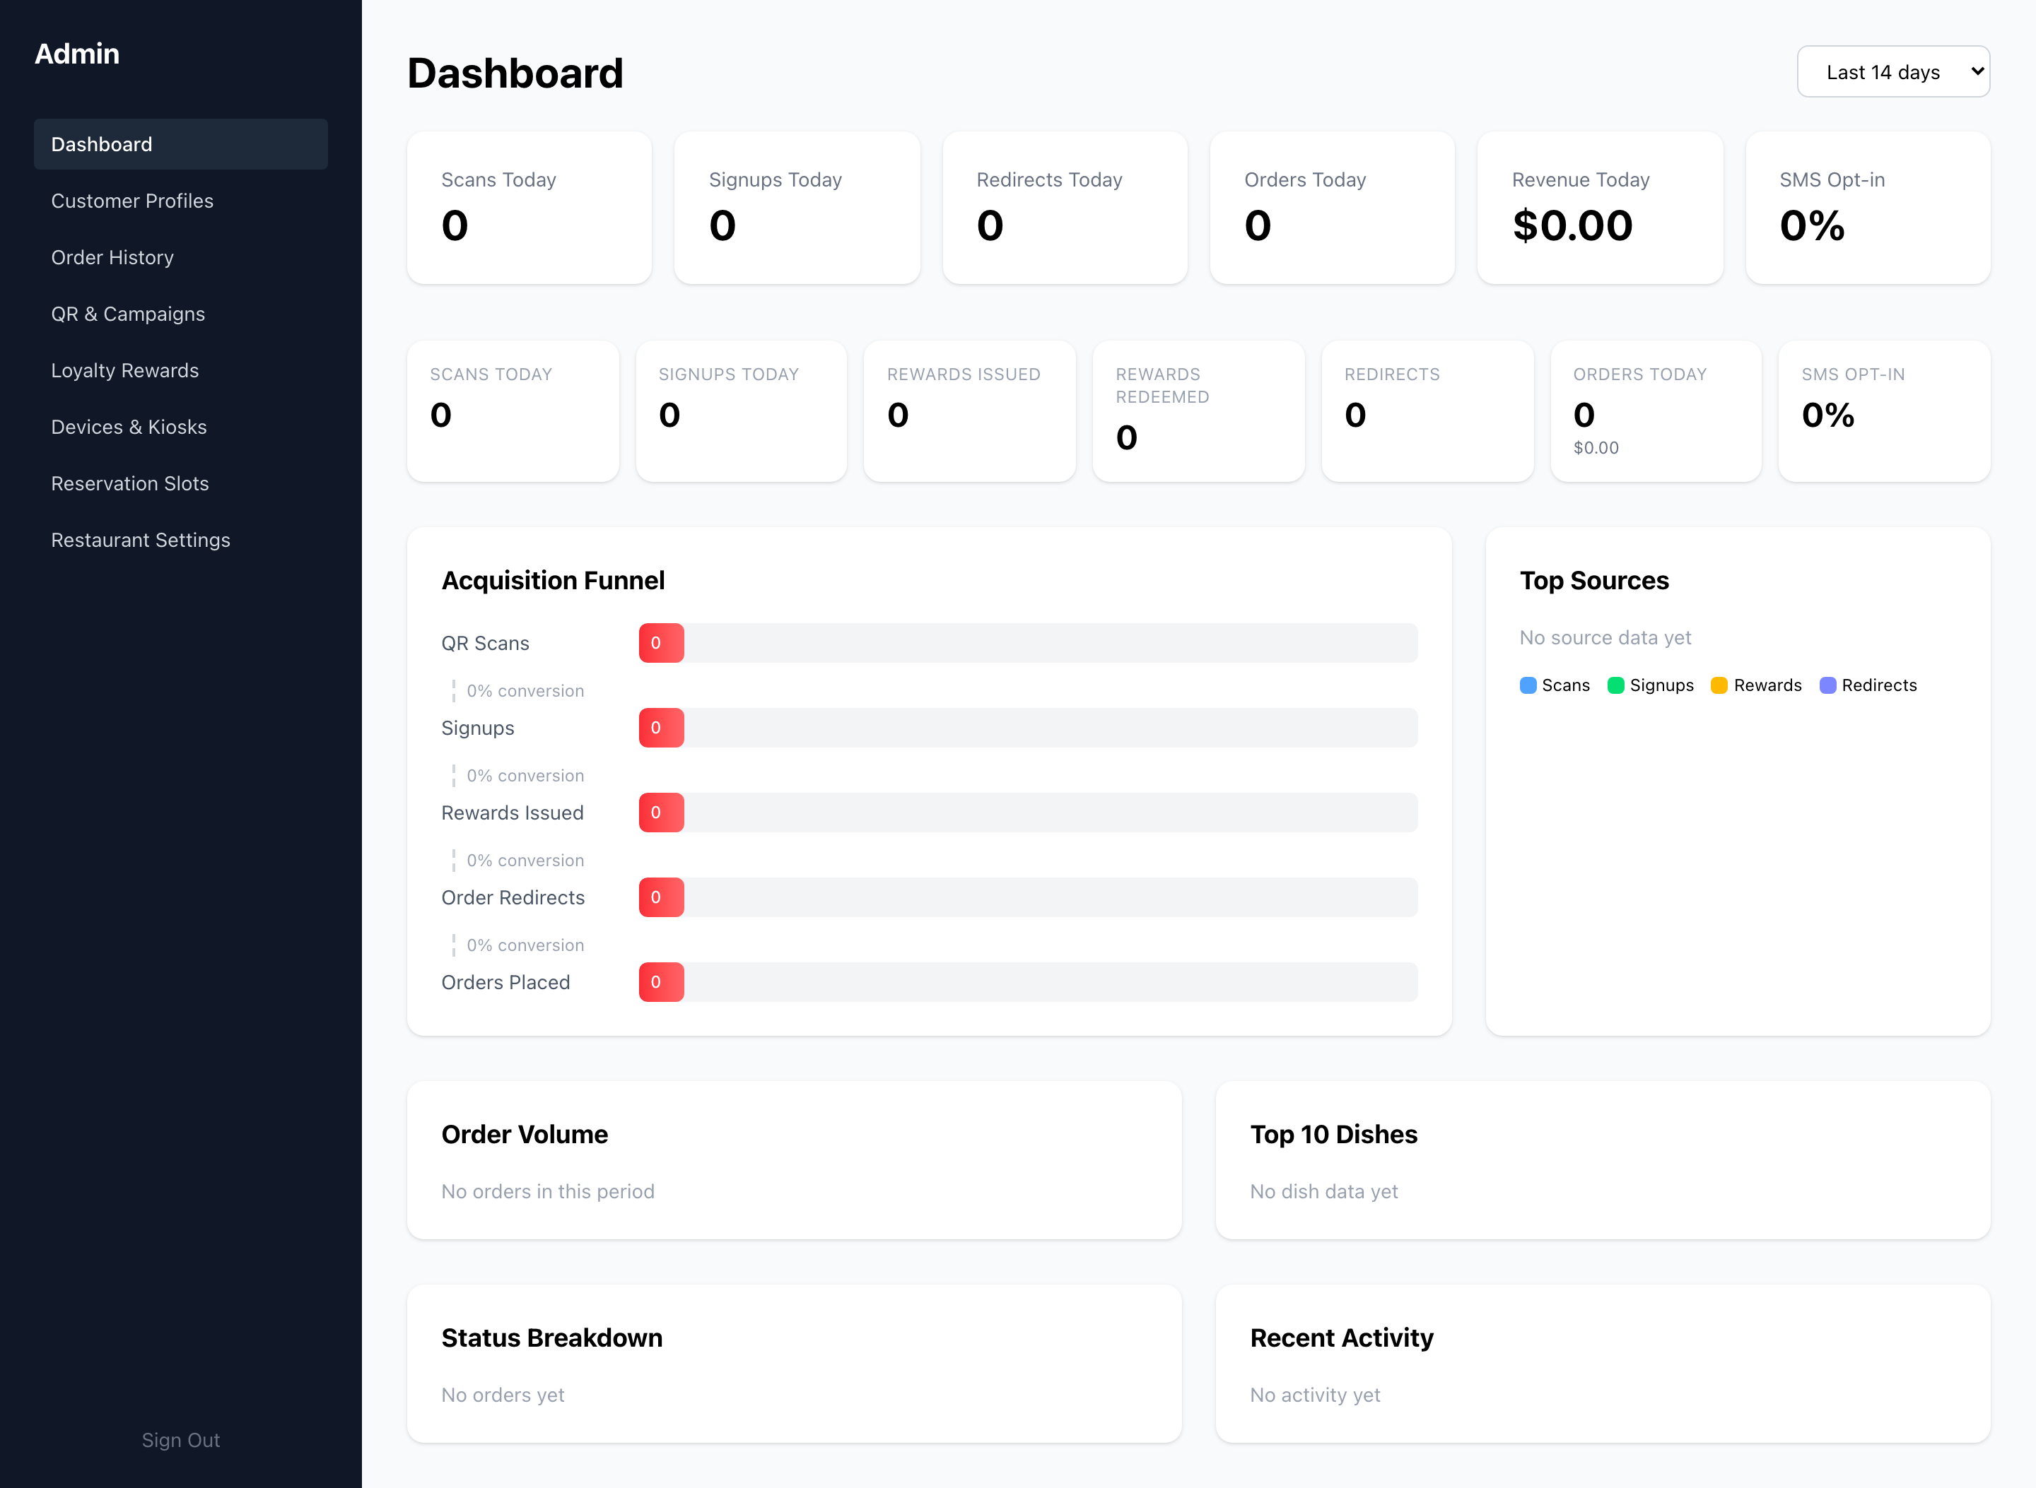
See exactly what's working
Attribution that proves ROI
The dashboard shows scans, signups, rewards, orders and revenue at a glance — plus a top-sources breakdown that reveals which QR placement drove each signup. That's the number that justifies the program.

Slide 9
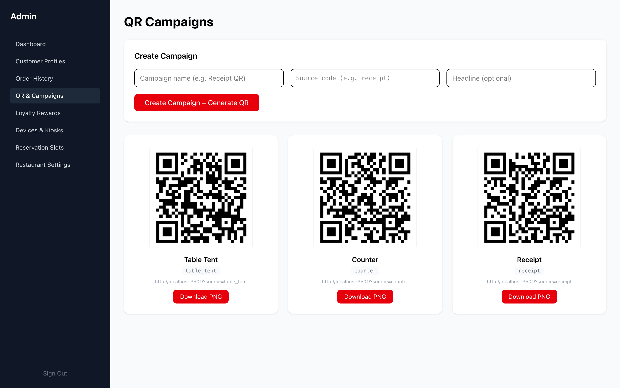
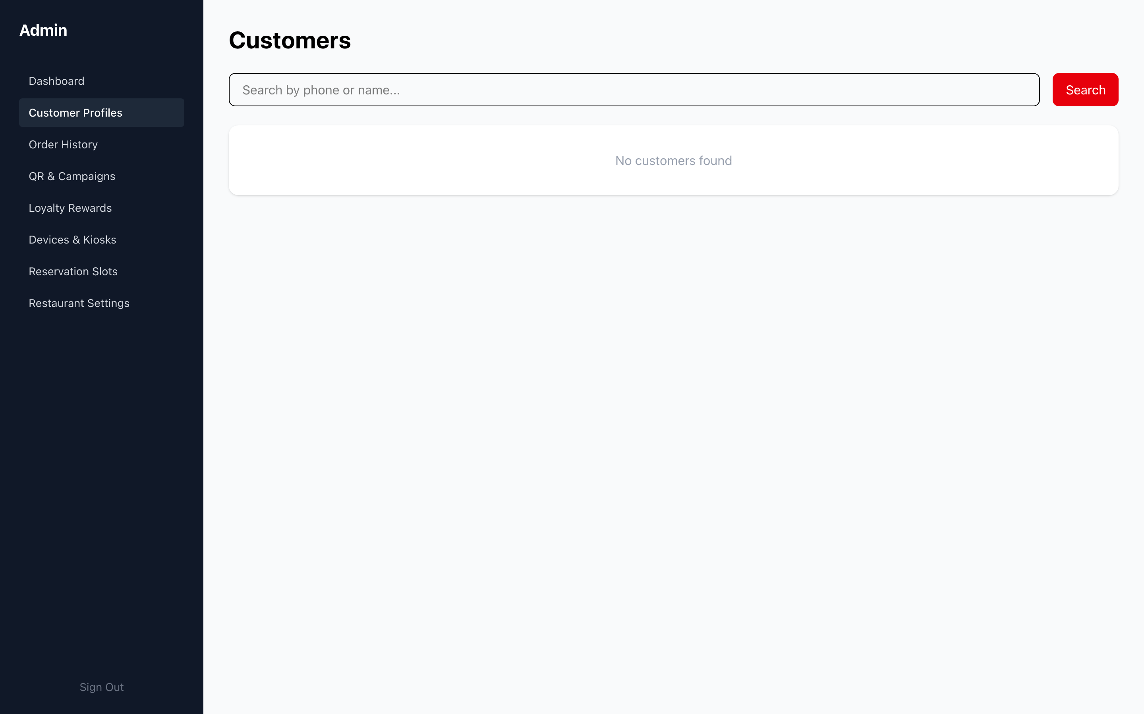
Run the whole program in one place
Generate printable QR codes
Every member, searchable

Slide 10
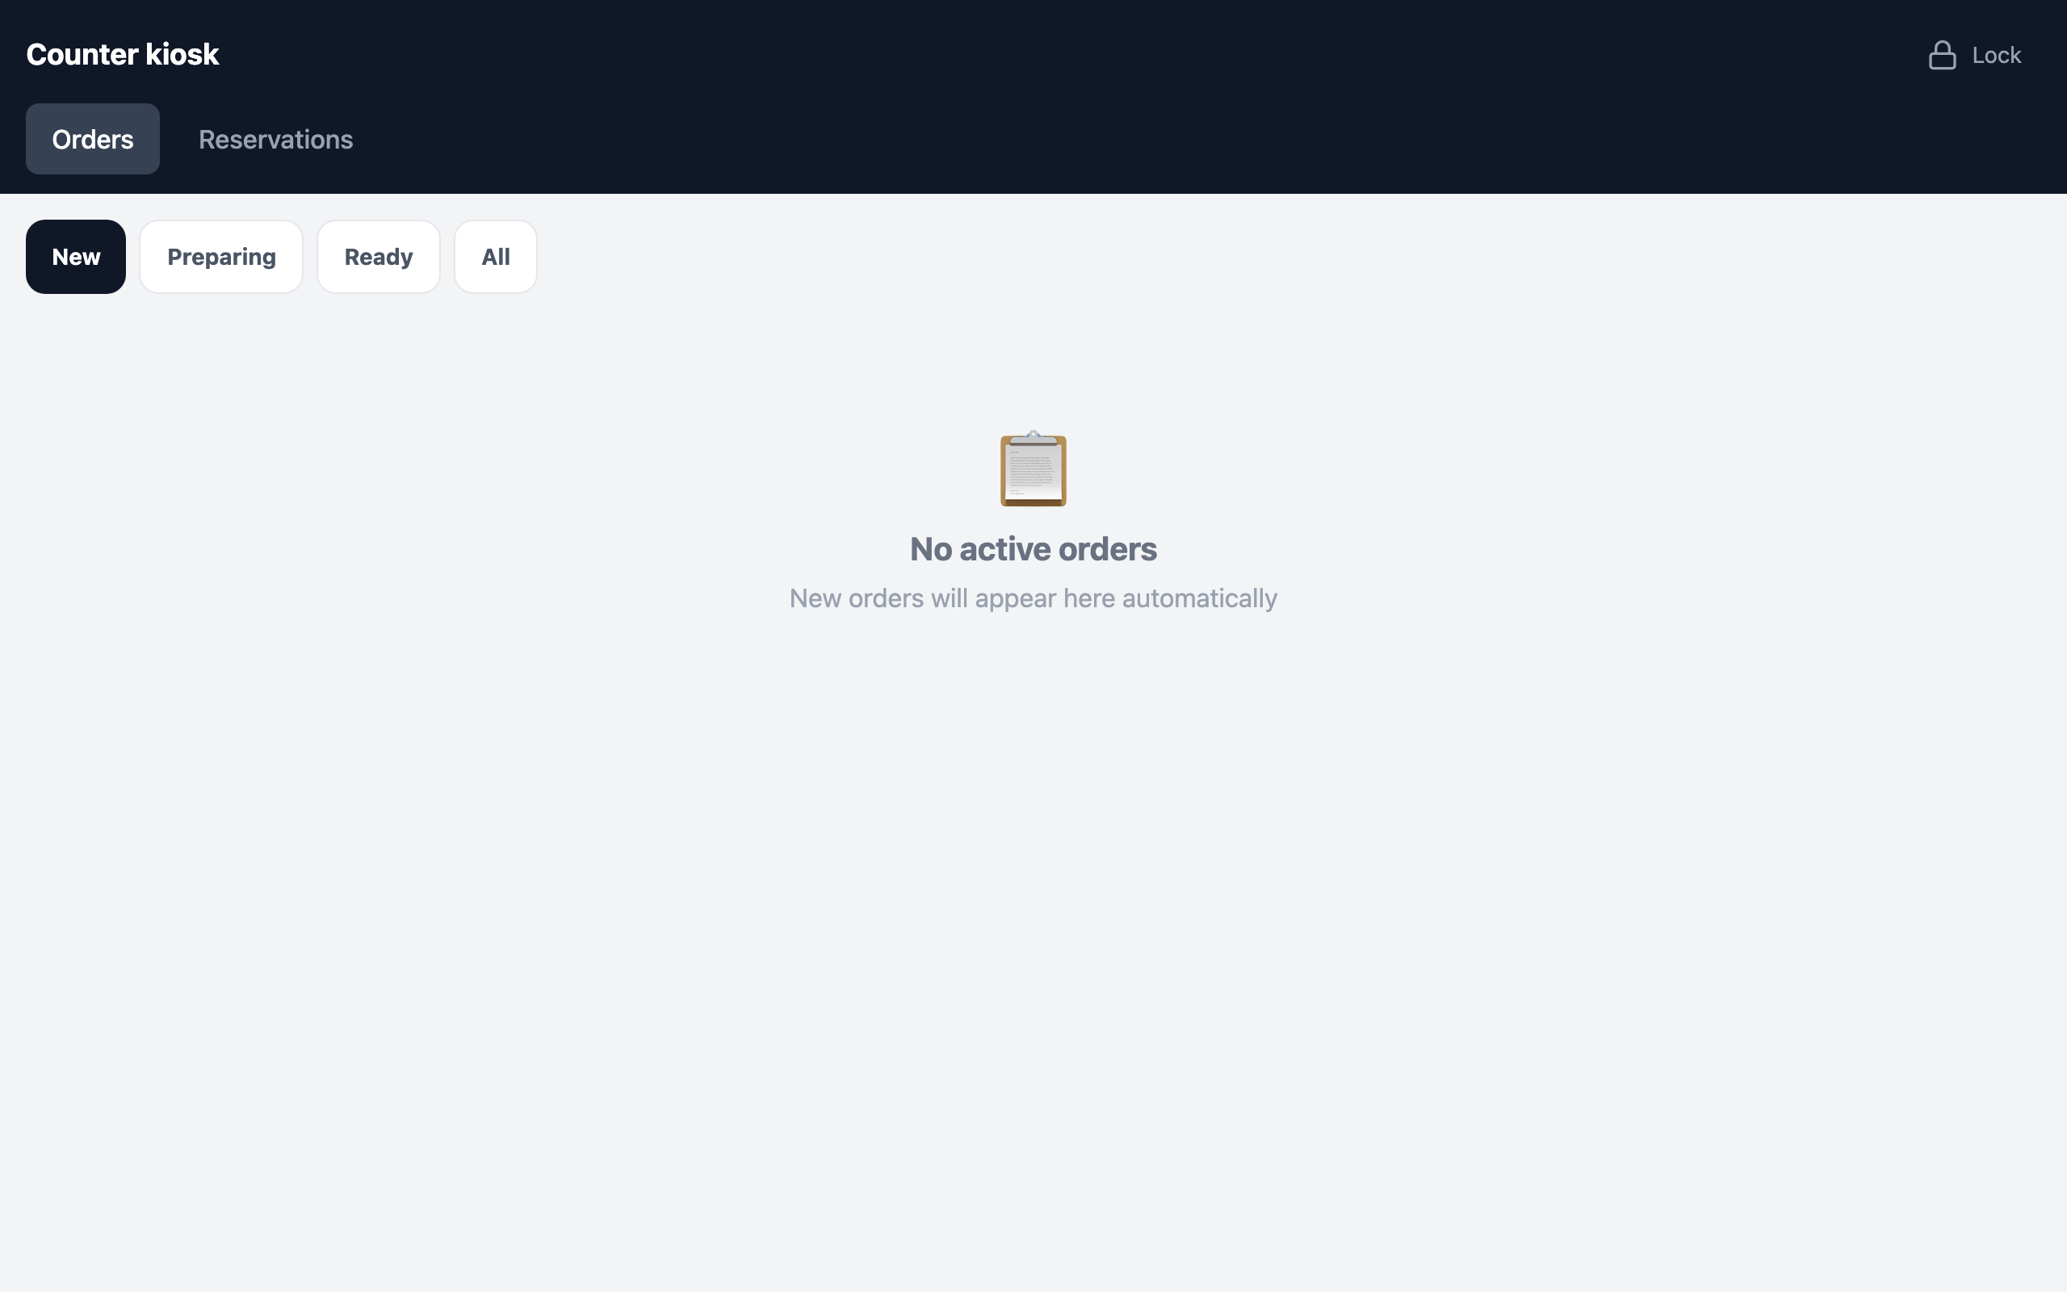
A dead-simple kiosk for staff
Runs on any tablet
The live queue moves New → Preparing → Ready. A new pickup order appears within seconds, and the diner is texted at each step. Pair the device with a one-time PIN — no staff accounts, no POS integration needed.

Slide 11
Restaurant-in-a-box
One profile → a fully branded, isolated deployment for any restaurant.
Fully branded
You own the data
Managed or owned
Your name, colours, logo and menu — not a generic app.
The member list and every order are yours to keep.
We run it for you, or hand it over on your own domain.

Slide 12
Let's put HongShing on every table.
Bridgeway Innovations
daniel.chen@bridgewayinnovations.ca

