Slide 1
PLANAHEAD(SOC)
軟體操作步驟
0252038 劉峻瑜 電子4A

Slide 2
1.open the planahead_driver_registeri_led_2.pptx
2.modify the else setting(next page)

Slide 3
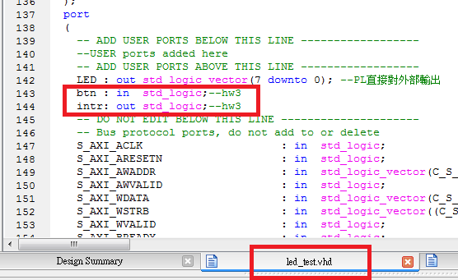

Slide 4
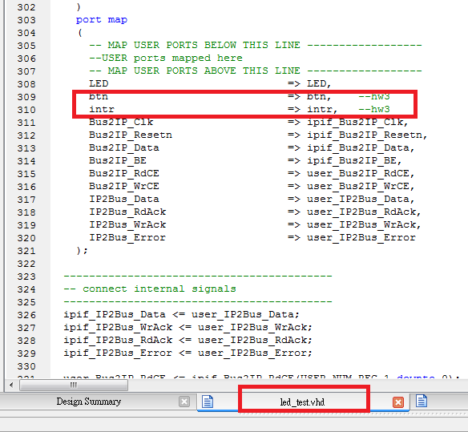

Slide 5
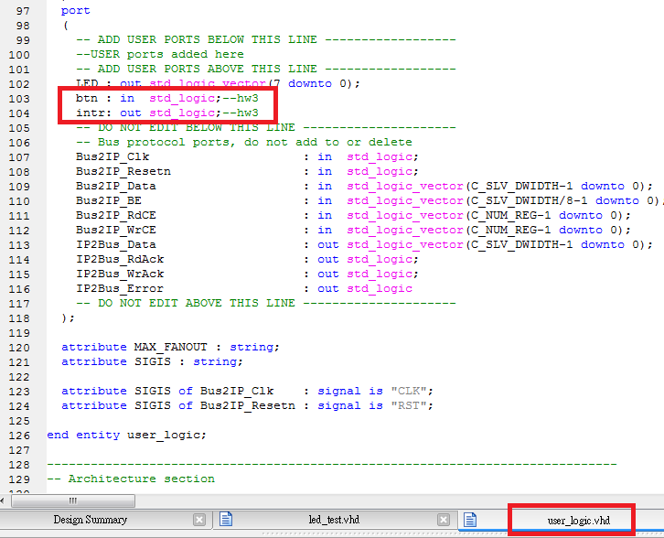

Slide 6
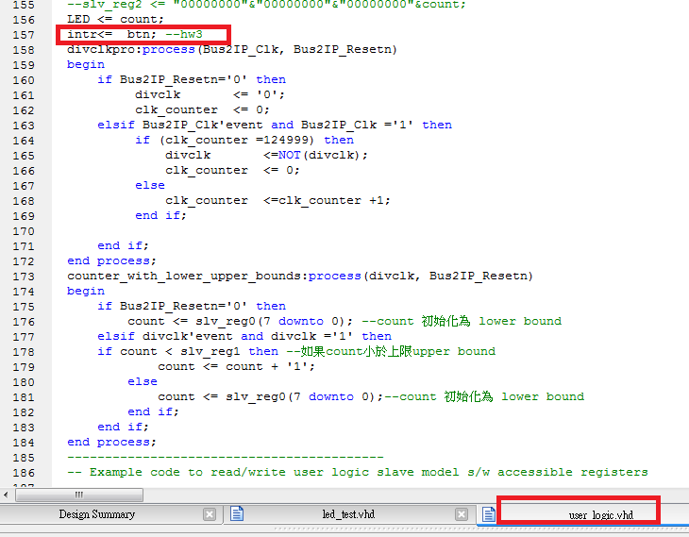

Slide 7
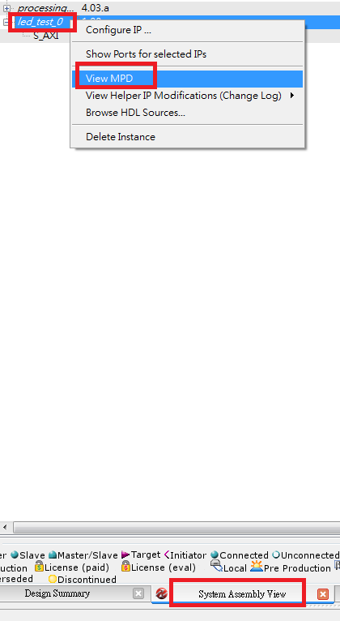

Slide 8
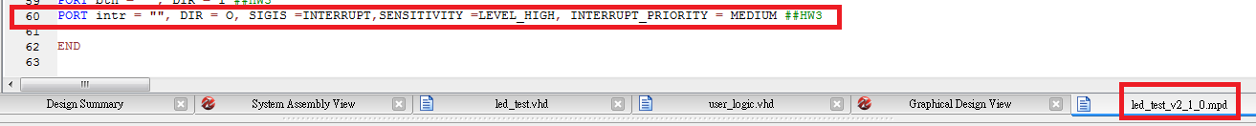
PORT intr = "", DIR = O, SIGIS =INTERRUPT,SENSITIVITY =LEVEL_HIGH, INTERRUPT_PRIORITY = MEDIUM ##HW3

Slide 9
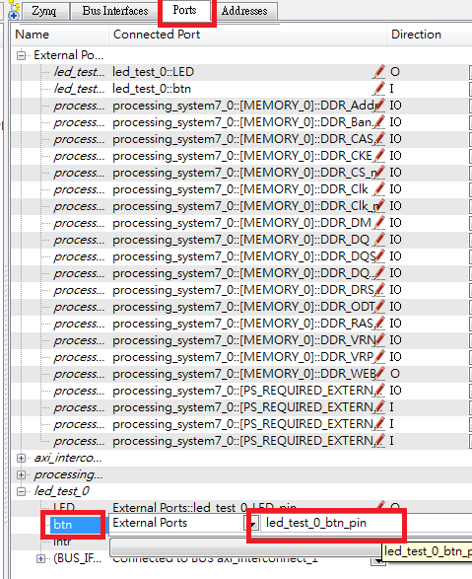
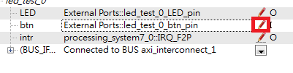
1.Click the pen

Slide 10
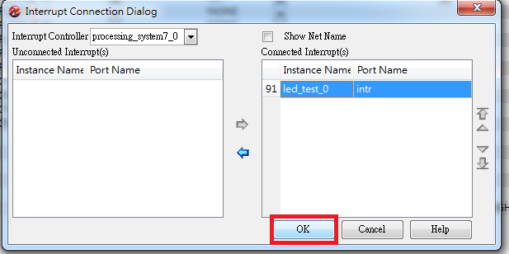
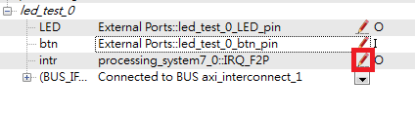
1.Click the pen

Slide 11
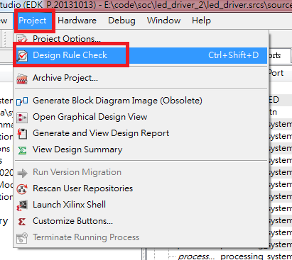
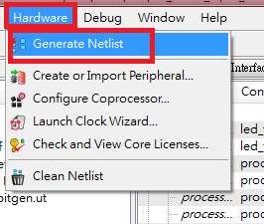

Slide 12
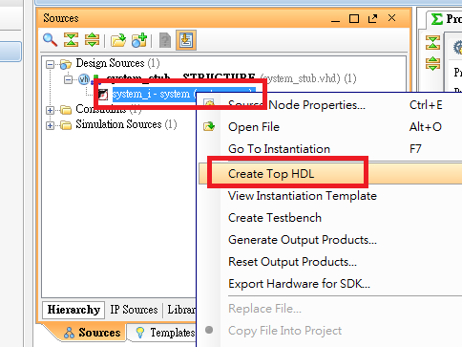

Slide 13
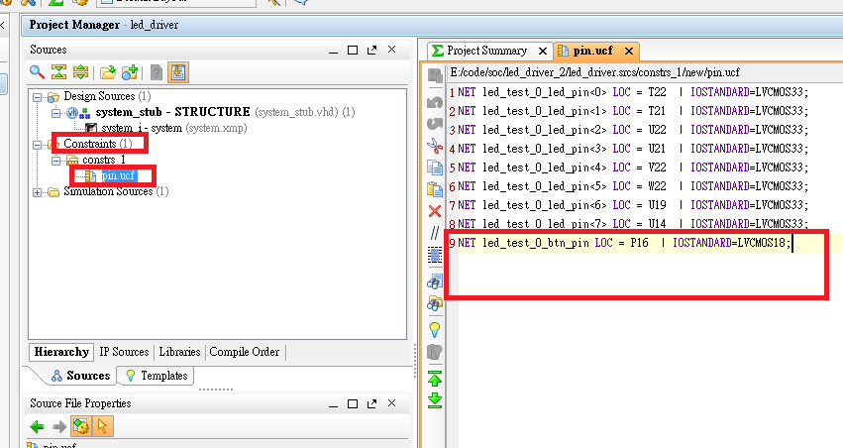
NET led_test_0_btn_pin LOC = P16 | IOSTANDARD=LVCMOS18;

Slide 14
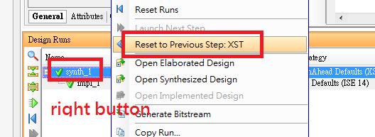
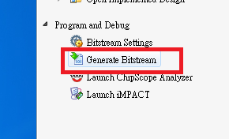
圖一. 圖二.
1.Then download .bit

Slide 15

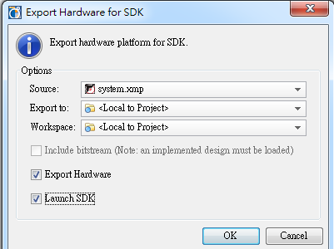

Slide 16
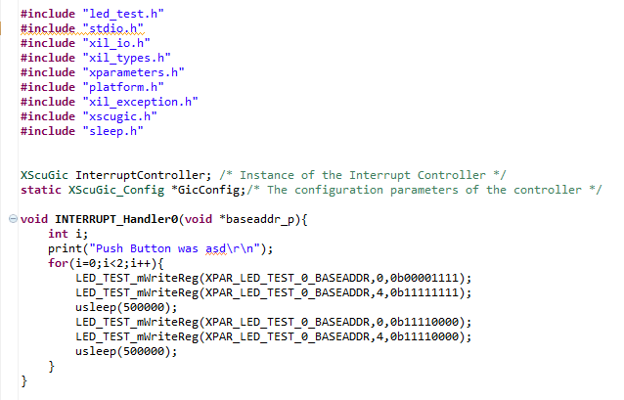
Helloworld.c
#include "led_test.h"
#include "stdio.h"
#include "xil_io.h"
#include "xil_types.h"
#include "xparameters.h"
#include "platform.h"
#include "xil_exception.h"
#include "xscugic.h"
#include "sleep.h"
XScuGic InterruptController; /* Instance of the Interrupt Controller */
static XScuGic_Config *GicConfig;/* The configuration parameters of the controller */
void INTERRUPT_Handler0(void *baseaddr_p){
int i;
print("Push Button was asd\r\n");
for(i=0;i<2;i++){
LED_TEST_mWriteReg(XPAR_LED_TEST_0_BASEADDR,0,0b00001111);
LED_TEST_mWriteReg(XPAR_LED_TEST_0_BASEADDR,4,0b11111111);
usleep(500000);
LED_TEST_mWriteReg(XPAR_LED_TEST_0_BASEADDR,0,0b11110000);
LED_TEST_mWriteReg(XPAR_LED_TEST_0_BASEADDR,4,0b11110000);
usleep(500000);
}
}

Slide 17
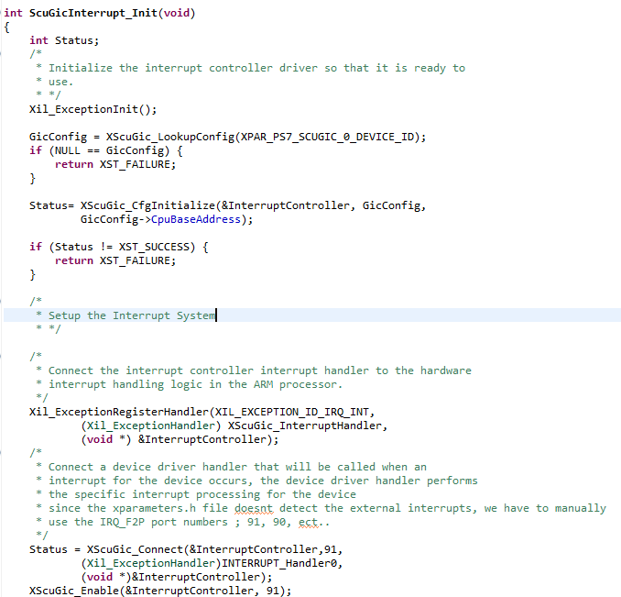
int ScuGicInterrupt_Init(void)
{
int Status;
/*
* Initialize the interrupt controller driver so that it is ready to
* use.
* */
Xil_ExceptionInit();
GicConfig = XScuGic_LookupConfig(XPAR_PS7_SCUGIC_0_DEVICE_ID);
if (NULL == GicConfig) {
return XST_FAILURE;
}
Status= XScuGic_CfgInitialize(&InterruptController, GicConfig,
GicConfig->CpuBaseAddress);
if (Status != XST_SUCCESS) {
return XST_FAILURE;
}
/*
* Setup the Interrupt System
* */
/*
* Connect the interrupt controller interrupt handler to the hardware
* interrupt handling logic in the ARM processor.
*/
Xil_ExceptionRegisterHandler(XIL_EXCEPTION_ID_IRQ_INT,
(Xil_ExceptionHandler) XScuGic_InterruptHandler,
(void *) &InterruptController);
/*
* Connect a device driver handler that will be called when an
* interrupt for the device occurs, the device driver handler performs
* the specific interrupt processing for the device
* since the xparameters.h file doesnt detect the external interrupts, we have to manually
* use the IRQ_F2P port numbers ; 91, 90, ect..
*/
Status = XScuGic_Connect(&InterruptController,91,
(Xil_ExceptionHandler)INTERRUPT_Handler0,
(void *)&InterruptController);
XScuGic_Enable(&InterruptController, 91);
/*
* Enable interrupts in the ARM
*/
Xil_ExceptionEnable();
/*
* Set interrupts PriorityTriggerType
*/
XScuGic_SetPriorityTriggerType(&InterruptController, 91,
0xa0, 3);
if (Status != XST_SUCCESS)
{
return XST_FAILURE;
}
}

Slide 18
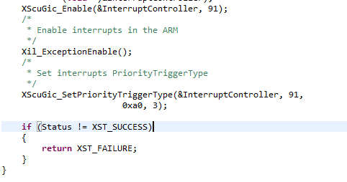

Slide 19
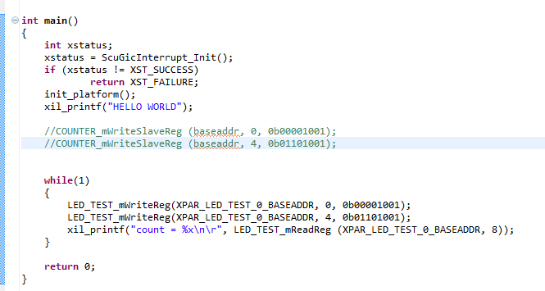
int main()
{
int xstatus;
xstatus = ScuGicInterrupt_Init();
if (xstatus != XST_SUCCESS)
return XST_FAILURE;
init_platform();
xil_printf("HELLO WORLD");
//COUNTER_mWriteSlaveReg (baseaddr, 0, 0b00001001);
//COUNTER_mWriteSlaveReg (baseaddr, 4, 0b01101001);
while(1)
{
LED_TEST_mWriteReg(XPAR_LED_TEST_0_BASEADDR, 0, 0b00001001);
LED_TEST_mWriteReg(XPAR_LED_TEST_0_BASEADDR, 4, 0b01101001);
xil_printf("count = %x\n\r", LED_TEST_mReadReg (XPAR_LED_TEST_0_BASEADDR, 8));
}
return 0;
}

Slide 20
1. download your .bit to fpga
2.check uart port
3. Turn on the power
4.open the console
5.press the middle button check if product the interrupt

