Slide 1

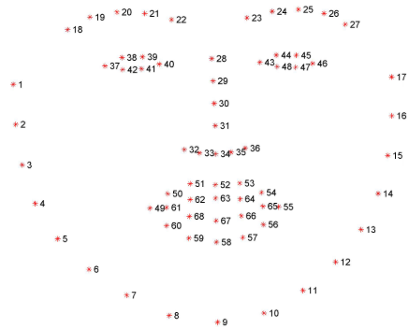

Emotion Recognition Using Facial Expressions
Project Number:
By: Gal Kashi & Chen Eilon Advisor: Amir Glober?
Project Carried Out at ________________
You may add here the logo of the company where you made the project
Introduction
Communicating – “the imparting or exchanging of information or news” - Google Translate
“The most important thing in communication is hearing what isn’t said.” – Peter F. Drucker
Nowadays, communication is not limited to living creatures only, but to machines as well. Meaning, Machines are now starting to exchange data with humans.
In order to help technology communicate better with humans – we need to pay attention to more than the verbal or textual data.
This is where Emotion Recognition kicks in.
If we could have analyze human’s emotions in addition to words, we would be able to offer them a much better automatic adjusted response.
This will enable automation of medical treatments and other human actions – Which emotion can we recognize?
According to Paul Ekman, there are six basic emotions that are expressed by certain facial expressions that are shared by people in all cultures: anger, happiness, surprise, disgust, sadness, and fear.
Training the Application
In our research in the past few month we found that emotional prediction can be much better when normalized according to a specific face.
In order to do that the application learns at firsts the neutral face of the user – and only that it can start working.
Machine Learning
We have tries many methods of predicting emotions, such as – SVM, KNN, Logistic Regression, Dense NNs and CNNs.
Datasets
In order to train machine learning algorithms we need labeled data. In this project we used 4 main labeled datasets:
Affectnet
CK+
MUG database
Oulu University facial expression database
In our final model we have used about 200 subjects, each making all 6 expressions.
Image preprocessing
In order to be analyzed, images need to be preprocessed –
Resizing & changing to gray scale. Then we find face
borders and 68 landmarks (with trained NN from DLIB libarary)
So, Which frames are interesting?
In order to react in real-time – we need to decide which frames to process.
We preprocessing each frame and compute it’s normalized Euclidian distances between all landmarks. Then we compute the Euclidian distance between the current frame vector and the last interesting vector. If the distance is bigger than a pre-defined threshold – the current frame is interesting.
If a frame is interesting – We continue to checking the face mood.
Results
After months of research, we have reached a precision of 85% in predicting 6 class: Happy, Sad, Surprise, Fear, Angry and Disgust
Finding the emotion in the frame
Extracting Features
We define a facial expression as a vector of normalized Euclidian distances and angles between 29 facial landmarks (out of 68).
The final frame’s vector is the subtraction between it’s vector as defined above and the vector of the user neutral face as defined in the application training phase.
Predicting emotion
The final frame’s vector is fed to a “machine learning” model we trained.
The algorithm we decided to use was logistic regression.
Difficulties
People tend to express emotions more explicitly in front of other humans, in opposed to machines.
People may feel more than one emotion.
Some emotions are harder to separate than others – such as Angry and Disgust.
Dynamic music application
We want to use emotion recognition to “guess” what a client wants to listen to – in order to improve the user experience and to lessen the “next” button pushes.
In order to do that, we need to music application to process frames of the listener’s face and make decisions in Real-Time.
Conclusions
Predicting emotions is not an easy task. Especially when dealing with different types of faces.
We believe that this model could be improved by better learning of individuals, and by enlarging the dataset.

