Slide 1
User Tracking System Based on RFID Signal Proposal
NCTU NSS 2018
Chengfa Huang
Willy Cheng-Fa Huang
2018.08.09 @NCTU EC-345

Slide 2
Outline
Environment Statement
Motivation
Challenge

Slide 3
Basic Elements

Slide 4
RFID Standard
Bar code
Traditional wireless
identification
Defacement
Line of sight
Manual manipulation
Read separately
Radio Frequency IDentification
Brand new wireless
identification
RF based communication
Non-line of sight
System based operation
Read simultaneously

Slide 5
RFID Reading Frequency
Frequency | Price range | Read Range | Limitations | Applications
Low Frequency 125-134 kHz | low | Low ( < 1 m.) | Low reading speed | Animal tracking
High Frequency 13.56 Mhz | Low to Middle | Low ( < 1.5 m) | Problems with metal | Library, access control
Ultra-high Freq. 860-930 MHz | Middle to High | High ( > 10 m) | Interference problems | Vehicle tracking
Microwave 2.4 GHz | High | High ( > 50 m) | Not widely deployed | Vehicle access control

Slide 6
RFID Reading Frequency
國內RFID頻段
FCC開放RFID頻段
中華電信
Up link
遠傳
UP
RFID
中華電信
Down link
遠傳
DL
增頻
增頻
MHz
891.4
895
902
910
915
922
928
940
955
960
892
937

Slide 7
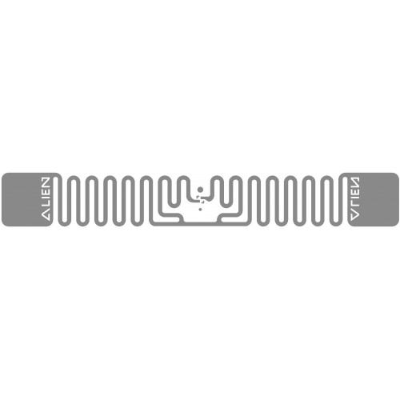
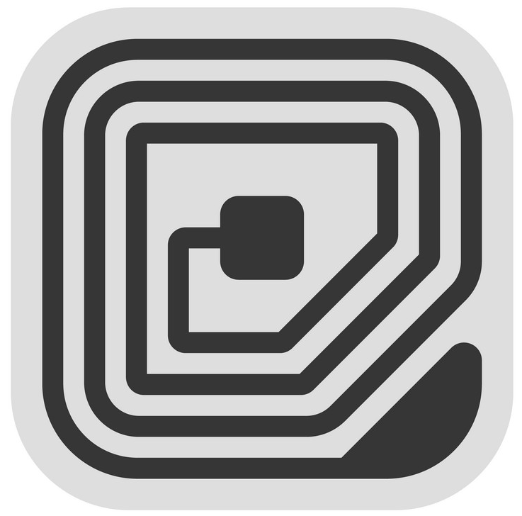
RFID Setting
Tag Type | Reading Distance | Characteristic
Passive | < 4m | Battery free Cheap
Active | > 100m | Battery loaded Expensive

Slide 8
RFID Setting
Tag Type | Reading Distance | Characteristic
Passive | < 4m | Battery free Cheap
Active | > 100m | Battery loaded Expensive

Slide 9
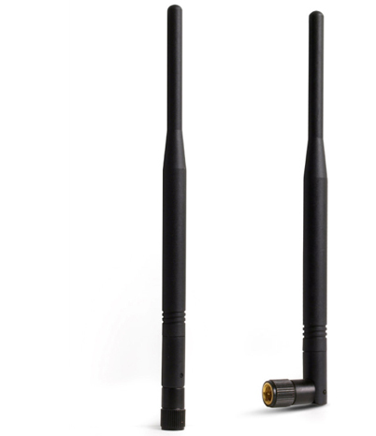
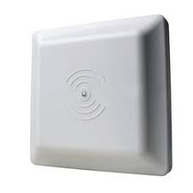
RFID Setting

Slide 10
RFID Setting

Slide 11
Protocol

Slide 12
Backscatter
Notes:
A reader transmits information to a tag by modulating an RF signal

Slide 13

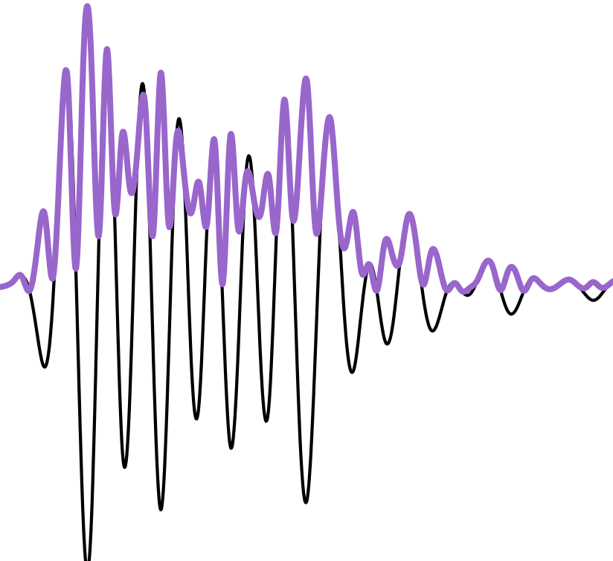
Backscatter
Notes:
A reader transmits information to a tag by modulating an RF signal

Slide 14
Backscatter
Notes:
The tag receives both down-link information and the entirety of its
operating energy from this RF signal.

Slide 15
Backscatter
Power
Command
Notes:
The tag receives both down-link information and the entirety of its
operating energy from this RF signal.

Slide 16
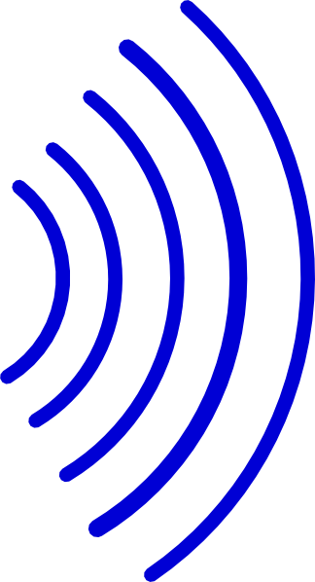
Backscatter
Carrier Wave
Power
Notes:
The reader transmits a continuous RF wave (CW) which assures that
the tag remains powered

Slide 17
Backscatter
Notes:
The tag then transmits its response by modulating the reflection coefficient of its antenna.

Slide 18
Backscatter
Notes:
The tag then transmits its response by modulating the reflection coefficient of its antenna.

Slide 19
Backscatter
Notes:
The reader is able to decode the tag response by detecting the variation in the reflected CW.

Slide 20
Backscatter
Notes:
The reader is able to decode the tag response by detecting the variation in the reflected CW.

Slide 21
Backscatter
Notes:
The reader is able to decode the tag response by detecting the variation in the reflected CW.

Slide 22
UHF EPC
Physical Layer
RFID tags communicate by “backscattering” signals that are concurrent with reader transmissions, and use a variety of frequencies and encodings under the control of the reader.
MAC Layer
Readers and tags use a variation on slotted Aloha to solve the multi-access problem in a setting where readers can hear tags but tags cannot hear each other.

Slide 23
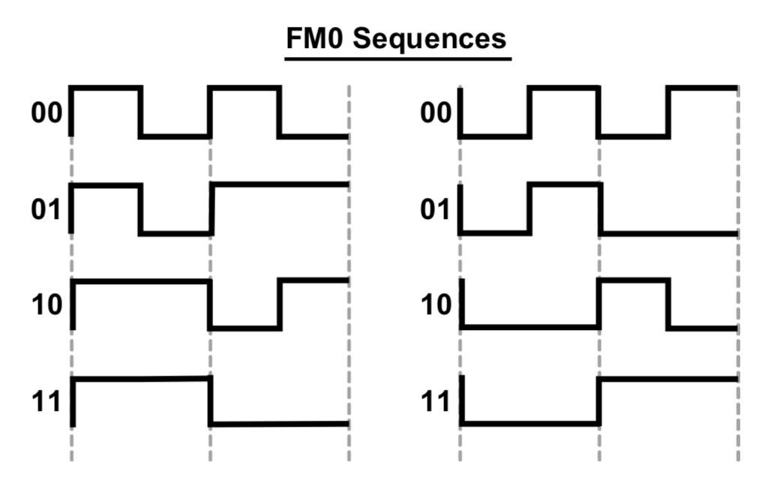
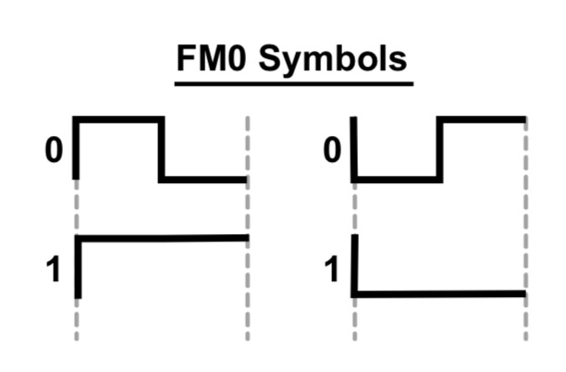
FM0

Slide 24
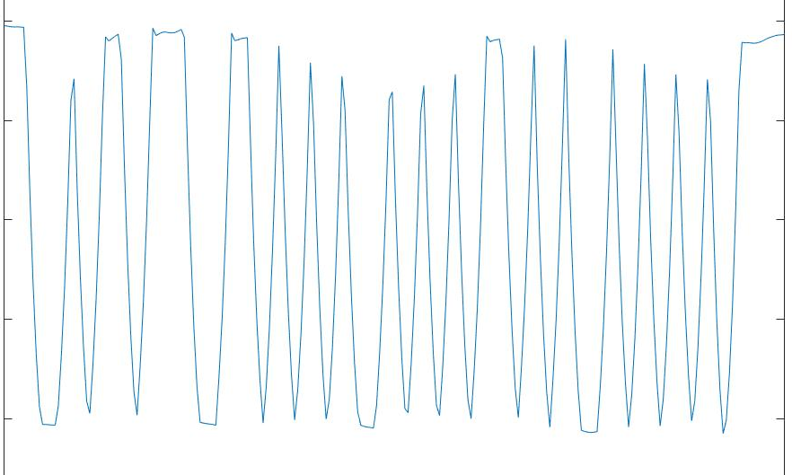
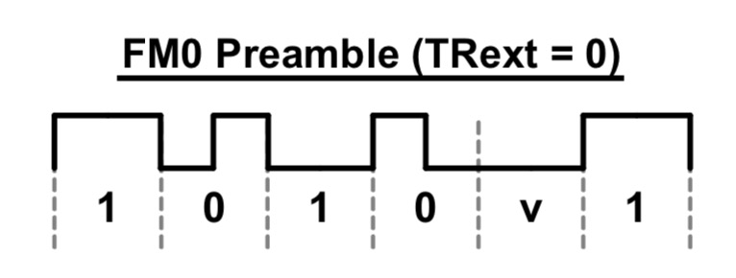
FM0
0
1 0 10 v 1
Preamble
Notes:
Find some examples

Slide 25
MAC Layer
Based on Framed Slotted Aloha
Each frame has a number of slots
Each tag will reply in one randomly selected slot per frame
The number of slots in the frame is determined by the reader and can be varied on a per frame basis

Slide 26
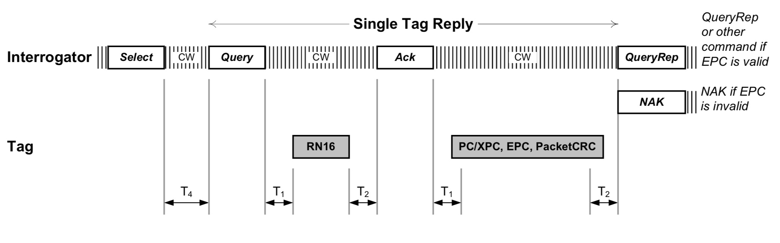
Query round

Slide 27
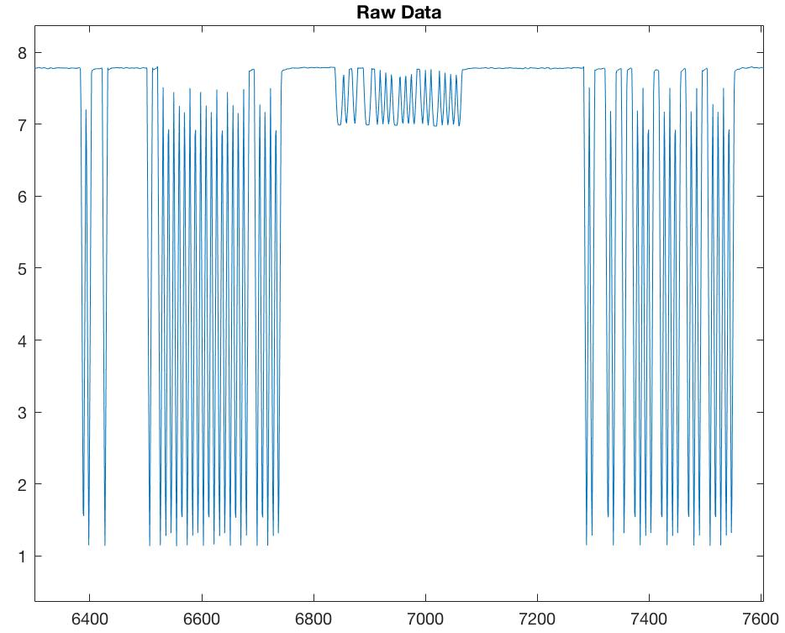
Notes:
找實際訊號圖

Slide 28
RN16
1 0 0 01000 1 00 100 00
Preamble
RN16
Notes:
Find some examples

Slide 29
Query round
Query Round
an individual frame : Query Cycle
the series of Query Rounds between power down periods
The reader can optionally transmit a Select command
Limits the number of active tags by providing a bit mask only tags with ID’s (or memory locations) that match this mask will respond in the subsequent round

Slide 30
Query round
Query Round
an individual frame : Query Cycle
the series of Query Rounds between power down periods
The reader can optionally transmit a Select command
Limits the number of active tags by providing a bit mask only tags with ID’s (or memory locations) that match this mask will respond in the subsequent round

Slide 31
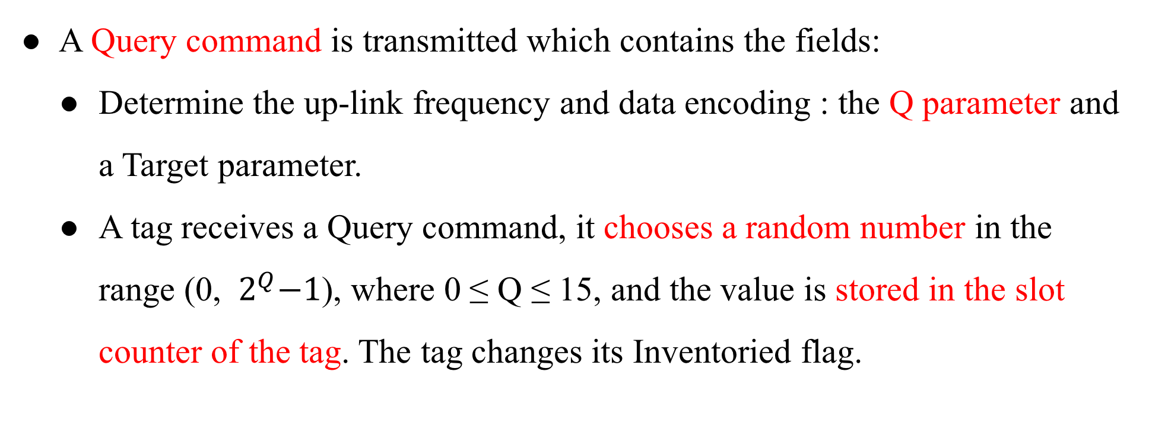
Query round
A Query command is transmitted which contains the fields:
Determine the up-link frequency and data encoding : the Q parameter and a Target parameter.
A tag receives a Query command, it chooses a random number in the range (0, ${ 2}^{Q}−1$), where 0 ≤ Q ≤ 15, and the value is stored in the slot counter of the tag. The tag changes its Inventoried flag.

Slide 32
Query round
A Query command is transmitted which contains the fields:
Determine the up-link frequency and data encoding : the Q parameter and a Target parameter.
A tag receives a Query command, it chooses a random number in the range (0, ${ 2}^{Q}−1$), where 0 ≤ Q ≤ 15, and the value is stored in the slot counter of the tag. The tag changes its Inventoried flag.

Slide 33
Query round
If a tag stores a 0 in its slot counter, it will transmit a 16 bit random number (RN16) immediately.
The reader will echo the RN16 in an ACK packet after receiving it.
If the tag successful receives the ACK with the correct random number, the tag will backscatter its ID.

Slide 34
Query round
If a tag stores a 0 in its slot counter, it will transmit a 16 bit random number (RN16) immediately.
The reader will echo the RN16 in an ACK packet after receiving it.
If the tag successful receives the ACK with the correct random number, the tag will backscatter its ID.

Slide 35
Query round
The reader will send a QueryRepeat command to cause the tag to toggle its Inventoried flag.
If the ID was not successfully received by the reader, a NAK command is sent which resets the tag so that a subsequent QueryRepeat will not result in Inventoried flag being changed.
A QueryRepeat signals the end of the slot.

Slide 36
Query round
The reader will send a QueryRepeat command to cause the tag to toggle its Inventoried flag.
If the ID was not successfully received by the reader, a NAK command is sent which resets the tag so that a subsequent QueryRepeat will not result in Inventoried flag being changed.
A QueryRepeat signals the end of the slot.

Slide 37
Query round
On receiving the command, the remaining tags will:
Decrement their slot counter
Respond with a RN16 if their slot counter is set to 0.
The process then repeats, with the number of QueryRepeats being equal to the number of slots set using the Q parameter.

Slide 38
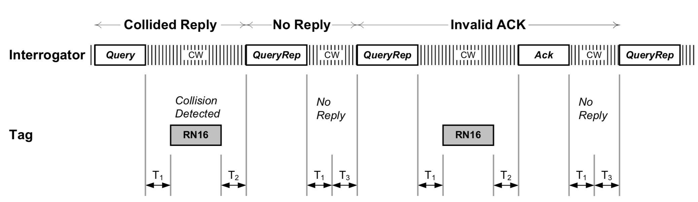
Query round
Notes:
撞掉失敗，或是沒有人倒數到 0

Slide 39
Related Work
Fundamental
Michael Buettner , David Wetherall An empirical study of UHF RFID performance. 14th ACM Int. Conf. on MobiCom
EPCglobal. Epc radio-frequency identity protocols class-1 generation-2 uhf rfid protocol for communications at 860 mhz-960 mhz version 2.0.0. , 2013

Slide 40
Related Work
Localization
Jue Wang, Dina Katabi Dude, where's my card?: RFID positioning that works with multipath and non-line of sight. the ACM SIGCOMM, 2013
Tracking
Lei Yang, Yekui Chen Tagoram: Real-Time Tracking of Mobile RFID Tags to High Precision Using COTS Devices. ACM Int. Conf. on MobiCom, 2014
Device-free
Chuyu Wang, Jian Liu, Yingying Chen Multi-Touch in the Air: Device-Free Finger Tracking and Gesture Recognition via COTS RFID. IEEE Infocom, 2018

Slide 41
Related Work
Search tags
Jihong Yu, Wei Gong, Jiangchuan Liu Fast and Reliable Tag Search in Large-Scale RFID Systems: A Probabilistic Tree-based Approach. IEEE Infocom, 2017
Find missing/unknown tags
Muhammad Shahzad, Alex X. Liu Fast and Reliable Detection and Identification of Missing RFID Tags in the Wild. IEEE/ACM Transactions on Networking, 2016
Find moving tag
Chuyu Wang, Lei Xie, Wei Wang Moving Tag Detection via Physical Layer Analysis for Large-Scale RFID Systems. IEEE INFOCOM, 2016

Slide 42
Reference
https://www.flaticon.com/
https://www.sitebuilderreport.com/stock-up
https://en.wikipedia.org/wiki/Friis_transmission_equation
https://en.wikipedia.org/wiki/Path_loss
https://ccrma.stanford.edu/~jos/fp/Phase_Delay.html
https://en.wikipedia.org/wiki/Communication_channel
https://en.wikipedia.org/wiki/Fading
http://www.sengpielaudio.com/calculator-timedelayphase.html
EPC RFID protocols Class-1 Gen2 UHF RFID protocol for communications
An empirical study of UHF RFID performance

