Slide 1
User Tracking System Based on RFID Signal Proposal
NCTU NSS 2018
Chengfa Huang
Willy Cheng-Fa Huang
2018.08.09 @NCTU EC-345

Slide 2
Outline
Motivation
Environment Statement
Challenge

Slide 3
Motivation

Slide 4
圖文
無人商店崛起
找 Amazon 等照片
物品結帳機制猜測
有人進到商店
資料庫建立
定位
走到每個地方
判斷拿走物品
結帳偵測
RFID NLOS 輕量 方便 不易損壞
UHF

Slide 5
RFID Standard
Bar code
Traditional wireless
identification
Defacement
Line of sight
Manual manipulation
Read separately
Radio Frequency IDentification
Brand new wireless
identification
RF based communication
Non-line of sight
System based operation
Read simultaneously

Slide 6
RFID Reading Frequency
Frequency | Price range | Read Range | Limitations | Applications
Low Frequency 125-134 kHz | low | Low ( < 1 m.) | Low reading speed | Animal tracking
High Frequency 13.56 Mhz | Low to Middle | Low ( < 1.5 m) | Problems with metal | Library, access control
Ultra-high Freq. 860-930 MHz | Middle to High | High ( > 10 m) | Interference problems | Vehicle tracking
Microwave 2.4 GHz | High | High ( > 50 m) | Not widely deployed | Vehicle access control

Slide 7
Environment Statement

Slide 8
Region
Implementation
Place
Super market
Shopping mall
Convenient store
Definition
What is region
水果
生活用品
食物
冰…

Slide 9
RFID Setting
Passive tag
Object tag
Wrist tag
Reader
每個 region
Data base 建立

Slide 10
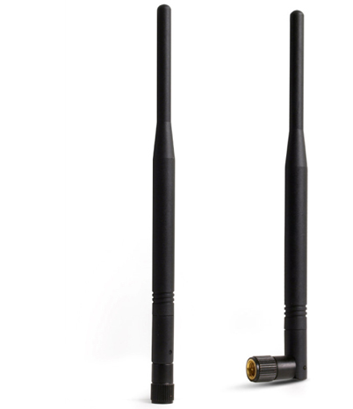
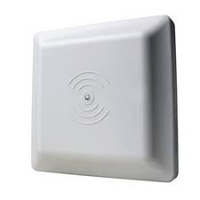
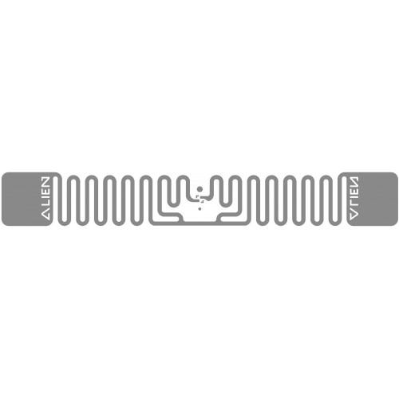
RFID Setting

Slide 11
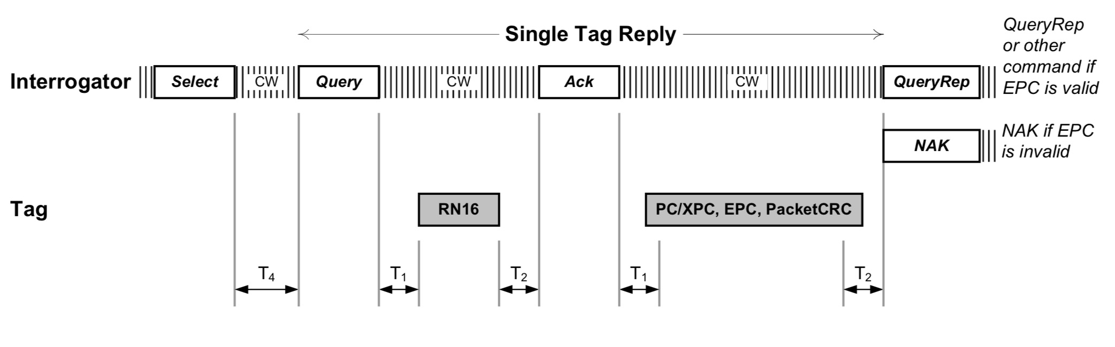


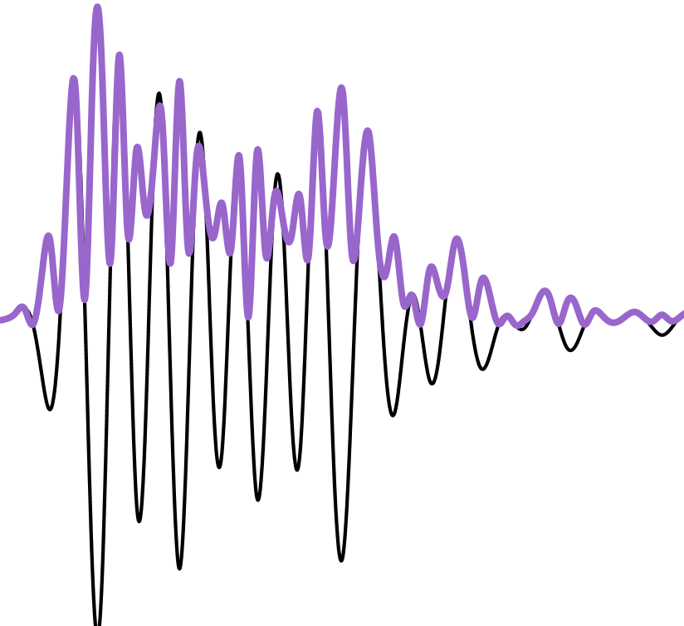
Backscatter
Carrier Wave
Power
Notes:
The reader transmits a continuous RF wave (CW) which assures that
the tag remains powered

Slide 12
Challenge

Slide 13
Problem
how to detect the subregion: Detect for the signal variation in each region
how to detect unknown tag: when we found the signal variation, asking for the ID and start tracking it.
how to match tag-object: pair the tags

Slide 14
Reference
https://www.flaticon.com/
https://www.sitebuilderreport.com/stock-up

