Slide 1
Freshman Training Course RFID
NCTU NSS-Lab 2018
Cheng-Fa Huang
Willy Cheng-Fa Huang
2018.08.14 @NCTU EC-614

Slide 2
Outline
Basic Elements
Protocol
Related Work
Reference

Slide 3
Basic Elements
Notes:
基礎設備介紹

Slide 4
RFID Standard
Bar code
Traditional wireless
identification
Defacement
Line of sight
Manual manipulation
Read separately
Radio Frequency IDentification
Brand new wireless
identification
RF based communication
Non-line of sight
System based operation
Read simultaneously
Notes:
最傳統最常見的無線辨識碼是所謂的 bar code
雖然很方便，但卻有許多缺點必須很近、表面必須乾淨、LOS
LOS tx 與 rx 之間沒有障礙物
RFID tag 可以同時很多一起讀 NLOS 不易毀損

Slide 5
RFID Reading Frequency
Frequency | Price range | Read Range | Limitations | Applications
Low Frequency 125-134 kHz | low | Low ( < 1 m.) | Low reading speed | Animal tracking
High Frequency 13.56 Mhz | Low to Middle | Low ( < 1.5 m) | Problems with metal | Library, access control
Ultra-high Freq. 860-930 MHz | Middle to High | High ( > 10 m) | Interference problems | Vehicle tracking
Microwave 2.4 GHz | High | High ( > 50 m) | Not widely deployed | Vehicle access control
Notes:
Tag 有幾種不同的讀取頻率
目前主要是用 Ultra high freq.

Slide 6
RFID Reading Frequency
國內RFID頻段
FCC開放RFID頻段
中華電信
Up link
遠傳
UP
RFID
中華電信
Down link
遠傳
DL
增頻
增頻
MHz
891.4
895
902
910
915
922
928
940
955
960
892
937
Notes:
每個頻段都會經過分配，目前國內使用 RFID 的頻段是 922~928 MHz
再來介紹 RFID 使用物件及特性
FCC : Federal Communications Commission

Slide 7
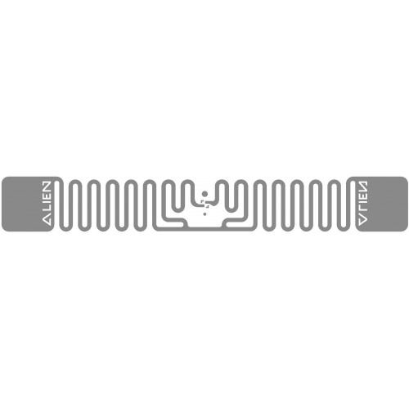

RFID Setting
Tag Type | Reading Distance | Characteristic
Passive | < 4m | Battery free Cheap
Active | > 100m | Battery loaded Expensive
Notes:
Tag 分成兩種都是靠反射來傳送訊息
Passive 利用 reader 訊號做充電
Active 就是 裝電池或有其他充電來源

Slide 8
RFID Setting
Tag Type | Reading Distance | Characteristic
Passive | < 4m | Battery free Cheap
Active | > 100m | Battery loaded Expensive
Notes:
常用的是 passive

Slide 9
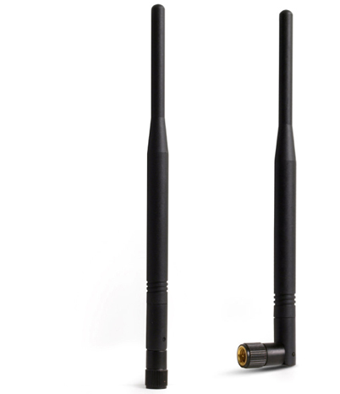
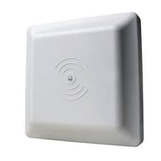
RFID Setting
Notes:
天線基本上有兩種型態
當 reader 同時扮演 rx tx 的角色

Slide 10
RFID Setting
Notes:
將 tag 放在不同位置會有不同的 效果
發現右邊這種放法收到的訊號比較好

Slide 11
Protocol

Slide 12
Backscatter
Notes:
一個 passive tag 一個 reader

Slide 13


Backscatter
Carrier Wave
Power
Notes:
Reader 會透過穩定的 carrier wave 送能量給 tag
讓 tag 有能量回傳資訊

Slide 14
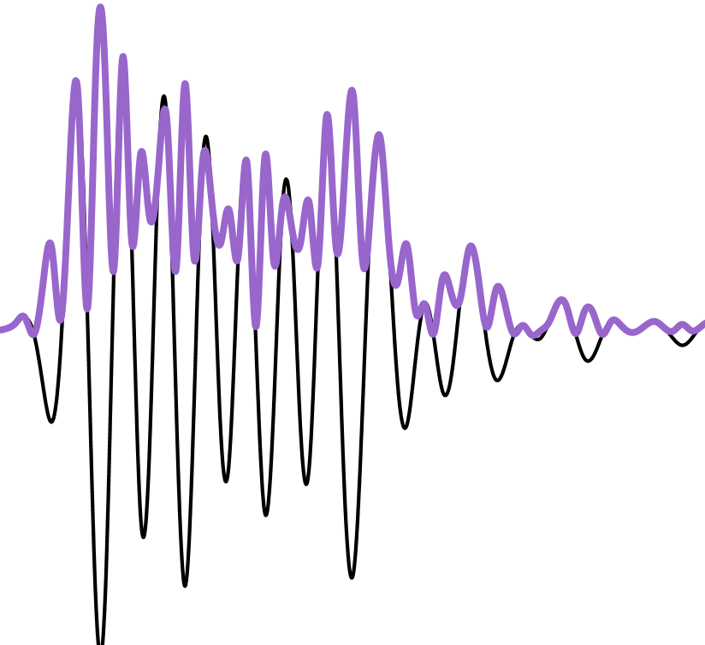
Backscatter
Notes:
Reader 會根據使用者要做的指示將訊號轉成可傳送的波

Slide 15
Backscatter
Notes:
Reader 送到每個 tag

Slide 16
Backscatter
Power
Command
Notes:
Tag 同時收到能量及訊息

Slide 17
Backscatter
Notes:
將回應轉成可送的波

Slide 18
Backscatter
Notes:
回送給 reader

Slide 19
Backscatter
Notes:
Reader 收到來自 tag 包含回傳carrier wave 及 回復 的波

Slide 20
Backscatter
Notes:
透過 decode 技術把 carrier wave 拿掉得到正確的 訊號

Slide 21
Backscatter
Notes:
最後轉回可被電腦分析的訊號即完成一趟下達指令的流程

Slide 22
UHF EPC
Physical Layer
RFID tags communicate by “backscattering” signals that are concurrent with reader transmissions, and use a variety of frequencies and encodings under the control of the reader.
MAC Layer
Readers and tags use a variation on slotted Aloha to solve the multi-access problem in a setting where readers can hear tags but tags cannot hear each other.
Notes:
圖解完後解釋如何解開訊號
實體層是透過頻率變化及reader encode 做出訊號
主要是用 slotted Aloha 解決多 tag reader 的問題
接下來解釋這兩層的資訊

Slide 23
UHF EPC
Physical Layer
Physical Layer
RFID tags communicate by “backscattering” signals that are concurrent with reader transmissions, and use a variety of frequencies and encodings under the control of the reader.
MAC Layer
Readers and tags use a variation on slotted Aloha to solve the multi-access problem in a setting where readers can hear tags but tags cannot hear each other.

Slide 24
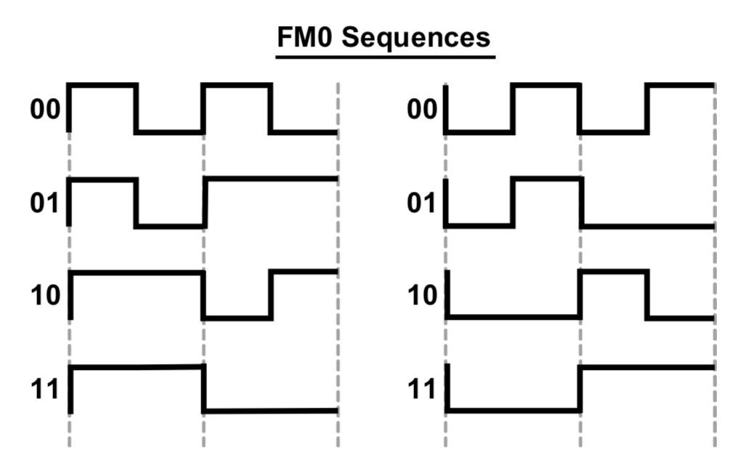
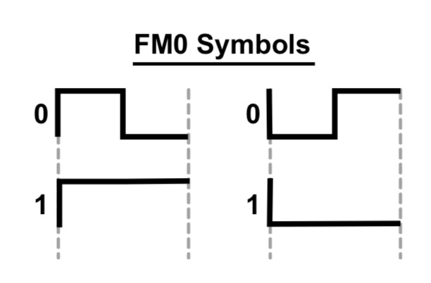
FM0
Notes:
訊號的編碼
一個週期分兩小段來看 中間有轉折的為 0
沒有轉折為 1

Slide 25
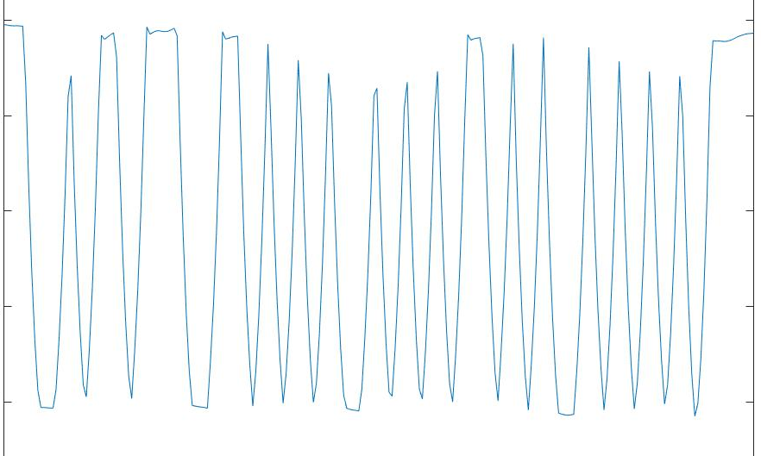
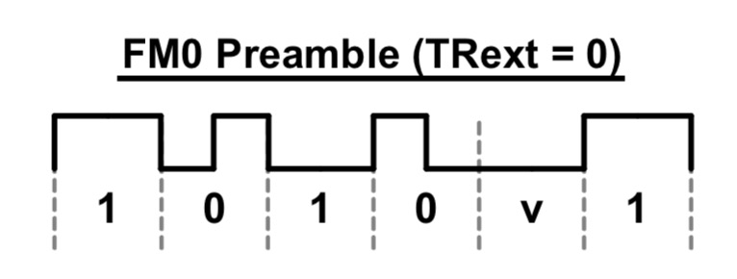
FM0
0
1
0
v
1
1
Preamble
Notes:
以 Tag 回傳的 RN16 訊號為例
前面是 preamble

Slide 26
MAC Layer
Based on Framed Slotted Aloha
Each frame has a number of slots
Each tag will reply in one randomly selected slot per frame
The number of slots in the frame is determined by the reader and can be varied on a per frame basis
Notes:
簡單介紹最基本的 slotted Aloha
一段訊號運送時間 稱為一個 frame，所有tag 會在這段時間完成所有事
每個 frame 有許多 slots 每個 tag 會隨機選擇一個 slot 回傳訊號
每段 frame 中的 slot 有可能因為不同的需要而有所改變

Slide 27
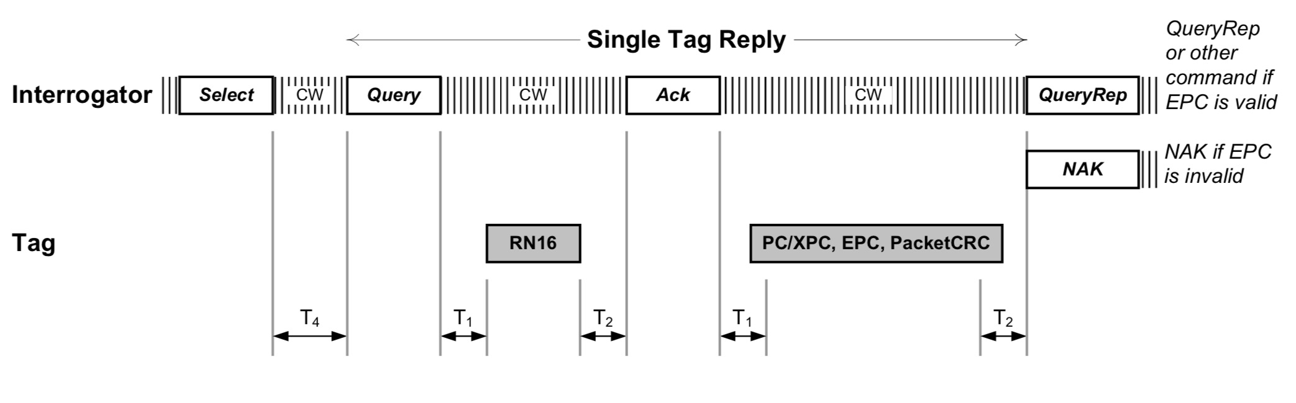
Query round
Notes:
這是一個收到 tag 的正確流程

Slide 28
Query round

Slide 29
Query round
Query Round
an individual frame : Query Cycle
the series of Query Rounds between power down periods
The reader can optionally transmit a Select command
Limits the number of active tags by providing a bit mask only tags with ID’s (or memory locations) that match this mask will respond in the subsequent round
Notes:
Selected command 就像字面上的意思一樣
可用可不用，主要是用限制 tag 回傳數量

Slide 30
Query round

Slide 31
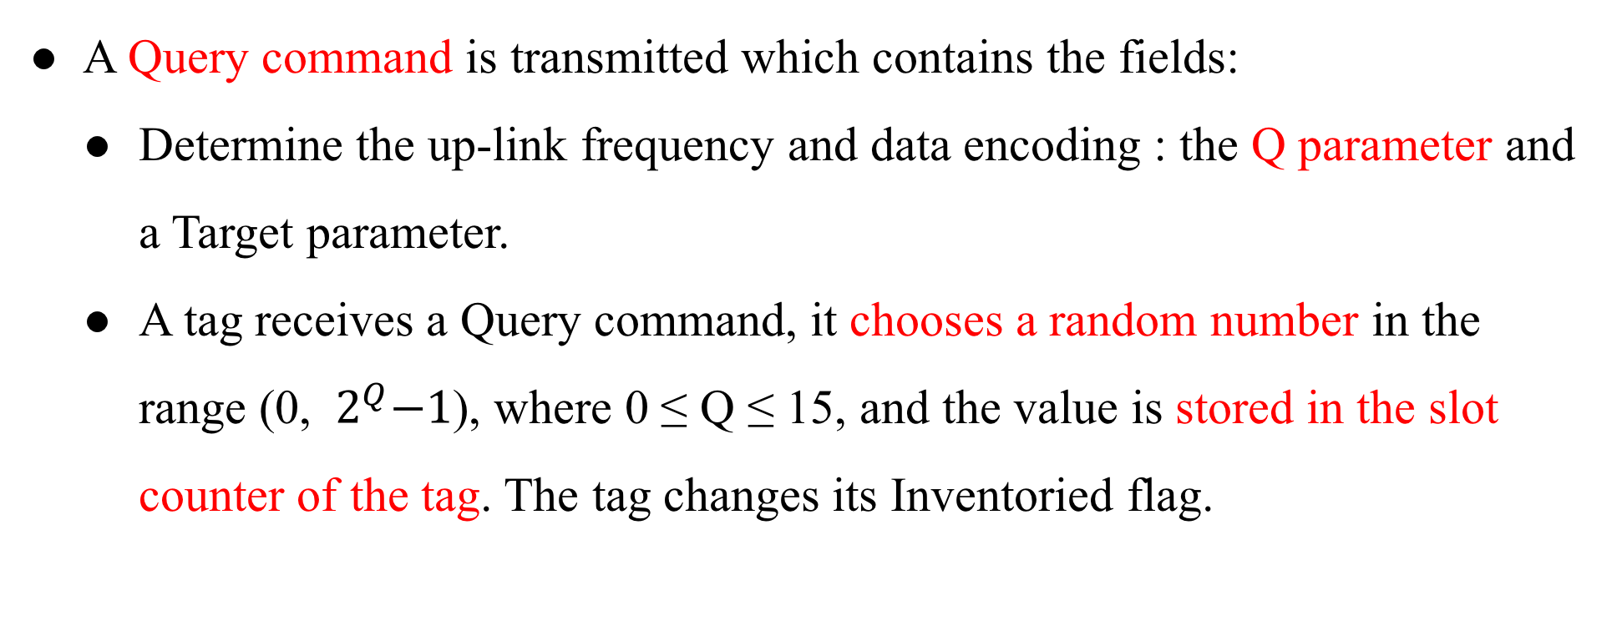
Query round
A Query command is transmitted which contains the fields:
Determine the up-link frequency and data encoding : the Q parameter and a Target parameter.
A tag receives a Query command, it chooses a random number in the range (0, ${ 2}^{Q}−1$), where 0 ≤ Q ≤ 15, and the value is stored in the slot counter of the tag. The tag changes its Inventoried flag.
Notes:
Query 階段會 送出一個 0~15的 Q值 及 目標參數用來設定要蒐的 tag
所有Tag 收到此訊息會以 Q 值產生隨機數字開始倒數直到0

Slide 32
Query round

Slide 33
Query round
If a tag stores a 0 in its slot counter, it will transmit a 16 bit random number (RN16) immediately.
The reader will echo the RN16 in an ACK packet after receiving it.
If the tag successful receives the ACK with the correct random number, the tag will backscatter its ID.
Notes:
倒數到 0 tag 會回傳 RN16 就是 16 bits 的隨機數字
編碼也是用 FM0
Reader 成功收到 RN16 會回復 RN16 以及 ACK
Tag 收到後會回傳 ID

Slide 34
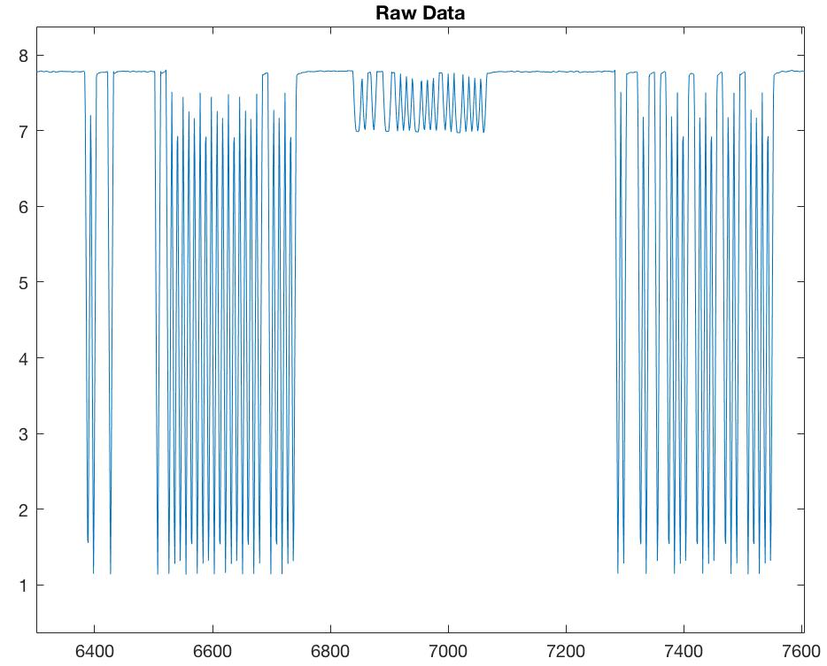
Notes:
這是實際收到 RN16 的訊號圖

Slide 35
RN16
1
0
0
0
0
0
0
1
0
1
0
0
1
0
0
0
Preamble
RN16
Notes:
經過 decode 應該會是

Slide 36
Query round

Slide 37
Query round
The reader will send a QueryRepeat command to cause the tag to toggle its Inventoried flag.
If the ID was not successfully received by the reader, a NAK command is sent which resets the tag so that a subsequent QueryRepeat will not result in Inventoried flag being changed.
A QueryRepeat signals is the end of the slot.
Notes:
若 reader 收到不對的 ID 格式，會送 NAK 讓下次 Query 知道沒有這個 ID
成功的話會用 QueryRepeat 結束這 slot 同時也看下一步要做甚麼

Slide 38
Query round
On receiving the command, the remaining tags will:
Decrement their slot counter
Respond with a RN16 if their slot counter is set to 0.
The process then repeats, with the number of QueryRepeats being equal to the number of slots set using the Q parameter.
Notes:
其他 tag 會
倒數直到 0
不斷重複以上步驟

Slide 39
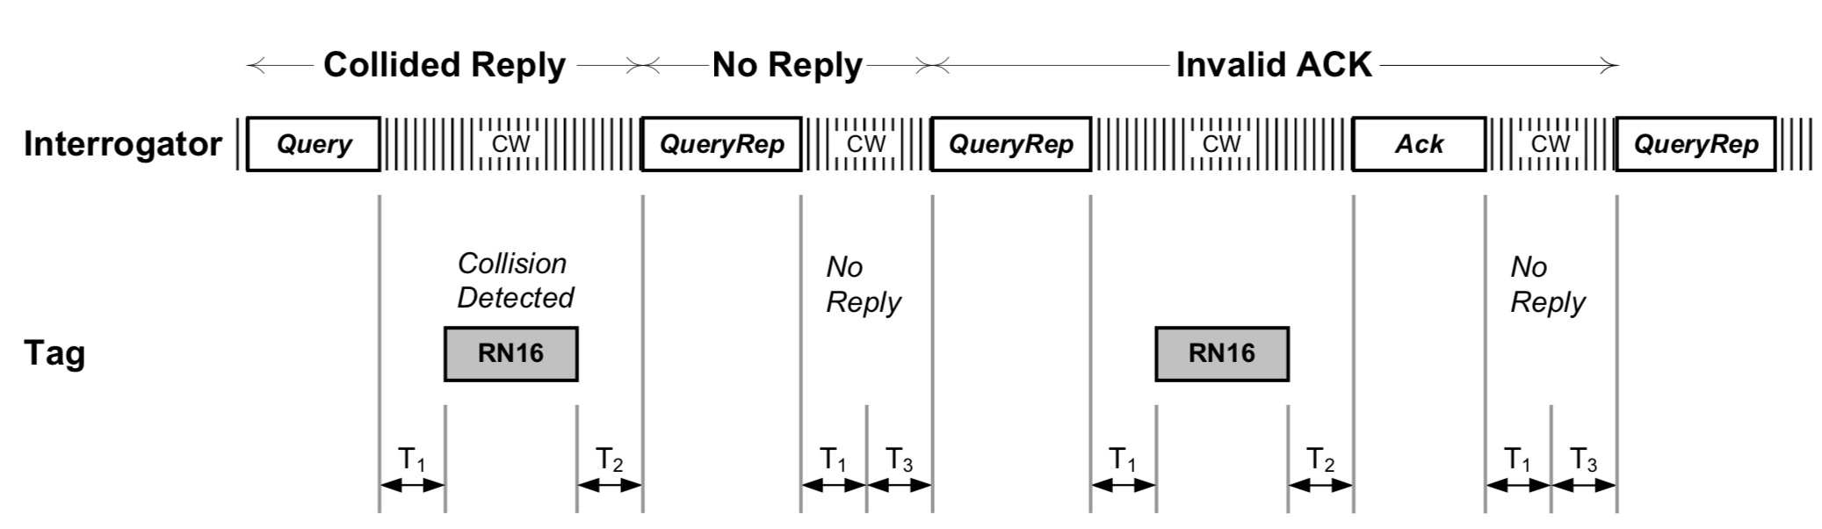
Query round
Notes:
撞掉失敗，或是沒有人倒數到 0

Slide 40
Related Work
Fundamental
Michael Buettner , David Wetherall An empirical study of UHF RFID performance. 14th ACM Int. Conf. on MobiCom
EPCglobal. Epc radio-frequency identity protocols class-1 generation-2 uhf rfid protocol for communications at 860 mhz-960 mhz version 2.0.0. , 2013
Notes:
簡單的有一篇 paper 可以看
還有 EPC 規格說明

Slide 41
Related Work
Localization
Jue Wang, Dina Katabi Dude, where's my card?: RFID positioning that works with multipath and non-line of sight. the ACM SIGCOMM, 2013
Tracking
Lei Yang, Yekui Chen Tagoram: Real-Time Tracking of Mobile RFID Tags to High Precision Using COTS Devices. ACM Int. Conf. on MobiCom, 2014
Device-free
Chuyu Wang, Jian Liu, Yingying Chen Multi-Touch in the Air: Device-Free Finger Tracking and Gesture Recognition via COTS RFID. IEEE INFOCOM, 2018
Notes:
以下是RFID 的相關問題的 代表 paper

Slide 42
Related Work
Search tags
Jihong Yu, Wei Gong, Jiangchuan Liu Fast and Reliable Tag Search in Large-Scale RFID Systems: A Probabilistic Tree-based Approach. IEEE INFOCOM, 2017
Find missing/unknown tags
Muhammad Shahzad, Alex X. Liu Fast and Reliable Detection and Identification of Missing RFID Tags in the Wild. IEEE/ACM Transactions on Networking, 2016
Find moving tag
Chuyu Wang, Lei Xie, Wei Wang Moving Tag Detection via Physical Layer Analysis for Large-Scale RFID Systems. IEEE INFOCOM, 2016
Notes:
以下是RFID 的相關問題的 代表 paper

Slide 43
Reference
https://www.flaticon.com/
https://www.sitebuilderreport.com/stock-up
EPC RFID protocols Class-1 Gen2 UHF RFID protocol for communications
An empirical study of UHF RFID performance
INFOCOM
SIGCOM
MobiCOM
Notes:
所有參考資料

Slide 44
RFID
R
Ready to Find an Interesting Domain
F
I
D

