Slide 1
Freshman Training Course Signal
NCTU NSS 2018
Chengfa Huang
Willy Cheng-Fa Huang
2018.08. @NCTU EC-345

Slide 2
Outline
Channel
Friis Transmission Equation
RFID

Slide 3
Outline
Channel
Friis Transmission Equation
RFID
Channel

Slide 4

Signal Representation
General form
Called the canonical representation of a
band-pass signal
Q
amplitude
frequency
phase
s(t)
a(t)
a(t)
I

Slide 5
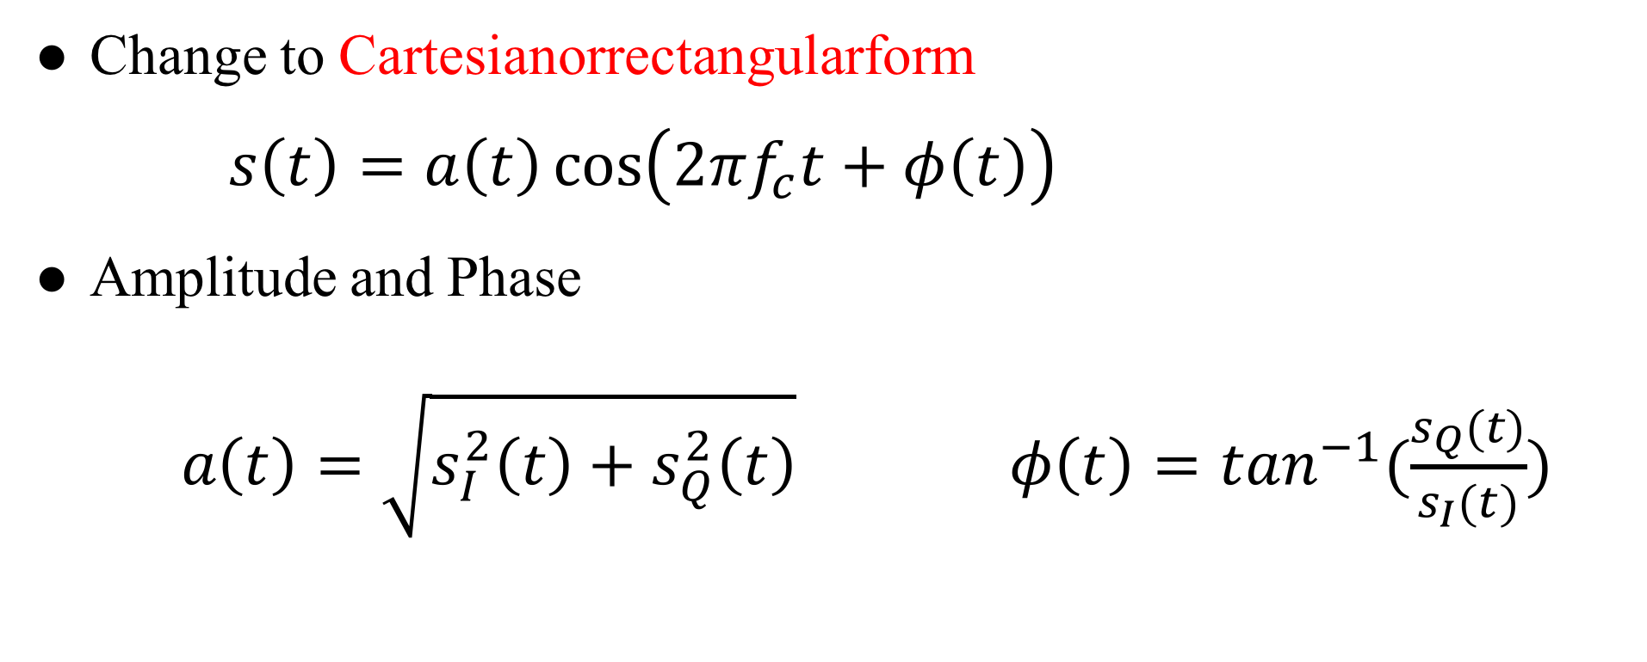
Linear Channels
Change to Cartesianorrectangularform
$s\left(t\right)=a\left(t\right)\cos\left(2πf_{c}t+φ\left(t\right)\right)$
Amplitude and Phase
$a\left(t\right)=\sqrt{s_{I}^{2}\left(t\right)+s_{Q}^{2}\left(t\right)} φ\left(t\right)=\tan^{−1}(\frac{s_{Q}(t)}{s_{I}(t)})$
Notes:
Time -> FFT -> freq. $ω=2πf$

Slide 6
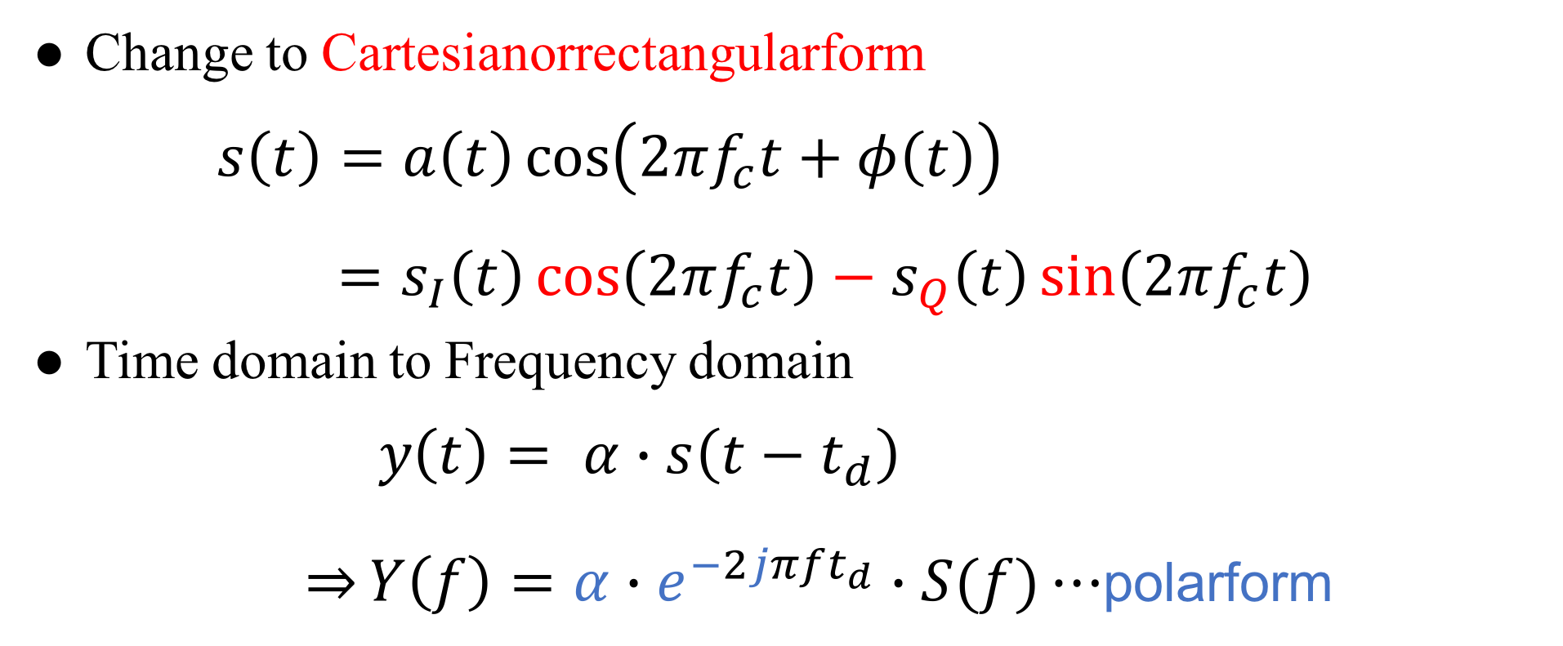
Linear Channels
Change to Cartesianorrectangularform
$s\left(t\right)=a\left(t\right)\cos\left(2πf_{c}t+φ\left(t\right)\right)$
$=s_{I}\left(t\right)\cos\left(2πf_{c}t\right)−s_{Q}\left(t\right)\sin\left(2πf_{c}t\right)$
Time domain to Frequency domain
$y\left(t\right)= α∙s\left(t−t_{d}\right)$
$\overset{⇒}{}Y\left(f\right)=α∙e^{−2jπft_{d}}∙S(f)⋯$polarform
Notes:
Time -> FFT -> freq. $ω=2πf$

Slide 7
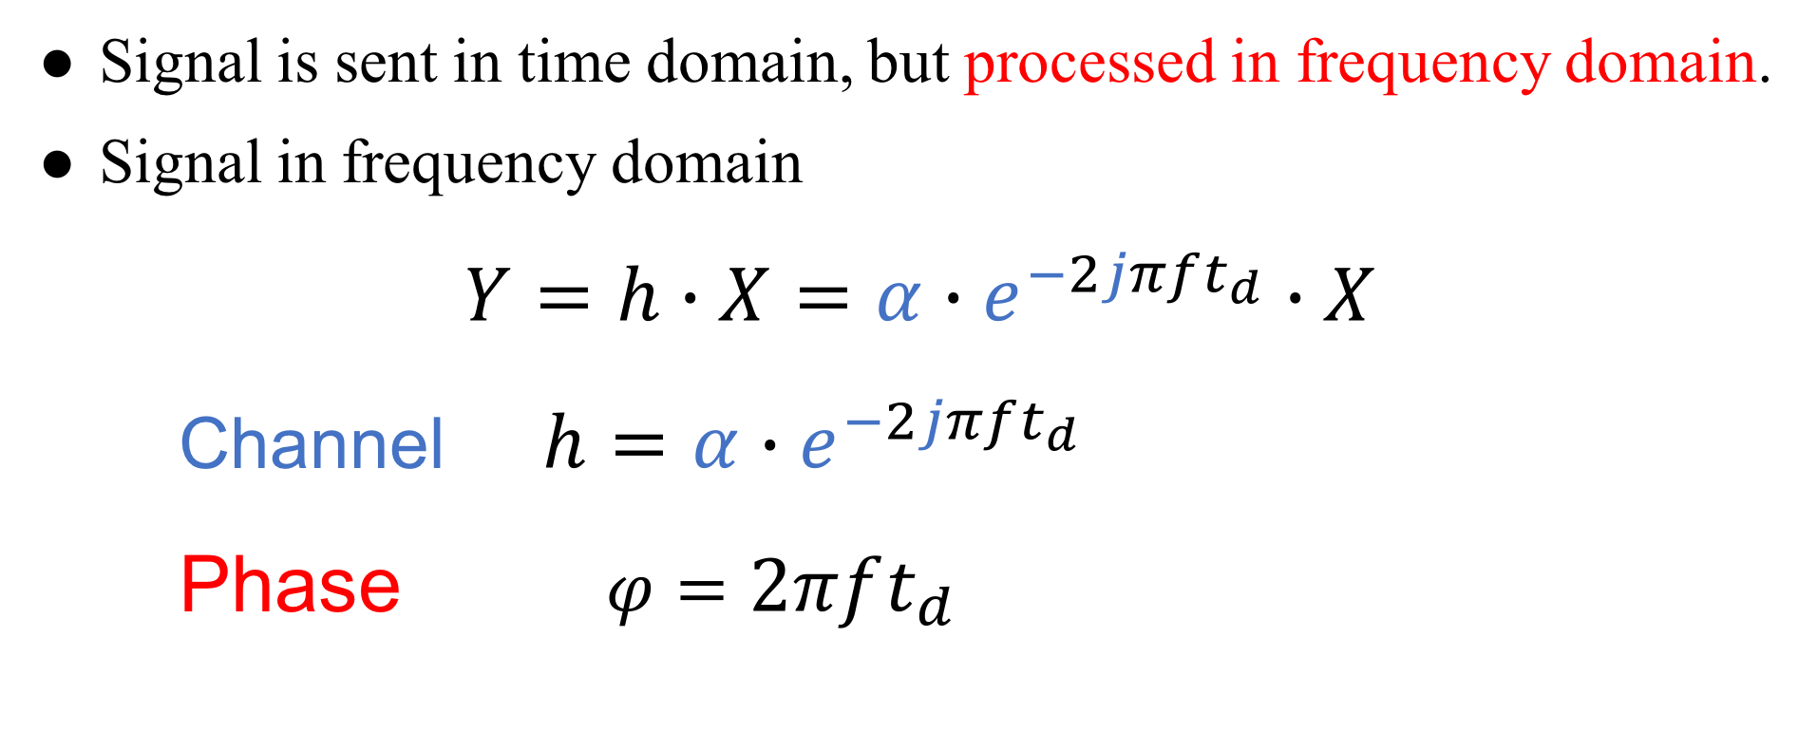
Channel
Signal is sent in time domain, but processed in frequency domain.
Signal in frequency domain
$Y=h∙X=α∙e^{−2jπft_{d}}∙X$
Channel $h=α∙e^{−2jπft_{d}}$
Phase $φ=2πft_{d}$
Notes:
Time domain 送
Frequency domain 分析

Slide 8
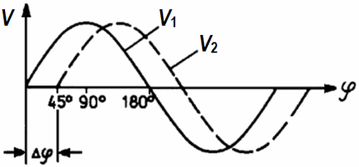
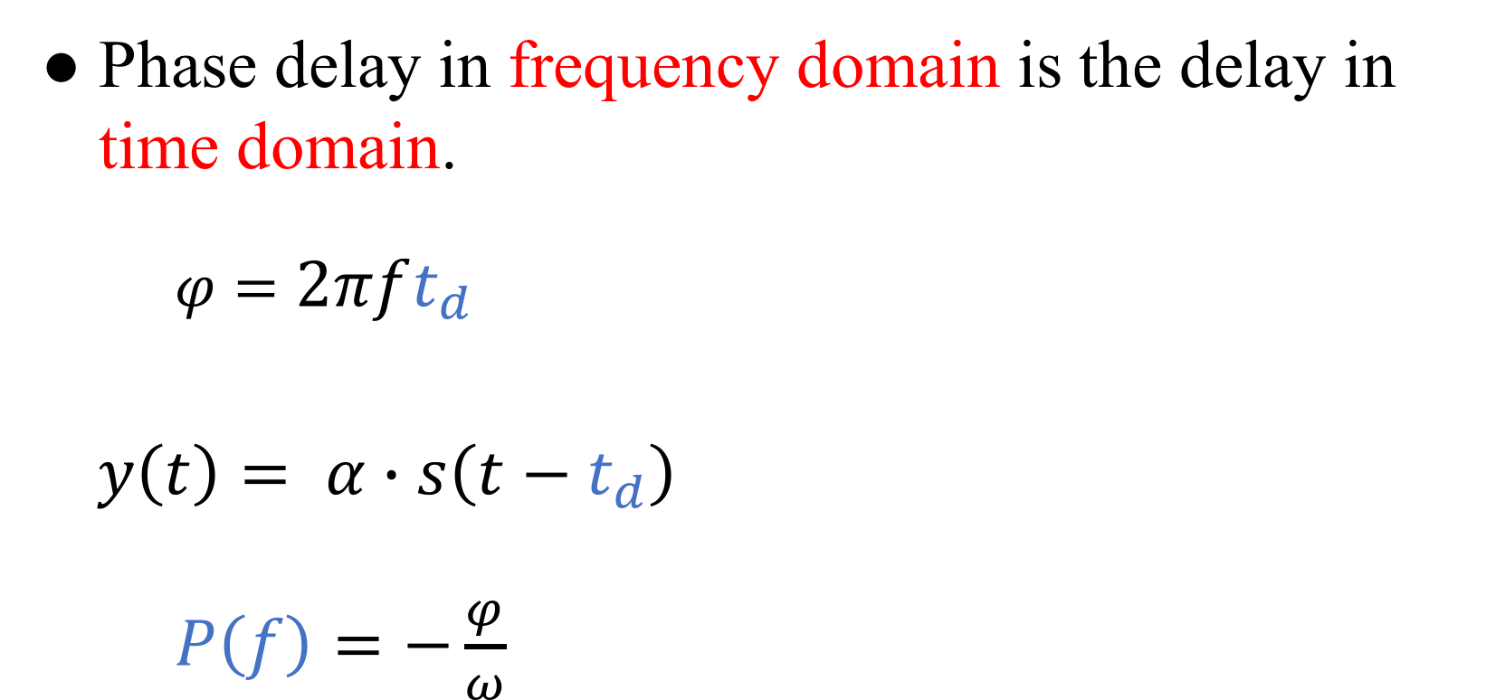
Phase Delay
Phase delay in frequency domain is the delay in time domain.
$φ=2πft_{d}$
$y\left(t\right)= α∙s\left(t−t_{d}\right)$
$P\left(f\right)=−\frac{φ}{ω}$

Slide 9
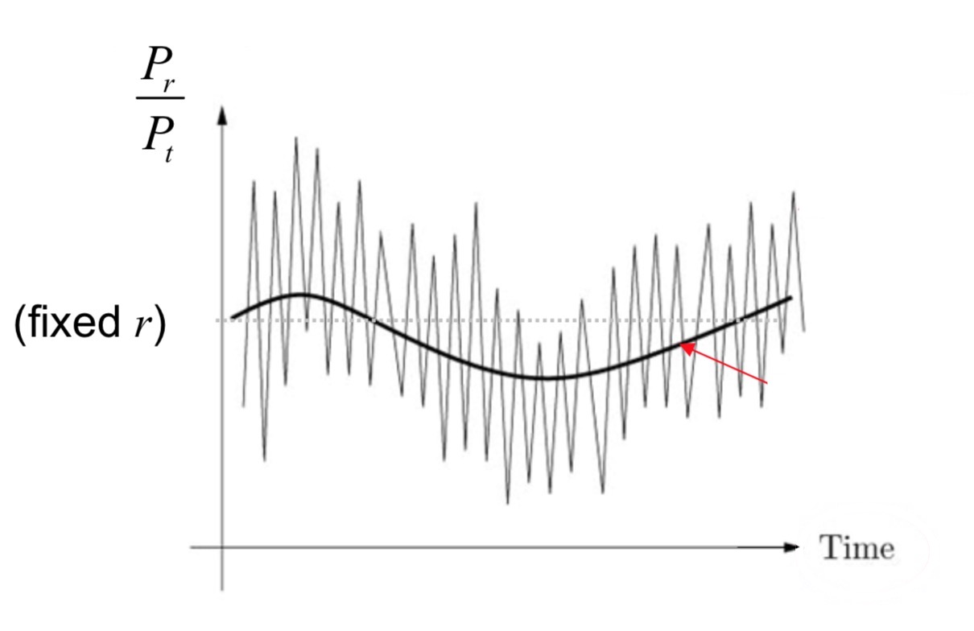
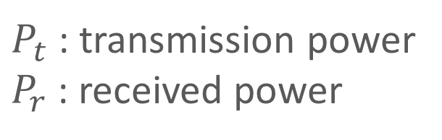
Channel Fading
Fluctuation of the local mean:
Small-scale fading
Fluctuation of the local mean:
Large-scale fading
$P_{t}$ : transmission power
$P_{r}$ : received power

Slide 10
Small-Scale Fading

Slide 11
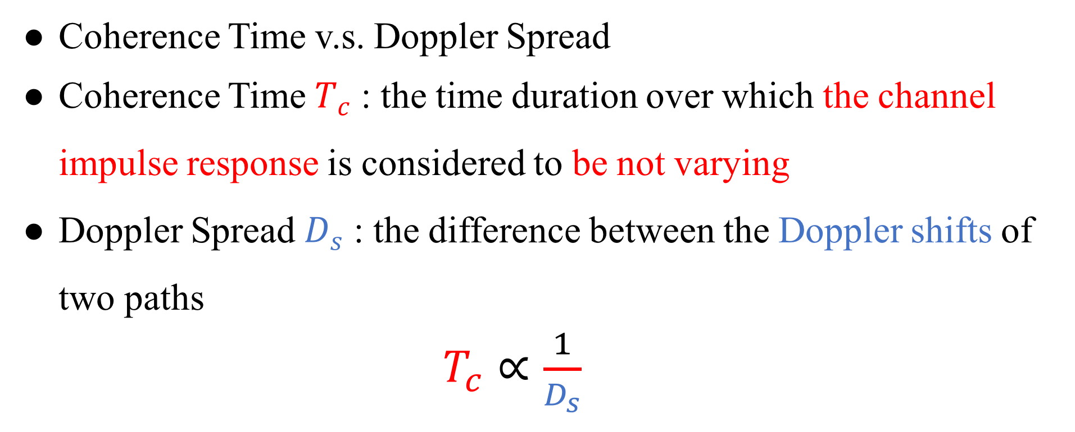
Channel Fading
Coherence Time v.s. Doppler Spread
Coherence Time $T_{c}$ : the time duration over which the channel impulse response is considered to be not varying
Doppler Spread $D_{s}$ : the difference between the Doppler shifts of two paths
$T_{c}∝\frac{1}{D_{s}}$

Slide 12
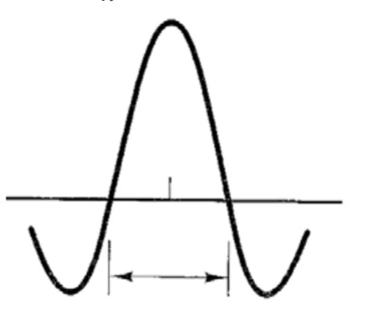
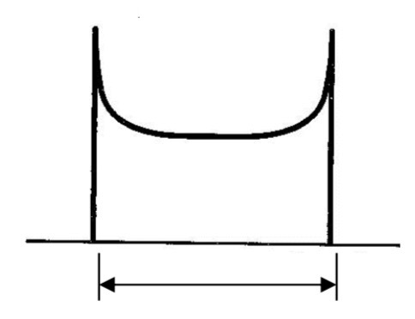


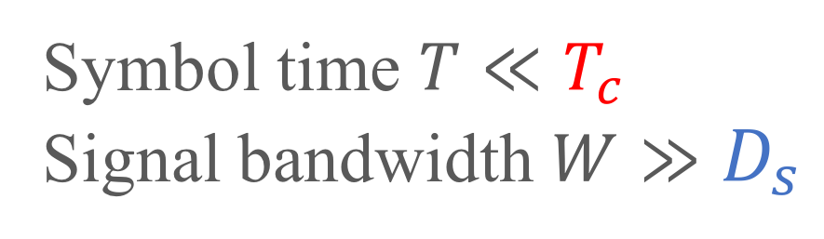

Channel Fading
Time Domain
Frequency Domain
$T_{c}∝\frac{1}{D_{s}}$
FFT
iFFT
$$T_{c}$$
$$D_{s}$$
Coherence time
Doppler Spread
Symbol time $T≪T_{c}$
Signal bandwidth $W≫D_{s}$
Slow Fading

Slide 13
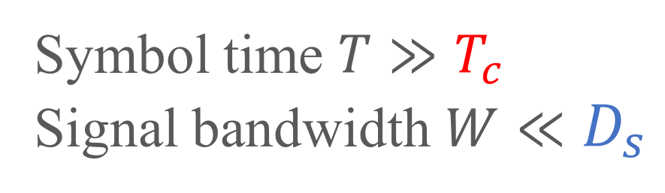
Channel Fading
Time Domain
Frequency Domain
$T_{c}∝\frac{1}{D_{s}}$
FFT
iFFT
$$T_{c}$$
$$D_{s}$$
Coherence time
Doppler Spread
Symbol time $T≫T_{c}$
Signal bandwidth $W≪D_{s}$
Fast Fading

Slide 14
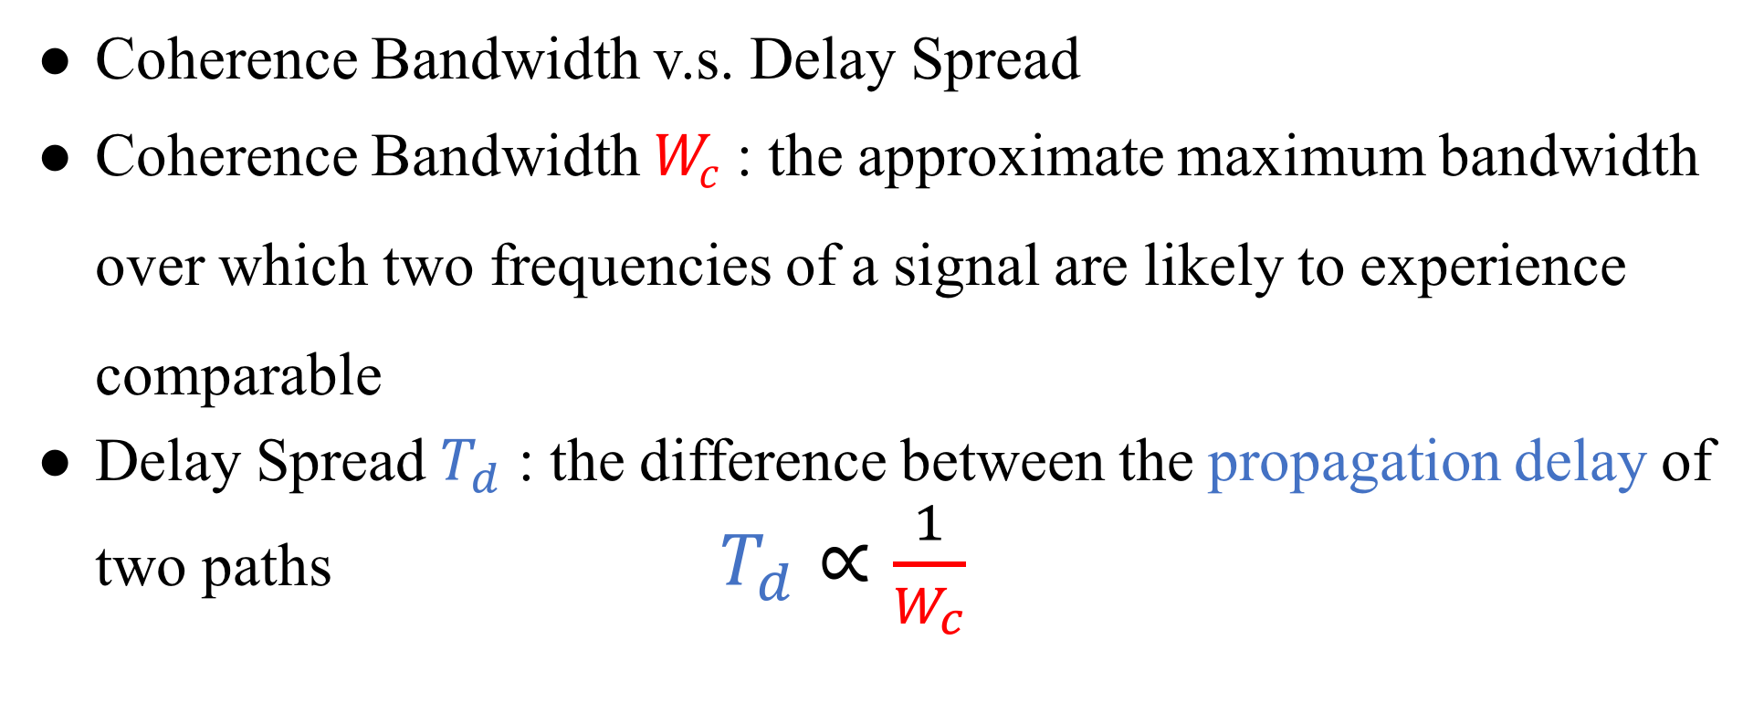
Channel Fading
Coherence Bandwidth v.s. Delay Spread
Coherence Bandwidth $W_{c}$ : the approximate maximum bandwidth over which two frequencies of a signal are likely to experience comparable
Delay Spread $T_{d}$ : the difference between the propagation delay of two paths $T_{d}∝\frac{1}{W_{c}}$

Slide 15
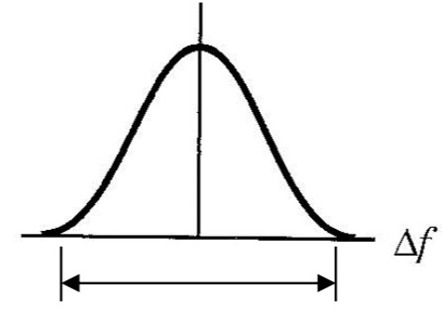
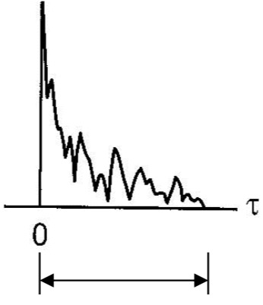



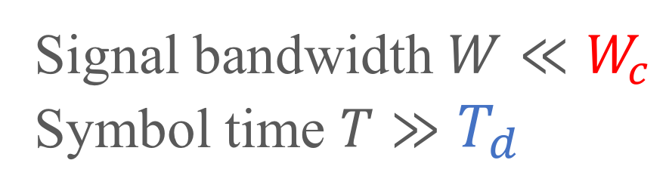
Channel Fading
Frequency Domain
Time Domain
$W_{c}∝\frac{1}{T_{d}}$
iFFT
FFT
$$W_{c}$$
$$T_{d}$$
Coherence Bandwidth
Delay Spread
Signal bandwidth $W≪W_{c}$
Symbol time $T≫T_{d}$
Flat Fading

Slide 16
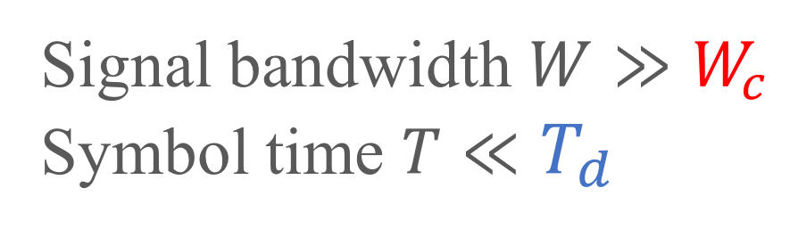
Channel Fading
Frequency Domain
Time Domain
$W_{c}∝\frac{1}{T_{d}}$
iFFT
FFT
$$W_{c}$$
$$T_{d}$$
Coherence Bandwidth
Delay Spread
Frequency-selective
Fading
Signal bandwidth $W≫W_{c}$
Symbol time $T≪T_{d}$

Slide 17
Large-Scale Fading

Slide 18
Path Loss
Linear path loss of the channel is the ratio of transmit
power to receive power.
The power of received signal is averaged over any random
variations due to shadowing.
Shadowing is the effect that the received signal power
fluctuates due to objects obstructing the propagation path
between tx and rx.

Slide 19
Outline
Channel
Friis Transmission Equation
RFID
Friis Transmission Equation

Slide 20
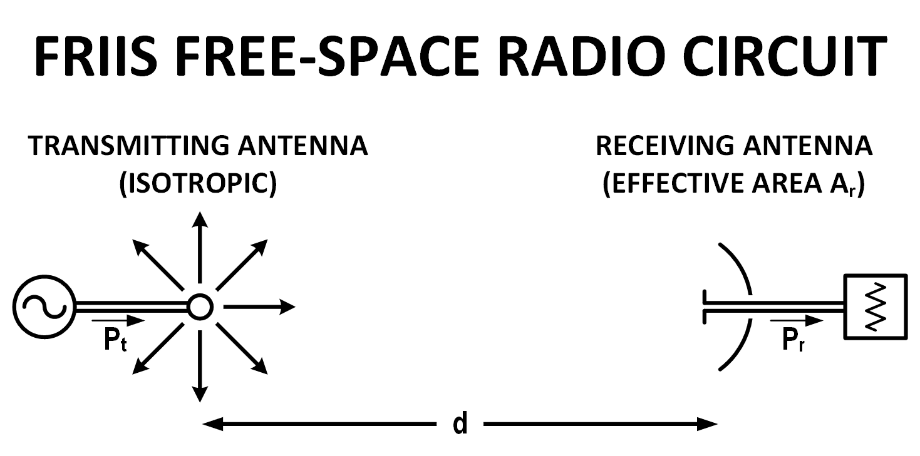
Why Friis’ Formula
Dispense with the usage of directivity or gain when describing antenna performance
Descriptor of antenna capture area
Notes:
通常會用 gain 表達天線的 performance
Friis 認為現有的公式都太多係數要記
Capture area 展現 free space radio circuit 的特色

Slide 21
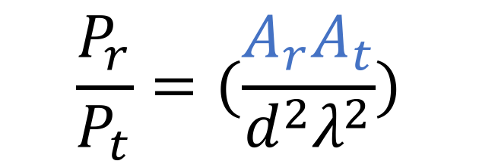
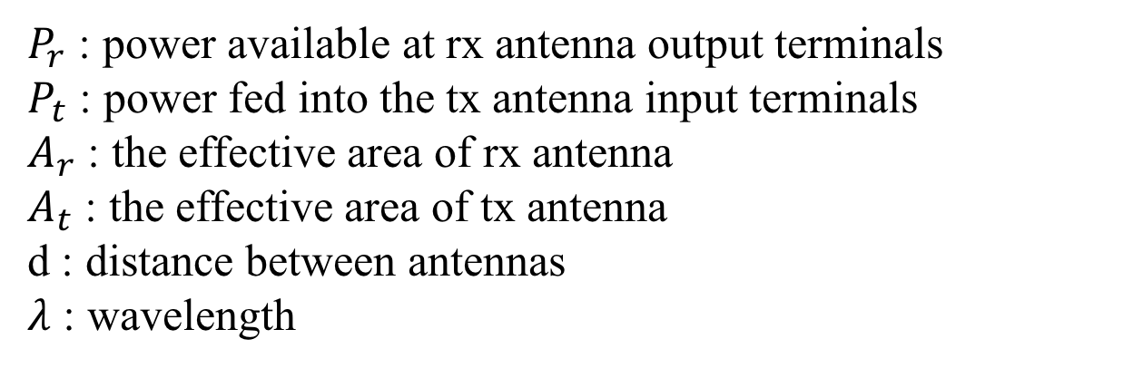
Friis’ Original Formula
$$\frac{P_{r}}{P_{t}}=(\frac{A_{r}A_{t}}{d^{2}λ^{2}})$$
$P_{r}$ : power available at rx antenna output terminals
$P_{t}$ : power fed into the tx antenna input terminals
$A_{r}$ : the effective area of rx antenna
$A_{t}$ : the effective area of tx antenna
d : distance between antennas
$λ$ : wavelength

Slide 22
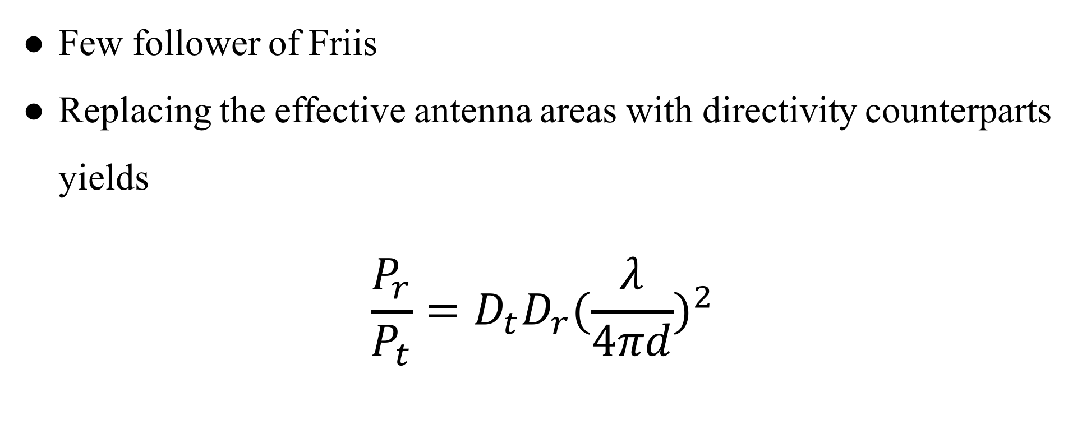
Contemporary Formula
Few follower of Friis
Replacing the effective antenna areas with directivity counterparts yields
$$\frac{P_{r}}{P_{t}}=D_{t}D_{r}{(\frac{λ}{4πd})}^{2}$$

Slide 23

Contemporary Formula
$$\frac{P_{r}}{P_{t}}=D_{t}D_{r}{(\frac{λ}{4πd})}^{2}$$
$$P_{r}(dBm)=P_{t}+D_{r}+D_{t}+20\log_{10}(\frac{λ}{4πd})$$
Notes:
D_{t} and D_{r} are the antenna directivities
the antenna directivities are linear values

Slide 24
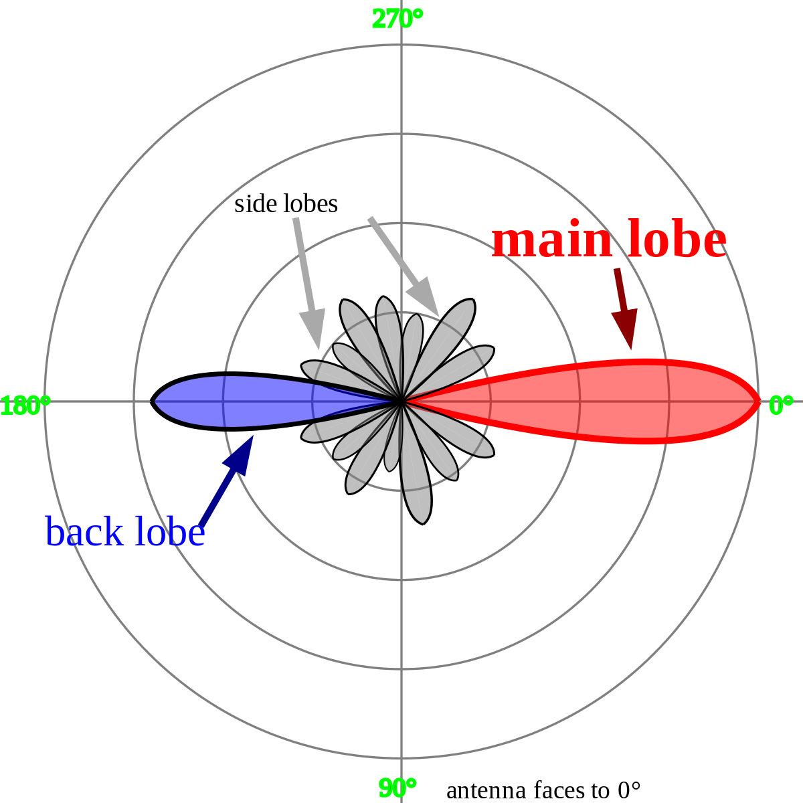

Directivities
$$D=\frac{2}{1−cos\frac{θ}{2}}$$
$$D_{dBi}=10∙\log_{10}D$$
Notes:
看個角度的訊號最強

Slide 25

Isotropic Radiator
Notes:
點來源

Slide 26
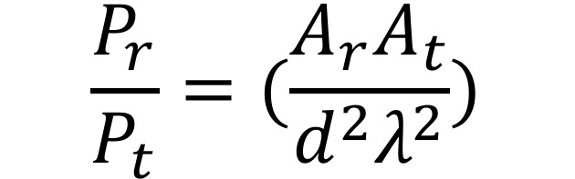
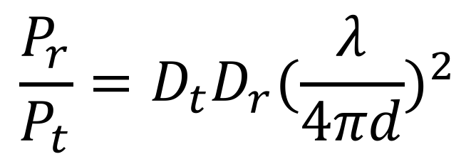
$$\frac{P_{r}}{P_{t}}=(\frac{A_{r}A_{t}}{d^{2}λ^{2}})$$
$$\frac{P_{r}}{P_{t}}=D_{t}D_{r}{(\frac{λ}{4πd})}^{2}$$
Notes:
最後還是加入了 directivity 來呈現天線的效能

Slide 27
Channel Fading Summary
Small-scale fading
Doppler spread
Slow fading
Fast fading
Delay spread
Flat fading
Frequency-selective fading
Large-scale fading
Path loss
Shadowing
Mobility
Multipath

Slide 28
Demo

Slide 29
Outline
Channel
Friis Transmission Equation
RFID
RFID

Slide 30
Basic Elements

Slide 31
RFID Standard
Bar code
Traditional wireless
identification
Defacement
Line of sight
Manual manipulation
Read separately
Radio Frequency IDentification
Brand new wireless
identification
RF based communication
Non-line of sight
System based operation
Read simultaneously

Slide 32
RFID Reading Frequency
Frequency | Price range | Read Range | Limitations | Applications
Low Frequency 125-134 kHz | low | Low ( < 1 m.) | Low reading speed | Animal tracking
High Frequency 13.56 Mhz | Low to Middle | Low ( < 1.5 m) | Problems with metal | Library, access control
Ultra-high Freq. 860-930 MHz | Middle to High | High ( > 10 m) | Interference problems | Vehicle tracking
Microwave 2.4 GHz | High | High ( > 50 m) | Not widely deployed | Vehicle access control

Slide 33
RFID Reading Frequency
國內RFID頻段
FCC開放RFID頻段
中華電信
Up link
遠傳
UP
RFID
中華電信
Down link
遠傳
DL
增頻
增頻
MHz
891.4
895
902
910
915
922
928
940
955
960
892
937

Slide 34
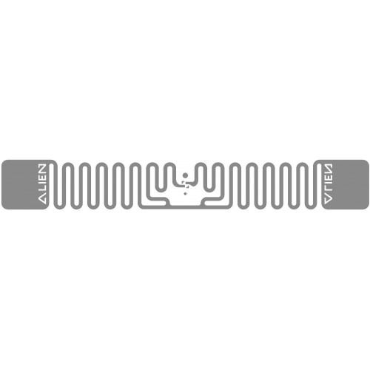

RFID Setting
Tag Type | Reading Distance | Characteristic
Passive | < 4m | Battery free Cheap
Active | > 100m | Battery loaded Expensive

Slide 35
RFID Setting
Tag Type | Reading Distance | Characteristic
Passive | < 4m | Battery free Cheap
Active | > 100m | Battery loaded Expensive

Slide 36
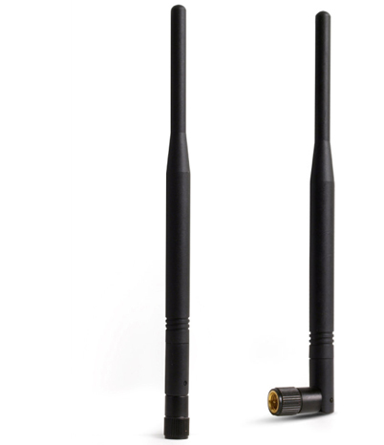
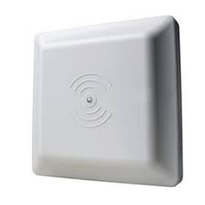
RFID Setting

Slide 37
RFID Setting

Slide 38
Protocol

Slide 39
Backscatter
Notes:
A reader transmits information to a tag by modulating an RF signal

Slide 40

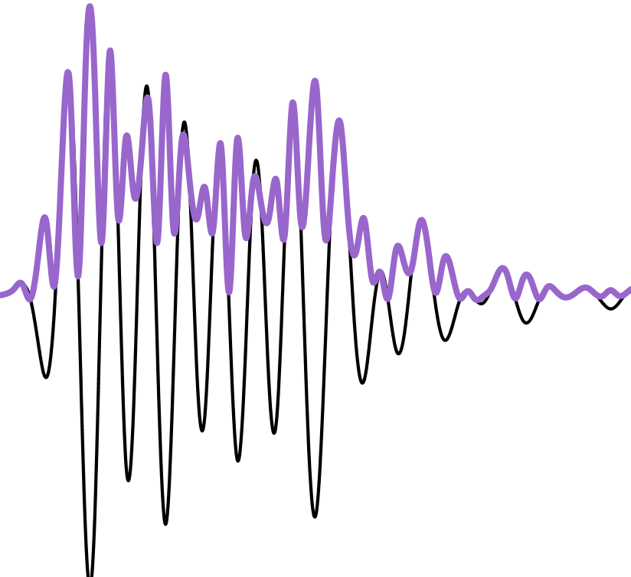
Backscatter
Notes:
A reader transmits information to a tag by modulating an RF signal

Slide 41
Backscatter
Notes:
The tag receives both down-link information and the entirety of its
operating energy from this RF signal.

Slide 42
Backscatter
Power
Command
Notes:
The tag receives both down-link information and the entirety of its
operating energy from this RF signal.

Slide 43
Notes:
找實際訊號圖

Slide 44

Backscatter
Carrier Wave
Power
Notes:
The reader transmits a continuous RF wave (CW) which assures that
the tag remains powered

Slide 45
Backscatter
Notes:
The tag then transmits its response by modulating the reflection coefficient of its antenna.

Slide 46
Backscatter
Notes:
The tag then transmits its response by modulating the reflection coefficient of its antenna.

Slide 47
Backscatter
Notes:
The reader is able to decode the tag response by detecting the variation in the reflected CW.

Slide 48
Backscatter
Notes:
The reader is able to decode the tag response by detecting the variation in the reflected CW.

Slide 49
Backscatter
Notes:
The reader is able to decode the tag response by detecting the variation in the reflected CW.

Slide 50
UHF EPC
Physical Layer
RFID tags communicate by “backscattering” signals that are concurrent with reader transmissions, and use a variety of frequencies and encodings under the control of the reader.
MAC Layer
Readers and tags use a variation on slotted Aloha to solve the multi-access problem in a setting where readers can hear tags but tags cannot hear each other.

Slide 51
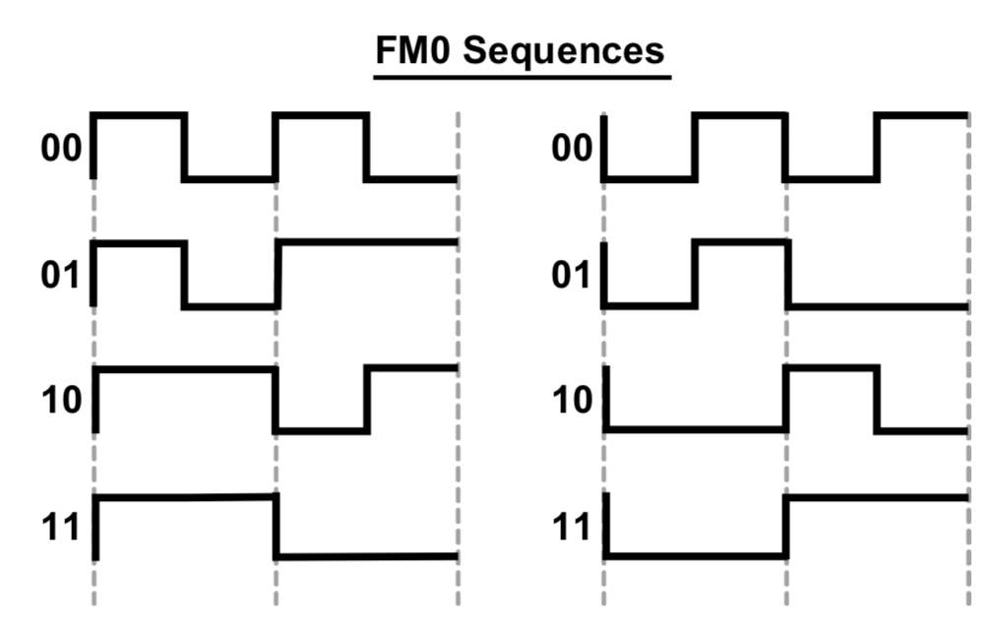
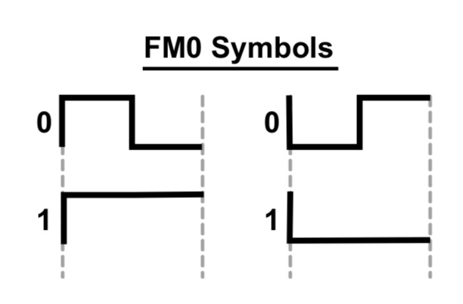
FM0

Slide 52
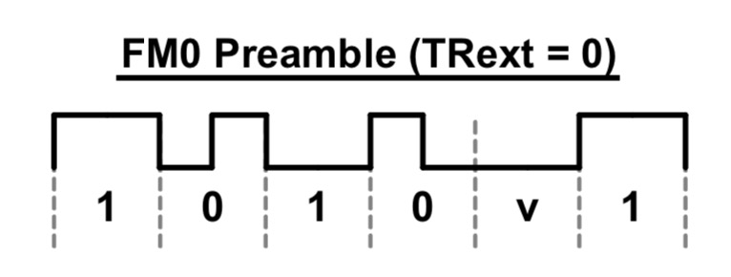
FM0
Notes:
Find some examples

Slide 53
MAC Layer
Based on Framed Slotted Aloha
Each frame has a number of slots
Each tag will reply in one randomly selected slot per frame
The number of slots in the frame is determined by the reader and can be varied on a per frame basis

Slide 54
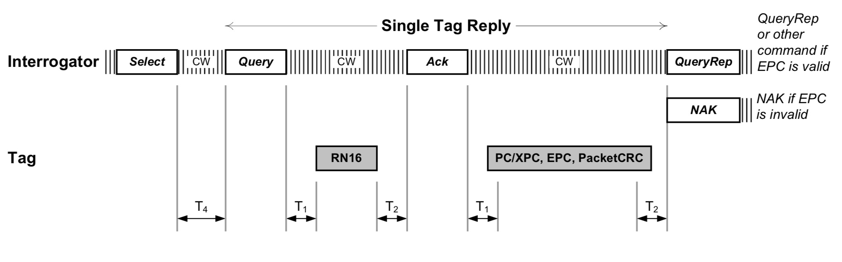
Query round

Slide 55
Query round
Query Round
an individual frame : Query Cycle
the series of Query Rounds between power down periods
The reader can optionally transmit a Select command
Limits the number of active tags by providing a bit mask only tags with ID’s (or memory locations) that match this mask will respond in the subsequent round

Slide 56
Query round
Query Round
an individual frame : Query Cycle
the series of Query Rounds between power down periods
The reader can optionally transmit a Select command
Limits the number of active tags by providing a bit mask only tags with ID’s (or memory locations) that match this mask will respond in the subsequent round

Slide 57
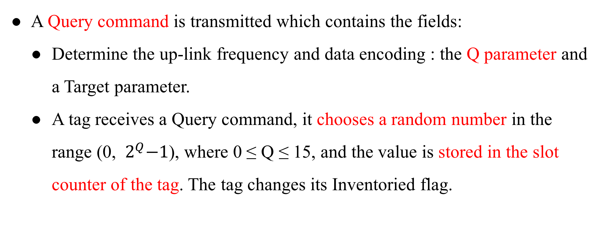
Query round
A Query command is transmitted which contains the fields:
Determine the up-link frequency and data encoding : the Q parameter and a Target parameter.
A tag receives a Query command, it chooses a random number in the range (0, ${ 2}^{Q}−1$), where 0 ≤ Q ≤ 15, and the value is stored in the slot counter of the tag. The tag changes its Inventoried flag.

Slide 58
Query round
A Query command is transmitted which contains the fields:
Determine the up-link frequency and data encoding : the Q parameter and a Target parameter.
A tag receives a Query command, it chooses a random number in the range (0, ${ 2}^{Q}−1$), where 0 ≤ Q ≤ 15, and the value is stored in the slot counter of the tag. The tag changes its Inventoried flag.

Slide 59
Query round
If a tag stores a 0 in its slot counter, it will transmit a 16 bit random number (RN16) immediately.
The reader will echo the RN16 in an ACK packet after receiving it.
If the tag successful receives the ACK with the correct random number, the tag will backscatter its ID.

Slide 60
Query round
If a tag stores a 0 in its slot counter, it will transmit a 16 bit random number (RN16) immediately.
The reader will echo the RN16 in an ACK packet after receiving it.
If the tag successful receives the ACK with the correct random number, the tag will backscatter its ID.

Slide 61
Query round
The reader will send a QueryRepeat command to cause the tag to toggle its Inventoried flag.
If the ID was not successfully received by the reader, a NAK command is sent which resets the tag so that a subsequent QueryRepeat will not result in Inventoried flag being changed.
A QueryRepeat signals the end of the slot.

Slide 62
Query round
The reader will send a QueryRepeat command to cause the tag to toggle its Inventoried flag.
If the ID was not successfully received by the reader, a NAK command is sent which resets the tag so that a subsequent QueryRepeat will not result in Inventoried flag being changed.
A QueryRepeat signals the end of the slot.

Slide 63
Query round
On receiving the command, the remaining tags will:
Decrement their slot counter
Respond with a RN16 if their slot counter is set to 0.
The process then repeats, with the number of QueryRepeats being equal to the number of slots set using the Q parameter.

Slide 64
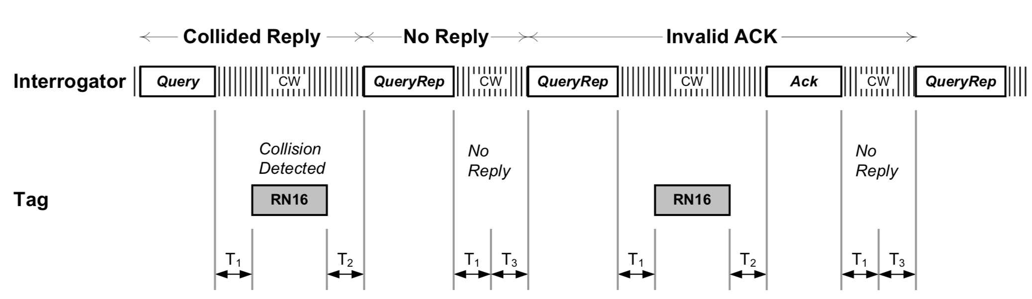
Query round
Notes:
撞掉失敗，或是沒有人倒數到 0

Slide 65
Related Work
Fundamental
Michael Buettner , David Wetherall An empirical study of UHF RFID performance. 14th ACM Int. Conf. on MobiCom
EPCglobal. Epc radio-frequency identity protocols class-1 generation-2 uhf rfid protocol for communications at 860 mhz-960 mhz version 2.0.0. , 2013

Slide 66
Related Work
Localization
Jue Wang, Dina Katabi Dude, where's my card?: RFID positioning that works with multipath and non-line of sight. the ACM SIGCOMM, 2013
Tracking
Lei Yang, Yekui Chen Tagoram: Real-Time Tracking of Mobile RFID Tags to High Precision Using COTS Devices. ACM Int. Conf. on MobiCom, 2014
Device-free
Chuyu Wang, Jian Liu, Yingying Chen Multi-Touch in the Air: Device-Free Finger Tracking and Gesture Recognition via COTS RFID. IEEE Infocom, 2018

Slide 67
Related Work
Search tags
Jihong Yu, Wei Gong, Jiangchuan Liu Fast and Reliable Tag Search in Large-Scale RFID Systems: A Probabilistic Tree-based Approach. IEEE Infocom, 2017
Find missing/unknown tags
Muhammad Shahzad, Alex X. Liu Fast and Reliable Detection and Identification of Missing RFID Tags in the Wild. IEEE/ACM Transactions on Networking, 2016
Find moving tag
Chuyu Wang, Lei Xie, Wei Wang Moving Tag Detection via Physical Layer Analysis for Large-Scale RFID Systems. IEEE INFOCOM, 2016

Slide 68
Reference
https://www.flaticon.com/
https://www.sitebuilderreport.com/stock-up
https://en.wikipedia.org/wiki/Friis_transmission_equation
https://en.wikipedia.org/wiki/Path_loss
https://ccrma.stanford.edu/~jos/fp/Phase_Delay.html
https://en.wikipedia.org/wiki/Communication_channel
https://en.wikipedia.org/wiki/Fading
http://www.sengpielaudio.com/calculator-timedelayphase.html
EPC RFID protocols Class-1 Gen2 UHF RFID protocol for communications
An empirical study of UHF RFID performance

