Slide 1
Freshman Training Shop Signal
NCTU NSS 2018
Chengfa Huang
Willy Cheng-Fa Huang
2018.08. @NCTU EC-345

Slide 2
Outline
Channel
Friis Transmission Equation
RFID

Slide 3
Outline
Channel
Friis Transmission Equation
RFID
Channel

Slide 4

Signal Representation
General form
Called the canonical representation of a
band-pass signal
Q
amplitude
frequency
phase
s(t)
a(t)
a(t)
I

Slide 6
Outline
Channel
Friis Transmission Equation
RFID
Friis Transmission Equation

Slide 7
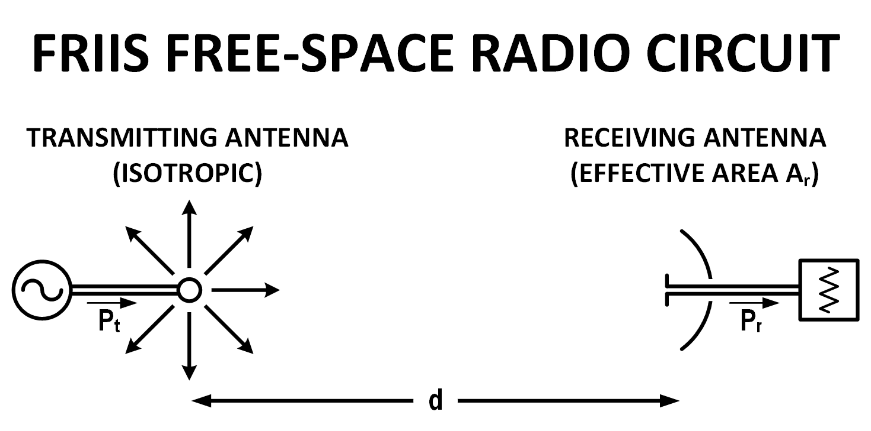
Why Friis’ Formula
Dispense with the usage of directivity or gain when describing antenna performance
Descriptor of antenna capture area
Notes:
通常會用 gain 表達天線的 performance
Friis 認為現有的公式都太多係數要記
Capture area 展現 free space radio circuit 的特色

Slide 8
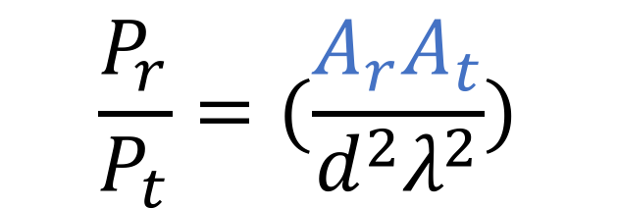
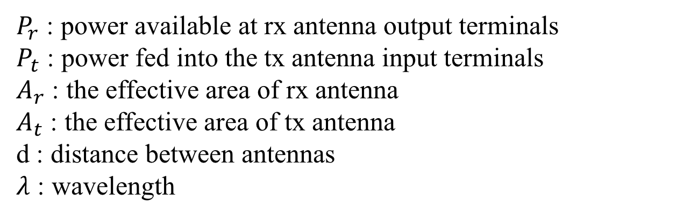
Friis’ Original Formula
$$\frac{P_{r}}{P_{t}}=(\frac{A_{r}A_{t}}{d^{2}λ^{2}})$$
$P_{r}$ : power available at rx antenna output terminals
$P_{t}$ : power fed into the tx antenna input terminals
$A_{r}$ : the effective area of rx antenna
$A_{t}$ : the effective area of tx antenna
d : distance between antennas
$λ$ : wavelength

Slide 9
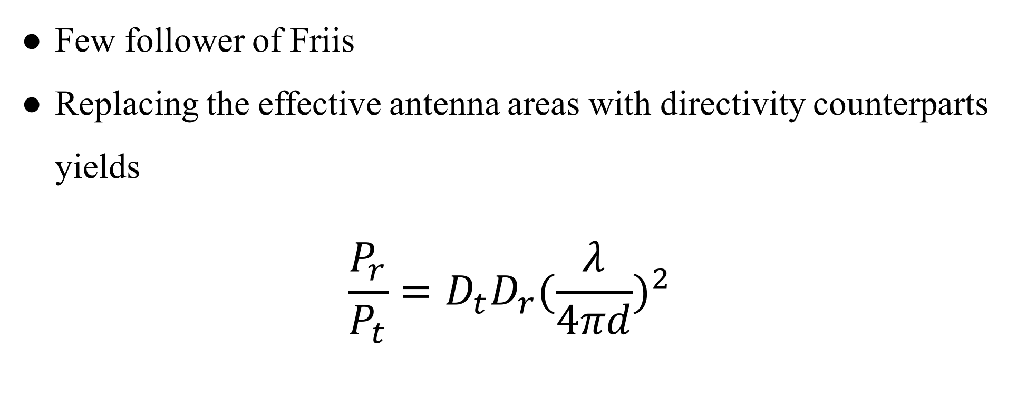
Contemporary Formula
Few follower of Friis
Replacing the effective antenna areas with directivity counterparts yields
$$\frac{P_{r}}{P_{t}}=D_{t}D_{r}{(\frac{λ}{4πd})}^{2}$$

Slide 10

Contemporary Formula
$$\frac{P_{r}}{P_{t}}=D_{t}D_{r}{(\frac{λ}{4πd})}^{2}$$
$$P_{r}(dBm)=P_{t}+D_{r}+D_{t}+20\log_{10}(\frac{λ}{4πd})$$
Notes:
D_{t} and D_{r} are the antenna directivities
the antenna directivities are linear values

Slide 11
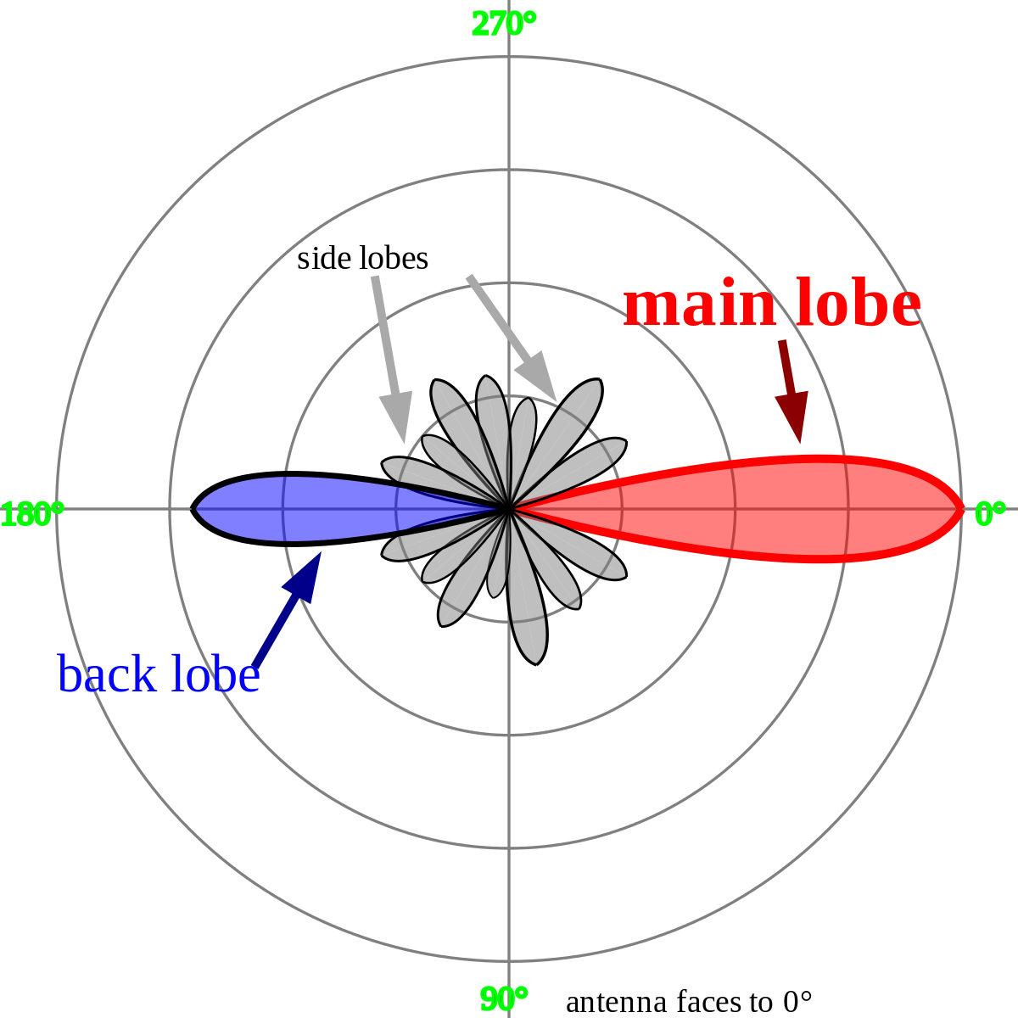

Directivities
$$D=\frac{2}{1−cos\frac{θ}{2}}$$
$$D_{dBi}=10∙\log_{10}D$$
Notes:
看個角度的訊號最強

Slide 12

Isotropic Radiator
Notes:
點來源

Slide 13
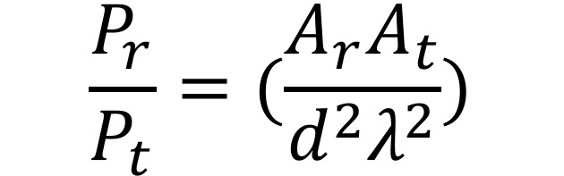
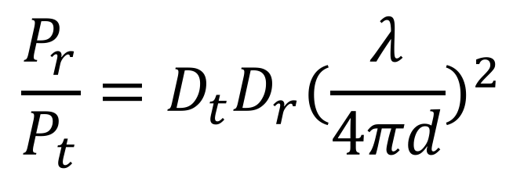
$$\frac{P_{r}}{P_{t}}=(\frac{A_{r}A_{t}}{d^{2}λ^{2}})$$
$$\frac{P_{r}}{P_{t}}=D_{t}D_{r}{(\frac{λ}{4πd})}^{2}$$
Notes:
最後還是加入了 directivity 來呈現天線的效能

Slide 14
Outline
Channel
Friis Transmission Equation
RFID
RFID

Slide 15
Reference
https://www.flaticon.com/
https://www.sitebuilderreport.com/stock-up
https://en.wikipedia.org/wiki/Friis_transmission_equation

