Slide 1
Freshman Training Shop Signal
NCTU NSS 2018
Chengfa Huang
Willy Cheng-Fa Huang
2018.08. @NCTU EC-345

Slide 2
Outline
Channel
Friis Transmission Equation
RFID

Slide 3
Outline
Channel
Friis Transmission Equation
RFID
Channel

Slide 4

Signal Representation
General form
Called the canonical representation of a
band-pass signal
Q
amplitude
frequency
phase
s(t)
a(t)
a(t)
I

Slide 5
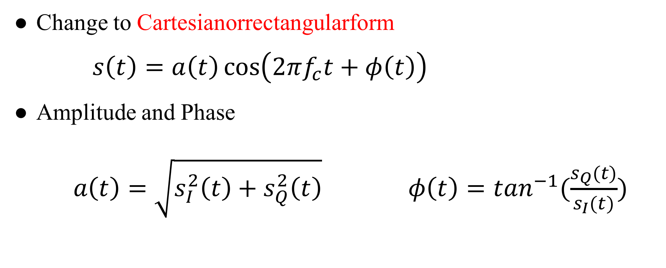
Linear Channels
Change to Cartesianorrectangularform
$s\left(t\right)=a\left(t\right)\cos\left(2πf_{c}t+φ\left(t\right)\right)$
Amplitude and Phase
$a\left(t\right)=\sqrt{s_{I}^{2}\left(t\right)+s_{Q}^{2}\left(t\right)} φ\left(t\right)=\tan^{−1}(\frac{s_{Q}(t)}{s_{I}(t)})$
Notes:
Time -> FFT -> freq. $ω=2πf$

Slide 6
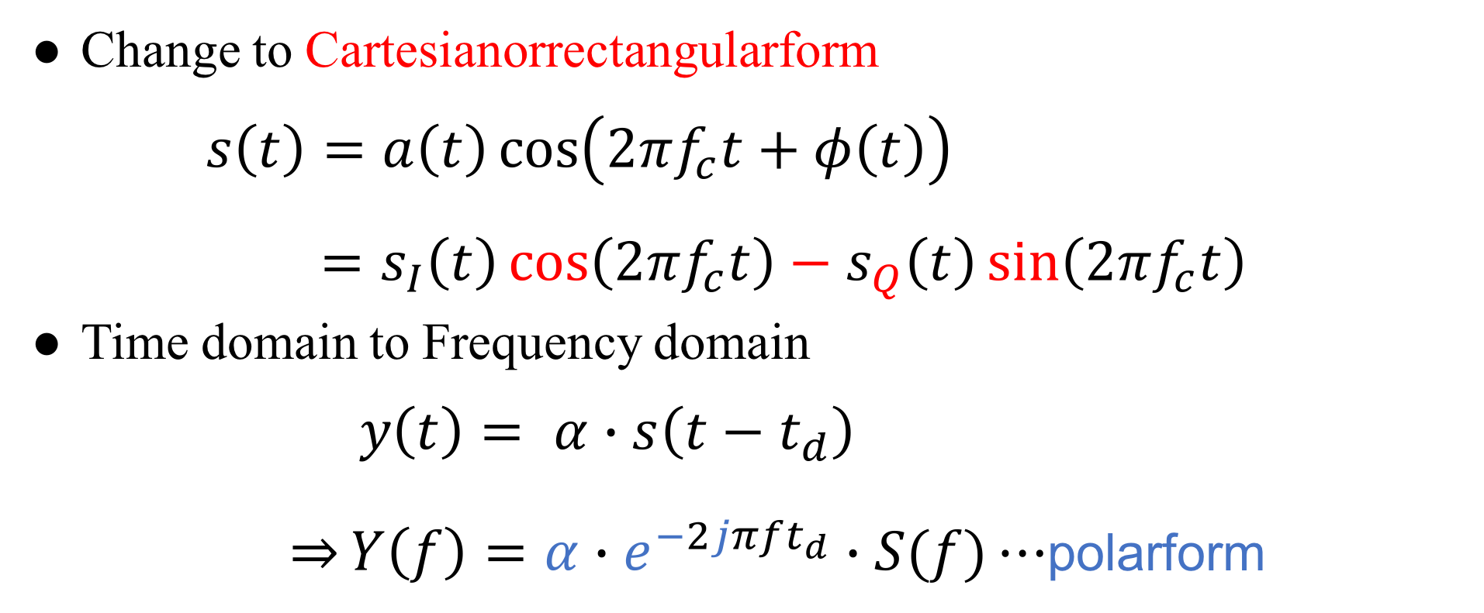
Linear Channels
Change to Cartesianorrectangularform
$s\left(t\right)=a\left(t\right)\cos\left(2πf_{c}t+φ\left(t\right)\right)$
$=s_{I}\left(t\right)\cos\left(2πf_{c}t\right)−s_{Q}\left(t\right)\sin\left(2πf_{c}t\right)$
Time domain to Frequency domain
$y\left(t\right)= α∙s\left(t−t_{d}\right)$
$\overset{⇒}{}Y\left(f\right)=α∙e^{−2jπft_{d}}∙S(f)⋯$polarform
Notes:
Time -> FFT -> freq. $ω=2πf$

Slide 7
Channel Fading

Slide 8
Phase Delay

Slide 9
Path Loss

Slide 10
Outline
Channel
Friis Transmission Equation
RFID
Friis Transmission Equation

Slide 11
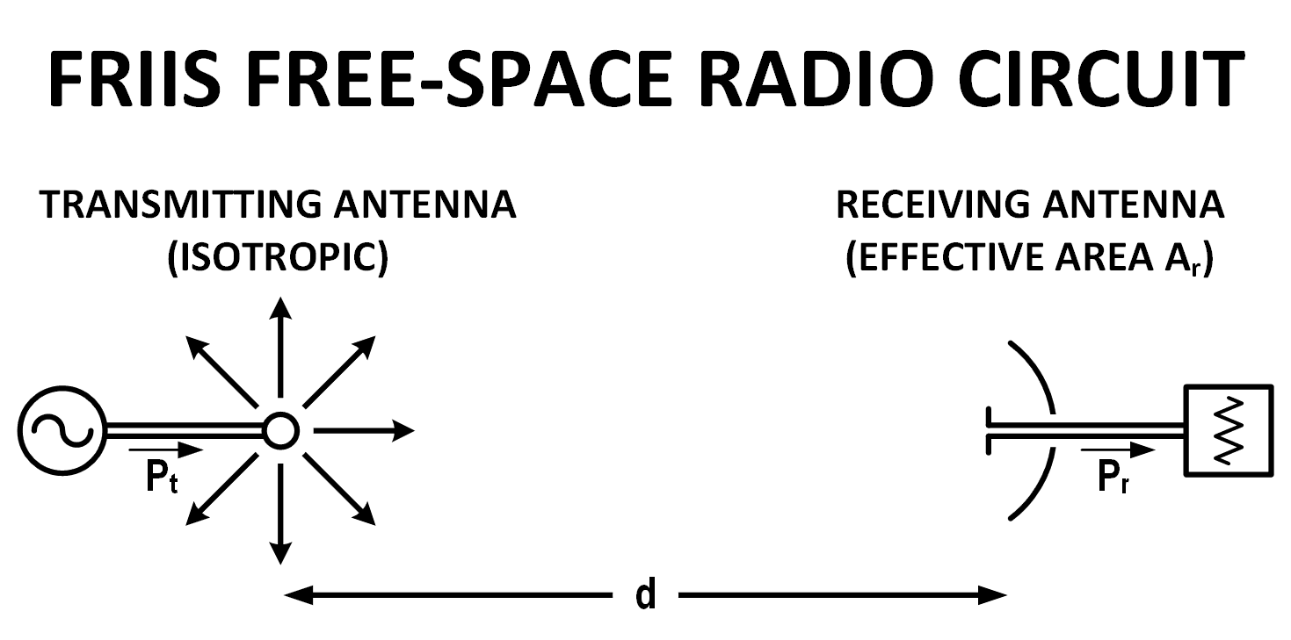
Why Friis’ Formula
Dispense with the usage of directivity or gain when describing antenna performance
Descriptor of antenna capture area
Notes:
通常會用 gain 表達天線的 performance
Friis 認為現有的公式都太多係數要記
Capture area 展現 free space radio circuit 的特色

Slide 12
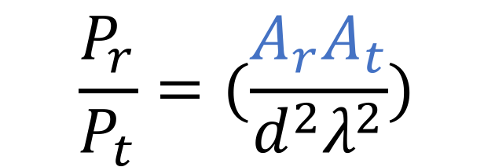
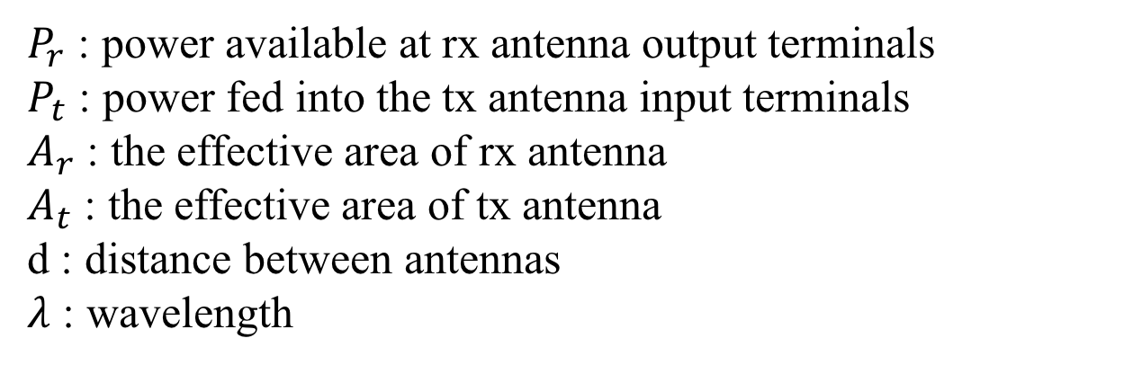
Friis’ Original Formula
$$\frac{P_{r}}{P_{t}}=(\frac{A_{r}A_{t}}{d^{2}λ^{2}})$$
$P_{r}$ : power available at rx antenna output terminals
$P_{t}$ : power fed into the tx antenna input terminals
$A_{r}$ : the effective area of rx antenna
$A_{t}$ : the effective area of tx antenna
d : distance between antennas
$λ$ : wavelength

Slide 13
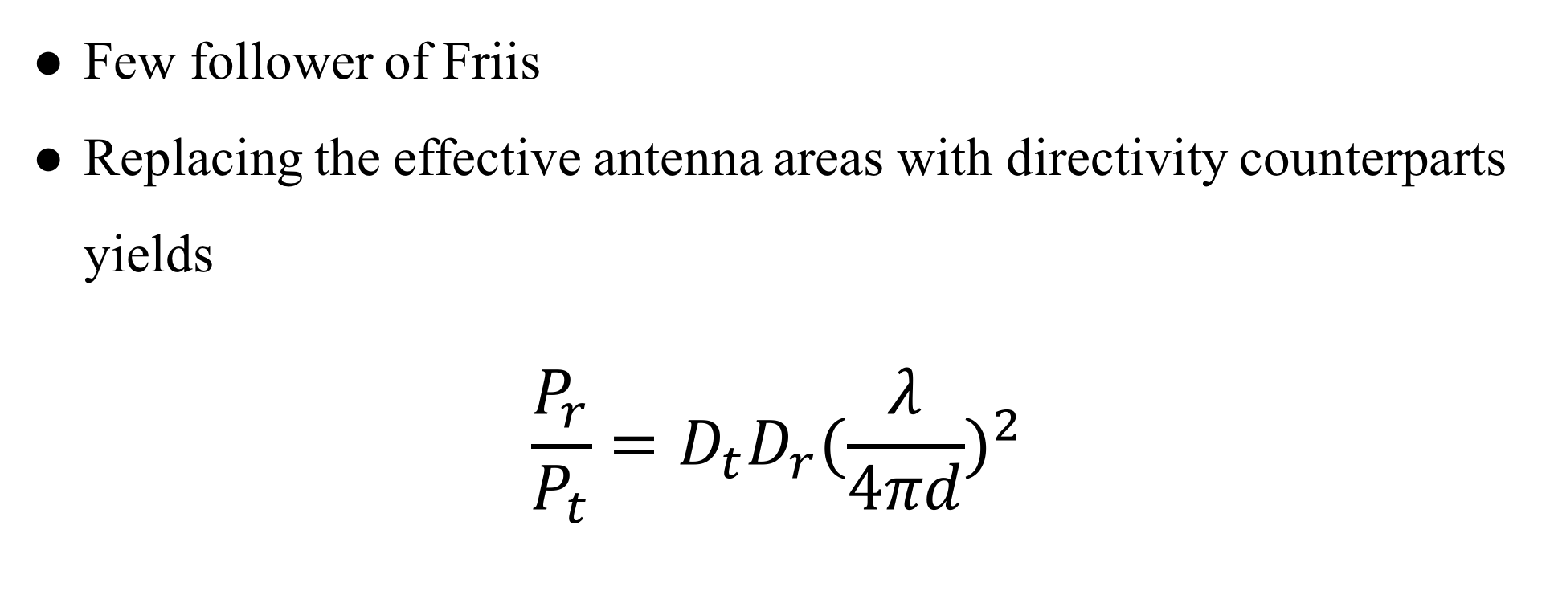
Contemporary Formula
Few follower of Friis
Replacing the effective antenna areas with directivity counterparts yields
$$\frac{P_{r}}{P_{t}}=D_{t}D_{r}{(\frac{λ}{4πd})}^{2}$$

Slide 14

Contemporary Formula
$$\frac{P_{r}}{P_{t}}=D_{t}D_{r}{(\frac{λ}{4πd})}^{2}$$
$$P_{r}(dBm)=P_{t}+D_{r}+D_{t}+20\log_{10}(\frac{λ}{4πd})$$
Notes:
D_{t} and D_{r} are the antenna directivities
the antenna directivities are linear values

Slide 15
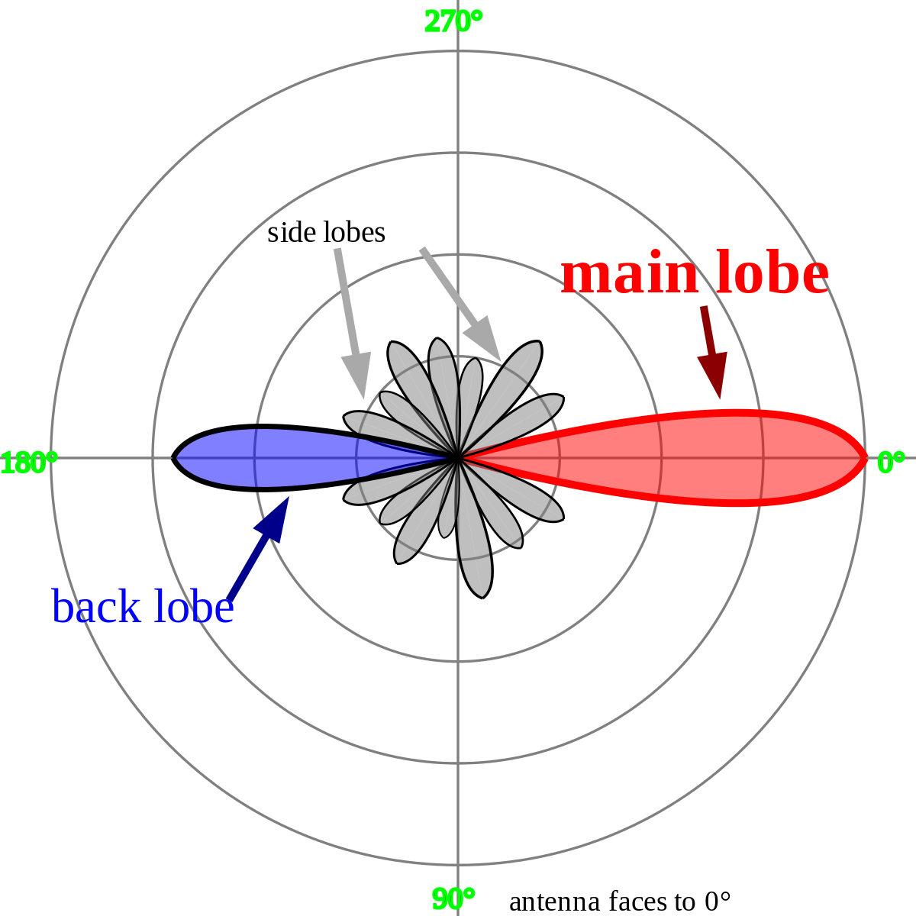

Directivities
$$D=\frac{2}{1−cos\frac{θ}{2}}$$
$$D_{dBi}=10∙\log_{10}D$$
Notes:
看個角度的訊號最強

Slide 16
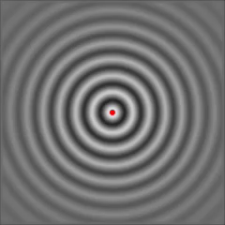
Isotropic Radiator
Notes:
點來源

Slide 17
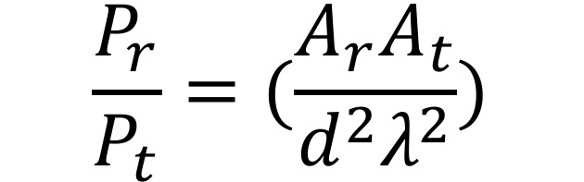
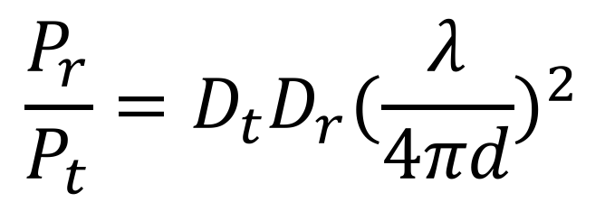
$$\frac{P_{r}}{P_{t}}=(\frac{A_{r}A_{t}}{d^{2}λ^{2}})$$
$$\frac{P_{r}}{P_{t}}=D_{t}D_{r}{(\frac{λ}{4πd})}^{2}$$
Notes:
最後還是加入了 directivity 來呈現天線的效能

Slide 18
Outline
Channel
Friis Transmission Equation
RFID
RFID

Slide 19
Reference
https://www.flaticon.com/
https://www.sitebuilderreport.com/stock-up
https://en.wikipedia.org/wiki/Friis_transmission_equation

