Slide 1
Freshman Training Course Signal
NCTU NSS 2018
Chengfa Huang
Willy Cheng-Fa Huang
2018.08. @NCTU EC-345

Slide 2
Outline
Channel
Friis Transmission Equation
RFID

Slide 3
Outline
Channel
Friis Transmission Equation
RFID
Channel

Slide 4

Signal Representation
General form
Called the canonical representation of a
band-pass signal
Q
amplitude
frequency
phase
s(t)
a(t)
a(t)
I

Slide 5
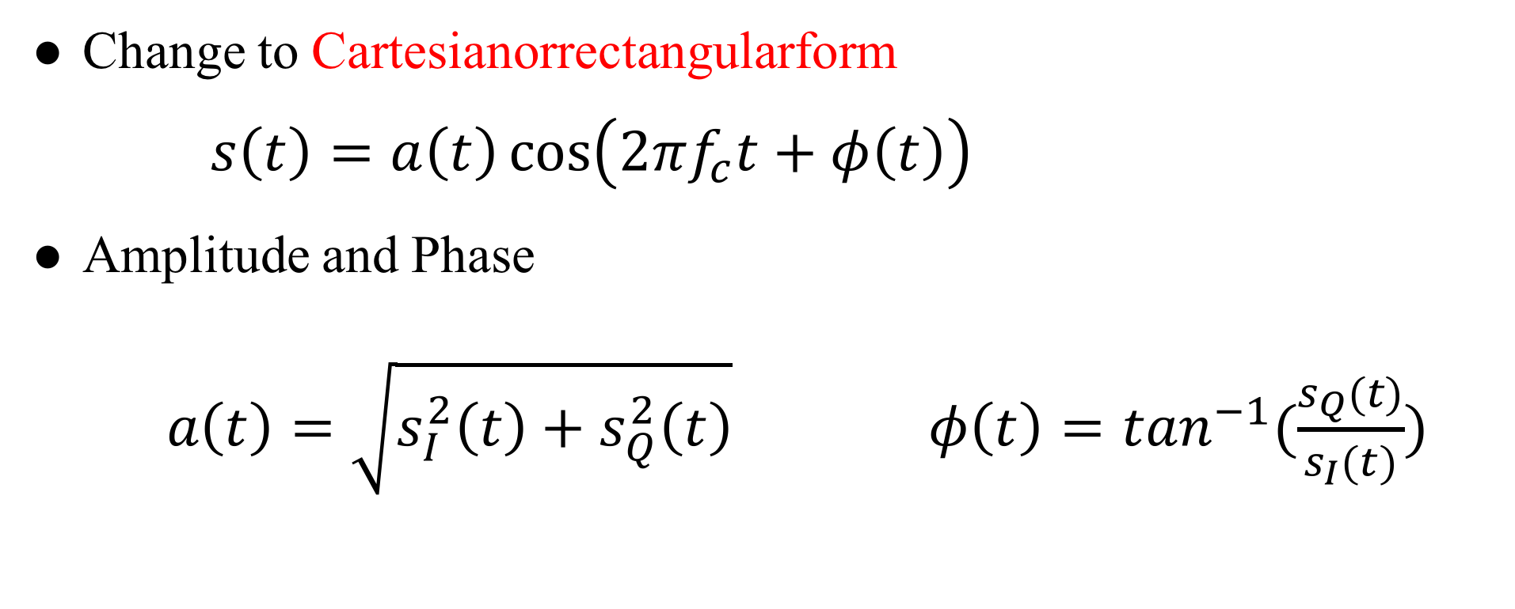
Linear Channels
Change to Cartesianorrectangularform
$s\left(t\right)=a\left(t\right)\cos\left(2πf_{c}t+φ\left(t\right)\right)$
Amplitude and Phase
$a\left(t\right)=\sqrt{s_{I}^{2}\left(t\right)+s_{Q}^{2}\left(t\right)} φ\left(t\right)=\tan^{−1}(\frac{s_{Q}(t)}{s_{I}(t)})$
Notes:
Time -> FFT -> freq. $ω=2πf$

Slide 6
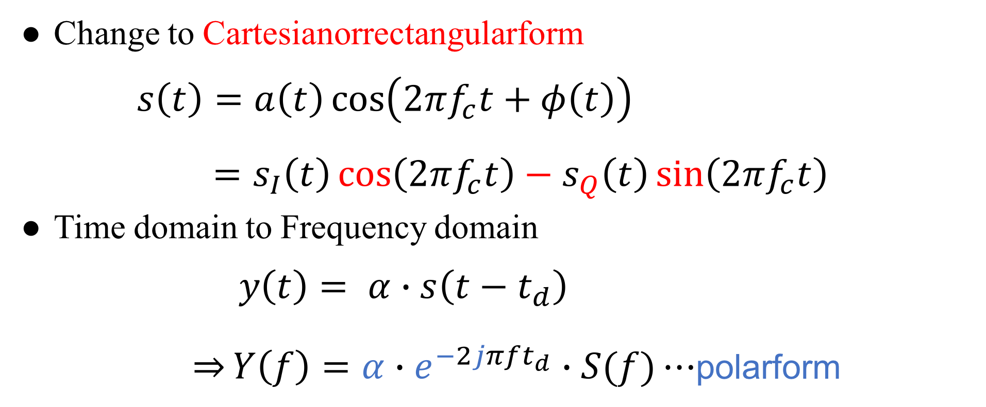
Linear Channels
Change to Cartesianorrectangularform
$s\left(t\right)=a\left(t\right)\cos\left(2πf_{c}t+φ\left(t\right)\right)$
$=s_{I}\left(t\right)\cos\left(2πf_{c}t\right)−s_{Q}\left(t\right)\sin\left(2πf_{c}t\right)$
Time domain to Frequency domain
$y\left(t\right)= α∙s\left(t−t_{d}\right)$
$\overset{⇒}{}Y\left(f\right)=α∙e^{−2jπft_{d}}∙S(f)⋯$polarform
Notes:
Time -> FFT -> freq. $ω=2πf$

Slide 7
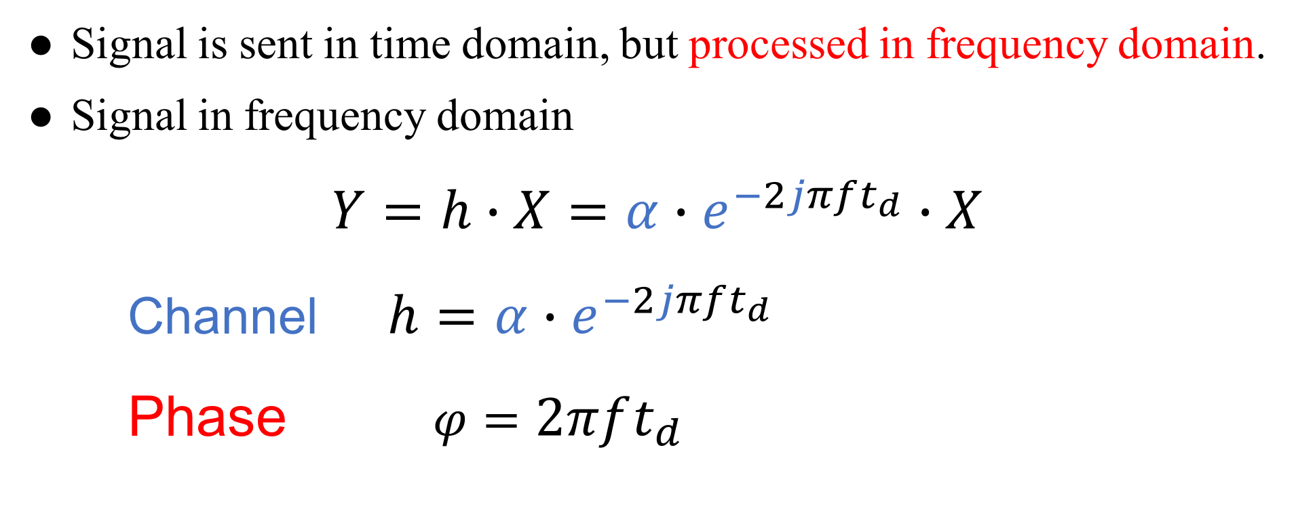
Channel
Signal is sent in time domain, but processed in frequency domain.
Signal in frequency domain
$Y=h∙X=α∙e^{−2jπft_{d}}∙X$
Channel $h=α∙e^{−2jπft_{d}}$
Phase $φ=2πft_{d}$
Notes:
Time domain 送
Frequency domain 分析

Slide 8
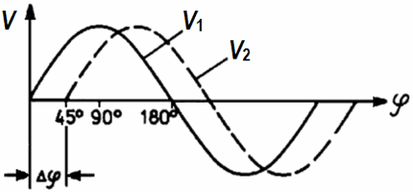
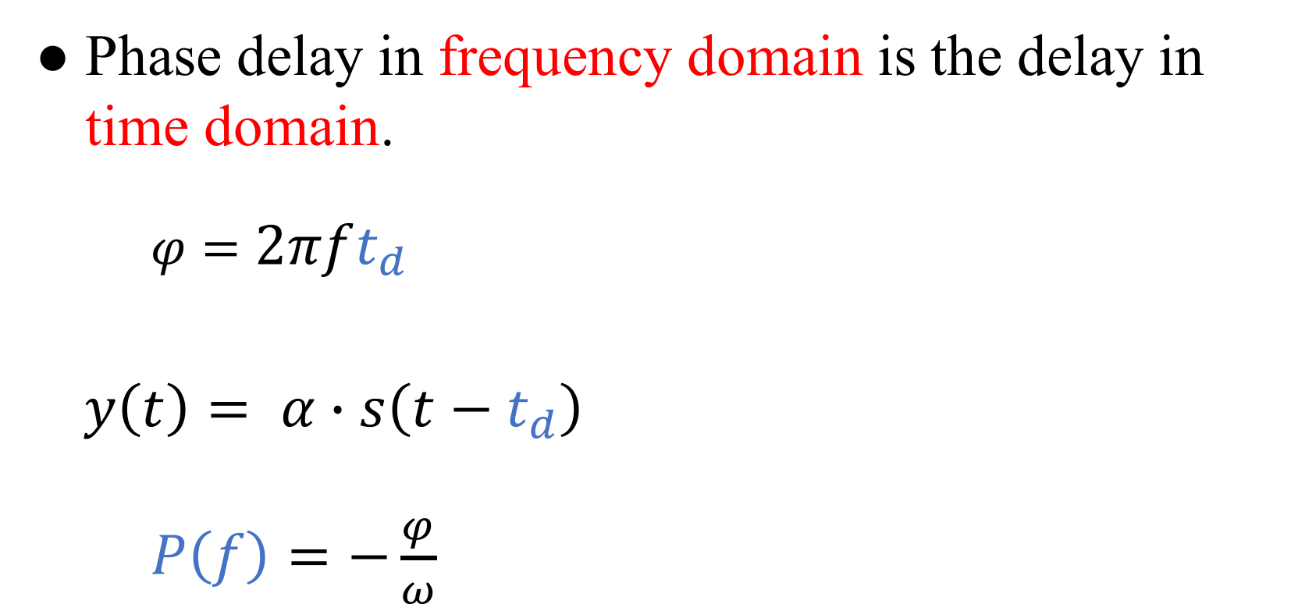
Phase Delay
Phase delay in frequency domain is the delay in time domain.
$φ=2πft_{d}$
$y\left(t\right)= α∙s\left(t−t_{d}\right)$
$P\left(f\right)=−\frac{φ}{ω}$

Slide 9
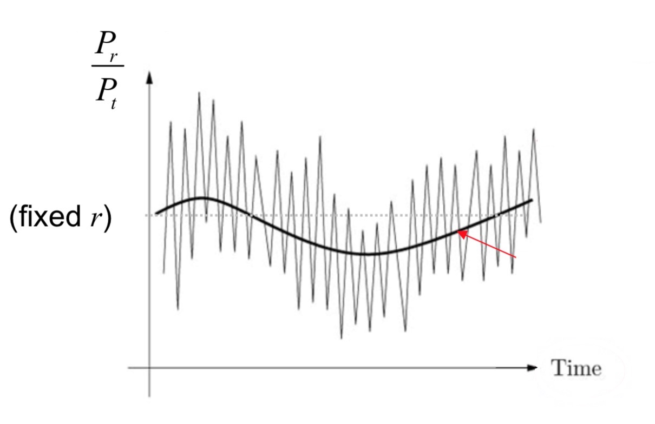
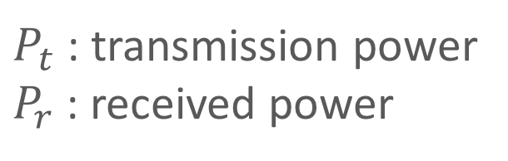
Channel Fading
Fluctuation of the local mean:
Small-scale fading
Fluctuation of the local mean:
Large-scale fading
$P_{t}$ : transmission power
$P_{r}$ : received power

Slide 10
Small-Scale Fading

Slide 11
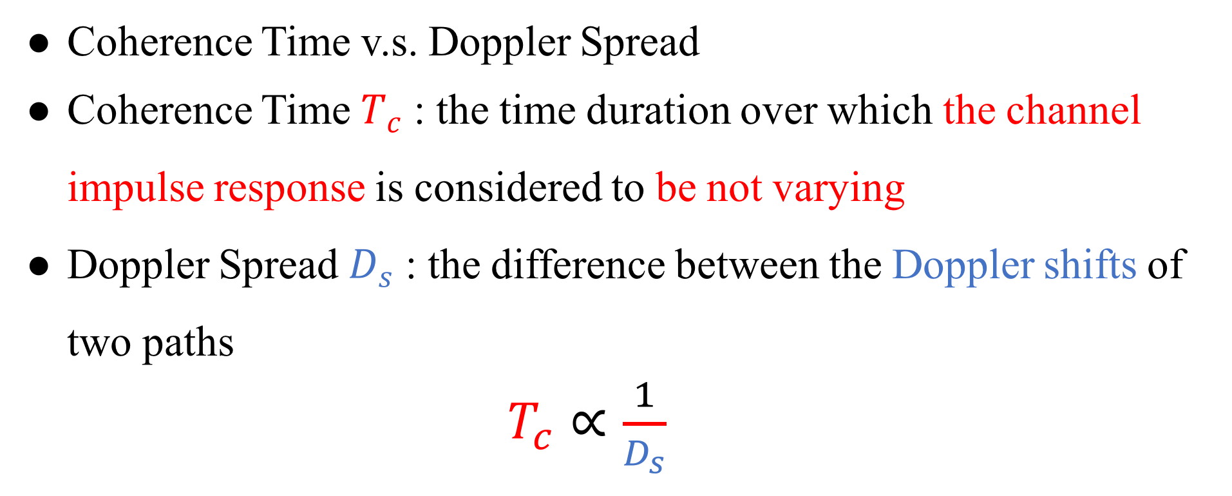
Channel Fading
Coherence Time v.s. Doppler Spread
Coherence Time $T_{c}$ : the time duration over which the channel impulse response is considered to be not varying
Doppler Spread $D_{s}$ : the difference between the Doppler shifts of two paths
$T_{c}∝\frac{1}{D_{s}}$

Slide 12
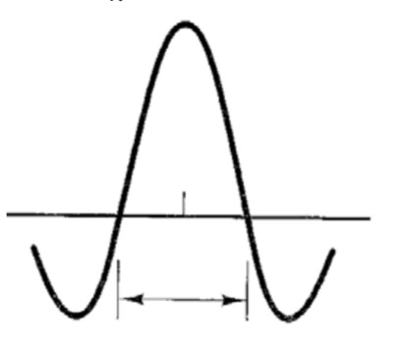
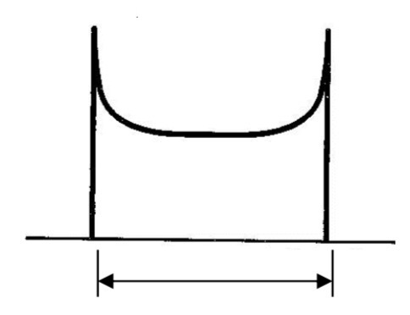


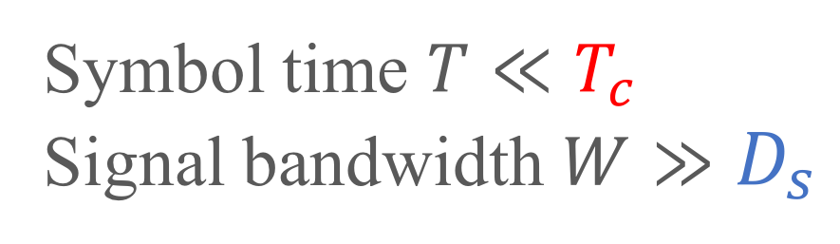

Channel Fading
Time Domain
Frequency Domain
$T_{c}∝\frac{1}{D_{s}}$
FFT
iFFT
$$T_{c}$$
$$D_{s}$$
Coherence time
Doppler Spread
Symbol time $T≪T_{c}$
Signal bandwidth $W≫D_{s}$
Slow Fading

Slide 13
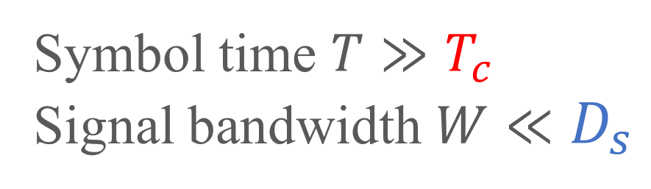
Channel Fading
Time Domain
Frequency Domain
$T_{c}∝\frac{1}{D_{s}}$
FFT
iFFT
$$T_{c}$$
$$D_{s}$$
Coherence time
Doppler Spread
Symbol time $T≫T_{c}$
Signal bandwidth $W≪D_{s}$
Fast Fading

Slide 14
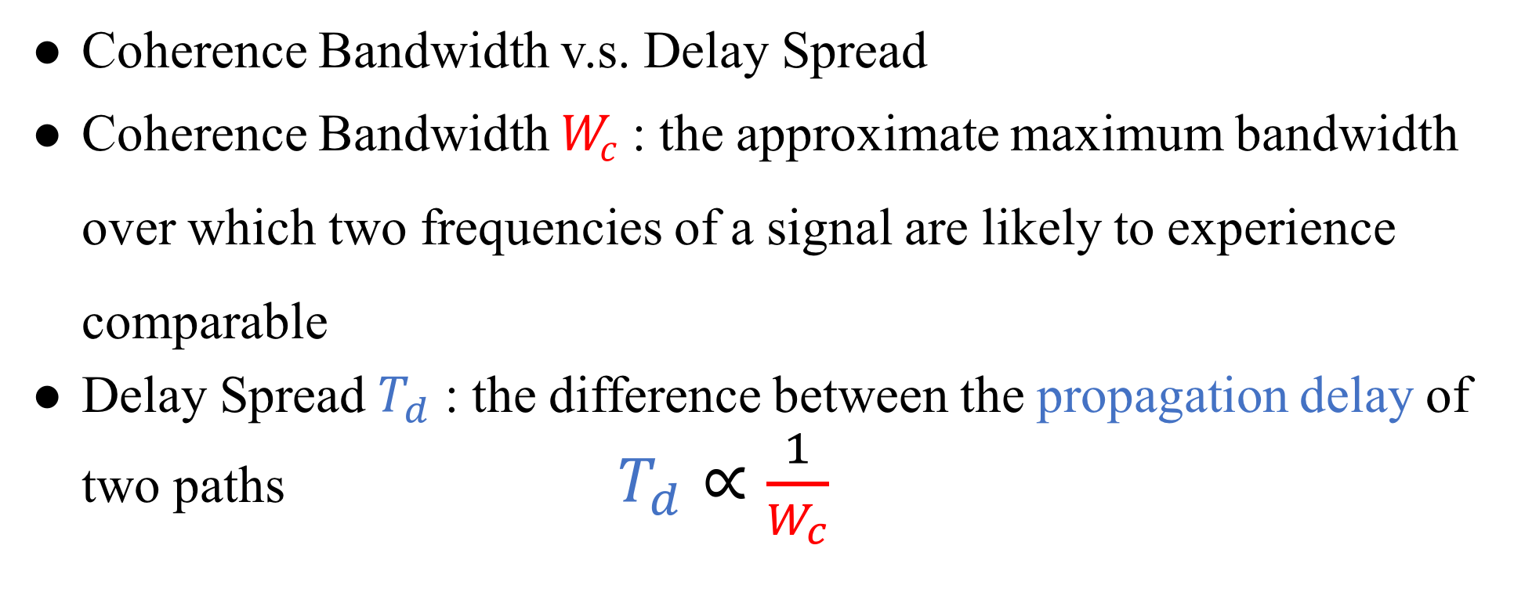
Channel Fading
Coherence Bandwidth v.s. Delay Spread
Coherence Bandwidth $W_{c}$ : the approximate maximum bandwidth over which two frequencies of a signal are likely to experience comparable
Delay Spread $T_{d}$ : the difference between the propagation delay of two paths $T_{d}∝\frac{1}{W_{c}}$

Slide 15
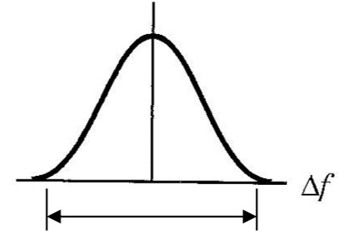
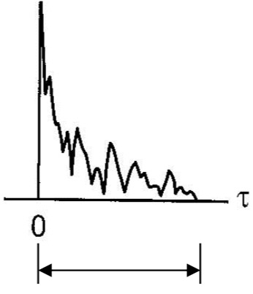



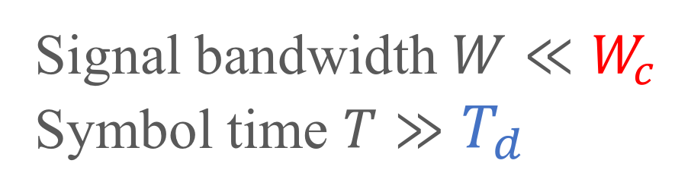
Channel Fading
Frequency Domain
Time Domain
$W_{c}∝\frac{1}{T_{d}}$
iFFT
FFT
$$W_{c}$$
$$T_{d}$$
Coherence Bandwidth
Delay Spread
Signal bandwidth $W≪W_{c}$
Symbol time $T≫T_{d}$
Flat Fading

Slide 16
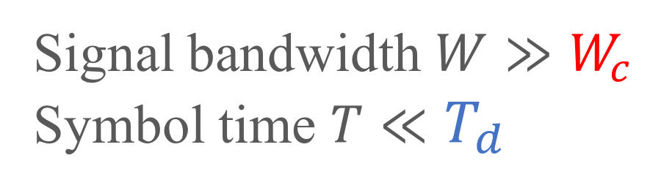
Channel Fading
Frequency Domain
Time Domain
$W_{c}∝\frac{1}{T_{d}}$
iFFT
FFT
$$W_{c}$$
$$T_{d}$$
Coherence Bandwidth
Delay Spread
Frequency-selective
Fading
Signal bandwidth $W≫W_{c}$
Symbol time $T≪T_{d}$

Slide 17
Large-Scale Fading

Slide 18
Path Loss
Linear path loss of the channel is the ratio of transmit
power to receive power.
The power of received signal is averaged over any random
variations due to shadowing.
Shadowing is the effect that the received signal power
fluctuates due to objects obstructing the propagation path
between tx and rx.

Slide 19
Outline
Channel
Friis Transmission Equation
RFID
Friis Transmission Equation

Slide 20
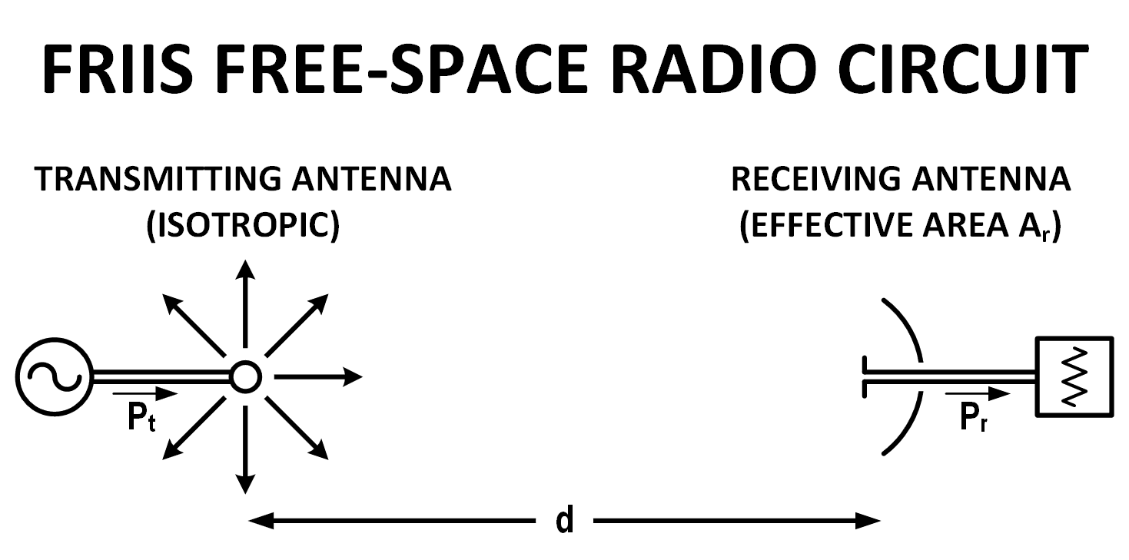
Why Friis’ Formula
Dispense with the usage of directivity or gain when describing antenna performance
Descriptor of antenna capture area
Notes:
通常會用 gain 表達天線的 performance
Friis 認為現有的公式都太多係數要記
Capture area 展現 free space radio circuit 的特色

Slide 21
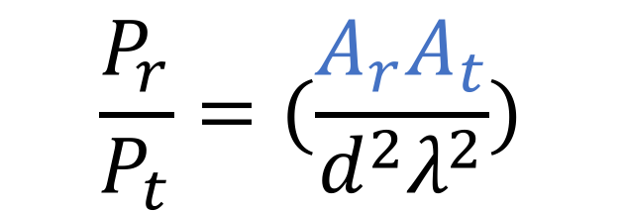
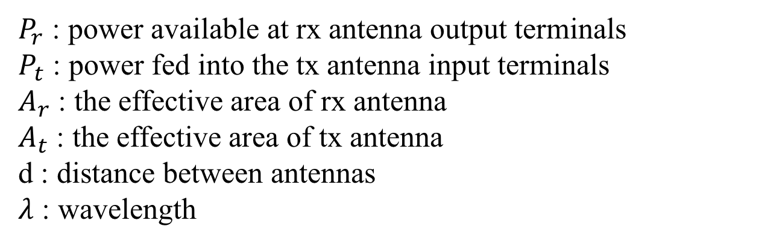
Friis’ Original Formula
$$\frac{P_{r}}{P_{t}}=(\frac{A_{r}A_{t}}{d^{2}λ^{2}})$$
$P_{r}$ : power available at rx antenna output terminals
$P_{t}$ : power fed into the tx antenna input terminals
$A_{r}$ : the effective area of rx antenna
$A_{t}$ : the effective area of tx antenna
d : distance between antennas
$λ$ : wavelength

Slide 22
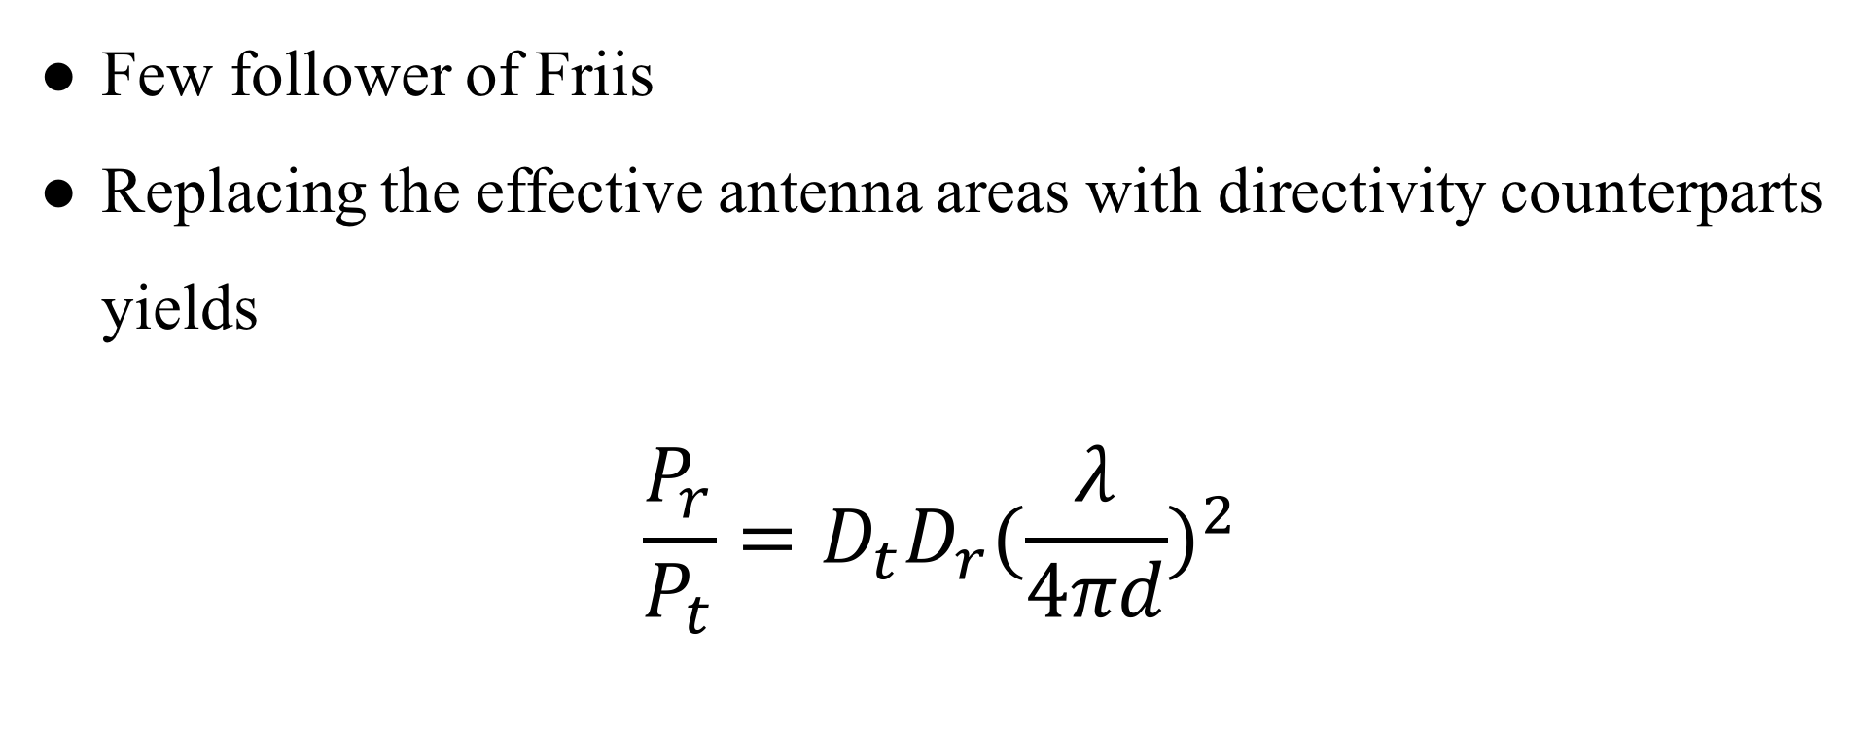
Contemporary Formula
Few follower of Friis
Replacing the effective antenna areas with directivity counterparts yields
$$\frac{P_{r}}{P_{t}}=D_{t}D_{r}{(\frac{λ}{4πd})}^{2}$$

Slide 23

Contemporary Formula
$$\frac{P_{r}}{P_{t}}=D_{t}D_{r}{(\frac{λ}{4πd})}^{2}$$
$$P_{r}(dBm)=P_{t}+D_{r}+D_{t}+20\log_{10}(\frac{λ}{4πd})$$
Notes:
D_{t} and D_{r} are the antenna directivities
the antenna directivities are linear values

Slide 24
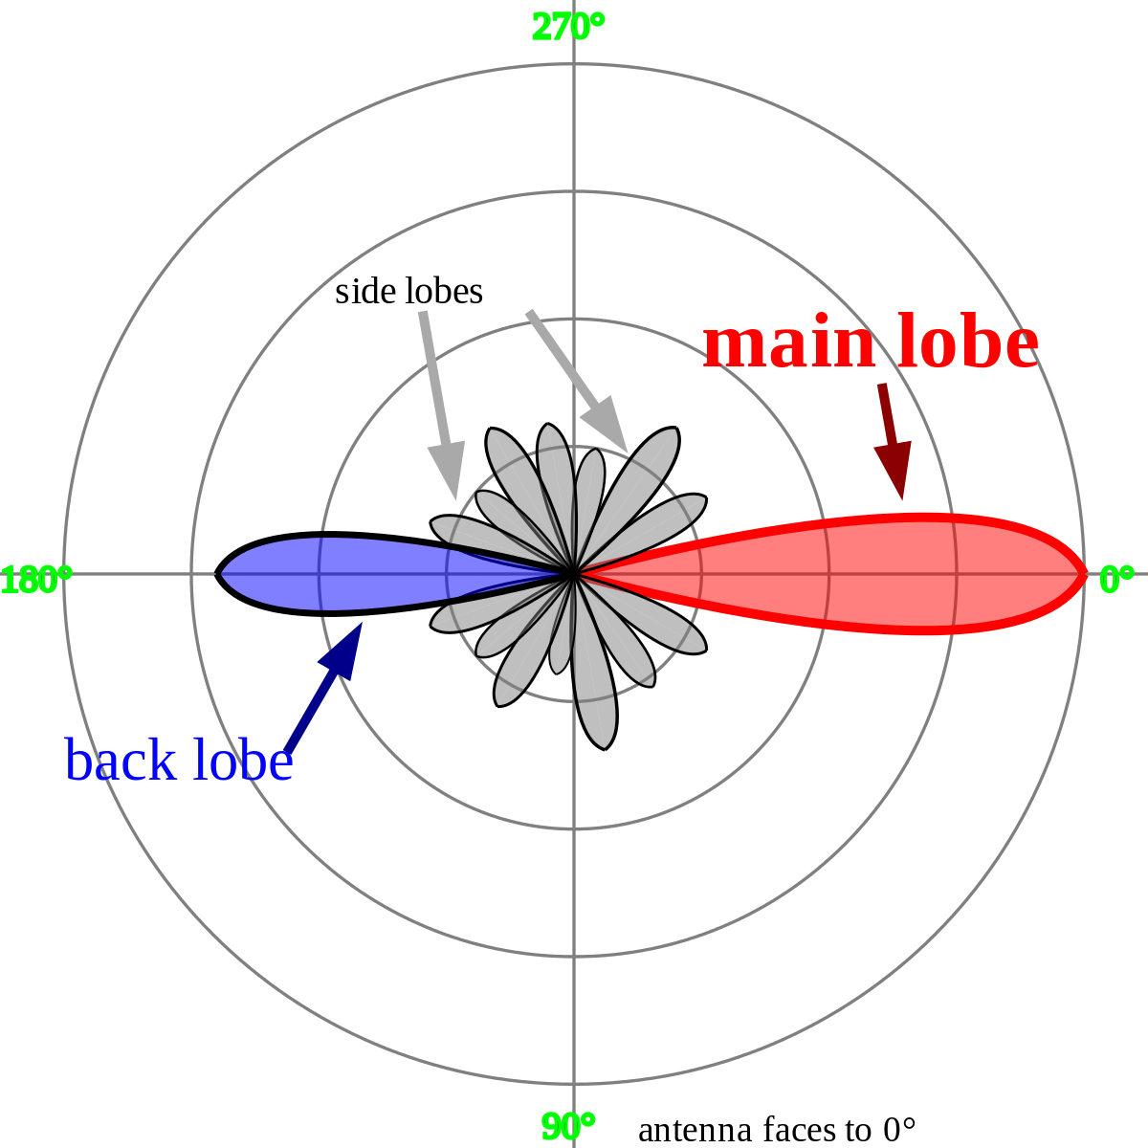

Directivities
$$D=\frac{2}{1−cos\frac{θ}{2}}$$
$$D_{dBi}=10∙\log_{10}D$$
Notes:
看個角度的訊號最強

Slide 25
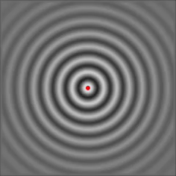
Isotropic Radiator
Notes:
點來源

Slide 26
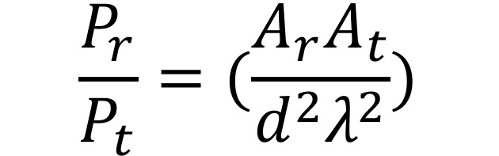
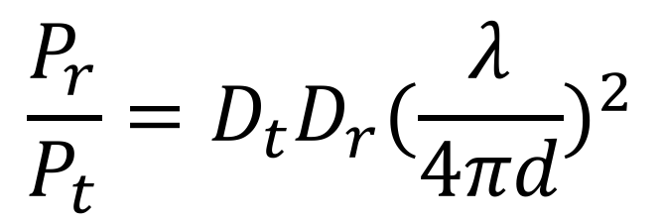
$$\frac{P_{r}}{P_{t}}=(\frac{A_{r}A_{t}}{d^{2}λ^{2}})$$
$$\frac{P_{r}}{P_{t}}=D_{t}D_{r}{(\frac{λ}{4πd})}^{2}$$
Notes:
最後還是加入了 directivity 來呈現天線的效能

Slide 27
Channel Fading Summary
Small-scale fading
Doppler spread
Slow fading
Fast fading
Delay spread
Flat fading
Frequency-selective fading
Large-scale fading
Path loss
Shadowing
Mobility
Multipath

Slide 28
Outline
Channel
Friis Transmission Equation
RFID
RFID

Slide 29
RFID Standard
Bar code
Traditional wireless
identification
Defacement
Line of sight
Manual manipulation
Read separately
Radio Frequency IDentification
Brand new wireless
identification
RF based communication
Non-line of sight
System based operation
Read simultaneously

Slide 30
RFID Reading Frequency
Frequency | Price range | Read Range | Limitations | Applications
Low Frequency 125-134 kHz | low | Low ( < 1 m.) | Low reading speed | Animal tracking
High Frequency 13.56 Mhz | Low to Middle | Low ( < 1.5 m) | Problems with metal | Library, access control
Ultra-high Freq. 860-930 MHz | Middle to High | High ( > 10 m) | Interference problems | Vehicle tracking
Microwave 2.4 GHz | High | High ( > 50 m) | Not widely deployed | Vehicle access control

Slide 31
RFID Reading Frequency
國內RFID頻段
FCC開放RFID頻段
中華電信
Up link
遠傳
UP
RFID
中華電信
Down link
遠傳
DL
增頻
增頻
MHz
891.4
895
902
910
915
922
928
940
955
960
892
937

Slide 32
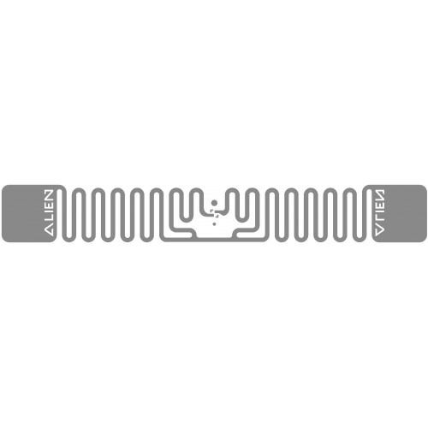

RFID Setting
Tag Type | Reading Distance | Characteristic
Passive | < 4m | Battery free Cheap
Active | > 100m | Battery loaded Expensive

Slide 33
RFID Setting
Tag Type | Reading Distance | Characteristic
Passive | < 4m | Battery free Cheap
Active | > 100m | Battery loaded Expensive

Slide 34
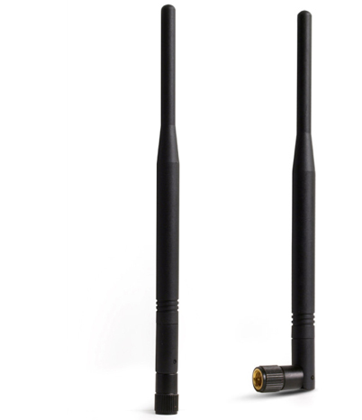
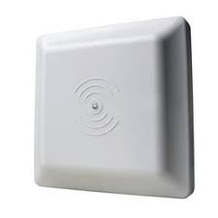
RFID Setting

Slide 35
RFID Setting

Slide 36
RFID Protocol
Backscatter
UHF EPC
FM0
MAC Layer
Query round picture
Query round step by step

Slide 37
Reference
https://www.flaticon.com/
https://www.sitebuilderreport.com/stock-up
https://en.wikipedia.org/wiki/Friis_transmission_equation
https://en.wikipedia.org/wiki/Path_loss
https://ccrma.stanford.edu/~jos/fp/Phase_Delay.html
https://en.wikipedia.org/wiki/Communication_channel

