Slide 1
Freshman Training Course Signal
NCTU NSS-Lab 2018
Cheng-Fa Huang
Willy Cheng-Fa Huang
2018.08.14 @NCTU EC-614

Slide 2
Outline
Channel
Friis Transmission Equation
Demo
Reference

Slide 3
Outline
Channel
Friis Transmission Equation
Demo
Reference
Channel

Slide 4

Signal Representation
General form
Called the canonical representation of a
band-pass signal
Q
amplitude
frequency
phase
s(t)
a(t)
a(t)
I
Notes:
這是訊號 gerneral form
IQ domain 上表示
Band pass 訊號典型表示式
還有很多表示訊號的式子

Slide 5
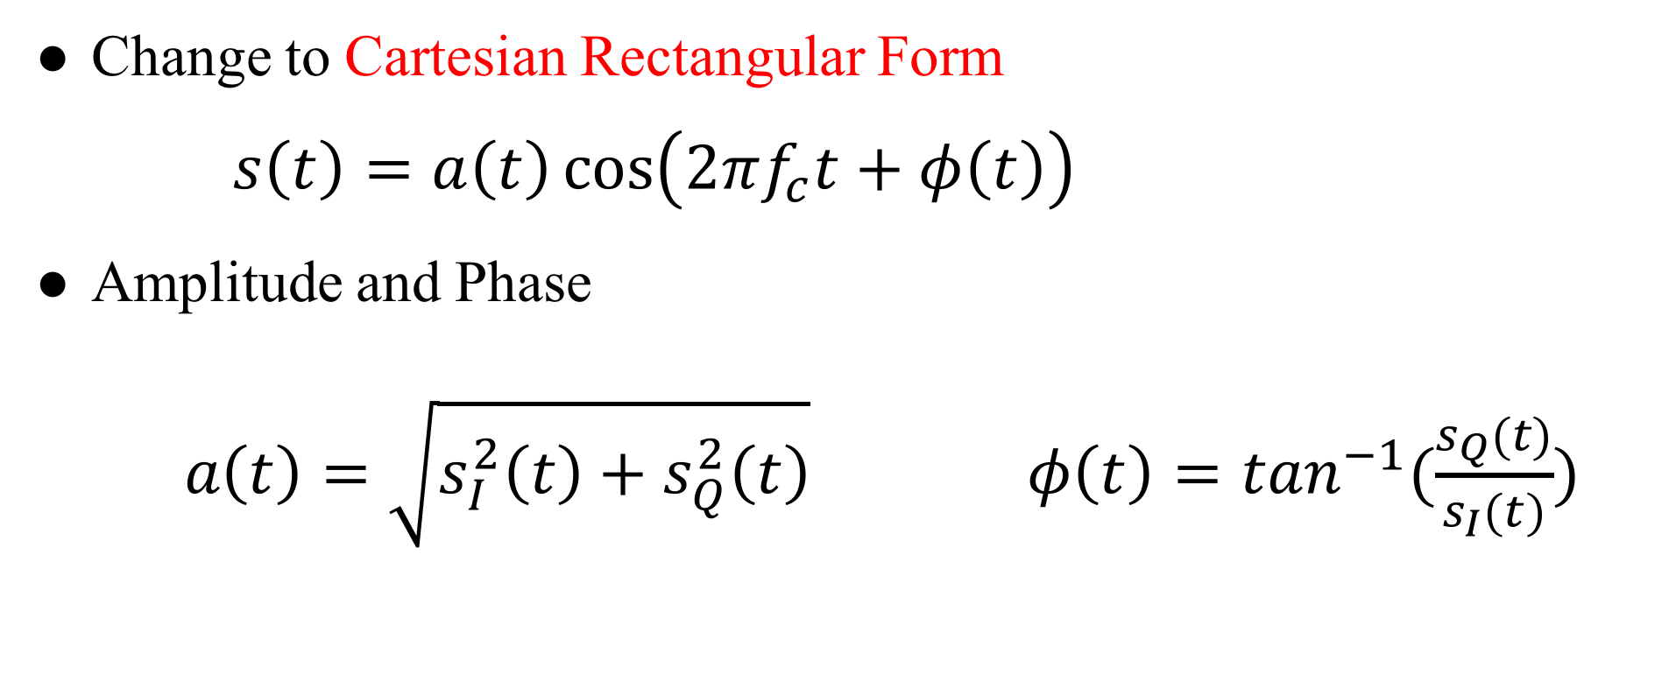
Linear Channels
Change to Cartesian Rectangular Form
$s\left(t\right)=a\left(t\right)\cos\left(2πf_{c}t+φ\left(t\right)\right)$
Amplitude and Phase
$a\left(t\right)=\sqrt{s_{I}^{2}\left(t\right)+s_{Q}^{2}\left(t\right)} φ\left(t\right)=\tan^{−1}(\frac{s_{Q}(t)}{s_{I}(t)})$
Notes:
ＩＱ座標 轉換 笛卡爾坐標系
ampl. Phase 轉換

Slide 6
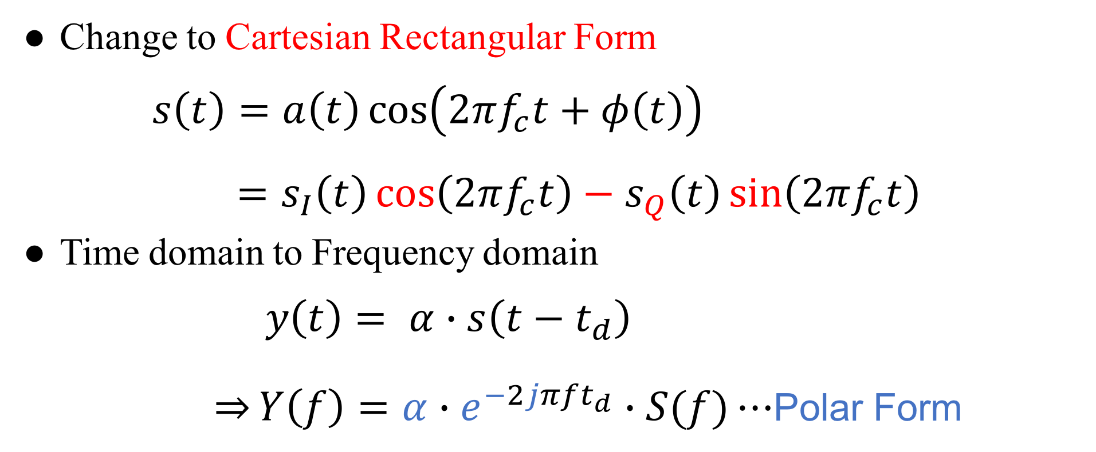
Linear Channels
Change to Cartesian Rectangular Form
$s\left(t\right)=a\left(t\right)\cos\left(2πf_{c}t+φ\left(t\right)\right)$
$=s_{I}\left(t\right)\cos\left(2πf_{c}t\right)−s_{Q}\left(t\right)\sin\left(2πf_{c}t\right)$
Time domain to Frequency domain
$y\left(t\right)= α∙s\left(t−t_{d}\right)$
$\overset{⇒}{}Y\left(f\right)=α∙e^{−2jπft_{d}}∙S(f)⋯$Polar Form
Notes:
用 剛剛的轉換與 cos 相加 公式拆解
可得笛卡爾座標
Time -> FFT -> freq. 有些地方會寫 $ω=2πf$
今天 focus 這部分 channel

Slide 7
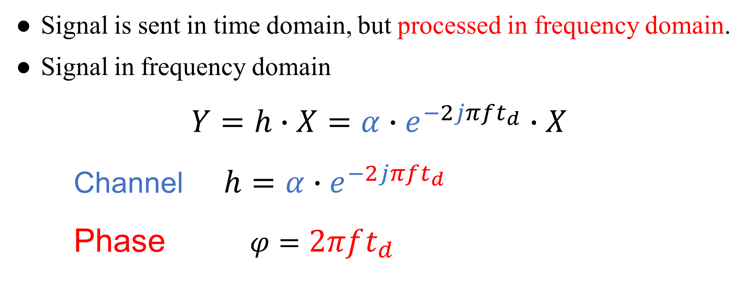
Channel
Signal is sent in time domain, but processed in frequency domain.
Signal in frequency domain
$Y=h∙X=α∙e^{−2jπft_{d}}∙X$
Channel $h=α∙e^{−2jπft_{d}}$
Phase $φ=2πft_{d}$
Notes:
Time domain 送
Frequency domain 分析
記好 channel and phase 的長相

Slide 8

Shannon-Hartley Equation
$$C=B\log_{2}\left(1+\frac{S}{N}\right)$$
capacity
bandwidth
SNR

Slide 9
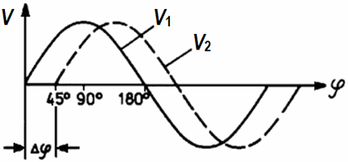
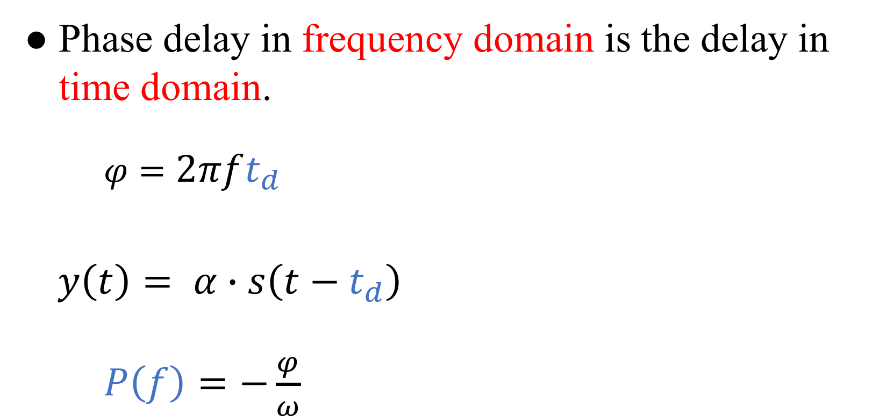
Phase Delay
Phase delay in frequency domain is the delay in time domain.
$φ=2πft_{d}$
$y\left(t\right)= α∙s\left(t−t_{d}\right)$
$P\left(f\right)=−\frac{φ}{ω}$
Notes:
頻域的 phase delay 就是時域的延遲
從第二式可得
P(f) 就是 phase delay

Slide 10
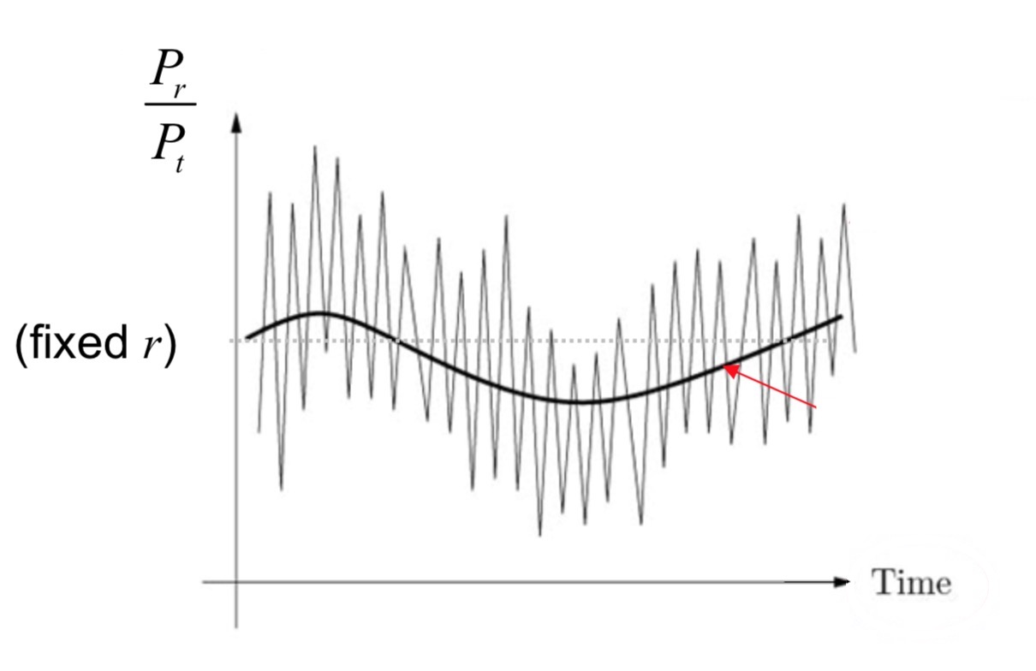
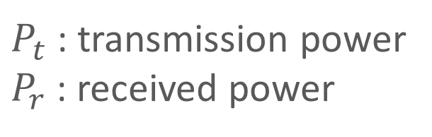
Channel Fading
Fluctuation of the local mean:
Small-scale fading
Fluctuation of the local mean:
Large-scale fading
$P_{t}$ : transmission power
$P_{r}$ : received power
Notes:
時域的訊號圖 送出與接收 power 的比值圖
較大的模型波動稱為 large scale fading
較小的模型波動稱為 small scale fading

Slide 11
Small-Scale Fading
Notes:
先介紹 small scale fading

Slide 12
Channel Fading
Mobility
Slow Fading
Fast Fading
Multipath
Flat Fading
Frequency-selective Fading
Notes:
主要以兩種原因分成四種 fading

Slide 13
Channel Fading
Mobility
Slow Fading
Fast Fading
Multipath
Flat Fading
Frequency-selective Fading
Mobility
Slow Fading
Fast Fading
Notes:
在這先介紹以移動影響 channel 的其中兩種 fading

Slide 14
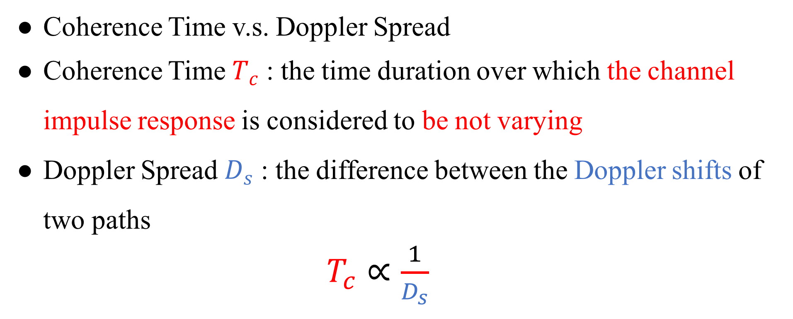
Channel Fading
Coherence Time v.s. Doppler Spread
Coherence Time $T_{c}$ : the time duration over which the channel impulse response is considered to be not varying
Doppler Spread $D_{s}$ : the difference between the Doppler shifts of two paths
$T_{c}∝\frac{1}{D_{s}}$
Notes:
因為是 移動的影響 所以頻域方面會考慮 Doppler 效應
Coherence time 就是一段時間 channel impulse response 沒有改變
Tc Ds 成反比

Slide 15
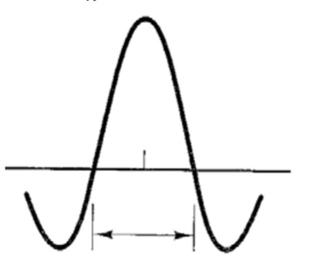
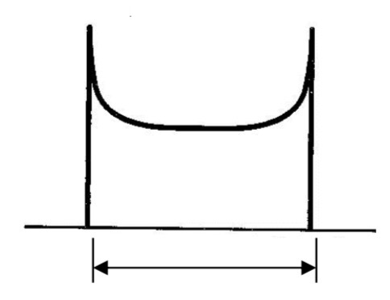



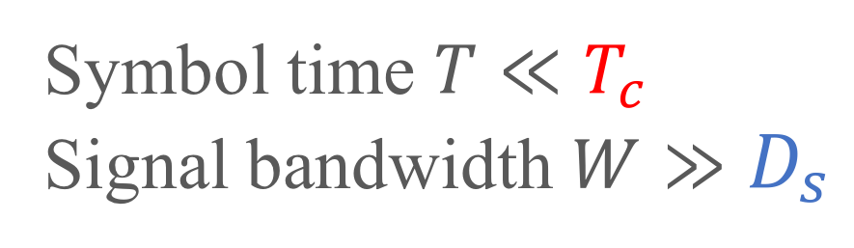
Channel Fading
Time Domain
Frequency Domain
$T_{c}∝\frac{1}{D_{s}}$
FFT
iFFT
$$T_{c}$$
$$D_{s}$$
Coherence time
Doppler Spread
Symbol time $T≪T_{c}$
Signal bandwidth $W≫D_{s}$
Slow Fading
Notes:
先定義 threshold Tc Ds
Symbol time < Tc W>Ds slow

Slide 16
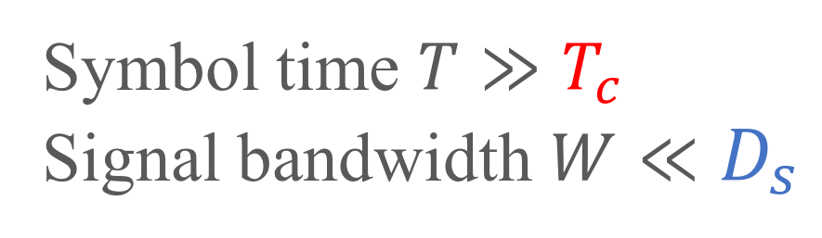
Channel Fading
Time Domain
Frequency Domain
$T_{c}∝\frac{1}{D_{s}}$
FFT
iFFT
$$T_{c}$$
$$D_{s}$$
Coherence time
Doppler Spread
Symbol time $T≫T_{c}$
Signal bandwidth $W≪D_{s}$
Fast Fading
Notes:
相反地就是 fast

Slide 17
Channel Fading
Mobility
Slow Fading
Fast Fading
Multipath
Flat Fading
Frequency-selective Fading
Multipath
Flat Fading
Frequency-selective Fading
Notes:
接下來介紹以 multipath 影響 channel 的其中兩種 fading

Slide 18
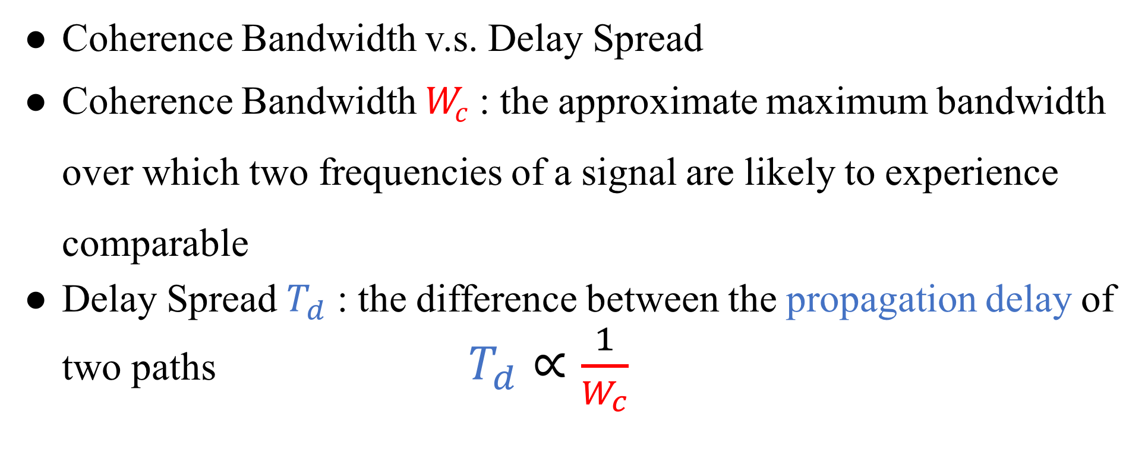
Channel Fading
Coherence Bandwidth v.s. Delay Spread
Coherence Bandwidth $W_{c}$ : the approximate maximum bandwidth over which two frequencies of a signal are likely to experience comparable
Delay Spread $T_{d}$ : the difference between the propagation delay of two paths $T_{d}∝\frac{1}{W_{c}}$
Notes:
針對 multipath 由兩個指標做判斷
Coherence Bandwidth : 兩訊號大致最大的頻寬
Delay Spread : 兩段路徑的 propagation delay 的差距

Slide 19
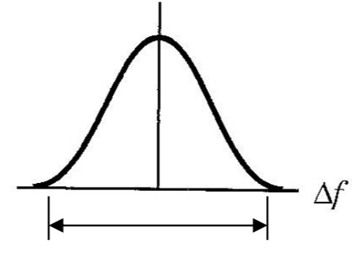
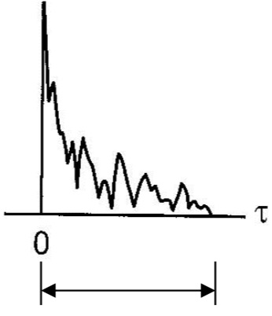



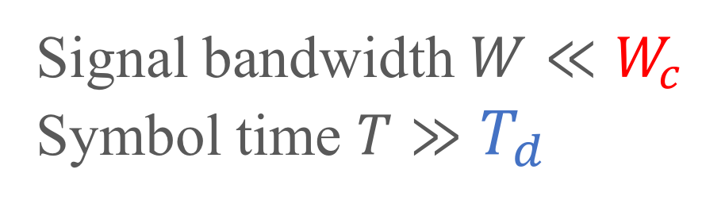
Channel Fading
Frequency Domain
Time Domain
$W_{c}∝\frac{1}{T_{d}}$
iFFT
FFT
$$W_{c}$$
$$T_{d}$$
Coherence Bandwidth
Delay Spread
Signal bandwidth $W≪W_{c}$
Symbol time $T≫T_{d}$
Flat Fading
Notes:
訊號在頻域的比閥值小而時域超過 delay spread

Slide 20
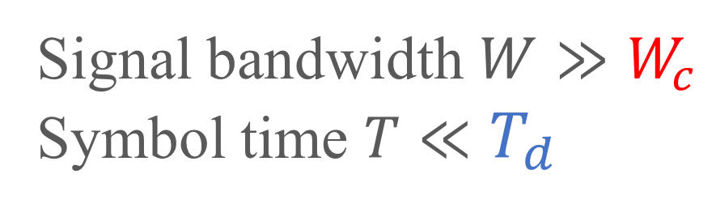
Channel Fading
Frequency Domain
Time Domain
$W_{c}∝\frac{1}{T_{d}}$
iFFT
FFT
$$W_{c}$$
$$T_{d}$$
Coherence Bandwidth
Delay Spread
Frequency-selective
Fading
Signal bandwidth $W≫W_{c}$
Symbol time $T≪T_{d}$
Notes:
相反稱為 Frequency-selective Fading

Slide 21
Large-Scale Fading
Notes:
前面介紹的是 small scale fading
接下來介紹 large scale fading

Slide 22
Path Loss
Linear path loss of the channel is the ratio of transmit
power to receive power.
The power of received signal is averaged over any random
variations due to shadowing.
Shadowing is the effect that the received signal power
fluctuates due to objects obstructing the propagation path
between tx and rx.
Notes:
看 Path loss 主要是看送出比上收到的能量
收到的訊號會受到 fading 的影響稱為 shadowing
最常見的就是 tx rx 間的傳送路徑有東西阻擋

Slide 23
Outline
Channel
Friis Transmission Equation
Demo
Reference
Friis Transmission Equation
Notes:
針對 path loss 的描述
Friis 提出一個公式來表達

Slide 24
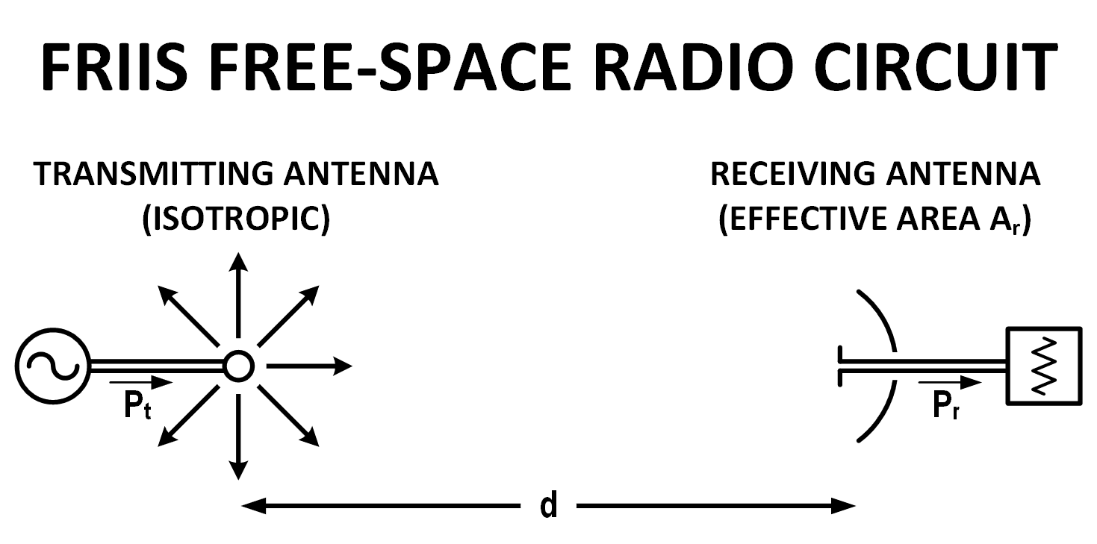
Why Friis’ Formula
Dispense with the usage of directivity or gain when describing antenna performance
Descriptor of antenna capture area
Notes:
通常會用 gain 表達天線的 performance
Friis 認為現有的公式都太多係數要記
Capture area 展現 free space radio circuit 的特色

Slide 25
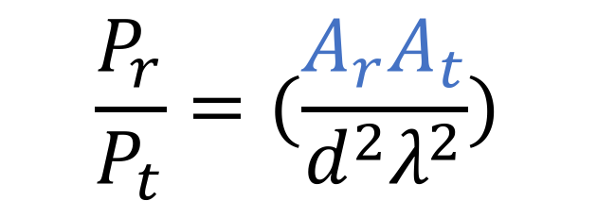
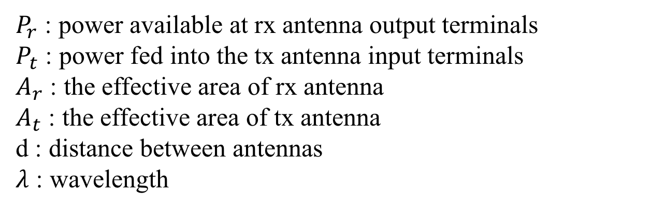
Friis’ Original Formula
$$\frac{P_{r}}{P_{t}}=(\frac{A_{r}A_{t}}{d^{2}λ^{2}})$$
$P_{r}$ : power available at rx antenna output terminals
$P_{t}$ : power fed into the tx antenna input terminals
$A_{r}$ : the effective area of rx antenna
$A_{t}$ : the effective area of tx antenna
d : distance between antennas
$λ$ : wavelength
Notes:
單純用可以量測的數據描述收到及送出訊號的能量比值

Slide 26
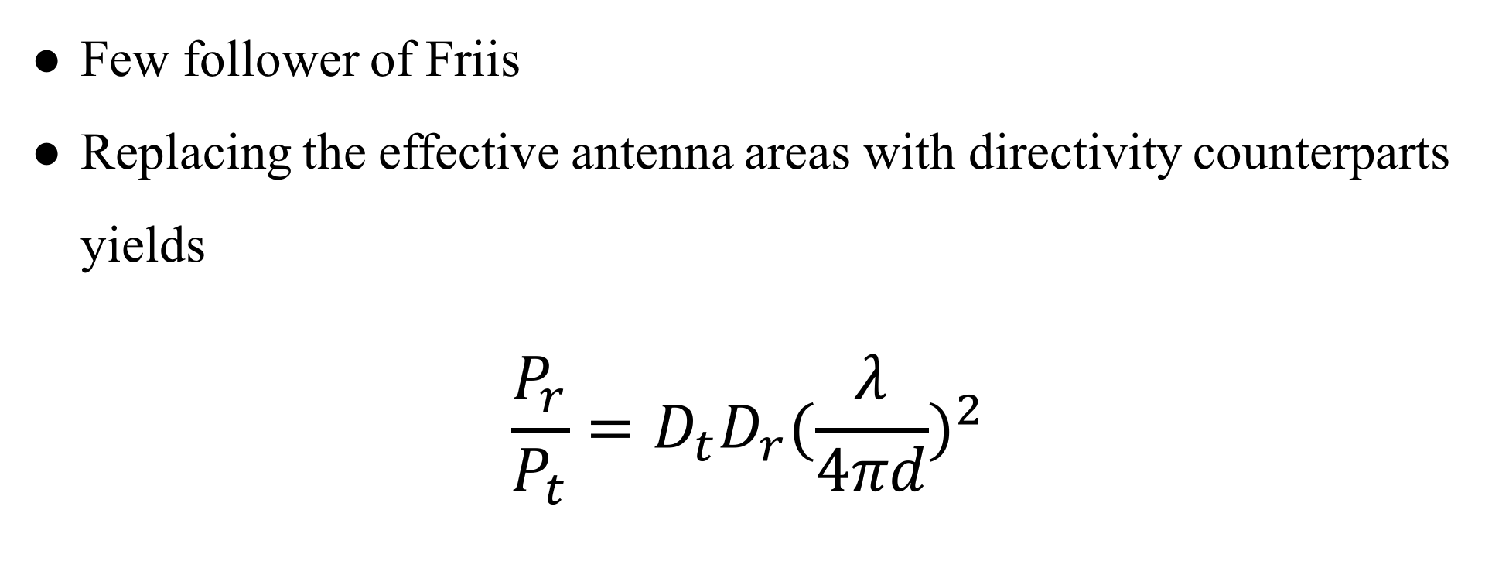
Contemporary Formula
Few follower of Friis
Replacing the effective antenna areas with directivity counterparts yields
$$\frac{P_{r}}{P_{t}}=D_{t}D_{r}{(\frac{λ}{4πd})}^{2}$$
Notes:
但後來大家都不用 有效天線面積 而改用 antenna directivities
D 的介紹投影片有，有興趣可自行閱讀

Slide 27

Contemporary Formula
$$\frac{P_{r}}{P_{t}}=D_{t}D_{r}{(\frac{λ}{4πd})}^{2}$$
$$P_{r}(dBm)=P_{t}+D_{r}+D_{t}+20\log_{10}(\frac{λ}{4πd})$$
Notes:
D_{t} and D_{r} are the antenna directivities
the antenna directivities are linear values

Slide 28
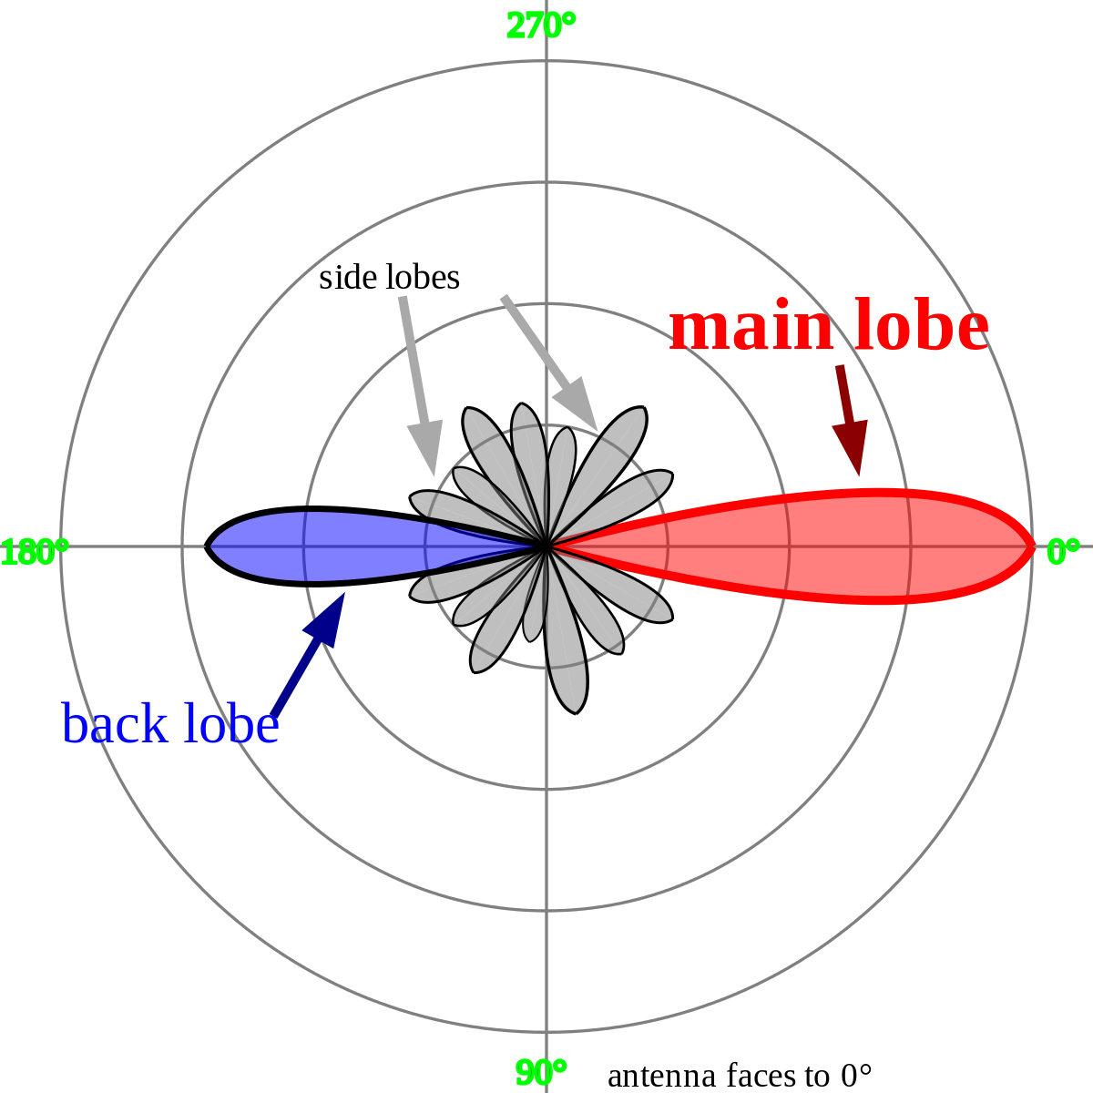

Directivities
$$D=\frac{2}{1−cos\frac{θ}{2}}$$
$$D_{dBi}=10∙\log_{10}D$$
Notes:
看個角度的訊號最強 以 D 表示之

Slide 29
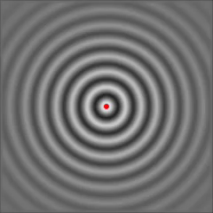
Isotropic Radiator
Notes:
dBi 的 ｉ的意思是 從點來源發散出的訊號的 能量（dB）

Slide 30
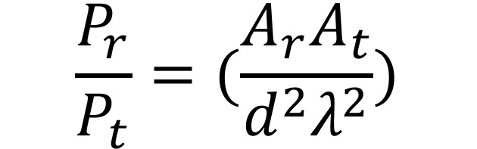
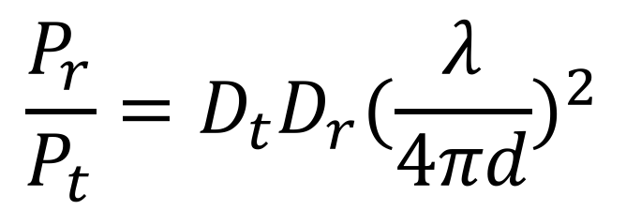
$$\frac{P_{r}}{P_{t}}=(\frac{A_{r}A_{t}}{d^{2}λ^{2}})$$
$$\frac{P_{r}}{P_{t}}=D_{t}D_{r}{(\frac{λ}{4πd})}^{2}$$
Notes:
從一開始有效天線面積到最後常用的 directivity 來呈現天線的效能

Slide 31
Channel Fading Summary
Small-scale fading
Doppler spread
Slow fading
Fast fading
Delay spread
Flat fading
Frequency-selective fading
Large-scale fading
Path loss
Shadowing
Mobility
Multipath
Notes:
Small scale
以 time domain 來分類，Doppler mobility Delay multipath
Large scale
Path loss shadowing

Slide 32
Demo
https://github.com/ChenFaHaung/Signal_Training_Freshman/tree/master/Sample%20Code
Notes:
看 matlab 小示範

Slide 33
Notes:
剛剛畫出來的圖是 圓形的原因

Slide 34
Reference
https://www.flaticon.com/
https://www.sitebuilderreport.com/stock-up
https://en.wikipedia.org/wiki/Friis_transmission_equation
https://en.wikipedia.org/wiki/Path_loss
https://ccrma.stanford.edu/~jos/fp/Phase_Delay.html
https://en.wikipedia.org/wiki/Communication_channel
https://en.wikipedia.org/wiki/Fading
http://www.sengpielaudio.com/calculator-timedelayphase.html
Notes:
所有參考資料

Slide 35
