Slide 1
Freshman Training Course Signal
NCTU NSS 2018
Chengfa Huang
Willy Cheng-Fa Huang
2018.08. @NCTU EC-345

Slide 2
Outline
Channel
Friis Transmission Equation
RFID

Slide 3
Outline
Channel
Friis Transmission Equation
RFID
Channel

Slide 4

Signal Representation
General form
Called the canonical representation of a
band-pass signal
Q
amplitude
frequency
phase
s(t)
a(t)
a(t)
I

Slide 5
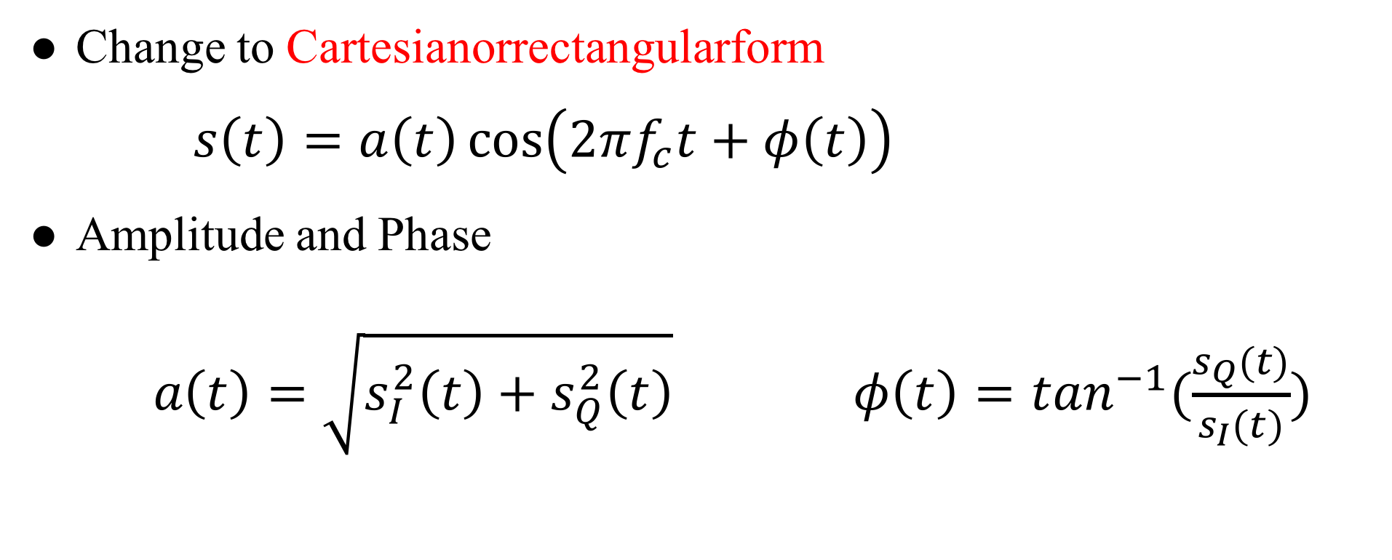
Linear Channels
Change to Cartesianorrectangularform
$s\left(t\right)=a\left(t\right)\cos\left(2πf_{c}t+φ\left(t\right)\right)$
Amplitude and Phase
$a\left(t\right)=\sqrt{s_{I}^{2}\left(t\right)+s_{Q}^{2}\left(t\right)} φ\left(t\right)=\tan^{−1}(\frac{s_{Q}(t)}{s_{I}(t)})$
Notes:
Time -> FFT -> freq. $ω=2πf$

Slide 6
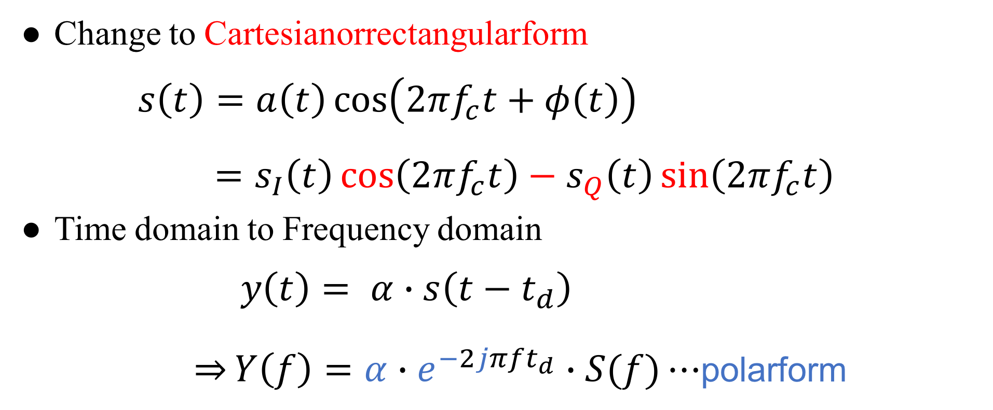
Linear Channels
Change to Cartesianorrectangularform
$s\left(t\right)=a\left(t\right)\cos\left(2πf_{c}t+φ\left(t\right)\right)$
$=s_{I}\left(t\right)\cos\left(2πf_{c}t\right)−s_{Q}\left(t\right)\sin\left(2πf_{c}t\right)$
Time domain to Frequency domain
$y\left(t\right)= α∙s\left(t−t_{d}\right)$
$\overset{⇒}{}Y\left(f\right)=α∙e^{−2jπft_{d}}∙S(f)⋯$polarform
Notes:
Time -> FFT -> freq. $ω=2πf$

Slide 7
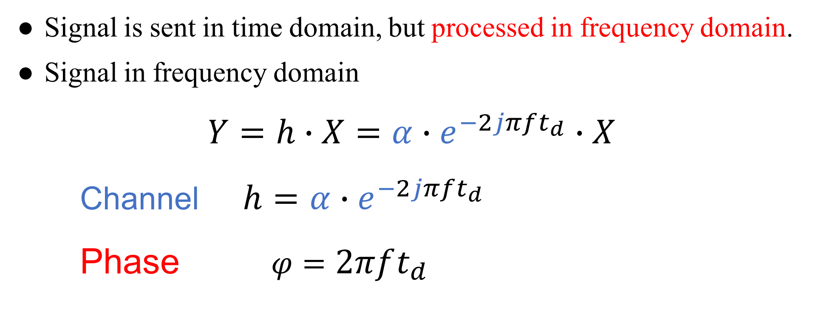
Channel
Signal is sent in time domain, but processed in frequency domain.
Signal in frequency domain
$Y=h∙X=α∙e^{−2jπft_{d}}∙X$
Channel $h=α∙e^{−2jπft_{d}}$
Phase $φ=2πft_{d}$
Notes:
Time domain 送
Frequency domain 分析

Slide 8
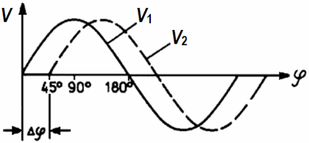
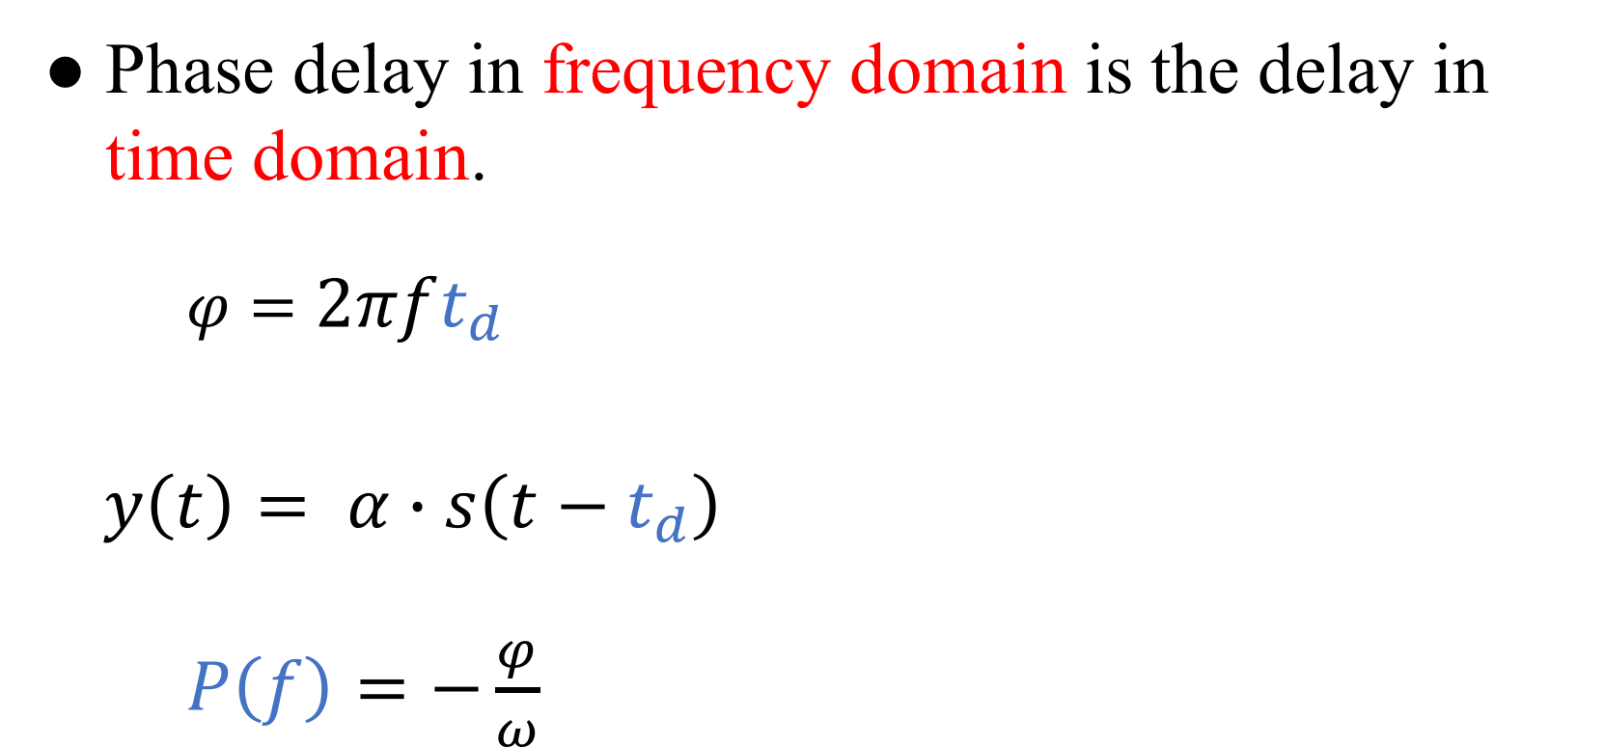
Phase Delay
Phase delay in frequency domain is the delay in time domain.
$φ=2πft_{d}$
$y\left(t\right)= α∙s\left(t−t_{d}\right)$
$P\left(f\right)=−\frac{φ}{ω}$

Slide 9
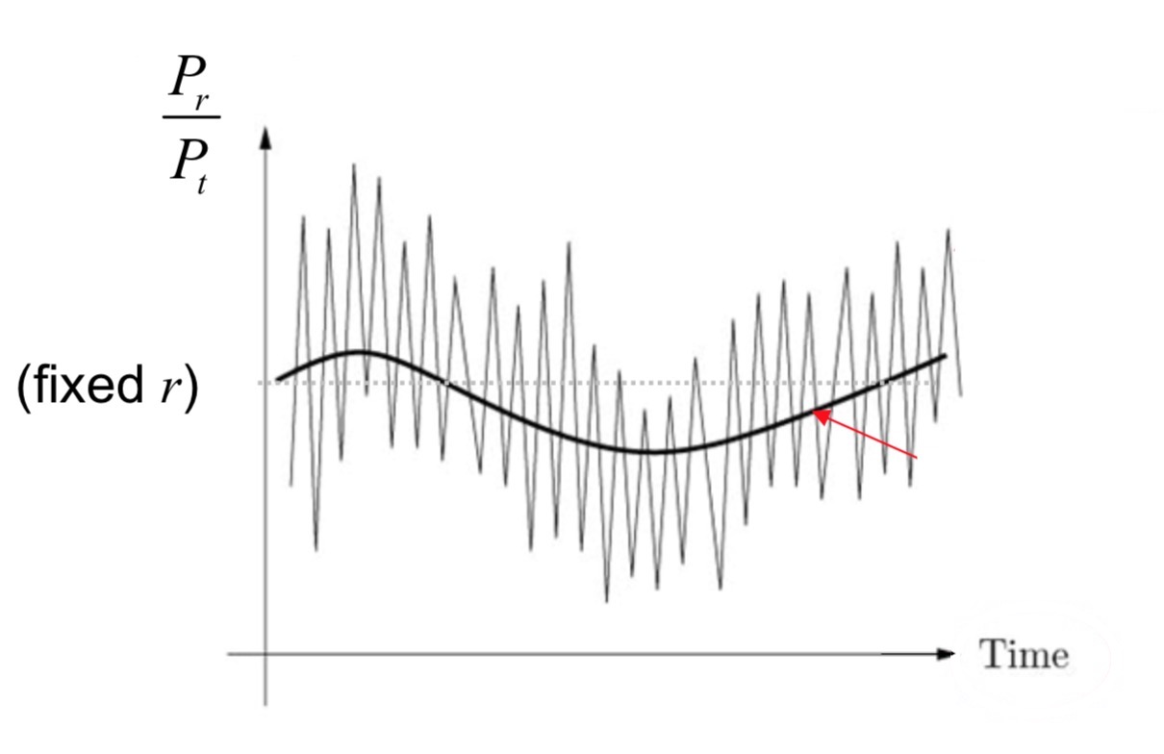
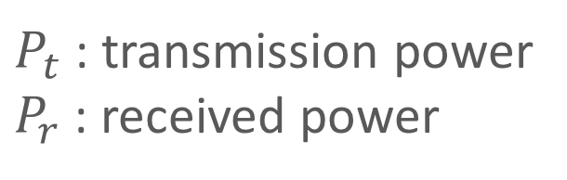
Channel Fading
Fluctuation of the local mean:
Small-scale fading
Fluctuation of the local mean:
Large-scale fading
$P_{t}$ : transmission power
$P_{r}$ : received power

Slide 10
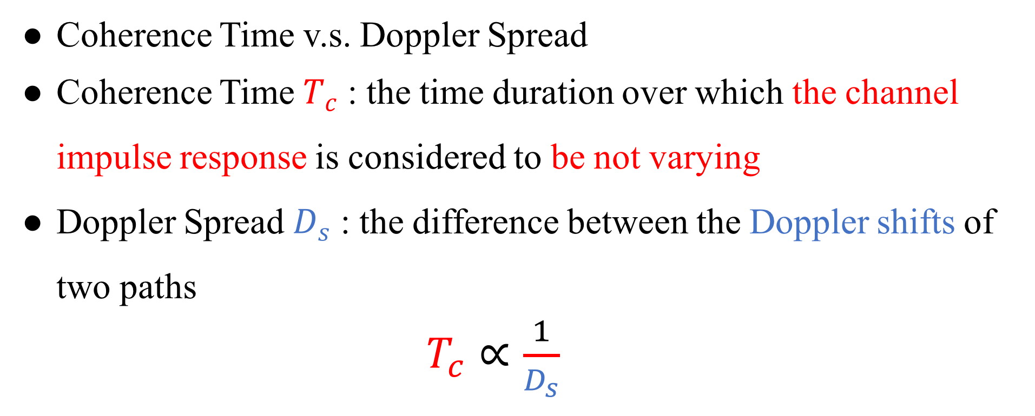
Channel Fading
Coherence Time v.s. Doppler Spread
Coherence Time $T_{c}$ : the time duration over which the channel impulse response is considered to be not varying
Doppler Spread $D_{s}$ : the difference between the Doppler shifts of two paths
$T_{c}∝\frac{1}{D_{s}}$

Slide 11
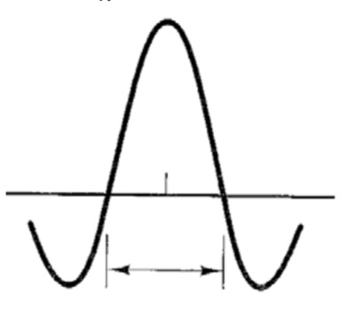
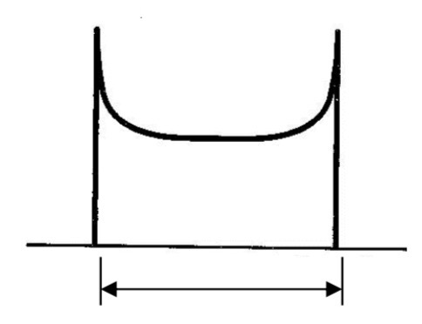

Channel Fading
$$T_{c}∝\frac{1}{D_{s}}$$

Slide 12
Path Loss

Slide 13
Outline
Channel
Friis Transmission Equation
RFID
Friis Transmission Equation

Slide 14
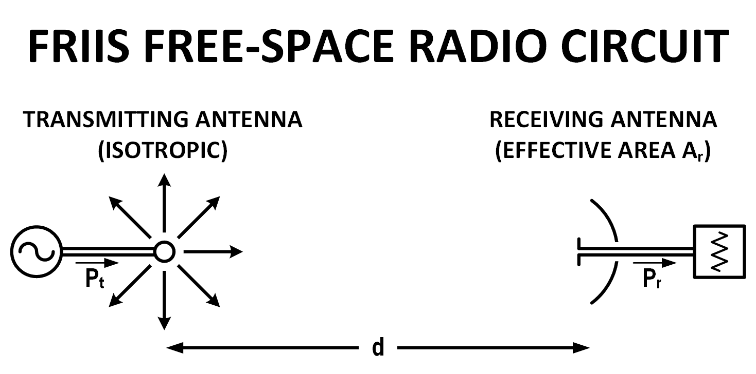
Why Friis’ Formula
Dispense with the usage of directivity or gain when describing antenna performance
Descriptor of antenna capture area
Notes:
通常會用 gain 表達天線的 performance
Friis 認為現有的公式都太多係數要記
Capture area 展現 free space radio circuit 的特色

Slide 15
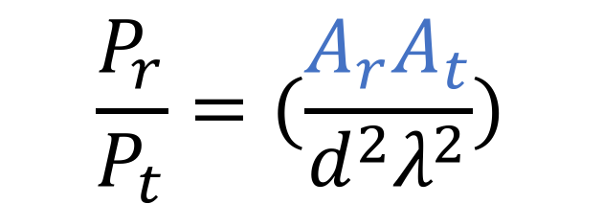
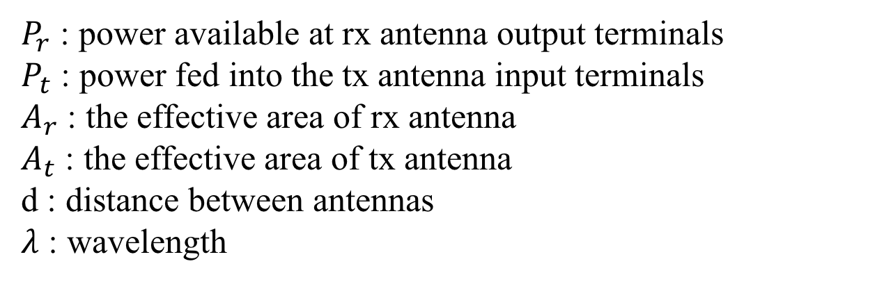
Friis’ Original Formula
$$\frac{P_{r}}{P_{t}}=(\frac{A_{r}A_{t}}{d^{2}λ^{2}})$$
$P_{r}$ : power available at rx antenna output terminals
$P_{t}$ : power fed into the tx antenna input terminals
$A_{r}$ : the effective area of rx antenna
$A_{t}$ : the effective area of tx antenna
d : distance between antennas
$λ$ : wavelength

Slide 16
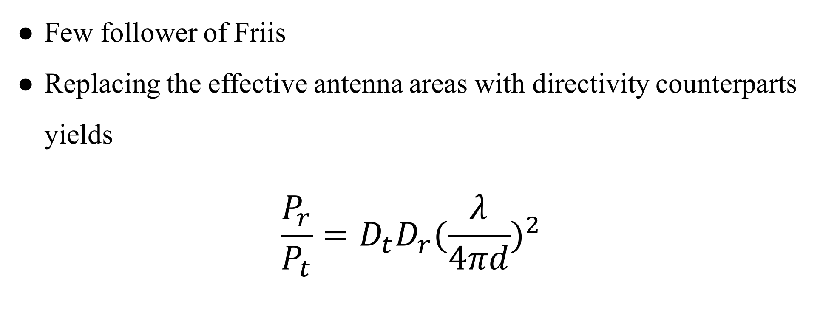
Contemporary Formula
Few follower of Friis
Replacing the effective antenna areas with directivity counterparts yields
$$\frac{P_{r}}{P_{t}}=D_{t}D_{r}{(\frac{λ}{4πd})}^{2}$$

Slide 17

Contemporary Formula
$$\frac{P_{r}}{P_{t}}=D_{t}D_{r}{(\frac{λ}{4πd})}^{2}$$
$$P_{r}(dBm)=P_{t}+D_{r}+D_{t}+20\log_{10}(\frac{λ}{4πd})$$
Notes:
D_{t} and D_{r} are the antenna directivities
the antenna directivities are linear values

Slide 18
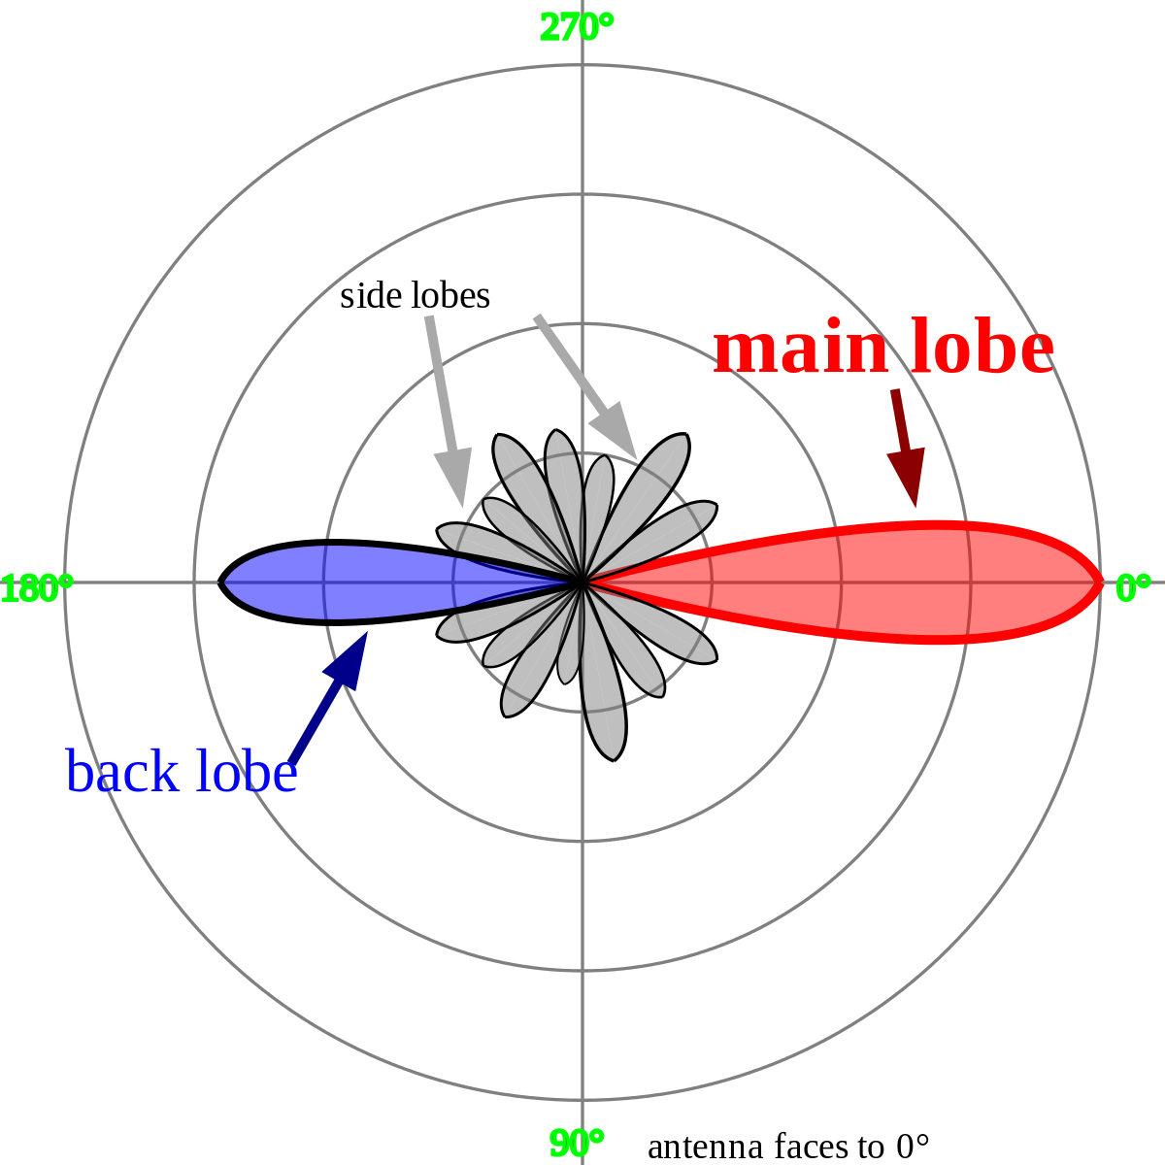

Directivities
$$D=\frac{2}{1−cos\frac{θ}{2}}$$
$$D_{dBi}=10∙\log_{10}D$$
Notes:
看個角度的訊號最強

Slide 19
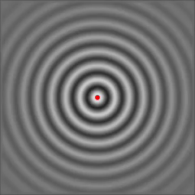
Isotropic Radiator
Notes:
點來源

Slide 20
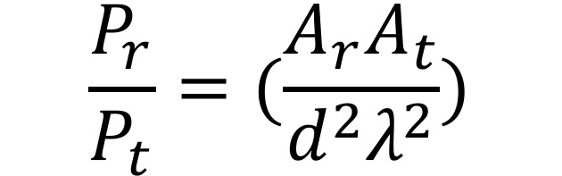
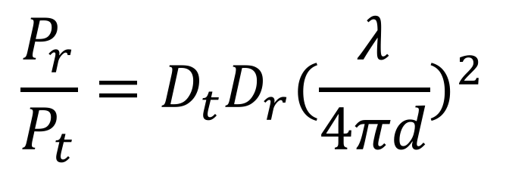
$$\frac{P_{r}}{P_{t}}=(\frac{A_{r}A_{t}}{d^{2}λ^{2}})$$
$$\frac{P_{r}}{P_{t}}=D_{t}D_{r}{(\frac{λ}{4πd})}^{2}$$
Notes:
最後還是加入了 directivity 來呈現天線的效能

Slide 21
Outline
Channel
Friis Transmission Equation
RFID
RFID

Slide 22
Reference
https://www.flaticon.com/
https://www.sitebuilderreport.com/stock-up
https://en.wikipedia.org/wiki/Friis_transmission_equation

