Slide 1

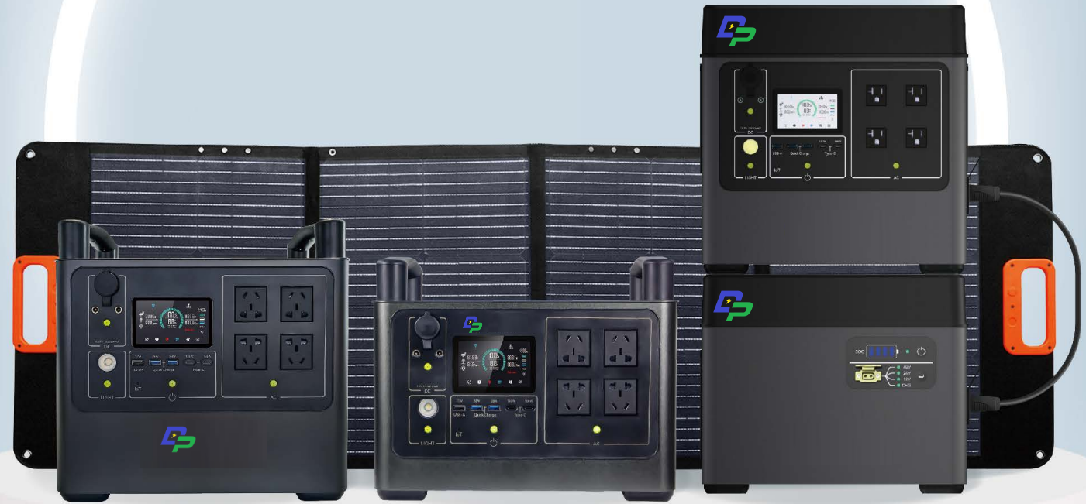
Dongguan Depu Energy Technology Co., LTD

Slide 2
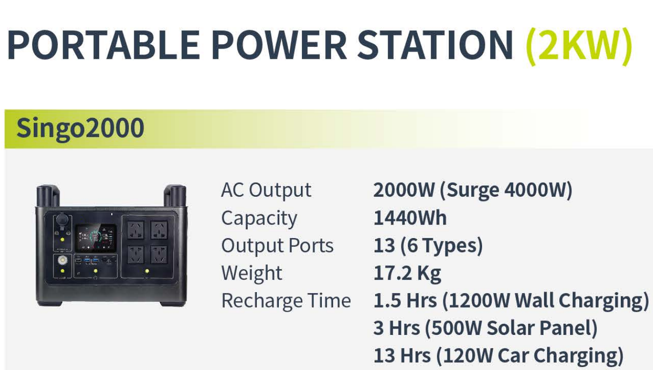
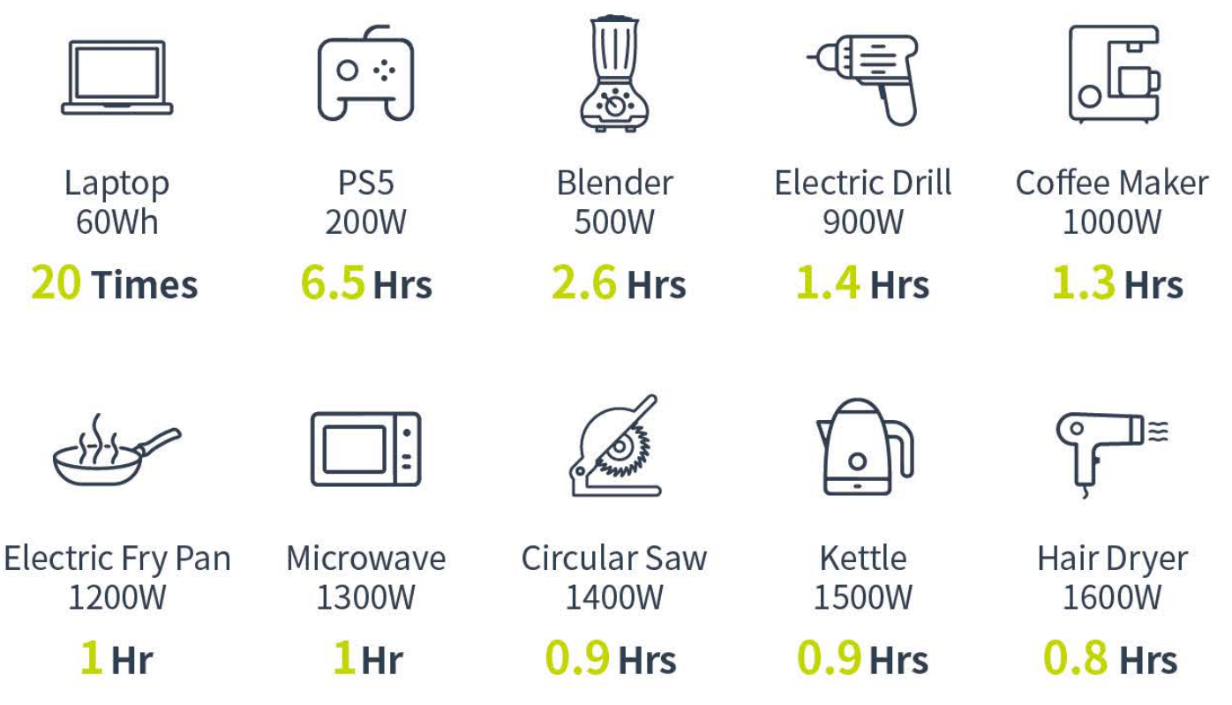
便携式储能

Slide 3
～Thanks～

