Slide 1

Dongguan Depu Energy Technology Co., LTD

Slide 2
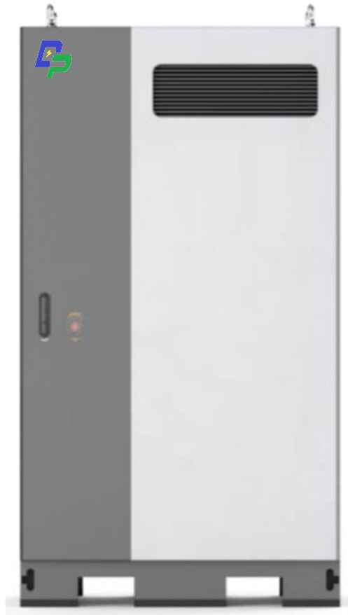
工商业储能
EPS
Technical Specification
Model | MM200k-B
Energy | ≥197kWh
（W*H*D） | 1100mm*2200mm*1400mm
Cycle life | ≥6000 times（0.5P）
AC Input voltage | 400V 50Hz 3P+PE
Input Charging Power | 98kW
Grid-connected power | 98kVA
Thermal management | Liquid cooling
IP grade | IP54 for Product and IP67 for High voltage system
Operational temperature | -30℃~55℃
Storage temperature | -30℃-60℃
Product Highlights:
The fire extinguishing device is directly connected to each battery box, and is configured with two-stage fire protection to ensure safe and controllable energy storage.
Small footprint, can be dispersed deployment, centralized scheduling, easy to flexible placement.
Real-time monitoring to achieve unattended. With EPS function.

Slide 3
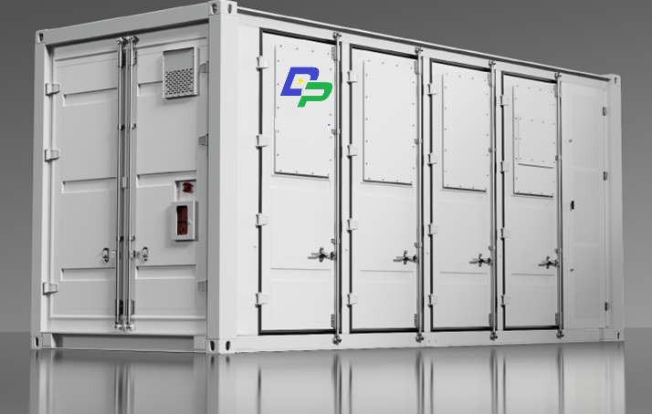
集装箱储能
Technical Specification
Model | MM2000k-B
Energy | ≥2.2MWh
（L*W*H） | 5900mm*2350mm*2390mm
Cycle life | ≥6000 times（0.5P）
AC Input voltage | 400V AC±5% 50Hz 3P+PE
Rated charging power | 1000W
DC output voltage | 770V～1124.2V
Thermal management | Liquid cooling
IP grade | IP55 for Product and IP67 for High voltage system
Operational temperature | -30℃~55℃
Storage temperature | -30℃-60℃
Product Highlights:
The fire protection device is directly connected to each battery box to ensure safe and controllable electrochemical energy storage.
Intelligent liquid cooling temperature control, reduce the auxiliary power consumption of the system.。
Pre-installed design, can be transported, no battery installation work 。

Slide 4
～Thanks～

