Slide 1


Dongguan Depu Energy Technology Co., LTD

Slide 2


Slide 3
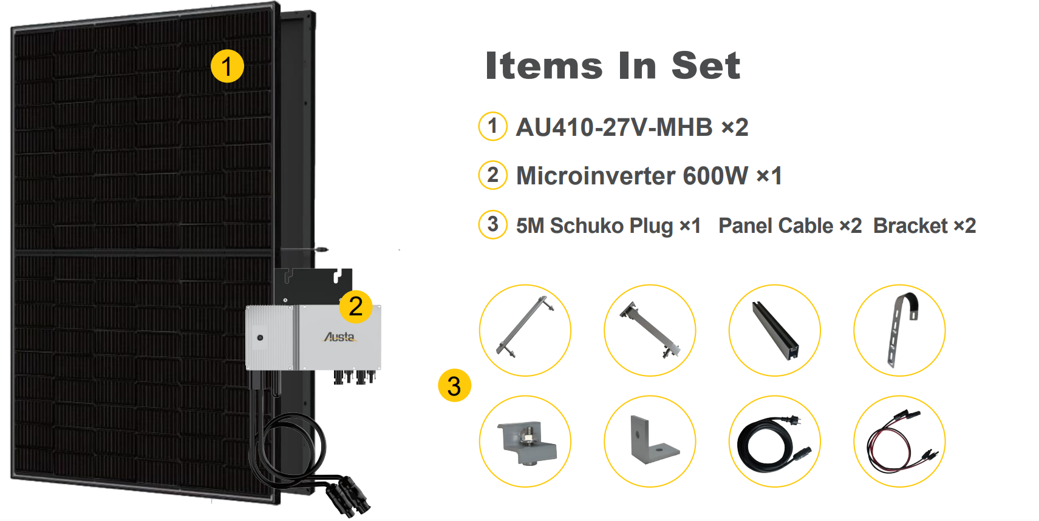
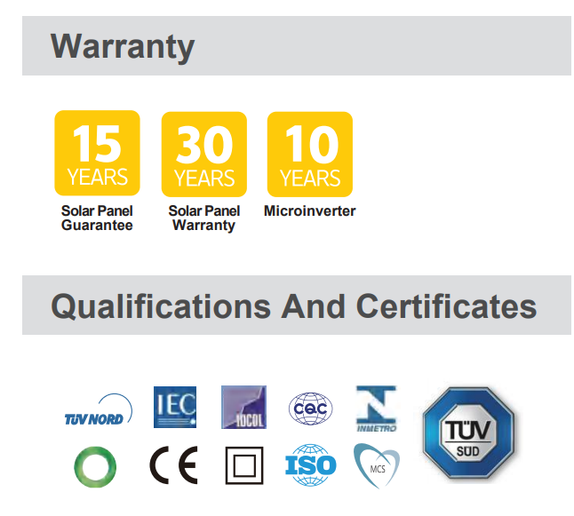

Slide 4
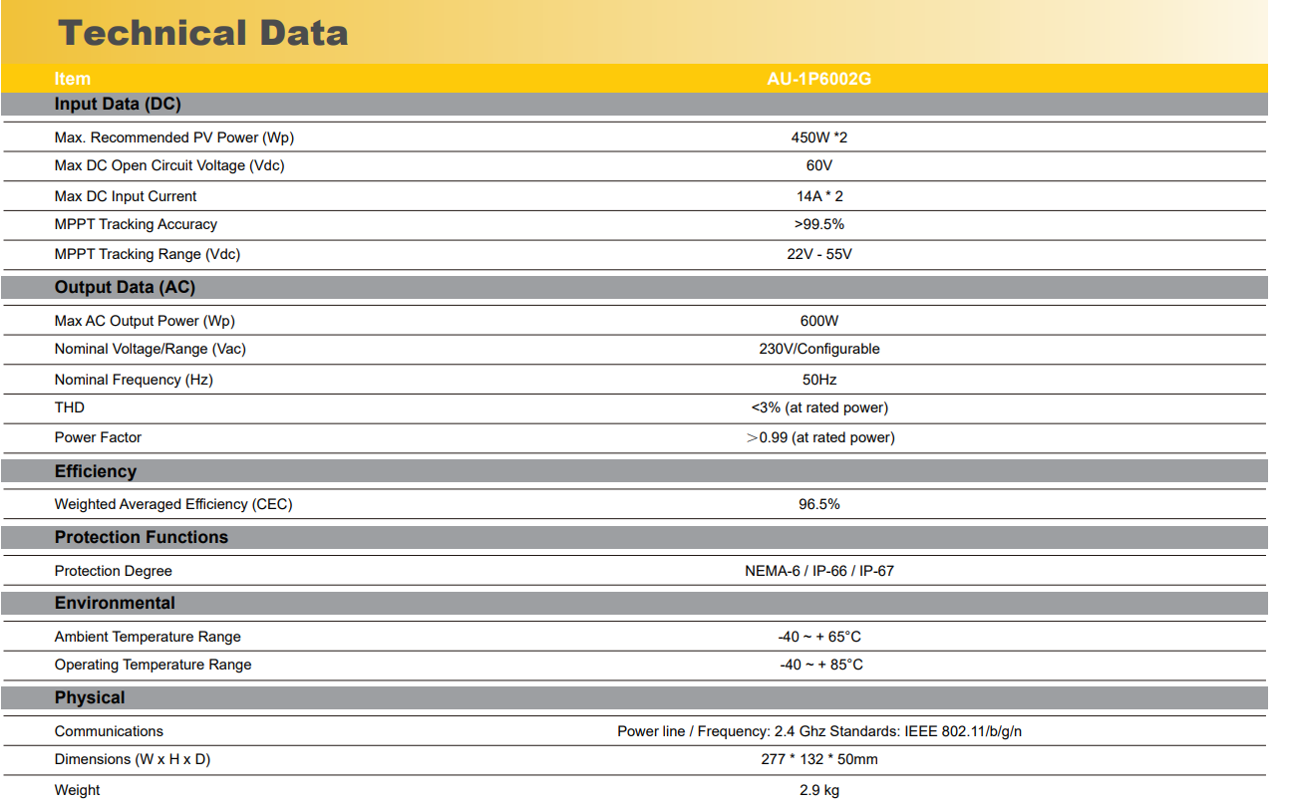

Slide 5
～Thanks～

