Slide 1
Advanced Topics in Programming Lab 9.5 – Design patterns
Slides by Dr Marina Litvak

Slide 2
Idea of Listeners
We will provide a possibility to register for listening to different threads
OOP:
Every LISTENER/OBSERVER must implement the same interface with reaction method that will be implemented differently in each one
Every SUBJECT/OBSERVABLE must implement the following methods for adding and removing listeners, and notification to all listeners
Notes:
הרעיון של ליסינרס זה שגם הצד המקשיב וגם הצד שמספק שירות למקשיב יהיו מסונכרנים בינהם עם מתודות מסוימות, כלומר כאשר יש שינוי בצד שמקשיבים לו אז הצד המקשיב חייב להיות מסונכרן ובאמת לפעול בהתאם לשינויים.

Slide 3
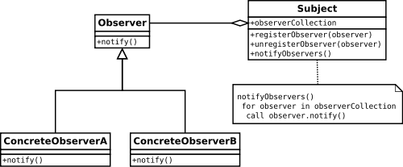
Observer design pattern
Notes:
כאן נציג דיאגרמת uml בסיסית של האובסרבר דיזיין פטרן. בעצם הסאבג'קט מכיל בתוכו את כל הצופים בו

Slide 4
Observable and Observer
Observable:
Class built-in in java which allows objects to be observed and notify their changes to other interested objects
Has the following methods:
Add
Delete
Notify
…
Observer
Inteface built-in is implemented by objects that want to be notified of changes in the observed objects
Notes:
בעצם כאשר אובייקט מסוג אובסרבל משתנה הוא רוצה להשתמש במתודה של update של אותו צופה

Slide 5
Listener or Observer
Listener/Observer
interface Observer{
public void notify(String msg);
}
class MyObserver implements Observer {
public void notify(String msg){..}
…
}
public static void main(String[] ..){
Observable t = new Observable();
Observer ob = new MyObserver();
t. registerObserver(ob);
t.start();
Subject/Observable
class Observable extends Thread{
Vector<Observer> list;
public void registerObserver(Observer ob){
list.add(ob); }
public void unregisterObserver(Observer ob){ list.remove(ob); }
private void notifyObservers(String msg){
for(Observer ob : list)
ob.notify (msg);
}
Notes:
כאן ניתן לראות דוגמאות לשני סוגי האובייקטים בשימוש טרדים. כאמור המטרה בסוף זה לעדכן את כולם באופן מקבילי מה שחוסך לנו בזמן בעצם.

Slide 6
Owner = observer
We will define our own interface Observer, but it is possible to use java.util.Observer
Notes:
כמובן שאפשר גם להגדיר בעצמינו את הממשק של observer ולא להסתמך על מה שיש ב- java

Slide 7

Example
We will create virtual cats
They sleep most of time
We want to know how long was their sleep after they woke up

Slide 8
Concrete observer 1
public class Owner implements Observer{
@Override
public void notify(String msg) {
System.out.println("+++++++++++++++++++");
System.out.println(“OWNER got a notification: "+msg);
play();
}
}

Slide 9
Concrete observer 2
public class Vet implements Observer{
@Override
public void notify(String msg) {
System.out.println("*******************");
System.out.println(“VET got a notification: "+msg);
checkup();
}
}

Slide 10
Subject/Observable
public class Cat extends Thread {
private Vector<Observer> list = new Vector<Observer>(); //vector is synchronized
public Cat (name){ super(name); }
public void registerObserver(Observer l){list.add(l);}
public synchronized void unregisterObserver(Observer l) {
int index = list.indexOf(l);
list.set(index, list.lastElement());
list.remove(list.size()-1);
}
public void run(){
long time = (long)(Math.random()*1000L);
try {
sleep(time);
} catch (InterruptedException e) {System.out.println("Got an exception");}
notifyObservers(" is awake and hungry after "+time+" hours of sleeping");
}
private void notifyObservers(String msg){
for (Observer l : list) {
l.notify(getName()+msg);
}
}
DANGER: CRITICAL SECTION!!!
Must be synchronized!
list.remove(l);
Is shorter and synchronized but less efficient
Notes:
במקרה שלנו פה החתול הוא observable.
שימו לב להערה האדומה שמראה שהפונקציה של מחיקה צריכה להיות מסונכרנת

Slide 11
Test
public class TestManyMany {
public static void main(String[] args) {
//create two listeners
Observer o = new Owner();
Observer v = new Vet();
//create and run cats
Cat[] c = new Cat[args.length];
for(int i = 0; i<args.length; i++){
c[i] = new Cat(args[i]);
//add listeners to a cat
c[i].registerObserver(o);
c[i].registerObserver(v);
c[i].start();
}
}
Create two listeners
Register listeners
Run cat’s thread

Slide 12
The same using java.util.Observable
public class Cat extends Observable implements Runnable{
private String name;
public Cat(String name){ this.name = name; }
public void run(){
long time = (long)(Math.random()*1000L);
try {
sleep(time);
} catch (InterruptedException e){
System.out.println("Got an exception");
}
setChanged();
notifyObservers(" is awake and hungry after "+time+" hours of sleeping");
}
}
Notes:
דוגמה לזה שאנחנו משתמשים בעצם בclass built in של observable

Slide 13
Decorator Design Pattern
Allows to add new behavior to other objects at runtime.
Analogy:
GUI components where a decorator object contains a border or shadow which it uses to actually visually decorate another graphical component.
A decorator can also add new functionality to existing components, like scrolling and zooming.
Notes:
דיברנו

Slide 14
Decorator vs. inheritance
Inheritance allows to create child objects with a new behavior during implementation
extends the abilities of ‘a class’
Decoration allows the transparent extension of particular objects at runtime
You can choose any single object of a class and modify its behavior leaving the other instances unmodified
You don't have to subclass several times for the same functionality - you can add one decorator (one "functionality" or "behavior") to many objects and vice versa
Advantage of Decorator:
a large number of independent ways to extend functionality, especially when you can't predict at design time which combinations of extensions will be used during runtime

Slide 15
When to use?
Use the decorator pattern to:
add responsibilities to individual objects transparently and
remove these (encapsulated) responsibilities again without affecting other object;
extend classes without sub-classing/inheritance
to avoid an explosion of the number of subclasses to support different combinations of extensions

Slide 16
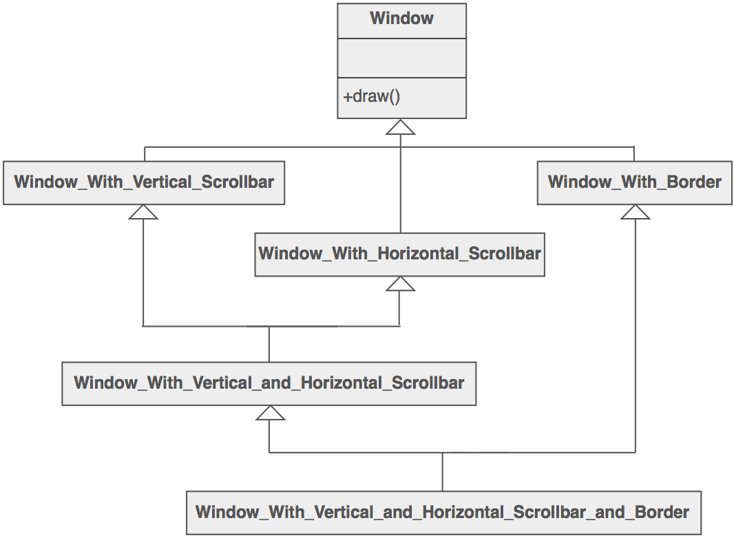
Problem with inheritance
Too much options, too big hierarchy
Notes:
דוגמה מעצבנת טיפה אבל במקרה שלנו בjava אין ירושה מרובה

Slide 17
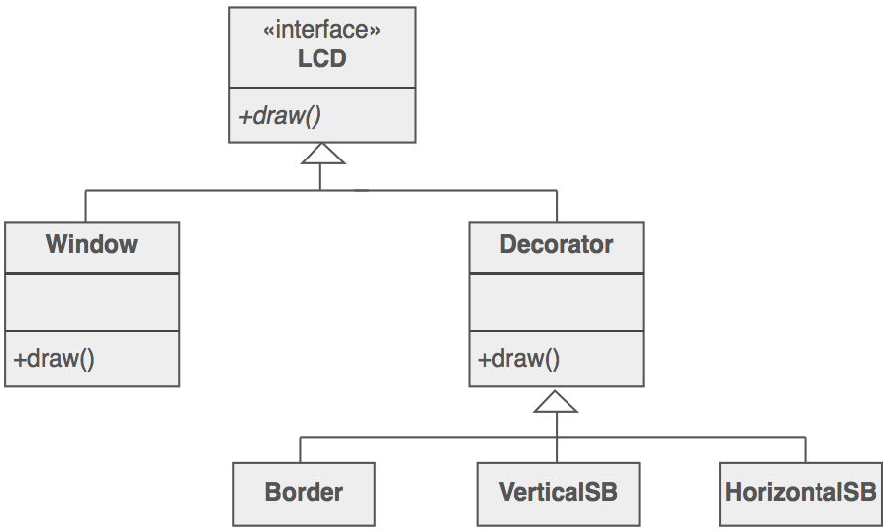
With Decorator
More flexibility

Slide 18
Design
Decorator maintains the same interface as the object it "decorates“;
accepts the object it is "decorating" as an argument in its constructor;
keeps this original object in a private member variable - delegation.
Meaning: constructing a wrapper around an object by extending its behavior.
The wrapper will do its job and delegate the call to the wrapped instance.

Slide 19
Step by step
Define an interface for the class which will have decorators.
Implement that interface with basic functionalities.
Create the decorator base class – an abstract class that contains (aggregation) an attribute type of the interface.
The constructor assigns the interface type instance to that attribute.
Extend this class and create as many concrete decorator classes.
The concrete decorator class will add its own methods.
After / before executing its own method the concrete decorator will call the base instance’s method.
Key to this Decorator DP is the binding of method and the base instance at runtime based on the object passed as parameter to the constructor. Thus dynamically customizing the behavior of that specific instance.

Slide 20
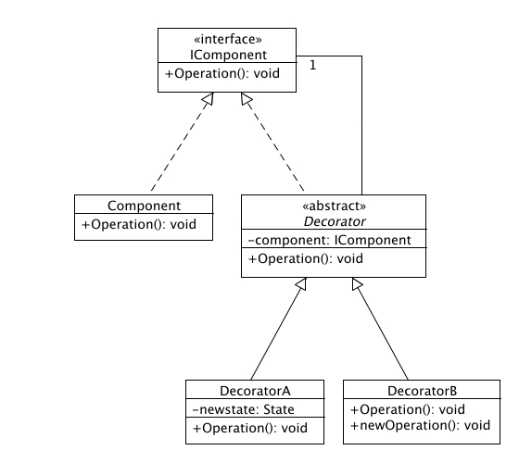
Decorator

Slide 21
An ice-cream idea..
You create a basic ice-cream and then add toppings to it as you prefer.
The added toppings change the taste of the basic ice-cream.
You can add as many topping as you want.

Slide 22
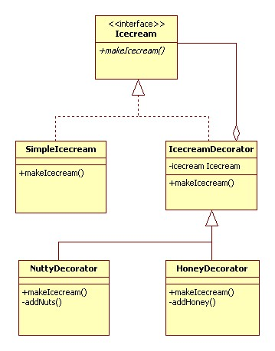
Icecream decorators

Slide 23
Very simple example http://javapapers.com/design-patterns/decorator-pattern/
An interface depicting an icecream:
public interface Icecream {
public String makeIcecream();
}

Slide 24
Example, cont.
The concrete implementation of this interface. This is the base class on which the decorators will be added.
public class SimpleIcecream implements Icecream {
@Override
public String makeIcecream() {
return "Base Icecream";
}
}

Slide 25
Example, cont.
The decorator class – the core of the decorator DP.
It contains an attribute for the type of interface.
Instance is assigned dynamically at the creation of decorator using its constructor.
Once assigned that instance method will be invoked
public abstract class IcecreamDecorator implements Icecream {
protected Icecream specialIcecream;
public IcecreamDecorator(Icecream specialIcecream) {
this.specialIcecream = specialIcecream;
}
public String makeIcecream() {
return specialIcecream.makeIcecream();
}
}

Slide 26
Example, cont.
Concrete decorator #1.
When the decorator is created the base instance is passed using the constructor and is assigned to the super class.
In the makeIcecream method we call the base method followed by its own method addNuts(). This addNuts() extends the behavior by adding its own steps.
public class NuttyDecorator extends IcecreamDecorator {
public NuttyDecorator(Icecream specialIcecream) {
super(specialIcecream);
}
public String makeIcecream() {
return specialIcecream.makeIcecream() + addNuts();
}
private String addNuts() { return " + cruncy nuts"; } }

Slide 27
Example, cont.
Concrete decorator #2.
In the makeIcecream method we call the base method followed by its own method addHoney().
public class HoneyDecorator extends IcecreamDecorator {
public HoneyDecorator(Icecream specialIcecream) { super(specialIcecream);
}
public String makeIcecream() {
return specialIcecream.makeIcecream() + addHoney();
}
private String addHoney() { return " + sweet honey"; }
}

Slide 28
Execution of the decorator pattern
We can use as many decorators in any order we want.
This flexibility and changing the behavior of an instance of our choice at runtime is the main advantage of the decorator DP.
public class TestDecorator {
public static void main(String args[]) {
Icecream icecream = new HoneyDecorator(
new NuttyDecorator(new SimpleIcecream()));
System.out.println(icecream.makeIcecream());
}
}

Slide 29
Bridge Design Pattern
Decouple an abstraction from its implementation so that the two can vary independently
Allows different implementations of an interface to be decided upon dynamically.

Slide 30
Moivation
Avoid a permanent binding between an abstraction and its implementation
Both the abstractions and their implementation should be extensible by subclassing
Changes in the implementation of an abstraction do not impact the clients
Share an implementation among multi objects and this facts should be hidden from the client

Slide 31
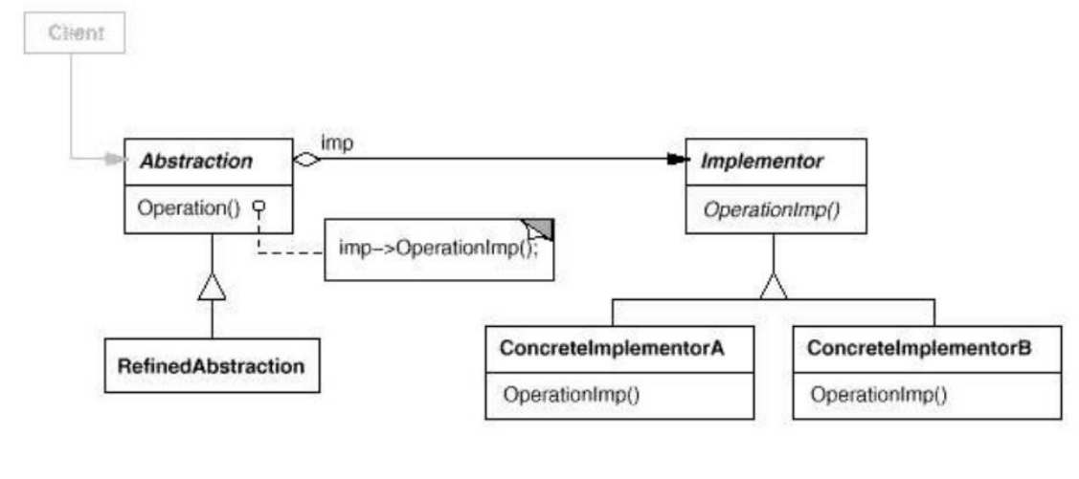
Structure

Slide 32
Before Bridge DP
Vehicle
Car
Bike
ProduceCar
AssembleCar
ProduceBike
AssembleBike

Slide 33
After Bridge DP
BRIDGE
Vehicle
Workshop
Car
Bike
Producer
Assembler

Slide 34
Example in Java
Abstraction:
/** * abstraction in bridge pattern * */
abstract class Vehicle {
protected Workshop workShop1;
protected Workshop workShop2;
protected Vehicle(Workshop workShop1, Workshop workShop2) {
this.workShop1 = workShop1;
this.workShop2 = workShop2;
}
abstract public void manufacture();
}

Slide 35
Example in Java, cont.
Refine Abstraction 1:
/** * Refine abstraction 1 in bridge pattern */
public class Car extends Vehicle {
public Car(Workshop workShop1, Workshop workShop2) {
super(workShop1, workShop2);
}
@Override
public void manufacture() {
System.out.print("Car ");
workShop1.work();
workShop2.work();
}
}

Slide 36
Example in Java, cont.
Refine Abstraction 2:
/** * Refine abstraction 2 in bridge pattern */
public class Bike extends Vehicle {
public Bike(Workshop workShop1, Workshop workShop2) {
super(workShop1, workShop2);
}
@Override
public void manufacture() {
System.out.print("Bike ");
workShop1.work();
workShop2.work();
}
}

Slide 37
Example in Java, cont.
Implementer:
/** * Implementer for bridge pattern * */
public interface Workshop {
public void work();
}

Slide 38
Example in Java, cont.
Concrete implementation 1:
/** * Concrete implementation 1 for bridge pattern * */
public class Producer implements Workshop {
@Override
public void work() {
System.out.print("Produced");
}
}

Slide 39
Example in Java, cont.
Concrete implementation 2:
/** * Concrete implementation 2 for bridge pattern * */
public class Assembler implements Workshop {
@Override
public void work() {
System.out.println(" Assembled.");
}
}

Slide 40
Example in Java, cont.
Demo:
/* * Demonstration of bridge design pattern */
public class BridgePattern {
public static void main(String[] args) {
Vehicle vehicle1 = new Car(new Producer(), new Assembler());
vehicle1.manufacture();
Vehicle vehicle2 = new Bike(new Producer(), new Assembler());
vehicle2.manufacture();
}
}

